Slide 1

BDD Training: Burnout
November 13, 2023
Sari Maple, Director, Human Resources
smaple@vfw.org
816-968-1135
Notes:
Three separate topics we’ll cover today:
Active Listening
Customer Service
Disengaging from Work

Slide 2
Learning Objectives Disconnecting from Work
Review the symptoms and signs of burnout
Define a Sensitive Striver
What is the Sensitive Striver Struggle
Discuss 7 ways to detach from work (without the guilt)
Make an action plan to force yourself to leave work at work
Have fun

Slide 3
Burnout – do any of these sound familiar?
You work 8 – 10-hour days hunched over your laptop, hardly stopping for food or water
You go back to work after dinner to knock off “just a few more things” from your to-do list but still go to bed feeling restless
You dream about work and sometimes wake up with nightmares about the day ahead or things you forgot to do
You spend your weekend trying to “catch up” on work instead of devoting time to family, self-care, or hobbies

Slide 4
Burnout – do any of these sound familiar?
You feel guilty when you indulge in well-deserved rest
You tell yourself you should be doing something more productive with your down time
You don’t feel restored even after taking a few days off
You have your email downloaded to your personal (or work) phone and answer emails at all times of the day or night
You wake up in the middle of the night and check/respond to emails

Slide 5
Burnout Symptoms:
Headaches
Stomach aches/intestinal issues
Fatigue
Frequent illness
Changes in appetite/sleep
Depression
Lost interest in socializing with family and friends
Workplace dread
Hair Loss
Lack of sleep
Chronic Anxiety
Performance decline

Slide 6
Sensitive Strivers:
High achiever who is also more sensitive to their emotions, the world, and the behavior of those around them
Have a special set of genes that leads them to process information more deeply than their less sensitive peers.
Driven to success and give their 100% to everything they do – all with an inner world on overdrive. Many are former gold-star students who bring that same commitment to the workplace.
Burnout is common among Sensitive Strivers

Slide 7
Why Sensitive Strivers Struggle to Take Time Away from Work
Poor Boundaries
Sensitive Strivers have off-the-charts empathy which can make it hard to say no and set boundaries
Desire to Prove their Value
Working and accomplishing more makes us feel good about ourselves
Perfectionism
Holding oneself to unrealistically high, exacting standards with a compulsion to follow through on every task, even when it’s not important or a top priority

Slide 8
7 Ways to Emotionally Detach from Work (and relax without Guilt)
View Relaxation as an Investment
Think about your Team
Take it Slow
Separate your feelings from your Identity
Ditch the Scarcity Mindset
Create Friction
Set Expectations and have Contingencies

Slide 9
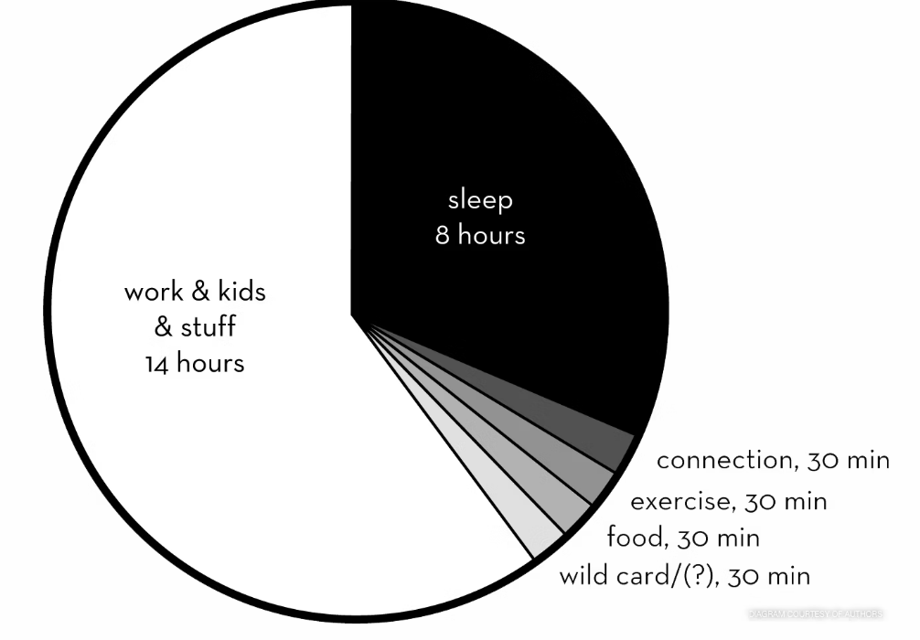
The 42% Rule (to combat burnout)

Slide 10
Recap
Any ‘aha’ moments?
Did you find anything helpful?
Goal setting for following the 42% rule?
Any other feedback?

Slide 11
Thank You
Sari Maple, Director, Human Resources
smaple@vfw.org
816-968-1135 Office
816-529-7959 Cell

