Slide 1

BDD Training:
Disconnecting from Work
November 13, 2023
Sari Maple, Director, Human Resources
smaple@vfw.org
816-968-1135
Notes:
Three separate topics we’ll cover today:
Active Listening
Customer Service
Disengaging from Work

Slide 2
Learning Objectives
Disconnecting from Work
Review the symptoms and signs of burnout
Define a Sensitive Striver
  What is the Sensitive Striver Struggle
Discuss 7 ways to detach from work (without the guilt)
Make an action plan to force yourself to leave work at work
Have fun

Slide 3
Burnout – do any of these sound familiar?
You work 8 – 10-hour days hunched over your laptop, hardly stopping for food or water
You go back to work after dinner to knock off “just a few more things” from your to-do list but still go to bed feeling restless
You dream about work and sometimes wake up with nightmares about the day ahead or things you forgot to do
You spend your weekend trying to “catch up” on work instead of devoting time to family, self-care, or hobbies

Slide 4
Burnout – do any of these sound familiar?
You feel guilty when you indulge in well-deserved rest (or you leave work on time)
You tell yourself you should be doing something more productive with your down time
You don’t feel restored even after taking a few days off
You have your email downloaded to your personal (or work) phone and answer emails at all times of the day or night
You wake up in the middle of the night and check/respond to emails
Notes:
If you answered yes to more than three of these statements, you’re likely overworking and on a surefire path to burnout!
What is SO important you can’t do it the next day?

Slide 5
Burnout Symptoms:
  Headaches
  Stomach aches/intestinal issues
  Fatigue
  Frequent illness
  Changes in appetite/sleep
  Depression
  Lost interest in socializing with family and friends
  Workplace dread
  Hair Loss
  Lack of sleep
  Chronic Anxiety
  Performance decline
Notes:
Job burnout is a special type of work-related stress – a state of physical or emotional exhaustion that also involves a sense of reduced accomplishment and loss of personal identify.

Slide 6
Sensitive Strivers:
High achiever who is also more sensitive to their emotions, the world, and the behavior of those around them
Have a special set of genes that leads them to process information more deeply
Driven to success and give their 100% to everything they do – all with an inner world on overdrive
Burnout is common among Sensitive Strivers
Notes:
They are so loyal to other people, and the path to success society has laid out that they blindly pursue more achievement without ever stopping to define what makes them happy. Many Sensitive Strivers have also never been taught to recognize how their sensitivity shapes their lives, and they lack a game plan to channel their ambition and drive in a way that emboldens, rather than drains them.
Sensitive Strivers bring a deep sense of responsibility to everything they do. They are relied on to follow through, keep their word, meet deadlines. They’re driven and tirelessly committed, which is a tremendous strength! But if left unchecked, that sense of responsibilities can devolve into over-functioning – a state where Sensitive Strivers prioritize their professional duties ahead of their personal needs. This create a vicious cycle where guilt sabotages your time off.

Slide 7
Why Sensitive Strivers Struggle to Take Time Away from Work
Poor Boundaries
  Sensitive Strivers have off-the-charts empathy which can make it hard to say no and set boundaries
Desire to Prove their Value
  Working and accomplishing more makes us feel good about ourselves
Perfectionism
  Holding oneself to unrealistically high, exacting standards with a compulsion to follow through on every task, even when it’s not important or a top priority
Notes:
Poor Boundaries: Sensitive Strivers have off-the-charts empathy, which makes it hard to say no and set boundaries. As a result, they may too readily accommodate every request that comes their way and find it hard to push back or speak when they should. Poor boundaries also blurs the lines between work and personal time. They struggle to “turn off” at the end of the day and allow work to bleed into personal time and mind when off the clock.

Slide 8
7 Ways to Emotionally Detach from Work (and relax without Guilt)
View Relaxation as an Investment
Think about your Team
Take it Slow
Separate your feelings from your Identity
Ditch the Scarcity Mindset
Create Friction
Set Expectations and have Contingencies
Notes:
Take heart, because not all is lost. Changing your relationship with downtime is first and foremost an inner job. It involves shifting your mindset to let go of guilt and value long-term sustainability instead.
- View relaxation as investment
I know, I know, you’re probably rolling your eyes, but hear me out. Your brain is like a muscle and it’s not designed to go at full speed constantly. Just like the rest of your body, your brain needs time to recoup so it can grow stronger.
High-achievers often dismiss this idea because it sounds lazy and passive. Here’s a quick tip to counter that: switch out “rest” for “recovery”. Rather than telling yourself you need to rest, reframe it as recovery. Recovery is a more active, purposeful process, which will remind you that your downtime is both meaningful and necessary.
2 - Think about your team
As an empathetic Sensitive Striver, it’s important to realize that taking breaks isn’t just about you.
Whether you realize it or not, the people around you observe your actions. If you respond to emails at all hours, they’ll feel compelled to do the same. If you don’t take a vacation, they won’t either.
Especially if you're a leader, people look to you as a role model and will follow your behavior. You set the expectations and norms for your team, so take a moment to consider how you may be complicit in creating or perpetuating an “always-on” culture at your company.
Explicitly talk to your team about burnout and the importance of mental and emotional health. Not only is this good management, but it will also force you (in a positive way!) to practice what you preach because you’ll want to act in integrity.
And if you’re not a leader, consider that you do your team a disservice if you continue to relentlessly push yourself. They probably can’t afford to lose you or have you burn out, so invest in rest as much for them as for yourself.
3 - Take it slow
Being overachievers, a lot of my clients try to “win” at rest. Meaning, they go from nothing to everything:
Working eight days a week for months to taking two weeks off for vacation
Not even breaking for lunch to attempting to block off an entire afternoon for self-care.
Ironically, when you rush into relaxation, it can be a shock to your sensitive nervous system. You’ve gone from being totally amped up to screeching on the breaks. Your body experiences this as a withdrawal. Your brain has come to rely on stress chemicals to get things done, so when the “drug” disappears, you feel all sorts of uncomfortable emotions – anxiety, fatigue, panic.
Focus on taking it slow. Ease yourself into taking breaks. For example, block off your calendar so you give yourself 15 minutes to decompress after each meeting. Or perhaps try taking off every Friday for one month.
4 - Separate your feelings from your identity
Be patient with the discomfort that arises as you begin to take small breaks, because it will.
Expect to feel some guilt, and recognize that it is simply an old, outdated reaction that you’re rewiring. These are fleeting emotions –– like waves that will crest or clouds passing in the sky –– but not necessarily things you need to take action on.
Additionally, be mindful not to fall into the trap of emotional reasoning. Emotional reasoning happens when you believe that your emotional reactions prove something is true. Put simply, emotional reasoning is believing “I feel guilty for resting, therefore resting is bad.” Or worse, “I feel guilty when I take a break, therefore I am lazy / not productive enough.” Work on challenging and reframing those thoughts.
5 - Ditch the scarcity mindset
Sensitive Strivers often feel guilty about disconnecting from work because they obsess about all the tasks that aren’t done, where they’re falling short, and everything left to accomplish ahead. But focusing on what you lack sends you into a state of stress where it’s nearly impossible to relax.
It’s crucial, then, that you learn to celebrate your achievements. You may not feel like throwing yourself a parade, but you can at least appreciate how far you’ve come and focus on what you have accomplished versus all that’s left to do.
Sophia, the client I introduced you to earlier, tried this and realized she was needlessly beating herself up. In fact, in the last few months she had turned a dysfunctional team around, presented at a conference, and saved the company million with a key product launch. Recognizing what was going well gave Sophia relief and allowed her to enjoy her time off.
6 - Create friction
Make it harder to go back to work during your off-hours. For instance, many of my clients have success with:
Logging out of all work programs at the end of the day
Shutting down their computer and putting it in a different room
Deleting email apps from their phone
7 - Set expectations and have contingencies
Many roles require you be on call for emergencies or to put out proverbial fires. If this is true for you, then establish clear working hours and escalation plans with your team that outlines how to reach you and under what circumstances.
For example, you might say, “Going forward, I’ll be unavailable after 7 PM. If you need me after that time, please send me an email. If it’s urgent (which is defined by XYZ) then please text me.”
If you have a manager that emails you at all hours, maintain your boundaries by acknowledging the message, but punting the work to an appropriate time. (i.e. “Thanks for your message. I spend Saturdays with my family, but will address this first thing Monday.”

Slide 9
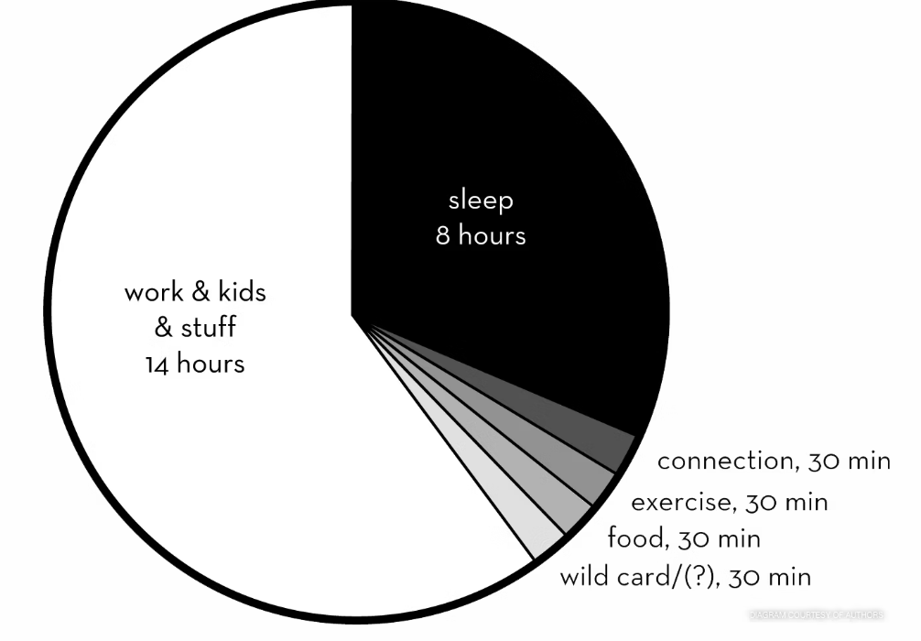
The 42% Rule (to combat burnout)
Notes:
Emily Nagoski and Amelia Nahoski did extensive research and are well respected leaders in the field. Their studies results in the 42% Rule.
What is the 42 % rule?
Science is pretty clear we need to incorporate 42% of our daily living to ‘recovery’. That's the percentage of time your body and brain need you to spend resting. It's about 10 hours out of every 24. It doesn't have to be every day; it can average out over a week or a month or more.
“That’s ridiculous! I don’t have that kind of time!” you might protest — and we predicted you might feel that way. I love this quote from their research:
We’re not saying you should take 42 percent of your time to rest; we’re saying if you don’t take the 42 percent, the 42 percent will take you. It will grab you by the face, shove you to the ground, put its foot on your chest, and declare itself the victor.
• Eight hours of sleep opportunity, give or take an hour.
• 20 to 30 minutes of “stress-reducing conversation” with your partner or other trusted loved one.
• 30 minutes of physical activity. Do this with the explicit mindset of gear-switching, feels-purging, rest-getting freedom. Physical activity counts as “rest” partly because it improves the quality of your sleep and partly because it completes the stress response cycle, transitioning your body out of a stressed state and into a resting state.
• 30 minutes of paying attention to food. “30 minutes?” you say. Don’t fret. That includes all meals, shopping, cooking, and eating, and it doesn’t have to be all at once. It can be with people or alone, but it can’t be while working or driving or watching TV or even listening to a podcast. Pay attention to your food for half an hour a day. This counts as rest partly because it provides necessary nourishment and partly because it’s active rest, a change of pace, apart from the other domains of your life. Think of it as meditation.
• And a 30-minute wild card, depending on your needs. For some people, this will be extra physical activity, because they need that much to feel good. For others, it will be preparation for their sleep opportunity, because they know their brains need time to transition from the buzzing state of wakefulness into the quiet that allows the brain to sleep. For still others, it will be social play time, because their appetite for social engagement is strong. And for some, it’s simply a buffer for travel and changing clothes and other rest-preparation time (because: reality) during which you engage your default mode network — that is, you let your mind wander.
BREAKOUT:
What does your breakdown look like now?
How can you get closer to the 42% Rule?

Slide 10
Breakout
What does your breakdown look like now?
How can you get closer to the 42% Rule?

Slide 11
Recap
Any ‘aha’ moments?
Did you find anything helpful?
Any other feedback?

Slide 12
Thank You
Sari Maple, Director, Human Resources
smaple@vfw.org
816-968-1135 Office
816-529-7959 Cell

Slide 13
Additional Resources on Sensitive Strivers and Workaholism
https://www.youtube.com/watch?v=8RPnxuYApNU 5.34
https://www.youtube.com/watch?v=3wTdDuUya-s 1:58
https://tammacapital.com/32-2-workaholism/ 40:34
6:00 –
https://www.youtube.com/watch?v=UZ9EaTUAWe8 18:15
https://www.youtube.com/watch?v=L9aDz6mpTJQ 19:31

