Slide 1
Rating Review Update
Shane Hancock
Rating Consultant
November 2023

Slide 2
Agenda
Rating Decision Complete (RDC) status
Final Review
Application Errors
Current Denied Trends

Slide 3
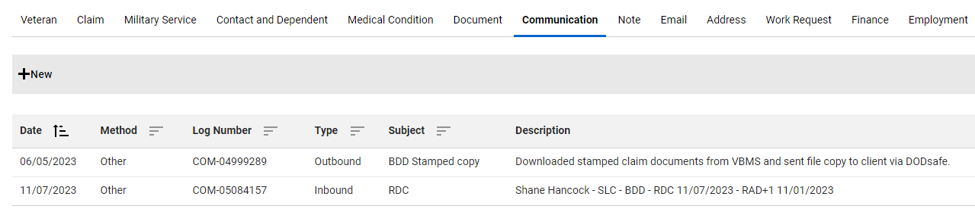
Rating Decision Complete
Signature block example
Shane Hancock – Salt Lake City (SLC) – Benefits Delivery at Discharge (BDD) – Rating Decision Complete (RDC) (Date) – Released from Active Duty (RAD)+1 (date)

Slide 4
Rating Decision Complete
526ez
Anticipated date of release from active duty
Conditions claimed
Signature
Notes:
Page 9 – Block 8

Slide 5
Rating Decision Complete
Dependency Claim Errors
686C not submitted at the time of claim
686C Errors
Missing social security numbers
Helpless child for all age children checked
Form not signed
686C missing in document section of TVB
Missing information in TVB
Notes:
Most common errors missing social security numbers for dependents and not signed. Some reps have not filed 686; SHARE has dependents listed.

Slide 6
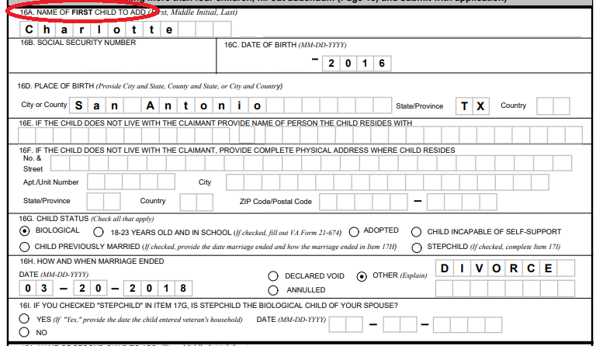
Rating Decision Complete
Notes:
Child married and divorced at the age of 2.

Slide 7
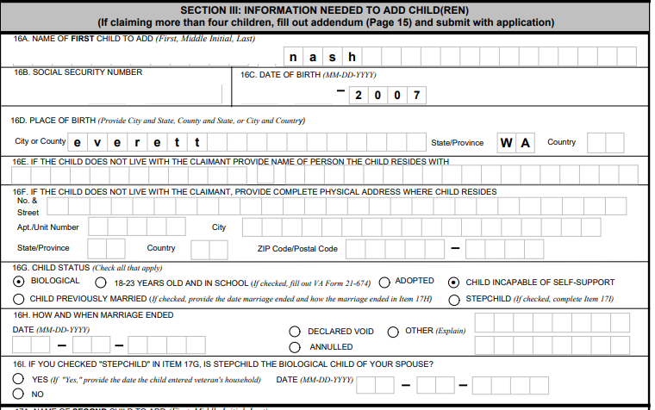
Rating Decision Complete
Notes:
Child age is 16.

Slide 8
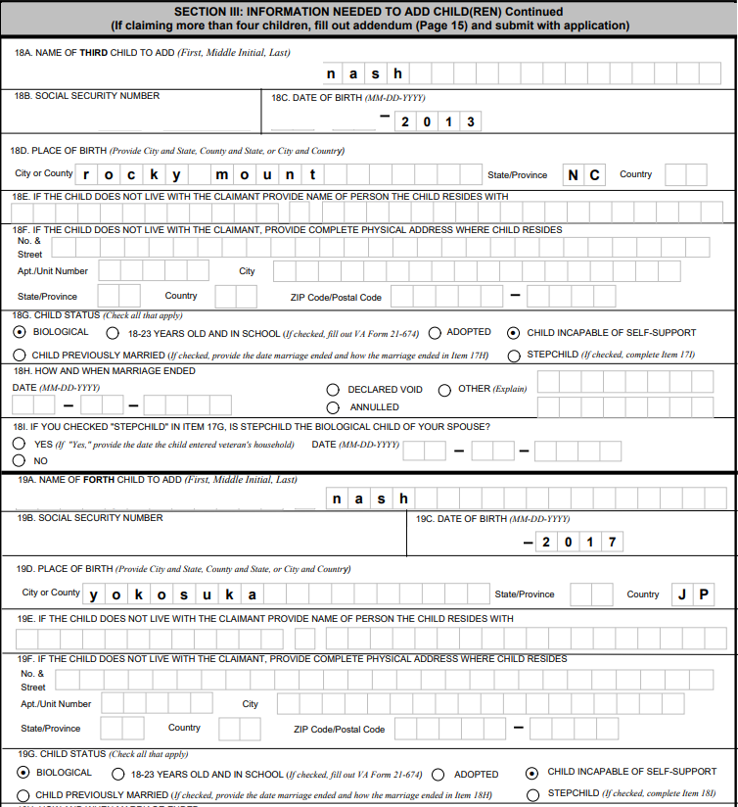
Rating Decision Complete
Notes:
Child age is 10 and 6

Slide 9
Rating Decision Complete
Application Error
21-22
Correct 21-22A (Jul 2023)
Section IV Authorization Information (20 and 22)
21-22 not found in documents section of TBV
Notes:
21-22 vs 21-22a
Form 21-22 Oct 2014 Blocks 12 and 14
Form 21-22 Feb 2019 Block 19 and 21

Slide 10
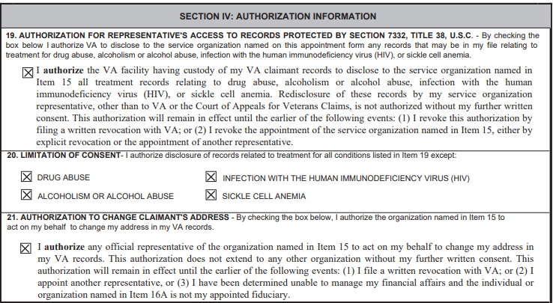
Rating Decision Complete

Slide 11
Final Review
526ez
Verifying all conditions claim have been addressed.
Review of all conditions granted.
In depth review of denied conditions
686c
Verification veteran is correctly being compensated for all dependents
674 as needed
DD214
Verification of RAD+1

Slide 12
Trends
Condition claimed and denied
Loss of tooth
Athletes Foot
Discolored and thickening toenails
Sleep apnea without sleep study
Project Shipboard Hazard Defense (SHAD)
Hair loss
Heat exhaustion
Acute conditions

Slide 13
Trends
Example 1
19 condition claimed
9 conditions granted
53% of conditions claimed were not granted

Slide 14
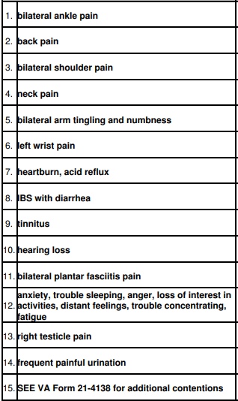
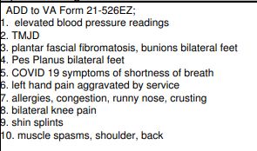
Trends

Slide 15
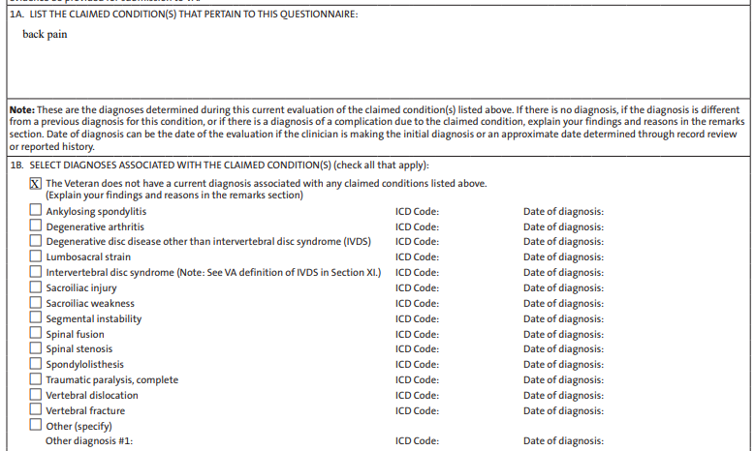
Trends

Slide 16
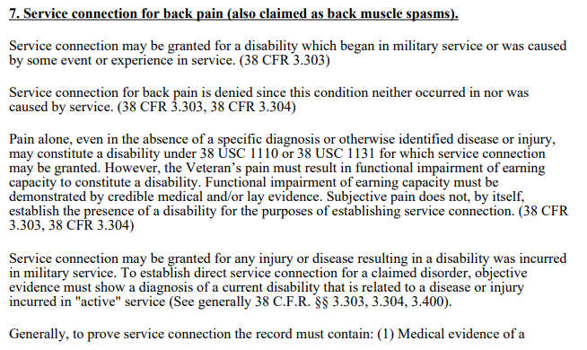
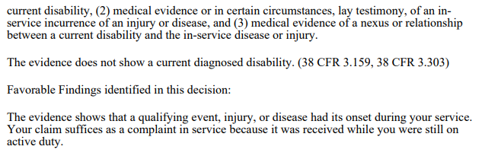
Trends

Slide 17
Trends
Example 2
28 conditions claimed
7 conditions granted
75% of conditions claimed were not granted

Slide 18
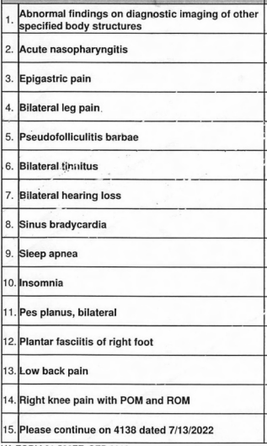
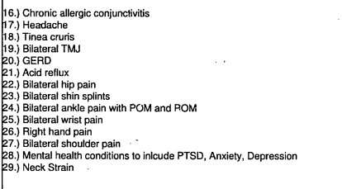
Trends

Slide 19
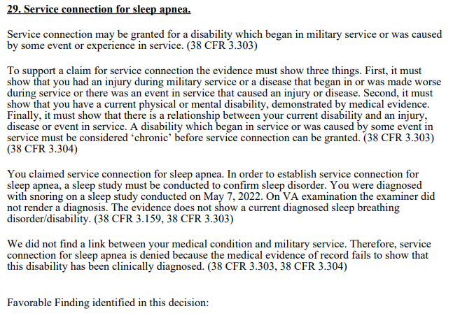

Trends

Slide 20
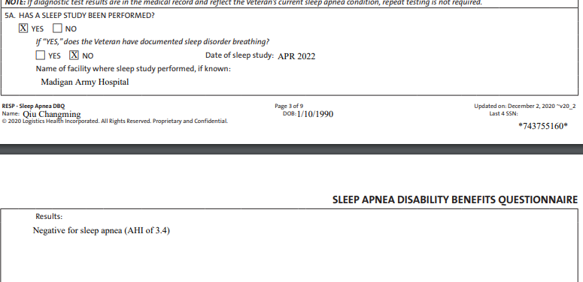
Trends

Slide 21
Trends
Example 3
Two 526ez submitted
One was blank expect for SSN and a list of conditions on page 15
Second was complete with different conditions on page 15
Also submitted 4138 with 10 conditions

Slide 22
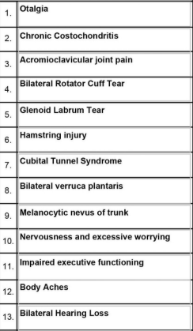
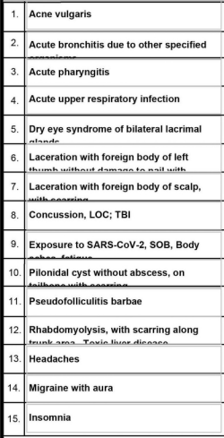
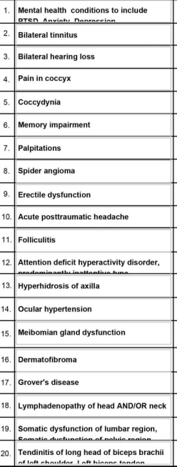
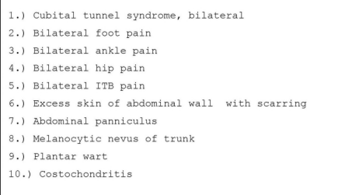
Trends
526ez SSN Only
Completed 526ez
4138
Notes:
Wise person once said, “I like to give my clients their best claim the first time”
Human Effect
Frustration
Time
Exam ordering
Delay in claim

Slide 23
Trends
Example 3
Acute posttraumatic headache
Headaches
Migraine with aura
Body aches
Hamstring injury
Acute upper respiratory infection
Acute pharyngitis
Acute bronchitis due to other specified

Slide 24
Trends
Example 3
Mental health conditions including PTSD, anxiety and depression
Memory impairment
Attention Deficit Hyperactivity Disorder
Insomnia
Concussion, LOC; TBI
Impaired executive functioning

Slide 25
Trends
Example 3
Glenoid Labrum Tear
Bilateral rotator cuff tear
Acromioclavicular joint pain
Laceration with foreign body of left thumb without damage to nail
Laceration with foreign body of scalp with scarring
Rhabdomyolysis, with scarring along trunk area toxic liver disease

Slide 26
Conclusion
Questions

