Slide 1

BDD Training:
Active Listening
November 13, 2023
Sari Maple, Director, Human Resources
smaple@vfw.org
816-968-1135

Slide 2

Learning Objectives
Active Listening
Learn more about the listening process
Define types of listening
Review common challenges to being an effective listener
Learn how to become better (more effective) listener
Have some fun
Notes:
This will NOT be just me talking. I need feedback (to know you’re listening) and to keep us all engaged. I’ll expect to have some fun too! Nothing we talk about will be new or rocket science, but hopefully a refresher and help us all be more self aware of our strengths and areas of improvement.

Slide 3
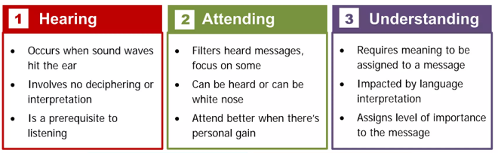
Listening Process
Notes:
Hearing: I sleep with my windows open and hear noises all night. They don’t usually wake me up, but I do subconsciously hear them.
Attending: Sometimes I’ll focus on a certain noise – cat meowing, cars burning rubber, plane flying over. Still kind of a subconscious white noise.
Understanding: Level of importance – if I hear my cat in a fight with another cat. Hear police sirens after cars are burning rubber.

Slide 4
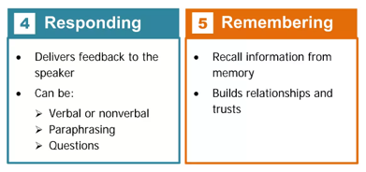
Listening Process
Notes:
Responding: I jump out of bed to go let the cat in. My ‘feedback’ is my non-verbal action (nonverbal, but definitely a response to the listening process) My question – is to my cat “what kind of fight are you in now? Let’s get you inside and out of dangers way.”
Remembering: Don’t let the cats out after dark.
Thanksgiving: Tryptophan starts doing its magic after the meal. What time is it – football time. My dad would turn on the game, lay in his recliner, and the next thing, he would be snoring. We would change the channel. He would immediately wake up – what are you doing? I’m watching the game. Sound asleep/snoring. What’s the score? What’s happening. Regardless, the noise (stimulus) stopped and he was immediately into the “ATTENDING” stage of the listening process. It was relevant > you turned off my white noise. Quickly went into UNDERSTANDING stage and onto the RESPONSE – which was always verbal (and loud). REMEMBERING stage usually involved him remembering that if he started snoring again, we were going to change the channel. ☺
QUESTION: At what point in the listening process does ACTIVE LISTENING BEGIN? (Responding: eye contact, no looking at your cell phone, leaning in, facial recognition)

Slide 5
Active Listening Exercise:
If you know this “test” don’t reveal the answers to others. Do not make any sounds when you figure out the answer as it may give a clue to others.
Just listen closely. Raise your hand as you know the answer.
Notes:
What level of listening did you focus on? First time maybe just heard the story, some people understood the first time, Some remembered, understood, and were able to respond. (I failed the first time I read the story.)

Slide 6
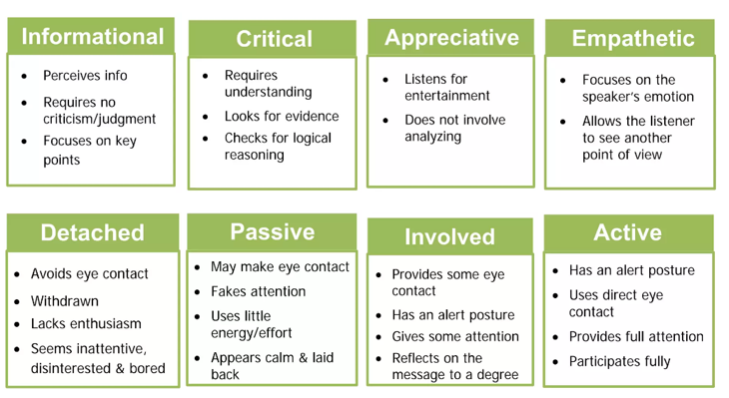
Types of Listening
Notes:
In your daily interactions, which of these listening types do you use? Can effective listening occur at any of these stages?
Any of the listening categories you don’t use, or try not to use?
BREAK OUT:
What can affect your ability to be an effective listener?
What can you do to improve or overcome these challenges?
Could be within your control – may not be within your control:
Distractions
Hinderances
Impedes

Slide 7
Setting the Stage for Improved Listening
Schedule at least a 5-minute break between appointments?
Do you have a candle warmer to offset odors?
Do you have snacks (healthy)? Water?
Do you have someone to vent to and clear your head before needing to focus on the next person?
Do you keep a ‘to-do’ list, so you can feel less overwhelmed? Accomplished?
Notes:
BREAK OUT:
What can affect your ability to be an effective (Active) listener?
Workload (overwhelmed)
Environment (noises, phone ringing, emails dinging)
Personal issues (Mind on other things)
Dislike for a person (some people just get on our nerves)
Distractions (smell, hangry)
Physical distractions (uncomfortable, room temperature)
Person talks too quietly, too fast, accent
Refocusing after an upsetting conversation
Personal Biases
Selective Hearing
What can you do to improve or overcome these issues?
See slide for my solutions

Slide 8
Mistakes when Listening
https://www.youtube.com/watch?v=-4EDhdAHrOg
Interrupting the speaker
Judging or criticizing the speaker
Getting distracted or bored
Giving advice or solutions
Faking or exaggerating your reactions
Making assumptions or jumping to conclusions
https://www.youtube.com/watch?v=p1jzdSzGHnA
Notes:
Mistakes: see slide
Difference between Speech and Thought Rate: People speak at 125 to 175 words a minute; we can process between 400 – 800 words per minute. This is when we have time to employ SELECTIVE LISTENING. This is our tendency to pay attention to the messages that benefit us in some way and filter others out. This is also when we have time to employ PREJUDICED (biased) LISTENING. We make assumptions based on our own personal biases or beliefs.

Slide 9
Listening Exercise
Group 1: Count the number of times I say the word “Right” or “Wright”
Group 2: Count the number of times I say the word “Left”
Group 3: Just listen to the story
Notes:
Breakout Groups:
Questions:
Who was left at home? Why did they leave her at home?
As they tried to leave the driveway, what was in the street?
Why did Timmy go back home?
Why did Susan get out of the car?
Why did Shelly leave the car?
What was Tommy doing in the backseat of the car?

Slide 10
Questions About Story
Group 1: Were you more focused on the word “Right” than the facts of the story?
Group 2: Were you more focused on the word “Left” than the facts of the story?
Group 3: Did you feel like you could just relax and listen to the story?
Notes:
Group 1: Be honest, of the 6 questions, how many could you answer?
Group 2: Be honest, of the 6 questions, how many could you answer?
Group 3: How many could you answer?

Slide 11
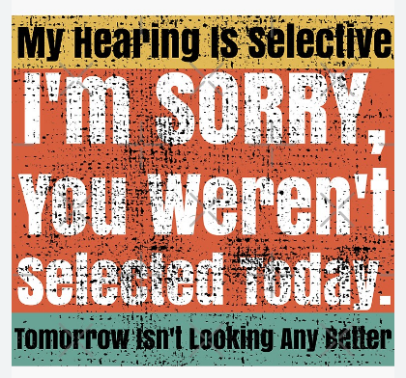
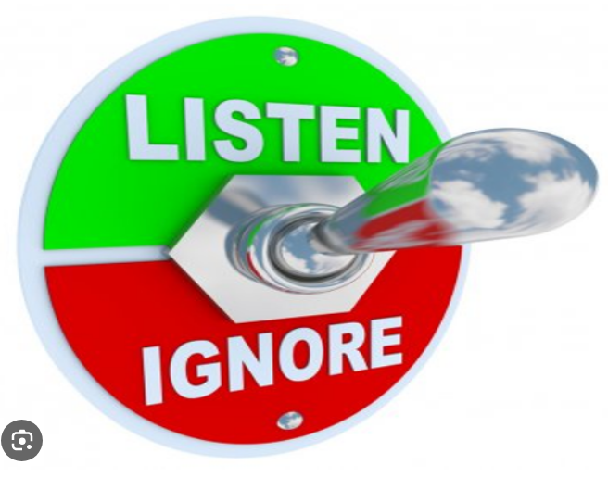
Selective Listening
Focusing your attention on some specific information
Consciously or unconsciously choosing to listen to what is relevant to you and ignore what isn’t
Notes:
Some ulterior motive when listening. Personal relationships – work relationships examples.

Slide 12
Listening Exercise
A businessman had just turned off the lights in the store when a man appeared and demanded money. The owner opened a cash register. The contents of the cash register were scooped up, and the man sped away. A member of the police force was notified promptly.
Notes:
Read the story twice. Answer the questions. True, False, Don’t know
Everyone heard the same story yet answered differently. Why?

Slide 13
True, False, or ?
A man appeared after the owner had turned off the lights?
The robber was a man?
The man did not demand money?
The man who opened the cash register was the owner?
The store owner scooped up the contents of the cash register and ran away.
Someone opened the cash register?
The robber got away with the contents of the cash register.
Notes:
A man appeared after the owner had turned off the lights? ??? The businessman turned off the lights. (He may/may not have been the owner)
The robber was a man? ??? You don’t know that it was a robber. A man appeared and demanded money.
The man did not demand money? FALSE – A man appeared and demanded money.
The man who opened the cash register was the owner? ??? The owner opened the cash register. It did not specify if the owner was a man or woman.
The store owner scooped up the contents of the cash register and ran away. ??? The contents of the cash register were scooped up, and the man sped away. The story does not indicate who scooped up the contents of the cash register.
Someone opened the cash register? TRUE The owner opened a cash register.
The robber got away with the contents of the cash register. ??? Was it a robber?

Slide 14
True, False, or ?
The robber demanded money from the owner.
The story did not involve any women.
The owner of the store contacted the police.
The event took place at the close of the business day.
Notes:
The robber demanded money from the owner. ??? Was it a robbery?
The story did not involve any women. ??? Gender of the owner was never identified.
The owner of the store contacted the police. ??? It doesn’t say who contacted the police.
The event took place at the close of the business day. ??? A businessman had just turned off the lights in the store when a man appeared and demanded money. We don’t know what time of the day he turned off the lights.

Slide 15
Biases When Listening
We all have internal bias and preconceived notions/beliefs
When we let our biases drive our thoughts, we don’t listen openly and authentically
This results in inaccurate or incomplete information and misguided responses to what someone is saying
When your mind tries to verify a preconceived notion, you can miss the obvious (James Cook)
Notes:
Similar to selective hearing, we all have preconceived ideas, feelings, motives, and prejudices that we bring into a conversation. Due to the complex nature of our opinions, these preconceived ideas can affect what we hear. For instance, if you realize that the way a person speaks reminds you of an irritating acquaintance – be on guard for reacting to that person the way you would react to the acquaintance. You can’t necessarily rid yourself of your biases, but being aware and recognizing them helps to set them aside and listen/connect with the person.

Slide 16
Listening Exercise
Differing Viewpoints:
Group 1: Pineapple does not belong on pizza
Fruit doesn’t count as dessert
Group 2: Spring is better than Fall
Toilet paper should go over (not under) the roll
Group 3: Aliens exist
Listening to Audio Books is does not count as reading
Notes:
The art of intentional active listening starts with respecting other opinions and viewpoints. In your Breakout group, create your case for the viewpoints you’ve been given.
The other two groups will listen to you make your case using unbiased listening, respect and patience. The other groups will also ask questions with the intent to understand without judgement.
Prepare your case on your own viewpoint.
Be prepared to ask questions for better understanding, no judgement.

Slide 17
Recap
Anything new? Anything a refresher?
Did you find anything helpful?
Goal setting for improved listening?
Any other feedback?
Notes:
We have discussed a LOT! I can also send everyone a copy of the Power Point presentation. But, what did you find most helpful? What was a repeat, but good as a refresher? How can you improve your listening effectiveness? (Do you talk to each other, email each other, compare stories?

Slide 18
Thank You
Sari Maple, Director, Human Resources
smaple@vfw.org
816-968-1135 Office
816-529-7959 Cell

