Slide 1
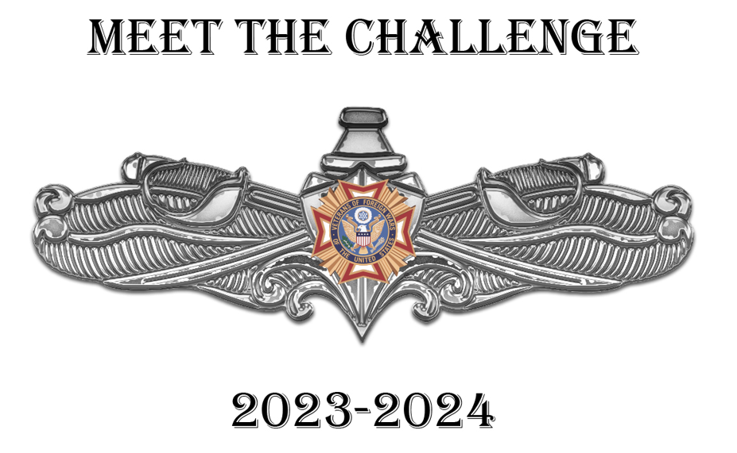
BDD Training: Customer Service & Communication Styles
November 13, 2023
Sari Maple, Director, Human Resources
smaple@vfw.org
816-968-1135

Slide 2

Learning Objectives: Excellent Customer Service
Review the basics of Good Customer Service
Determine your Preferred Communication Style
Discover ways to flex your communication style to better connect with others
Have fun
Notes:
This will NOT be just me talking. I need input from everyone to keep us all engaged. I’ll expect to have some fun too! Nothing we talk about will be new or rocket science, but hopefully a refresher and help us all be more self aware of our strengths and areas needing improvement.

Slide 3
Customer Service Basics
First Impression
Courtesy Counts
Attitude is Everything
Doing the Right Thing
Notes:
First Impression: Think of a time when YOU were the customer and received either excellent customer service or horrible customer service? What made it a bad experience? What made it a good experience? Give examples.
Acknowledge presence
Voice tone
Body language (angry, bored, overwhelmed, irritated)
Good/Bad:
Courtesies – helped immediately, or made to wait? Smile? Expressing concern, empathy, genuine. Personal phone calls, eating, texting
Attitude: stress, demeanor, body language, introductions, smile, confidence, interest, empathy, listening, not interrupting
Doing the right thing: Ethical, honest, only as good as your word, under promise/over deliver, treating all customer fairly and equally. Always be truthful, never make misleading claims. It’s ok to say “I don’t know.” Never comment negatively about competitors.

Slide 4
Breakout:
What are things you can do to make a good first impression?
What are things you can say to your customers that incorporate basic courtesies?
How can you present a good attitude?
Think of an example where a customer asked you to do something unethical, or to not follow rules/SOP. How did you respond?
Notes:
BREAK OUT:
A LOT (not everything) but most of providing excellent customer service is first being a good listener. But also being able to communicate effectively with a client. Which is why I want to switch our focus to how we communicate with other people. Keep in mind, my customers are internal – employees, supervisors, directors. But, knowing how to communicate well can be useful in all interactions (external and internal customers).
Are all these things related to communication? Interaction?

Slide 5
Communications Inventory
The Platinum Rule by Tony Alessandra, PhD. And Michael J. O’Conner PhD.
Designed to determine your ‘go-to’ communication style in everyday related situations
Shows the one style that MOST describes you
No right or wrong style
https://www.wghill.com/SampleReportEN.pdf
Notes:
DiSC: I (Influencer
Eneagram: (Achiever)
MMPI: INFJ or ENFJ

Slide 6
Communications Style Inventory
If you circled the G and D, you tend towards being a Controller/Director.
If you circled the O and D, you show many qualities of a Promoter/Socializer.
If you circled the O and I, you’re predominantly a Supporter/Relater.
If you circled the G and I, you have lots of Analyzer/Thinker characteristics.
Notes:
Were your results surprising? Have your results changed (if you’ve taken this or similar tests in the past?)
DiSC (influencer)
Eneagram (Achiever)

Slide 7
Communication Style: Controller/Director
Values getting the job done
Decisive risk taker
Good at delegating work to others
Not shy but private about personal matters, comes on strong in conversations
Likes to be where the action is
Take charge, enterprising, competitive, efficient approach
Fearless; no obstacle is too big to tackle
Results Oriented
Notes:
If your inventory indicated your most comfortable style of communication is Controller/Director – what do you agree with? What do you disagree with?
If your inventory was NOT a Controller/Director – do you know someone (NO NAMES) that you feel would fall in this category? What issues have you had communicating with this person? How does this person come across in interactions?

Slide 8
Communication Style: Promoter/Socializer
Entertainer
Values enjoyment and helping others with the same
Full of ideas and impulsive in trying them
Wants work to be fun for everyone
Talkative and open about self; asks others’ opinions; loves to brainstorm
Flexible, easily bored with routine
Intuitive, creative, spontaneous, approach
Optimistic; nothing is beyond hope
Celebration Oriented
Notes:
If your inventory indicated your most comfortable style of communication is Promoter/Socializer – what do you agree with? What do you disagree with?
If your inventory was NOT a Promoter/Socializer – do you know someone (NO NAMES) that you feel would fall in this category? What issues have you had communicating with this person? How does this person come across in interactions?

Slide 9
Communication Style: Supporter/Relator
Harmonizer
Values acceptance and stability in circumstances
Slow with big decisions; dislikes change
Builds networks of friend to help do work
Good listener; nervous about voicing contrary opinions, concerned for others’ feelings
Easy-going; likes slow, steady pace
Friendly and Sensitive; no person is unlovable
Relationship Oriented
Notes:
If your inventory indicated your most comfortable style of communication is Supporter/Relator – what do you agree with? What do you disagree with?
If your inventory was NOT a Supporter/Relator – do you know someone (NO NAMES) that you feel would fall in this category? What issues have you had communicating with this person? How does this person come across in interactions?
In HR, I had all three of us complete the assessment. We have a Controller/Director, a Promoter/Socializer, and a Supporter/Relator. We all get along really well.
How does that create challenges for us in the department?

Slide 10
Communication Style: Analyzer/Thinker
Assessor
Values accuracy in details and being right
Plans thoroughly before deciding to act
Prefers to work alone
Introverted; quick to think and slow to speak; closed about personal matters
Highly organized, even plans being spontaneous
Cautious, logical, thrifty approach
Thoughtful; no problem is too big to ponder
Idea Oriented
Notes:
If your inventory indicated your most comfortable style of communication is Analyzer/Thinker – what do you agree with? What do you disagree with?
If your inventory was NOT a Analyzer/Thinker – do you know someone (NO NAMES) that you feel would fall in this category? What issues have you had communicating with this person? How does this person come across in interactions?

Slide 11
Communication Style Exercises
George can quickly tell what’s going on in any situation and is not afraid to speak out about what should be done. When you first met George, you notice he is friendly. Later you realize he hasn’t told you much about his personal life. You go out to lunch with George. He orders steak medium rare, but the meat is served nearly raw. George shouts for the waiter and complaints loudly. The waiter apologizes and takes the steak back to be cooked longer, but George does not want to wait. He demands to see the manager and tells her in the future he’ll eat elsewhere. You both leave immediately and grab lunch at a drive-through and are back in the office in time for George’s next meeting.
What communication style is George and why do you feel this way?
Notes:
Director/Commander

Slide 12
Communication Style Exercises
Dave is a really nice guy. He’s open and always willing to listen. On his desk are lots of photos with family and friends, many of them taken at Disneyland, the “happiest place on earth.” Dave usually dresses in soft, warm colors, ad hates to wear a coat and tie. You go out to lunch with Dave and he orders steak, well done. When he cuts into it, it’s overdone and tough. He doesn’t say a thing to you and continues to eat. The waiter comes by and asks, “How’s your steak?” Dave hesitantly responds he’s sorry to say he likes his steak a little more tender. The waiter asks, “Would you like me to take it back?” Dave answers, only if it’s not too much trouble.”
What communication style is Dave and why do you feel this way?
Notes:
Supporter/Relator

Slide 13
Communication Style Exercises
Jean is a rather complicated person. She cares a lot about what others think of her, but she is sometimes callous about the feelings of others. She’s both sensitive and insensitive at times. It can be confusing. There is no confusion about one thing – Jean is an excellent planner. She gathers all the data and can foresee potential problems. She researches ways to avoid them, at little cost to the organization. At her desk, Jean displays her framed college diploma, and a list of company policies. You go out to lunch with Jean who orders steak medium well. It’s a shade too pink for her, so she requests the waiter to have the chef cook it for exactly 2 and a half minutes longer.
What communication style is Jean and why do you feel this way?
Notes:
Analyzer/Thinker

Slide 14
Communication Style Exercises
Caroline is a popular person who knows everyone’s name at work. Caroline speaks her mind but doesn’t like to alienate others in the process. She tries to make everyone feel good about themselves and her. At her desk is a blown-up photo of her and the team at last year’s Holiday party. You go out to lunch with Caroline and the steak is not cooked to her liking at all. She calls the waiter over immediately and asks for another plate. She quickly decides to try something else. “Bring me the swordfish special instead.”
What communication style is Caroline and why do you feel this way?
Notes:
Promoter/Socializer
There is no right or wrong communication style. There may be situations where one style is more effective or customer focused. But, that’s when we need to aware of our personal style, what we’re most comfortable with. What our ‘go-to’ reactions are. If we’re aware, we can also flex our style to better communicate with our internal and external customers.

Slide 15
Adaptability – Flexing Your Style
When talking to a Controller/Director:
Get right down to business and stay on topic
Be prepared to field follow-up questions on the spot so you can answer with confidence
Expect them to be decisive and fairly blunt
Avoid making promises you can’t deliver on (under promise/over deliver)
Don’t expect them to open up about their weekend plans or discuss personal life
Notes:
Adaptability is when you can apply your style’s strengths or modify your style’s weaknesses in order to meet the needs of a particular situation or relationship. Another term is “Social Intelligence”.
Often, when we do what comes naturally, we might alienate others without realizing it. So, it’s essential we are aware of our own natural tendencies, and the characteristics of others. Most importantly, learning how to flex or adapt to other communication styles will help provide better customer service to internal and external customers (coworkers, clients, you boss, etc.)

Slide 16
Adaptability – Flexing Your Style
When talking to a Promoter/Socializer:
Leave plenty of time for talk and social niceties
Ask them about their family, children – be prepared to talk about yours
Let them “experience” what you are communicating
Talk in terms of people and stories
Use lots of examples
Put details and facts in writing for them to refer back to after a verbal conversation
Don’t expect them to dive deep into the details with you

Slide 17
Adaptability – Flexing Your Style
When talking to a Supporter/Relator:
Don’t come on too strong
Practice active listening and confirm that you’ve heard them by summarizing what they just said to you
Approach them with a relaxed vibe and break the ice by acknowledging a recent contribution they’ve made
Don’t ask for big decisions right away
Provide plenty of reassurance
Talk in terms of security
Notes:
Developing and strengthening the relationship is key.

Slide 18
Adaptability – Flexing Your Style
When talking to an Analyzer/Thinker:
Make sure you are well prepared
Have plenty of facts and figures
Be prepared for skepticisms
Answer all of their questions
Go relatively slow to give them time to think and analyze
Expect them to double- and triple- check all the relevant information before making a decision
Don’t expect them to ease into a conversation with chit-chat

Slide 19
Capitalize on others’ Strengths
Controller/Directors are often excitable and love a good challenge. They’re the ones you want to recruit support for an over-the-moon project you’ve been thinking about.
Promoter/Socializers strive to be emotionally honest and are quick to trust those around them. If you’re trying to reshape the culture on your team, an influencer might be the perfect partner in crime.

Slide 20
Capitalize on others’ Strengths
Analyzer/Thinker types are not only cautious, but highly systematic. They’re the person you want to partner with when assessing risk.
Supporter/Relators are even-keel people who love to be in a cooperative environment where everyone understands their roles and responsibilities. If your team is in turmoil, a relator will be a strong ally to help rebuild the team.

Slide 21
Breakout
What is your personal Communication Style (according to the inventory)?
What do you feel is the most positive about your style? Undesirable?
What would others say is the most positive about your style? Undesirable?
How can you flex your own style to better communicate with others?

Slide 22
Recap
Any ‘aha’ moments?
Did you find anything helpful?
Goal setting?
Any other feedback?
Notes:
Think of someone (internal customer/co workers, friend, family member, external customer) you have had a difficult time connecting with. What do you think their style is? What can you do to better connect?
What is one goal or take-away from this session?

Slide 23
Thank You
Sari Maple, Director, Human Resources
smaple@vfw.org
816-968-1135 Office
816-529-7959 Cell

