Slide 1

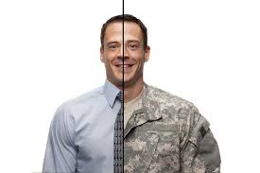



DoD and VA Collaboration Transitioning our service members from soldier to civilian Amy Heinz MSW,LCSW

Slide 2
VA Liaison Program:
Since 2003, VA has collaborated with the Department of Defense (DoD) to transition the health care of ill or injured active duty servicemembers from MTF’s to VA healthcare
Originally established to transition military personnel returning from theaters of combat often with life altering medical conditions (TBI, Visually impaired, complex care, PTSD, etc.)
VA Liaisons now transition other active duty military personnel and Veterans within a broader population who will benefit from VA healthcare and benefits.
VA Liaisons for Healthcare are independent clinical practitioners (LICSW or R.N.) using advanced practice skills and expertise to coordinate care between DoD and VA.

Slide 3
Purpose of VA liaison program
Provide real time transition to DoD service members to VA healthcare and what to expect from the VA
Connect service members with their local VA points of contact through Transition and Care Management program
Partner with DoD to coordinate complex care needs of service members who are still pending transition and med boards
TBI coordination of care, Blind Rehab, Polytrauma experts
Be your subject matter experts on VA healthcare, services and opportunities
To welcome service members into the VA and be the first positive connection to becoming a Veteran
Notes:
Service members will know when their first VA appointment is when they leave the MTF
Early engagement with the liaison for complex cases is preferred

Slide 4

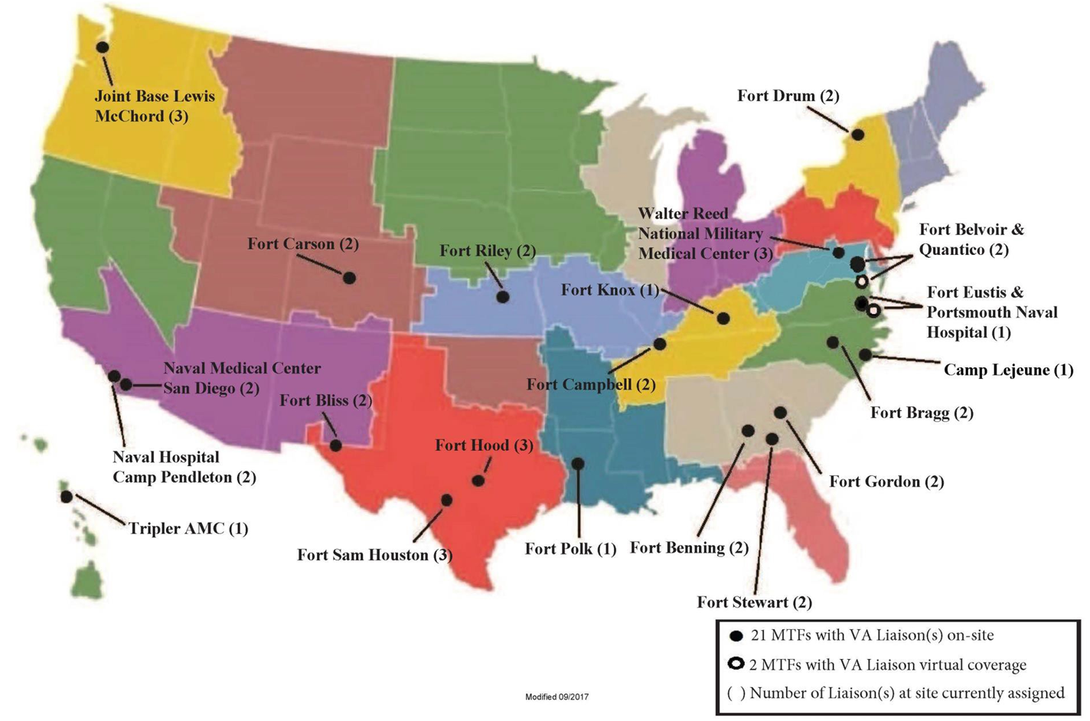
Notes:
MTF’s with liaisons on site-
Liaisons serve the ADSM at the installations and within the SRU units. These locations were determined by size of the installation and number of soldiers transitioning through MEB’s, SRU’s, etc.
In order to expand services to installations that may not have had the population size to warrant a full time liaison we have added “virtual liaisons” at the following installations

Slide 5
Virtual Liaison locations and regions
Syracuse VAMC
Eastern Colorado HCS
Eastern Kansas HCS
San Diego VAMC
Louisville VAMC
Philippines
Guam
Hawaii
American Samoa
Virgin Islands
Puerto Rico
Virtual Liaison Sites
Syracuse/Fort Drum
Eastern Kansas HCS/Fort Riley
San Diego
Louisville/Fort Knox
Eastern Colorado/Fort Carsen
Notes:
These positions will serve a broader geographical region and provide virtual connection of care to the VA the service member is transitioning to.

Slide 6
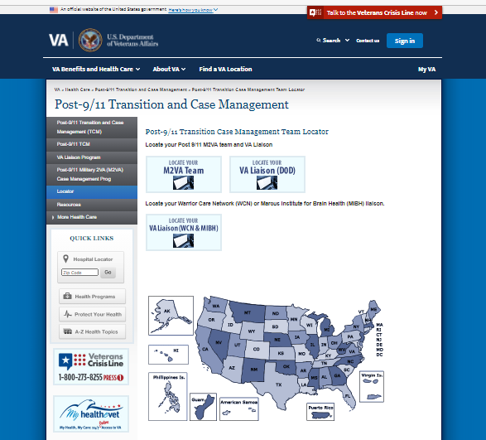
Contact Information
Locate a VA Liaison for Healthcare or a
Post-9/11 Military2VA CM Team
https://www.va.gov/POST911VETERANS/Locator.asp

Slide 7
Why refer?!?!

Slide 8
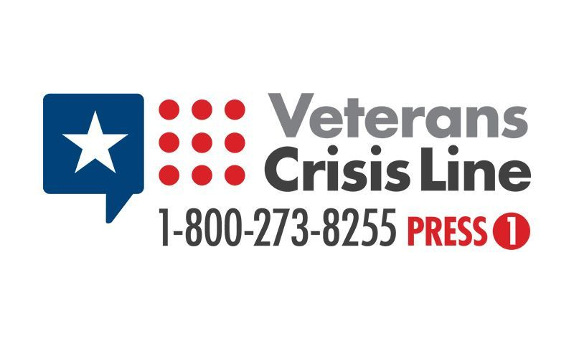
Why refer? Suicide Prevention 21 a day
In 2015, an average of 20.6 active-duty Service members, non-activated Guard or Reserve members, and other Veterans died by suicide each day. *
ONLY 6.1 of these were Veterans who had recently used VHA services. *
Suicide rates increased for Veteran and non-Veteran populations from 2005 to 2015. However, rates for Veterans who did NOT receive care in the VHA increased faster among VHA using Veterans. *
RESOURCES ARE VITAL to ending Veteran suicide
VA liaisons are your in-person resource
VA liaisons are your connection to EVERY VA across the nation
VA liaisons can establish mental health treatment while the service member is on transition leave
VA liaisons mitigate risks
VA liaisons provide the transitioning service member hope
*Dept of Veterans Affairs Office of MH and SP Fact Sheet June 2018
Notes:
1st statistic- so 72% of the veterans that died by suicide had not recently used VHA services
2nd statistic- suicide rates among Veterans not using VHA increased faster
My experience as a VA liaison-
service members have disclosed un-reported MST
thoughts/attempts at suicide that have never been documented or treated
disclosed unplanned pregnancies
disclosed marital strife and plans for divorce after separation
offers a safe space for transitioning service members to express their fears, concerns

Slide 9
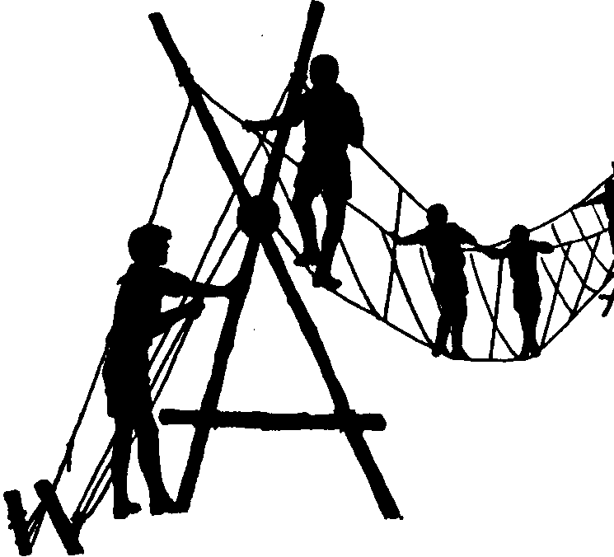
You help build the bridge
Service members often rely on you as a trusted provider
Medical care has been directed and coordinated for them throughout their career
Transitioning service members are more at risk during their 1st year of separation for suicide, homelessness, unemployment and marital strain

Slide 10
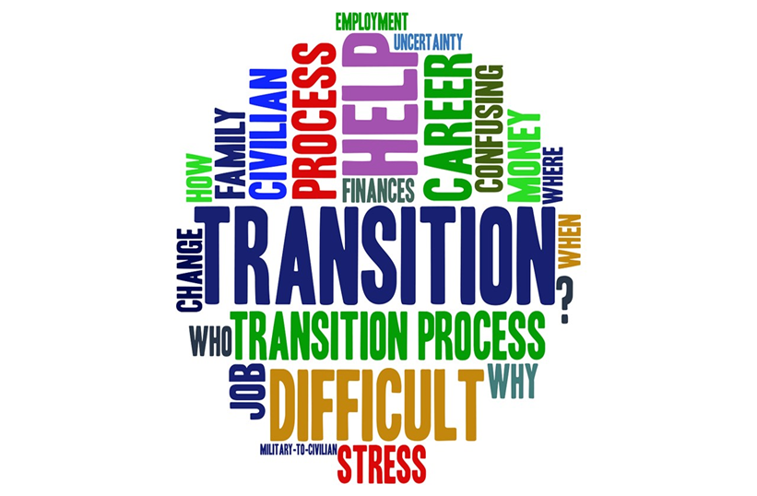
Who can refer? ANYONE
Nurse case managers
PEBLOs, MSCs
AW2 Advocates/RCC
MTF Social Workers
VBA representatives
Ombudsmans
Self referral

Slide 11

Who to refer?
*IDES/MEB soldiers transitioning out
*SM getting out EAS/ETS
*Chapters (regardless of type) who need medical coordination of care or education regarding VA
Including dual process servicemembers
*Career retirees
*Any service member who makes you think -------”huh, I’m a little worried about what’s going to happen to him/her when they discharge”
*Questions- just call and ask!

Slide 12
Basic VA Eligibility
MEB service members will be eligible for comprehensive VA healthcare
Combat Veterans (CV) - receive 5 years of FREE medical care from the VA for conditions that are combat related
Survivors of MST can receive free medical and mental health care related to MST (regardless of d/c and length of time served). No reporting needed
National Guard and Reservists have different eligibility guidelines
Completing VA enrollment service members can get mental health treatment
Bottom line- if you are not sure if a service member will be eligible for VA- call your liaison!

Slide 13
When to refer?
For IDES/MEB service members- when final ratings are signed
For other referrals (ETS, career) approximately 30-60 days prior to transition leave beginning
Chapters- as soon as the service member knows the chapter is being issued
REFRADS- once orders are prepared

Slide 14
How to refer? ***1st complete 10-0454 (MTF referral form)***
For IDES/MEB soldiers
Military ratings
NARSUM
VA proposed ratings
Upcoming medical procedures, specialty care already scheduled
For ALL referrals
Synopsis included on referral form of ongoing medical and mental health needs
Medical records for most recent visit with specialty care within 6 months (neurology, pulmonology, etc.)
Medication list
Any DME/prosthetics used
Email encrypted referral packet to VA liaison in your area
(Establish DoD/VA electronic handshake for secure emails prior)
Notes:
Once you have identified a SM would benefit from a referral to the VA liaison, complete the 10-0454 MTF referral form. This provides the needed information for the Liaison to contact the SM and also all the needed information for the SM to become “registered” with their receiving VAMC they will be referred to.
Good practice to establish an “electronic handshake” with the VA liaison to ensure they can receive encrypted email from you

Slide 15
Service member expectations
An individualized intake assessment specific to medical/mental health needs, ongoing treatment needs to transition to the VA, psychosocial concerns, and any questions about their transition
Service member will leave the intake session with a local VA point of contact
1st VA appointment scheduled at the receiving VA upon leaving the MTF
Receive resources for VA programs and how to file for additional SC benefits
Liaisons will make attempts to reach the service member via phone or email- timeliness is important in the transition process
Notes:
If the liaison referral is closed this does NOT affect the SM’s eligibility for VA healthcare, benefits, etc. This is a service provided not a requirement for transitioning SM’s.

Slide 16
Tricare Auths
For a smooth transitionary process, ADSMs can be seen at the VA while on transition leave
Requires a Tricare Authorization be entered for the receiving VA regardless of East or West Region
VA liaison will send the request with name, VA location, local VA POC, service needed, dates of service needed
VA liaisons will forward the completed approved authorization to the receiving VA within 3-5 business days
https://health.mil/About-MHS/OASDHA/Defense-Health-Agency/TRICARE-Health-Plan/Defense-Health-Agency-Great-Lakes

Slide 17

Identify the soldier
MEB with signed ratings
ETS, Chapter or Career with care needs
Complete MTF referral form VA10-0454
Or call VA liaison with demographic info
Provide MEB documents and pertinent medical records for specialty care
VA liaison contacts service member and completes intake regarding clinical care needs

Slide 18
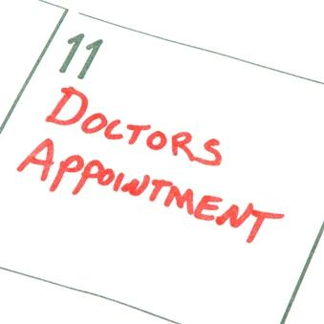
If liaison requests Tricare Auth assist in obtaining
VA liaison forwards documentation, intake information, need for VA care, specialty consult requests and Tricare Auths to receiving VA
Receiving VA reviews information, registers and contacts service member and schedules first appointments at VA
VA liaison notifies referring party of scheduled appointments to “close the loop”

Slide 19
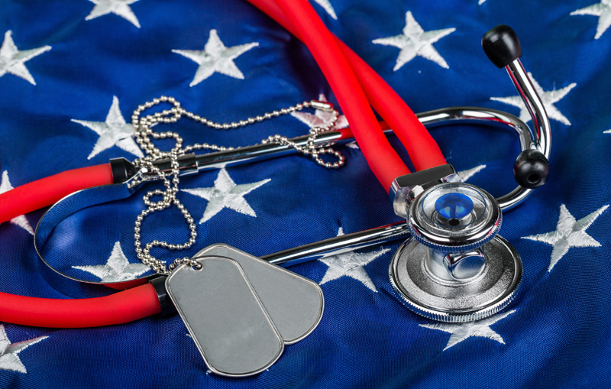
Questions?
Thank you for YOUR service to our Service Members and future Veterans!

