Slide 1
Board of Veterans Appeals
Chance Sizemore
Appeals Consultant

Slide 2
Board of Veterans Appeals
Why are we discussing the BVA during a Pre-discharge conference?
Your BDD clients may call you after they receive their decision, and you should be able to give them some general advice about an appeal before directing them to their local representative.

Slide 3
BVA Breakdown
The Board is under the administrative control and supervision of the BVA Chairman who reports directly to the Secretary.
The Chairman is appointed by the President, and confirmed by the Senate, for a term of six years.
There are 134 Veterans Law Judges (VLJ), and each VLJ is assigned at least one team of lawyers. However, some more veteran judges have several teams of lawyers, and every team has a Lead Lawyer.

Slide 4
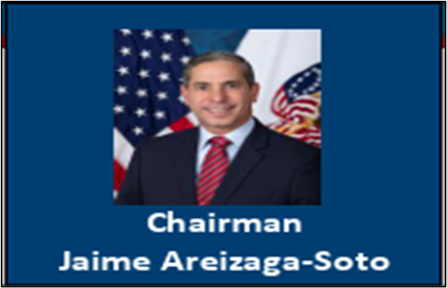
Current Goals of the Chairman
The Board is primarily working on original legacy appeals to finalize and sunset the legacy appeal program
Sunsetting Travel Board cases
Converting Travel Board requests into video/virtual hearings
Notes:
30 Travel Boards currently requested per Chairman’s VSO brief of October 19, 2023.

Slide 5

BVA Hearing Branch Organizational Chart
Bridget Malone
South/Texas
Salvador Ambriz
Atlantic/Southeast
Jennifer Simmons
Northwest Plains & Southwest
CHRISTOPHER SANTORO
Senior Deputy Vice Chairman
Timothy Owens
(Midwest/Northeast)
Raeed Tayeh
(Ops Tm/Cust Svc)
HUNTER JOHNSON, III
Hearing Branch Chief
Leven Pressley-Sanders
(Deputy Branch Chief)

Slide 6
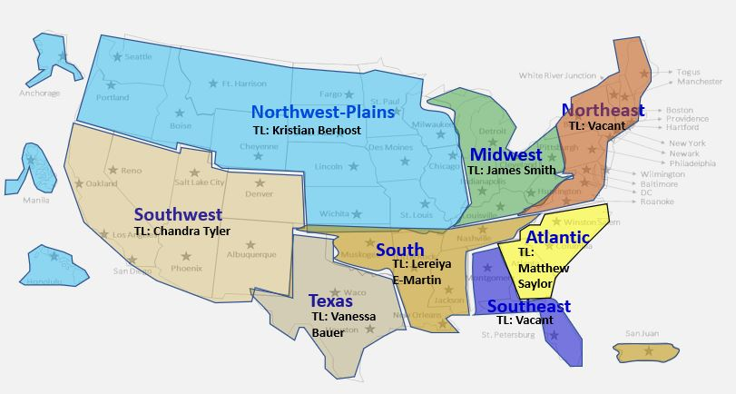
BVA Hearing Branch Regional Chart
Deputy Branch Chief | Regional Oversight
Bridget Malone | Texas, South, Puerto Rico
Leven Pressley | NW-Plains Pacific islands
Tim Owens | Midwest, Northeast
Sal Ambriz | Southeast

Slide 7
VFW BVA Staff
Supervisor:
Jeff Wishneski
Appeals Consultant
Sylvester Jones
Appeals Consultant
George Sheets
Appeals Consultant
Dianne Winston
Appeals Consultant
Chance Sizemore
Appeals Consultant
Isabel Hicks
Appeals Consultant:
Cynthia Archuleta
Appeals Consultant
Didi Ruiz
Notes:
7 Consultants for the entire planet
More than 103 years of experience at the BVA combined

Slide 8
Function of VFW BVA Staff
Represents clients at the BVA
NVS BVA Staff new tool: Case Review
Write informal hearing presentations (IHPs) in lieu of hearings for clients
Bring to the attention and inform leadership to trends or other issues:
First CLCW case to prevail was VFW at the BVA
3.317 Compensation for certain disabilities occurring in Persian Gulf veterans.
RO Specific Issues: Reductions & Rogue Actors
AMA/RAMP Pilot Program
Notes:
We used to get appeals which may or may not have any substance within NOD, Form 9 or 646, and we would review the entire file and find arguments to support clients which was a very lengthy process that did not always bear fruit.
Under new leadership, and the fact that the backlog was moved from the RO to BVA, it was put out at training and while drafting our new guidance, that something of substance should be indicated within appeal correspondence of what the client’s issue with the previous decision is or what evidence was not considered appropriately.
It still remains a very big problem that the field does not adhere to the new standard, but instead of the BVA staff paying for the poor processing from the field, their clients now do when we are not able to figure out the reason they are appealing.
Therefore, if you do assist a client in filing an appeal, then please at-a-minimum provide the purpose of the appeal – even if its just that the client disagrees with percentage or had an inadequate exam.
First CLCW case predates presumptive and when only medical care was being offered
VA attempted to minimize issue which was hard to capture in their ran reports because they attempted to only look for coded gulf war claims and missed where the RO just created claims with individual issues. Nonetheless, the attention brought about from VFW testimony to Congress has corrected the issue in most cases. We no longer are seeing the same poor processing of such claims any longer.
Reductions, this is a continued issue which I will get to specifically later, but at least during Legacy and prior to Work Que we were able to identify issues at specific ROs and inform leadership which got it addressed and corrected. It is definitively much harder now to even determine which RO or VA personnel even worked on the case and lack of transparency is still an issue at the RO level. (Ex. W. Thomas case)
We have been tasked since COVID with handling all PR hearings and quickly identified there was something amidst going on down there. Brought it to leadership attention who went down and discovered a rogue PSO was submitting very frivolous claims and appeals which they had no business doing neither. If you are not familiar with PR cases, then quickly they all are almost entirely reservists and those who do not get activated for deployments supporting combat operations often are upset when they retire or discharge the reserves and attempt to file compensation claims and are informed that they are not afforded the same considerations as regular active duty.
Participated and reviewed the AMA process through its pilot program prior to February 2019. Negative review on quality and only positive was speed

Slide 9
VFW POA Revocation for BVA Cases
Below are some common reasons why the VFW BVA staff may revoke representation:
Recording an accredited representative by a client without the representative’s explicit written consent.
BVA Staff are fully remote and there has been a trend recently of this issue
Repeated and persistent failure by a client to cooperate with a VFW representative
One of the more frequent revocations pursued by BVA Staff
Mental health and competency must be considered
Will normally attempt to assign another consultant before revoking
Dual Representation
Though VA allows it, VFW does not
*The BVA is enforcing the requirement that we must submit a motion with good cause to revoke and allow the VLJ to decide it.
Notes:
Normative issues BVA staff deal with in representing clients
4(C) historically has been more of an issue for in-person hearings and can be a result of insecurities or prejudices about race and sex
Nonetheless, it has occurred with virtual cases since COVID but not as often as when in-person

Slide 10
POA Revocation Example: BVA
Army veteran served from 1999-2006
Veteran was represented by a lawyer for an initial claim for service connection
$70000 was paid to the lawyer (20% of the retroactive benefits) from fee agreement
The lawyer filed an appeal to the BVA for several remaining issues with a caveat that argument would be presented in person during a BVA hearing
While waiting for the hearing, the veteran signed on with the VFW without removing the lawyer as their representative to challenge an incompetency decision at the VARO which the local VFW representative appealed to the BVA
After review at the BVA, the appeals consultant requested to revoke representation
Why did the appeals consultant revoke representation?
Were they correct to do so?
Notes:
Run a poll Should Representation have been revoked? Y/N/IDK
Dual Representation is not allowed
VFW becomes POA for an incompetency challenge and now had to take on BVA appeal several years after revocation and have no idea why the issues were even filed for or appealed. Even if they had removed the lawyer, VFW should still revoke because she had a pending appeal.

Slide 11
POA Revocation Example: BVA
Although the VA allowed the VFW to accept representation for the incompetency claim, NVS Policy and Procedure does not allow dual representation
Once an appeal is filed at the BVA, the NVS Director or designee must approve any changes in POA
Since the veteran did not revoke POA with the lawyer and the NVS Director did not approve the POA acceptance, it was correct to revoke representation

Slide 12
POA Revocation Example: BVA
Jenny Kosar is an Air Force veteran who has an appeal pending at the BVA. When Chance called her to discuss the appeal and conduct a pre-hearing conference, she was not pleased with the advice given. Although Chance gave Jenny the proper advice, she did not feel it was accurate and asked him to repeat himself so that she could record him and present the recording to a different representative for their opinion.
Should Chance revoke representation?
Why?
Notes:
Run a Poll – Should Chance revoke representation? Y/N/IDK

Slide 13
POA Revocation Example: BVA
In this case Chance has the right to revoke representation if he does not consent to being recorded. If the veteran insists after being advised that there is no consent, Chance should end the call and revoke representation.
Note: This policy applies to all representatives at any time during the claim process, not only to BVA Appeals Consultants.

Slide 14
Which Appeal Lane?
Currently there are three options for appeals at the BVA:
Direct Review
Great for simple and routine cases
Believes the evidence is in the file and RO just got it wrong
Technically, it does not require an IHP as additional evidence, but we have option to provide one
Evidence Submission
Must have additional evidence for consideration
Normally a response to the missing info from denial
This is the least utilized option by clients, but it is often is the best option for a successful appeal
BVA Hearing
Evidence no longer available, such as fire cases.
Mental health cases
Claims for increase (separate & secondary ratings)
Complex cases: Do not expect the VA and its work queue to put a complicated puzzle together
Notes:
With these descriptions it is my intent to relay a layman’s understanding of when to use the differing lanes and not just citing the book definitions of the different lanes because that clearly is not working.
Unfortunately, we see a lot of cases missing more than one of the three requirements for SC and makes no sense to appeal to the BVA because the BVA only makes legal decisions and does not do any processing – Really emphasize that without a diagnosis its pointless to appeal, that’s why they need to do an accurate records review when submitting the BDD claim

Slide 15
BVA Appeal – VA Form 10182
AMA attempts to streamline appeals
Direct Review (No new evidence after submission)
Evidence Submission lane
BVA Hearing
In-person VACO handled solely by BVA Staff (longest)
Virtual (the future)/ Video
NO TRAVEL BOARDS
BVA Decisions appealed to United States Court of Appeals for Veterans Claims (CAVC) – 120 days from date of BVA Decision
“Bergmann & Moore brief”

Slide 16
What to Expect at a BVA Hearing
BVA hearings are considered non-adversarial, and the VA is required to provide the veteran with reasonable assistance in compiling evidence to prove the veteran's claim.
Hearings attempt to create a discussion between the client, rep & VLJ
VLJ can only ask “clarifying questions” and cannot give clients the 3rd degree
This isn’t Law and Order, and you CAN handle the truth!

Slide 17
Steps of a BVA Hearing
Preconference with VLJ
Prior to the start of the hearing you should have a quick discussion with the VLJ to validate issues, prevent any surprises, and make any requests. You shouldn’t introduce anything during testimony without bringing it up during the pre-conference
Testimony
Should have an opening that gives a summary of the case and why the client wanted a hearing over another lane
Always maintain professionality with VLJ and do not attack the VA
Clients must swear in, but VSOs do not
Complete waiver for witnesses and provide VLJ with spelling of names
VLJ will likely ask some clarifying questions – some let you talk first, others will jump straight to questions after your opening
Stay on point with testimony concerning why the issue was denied

Slide 18
Steps of a BVA Hearing
Conclusion
At the end of testimony, restate what the veteran wants and make sure everyone is on the same page
Be sure to thank the VLJ

Slide 19
What to Expect After Hearing or IHP
Cases are worked in docket order – hearings do not change that
After a hearing, the audio is sent out to a 3rd party in Maryland who transcribes it
Turn around is about 4 to 6 weeks
When the transcription returns, it is uploaded into the electronic file and the case is assigned back to storage/standby
Once the case docket comes up, the VLJ and team will make a decision
The case will be returned to the VFW BVA Office through the BVA 32/30 Box if additional evidence was received between IHP and docket. Does not apply to a hearing if evidence was expected and the file was left open.

Slide 20
BVA Adjudication & Decisions
BVA Decisions are typically single judge and are not precedent setting. (There is a process for a 3 to 5 judge panel to hear cases, but it is extremely rare and there has not been any in last 12 years for VFW BVA clients)
BVA cannot conduct any development and only has remand power for underdeveloped cases or VCAA adherence
The VLJ will divide the file into parts that are then assigned to different lawyers, then the team comes back together, and the Lead Lawyer drafts decision for VLJ signature
It’s a training exercise - many judges hope to move up to the higher courts, and the lawyers for them hope to become judges or move to higher courts

Slide 21
BVA Decisions
Differ from Rating Decisions. BVA decisions have numerous parts and can be confusing regarding grant/denied issues and those subject to remand because they appear in different parts.
Very detailed in analysis and laws/regulations applied.
Do not skip remand discussion, as RO personnel often do, and only focus on the Remand Orders. The discussion normally denotes what in previous processing caused the remand and what specifically is required for remedy.
Remand Orders are a detailed step by step instruction for RO personnel to follow at-a-minimum to satisfy development and afterwards can make a new determination if necessary.

Slide 22
A Potential BDD BVA Appeal?
Alice Stoney is a former BDD client of yours that wants to appeal a decision that denied service connection for her right knee. The decision stated:
The evidence does not show an event, disease or injury in service. (38 CFR 3.303, 38 CFR 3.304) Your service treatment records do not contain complaints, treatment, or diagnosis for this condition.
What should you advise Alice to do?
Notes:
Poll Question - What should you advise Alice to do?
Advise her to talk to her local representative about filing an HLR
Advise her to talk to her local representative about filing a Supplemental claim if she can get a diagnosis
Advise her to talk to her local representative about filing a BVA appeal
Tell her you can’t provide advice because you don’t handle appeals

Slide 23
BDD Appeals at the BVA
Types of BDD appeals most seen at BVA
Large number of issues (5+)
Large number of requests for increases
Multiple separate pending appeals
Numerous 1-2 issue appeals
From discussions with clients, especially at hearings, trying to get statutory 100 is very common (Chasing the hundred)
For lower ratings, the goal is 30 percent for dependents
Reductions after future exams
Why do you think these appeals are constantly filed?
How can we prevent the frivolous ones?

Slide 24
BDD Appeals at the BVA
Educate the service member up front!
Explain the exam process – make sure they know to not be a hero
Never advise the service member to not take meds, but explain that the exam should portray the true severity of the condition
If there is no diagnosis – there is no claim!
Explain that there may be a future exam – don’t stop treatment!
Be realistic with expectations

Slide 25
Board of Veterans Appeals
Contact Information:
BVA Assistance Line: 800-923-8387
Mr. Jeff Wishneski (Supervisor) 202-632-4605/202-382-2879
BVA Email Boardcustomerservice@va.gov
File Issues BVArepsupport@va.gov

Slide 26
QUESTIONS?
Chance Sizemore
(202) 815-6900
csizemore@vfw.org/ chance.sizemore@va.gov

