Slide 1
How to use Common Court Cases
By Crystal M. Trulove
April 2023

Slide 2


Introduction
Crystal M. Trulove
crystal.trulove@gmail.com
Background
Air Force
NOAA/National Weather Service
Department of Veterans Affairs
Veterans of Foreign Wars
Notes:
VFW since 2019

Slide 3

References
Court of Appeals for Veterans Claims (CAVC)
http://www.uscourts.cavc.gov/index.php
Search decisions
Keyword = Veteran’s name
View, download .pdf
Court of Appeals, Federal Circuit (CAFC)
http://www.cafc.uscourts.gov/
PACER (good luck)
FindLaw, or other websites
38 CFR
Multiple references will be covered in slides
M21-1
Multiple references will be covered in slides

Slide 4
Why use Court Cases?
Course Objectives:
Know where and how to look up court decisions
Understand 7 important court decisions
Feel confident about using these decisions in appeals
Elements 1, 2, and 3 refer to direct service connection claims

Slide 5
Setup of the courts
All federal courts
Does set precedent
VA at national level
Can set precedent
VA at local level
BVA/Board/Secretary

Slide 6

CAVC – Rice v Shinseki
A request for a total disability evaluation on the basis of individual unemployability (TDIU), 1) whether expressly raised by the veteran or reasonably raised by the record, 2) is not a separate claim for benefits.
Rice v. Shinseki (May 6, 2009) can be used for:
Establishing a relationship between IU and the associated SC disability evaluation(s)
Interpreting IU as a part of the underlying disability claim
establishing an effective date for IU benefit
reasonably raised claims for IU

Slide 7
CAVC – Rice v Shinseki
38 CFR 3.156 New evidence
38 CFR 3.400(o)(2) Increases in disability compensation
M21-1 VIII.iv.3.A.1.a. Establishing Entitlement to TDIU
M21-1 VIII.iv.3.B.1.e. Veteran’s Responsibility to Specify a Disability or Disabilities That Cause Unemployability
M21-1 VIII.iv.3.C.5.f. Handling Issues Identified on a VA Form 21-8940 Received During a Supplemental Claim
M21-1 VIII.iv.3.C.5.k. IU Effective Dates Associated With Appellate Status

Slide 8

CAVC – Mittleider v West
When it is not possible to separate the effects of an NSC condition from an SC condition, reasonable doubt should be resolved in the veteran’s favor.
Mittleider v. West (May 8, 1998) can be used for:
evaluating symptoms of SC and NSC disabilities that
cannot be separated

Slide 9
CAVC – Mittleider v West
38 CFR 3.102 Reasonable doubt
Refers to equipoise, not to absence of evidence
M21-1 V.ii.3.D.2.c. Evaluating Symptoms of SC and NSC Disabilities That Cannot Be Separated
Don’t rely on CAVC Langdon v. Wilkie (referenced in M21-1) because CAFC overruled this decision

Slide 10

CAVC – Perry v Brown
If BVA gets a BMAO (Board Medical Advisory Opinion), law requires that veteran be notified of the opinion and allowed opportunity to respond prior to a decision.
CAVC decision itself may not be as helpful as other things going on in this case, i.e. medical opinion regarding in-service evidence.
Perry v. Brown (February 22, 1996) used for:
Competency of lay evidence to establish criteria for element
2 (event in service) and 3 (nexus) in order to get an exam
Supporting a private physician medical nexus

Slide 11
CAVC – Perry v Brown
38 CFR 3.159(c)(4)(i)(B)&(C) Medical exams/opinions
(B) element 2, “event, injury, or disease”
(C) element 3, “nexus”
McLendon v. Nicholson – “low threshold” for exams
Buchanan v. Nicholson – in the case of no medical evidence in STRs, will be discussed in another slide
38 CFR 3.303(b) & (d) Principles relating to service connection; chronicity and continuity & post-service dx
M21-1 IV.i.1.B.1.b. In-service Event, Injury, or Disease

Slide 12

CAVC – Wilson v McDonough
VA must consider historical diastolic pressure readings when determining hypertension evaluations even if it is a claim for an increased rating.
Wilson v McDonough (December 20, 2021) can be used for:
Supporting a 10 percent evaluation for HTN
AO hypertension claims
38 CFR 3.303(d) Principles relating to service connection
(d) Postservice initial diagnosis of disease.

Slide 13
CAVC – Wilson v McDonough
38 CFR 4.104, DC 7101
7101 Hypertensive vascular disease (hypertension and isolated systolic hypertension):
Diastolic pressure predominantly 130 or more | 60
Diastolic pressure predominantly 120 or more | 40
Diastolic pressure predominantly 110 or more, or; systolic pressure predominantly 200 or more | 20
Diastolic pressure predominantly 100 or more, or; systolic pressure predominantly 160 or more, or; minimum evaluation for an individual with a history of diastolic pressure predominantly 100 or more who requires continuous medication for control | 10
Note (1): Hypertension or isolated systolic hypertension must be confirmed by readings taken two or more times on at least three different days. For purposes of this section, the term hypertension means that the diastolic blood pressure is predominantly 90mm. or greater, and isolated systolic hypertension means that the systolic blood pressure is predominantly 160mm. or greater with a diastolic blood pressure of less than 90mm.
Note (2): Evaluate hypertension due to aortic insufficiency or hyperthyroidism, which is usually the isolated systolic type, as part of the condition causing it rather than by a separate evaluation.
Note (3): Evaluate hypertension separately from hypertensive heart disease and other types of heart disease.

Slide 14

CAFC – Walker v Shinseki
For VA purposes, “chronic” diseases covered by provisions of 38 CFR 3.303(b), are only the chronic diseases identified in 38 CFR 3.309(a).
3.303(b)Chronicity and continuity. With chronic disease shown as such in service (or within the presumptive period under § 3.307) so as to permit a finding of service connection, subsequent manifestations of the same chronic disease at any later date, however remote, are service connected, unless clearly attributable to intercurrent causes.
Walker v. Shinseki (February 21, 2013) can be used for:
Information on chronicity and continuity of symptoms

Slide 15
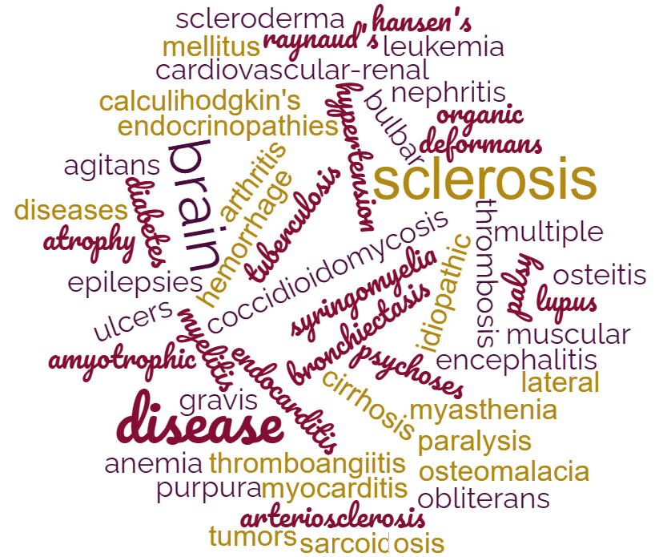
CAFC – Walker v Shinseki
38 CFR 3.309(a)

Slide 16
CAFC – Walker v Shinseki
38 CFR 3.303(b) Principles relating to service connection, must be used with…
38 CFR 3.309(a) Diseases subject to presumptive service connection; Chronic diseases
M21-1 V.ii.2.A.1.c. Establishing Direct SC Based on Chronicity
M21-1 V.ii.2.A.1.d. Establishing SC Based on Continuity of Symptoms

Slide 17

CAFC – Buchanan v Nicholson
VA cannot determine that lay evidence lacks credibility merely because it is unaccompanied by contemporaneous (at the same time) medical evidence.
Buchanan v. Nicholson (June 14, 2006) can be used for:
Competency of lay evidence to meet criteria for element 2 (event, injury, or disease in service) in order to get an exam

Slide 18
CAFC – Buchanan v Nicholson
38 CFR 3.307(b) Evidentiary basis of Presumptive service connection
M21-1 V.ii.2.B.1.g. Establishing Onset During a Required Manifestation Period
M21-1 IV.i.1.B.1.b. In-service Event, Injury, or Disease

Slide 19
CAFC – Jandreau v Nicholson
Lay evidence can be competent and sufficient to establish a diagnosis of a condition when
a layperson is competent to identify the medical condition,
the layperson is reporting a contemporaneous medical diagnosis, or
lay testimony describing symptoms at the time supports a later diagnosis by a medical professional.
Jandreau v. Nicholson (July 3, 2007) can be used for:
competency of lay evidence to establish criteria for element 1 (current disability) in order to get an exam
Notes:
Jan DRO

Slide 20
CAFC – Jandreau v Nicholson
38 CFR 3.159(c)(4) Department of Veterans Affairs assistance in developing claims
(4) providing medical exams/opinions
M21-1 IV.i.1.A.1.b. Regulatory Standard for Finding an Examination or Medical Opinion Necessary

Slide 21
Exercises
Ruma Nandini
Jeremy Li
Tammy Cole
Rodney White
Which court case or cases could help each of these veterans?
Write down the name of the case, and why you thought it could help.

Slide 22
Ruma Nandini – Marine Corps
Ruma Nandini calls to ask you a question about whether she can make a claim for increased evaluation for her service connected hypertension, currently evaluated at 0%. She was diagnosed with hypertension by a corpsman while she was still in the Marine Corps. She has been on prescription medication ever since and she tells you that her blood pressure readings are well within normal range now. Her condition is not a problem for her unless she forgets her medication. In that case, she gets mild headaches that go away as soon as she begins taking her hypertension meds again. Is that enough for her to qualify for an increase?

Slide 23
Jeremy Li - Army
Jeremy Li made a claim for SC for “gastritis with weight loss, nausea and vomiting.” He avoided seeing a medic on deployment in the Army but on one occasion his squad leader made him go. That treatment record says “nausea and feels like he might have to throw up.” In his post-deployment health assessment Li reported “stomach issues” but said Pepto Bismol made it better. There are no other relevant STRs and Li does not have any current medical records, but submitted statements from his buddy who was deployed with him, and from his girlfriend, that say Li started having these symptoms in service and has had them ever since.
The RO denied the claim, saying that neither record in his STRs resulted in a diagnosis, and the veteran is not competent to diagnose himself now. They said that this claim does not meet criteria for any of the three elements required for direct service connection.

Slide 24
Tammy Cole – Air Force
Tammy Cole underwent surgical resurfacing of her SC left hip in 2021. She had a disability evaluation of 30% under DC 5252 for limited flexion of the left thigh, and also 20% under DC 5253 for limited abduction of the left thigh. Cole made a claim for increase, and mentioned that her hip is so much worse that she has asked for reasonable accommodation so that her employer will purchase an ergonomic chair specially designed for limited hip mobility. She said she has used up all her paid time off due to hip pain.
On February 2, 2023 the Regional Office increased her disability evaluation to 40% under DC 5252 and C+C the 20% under DC 5253, stating that she was at the highest evaluation level possible for both. Ms. Cole asked you to take a look at her file and see if there is a way for her to qualify for a greater increase.

Slide 25
Rodney White – Marine Corps
Rodney White uses a cane for stability, and recently made a claim regarding his SC right knee and right ankle, hoping for an increase due to Rating Schedule changes that went into effect in February of 2021. In a decision dated January 18, 2023, his two joint disabilities were separated and each awarded a 10% disability evaluation, which does increase his benefit. Veteran White feels that his SC symptoms are bad enough to warrant a higher disability rating, but at the VAE he found it difficult to explain the additional impact of an old NSC hunting injury that resulted in a wound in his right leg near the knee. Even he gets confused about which injury causes which symptom.

Slide 26
QUESTIONS?
Crystal M. Trulove
crystal.trulove@gmail.com

Slide 27

2023 Proficiency Training Conference Survey
Class: Common Court Cases
Please scan the QR Code or click on the link below to take an anonymous survey about your experience during the 2023 Proficiency Training Conference.
https://www.research.net/r/HCMVV7Y

