Slide 1



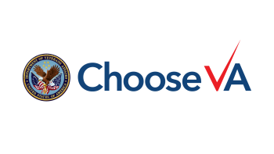

VA Insurance Service
Protect Those Who Matter Most
With VA Life Insurance
Department of Veterans Affairs (VA)
Veterans Benefits Administration (VBA)
Insurance Service (INS)

Slide 2


VA Insurance Overview
Mission
Vision
To provide our nation’s Veterans, service members, and military families insurance products and services.
To be the world-class leader for Veteran and military insurance delivery; where a diverse and caring workforce thrives, online technology advances efficiency, and our performance honors military service by exceeding expectations for value, timeliness, and customer service.
VA Insurance Service serves over 5.7 million Veterans, Service members, and military families with insurance coverage totaling $1.45 trillion.
Key Program Features:
Over 100 years of success
11 insurance programs
Competitive premium rates
Annual claims paid totaling over $2 billion
Online VALife application
Online death claims submission using DocuSign
Online instant loans
Virtual document upload

Slide 3
VA Insurance Overview
As the 12th largest insurance program in the United States, we are disbursing billions each year at record speed.
In fiscal year (FY) 2022, we averaged 2.4 days to disburse complete insurance claims at 98.4% financial accuracy.
Lives Insured by FY​
Fiscal Year​ | 2015​ | 2016​ | 2017​ | 2018​ | 2019​ | 2020​ | 2021​ | 2022
Face Amount ​ ($ in billions)​ | $1,241​ | $1,226​ | $1,215​ | $1,215​ | $1,174​ | $1,190​ | $1,208​ | 1,218
Total Lives Insured​ | 6,254,979​ | 6,115,127​ | 6,007,606​ | 5,924,525 ​ | 5,668,418 ​ | 5,631,119​ | 5,715,537 ​ | 5,624,676

Slide 4







VA Insurance Offerings
Veterans Affairs Life Insurance (VALife)
Servicemembers’ Group Life Insurance (SGLI)
“ To care for
him who shall have
borne the battle and
for his widow, and
his orphan.”
Servicemembers’ Group Life Insurance Traumatic Injury Protection (TSGLI)
Veterans’ Mortgage Life Insurance (VMLI)
Servicemembers’ Group Life Disability Extension (SGLI-DE)
Abraham Lincoln
Veterans’ Group Life
Insurance (VGLI)
Family Servicemembers’ Group Life Insurance (FSGLI)

Slide 5

Your VA Insurance Journey Line
Servicemembers’ Group
Life Insurance (SGLI)
Low-cost term life insurance for Service members
Effective March 1, 2023, automatic coverage of $500,000, if eligible, unless reduced or declined
Remains in effect 120 days after separation at no cost
Family SGLI (FSGLI) covers spouses and dependents for $100/10k
TSGLI provide automatic traumatic injury protection of $25,000 $100,000 for those covered by SGLI
Veterans’ Group Life Insurance (VGLI)
Allows separating Service members to convert their SGLI to renewable term insurance
Premiums based on age & amount of coverage
Must apply within 1 year and 120 days from separation; no health requirement if the Veteran applies within 240 days of separation
SGLI Disability Extension (SGLI DE)
Allows totally disabled separating service members to continue SGLI up to 2 years at no cost
VA Life Insurance (VALife):
Effective January 1, 2023, provides up to $40,000 of guaranteed acceptance whole life coverage to Veterans with service-connected disability ratings 0-100%, age 80 or under
No medical underwriting, builds cash value
2 year waiting period for full coverage
Veterans’ Mortgage Life Insurance (VMLI)
Provides mortgage life insurance up to $200,000 for disabled Veterans under age 70 who are approved for a VA Specially-Adapted Housing (SAH) grant
Benefit paid to mortgage lender

Slide 6

What is VALife?
On January 5, 2021, Public Law 116-315 established Veterans Affairs Life Insurance (VALife) as a new life insurance program for Veterans.
VALife offers guaranteed acceptance, whole life insurance coverage to more Veterans with service-connected disabilities than ever before.
VALife opened for enrollment on January 1, 2023.

Slide 7
Whole vs. Term Life Insurance
Whole Life Insurance
Builds cash value overtime
Policy lasts the entire life of the individual holder
Premiums are fixed for the life of the policy
Premiums are generally higher
Provides death benefit and cash value component that builds over the life of the policy
May have medical underwriting, VALife has no medical underwriting.
Term Life Insurance
Policy lasts for a set term (e.g., 5, 10, 15, or 20 years)
Premiums are fixed for set term, and group each new age bracket
Premiums are generally lower (at younger ages) with higher face value
No cash value component
Provides death benefit only
Has medical underwriting

Slide 8

Who is eligible for VALife?
Veterans age 80 and under with any level of service-connected disability rating (0-100%) from VA are eligible to apply, with no time limit.
There are no medical requirements for enrollment.
  Due to the absence of medical requirements, there is a two-year waiting period for full VALife coverage to take effect. This is a common practice with guaranteed acceptance whole life policies.
Veterans who are 81 or older may apply for VALife within two years of receiving notification of a new service-connected disability rating if they:
  Applied for VA disability compensation before age 81, and
  Received a new service-connected disability rating after turning 81.

Slide 9




What are the benefits of VALife?
Up to $40,000 in coverage, available in $10,000 increments
No medical requirements for enrollment
Fully automated online enrollment with instant approvals
Competitive premium rates
Cash value that builds over the life of the policy

Slide 10
How much does VALife cost?
VALife premium rates are cheaper the earlier you sign up.
Rates will not increase for the life of the policy.
Example Monthly Premium Rates*
Age | Coverage Amount | Monthly Premium
20 | $10,000 (minimum) | $11.40
40 | $40,000 (maximum) | $45.60
40 | $10,000 | $22.00
 | $40,000 | $88.00
60 | $10,000 | $50.00
 | $40,000 | $200.00
80 | $10,000 | $127.50
 | $40,000 | $510.00

Slide 11
How does VALife impact Veterans enrolled in S-DVI?
Can keep their S-DVI coverage during the two-year waiting period for VALife coverage to begin
If they apply for VALife on or before December 31, 2025
Veterans currently enrolled in S-DVI
If they apply for VALife on or after January 1, 2026
S-DVI coverage ends the day they enroll for VALife, and the two-year waiting period still applies
Service-Disabled Veterans Life Insurance (S-DVI) closed to new enrollment on December 31, 2022.
VALife does not offer waiver of premiums.
10

Slide 12




How can Veterans apply for VALife?
Veterans can manage all aspects of their VALife policy online.
Online
application
Online instant
decision
Online review and management of policy
Electronic filing of
death claim
Veterans can check eligibility and apply by VALife at https://insurance.va.gov/VALIFE/

Slide 13

Learn More About VALife
Visit the VALife website:
https://www.va.gov/life-insurance/options-eligibility/valife/
For additional information and frequently asked questions, https://www.benefits.va.gov/insurance/valife-faqs.asp

Slide 14
Contacts for VSO Communicators
Ruth Berkheimer, Senior Insurance Specialist
Ruth.Berkheimer@va.gov
Melinda Alexander, Insurance Specialist
Melinda.Alexander@va.gov
“Applying for VALife was the easiest process for accessing benefits within the VA.” - Veteran Policyholder

Slide 15
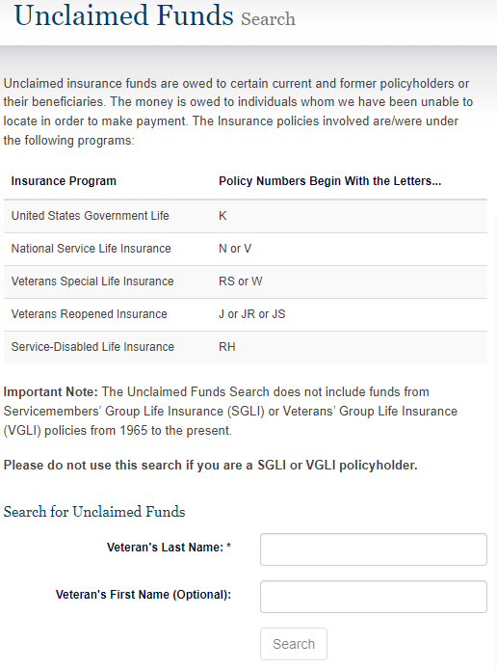
VA INS Unclaimed Funds Online Search Tool
Former policyholders, beneficiaries, and policyholder’s next of kin can use the Unclaimed Funds online search tool to identify if any Insurance funds are owed to individuals who VA has been unable to locate in order to make payment.
Unclaimed funds do not include funds from Servicemembers’ Group Life insurance (SGLI) or Veterans’ Group Life Insurance (VGLI).
Unclaimed funds range from monetary amounts below $150 to amounts above $1,000.
Proof of identity and entitlement is required to claim funds.
The Unclaimed Funds online search tool is found at: www.insurance.va.gov/UnclaimedFunds/Search

Slide 16
VA INS Unclaimed Funds Online Search Tool
What is proof of identity?
You must submit a copy of your Drivers License or other US or Government-issued identification.
Examples of Government-issued identification include:
Social Security Card
Social Security Statement
Passport
Medicare Card
What is proof of entitlement?
Entitlement to Property sought may be established through any of the following types of documentation:
Marriage Certificate
Death Certificate
Personal Records
Copy of Insurance Policy
Cemetery Records

Slide 17

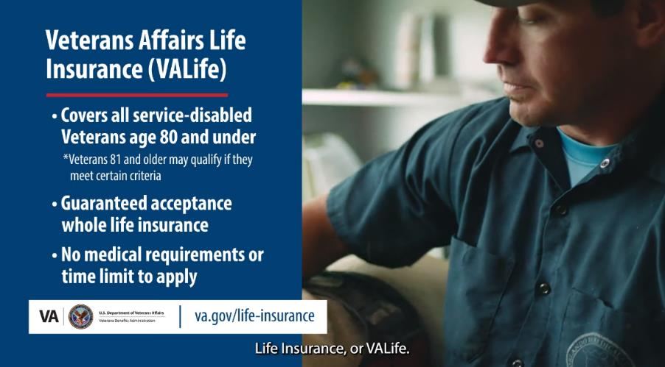
VA Insurance Financial Education Videos
Life Insurance Financial Education
VA INS Programs Overview

Slide 18
Questions?

