Slide 1
Interpreting Medical Records
& Determining Claimable Conditions
Notes:
Who here has a medical background?

Slide 2
How to Review Medical Records
Reviewing the STR is one of the most important functions of a BDD Representative
When reviewing records, don’t just look for diagnoses, look for treatment or anything else that could point to a potential claimable condition
Sometimes there will be a note that references a different condition that is not well described – an appendicitis surgery record may mention spine arthritis that was found by accident in an x-ray
Notes:
Bullet 2 – Sometimes the veteran will have been seen multiple times for something without a diagnosis – for example mental health treatment or multiple minor knee injuries this could show a chronic condition

Slide 3
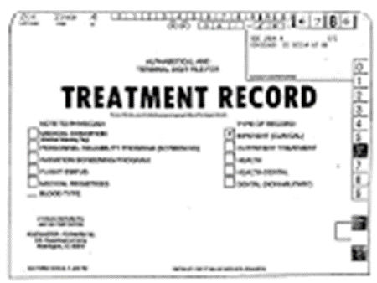
Types of Records
Hard Copy STRs: These are the “traditional” records that many think of when they think of STRs. The Hard Copy will likely contain the veteran’s exams (entrance, exit, PHA, PDHA etc.) as well as sick call slips and other routine medical records
HAIMS Record: Usually consists of a consolidation of tests and clinical reports including a list of active problems, medications, and diagnoses
ALHTA Record: Electronic records that have been in use since 2005 – consists of treatment records and electronic medical records

Slide 4
MHS GENESIS
MHS GENESIS is the Military Health System's new electronic health record. When fully deployed, MHS GENESIS will provide a single health record for service members, veterans, and their families.
As of Sept 2023, the Defense Health Agency has deployed MHS GENESIS to 126 parent hospitals and clinics through 21 ‘waves’
More than 170,000 DHA providers are using MHS GENESIS to provide health care to more than 7.0 million potential beneficiaries and deployment is 91% complete

Slide 5
MHS GENESIS Patient Portal
The MHS GENESIS Patient Portal is a secure website for 24/7 access to health information, including managing appointments and exchanging messages with care teams.
The new patient portal is launching at sites as MHS GENESIS deploys, replacing the TRICARE Online Secure Patient Portal.

Slide 6
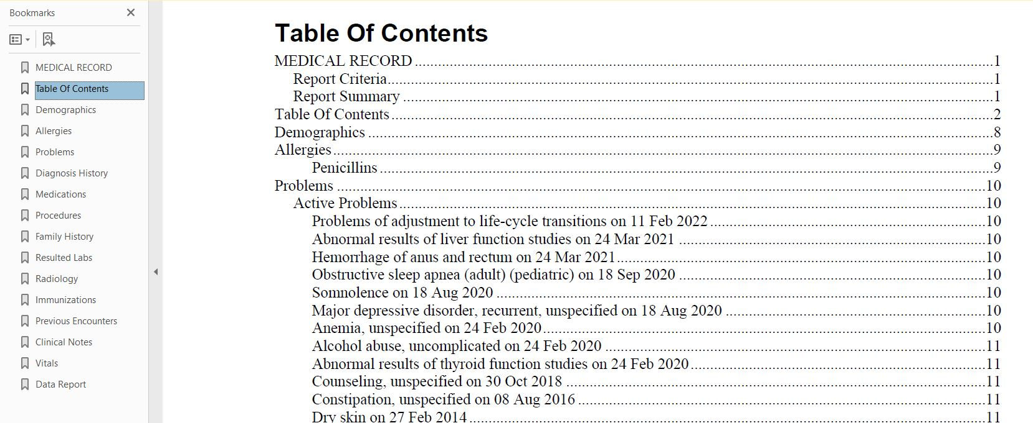
Table of Contents
Many records you review will be digitized and in PDF format with tabbed fields
Many claimable conditions will be found in the “Problems” area – but not everything there is claimable
This makes it easy to find claimable items but be sure to still review everything

Slide 7
What are you looking for? Exams
Entrance and Exit Physicals – Compare the exams to determine if there are any differences. Differences are likely going to be claimable issues
Periodic Health Assessments (PHAs) – These show snapshots of the veteran’s medical history and should be compared to the entrance and exit exams to determine changes in medical history during service
Post Deployment Health Assessments (PDHAs) – These exams will likely show any issues that happened during a deployment

Slide 8
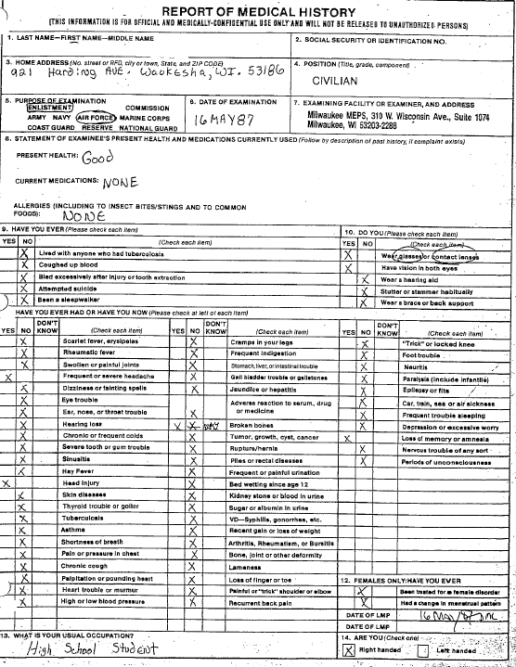
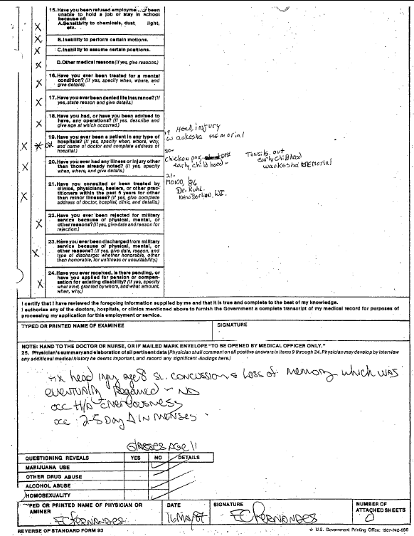
Entrance Exam Example
Notes:
Entrance exam SF 93
)

Slide 9
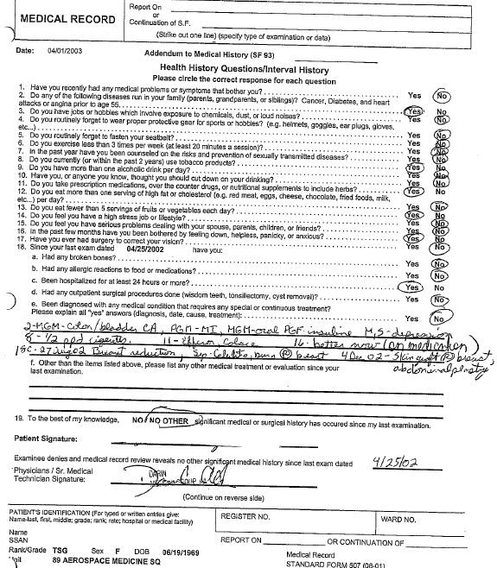
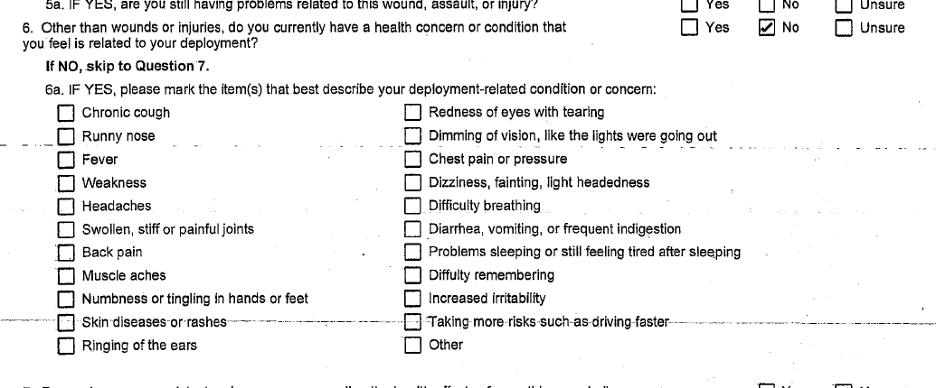
PERIODIC HEALTH ASSESSMENTS / POST DEPLOYMENT HEALTH ASSESSMENTS (PHAS & PDHAS)
Most veterans complete periodic health assessments throughout their career, especially if they were deployed
Make sure you pay attention to the possible exposures, and any changes the service member reports
However – what if the service member hid items during the exam after a deployment?
Notes:
These are mainly records reviews and a chance for service member to bring something up to the doctor if they have concerns.

Slide 10
What are you looking for? Reviewing the record
When reviewing the record be sure to be aware of what you may find in each type of record so that you can review the record more efficiently
You likely won’t need to review vaccination reports nearly as closely as a surgical report

Slide 11
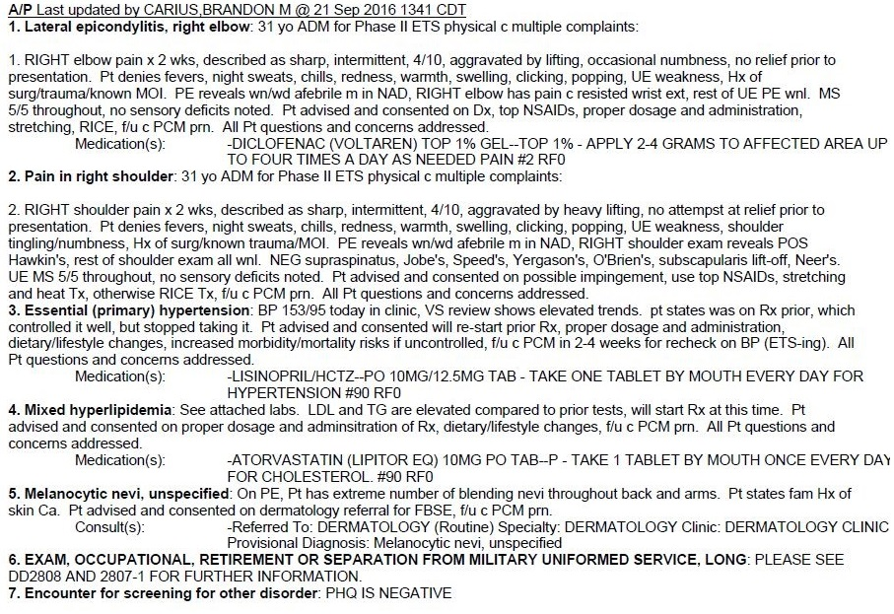
Physical Exam
What do you see in this record?

Slide 12
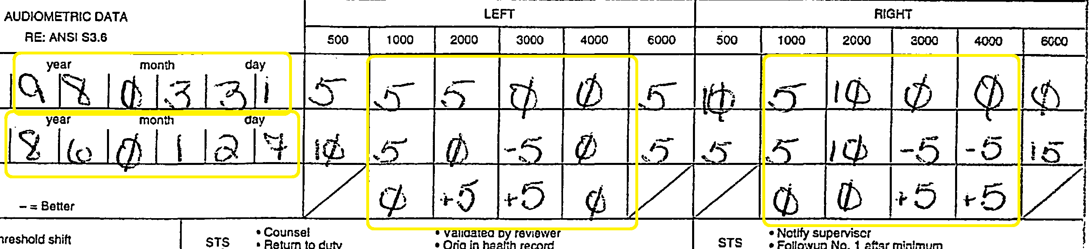
Audiograms
AUDIOGRAMS
For Audiograms, you need the average results of the 1000-4000 range
Be sure to check multiple tests
The tests may not show hearing loss for VA purposes, but they may show a threshold shift that could help prove delayed onset hearing loss later in life

Slide 13
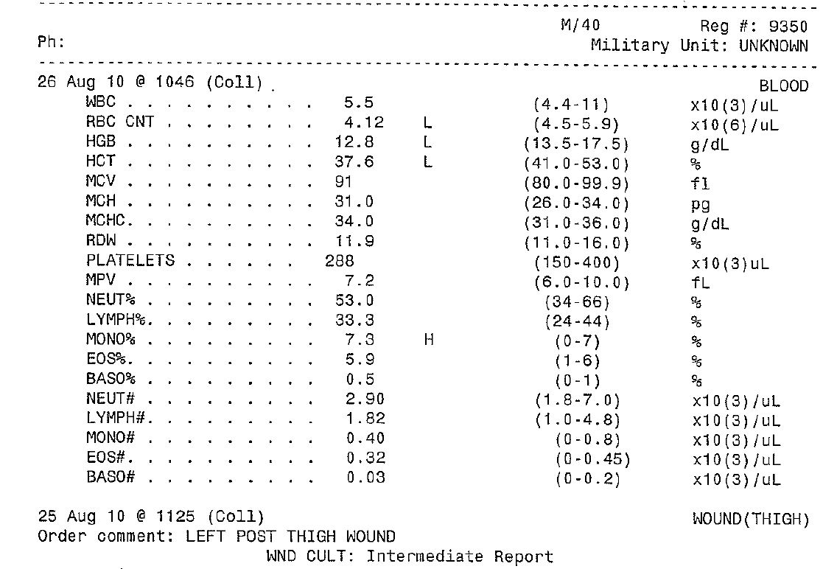
LAB REPORTS
Not expected to memorize labs
Most lab reports indicate normal/abnormal values
Look for any actual diagnoses on the lab report and attached documentation
Notes:
Lab results do not equal a diagnosis but can point to possible existence of disability.
Pay attention to the lab results that are noted “L” or “H” for low or high – see recommendations from doctor.

Slide 14
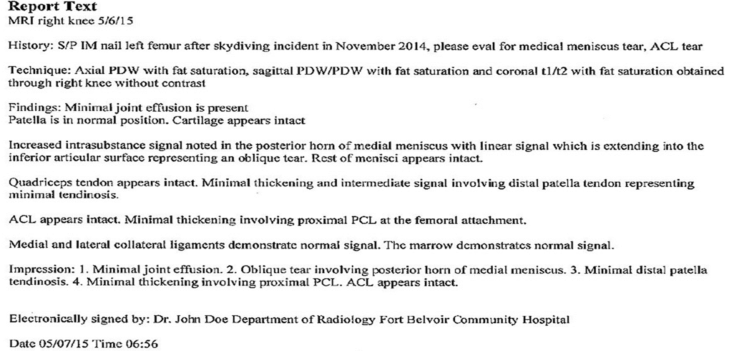
RADIOLOGY REPORTS/MRI’S
Radiology reports can reveal many conditions, sometimes ones the veteran wasn’t even aware of
What do you see in this record?
Notes:
IM- Intramuscular
ACL-anterior cruciate ligament (Knee)
What is important here? History: can establish timeline of injury: help determine path of service connection - during service? Secondary?
Impression: similar to “assessment”: Minimal joint effusion, tendinosis, tear of medial meniscus.
Type of exam: MRI shows soft tissue damage, x-ray often does not and might miss disabilities.

Slide 15
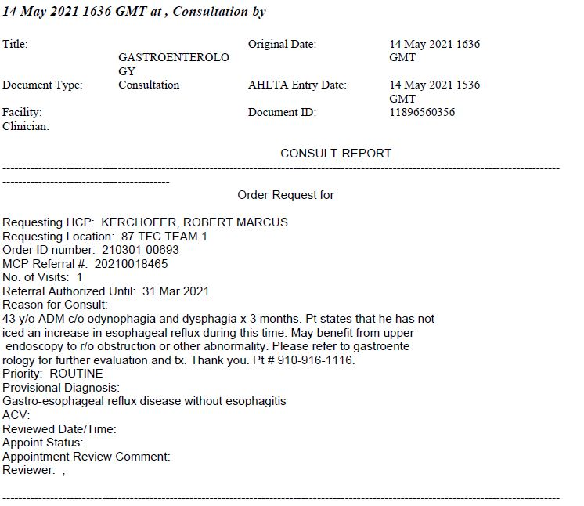
CONSULTATIONS / REFERRALS
Consultations and Referrals are great places to find proof that a condition exists
What do you see in this record?

Slide 16
PRIVATE TREATMENT RECORDS AND SPECIALTY EXAMS
Different look/format
Same information
          Note the date of the record
          Look for any symptoms listed
          Check for diagnoses
          Ask the veteran for clarification
Notes:
In addition to STRs veterans may also bring in private medical records and specialty exams for you to review and submit.
Though every medical facility’s records will look different, the same principles apply to your review:

Slide 17
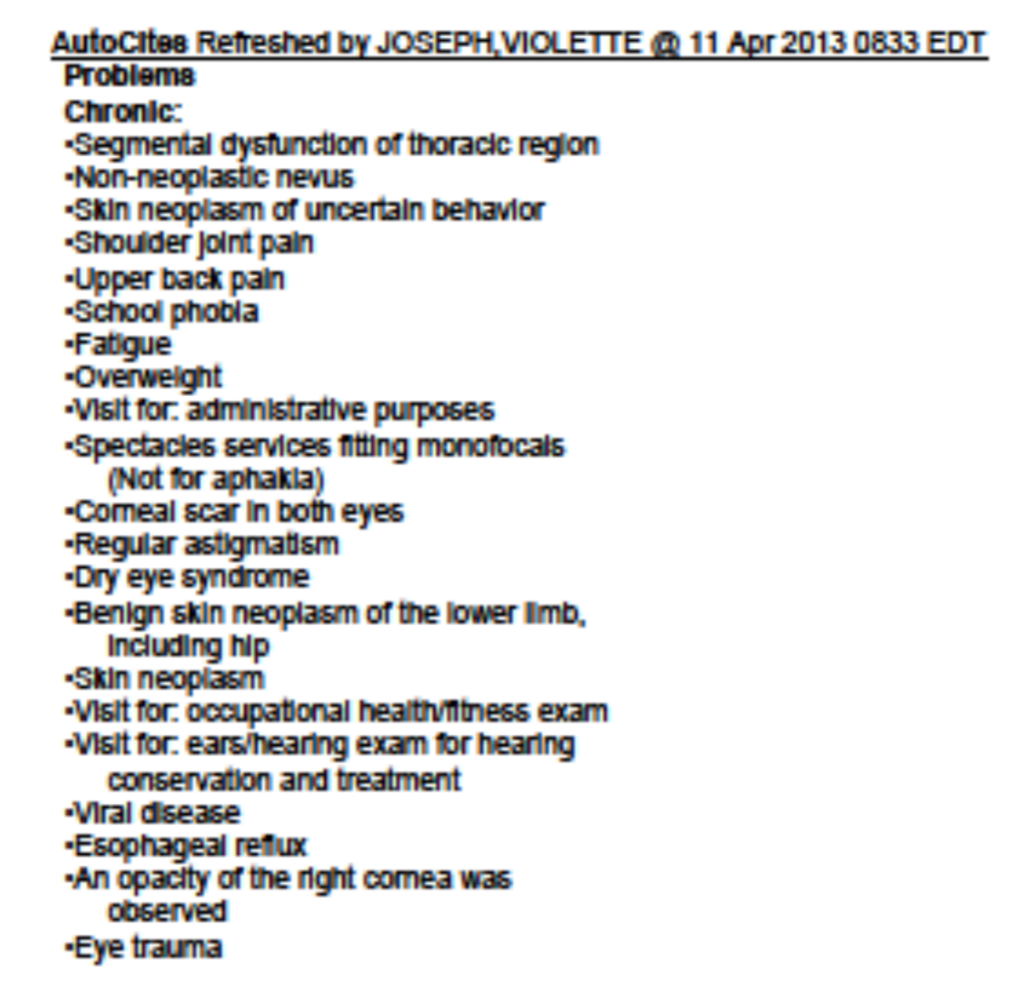
AutoCites
AutoCites are an excellent tool if used properly, but…
They are only a guide to point you in the right direction; they are not a list of items to claim!!
Instead use AutoCites as a starting point
What conditions would merit further reading in this record?
Notes:
Everything except regular astigmatism, overweight,
Spectacle services – maybe?

Slide 18
A FEW KEY POINTS TO REMEMBER
Not everything in the STRs is a claimable condition
Rarely are all the disabilities listed in the STR or medical records – so ask questions!
If a service member insists on filing for something that you cannot find in the medical records, add it to the claim. (Unless it involves fraud)
COMMUNICATION IS KEY!!

Slide 19
YOUR TURN
On the next slide there is a medical record with a few potentially claimable items
Review the record and then hit the hand raise button once you think you’ve found all the potentially claimable items
First one to get them all wins!

Slide 20
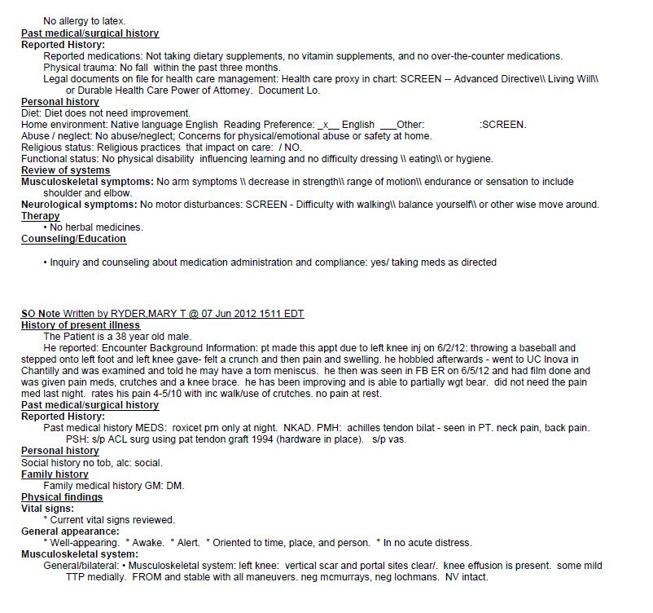
Notes:
Concerns for physical/emotional abuse at home (personal history)
Torn meniscus
Achillies tendon bilat
Neck pain
Back pain
ACL surgery – aggravation?
Vasectomy – were there complications?
Scar on left knee

Slide 21
LISTING DISABILITIES
Column 1
  List the current disability – 1 per line (can use bilateral: e.g. bilateral pes planus)
  *Exercise caution with abbreviations
Column 2
  If claiming as a presumptive or due to a specific incident (must verify using records for incident)
  If you don’t have verification of an incident leave it blank
Notes:
Column 2- Since BDD claims are normally direct SC – column 2 can usually be left blank
If it is not a presumptive and there is no record of an incident, do not take the SM word for it, instead leave blank.
VA SHOULD consider all paths to service connection (DOES NOT ALWAYS HAPPEN)

Slide 22
LISTING DISABILITIES
Column 3
  Brief explanation of how it relates to Column 2
  If Column 2 was blank, can still write an explanation
  Can be left blank
Column 4
  Do NOT leave blank
  If you do not have a specific date verified by written records, write “in service” or list the veteran’s entire service dates

Slide 23
Questions?
Notes:
Who here has a medical background?

