Slide 1
TVB Basic Data Entry
Mark Barrett
Associate Director, Field Operations, NVS
mbarrett@vfw.org
202-313-1726

Slide 2
Lesson Objectives
Terminal Objective
Understand the key elements of TVB’s essential Data Entry
Enabling Objectives
Understand critical elements of the Veterans Tab
Understand key elements of the Claims Tab
Understanding the two primary methods of claim submission
Understand the purpose of the Military Service Tab as it applies to the BDD claim process.
Understand the purpose of the Communications Tab as it applies to the BDD claim process.
Understand the comparison between the Rating Decision matrix and the Award matrix.

Slide 3
TVB Data Entry
WHY IS THIS IMPORTANT?
Some of the data auto-populates onto the various forms you use. Entering data only once is simplistic, accurate, and saves valuable time.
The most important reason is that we, as NVS Representatives and Review Specialists, do not live in a vacuum all to ourselves.
  We use specific vital elements of the data you provide within the BDD team and others within the organization for various purposes.

Slide 4
TVB Data Entry Key Elements
Veteran
  POA
  Assignments
The Claim
  Entries and submission methods
Military Service
Communications
Ratings
Awards

Slide 5
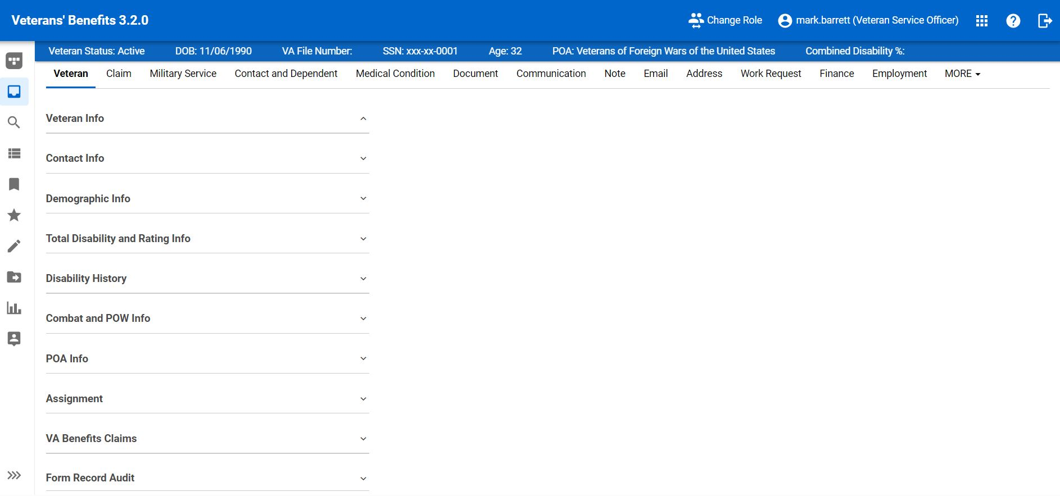
TVB data Entry the Veteran

Slide 6
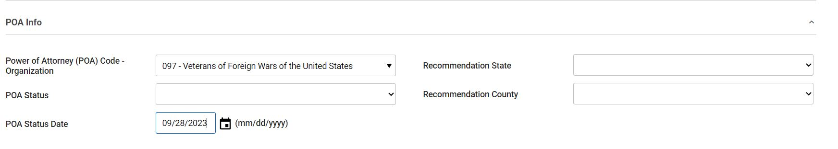
TVB Veteran POA Selection

Slide 7
Power of Attorney Selection
POA Selection
POA Info
Power of Attorney (POA) Code - Organization
097 – Veterans of Foreign Wars of the United States

Slide 8
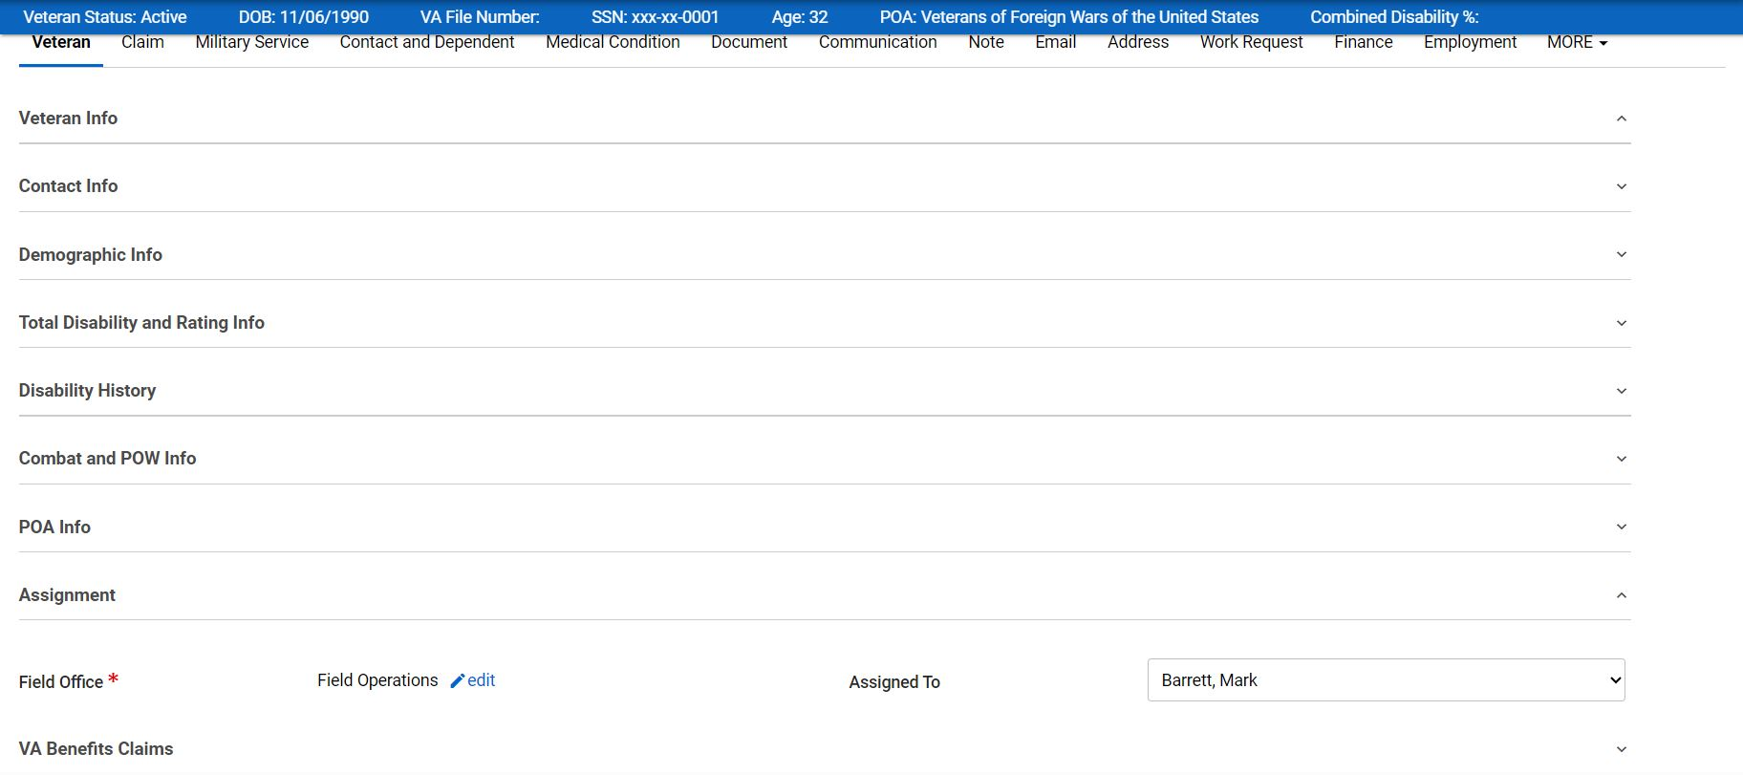
TVB Veteran Assignment

Slide 9
Veteran Assignment
Assignment Selection
Assignment
Field Operations / Edit
Assigned To
From Drop down Menu
Selection (Your Name)

Slide 10
TVB data Entry the Claim

Slide 11
TVB Claim Name
BDD CLAIM TYPE
BDD
180 – 90 Days to Separation / Retirement
BDD Excluded
89 – 1 Day Separation / Retirement
BDD Excluded
With First year of Separation for Reporting Purposes Only
FDC
Post Service Only

Slide 12
TVB Forms & Documents

Slide 13
TVB Claim Packaging

Slide 14
TVB Claim Direct Submission

Slide 15
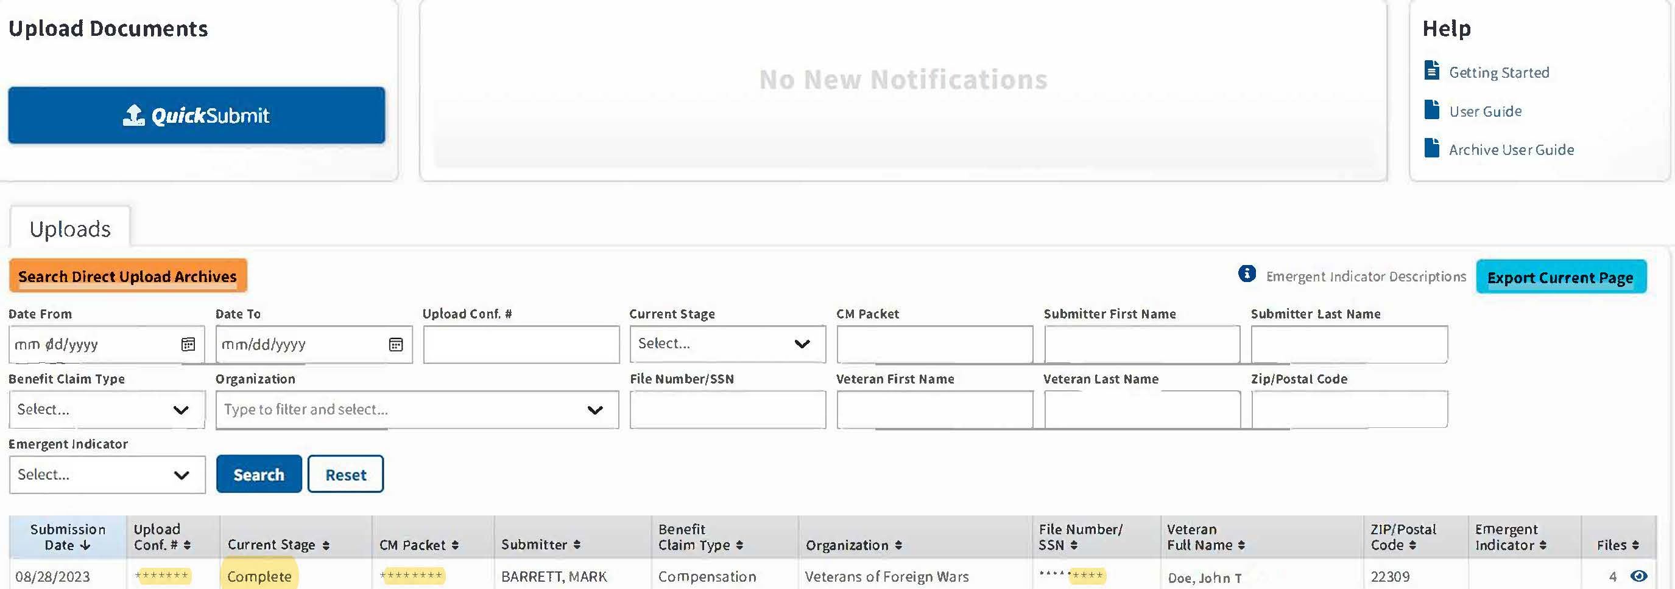
TVB Claim Quick Submission

Slide 16
TVB Submissions
Two Submission methods:
Direct Submit via TVB packaged claim
  Requires upload of all external medical evidence into TVB before packaging claim
  Once a successful ID is established, monitor the status until the claim indicates successful
Quick Submit outside of TVB
  All forms and external medical evidence must be retained in a file until confirmation of claim in VBMS is established.
  Quick Submit generates a successful seven-digit confirmation code will be generated once all documents are transmitted into VBMS.
Regardless of the submission method, all submitted files will sit in the VBMS intake mail portal until the submitted forms and evidence are populated.

Slide 17
TVB Data Military Service

Slide 18
TVB Military Service
Purpose:
Used to establish VFW eligibility
Allows the service member to initiate VA Healthcare sign-up early as an established combat veteran w/o the handicap of financial liability.
  VA Healthcare Groups 5, 7, and 8 are income-based
  VA Healthcare Group 6 is based on combat service
  VA Healthcare Groups 1, 2, and 3 are based on establishing service connection and the rating percentage assigned.

Slide 19
TVB Communications Tab

Slide 20
TVB Communications
Purpose:
To Provide quantitative evidence a claim has been received in the Veterans Benefits Management System (VBMS)
To provide qualitative evidence regarding client perception or concerns regarding a specific claim.
To update the status of a pending claim

Slide 21
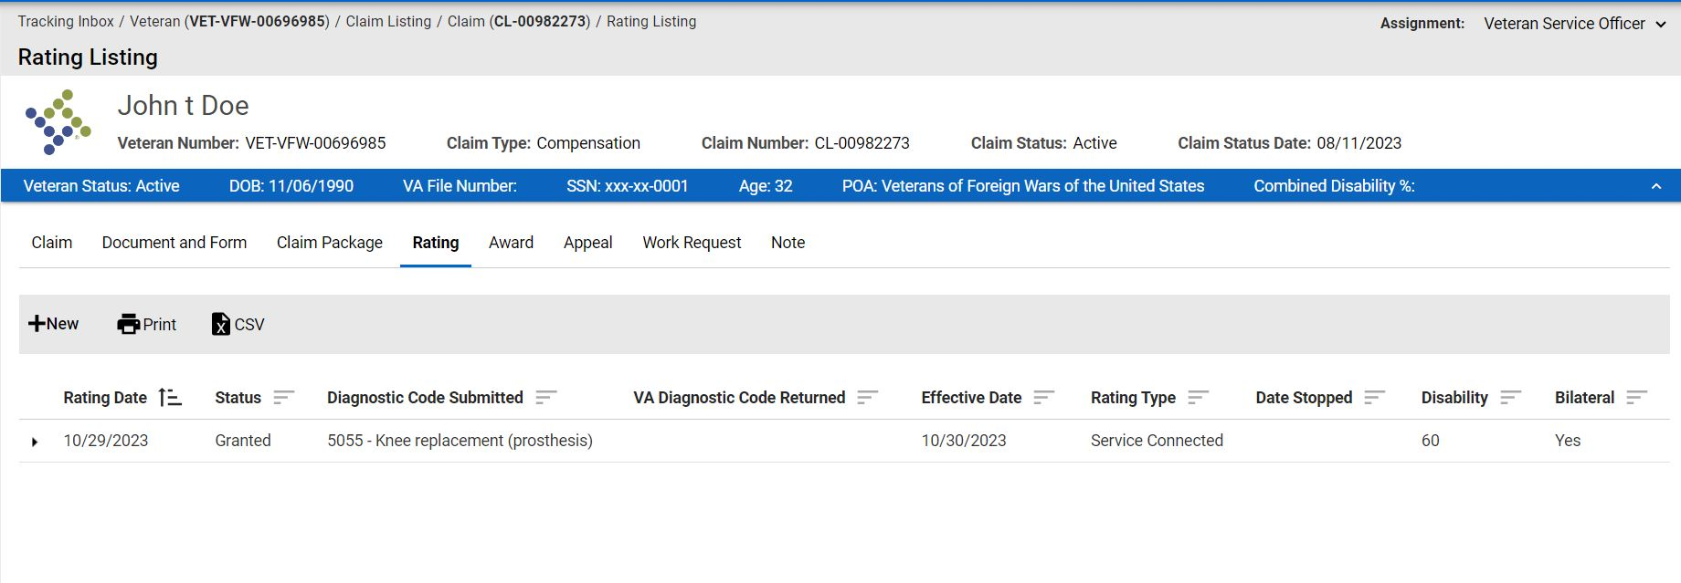
TVB Rating Cover

Slide 22
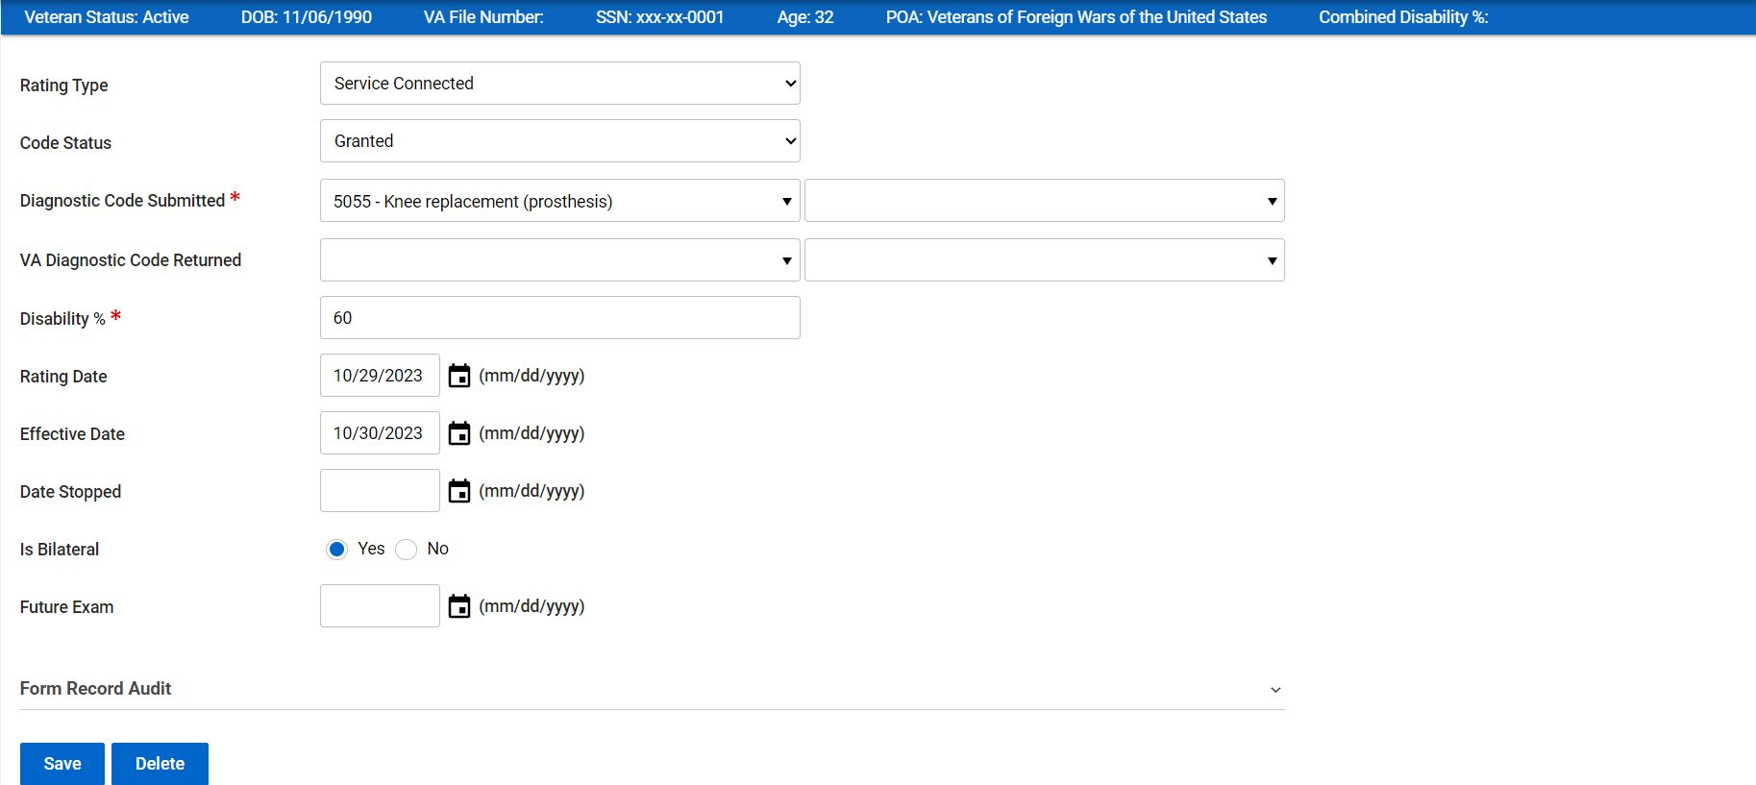
TVB Rating

Slide 23
TVB Rating
Rating Decision matrix key elements:
All Asterisks in TVB are mandatory entries. A non-entry in a mandatory field will result in an error.
  Diagnostic Code Submitted
  Disability percentage
The effective date can only be entered post service [typically the RAD + 1 date for BDD/BDDE claims]
  Entering a future date will result in an error.
Leave the effective date blank until you complete the Award entry. [Don’t forget to go back and fill in the date]

Slide 24
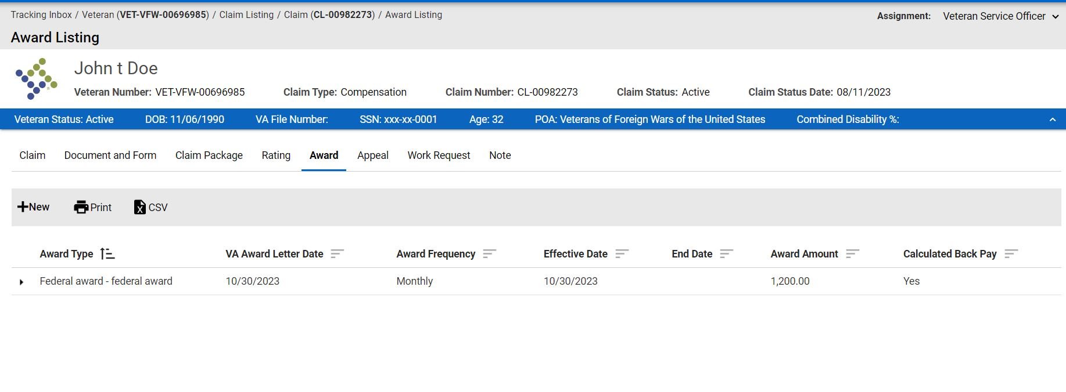
TVB Award Cover

Slide 25
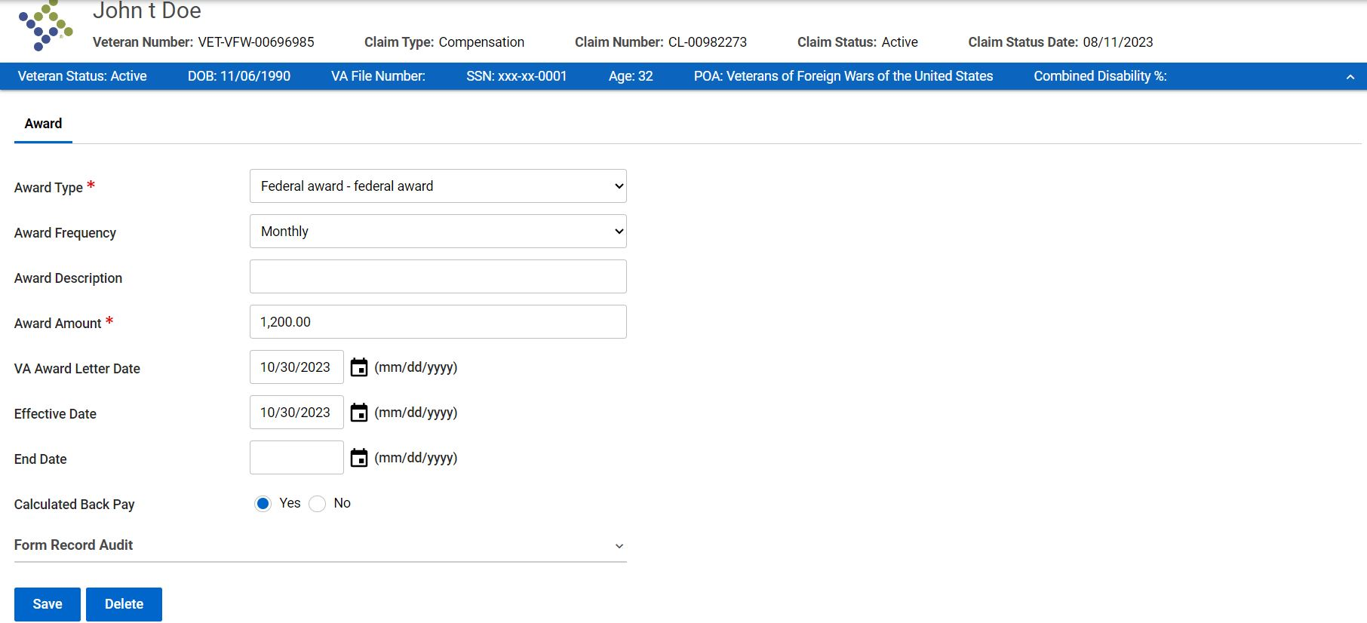
TVB Award

Slide 26
TVB Award
Award Decision matrix key elements:
All Asterisks in TVB are mandatory entries. A non-entry in a mandatory field will result in an error.
  Award Type [ Select Federal award – federal award ]
  Award Amount
The award letter date and effective date can not be a future date. [typically, the RAD + 1 date for BDD/BDD Excluded claims and FDCs if the claim started in the magic initial year following separation.]
  Entering a future date will result in an error.
Once these dates are entered, remember to return to the Rating matrix you completed and enter the effective date.

Slide 27
TVB Basic Data Entry
???QUESTIONS ???

