Slide 1
National Legislative Service
Pat Murray
Director
April 2023

Slide 2
The Importance of Legislative Advocacy
Impacts every veteran and family member
Veterans Preference
GI Bill
Toxic Exposures
Veterans benefits don’t just happen
Stronger and better advocates together
Protect what we have secured
Elimination of IU after reaching retirement age
Round down of cost-of-living adjustment

Slide 3
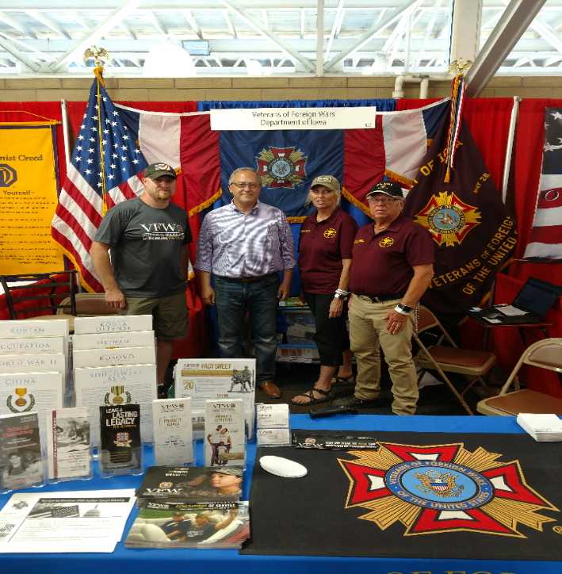
Make Legislative Advocacy a Priority
All politics is local!
Members of Congress
will turn to you
Share your experience, but
know the VFW’s stance
Campaign Season
Get Out the Vote
Work with our Legislative Committee Members
Inform them about issues
Every knowledgeable voice matters
Notes:
Know the members of Congress and US Senators from your state. Use your status and access to garner support for the VFW’s legislative priorities.
Election:
DO’s
Do attend candidate Town Hall Meetings and other events and push our issues.
Do set up voter registration drives /Get Out the Vote Campaigns on the local level.
Do provide carpool service on Election Day to help the elderly and disabled get to the voting booth.
Do support and work for your favorite candidates as a voting constituent. As an individual and VFW member you can work or campaign on behalf of your favorite candidate - and are encouraged to do so. • Do wear your VFW cap.
DON’Ts
Don’t endorse candidates on behalf of the VFW as a Post, District, Department or National Leader.

Slide 4
NLS Committee
They can be a leader in your department or an anchor.
It is much more than a figurehead job

Slide 5
Recent Victories
Honoring our PACT Act
Global War on Terrorism Memorial Location Act – FY22 NDAA
S. 2102, Dr. Kat Hendricks Thomas SERVICE Act & S. 2533, Making Advances in Mammography and Medical Options for Veterans Act – Public Law

Slide 6
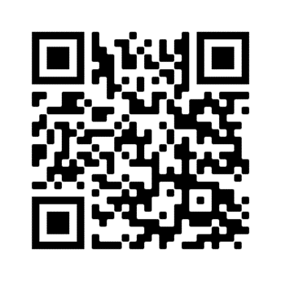
Join Action Corps
Weekly e-newsletter and Action Alerts
Be informed and involved
Take action and make a difference
Your engagement with your members of Congress is crucial in helping us get vital pieces of veterans legislation passed into law
Three ways to sign up:
Visit www.vfw.org/JoinActionCorps
Text “VFW” to 50457
Scan the QR Code
Notes:
Identify and support the next generation of VFW leaders.
Involve younger members in legislative advocacy.
Provide a semester-long curriculum to receive academic credit at both the undergraduate and graduate level.
Foster collaboration between VFW and student veterans at the local and national levels.

Slide 7

Take Action
IMPORTANCE OF ACTION CORPS
RECENT ACTION ALERTS
Demand the PACT Act Passes
180,000 messages sent

Slide 8
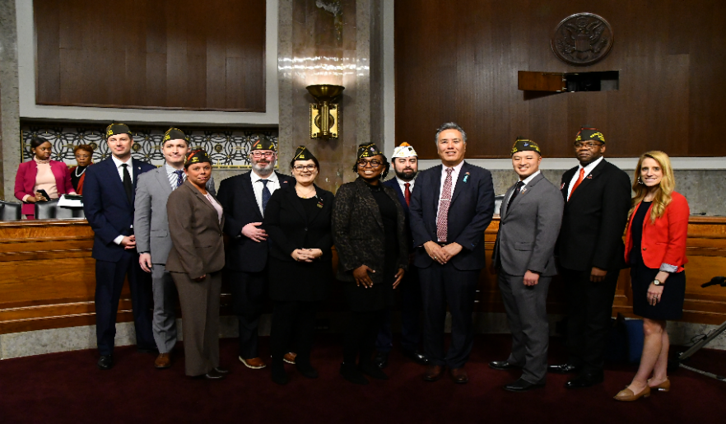
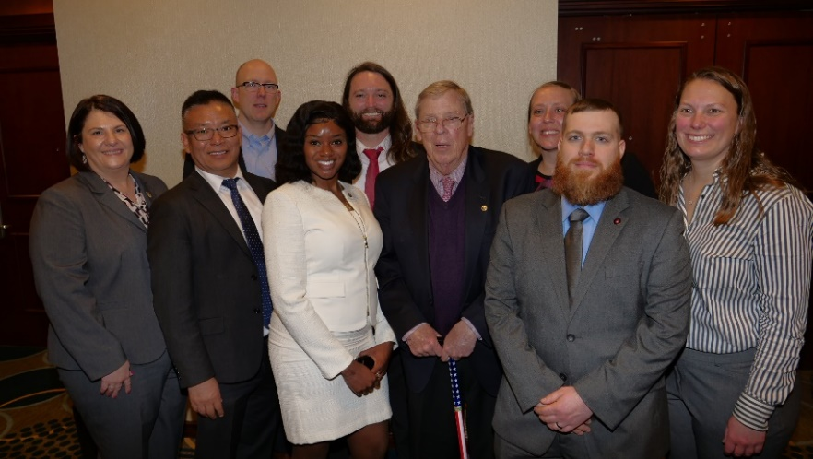
Student Fellowship
Selection Criteria
To Apply: VFW member or eligible for VFW membership (Must be a member once accepted)
Enrolled in an accredited institution of higher learning
Submission of an essay proposal addressing a key veterans’ policy issue
We need your help to recruit
Application period is open
www.vfw.org/studentfellowship
Notes:
Identify and support the next generation of VFW leaders.
Involve younger members in legislative advocacy.
Provide a semester-long curriculum to receive academic credit at both the undergraduate and graduate level.
Foster collaboration between VFW and student veterans at the local and national levels.

Slide 9

Current Priority Goals
Access to high-quality health care
Importance of education and employment opportunities for veterans
Improve the claims process
Maintain military quality of life
Many more…

Slide 10
Where You Can Help
Inform NVS and NLS staff about systemic issues
Provide as much detail as possible
– Generalizations don’t help, Specifics do…
Draft resolutions to enact change

Slide 11
We’re Here to Help
www.vfw.org/advocacy
Talking points & priority goals
Congressional testimony
Action Corps
Read the weekly
Take Action
Sign up advocates
Do’s and Don’ts

Slide 12
QUESTIONS?
Contact the VFW National Legislative Service
Email: pmurray@vfw.org
Call: (202)608-8365

