Slide 1
Understanding the Camp Lejeune Justice Act
Determining whether VFW members should pursue a CLJA remedy.
Veterans of Foreign Wars
Spring 2023 Service Officer Training
Annapolis, Maryland
April 18, 2023

Slide 2


Objectives
Today’s Topics:
Understanding CLJA
Whether CLJA is right for VFW members and their families
Choosing an advocate – understanding the difference between attorney fees and costs.

Slide 3

VFW – Bergmann & Moore Relationship
B&M Quick Facts:
Firm founded in 2004 by
former VA attorneys.
Accredited by VA’s OGC.
Staff of 100+, including 60 attorneys.
Focus on VA disability claims/appeals.
In 2014, VFW and B&M signed a MOU for B&M to represent Veterans with a Board denial before the Court.
Nine years of transparent representation before the Court at no cost to VFW or Veterans.

Slide 4

VFW – B&M Partnership Results over 9 years
B&M Court results reflect a 98.9% favorable outcome for Veterans over 9 years of representation:
January 1, 2015 – March 31, 2023 | Number of Appeals | Percentage
Total Appeal Dispositions (41 appeals dismissed/withdrawn mostly due to death of Veteran/claimant) | 3856
Favorable Outcomes | 3815 | 98.9%
Joint Motion for Remand (VA Errors B&M Identified) | 3450 | 89.5%
Court Decision (Full or Partial Remand) | 354 | 9.2%
Settlement | 11 | 0.3%
Unfavorable Outcomes (Full Affirmance) | 41 | 1.1%

Slide 5

VFW – B&M relationship related to CLJA
August 25, 2022 – new MOU adds CLJA representation:
Protect VFW members through education, advocacy, and assistance.
Ensure VFW members receive the maximum benefits permissible.
Prevent VFW members from accepting a one-time CLJA benefit to the detriment of greater VA benefits.
Notes:
MOU’s stated purpose is to “create, implement, and execute a service project for VFW members interested in participating” in the CLJA litigation.

Slide 6
Camp Lejeune Justice Act – a mass tort
CLJA basics:
Two-year (closing) window: qualified population may participate in mass tort litigation, with a two-year period ending August 10, 2024.
Who may file: “Veteran, or the legal representative of such an individual, who resided, worked, or was otherwise exposed (including in utero exposure)” at Camp Lejeune.
Requires exposure of “not less than 30 days” between August 1, 1953, and December 31, 1987.
Administrative claim is initiated with Dept of Navy. After six months, claimant may file a claim with the U.S. District Court for the Eastern District in North Carolina.
Notes:
This is unlike the J&J baby powder (Talc) mass tort.

Slide 7
What qualifies as a CLJA condition?
Any medical condition believed to be related to Camp Lejeune water exposure, so long as exposure was during the time and period prescribed . . . may be relatable for this claim!

Slide 8
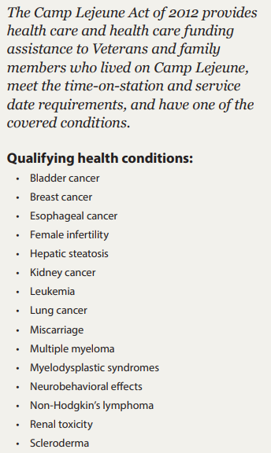
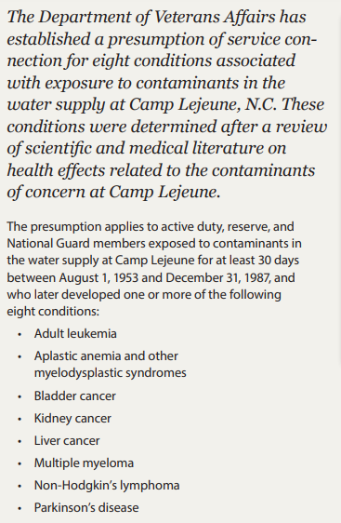
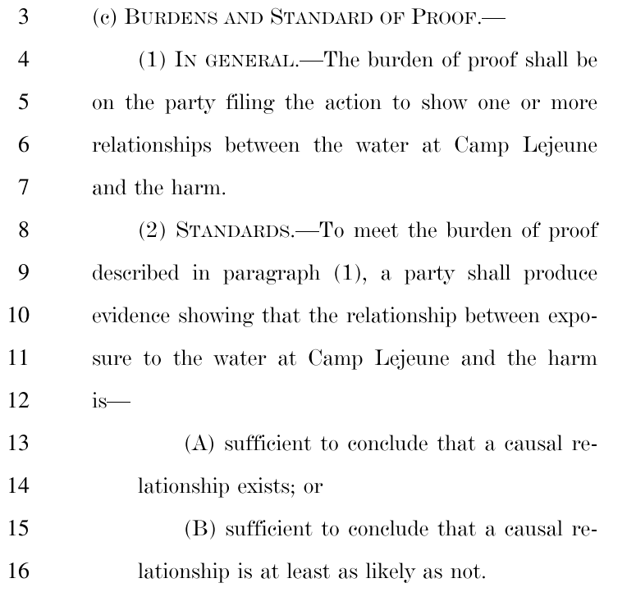
Presumptive conditions–not to be focused on
Source: Public Law 117-168, Section 804(c): https://www.congress.gov/bill/117th-congress/senate-bill/3373/text
Source: VA, Camp Lejeune: Veteran and family health and disability benefits https://www.publichealth.va.gov/docs/exposures/camp_lejeune_brochure.pdf
Notes:
Important notice -- Sec. 804 does not recognize any specific conditions, but VA previously recognized the conditions on the right

Slide 9
Who may bring a CLJA claim?
Veterans and their family members who lived/worked at Camp Lejeune.
This means a wife and/or children who lived on base.
A surviving child, spouse or parent may bring an action on behalf of a deceased claimant.
Examples:
A veteran/spouse may bring a claim on behalf of a deceased child.
A surviving child may bring an action on behalf of a deceased parent.
A child/adult who may have been born after their parent lived on base.
Notes:
The job of the advocate is to stretch the enabling law (CLJA) like a rubber band to include other claimants/conditions not presumptive.

Slide 10
How will a CLJA award affect VA benefits?
VA is on record stating that “VA compensation benefits or health care services will not be impacted by any relief (award) from a CLJA lawsuit.
VA is on record stating that if a claimant is awarded relief from a CLJA lawsuit, VA benefits will not be reduced and eligibility for other VA benefits or services will not be affected.
Notes:
Explain the “offset” language of 804 – This could change; Congress or even a court could change it. This is why we are involved – to ensure there are no surprises to VA benefits.

Slide 11
Will a CLJA award be affected by VA benefits?
Potentially, yes. If a claimant already receives VA benefits or services (disability benefits or health care services) for conditions related to contaminated water at Camp Lejeune, the justice-act awarded relief will be offset by the amount of any disability award/payment or other benefit VA provided.
Notes:
Note the difference between VA benefit/care offsetting CLJA award but no offset of VA benefit/care from CLJA award.
Important:
No one knows how this offset will be applied in practice
It seems unlikely VA will be able to apply it in any but the most obvious cases (in which VA benefits were recently granted based explicitly on CL presumptions) and maybe not even then.

Slide 12
Will a future VA award be affected by a past CLJA award?
No. VA is on record affirmatively stating that any action a claimant takes or award that is received under the CLJA will not influence a later VA decision to provide benefits or health care based upon exposure or the amount of compensation received from VA.

Slide 13
How should a Veteran vs. spouse/family member be counseled on how to proceed?
It the claimant is a Veteran or a spouse of a veteran who died from s/c disability (DIC), (and because VA disability benefits will not be affected by a CLJA award) we recommend these individuals file both a VA disability claim and a CLJA claim. The law allows two non-exclusive remedies, so it makes sense to avail to both.
If a claimant is a spouse or family member, and because the VA remedy is limited to care and healthcare reimbursement, we recommend filing a CLJA claim
Notes:
Because the VA disability provides distinctions between Veterans and family members, the answer is different

Slide 14
What should I look for when choosing a CLJA advocate?
All attorneys/advocates are not the same. We recommend you examine at least two things:
Does the attorney have a VA disability benefits background?
What does the proposed fee agreement say related to attorney fees and costs?

Slide 15
Understanding a CLJA fee agreement
What to look for:
Percentage of attorney fees
Amount of costs (and who is responsible for paying)
Whether there is a “fee” and “costs” cap.

Slide 16
What is the difference between an attorney “fee” and attorney “costs”? (1 of 2)
Attorney “fees” are like wages, and equate to time and labor of the attorney and their staff. “Fees” do not include case “costs.”
Attorney “costs” are generally unknown at the commencement of litigation. Costs are defined as expenses incurred in litigation. These relate to such things as court filing fees, and postage/courier fees, but also include claim-development costs which include medical nexus costs.

Slide 17
What is the difference between an attorney “fee” and attorney “costs.” (2 of 2)
A good CLJA attorney will not limit a claim to conditions/diseases the government considers presumptive (to toxic water exposure). Presumptive illnesses are considered easier cases as a medical link is considered established between the condition and the exposure. A medical nexus opinion is often necessary for a lawyer to establish a link between a particular medical condition (not deemed presumptive) and a disease/condition claimed as related to toxic water exposure.
Example: medical research clearly documents a link between toxic water exposure and excessive tooth decay. This condition is not on the presumptive list but may result in an award of benefits.

Slide 18
The truth related to “costs” (1 of 4)
Attorney “costs” are relevant because these can be in the thousands of dollars. One prominent attorney in the CLJA field has publicly suggested that his firm will be spending between $100,000 and $300,000 in medical costs per claimant/case.
Why is this important? Costs are taken out of any award to a Veteran/claimant.

Slide 19
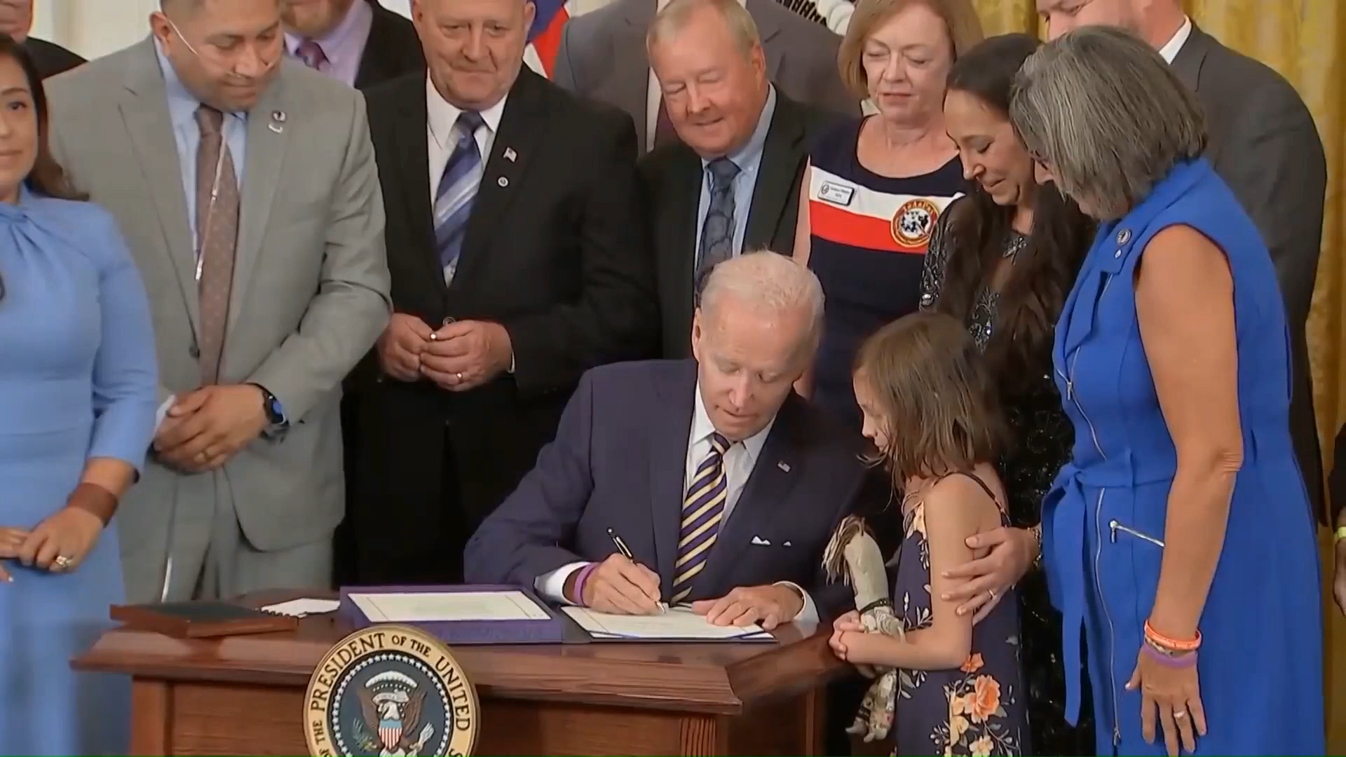
The truth related to “costs” (2 of 4)
Interview clip from Ed Bell from Bell Law Group
Notes:
Who is Ed Bell?

Slide 20
The truth related to “costs” (3 of 4)
A hypothetical – Putting “costs” into perspective
A Veteran signs a fee agreement calling for 25% attorney fees plus costs.
If this veteran wins a $250,000 settlement in court (related to toxic water exposure) and his law firm spent $100,000 in medical development costs, the veteran’s award, net of (after) fees and costs would be $112,500 ($250,000 - $100,000 x .75). This means the law firm would receive $137,500 in fees and costs and the Veteran receives $112,500.
This is precisely why any discussion about attorney fee must also include an understanding about “costs.”

Slide 21
Fee and Cost cap – B&M’s fee agreement (4 of 4)
The same hypothetical with a 33.3% cap on fees and costs:
A Veteran signs a fee agreement providing for a capped 33.3% attorney fee inclusive of costs.
If this veteran wins a $250,000 settlement in court (related to toxic water exposure) and even assuming the law firm spent $100,000 on medical development costs, the Veteran’s award, net of (after) fees and costs would be $166,500 ($250,000 x 66.6%).
This means the law firm would receive $83,500 in fees and costs, and the Veteran recovers $166,500.
This is B&M’s fee agreement.
Notes:
In this scenario the law firm would lose $16,5k but your members are safe. Under this scenario the Veteran/claimant receives $54,000 more in their pocket.
Need to stress we have no idea how costs will be attributed

Slide 22
What to do if you want to change law firms
Just because you already signed a POA with another law firm does not mean the Veteran/claimant is stuck – especially if the attorney fees and costs are high.
Note: the longer you wait the more difficult changing firms becomes
Notes:
Need to explain attorney cost liens.

Slide 23
What to do if you want to change law firms
The process to change firms is simple. You need to communicate in writing to the firm (email, text or letter). Your note/letter simply needs to say: “I would like to discharge you as my attorney in my CLJA claim. Please return any information I sent you.”
There is no need to wait for a reply. When you sign up with another firm you should provide the new firm with a copy of the note/letter.

Slide 24
Pursuing CLJA with Bergmann & Moore
VFW dedicated landing page:
www.camplejeunelitigationteam.com/VFW
In-person CLJA contact: 800-898-9450 (toll-free)

Slide 25
CLJA Q&A
Questions?
For any questions related to CLJA or this presentation, please contact Annita Best, CLJA Coordinator
Bergmann & Moore, LLC.
Via email: Abest@vetlawyers.com
Phone: 301-290-3148

Slide 26


Thank You!
Bergmann & Moore thanks the Veterans of Foreign Wars for allowing us to work with VFW to advocate for our nation’s Veterans.

Slide 27

2023 Proficiency Training Conference Survey
Class: PACT Offsets
Please scan the QR Code or click on the link below to take an anonymous survey about your experience during the 2023 Proficiency Training Conference.
https://www.research.net/r/HYP53BJ

