Slide 1
Post-9/11 Military2VA (M2VA) Case Management (CM) Program Behavioral Health Service Line Social Work Division
November 2023

Slide 2

Mission & Purpose
VHA Directive 1010: Transition & Care Management of Ill or Injured Service Members and New Veterans
Provide comprehensive care coordination and case management services to Post 9/11 transitioning Service Members and Veterans (SM/V), their Caregivers and families as they transition into the VA Health Care System and across the continuum of care.
Notes:
VHA Directive 1010: Establishes procedures in the transition of care, coordination of services, and case management of ill or injured Servicemembers and new Veterans by VHA Transition and Care Management staff members.
Veterans/Service Members may be transferring from an MTF, another VA or may present to the facility/program as a self referral.

Slide 3
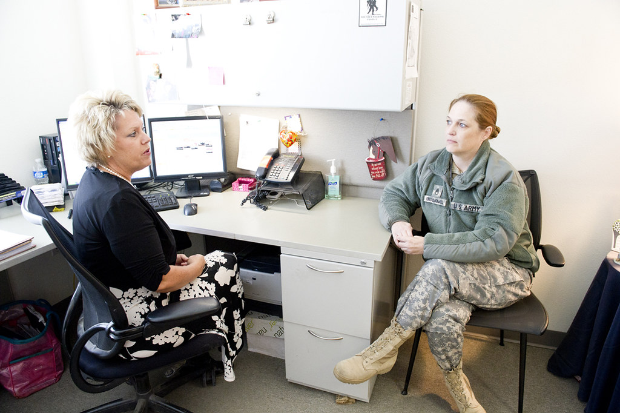
Scope of Services-Case Management
Facilitate care access & seamless transition across the health care continuum
Screen for case management needs
- Complex physical and/or mental health care needs
- Financial and/or housing concerns
- Barriers to effective readjustment to civilian life
Case Management of SM/Vs identified as Severely Ill/Injured
Coordination of care delivery
Reduction/elimination of barriers through advocacy
Collaborate with providers and facilities to support continuity of care
VA benefit education
Community/VA/DoD resource linkage based on needs

Slide 4
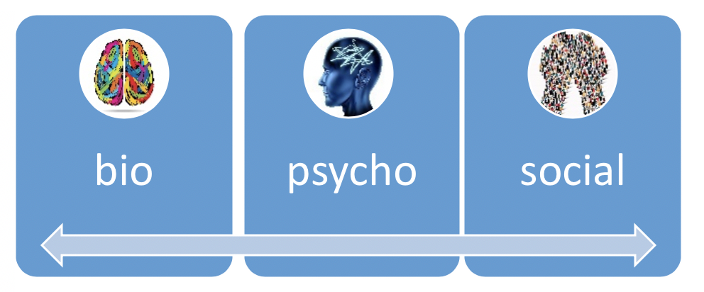

Initial Screen
Screen for case management needs
Healthcare
VA Benefits
Housing Issues
Financial Hardship
Employment
Relationship & Readjustment Issues
Legal Issues

Slide 5
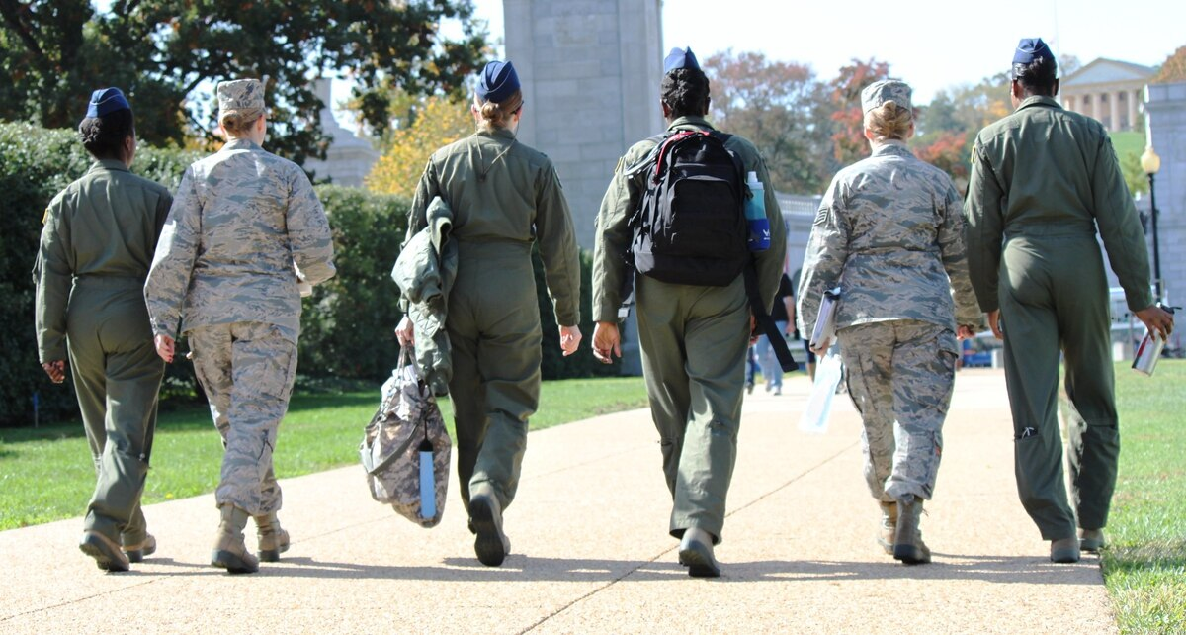
Veterans Benefits
VA provides enhanced enrollment opportunity and ten years of cost-free health care to veterans who served in a theater of combat operations, for any injury or illness associated with the deployment.

Slide 6

Dental Care Benefit
Cost free one time treatment of dental conditions for recently separated veterans who:
Served for 90 days or more
Apply within 180 days of separation
DD214 does not indicate necessary dental care was provided within 90 days of release or discharge

Slide 7

Fayetteville HCC Team Members:
Program Manager
Marisol Huertas 910-475-6255
Social Work Case Managers
Susan Deckant 910-475-6253
Stephanie Franklin 910-475-6703
Luz Rossi 910-475-6705
Andrea Bennerman 910-475-6149
Transition Patient Advocate
Angela Lee 910-475-6256
Program Support Assistant
Tevin Guy 910-475-6254
This Photo by Unknown Author is licensed under CC BY-NC

Slide 8
Ramsey/Jacksonville/Wilmington Case Managers
Ramsey St
Katheen Holmes
910-488-2120 Ext. 5945
Jacksonville-Telework
Jane Gray
910-475-6685
**At clinic by appointments only
All referrals go through the Program Manager

Slide 9
VA Liaison Roles for Active Duty Service Members
Are Licensed Clinical Social Workers or Registered Nurses
Work with clinical staff at both Department of Defense (DoD) Military Treatment Facilities (MTFs) and Department of Veterans Affairs (VA) Healthcare Facilities
Coordinate with clinical staff and case managers to review ongoing treatment plans and expedite the transition process
Collaborate with the MTF healthcare team to identify ongoing healthcare needs for ill and injured Servicemembers

Slide 10
VA Liaison Roles for Active Duty Service Members
Arrange care at the VA Healthcare Facility that can best meet Servicemembers' needs, closest to their home
Facilitate inpatient transfers from DoD to VA Healthcare Facilities
Educate Servicemembers, Veterans, their families and caregivers about VA healthcare benefits and services
Meet with Servicemembers, Veterans, their families and caregivers to discuss the VA system of care and the Servicemember's individual healthcare needs
Explain initial eligibility processes to Servicemembers, Veterans, their families and caregivers

Slide 11
VA Liaison Roles for Active Duty Service Members
Register the Servicemember at the identified VA Healthcare Facility before leaving the MTF
Obtain scheduled outpatient appointments ahead of departure from MTFs
Connect the Servicemember with the Post 9/11 Military2VA Case Management Program Manager who will coordinate ongoing care at the nearest VA Medical Center
Collaborate with federal, state and community agencies and programs that assist Servicemembers, Veterans, their families and caregivers during the transition process

Slide 12
Active Duty Point of Contacts
LIAISONS FOR HEALTHCARE FT LIBERTY, NCVA Liaison Program
Veronica Dawson-Melton // 910-907-7216 // veronica.r.melton.civ@health.mil
Paula Saffold // 910-907-1024 // paula.p.saffold.civ@health.mil
Geraldine 'Jeri' Veirs // 910-286-4779 // geraldine.s.veirs.civ@health.mil

Slide 13

Questions

