Slide 1
Processing PACT Act Claims
Vicki Von Loh
April 2023

Slide 2
The PACT Act
The Sergeant First Class Heath Robinson Honoring our Promise to Address Comprehensive Toxics (PACT) Act commonly referred to as “The PACT Act”
The new law is named for former Sgt. First Class Heath Robinson who died in 2020 after battling lung cancer for three years. Robinson’s illness was attributed to smoke exposure from burning trash pits during his deployment to Iraq in 2006 and 2007.

Slide 3
PACT Act Timeline
Introduced into the House on 6/17/2021
Reported to House, Part 1 2/22/2022
Passed House 3/3/2022
Passed Senate 6/16/2022
Signed into Law 8/10/2022 Public Law 117-168

Slide 4
PACT Act Timeline
Initial guidance issued by VA to field 8/10/2022
Interim guidance issued by VA to field 9/9/2022
VBA Letter 20-22-10 issued on 12/22/2022
VA personnel trained and to begin processing claims 1/1/2023
Three new locations added to radiation locations published in Federal Register on 3/13/2023

Slide 5
What is the PACT Act?
Expands and extends eligibility for VA health care for Veterans with toxic exposure and Veterans of the Vietnam era, Gulf War era, and Post-9/11 era and
Expands eligibility for benefits for Veterans exposed to toxic substances

Slide 6
Key Components
VA will improve the decision-making process
Every veteran will receive an initial toxic exposure screening and a follow-up every five years
Veterans who are not enrolled (but are eligible), will have an opportunity to enroll and receive screening
VA health care staff and claims processors will receive toxic exposure-related education and training
Research studies of mortality will be required
VA will build stronger, more skilled workforce
31 new medical facilities are authorized across country

Slide 7


Slide 8
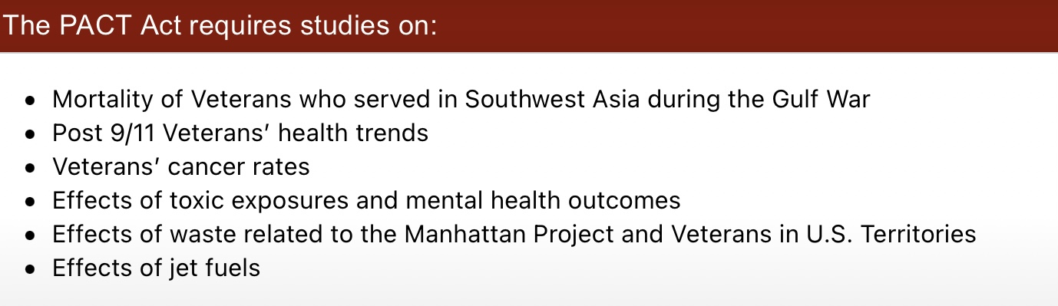

Slide 9
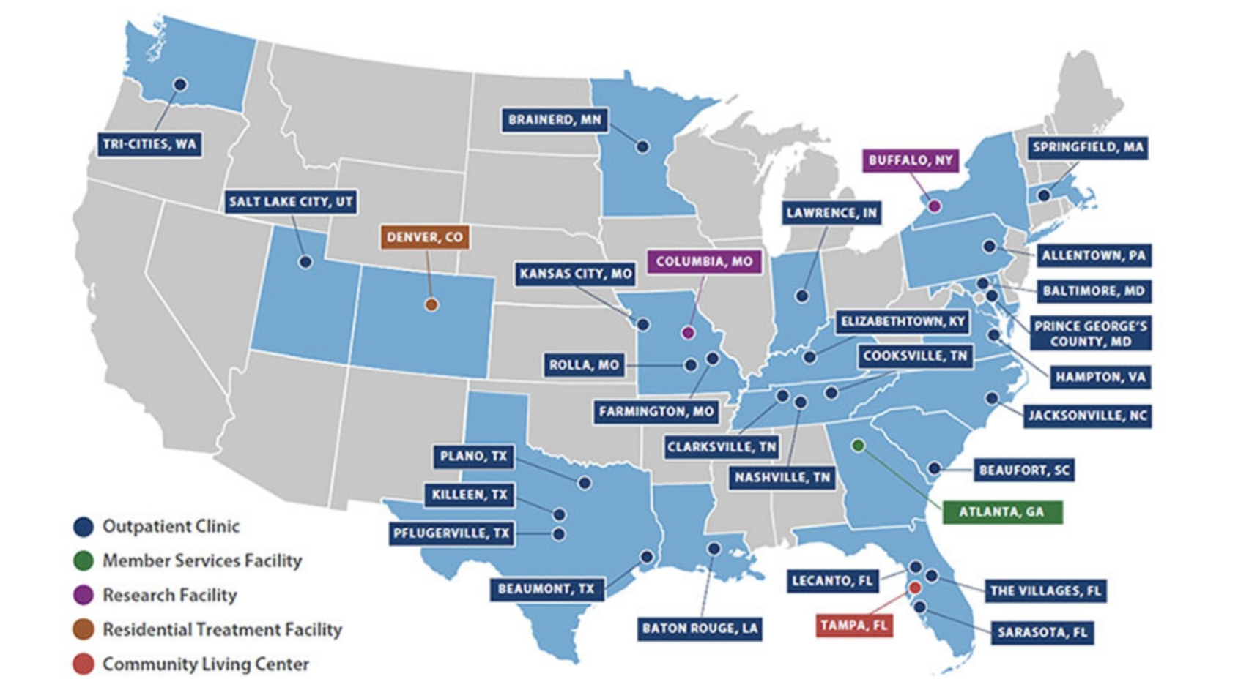
New VA Facilities

Slide 10
Definitions
Toxic exposure is defined in 38 USC 101(37) to include, a toxic exposure risk activity (TERA), as defined in Section 1710(e)(4), and an exposure to a substance, chemical or airborne hazard identified in the list under section 1119(b)(2).
38 USC 1710(e)(4) defines the terms Vietnam-era herbicide exposed, radiation exposed Veteran and TERA
38 USC 1119(b)(2) states the Secretary of VA shall establish and maintain a list that identifies substances, chemicals and airborne hazards that are appropriate for presumptions of specific toxic exposure for members who served in certain locations

Slide 11
Definitions
Toxic exposed Veteran is defined in 38 USC 101 (38) and means any Veteran described in Section 1710(e)(1) of this title.
38 USC 1710(e)(1) addresses healthcare eligibility and expands upon Vietnam herbicide exposed veterans, radiation exposed veterans Persian Gulf veterans, chemical and biological warfare testing, armed forces who served at Camp LeJeune and veterans who participated in a toxic risk activity.

Slide 12
Definitions
Toxic exposure risk activity (TERA) is defined in 38 USC 1710(e)(4)(C) as any activity that requires a corresponding entry into an exposure tracking records system (as defined in Section 1119(c); or that the Secretary determines qualifies for purposes of this subsection when taking into account what is reasonably prudent to protect the health of Veterans

Slide 13
Definitions
Individual Longitudinal Exposure Record (ILER)
Section 1119 (c) defines exposure tracking record system as any system, program, or pilot program used by the Secretary of Veterans Affairs or the Secretary of Defense to track how veterans or members of the Armed Forces have been exposed to various occupational or environmental hazards.

Slide 14
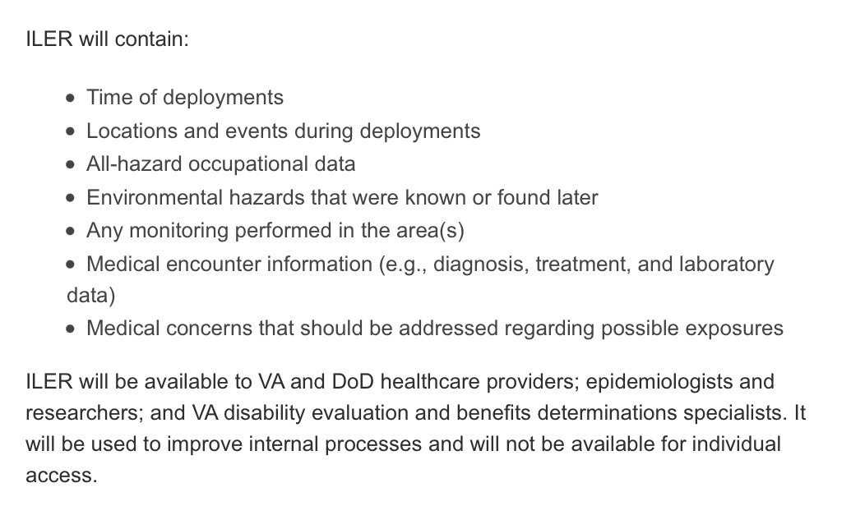

Slide 15
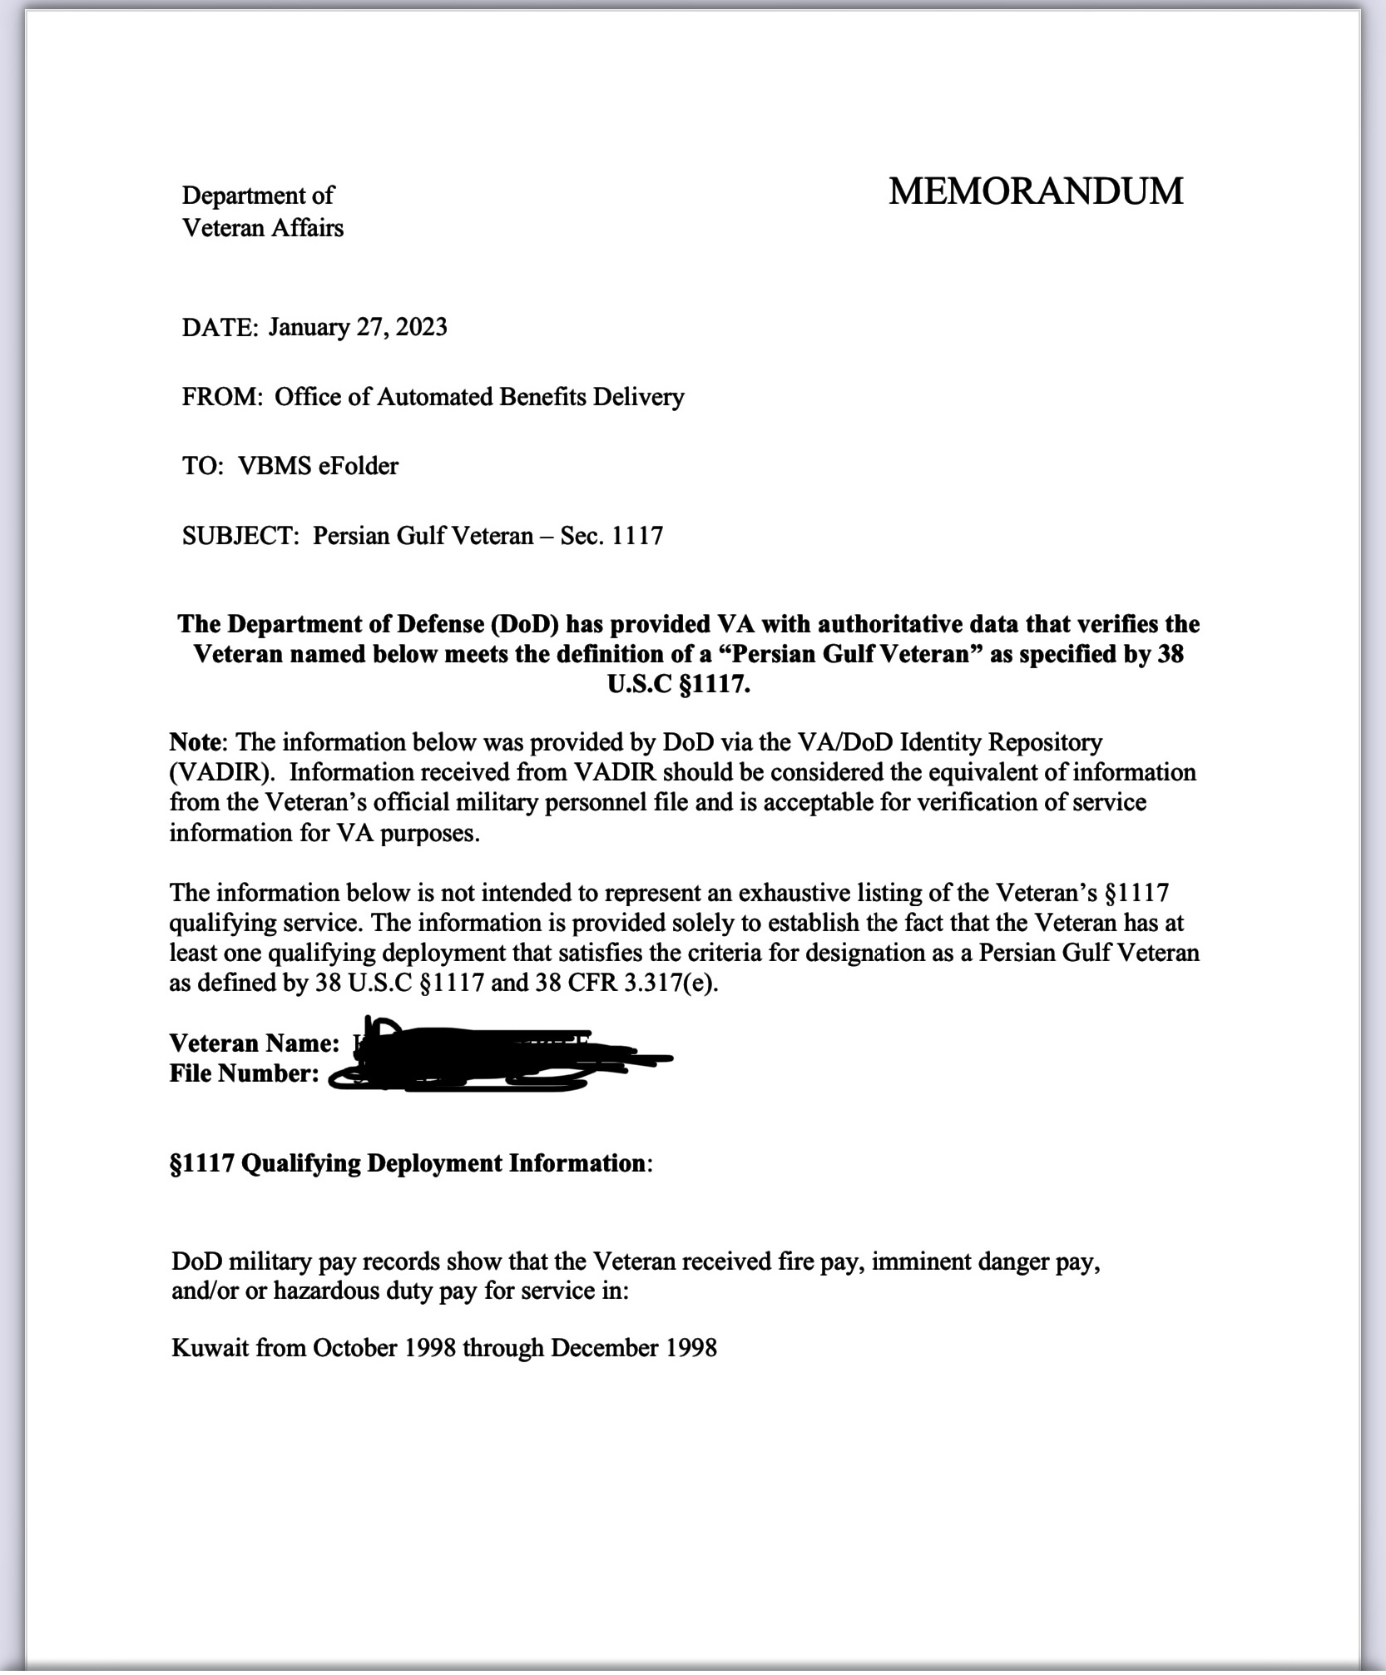
VA Letter showing service
Kuwait from October 1998 through December 1998

Slide 16
Title I Health Care Eligibility
The law expands health care eligibility to several groups of veterans who may not have been eligible before. These groups are broken into 3 new categories:
Category 1: Veterans who participated in a toxic exposure risk activity (as defined by law) while serving on active duty, active duty for training, or inactive duty training.
Category 2: Veterans who were assigned to a duty station (including airspace above) in certain locations during specific periods of time. These specific dates and locations can be found on slides 14 & 15 of this presentation.
Category 3: Veterans who deployed in support of Operation Enduring Freedom, Operation Freedom’s Sentinel, Operation Iraqi Freedom, Operation New Dawn, Operation Inherent Resolve, or Resolute Support Mission.

Slide 17
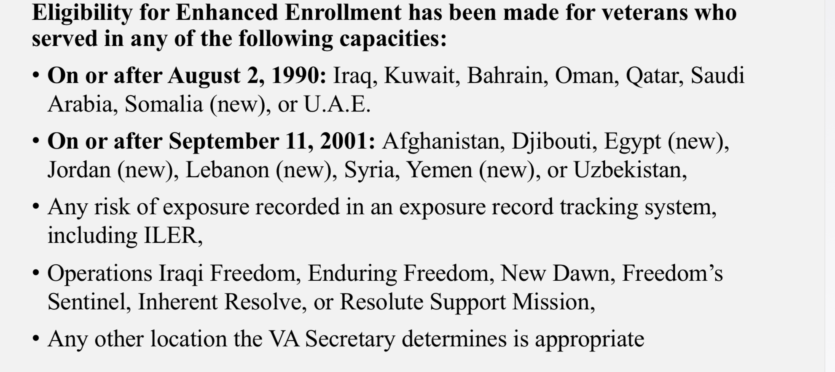
Health Care Eligibility (continued)

Slide 18
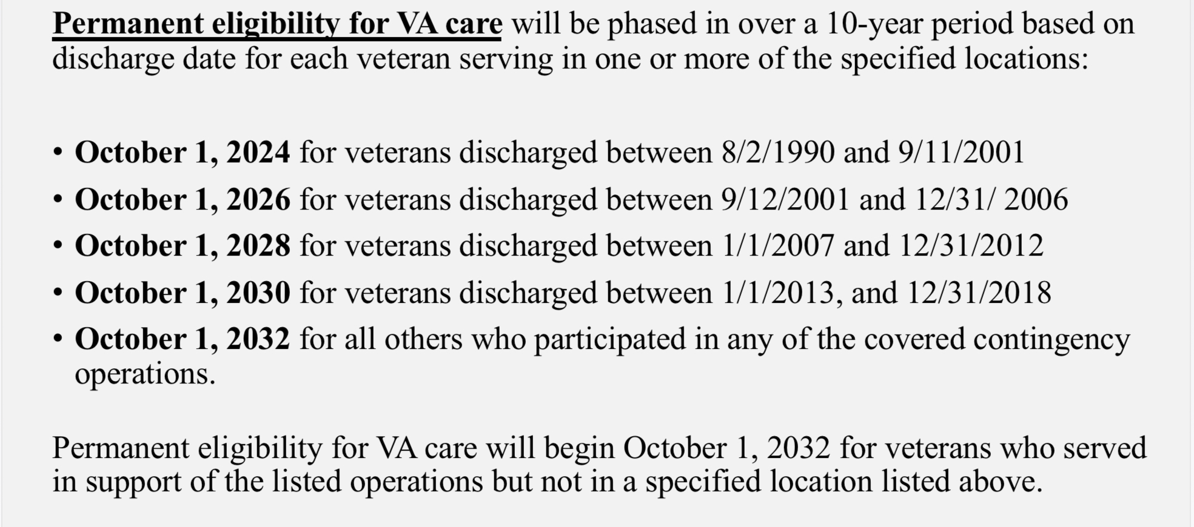
Dates For Health Care Eligibility (continued)

Slide 19
Title III – Establishment of Service Connected Process
There is now a requirement which requires the use of the Individual Longitudinal Exposure Record (ILER), ILER-like tool or similar database during claims adjudication. This will be used to determine in service exposure.
VA will establish a list of chemicals, substances and airborne hazards and presumes that a covered Veteran was exposed to the identified substances, chemicals and airborne hazards during qualifying service.
A medical nexus examinations will be required for toxic exposure risk activities, unless evidence of record is sufficient.

Slide 20
Service Connection (continued)
On or after August 2, 1990, performed active military, naval, air or space service while assigned to a duty station in, including airspace above:
Bahrain
Iraq
Kuwait
Oman
Qatar
Saudi Arabia
Somalia, or
United Arab Emirates, or

Slide 21
Service Connection (continued)
On or after September 11, 2001, performed active military, naval, air or space service while assigned to a duty station in, including airspace above:
Afghanistan Lebanon
Djibouti Syria
Egypt Yemen
Jordan Uzbekistan
or any other country determined relevant by the Secretary.

Slide 22
Title IV – Presumption of Service Connection
Nuclear Response or Radiation Exposed
Establishes presumptive service connection for veterans who participated in cleanup of Enewetak Atoll and radiation exposed veterans
Establishes presumptive service connection for veterans who participated in nuclear response near Palomares, Spain (1/17/66-3/31/1967) or Thule Air Force Base, Greenland (1/21/1968-9/25/1968)

Slide 23
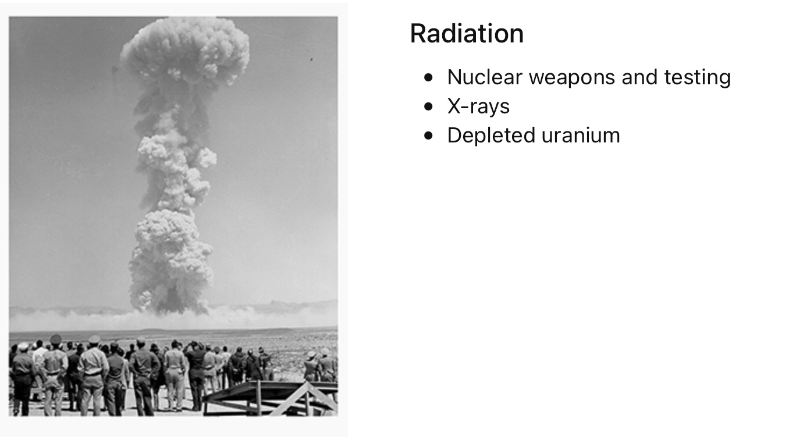

Slide 24
Service Connection (continued)
Expands exposure to certain herbicide agents
Service in Thailand at any United States or Royal Thai base, without regard to the military occupational specialty the Veteran performed or where on the base the veteran was located (1/9/1961-6/30/1976)
Service in Laos (12/1/1965-9/30/1969)
Service in Cambodia at Mimot or Krek, Kampong Cham Province (4/16/1969-4/30/1969)
Guam or American Samoa, or in the territorial waters thereof (1/9/1962-7/31/1980)
Service on Johnston Atoll or on a ship that called at Johnston Atoll (1/1/1972-9/30/1977)

Slide 25
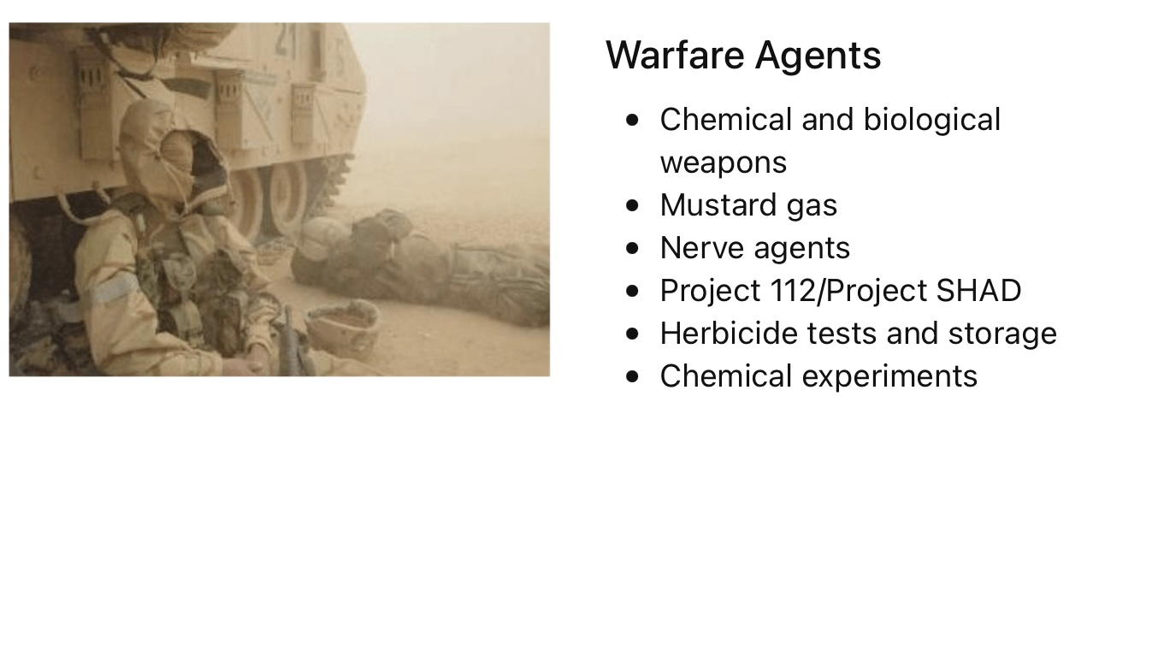

Slide 26
Service Connection (continued)
Improves service connected disability compensation occurring in Persian Gulf veterans
Removes the manifestation period for Persian Gulf veterans, allowing for a qualifying chronic disability to manifest to any degree of disability at any time
Expands the service areas that qualify under the definition of Persian Gulf veteran to include the Southwest Asia theater of operations or in Afghanistan, Israel, Egypt, Turkey, Syria, or Jordan

Slide 27
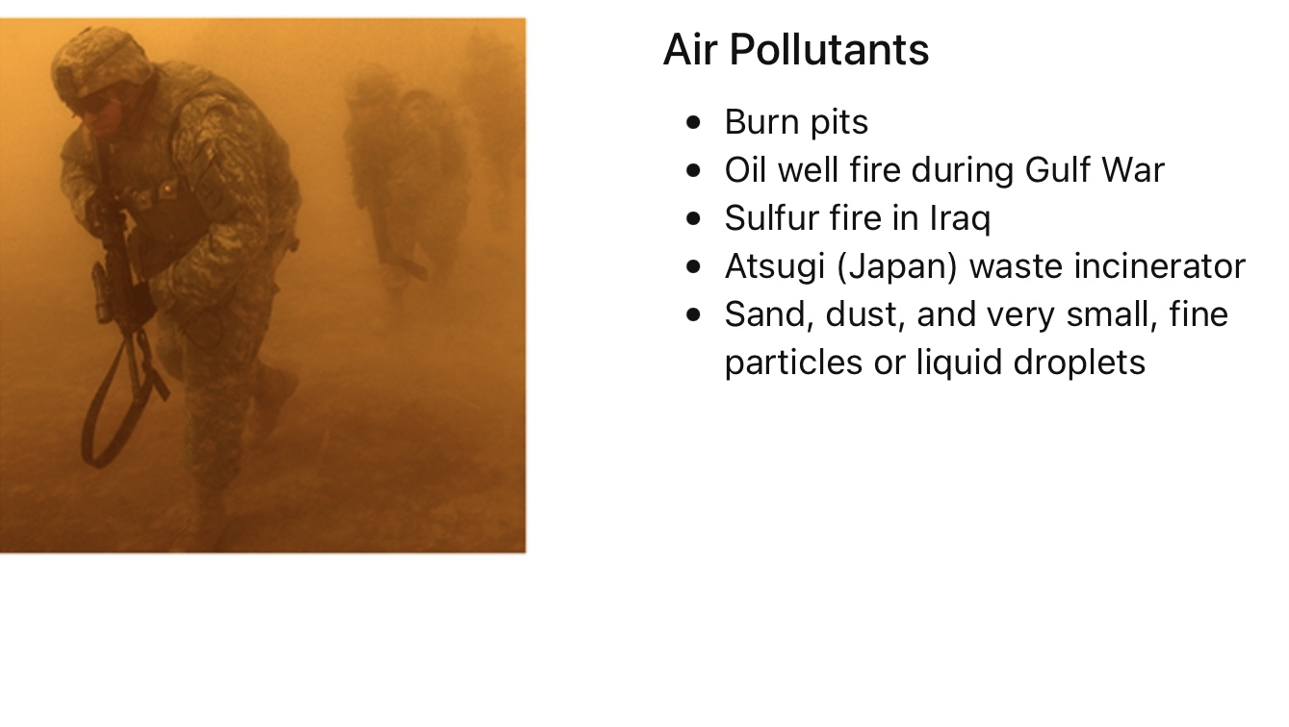

Slide 28
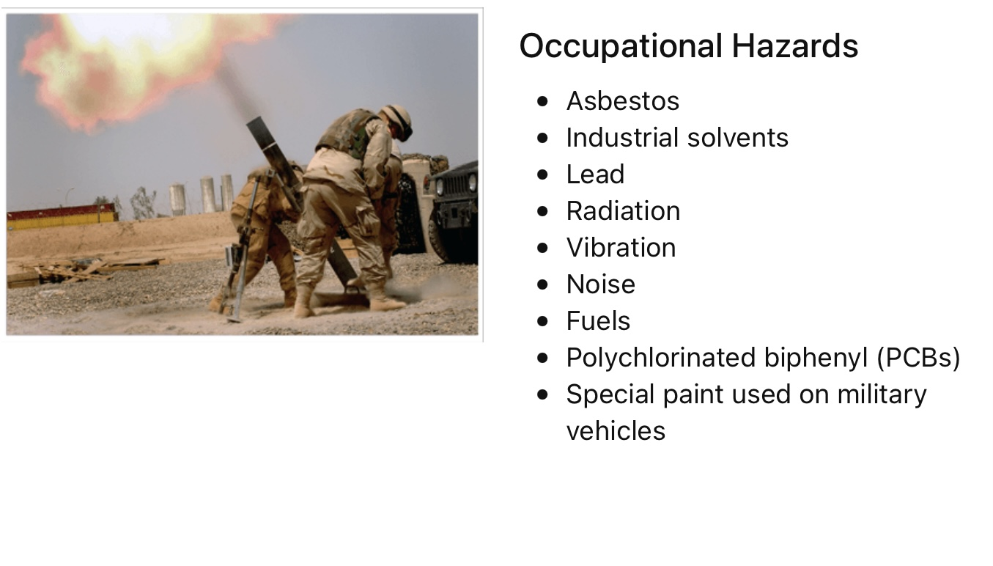

Slide 29
Service Connection (continued)
Service on or after August 2, 1990, in, or the airspace above:
Bahrain
Iraq
Kuwait
Oman
Qatar
Saudi Arabia
Somalia or
United Arab Emirates or

Slide 30
Service Connection (continued)
Service on or after September 11, 2001, in, or the airspace above:
Afghanistan
Djibouti
Egypt
Jordan
Lebanon
Syria
Yemen or
Uzbekistan

Slide 31
Service Connection (continued)
This establishes 25 new conditions – 13 lung conditions and 12 cancers under 38 USC 1120 as presumptively related to exposure to burn pits and other toxins for Veterans with qualifying service under new 38 USC 1119
Some of the new presumptive conditions are specific diagnoses while other are general, allowing VBA to interpret the law. VBA will further define the qualifying cancers and eligible diagnoses that may fall under the broad cancer categories, such as head cancer, neck cancer, gastrointestinal cancer and reproductive cancer. VBA should apply liberal consideration.

Slide 32
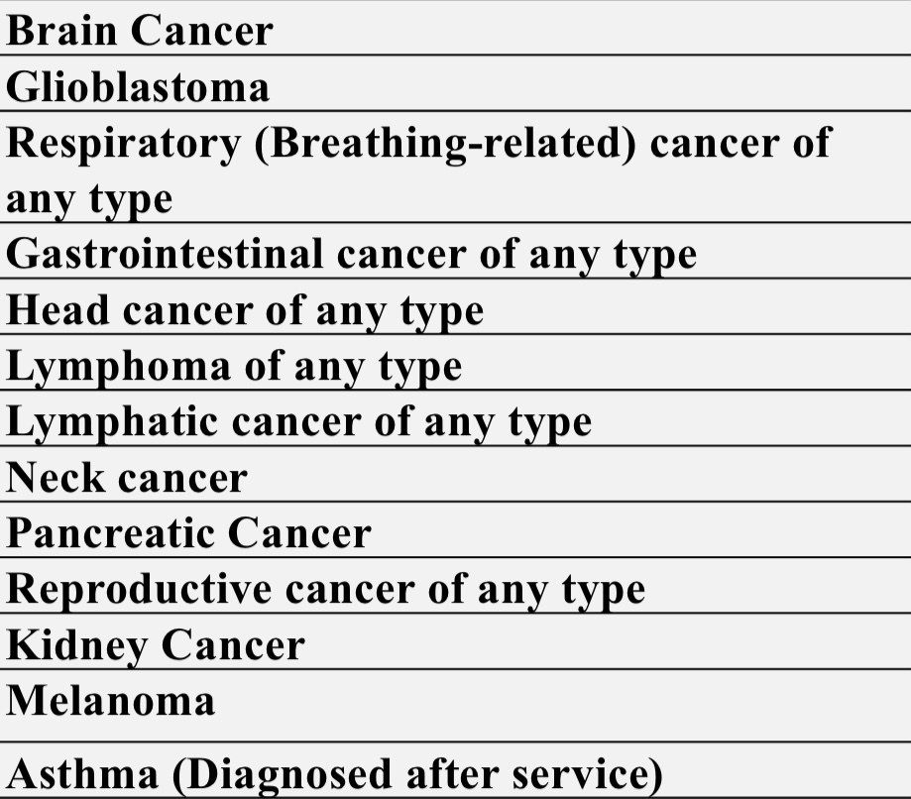
New Presumptive Conditions

Slide 33
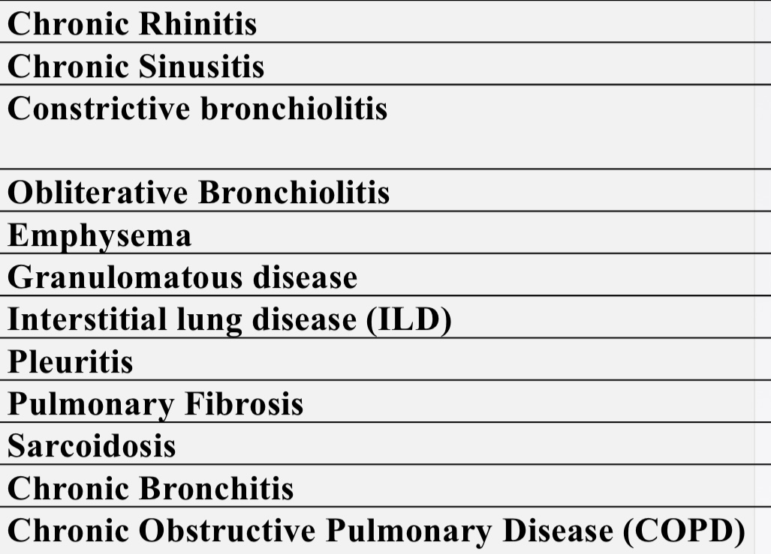
New Presumptive Conditions (continued)

Slide 34
Effective
Date
Considerations
For
Service Connection

Slide 35
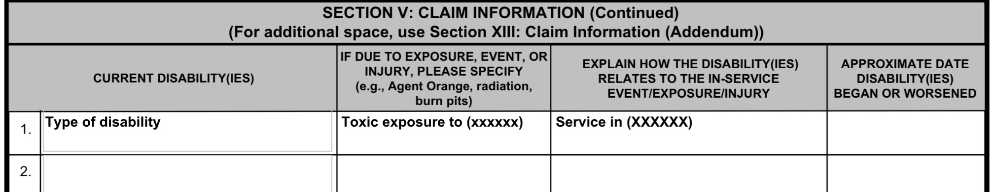
Effective Date Considerations
Original claim for service connection filed within one year when PACT Act was signed into law
In Section IV type of disability enter Toxic ExposureCondition and how disability related to in-service enter Service in (xxxxxx)
The effective date will be August 10, 2022, date of law

Slide 36
Effective Date Considerations
Original compensation claim for a newly added Pact Act presumptive condition was filed after one year of the law change
The effective date will be the date the claim was submitted
Intent to File (ITF) was submitted within one year of the Pact Act being signed into law and a compensation claim for a newly added PACT Act presumptive condition is filed within 1 year of ITF
The effective date will be August 10, 2022. The ITF preserves that date of claim

Slide 37
Effective Date Considerations
The veteran was denied benefits for a PACT Act presumptive condition prior to the PACT act being signed into law
The effective date will be August 10, 2022, or one year prior to the filing of the claim, whichever is later. The effective date cannot be earlier than August 10, 2022.
Submit a VA Form 20-0995, Decision Review Request: Supplemental Claim
On VA Form 20-0995 in Part II box 13A states to list the specific issues on appeal. Here you will write the condition and “Please see attached 21-4138 to satisfy requirement for new and relevant evidence.”

Slide 38
Effective Date Considerations
VA Form 21-4138, Statement in support of Claim stating:
(Veteran’s Name) has previously filed a claim for (condition) and this claim was denied on (date) due to (reason for denial). (Veteran’s name) served in (location) from (dates of service in that location) and is now eligible for presumptive service connection under the PACT Act of 2022.
Please accept this statement in conjunction with the law change as new and relevant evidence and review the veteran’s claim for (condition). Your attention to this matter is greatly appreciated

Slide 39
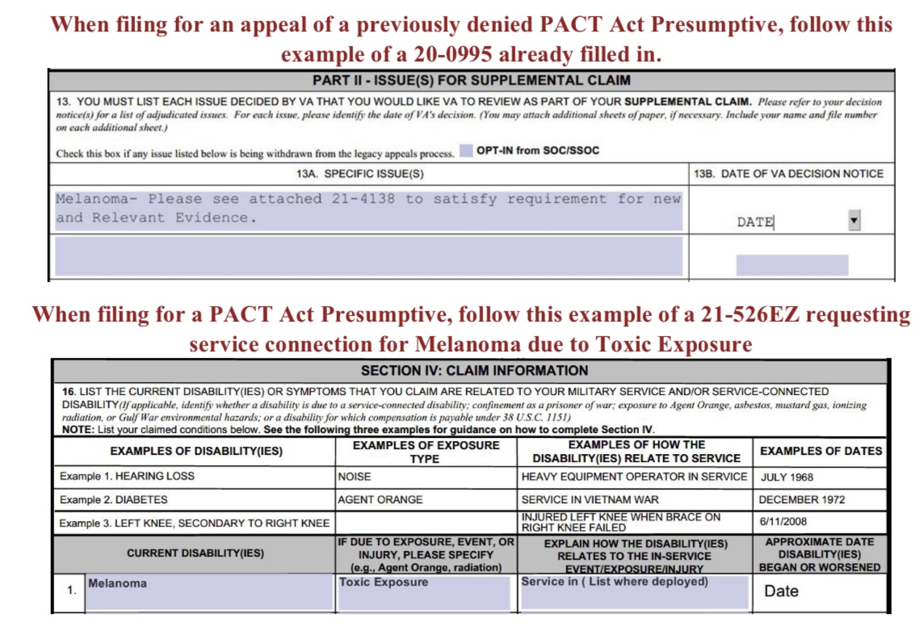
Effective Date Considerations

Slide 40
Effective Date Considerations
If there is a current claim pending for PACT Act, ie. Claim submitted before the law was passed, no action is required.
VA should consider the new presumptives as a pathway. You should track this claim to ensure it is being rated in accordance with the new law.

Slide 41
Effective
Date
Considerations
For
Dependency and Indemnity
Compensation

Slide 42
Consideration for DIC
Make sure death certificate states cause of death is one of new PACT Act presumptive conditions
Direct and secondary service connection can be considered to qualify for DIC/accrued benefits
Benefits can be established for survivors after veterans death
Application process has not changed to submit DIC claim

Slide 43
Effective Date Considerations
Dependency and Indemnity Compensation Claim (DIC) was filed and denied before the PACT act was signed
Submit VA Form 21-534EZ claiming DIC benefits along with the death certificate and VA Form 21-4138 explaining the surviving spouse was previously denied for DIC but is now eligible under the PACT Act.
The effective date will be the date the original DIC claim was filed

Slide 44
Effective Date Considerations
Dependency and Indemnity Compensation (DIC) claim filed after the PACT Act was signed
A VA Form 21P-534EZ form claiming DIC, along with the death certificate showing the veteran passed away from a PACT Act presumptive condition, will need to be filed.
The effective date will be August 10, 2022, or one year prior to the filing of the claim whichever is later. Effective date cannot be earlier than August 10, 2022.

Slide 45
Effective Date Considerations
Intent to File (ITF) was submitted within one year of the PACT Act being signed into law and a DIC claim for the added PACT Act presumptive condition is filed within one year of the IFT.
A VA Form 21P-534EZ form claiming DIC, along with the death certificate showing the veteran passed away from a PACT Act presumptive condition, will need to be filed.
The effective date will be August 10, 2022. The ITF preserves the date of the law change as the effective and the claim was submitted within the ITF window.

Slide 46
Additional DIC Possible Benefits
Accrued Benefits
Burials and Burial Allowance
Final Monthly Payment
Education and Training (Chapter 35)
Home Loan Guarantee
Health care such as CHAMPVA

Slide 47
Evidence
What type evidence is needed to file a successful claim?
Medical
Proof of service in required location
What else?

Slide 48
References
38 USC 101(37)
38 USC 1112
38 USC 1116
38 USC 1117
38 USC 1119
38 USC 1167
38 USC 1168
38 USC 1305
38 USC 1710
38 USC 5103A

Slide 49
References (continued)
38 USC 5101
38 USC 5110
38 CFR 3.102
38 CFR 3.114a
38 CFR 303
38 CFR 3.307
38 CFR 3.309
M21-1 XI.i.1.B
M21-1 X.ii.A.2

Slide 50
QUESTIONS?
Vicki Von Loh
402-499-6836
vvonloh@gmail.com

Slide 51
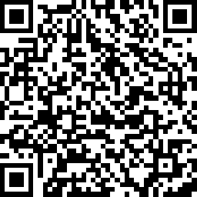
2023 Proficiency Training Conference Survey
Class: PACT ACT Claims
Please scan the QR Code or click on the link below to take an anonymous survey about your experience during the 2023 Proficiency Training Conference.
https://www.research.net/r/D2TSFV8

Slide 52
Question: True or false? In a claim involving service connection for multiple contentions, some of the claimed issues may require following TERA procedures while other claimed conditions may be exceptions to TERA. Only one TERA Memorandum is generally needed for the claim.
Answer: True
Review each contention based on the facts of the case.
Determining whether a TERA exception is met is contention-based, not claim based.
Some claimed issues may require following TERA procedures while others may be exceptions to TERA; however, only one completed TERA Memorandum is generally needed for the claim.

Slide 53
Scenario: The Veteran served honorably in the Army from January 3, 2004, to January 4, 2008, with a deployment to Iraq in 2007 and MOS of Intelligence Analyst. They claim service connection for kidney stones and sleep apnea on VA Form 21-526EZ received February 7, 2023. Service treatment records are silent for the claimed conditions during active service and the Veteran did not provide lay or medical evidence of a current disability.
Question: Is TERA applicable to the claimed contentions?
Answer: No

Slide 54
Scenario: Dana Roberts served in the Navy from May 15, 2008, to May 20, 2018. They submitted a VA Form 21-526EZ received February 8, 2023, for service connection of sleep apnea. In a lay statement, they allege that their sleep apnea is related to inservice complaints of snoring and daytime sleepiness which are noted in their STRs from active service. No diagnosis of sleep apnea is shown during active duty; however, the Veteran provided a copy of a sleep study dated February 8, 2023, showing a clinical diagnosis of obstructive sleep apnea requiring a CPAP for treatment.
Question: Is a TERA Exception met in this scenario? (Yes or No)
Answer: No
References: 38 U.S. 1168

Slide 55
Question: True or false? Hypertension will never be considered a non-presumptive disability for the purposes of TERA.
Answer: False

Slide 56
Question: True or false? When completing the TERA Memorandum, receipt of vaccines and medications during active service should be listed as non-deployment related toxic exposures since these are considered evidence of participation in a TERA.
Answer: False

Slide 57
Question: True or false? In general, if a claim for service connection is for a joint condition and the evidence is unclear as to whether the joint condition is related to physical trauma, unless there is competent medical or scientific evidence of record to the contrary, claims processors should presume the joint condition is related to physical trauma, thereby warranting the TERA exclusion.
Answer: True
References: M21-1, Part VIII, Subpart ii, 1.B.2.k

Slide 58
Scenario: Joe Hawkins served in the Marine Corps from May 23, 1973, to August 8, 1974, with RVN service documented on the DD form 214. They filed a VA form 21- 526EZ received on November 12, 2022, for asthma due to Agent Orange exposure and submitted VA Medical Center (VAMC) records documenting a diagnosis of asthma with a prescription of an albuterol inhaler since October 2, 2019. Their service treatment records are negative for symptoms or a diagnosis of asthma. Their military personnel file and an ILER search were negative for any additional TERAs. The Veteran did not submit any additional information with their claim.
Question: Which development actions are needed for this claim?
Answer:
Make the claim ready for decision
Complete a TERA memorandum
Affix the PACT Exam Exclusion – Sec.1168 special issue to the contention in VBMS
Schedule a TERA examination with a medical opinion
References: 38 U.S.C. § 1168 (b)

