Slide 1

VFW Training
November 2023

Slide 2
QTC Overview:

Slide 3




QTC Mission
Quality
Timeliness
Customer Service
Who We Are: Nationwide provider of occupational health and disability examination services focused on delivering high quality, technology-driven, exam solutions for our clients.
Mission: To provide high-quality, timely, and customer-focused medical examination service solutions.

Slide 4










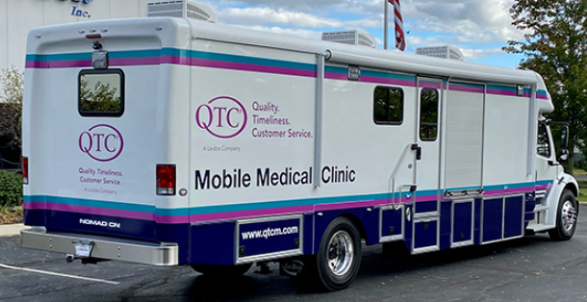
QTC Overview
3,000+ Employees, 17,000+ Medical Provider Network
Annual Services: >400,000 examinees and > 900,000 exams/diagnostics
VA Services
DOD
Disability and Occupational Health
Non Federal
VBA MDE
RHRP
DOL, FOH, RRB. FBI. USSS, SSA
IMX
Veterans Affairs
DHA
Dept. of Labor
Social Security Administration
US Railroad
Retirement
Federal Occ
Health
FBI
Secret Service
Multiple Customers
Disability Exams
Medical Readiness
Work Comp
Benefits Exams
Benefits Exams
OH Exams
OH Exams
OH Exams
IME / Case Mgt
23 Years
All 50 States
128 Military Sites
International
Contract Award 6/21
All 50 states +
25 Years
All 50 States
37 Years
7 States
23 Years
46 States
15 Years
All 50 States
9 Years under FOH
All 50 States
15 Years under FOH
All 50 States
Up to 26 years
9 states
Expertise
Provider Network Development | Tele-exams
Exam Protocol (Guided Medical Exams) | Clinic Operations
Case Management | Mobile Medicine
Examinee Call Center Management | Population Medicine
Infrastructure
17,000+ Provider Network | 358+ Traveling Providers
5 Case Management Centers | 256+ Per Diem Clinics
94+ Clinics | 10 Mobile Multi-Specialty Coaches
Examinations for America’s Heroes

Slide 5



QTC’s Focus on the Customer’s Experience
In mid-2021 QTC made the investment to establish a new department with a dedicated and mindful CX culture to drive customer service initiatives, and policies and procedures across the QTC organization.
This department’s primary focus is the Service Member/Veteran experience and ways to enhance their journey throughout the exam process with QTC.
Benefits of a robust Service Member/Veteran experience strategy is to deliver internal and external interactions that create exceptional, high-quality experiences in each interaction throughout the organization.
The motivation from this team is the ability to sustain our growth and refine our efforts to deliver High-Quality, Timely Services with Premier Service Member/Veteran Experiences (Q-T-C) to all of our customers and continue to make a positive difference in the lives of those we serve as well as their families.

Slide 6
QTC Examination Process

Slide 7













High Level Examination Process
QTC’s Six Step Operational Methodology
1
Request Processing
2
Appointment Support
3
Medical Examination
4
Appointment Support
5
Report Delivery
6
Billing & Payment
eProcess Case Management
Receive Request
Scheduling
Notification
Examination Record
QA Review/
Provider Collaboration
Results Packaging/
Delivery
Stakeholder Relationship Management and Portals
Exam
Track
Examinee
Portal
Provider
Portal
Medical
Evaluation
Protocol
Appointment Provider Availability System (APAS)
Automated Call
Distribution
Provider
Relationship
Management
Notes:
This slide is a high level overview of QTC’s case management process designed to support its 6 step operational methodology geared towards quality and timeliness.
In the top row, eProcess (QTC’s Case Management System) highlights the main activities that take place while the bottom row, focuses on the key stakeholders and applications setup to support the examination process.
Request Processing-Upon receiving an examination request via Exam Track, our Operational Support Analysts perform an initial triage which is to review the request for clear, consistent and complete exam instructions. It is in this step that a clarification response may be sent when there is an inconsistency that may impact our ability to deliver a complete and consistent exam.
Appointment support- Once an exam request is accepted, our case specialist begin the scheduling process by reaching out to the claimant for scheduling and providing access to the examinee portal. They use their Appointment Provider Availability system application which we touch on in a few moments.
Medical Examination- Providers are notified of an upcoming exam by the Provider portal and are typically expected to deliver results within 48 hours.
Appointment Support- QTC’s case management system allows for collaboration with the provider to ensure clear and consistent information is provided back to the VA. We will touch on quality shortly.
Report Delivery- Once a report appears to be consistent, clear and complete, the report is then on its final step…
Billing & Payment- Validates accurate services are billed before delivering the case back to VBMS and Virtual VA, making the case available in ExamTrack.

Slide 8




Claimant Notifications
Process Step | Text | Call | Mail
Case triaged |  |  | Welcome letter is sent via FedEx overnight
Case prepped | Automated welcome text | Automated welcome call
Case Specialist (scheduler) |  | 2 attempts
If unable to schedule after 3 days |  |  | No-contact letter is sent via FedEx overnight
Appointment scheduled
If appt is scheduled | Automated appt text | Automated appt call | Claimant notification packet sent
Appt Confirmation* | 24-72 hours before appt | 24-72 hours before appt
*Appointment confirmation text/calls will stop once claimant confirms appointment
Notes:
This slide gives you an overview of all the claimant notifications that are sent to a claimant during the notification process.
To the left is the step taken and you will see the method of communication.
Once an exam request is accepted at triage, a welcome letter is sent via FedEx Overnight.
Before the appointment is setup, the DBQ is prepared and once completed, a welcome text and call are sent to the claimant.
The case specialist makes 2 phone attempts (one per day) and will leave call back information if unsuccessful or review MR for alternate forms of contact.
After 3 days, another letter is sent via FedEx overnight for the claimant.
If possible, we reserve appointments that are in reasonable proximity to the claimant at which point a claimant is notified that an appointment has been set on their behalf and the notification packet will arrive at least 3 days prior to date of appointment.
Electronic appointment reminders are sent 24-72 hours before an appointment.

Slide 9
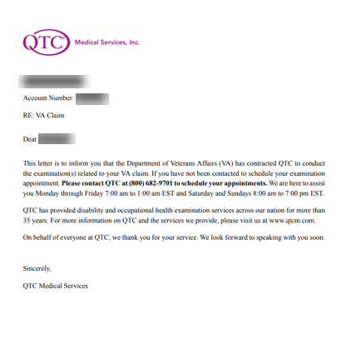
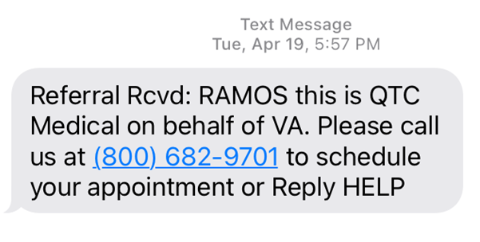
Examples of Claimant Notifications
Welcome Letter
Welcome Text Message

Slide 10
Availability
QTC’s scheduling application is geared towards providing a claimant with the closest/soonest options available.
On top of QTC’s scheduling search results, QTC’s polices require case specialists to always consider a claimant’s physical condition, location, and to maximize a claimant’s time with same day appointment scheduling.
If claimant is not available for exams within 8 calendar days, QTC will advise the claimant that we will transition the case back to the VA and QTC will submit a request for cancellation.
Claimants want to schedule past 8 days due to expressing extenuating circumstances are escalated to leadership for review/approval.
Service Members on Temporary Duty (TDY) need to be available as the exams can be processed and/or scheduled without positive contact.
Notes:
Prior to setting an appointment, all schedulers are expected to maximize scheduling search results in order to provide an efficient and timely experience that is within reasonable proximity to the claimant.
We always consider a claimants physical limitation and location.
QTC gives claimants up to 8 days for availability. When extenuating circumstances are present, QTC leadership considers the request. When they are just not willing or available, QTC will transition their case back to the VA.

Slide 11
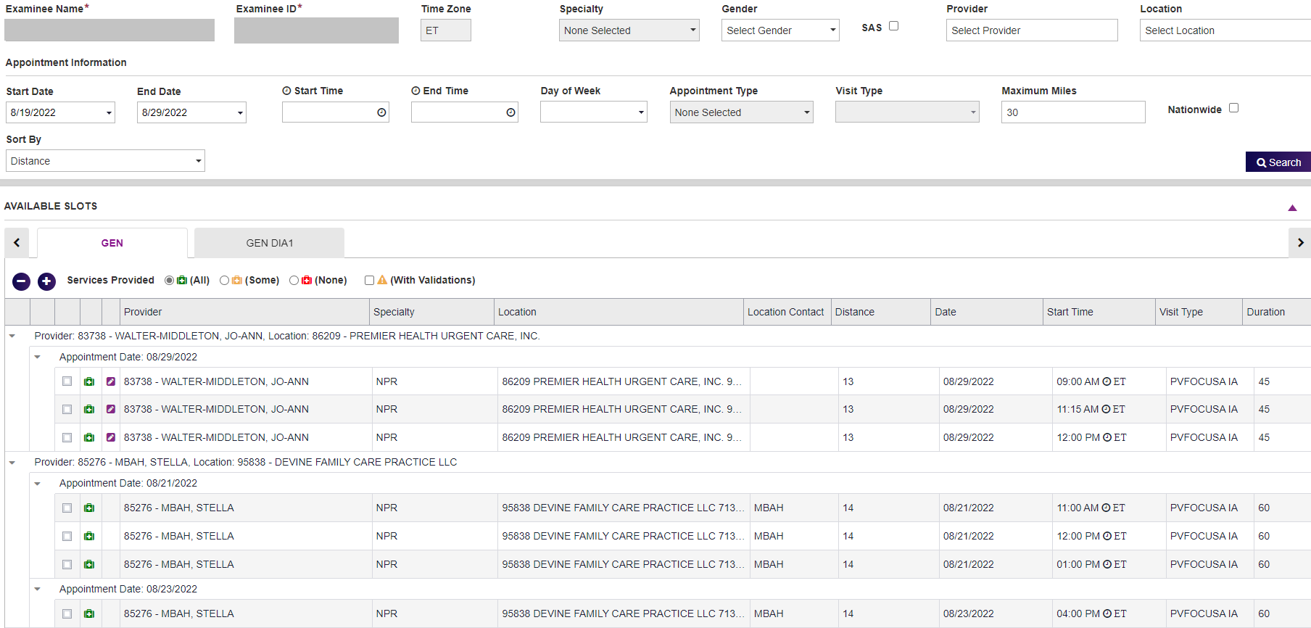
Availability (cont.)
QTC’s scheduling system shows the first available/closest provider to the claimant.

Slide 12
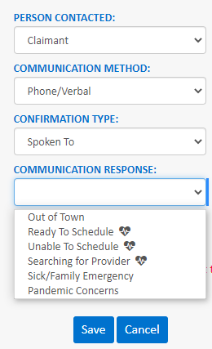
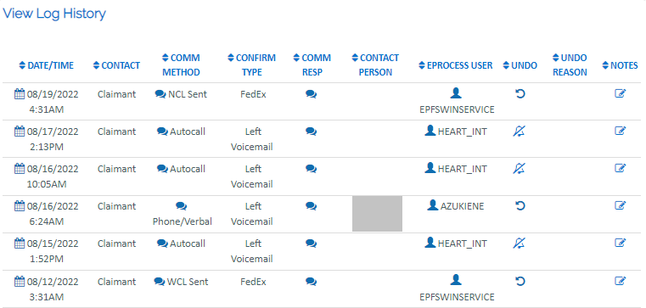
Tracking (Actions to Schedule Appt.)
Case Specialists are to enter case notes for each attempt and track Positive Contact (PCNT) within the case management system.
Contact attempts are shown in Exam Track
Notes:
Schedulers are asked to enter case notes and track Positive Contact within the case management system.
When a claimant is ready to schedule, unable to schedule or a search for a provider is needed, we stop heart communications until we can proceed.
All contact attempts recorded in this screen are shown in Exam Track.

Slide 13
Reserve Scheduling
Case Specialists (CS) are to make two attempts (one per day) and document all attempts to schedule.
Staff review medical records (MR) for alternate forms of contact if a number is invalid or disconnected.
After two outreach attempts (i.e. one per day) with no response, the CS will reserve schedule appointments if there is a provider within contractual mileage or a no-contact letter is sent if there are no providers within contractual mileage.
Per the VA Contract, the CS must ensure an appointment notification letter is delivered 3 days prior to appointment date when reserving an appointment.
Although QTC strives to have the letter delivered 5 days prior to the appointment.
Notes:
Claimants may not pick up their phone but, attend an appointment or, if an appointment is made on their behalf.
Schedulers do their best to reach a claimant by phone and search MR for alternate forms of contact.
If after two outreach attempts any of the appointments can be reserved scheduled (i.e... within reasonable proximity to the claimant) then, QTC will proceed.
QTC will only set an appointment that ensures a CNP packet will arrive 3 days prior to Date of Appointment.

Slide 14

Call Back and Rescheduling
QTC uses its “Task Builder” application to stay on top of claimants pending reschedule.
Case specialists are required to call back and reschedule claimants to complete the task within 24 hours.
Claimants have only one opportunity to reschedule any or all appointments. Exceptions to this rule are escalated to QTC leadership for approval.
If a claimant is unable to attend a rescheduled appointment within five calendar days from the original appointment, QTC submits a request for cancellation for the contentions associated with that appointment.

Slide 15
QTC Claimant Notification Packages

Slide 16
Claimant Notification Package (CNP)
Letters are tailored by Exam Setting (i.e. CNP/BDD/IDES) and includes the necessary appointment information that will guide claimants through the examination process.
The Appointment Notification Letter is made available to the claimant by mail within a Claimant Notification Packet (CNP) and Examinee Portal after an appointment has been set.
Includes Date/Time along with Provider name, specialty, address and credentialing information.
The CNP includes:
Cover Letter
Covid-19 Self Screening
QTC Appointment Letter with FAQs
Questionnaire
Driving Directions
Veteran Crisis Line (recently updated)
Separation Health Assessment (BDD)
** FAQs include:
Do I need to attend this appointment?
What do I need to do?
Should I bring my medical records?
What if I have specialized accessibility needs?
Is this examination free?
Will I be reimbursed for travel Expenses?
Notes:
We partner with Enterprise printing to send packets electronically for distribution via FedEx or USPS (dependent of claimant location).
The appointment notification letter is customized by exam setting (i.e. CNP/BDD/IDES) included within the packet along with basic QTC information, FAQs, driving directions and resources such as COVID-19 self-screening or the Veteran Crisis Line.
CNP also includes providers qualifications/credentials
Available in the CNP packet and the examinee portal, contain specific appointment information and an overview of the providers credentials
Do I need to attend this appointment- customized by exam setting
Will I be reimbursed for travel expenses – customized by exam setting

Slide 17
Delivery of Claimant Notification Package
QTC leverages an Enterprise Printing and Fulfilment System (EPFS) through a secured third party business partner.
Packages are automatically generated and are processed, printed, and mailed by the vendor, allowing QTC staff to focus on delivering exceptional customer service.
The print vendor processes packets at 1:30 am PT, 9:30 am PT, & 1:00 pm PT.
Mailing logic built into the system sends the packet by various methods to ensure it arrives at least 1 day prior to the date of appointment.
USPS First Class
FedEx Express Saver
FedEx 2 Day Service
FedEx Priority Overnight

Slide 18
CNP Challenges and Delays
Wrong Address (mail returned or forwarded)
Inclement Weather
FedEx challenges to reach some remote areas
Print Vendor Business Disruption (rare and claimants are typically rescheduled if necessary)
Scheduling after Printing Cut-off time (typically rescheduled)
Deliveries to Military Base Post Offices (BDD)
These reasons may result in the Claimant receiving the Appointment Notification Package late or after the exam date of appointment.

Slide 19

Future/Ongoing CNP Improvement Projects
Examinee Portal and MEP Integration (Medical History)
Option to complete questionnaires online
Option for Paperless CNP
Although exam packets can be printed from the Examinee Portal
Continuous Changes to Verbiage to Align with VA Requirements and Simplify Examination Process
Revision of the Physical CNP to Reduce Waste

Slide 20
VSO Supporting Claimants

Slide 21





Support Contact Numbers – Call Center
National Call Center
VA Operations | 800.682.9701 | Monday-Friday 7am-1am EST Saturday-Sunday 8am-7pm EST
International | 213.474.2790 | Monday-Friday 7am-1am EST Saturday-Sunday 8am-7pm EST
Support Services
VSO Support - Email
Scheduling & Appt. Directions
Transportation Requests
Reimbursements
Demographic Changes
WeCare@QTC.com

Slide 22
Obtaining Information for Claimant
Claimant can contact QTC ahead of time to provide verbal authorization to speak to a VSO on their behalf.
QTC will document this in case management notes for any future correspondences that may occur.
Claimant and VSO can contact QTC together and provide authorization to speak to VSO on their behalf.
QTC will document this in case management notes for any future correspondences that may occur.
If a claimant is unable to communicate effectively during the scheduling process, QTC staff will review medical records for a possible POA (i.e., Power of Attorney) or authorization of third party forms (e.g., VA Form 21-0845) to authorize another individual to communicate/arrange for scheduling on their behalf.
A copy is not required to be obtained or uploaded into EFM. Staff will document clearly in case management notes when a POA or third party is identified to speak on behalf of the claimant.
For any records that were not previously submitted with the claim,
it is the responsibility of the claimant to get them uploaded in their VA Record.
Notes:
Inquire on what the OSA process is when a VSO calls in for status/details
There is a dedicated VSO line that goes to OSA queue by selecting option for “VA Employee”. Do VSO’s know about this direct line? How is the screening process done to confirm person is in fact a VA Employee/VSO.
Research into VSO access to view status details in exam track (inquire w/ Program Mgmt.)
Notes 8/29:
Per OSAs, rarely will a VSO call in without claimant on the line. If it occurs, they are instructed to have claimant provide authorization before QTC can provide any appointment details.
Majority of inquiries from VSOs are regarding scheduling details, or if they VSO needs to coordinate transportation for claimant

Slide 23
Exam Expectations - Treatment Vs. Evaluation
Understanding the examination process assist in setting the right expectations for the exam and the best experience for the Service Member/Veteran.
Primary–care provider is to treat a condition(s) and maintain ones overall health
QTC examiner’s goal is to evaluate the claimed condition(s) that have been requested by the VA.
QTC examiner must follow strict instructions from the VA
Due to QTC examiners treating a condition, their approach may seem different that the approach of a primary care provider.
Our CNP packages highlight the difference between a QTC examiner and ones primary-care provider.
QTC Providers are trained to discuss the evaluation process to set expectations and best experience with Service Members/Veterans
Setting expectations together will assist in providing the best positive experiences

Slide 24
You asked…QTC listened
Reschedule information—Updating CNP with information as well as better layout of information
POC to direct issues—Created Veteran Service Liaison team
Providers of concern—Created ticket system to consolidate Survey responses, concerns from social media, QTCM.com, Call Center, etc.
Expand TH—Working with VSO organizations to provide areas and assist in connecting for TH
Providers not accepting paperwork/Questionnairs--Providers now required to accept paperwork from claimants at time of exam
Notes:
Prior to setting an appointment, all schedulers are expected to maximize scheduling search results in order to provide an efficient and timely experience that is within reasonable proximity to the claimant.
We always consider a claimants physical limitation and location.
QTC gives claimants up to 8 days for availability. When extenuating circumstances are present, QTC leadership considers the request. When they are just not willing or available, QTC will transition their case back to the VA.

Slide 25

Feedback From the Field

