Slide 1











State Service Officer Partnerships
Mike Figlioli
Director, NVS
Mfiglioli@vfw.org

Slide 2
Objectives
Vision
Accreditation Process
NVS Quality Assurance Program
Restricted Grant Usage
VFW Reporting
Power of Attorney Discussion
Open Discussion

Slide 3
Vision
Partnership, Collaboration, Support
State Agencies are critical to the VFW’s mission
Your states agencies are highly professional organizations subject to oversight and accountability through your elected state leaders
WE DON’T UNDERSTAND YOUR NEEDS AS WELL AS WE SHOULD. WE WANT TO CHANGE THAT.

Slide 4
Accreditation
As an organization recognized by VA for the purposes of preparation and prosecution of claims, VFW must establish guidelines for accreditation IAW 38 CFR §14.628
Guidelines are set forth in the NVS Policy & Procedure, as amended twice each year by the National Veterans Service Advisory Committee IAW VFW Manual of Procedure Section 518 (11)
Your states agencies partner with the VFW to serve as the VFW Department Service Office
VFW cross-accredits more than 1,600 state and county representatives

Slide 5
Accreditation
Process Overview:
State completes pre-employment background check on candidates
State submits VFW Accreditation Packet to NVS
NVS reviews for signature by National Certifying Representative (Mike Figlioli, Director, NVS)
NVS submits to VA OGC for processing
VA OGC notifies candidates and VFW of accreditation
VFW Accreditation Packet:
Letter of Appointment
VA Form 21 (Most recent – February 2020)
VFW Application for Accreditation
Background Investigation Certification
Completion certificate for TRIP or other comparable training offered by the State or NACVSO

Slide 6
Letter of Appointment
Items we look for:
By-name and title request for accreditation
Signature of appropriate authority:
State Director or Commissioner
State Rep. appointed to serve as VFW DSO
State Training or hiring manager
VFW Department Leadership
A formal letter is not required but is preferred. An email will suffice if it satisfies the name/title requirements and comes from the proper authority.

Slide 7
VA Form 21
The VA Form 21 must be properly filled out to be accepted
Commonly Missed Items:
1 – FULL name including middle
2 – Business Address
7A – Proper name of organization
Veterans or Foreign Wars of the U.S.; Veterans of Foreign Wars; VFW are all acceptable
7B – Do not use a generic VFW office address if the
applicant is a state or county employee
8 – Cross-accreditations must have a primary.
10 – Signature of designee – cannot be digital
11 – Must be a current address
12 – 15 must be left blank.
***Must be Feb 2020 version (a new version is pending approval)***

Slide 8
VFW Application
Items we look for:
Must be 01.01.2022 version
Current Employer
Email Address – REQUIRED
Have you ever been fired from a job?
If yes, MUST include explanation
Looking for red flags on customer service or reliability.
Example: Fired for failing to show up for shifts or for being rude to clients.
Have you even been convicted of a crime?
If yes, MUST include explanation.
Does not include minor traffic violations.
Looking for history of financial impropriety or violence.
Example: Convicted of check fraud or convicted of spousal abuse.

Slide 9
VFW Application
Items we look for:
Are you currently a service officer?
Yes; organization; dates
Are you currently accredited with any other organizations?
Must have a primary accreditation BEFORE applying for VFW accreditation; usually your state agency.

Slide 10
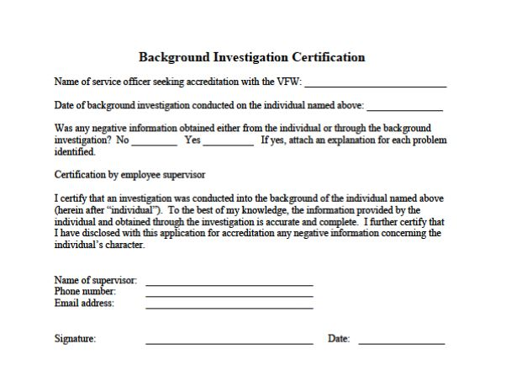
Background Investigation
Items we look for:
If yes for negative information, a separate page with an explanation must be included
Similar “red flags” as VFW Application
Fields with Supervisor, Phone, Email, Signature, and Date must be completed
“Supervisor” can include VFW Department leadership, but should be a supervisor with the State Agency
Cannot include administrative staff
Standards for Background Investigations outlined in NVS Policy & Procedure

Slide 11
Processing
Process Completion:
Forms are available in fillable PDF format electronically from NVS.
Request and submit forms to Theresa Aldana at Taldana@vfw.org
Once received, the packet will be reviewed and any areas needing correction will be identified prior to submission to OGC.
NVS will notify the individual and supervisor via email when the accreditation is approved by OGC or if there are any errors.
Discussion: What has your experience been like seeking VFW accreditations over the years?

Slide 12
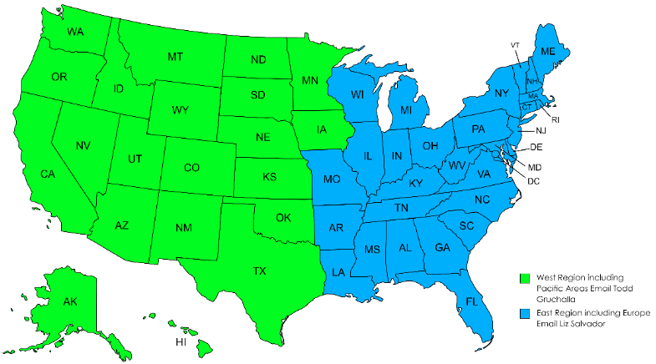
NVS Quality Assurance Program
In 2022 NVS hired 2 Regional QA Specialists to assist service offices, conduct site visits, and provide mentorship to accredited representatives
Our Goal: To visit each office at least every 2-3 years
VFW Department-run offices: This is an oversight and quality control visit.
State-run offices: Goal is to understand the relationship between the state and VFW, collect and share best practices, and build rapport.
Liz Salvador – East RQAS Lsalvador@vfw.org
Todd Gruchalla – West RQAS Tgruchalla@vfw.org

Slide 13
NVS Quality Assurance Program
Process:
NVS will REQUEST to visit in coordination with the appointed VFW DSO and the VFW Department Leadership
NVS will request to meet with State Agency Leadership and the VFW Department Commander
During the visit it is beneficial to visit the VA Regional Office, state agency headquarters, and any field offices deemed appropriate
Visits usually encompass 3 full business days
NVS will publish TWO reports: One for the VFW Department Leadership; One for the State Agency Leadership
Reports will be drafted in collaboration with the VFW DSO

Slide 14
Restricted Grant Usage
VFW Departments receive restricted grant funding from VFW National to support veterans’ service work in their state.
Some Examples of how to use these funds:
Background investigation fees
Travel and/or other expenses associated with outreach for accredited claims representation
Costs associated with attending annual NVS training on a space-available basis
Purchasing reference materials or development and printing of service office promotional materials
Costs associated with hosting or attending annual VFW Post Service Officer training, VFW events, or professional development
Purchasing IT equipment for VFW-accredited individuals to include ink, toner, bulk paper, postage, etc.
Though you may not be able to solicit the usage of these funds, be aware of this when the VFW Department requests your support outside of your day-to-day responsibilities.

Slide 15
Restricted Grant Usage
If the Department is in doubt as to the proper usage of funds, they are encouraged to
contact the Director, NVS or the office of the Quartermaster General.
It’s better to ask permission than forgiveness with restricted funds!!

Slide 16
VFW Reporting
In March 2023, the NVS Policy and Procedure was updated to remove the requirement for service offices to submit monthly claims reports to NVS
VFW receives monthly POA summaries from VA that are posted in the resources section of the OLP for your use
In lieu of the monthly reports, the DSO only needs to submit a PSO School of Instruction report to NVS that includes the date and location of the training, topics taught, and a roster of attendees.
What are your current state reporting requirements?
Is the monthly POA Summary Report sufficient?
Is there anything that the VFW could share with you to assist with your reporting requirements?

Slide 17
VFW Power of Attorney Acquisition
We understand that State agencies are prohibited from actively favoring one VSO over another when offering benefits assistance to clients.
NVS is encouraging VFW Departments that work with state-run agencies to better inform veterans that they can select VFW as their representation.
What are your experiences when veterans select POA for their claim?
What are your limitations as a state employee?

Slide 18
How Can NVS Help You??
Notes:
Potential topics: Pros/Cons of state office, relationship with VFW, state legislature support, infrastructure.

