Slide 1
Tyler’s Veterans Benefits (TVB)
VA Benefit Claims (VABC)
Brad Hazell
Assistant Director, NVS
bhazell@vfw.org

Slide 2
VA Benefits Claims
Two electronic submission methods available in TVB:
VA Benefits Intake: Electronic method of submitting claims and evidence from TVB into VA’s Centralized Mail Portal.
Requires VA action to establish documents submitted
Can submit most digital file types at any time
VA Benefits Claims: Electronic method of submitting claims and evidence from TVB directly into VA computer systems
Auto establishment
Capability to submit a 21-22, 21-0966, or a 21-526ez
*Only the 21-526ez can be submitted with additional documents*
Notes:
VA Benefits Intake similar to Direct Upload in Vetrapsec
VA Benefits Claims similar to D2D in Vetrapsec

Slide 3

VA Benefits Claims
What is VA Benefits Claims?
VA Benefits Claims is a feature within TVB which utilizes Application Programming Interface (API) to transmit data between TVB and the Veterans Benefits Management System (VBMS).
VA Benefits Claims can:
Establish Intents to File
Establish Power of Attorney
Check Power of Attorney and Claim Status
Establish Compensation Claims

Slide 4
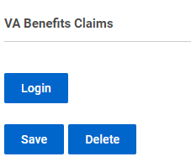
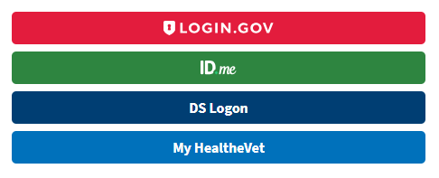
VA Benefits Claims
Login:
Open a Veteran’s TVB file
Scroll to bottom of screen and expand VA Benefits Claims
Select “Login”
Select your preferred method to sign into VA.gov
(your name must match VA systems)

Slide 5

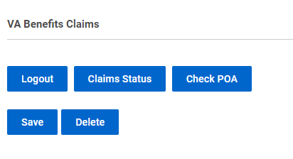
VA Benefits Claims
After Log In
When in the Veteran’s profile screen, you will have the ability to:
Check Claim Status
Check POA
*If you receive an error when checking Claim Status or POA, you will need to
update your login method to ensure your name matches VA login information.
Notes:
Breadcrumb trails have been added to slides to help reps ensure they are attempting to use VABC from the correct menu screen.

Slide 6

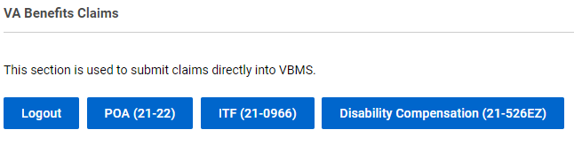
VA Benefits Claims
After Log In
When in the Veteran’s Claim screen, you have the ability
to submit:
VA Form 21-22, Appointment of VSO
as Claimant’s Representative (POA)
VA Form 21-0966, Intent to File
VA Form 21-526ez, Application for Disability Compensation
Notes:
POA check will work regardless of VFW being the POA

Slide 7
VA Benefits Claims 21-22 POA
VA Form 21-22 Appointment of VSO as Claimant’s Representative (POA)
After selecting “POA (21-22)” you will be required to select options located on the 21-22 and must first upload a signed 21-22. *Answers in TVB must match the uploaded 21-22
Requested POA: 097-Veterans of Foreign War of the United States
Select Signed Form Document: Previously uploaded signed 21-22
Select options: Authorization for Record Access, Limitations of Consent, Authorization to Change Address

Slide 8
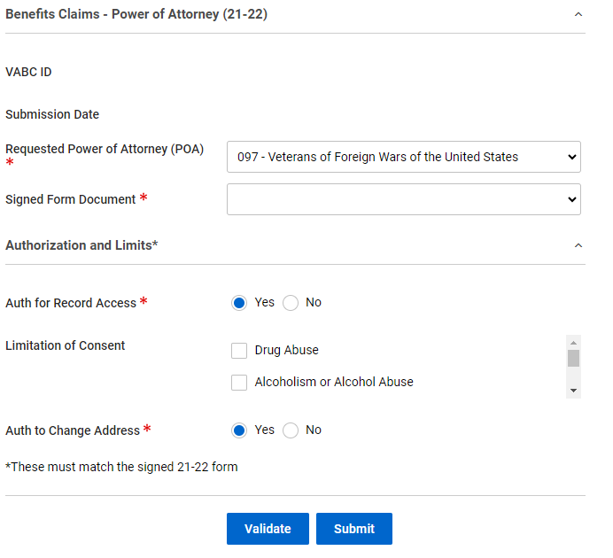
VA Benefits Claims 21-22 POA

Slide 9
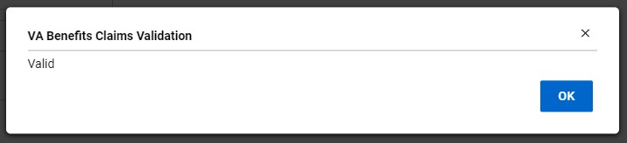

VA Benefits Claims 21-22 POA
Validate information
Submit

Slide 10
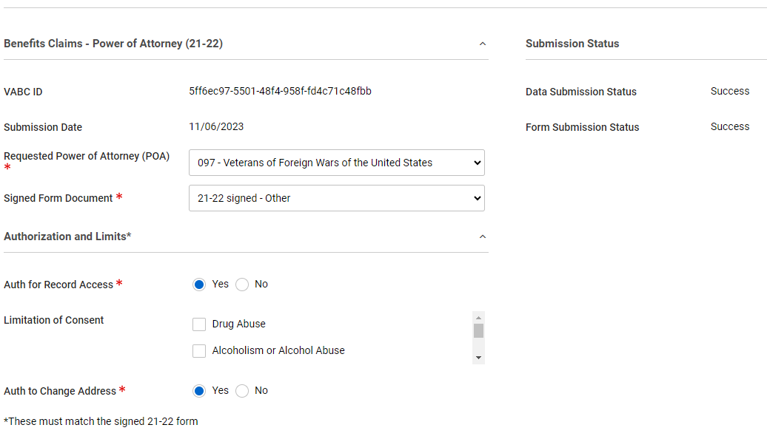
VA Benefits Claims 21-22 POA

Slide 11
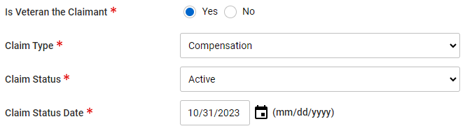

VA Benefits Claims 21-0966 ITF
VA Form 21-0966 Intent to File
Select the correct Claim Type
(Compensation, NSC Pension,
or DIC or Death Pension) and
complete the additional Claim Info required fields.
Select ITF (21-0966)

Slide 12
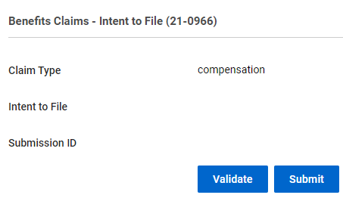
VA Benefits Claims 21-0966 ITF
VA Form 21-0966 Intent to File
Validate
Submit

Slide 13
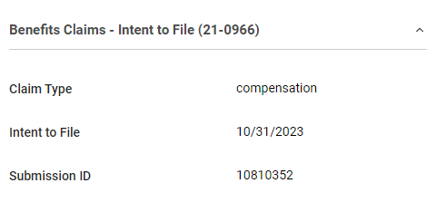
VA Benefits Claims 21-0966 ITF
VA Form 21-0966 Intent to File
After submitting the ITF
the screen will update to
show the submission date
and submission ID.

Slide 14
VA Benefits Claims 21-526ez
Benefits:
Claim will appear instantly in VBMS
No limit on number of characters to list disabilities
Known issues:
No option to select BDD as Claim Type
All attached documents will appear as Correspondence until relabeled by a VA employee

Slide 15
VA Benefits Claims 21-526ez
VA Form 21-526ez
Prior to using VABC to submit a 21-526ez, you must complete
Veteran’s Profile Information
Military Service Information
Medical Conditions
Direct Deposit Information
Claim Information
*VABC will allow you to submit without entering Direct Deposit Information

Slide 16
VA Benefits Claims 21-526ez
Prior to using VABC to submit a 21-526ez, you must complete the Veteran’s profile to ensure all questions on the application form are answered.
First and Last Name
Social Security Number
Date of Intake
Veteran Status
Currently a VA Employee
Expedited Flashes
Contact Information (Address must
be annotated as a mailing address)
Ever filed a claim with VA
Military Retirement Information
Severance / Separation Pay
Combat zone since 2001
POW
POA Organization Code (097)
Field Office and Assigned To

Slide 17

VA Benefits Claims 21-526ez
Prior to using VABC to submit a 21-526ez, you must complete the Veteran’s Military Service information to ensure all questions on the application form are answered.
Service Type
Dated Entered into Service
Place of Entry
Branch
Date Separated from Service
Place of Separation
Type of Discharge

Slide 18
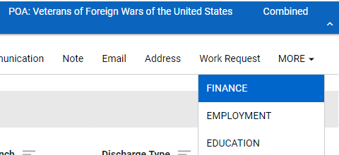
VA Benefits Claims 21-526ez
Adding Direct Deposit Info
From Veteran screen hover mouse over MORE and select FINANCE
Hover mouse over Direct Deposit and select New Direct Deposit

Slide 19
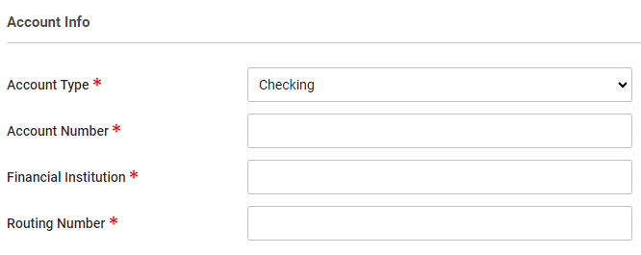
VA Benefits Claims 21-526ez
Adding Direct Deposit Info
Select Account Type
Complete required Direct Deposit information and save

Slide 20

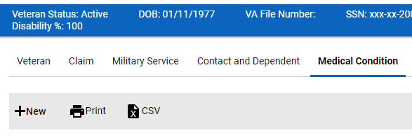
VA Benefits Claims 21-526ez
Adding Medical Conditions
Add disabilities under the Medical Condition menu by selecting +New.
Do not add Medical Conditions under the claim menu.
*Treatment information will not transfer if
Medical Condition is added through Claim Menu

Slide 21
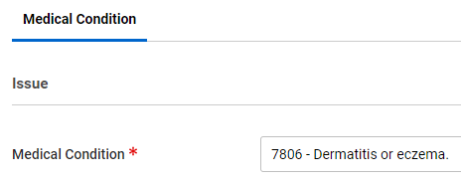
VA Benefits Claims 21-526ez
Adding Medical Conditions
Medical Conditions are in Diagnostic Code order
The Medical Conditions listed will be how they are listed in VBMS
The Diagnostic Code and hyphen will NOT appear
Example: This will show as “Dermatitis or eczema”

Slide 22
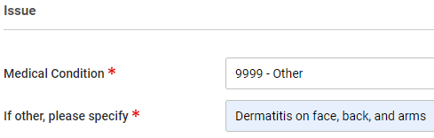
VA Benefits Claims 21-526ez
Adding Medical Conditions
Instead of trying to find the closest diagnostic code, select 9999 - Other
Type in the disability as you want it to appear in VBMS
Example: This will show as “Dermatitis on face, back, and arms”

Slide 23
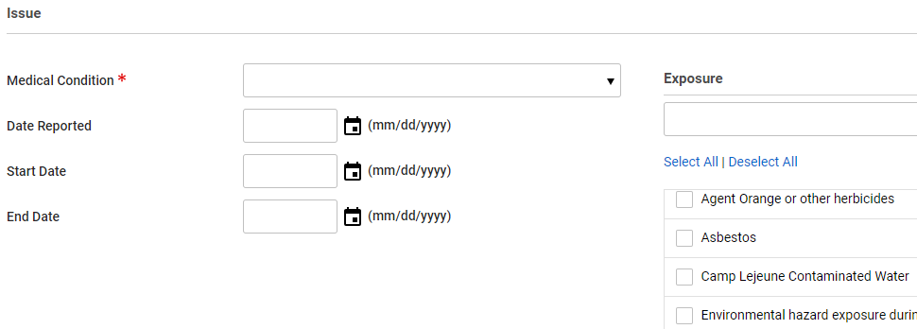
VA Benefits Claims 21-526ez
Adding Medical Conditions
Enter remaining information if known:
Date Reported
Start Date
End Date
Exposure Type

Slide 24
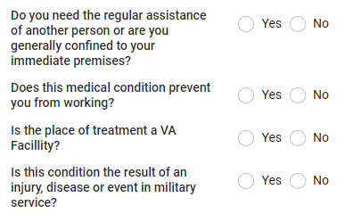
VA Benefits Claims 21-526ez
Adding Medical Conditions
Must answer four questions listed:
Aid and Assistance
Working
VA Treatment
Injury, Disease, or event in military service

Slide 25
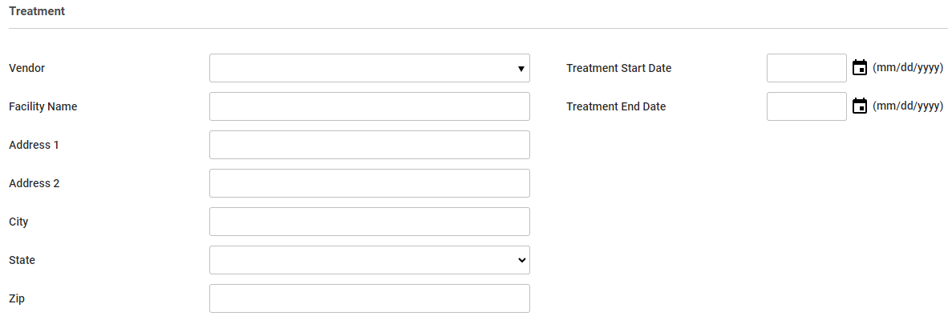
VA Benefits Claims 21-526ez
Adding Medical Conditions
Option to add Treatment Details:
Facility Name
Address
Start Date
End Date

Slide 26
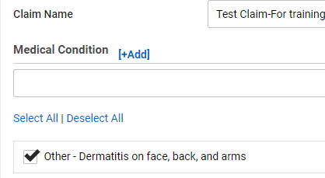

VA Benefits Claims 21-526ez
Adding Medical Conditions
From the Claim Menu select disability previously listed
Select Disability Compensation (21-526EZ)

Slide 27
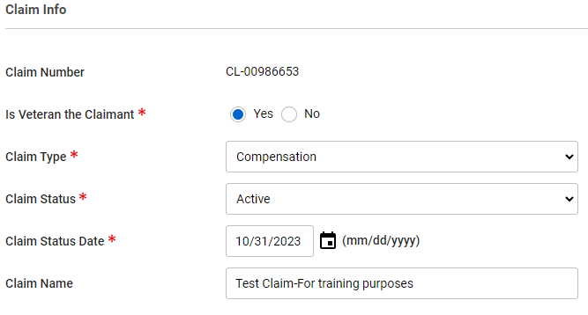
VA Benefits Claims 21-526ez
Is Veteran the Claimant
Claim Type
Claim Status Date

Slide 28
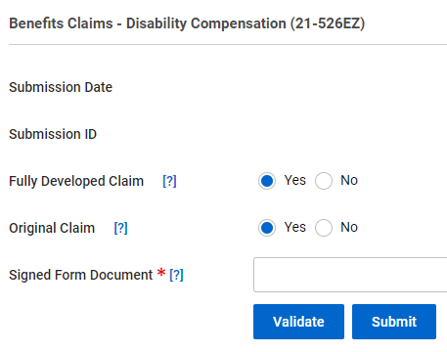
VA Benefits Claims 21-526ez
Fully Developed Claim?
Original Claim?
*Original Claims must have a 21-526ez uploaded with claimant’s signature
*Claim Type must match the
21-526ez

Slide 29
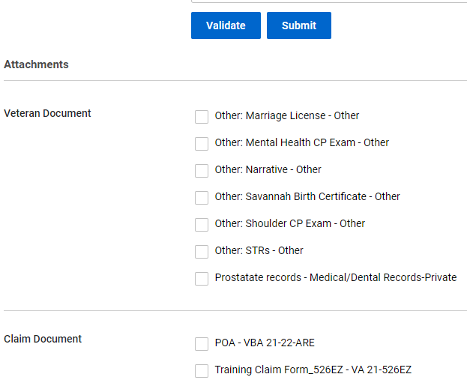
VA Benefits Claims 21-526ez
Select previously uploaded documents
Validate
Submit

Slide 30
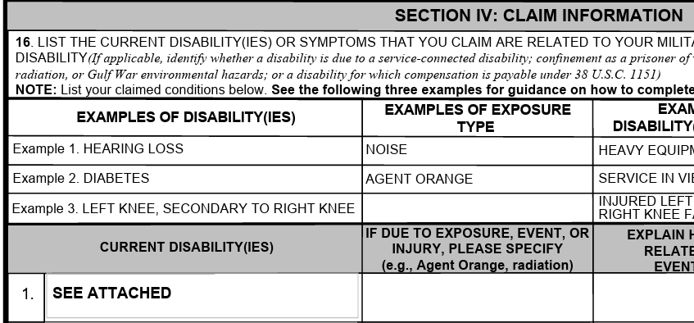
VA Benefits Claims 21-526ez
The 21-526ez will appear similar to claims submitted through VA.gov and will receive a VA.gov electronic date.

Slide 31
VA Benefits Claims
Questions?

