Slide 1
TVB Claims Management System

Slide 2
Lesson Objectives
TVB Home Screen click and explain each tile and column button
Creating a new veteran folder
Tabs in the veteran’s folder
The claim submission process

Slide 3
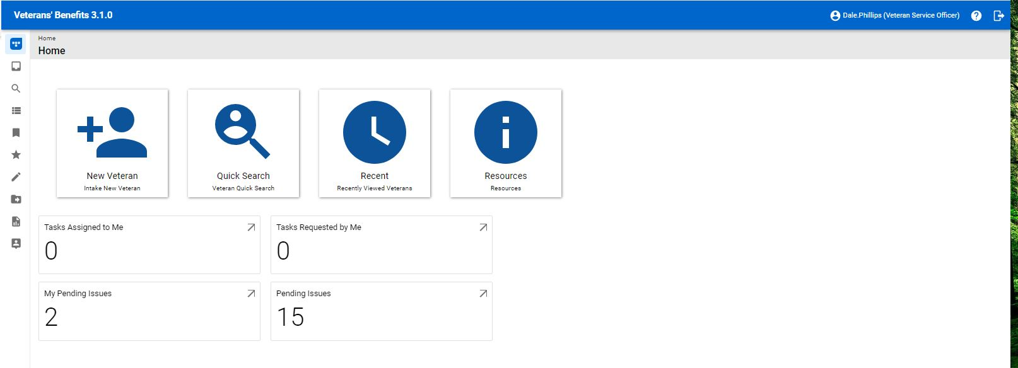
TVB Home Screen New Veteran
The New Veteran Button is used to create new veteran folders

Slide 4
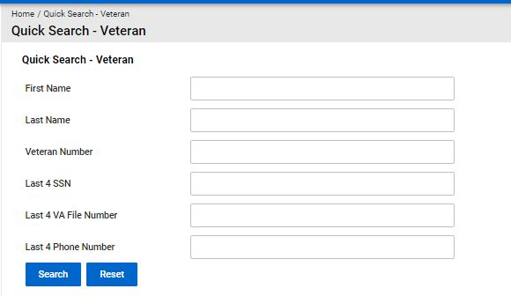
TVB Home Screen Quick Search
The Quick Search function allows you to search for veteran folders

Slide 5
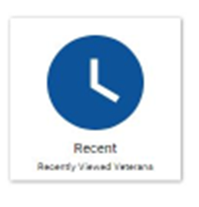
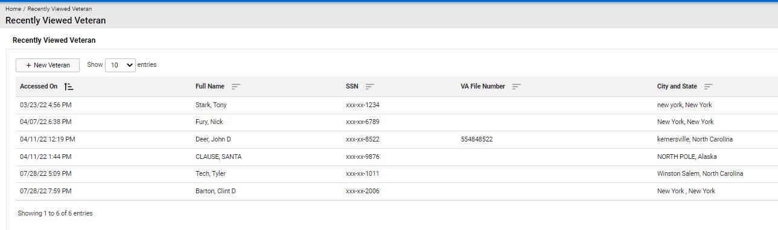
TVB Home Recent
The Recent function takes you to a listing of recent veteran folders you visited

Slide 6

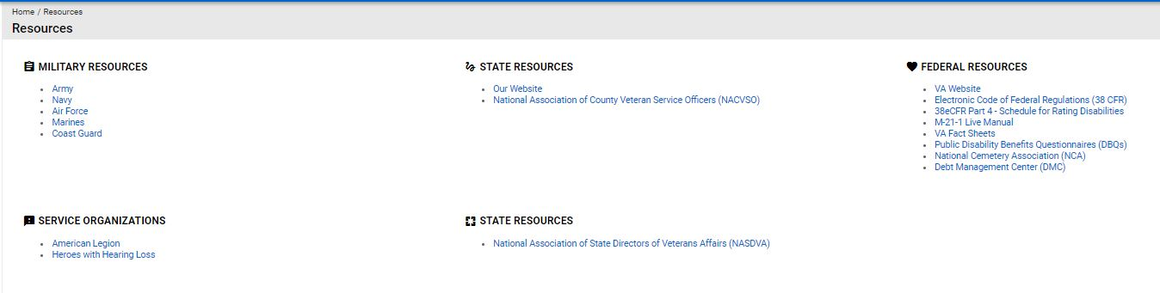
TVB Home Resources
The Resources function takes you to a listing of DOD and VA resources

Slide 7
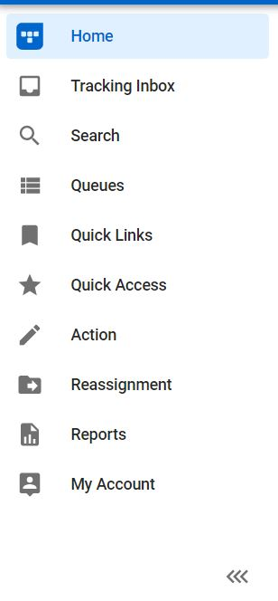
TVB Home Screen Columns
The home screen displays a column with icons. To expand this to show what each icon is named, click on the arrows marked below.

Slide 8
Adding a new Veteran
To add a new veteran from the home screen you will need to click on the icon that says:
“+ New Veteran”

Slide 9
Things to consider when adding a veteran
Not all the fields are required to create a record, but it is encouraged to fill out all applicable fields because:
Missing fields on veteran screen = missing fields on future claim forms submitted from TVB
If you omit the contact information, you may not be able to contact your veteran
The data will need to be captured at some point; capture it correctly in the beginning.
The more data you capture, the easier it is to track trends and search for specific situations
The data is only as good as the data entered “Garbage in Garbage out”

Slide 10
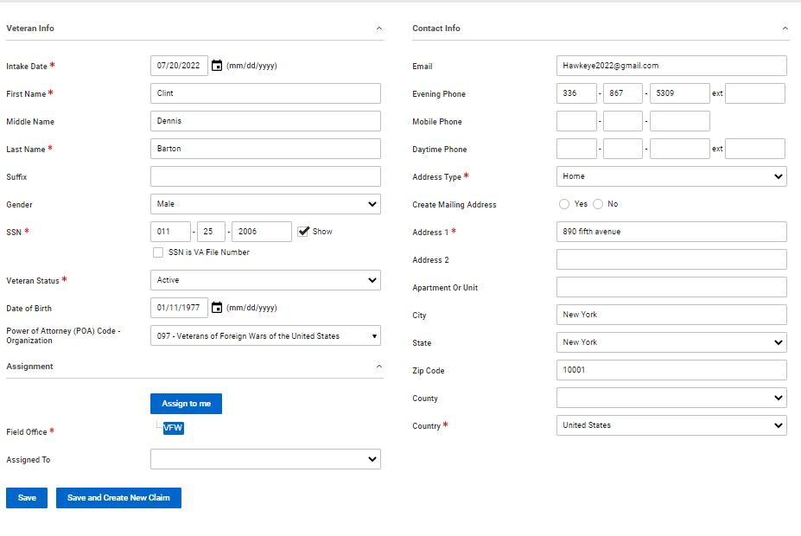
What to do with a completed veteran folder
Once all information is added for the new veteran you will be given two options
Save
Save and Create New Claim

Slide 11
Proceeding down the “Save” Path
Once in a Veteran’s folder, you will see a header with tabs that take you to other aspects of the veteran’s folder.
Special Note** When clicking a tab, to enter data into the corresponding section, you must click +New
Claim
Military Service
Contact and Dependent
Medical Condition
Document
Communication
Note
Email
Address
Work Request
Finance
Employment
Education
Previous Marriage
Other Names Served
Audit Log

Slide 12
Tabs in the veteran’s folder
Claim: Used to submit a claim through TVB
Military Service: Documents military service
Contact and Dependent: Captures dependent information
Medical Condition: Will be used to enter and track conditions to assist with claim submission. Currently not active – will be active in a future update
Document: Houses the veteran’s documents
Communication: Used to enter a communication about veteran
Note: For general use
Email: TVB can compose and send an email from the program but cannot receive email.

Slide 13
Tabs in the veteran’s folder
Address: Used to capture veteran’s address
Work Request: Used to assign a claim or action from one VSO to another
Finance: Captures veteran’s financial records
Employment: Captures veteran’s employment records
Education: Captures veteran’s education records
Previous Marriage: Captures veteran’s previous marriage
Other Names Served: Captures veteran’s aliases
Audit Log: Provides a history of actions taken by account users in the veteran’s folder

Slide 14
Tabs in Veteran Folder: Medical Condition
The current version of TVB has entry-level steps for Application Programming Interface (API) using the Medical Condition Tab.
Currently, this API is not ready for use but once it is, we will release training material on how to utilize this advanced functionality.

Slide 15
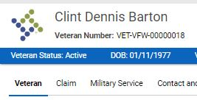

Submitting a claim to VA using TVB
Once you have your veteran folder opened, you will need to click on the Claim tab at the top.

Slide 16
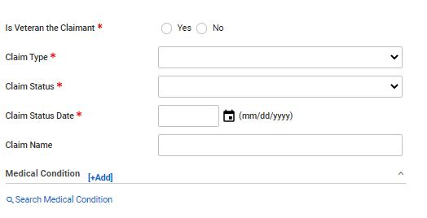
Submitting a claim to VA using TVB
Once you have clicked on the Claim tab you will enter in the required information:
Is Veteran the claimant?
Claim Type: Compensation, DIC, Education, NSC Pension etc.
Claim Status: Active, Closed, Pending, HLR, Remand etc.

Slide 17
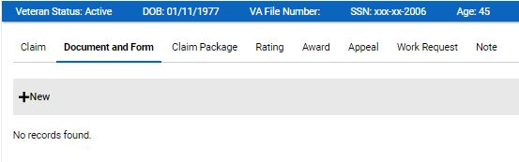
Submitting a claim to VA using TVB
Once you have saved you click, “Document and Form”
Underneath it click +New

Slide 18
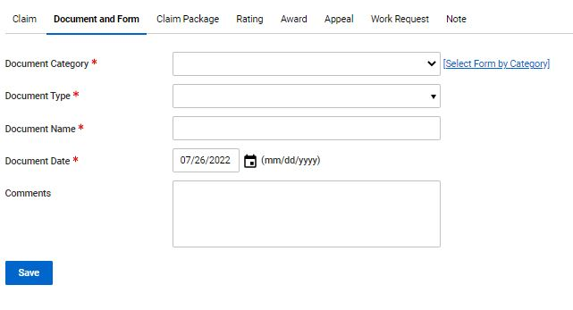
Submitting a claim to VA using TVB
Pressing +New takes you to this page where you will fill in the required fields
Document Category: Forms, General Correspondence, Other
Document Type: If Forms was previously selected VA Forms Populate this section
Document Name: does not auto populate
Document Date: This auto-populates to today’s date.

Slide 19
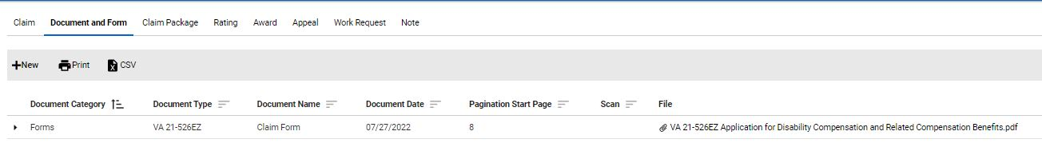
Submitting a claim to VA using TVB
Once the form has been generated, TVB will redirect you to the “Document and Form” Page and display your recently completed form.

Slide 20
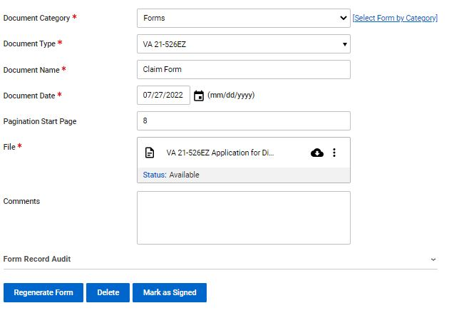
Submitting a claim to VA using TVB
With the required fields completed, move your mouse over the 3 circles and click “Edit”

Slide 21
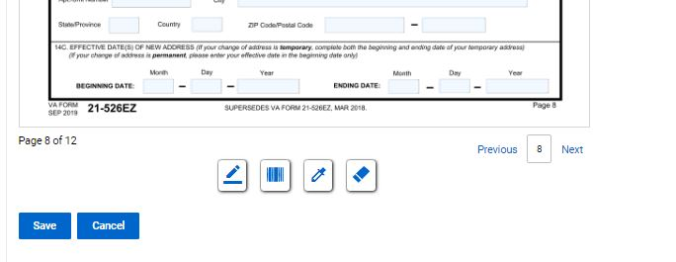
Submitting a claim to VA using TVB
At the bottom of the page you will see 4 symbols:
Add Signature Add Barcode Highlight Redact

Slide 22
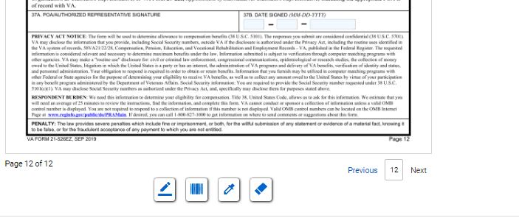
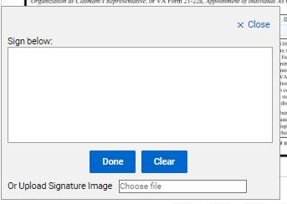

Submitting a claim to VA using TVB
Once the form is complete, it will need to be signed. To do this click “Add Signature” which will pop up the signature box.
In the signature box you can either manually create a signature using your mouse or upload a signature image. Once finished click save.

Slide 23

Submitting a claim to VA using TVB
Once the signed document has been saved, Click
Mark as Signed
Once the document has been marked as signed, no edits on the signed form can be made. You will need to hit Save and move on to the next step in the claim process

Slide 24
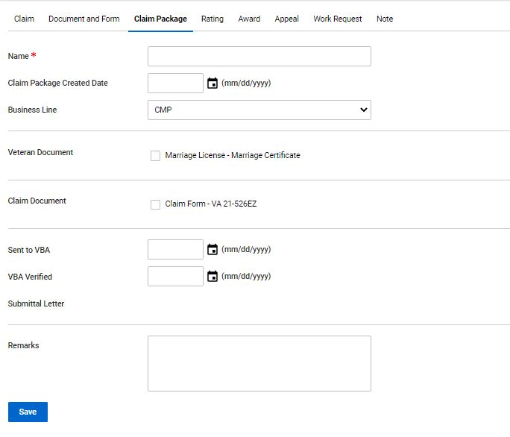
Submitting a claim to VA using TVB
On this screen you will need to enter in the following:
1) Name of the claim
2) Claim Package Created Date
3) Select the Business Line
4) Select all documents you want sent to VA
5) Select the date you sent the claim to VBA
Press Save

Slide 25
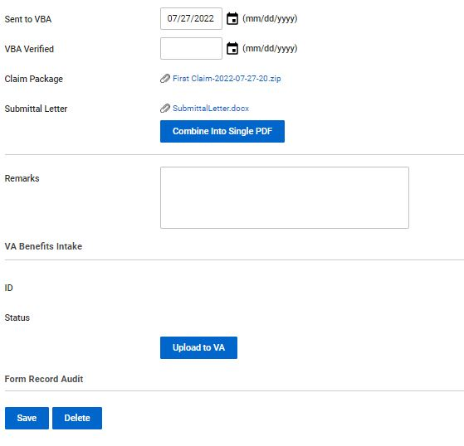

Submitting a claim to VA using TVB
Once saved you can view the changes prior to uploading the package to VA.
One thing to note is TVB will create a Submittal Letter which you can view. Once everything has been verified press “Upload to VA”

Slide 26
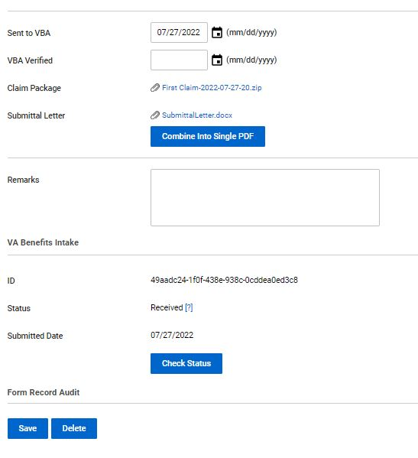

Submitting a claim to VA using TVB
After the claim is submitted you can check the status by clicking “Check Status”
Once the status shows received the effective date is preserved.

Slide 27
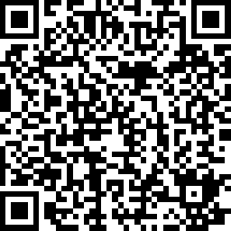
2023 Proficiency Training Conference Survey
Class: TVB Practical
Please scan the QR Code or click on the link below to take an anonymous survey about your experience during the 2023 Proficiency Training Conference.
https://www.research.net/r/DJ2F9W8

