Slide 1
BDD Exam Overview
Tony De Falco, Vice President of International Operations
Chris Ryan, Director of Operations-Predischarge

Slide 2
Agenda
Introductions
About Maximus and Veterans Evaluations Services (VES)
Compensation & Pension (C&P) Examination Overview focused on BDD
Q&A Session

Slide 3


Acquired VES in May of 2021
Largest provider of government-sponsored benefit appeal programs in the U.S.
Over 40 years of experience supporting the Government and communities with critical health and Veteran’s care programs
Headquartered in Tysons Corner, Virginia (Metro Washington, DC)
Founded by a Veteran as MES Solutions in 1978
Assisting the V.A. since 2008 with medical disability exams for active-duty service members and Veterans around the world
Headquartered in Houston, Texas

Slide 4

Mission Statement
To honor and serve America’s Veterans and Active-Duty Claimants by providing quality and timely reports through fair and objective evaluations performed by trained professionals in a respectful and hospitable environment.

Slide 5


VES Overview
1 million Veterans served in 2021 & 2022
20,000 exams delivered on average each week
6,500+ global network of clinicians
In all 50 states, D.C, and the five US Territories, plus over 40 countries around the world, and on four military bases.
3,000+ locations in the U.S including 40+ VES clinics and 4 mobile units
800+ international locations
90%+ satisfaction rating from Veterans about their exam experience
Notes:
Maximus acquired VES in May of 2021
Clinicians specialize in general medicine, psychology, psychiatry, neurology, neurosurgery, PM&R/physical medicine and rehabilitation, ophthalmology/optometry, dentistry, and audiology to meet many medical disability exam needs.
Website: https://www.ves.com/

Slide 6
Compensation & Pension (C&P) Examination
A C&P exam is a medical examination as part of the VA disability rating process.
The exam determines if a Veteran’s disability is service-related, and if so, how severe.
The exam can be performed by a VA provider or VA C&P exam contractor like VES.
C&P exams are not complete physical evaluations or treatment, they are a series of questions, records reviews, and diagnostic testing to determine the scope/severity of the claimed disability to provide a quality and ratable C&P exam.
The Dept. of Veterans Affairs makes the rating based off of the C&P exam; VES does not issue Veteran disability ratings, that is only a VA function.
BDD is a claim for disability benefits filed 180 to 90 days before leaving the military. This may help speed up the claim process so Vets can often get benefits sooner.
Notes:
A C&P exam is a medical examination scheduled by the VA as part of the disability rating process.
The C&P exam is to determine whether a Veteran’s disability is service-related, and if so, how severe it is.
Examples of service-related disabilities include PTSD and depression, hearing loss, musculoskeletal injuries, and any other disability acquired during your military service.
The C&P exam is performed by a VA general physician; VA C&P exam contractors, like VES C&P exam contractors; or a VA partner. Secondary exams performed by specialists may be necessary if the veteran’s disability is related to dental or psychiatric health.
C&P exams are not complete physical evaluations, nor are they aimed at providing you with a diagnosis or treatment options. Instead, they’re a series of questions intended to shed light on the scope of your disability to provide you with adequate benefits and pension plans.

Slide 7
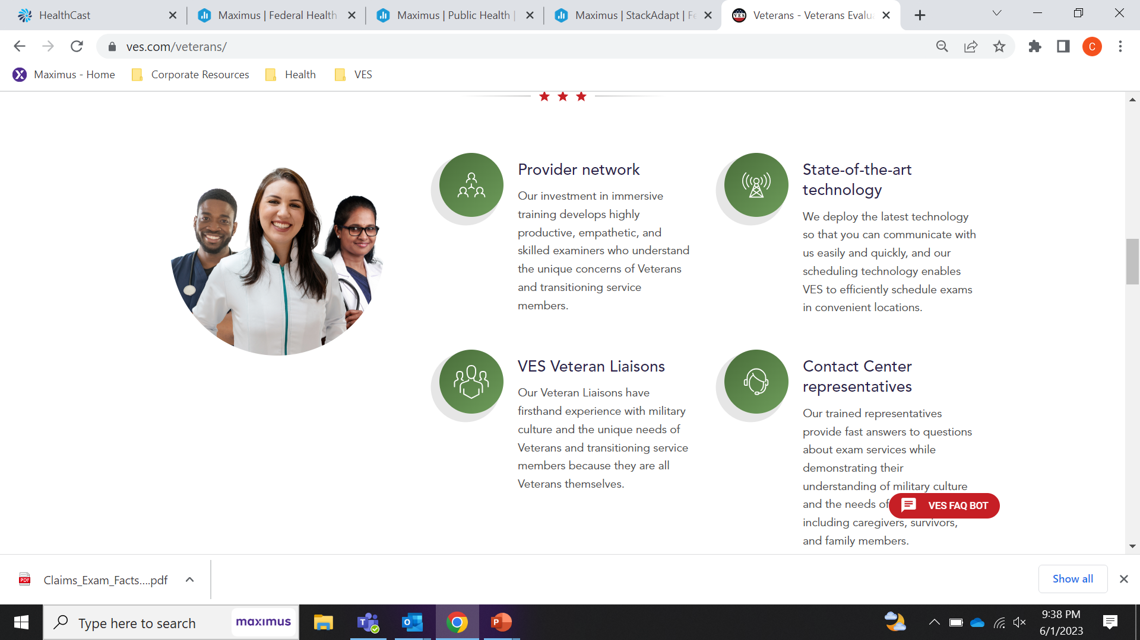
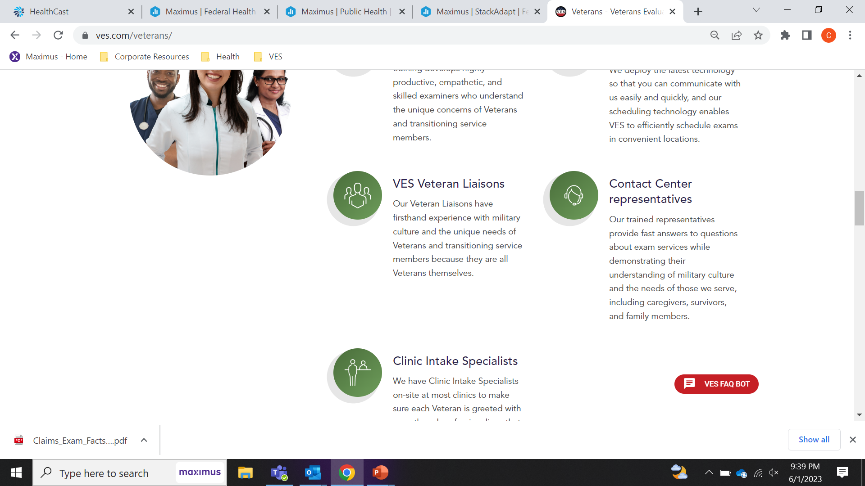
How We Support the Veterans and Transitioning Service Member Experience

Slide 8
How We Support the Veterans and Transitioning Service Member Experience With Our Unique Veteran Liaison Team
We want all of your feedback! Use the independent feedback cards.
Phone, web, and email available. ASK FOR THE LIAISON TEAM!

Slide 9
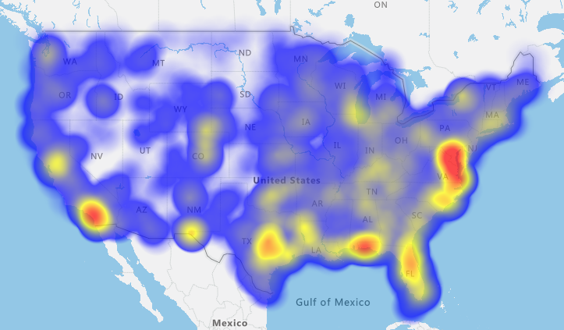
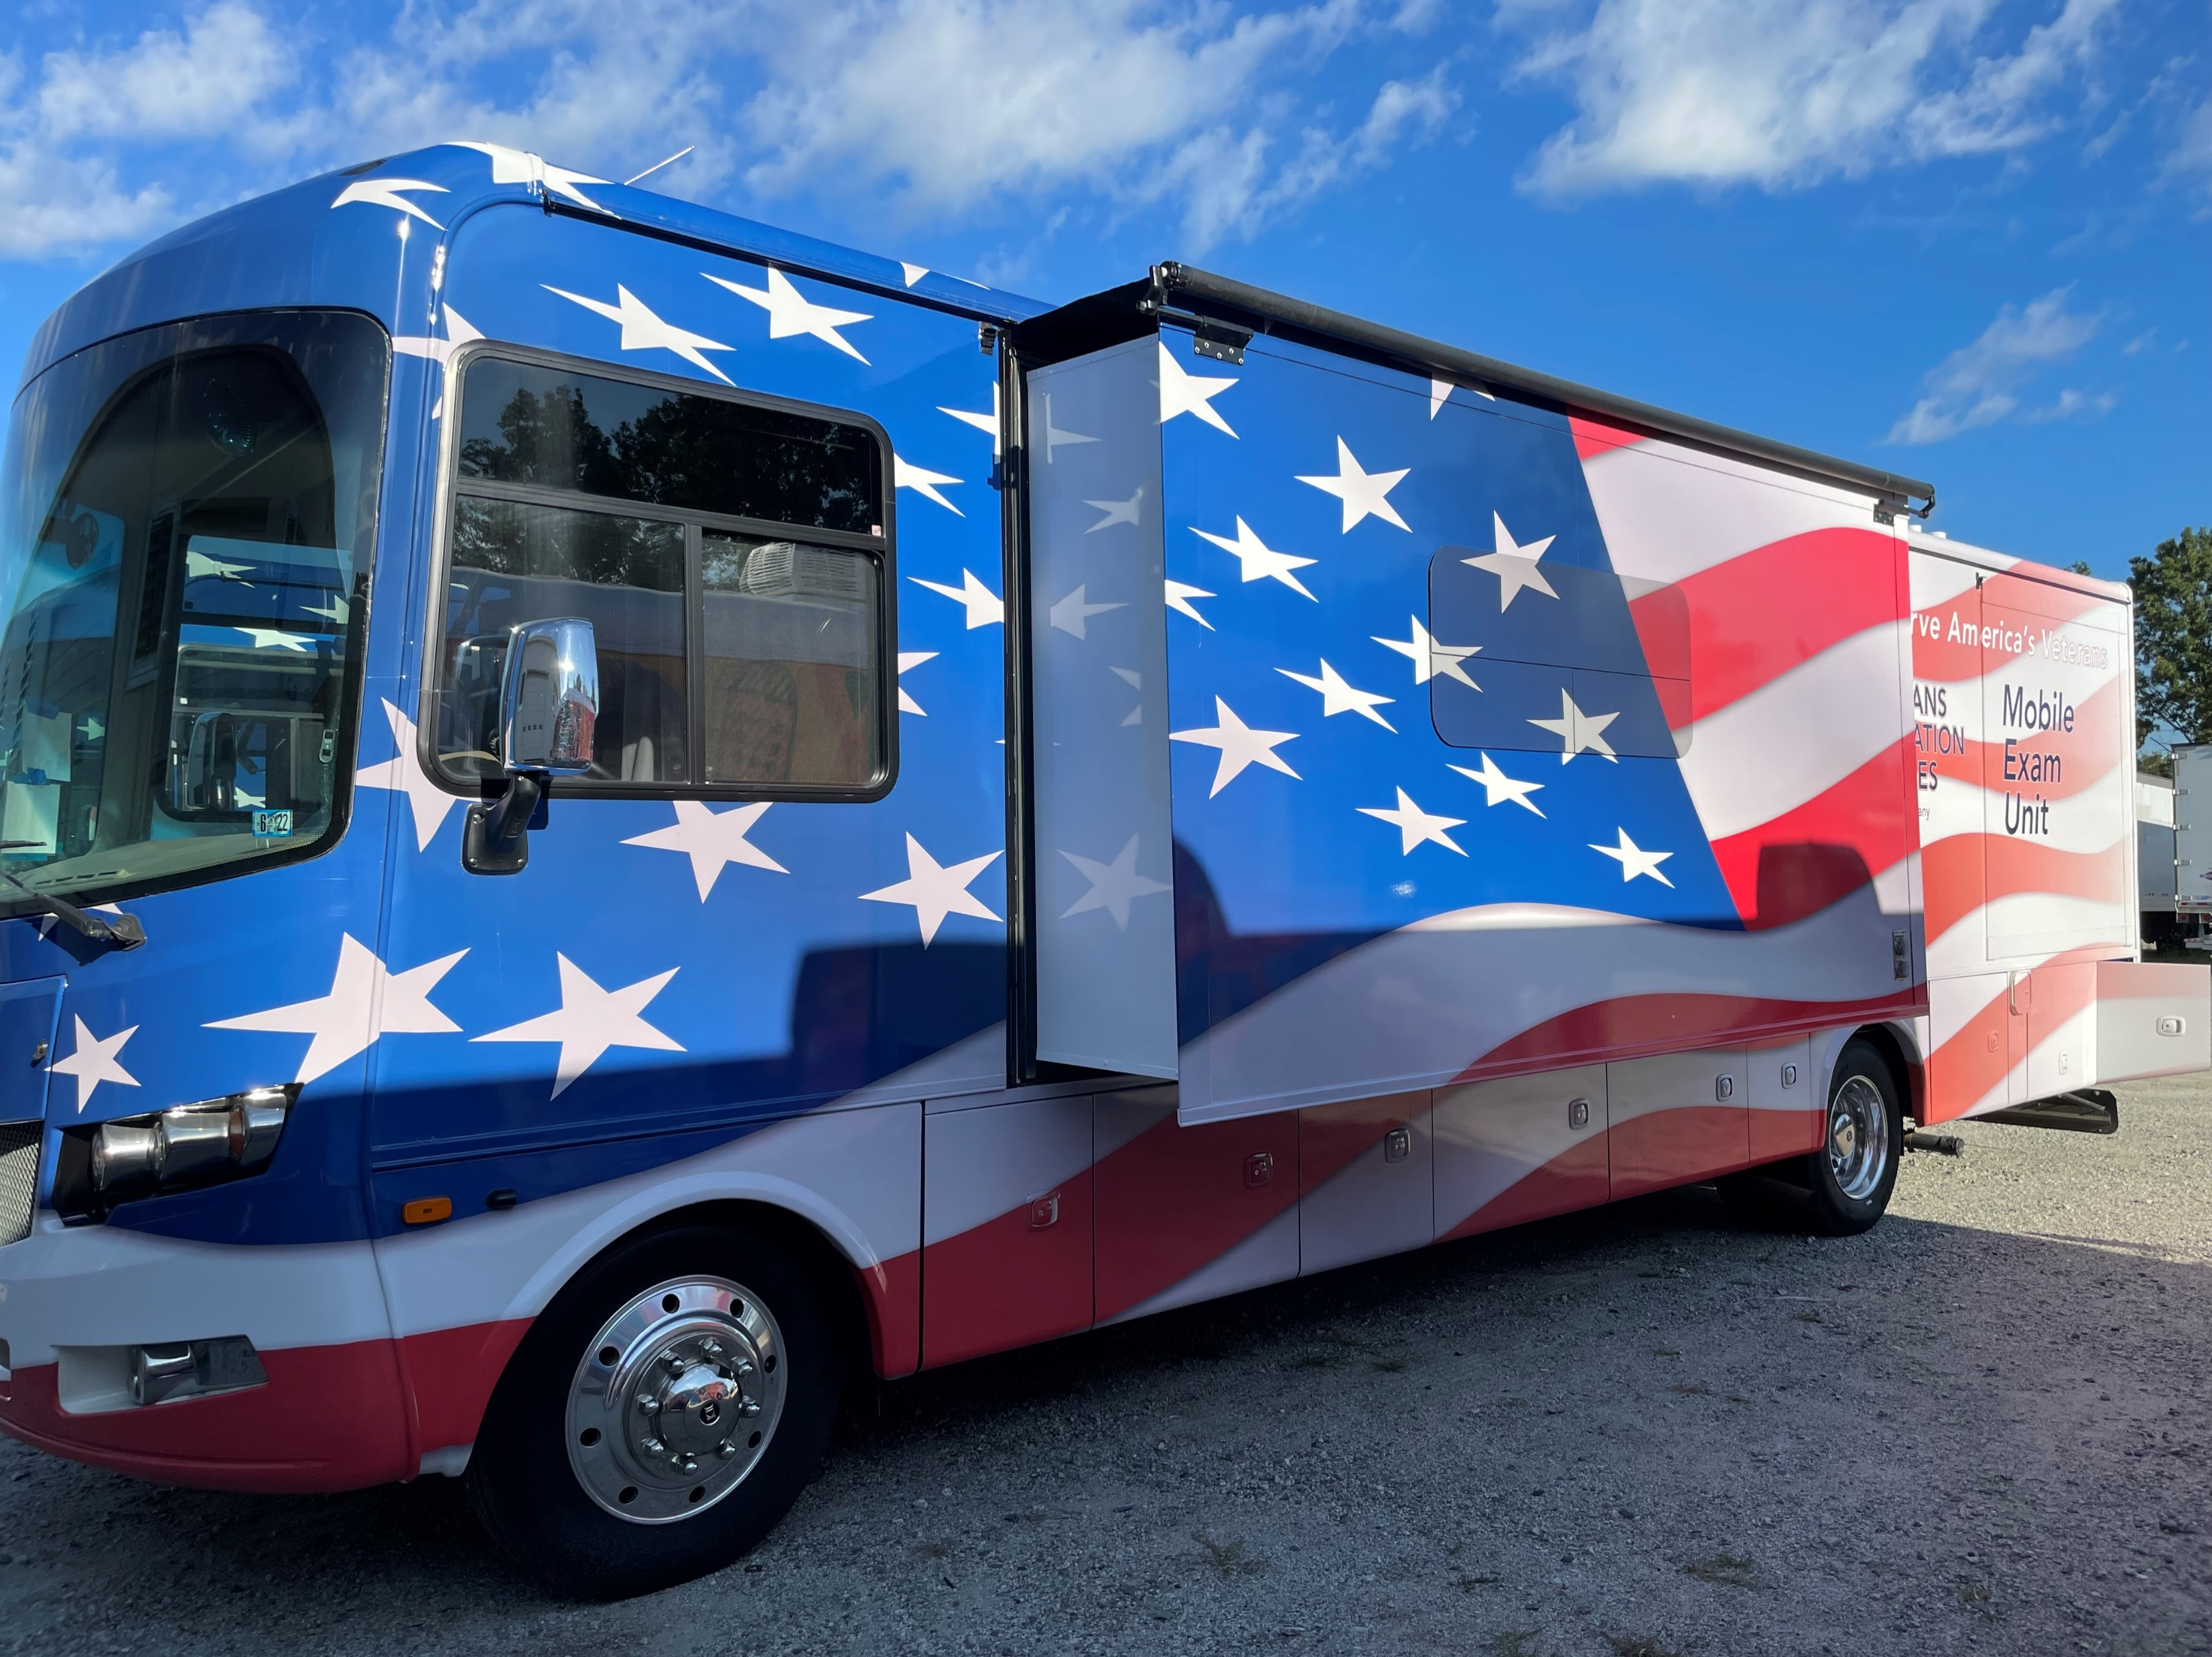
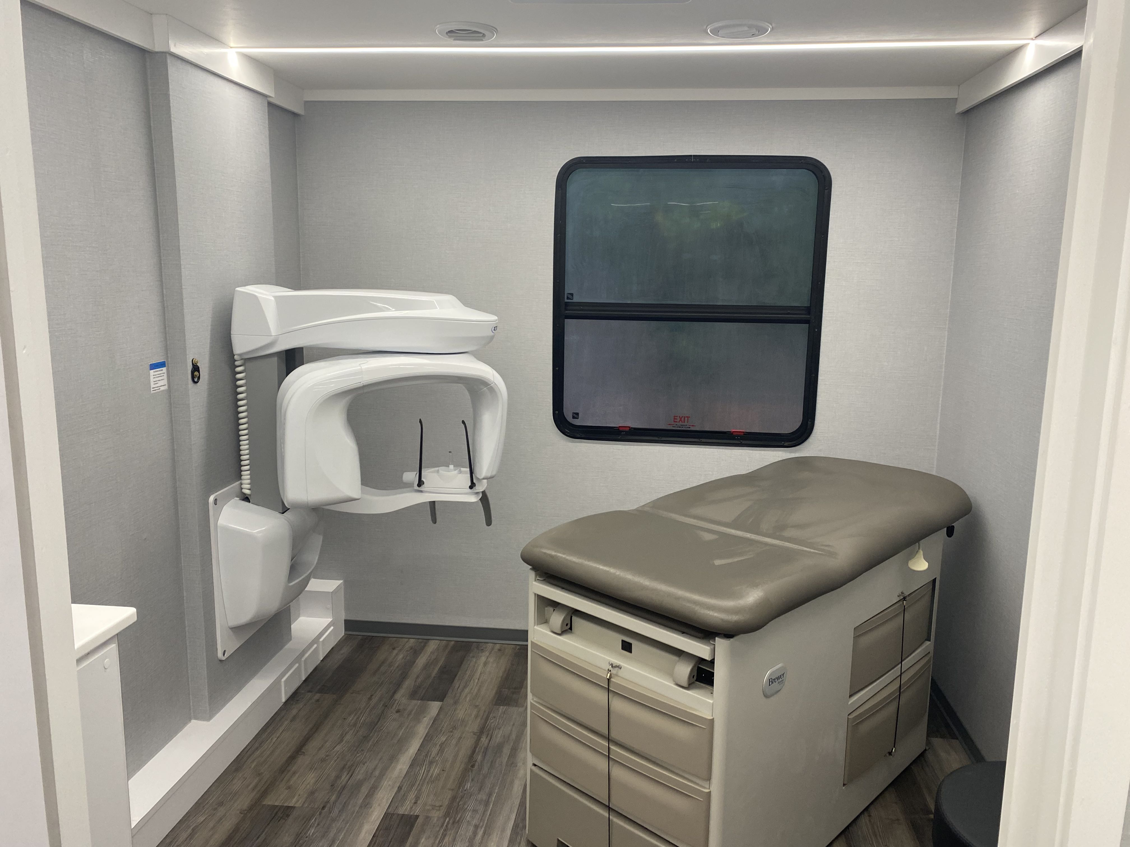
Supporting Equitable Access to Professionally Trained Clinicians
  Efforts are made to balance timeliness with convenience to Veterans and Service Members
  A clinician travel team and 4 mobile units deploy to decrease Vet mileage in remote areas
  Locations with higher average mileage are a focal point for clinician recruiting efforts
  140+ intakes in local communities and 8 RCMs in the field to ensure a positive Vet experience, give VES local knowledge, and assist providers.
  VES is always hiring around the country!
Recent heat map of exam locations and volume

Slide 10



What Happens During a C&P Exam?
Reviewing Your File
In most cases the provider will review your full medical claim file either before or after the appointment.
Your file is reviewed before and after as additional diagnostic testing may be ordered.
Physical Assessment
The provider will ask a series of questions and provide observations based on your conditions to assist in completing the DBQ for that claim.
As least as likely as not is a phrase you might hear or see (tie goes to the Veteran)
The pprovider will use the information to complete your C&P exam DBQs to submit to the VA. VES QCs every report.
Length of the Exam
C&P exams vary in length from 15 minutes for a basic scar exam or up to an entire day based on claimed conditions.

Slide 11

What Happens After the Exam?
The physician/provider prepares a report that includes information on your medical history, current symptoms, and severity of symptoms along with a professional opinion about your disability and whether it is or is not service related.
VA Quality Analysts QC Review every single report
The report and any testing is submitted securely to the VA Regional Office where the claim is then processed and rated by VA.
The VA reviews all the evidence and assigns a VA assignability rating.
It is VA staff (often an RVSR) at the VA Regional Office that makes the determination about your eligibility for disability benefits – not VES nor the VES physician/provider.
The C&P exam is a key piece of data in the decision-making process, though the RVSR bases the decision on all evidence submitted for a claim so other records could be reviewed by VA as part of the process.
VA is the sole legal custodian of records, not contractors. VES cannot give out any copies of reports (Some diagnostics are given if a critical finding occurs.)

Slide 12
Some FAQs
-What if I cannot make my BDD?
-Why can’t you use my doctor down the street?
-Why can’t you look at all the files and reports I brought to my exam?
-When will I get my travel pay?
-Why didn’t I get my hearing aid at my exam?
-Why am I not seeing a specialist?
-Why can’t you look at my insert-body-part-here claim also?
-Can you use my recent X-ray/MRI/Just had done?
-How do I get a copy of my exam? (Hint-only from VA)
-Is the exam really on a Saturday/Sunday?
-Do you provide transportation?
-The doctor/provider is not at the location anymore/Travel docs/Portability act?

Slide 13
Learn more via www.VES.com
Contact:
Tony De Falco
Vice President, International Services
Tony.DeFalco@VESservices.com
Chris Ryan
Director, Operations Pre-discharge
Chris.Ryan@VESservices.com
1-877-637-VETS (8387)
Thank you for your time and service!

