Slide 1

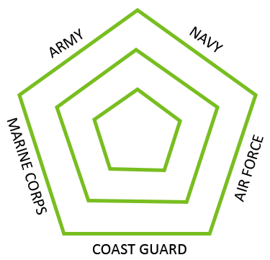


Veteran Healthcare & Partnering with Humana
Lifelong well-being for Veterans and their families

Slide 2



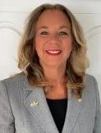
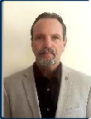
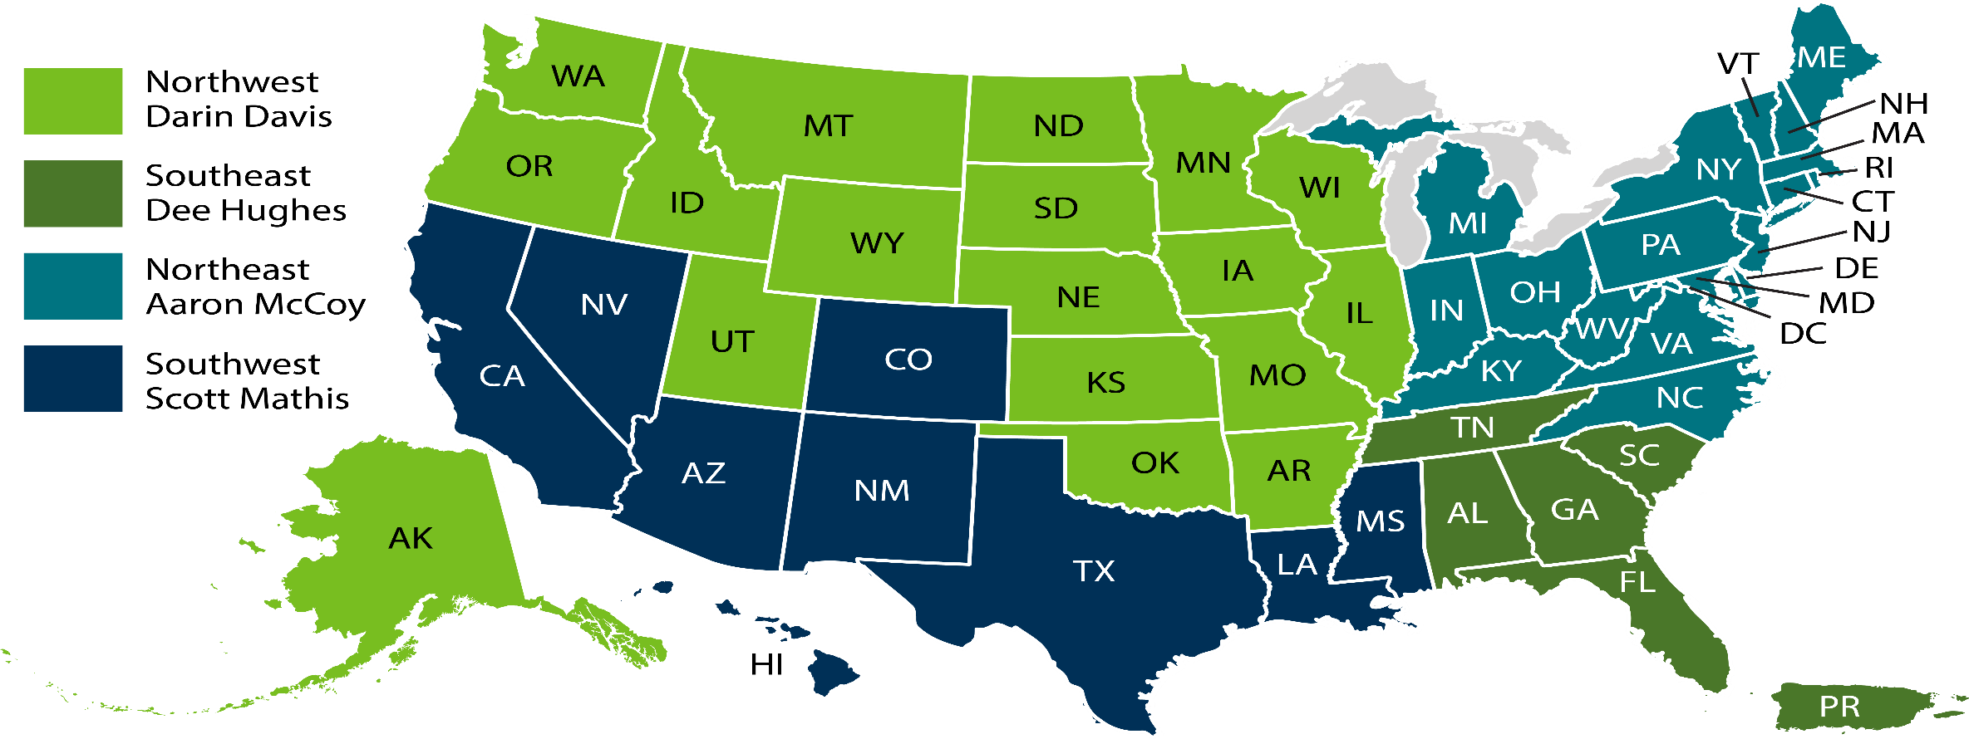
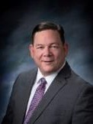


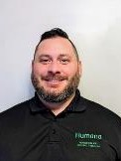

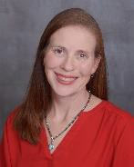
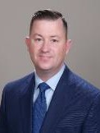

Regional Veteran Executives
Veteran Community Engagement Executives
Darin Davis
RVE
Northwest
Scott Mathis
RVE
Southwest
Aaron McCoy
RVE
Northeast
Dee Hughes
RVE
Southeast
George Vukovich
VCEE
OH
Dave McNeil
VCEE
NV/Southern CA
Megan Regan
VCEE PA
Ron Williams
VCEE AZ
Andy Zinkievich
VCEE NC/VA
Andrea Ortiz
VCEE
West TX
Beth Blume
VCEE KS/MO
Tim Delaney
VCEE IL
Allen Carey
VCEE
Orlando/Tampa
| 2
*For internal use only

Slide 3




Veterans
Large population, unique needs
8.5M
Veterans 65+
4.1M
VA Enrollees
Coverage gaps
Dental coverage
Access to non-VA Providers
National VA, Humana research
| 3

Slide 4
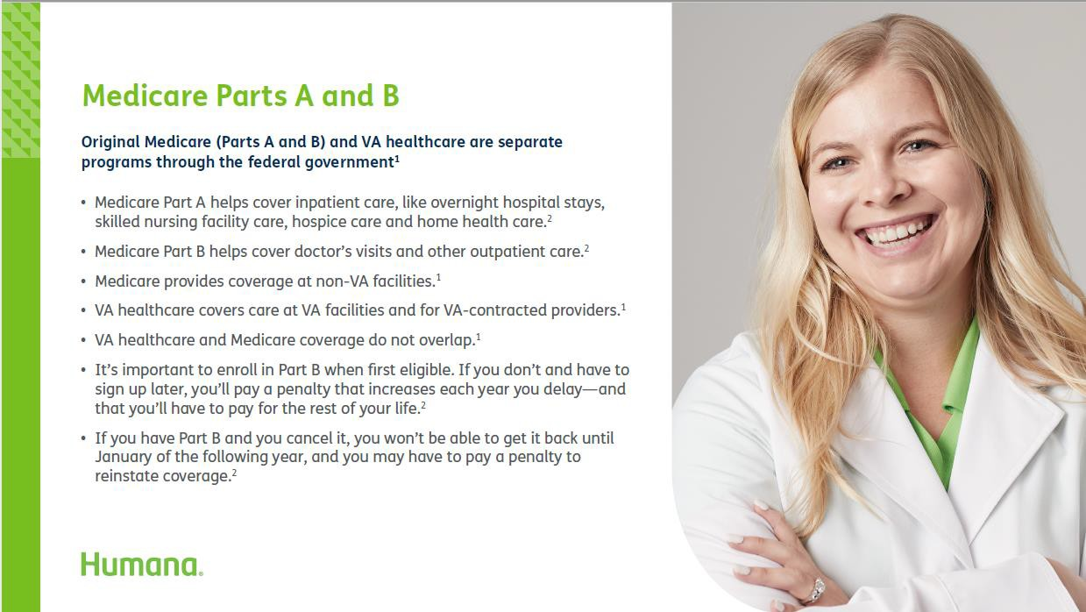
https://www.va.gov/health-care/about-va-health-benefits/va-health-care-and-other-insurance/

Slide 5
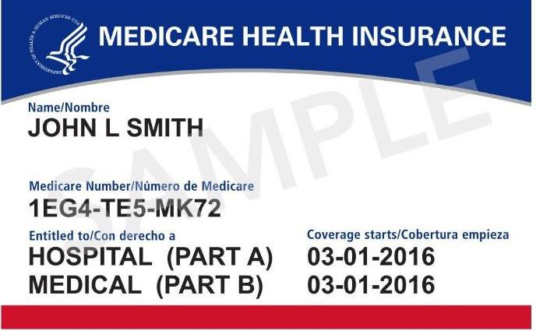
I have VA Healthcare, why take out Part B?
Some Veterans consider opting out of Part B, to avoid paying the Part B premium. If they need to apply for Part B after their Initial Enrollment Period (IEP), they may pay a penalty because the VA Healthcare is NOT creditable medical coverage for Part B of Medicare (VA healthcare is creditable coverage for Part D of Medicare)
“VA does not recommend Veterans cancel or decline coverage in Medicare (or other health care or insurance programs) solely because they are enrolled in VA health care.”
In order for a Veteran to get a Medicare Advantage plan, the person has to have Medicare Part B.
Medicare Part B and Medicare Advantage plans provides Veterans with more health care
options.
VA and Medicare Advantage do NOT interfere with each other nor do they coordinate benefits. The VA does not file claims with Medicare (Parts A, B or C). The VA is a provider, but is not health insurance.
https://www.va.gov/healthbenefits/resources/public ations/hbco/hbco_va_other_insurance.asp#:~:text=U nder%20Medicare%20Part%20B%2C%20VA,be%20pr ovided%20through%20an%20employer.&text=VA%2 0does%20not%20recommend%20Veterans,enrolled
%20in%20VA%20health%20care.
https://www.va.gov/health-care/about-va-health-benefits/va-health-care-and-other-insurance/

Slide 6


Benefits of Medicare Advantage
Obtain coverage for emergency services provided by non-VA providers
The combination of VA Health Care and a Medicare Advantage Plan provides the most options.
Choices and access to more providers, second opinions and RX formulary options
Potential savings opportunities
Plan extras

Slide 7
Benefits Continued:
The Plan is $0 premium and offers a Part B giveback (premium reduction/depends on market).
MA/MAPD plans may provide Medicare-eligible veterans with
additional health care services and location options.
MA/MAPD may give veterans transportation which can be used to attend appointments at the VA or with VA community providers
MA/MAPD may give veterans access to dental coverage.
MA/MAPD plans offer a broad network, including Urgent Care access.
Anyone with Medicare Parts A and B and not only veterans can enroll in any MA/MAPD plans
Veterans can choose and enroll in any MA/MAPD plans
The combination of VA Health Care and a Medicare Advantage Plan provides the most options.

Slide 8

TRICARE for Life, CHAMPVA & Medicare
Must enroll in both Part A & B of Medicare as soon as they are eligible
Generally, should have no out-of-pocket costs for services covered by both Medicare and either TFL or CHAMPVA
Billing between TFL or CHAMPVA and Medicare should occur automatically
Both TRICARE for Life and CHAMPVA already provide creditable drug coverage
| 8

Slide 9
Humana as a resource
Connect with your local Humana representative to have a resource for all Medicare questions
Humana agents can meet with veterans on the phone or in person
You can email VeteransChannel@humana.com if you don’t know
who to contact
| 9

Slide 10

Humana and NVS
How to partner with Humana in your Community
| 10

Slide 11
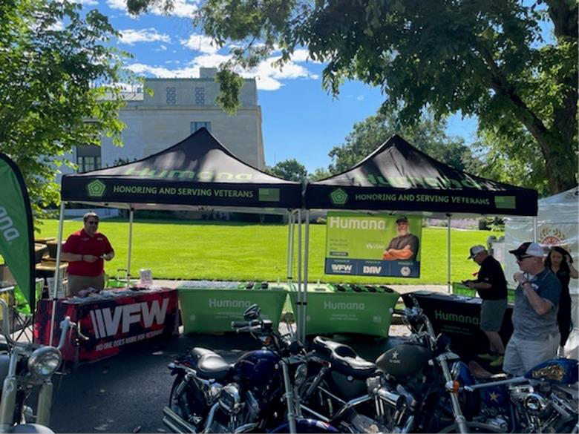
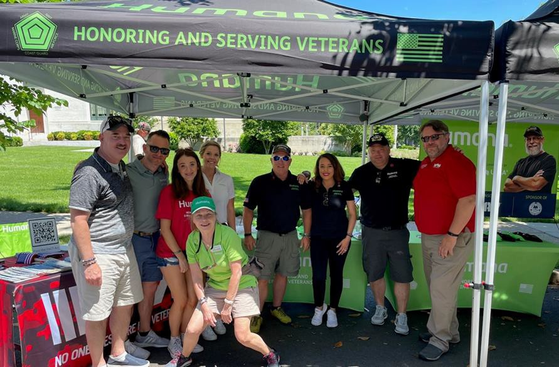
Attend Humana Events:
Humana attends and helps coordinate many veteran events throughout the year
Having a VSO on-site ensures that we have a subject matter expert on veterans' benefits
We often work with veterans that have not sought out their earned VA benefits
Confidential/For Agent Use Only
| 11

Slide 12
Help Humana with Education
Our teams work to train agents across the country throughout the year
Humana contracts with over 50,000 agents across the country
Many of our agents are not familiar with VSOs and all they do for veterans
Having a VSO attend our agent trainings helps agents understand what a VSO does and when to refer their clients to you for assistance
Confidential/For Agent Use Only
| 12

Slide 13
Utilize Humana locations:
Humana has Neighborhood Centers and Retail Locations throughout the U.S
VSOs can utilize Humana locations for meeting with veterans which may be more convenient in some communities
Humana Locations have been donated for VFW (and other Veteran Organization) meetings, where space permits
Confidential/For Agent Use Only
| 13

Slide 14





















































































Why veteran health goes beyond the exam room

Slide 15
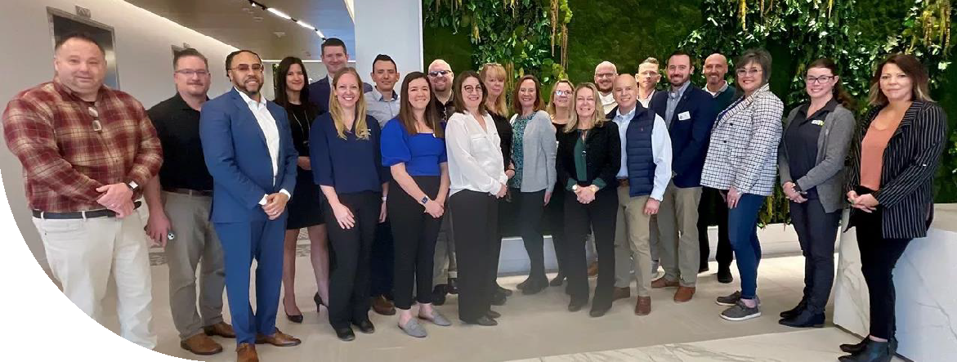










Connectors, conveners, catalysts for change in improving the health of Veterans and their families
COLLECTIVE IMPACT APPROACH
IDENTIFY Barriers
CO-CREATE Solutions
ACHIEVE Best Health
Veteran Service Officers are underutilized, not well known across generations of Veterans, and their role is often misunderstood
15 Things Veteran Service Officers Want You to Know curriculum
Educate and encourage Veterans to connect with a Veteran Service Officer

Slide 16
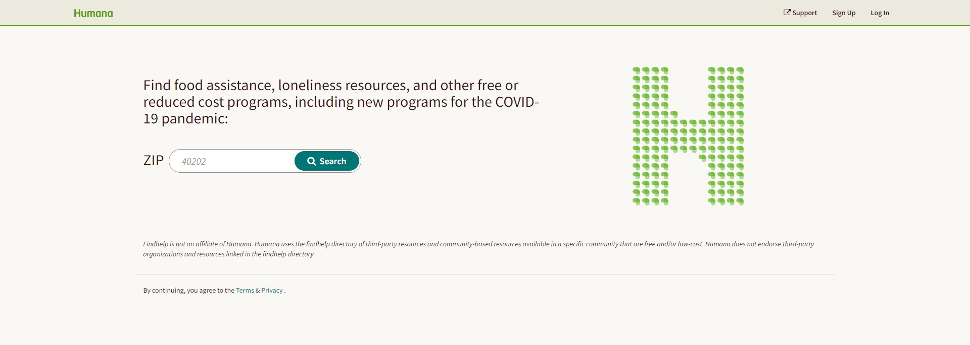
Connect veterans to resources in their local community
Humana Community Navigator
If an individual has identified health-related social needs, follow up by offering assistance connecting them to resources and services that may be available through their medical insurance, government programs and other community organizations through Humana Community Navigator (Humana.FindHelp.com). This service is used
to locate available food assistance, loneliness resources and other free or reduced-cost programs in an individual’s community.
In addition to providing access to thousands of resources, the following features are also available:
ZIP code search based on service area
Resources available to share via print, email and text
Multi-language options for resources
The ability to create folders to save favorites
Humana.FindHelp.com
Confidential/For Agent Use Only
| 16

Slide 17
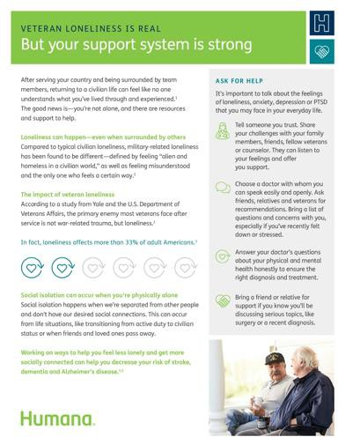
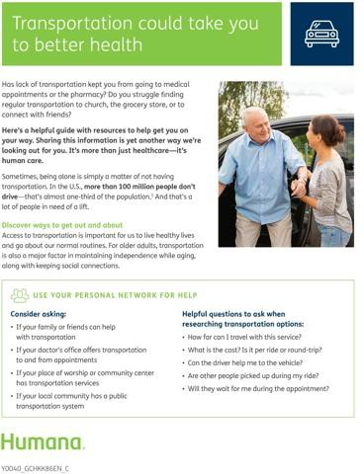

Flyers for print or download
Loneliness flyer
Transportation flyer Housing flyer
https://populationhealth.humana.com/communities/veterans-and-humana
Confidential/For Agent Use Only

Slide 18



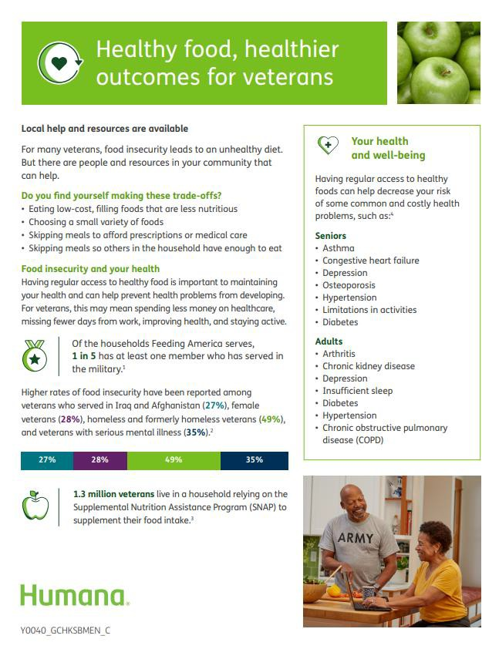
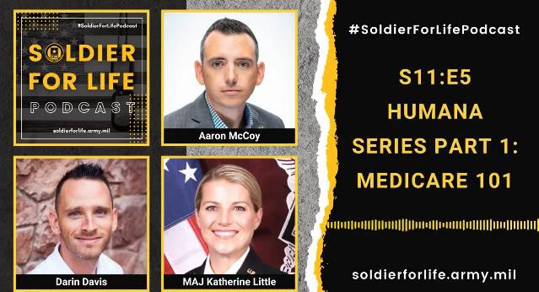
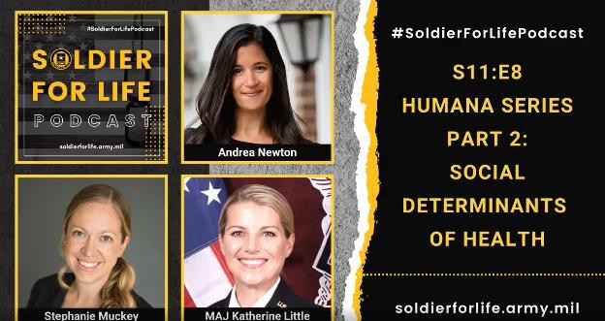
Thought Leadership
Resources available for Veteran members and providers supporting Veterans.
Provider Resources Videos / Podcasts
Supporting the Needs of your •
Veteran Patients
Humana Partnering for our Veterans
Soldier for Life S11:E5 Humana Series Part 1: Medicare 101
Soldier for Life S11:E8 Humana Series Part 2: Social Determinants of Health
Behind the Mission:
Humana’s Veteran Bold Goal
& SDOH
Lost and Found, A Health Equity Story
Member Resources
Loneliness & Social Isolation for Veterans Flyer
Food Insecurity for Veterans
Flyer
Transportation for Families & Seniors Flyer
Financial Strain for Seniors
Housing for Seniors
Issue Briefs
Health Equity
Access to Care
Food Insecurity
Loneliness
SDOH Data

Slide 19





*For internal use only

Slide 20
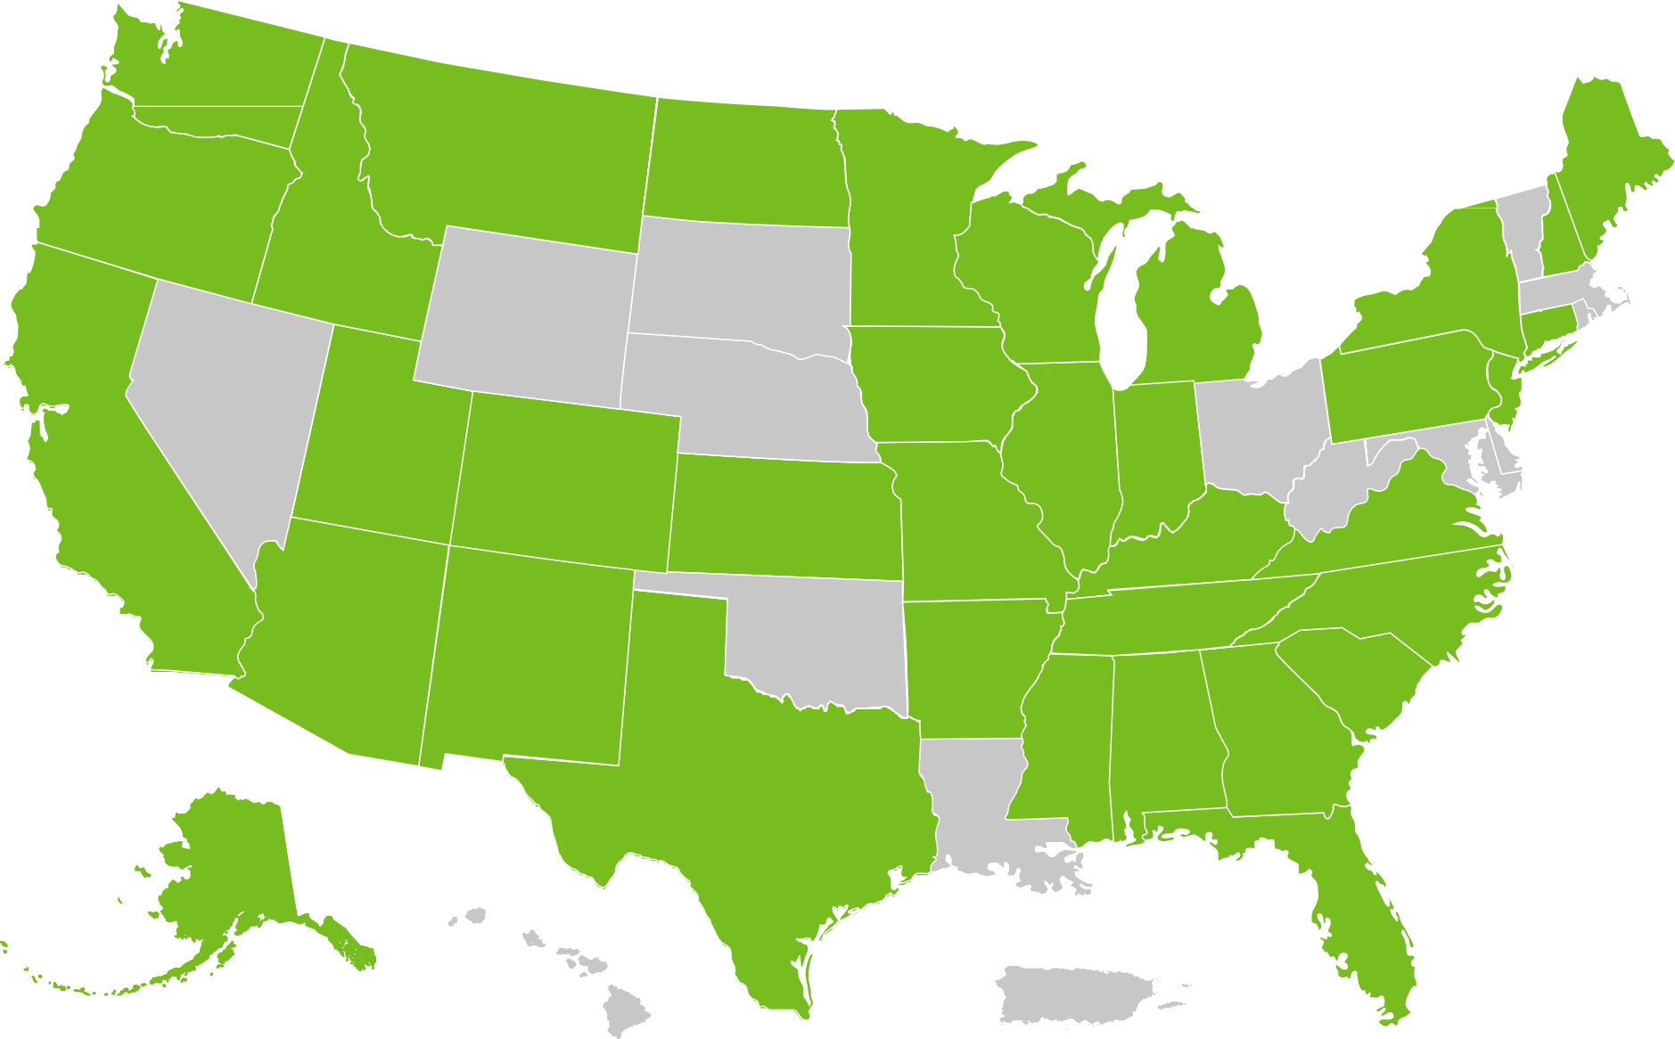
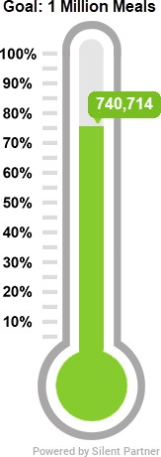
2023 Uniting to Combat Hunger Activations (3/30/2023)
WA
MT
ND
ME
OR
MN
ID
VT
NH MA
SD
WI
NY
WY
MI
CT
RI
IA
PA
MD
NV
NE
NJ
CA
UT
IL
IN
OH
CO
WV
DE
KS
MO
KY
VA
NC
SC
OK
TN
AZ
NM
AR
MS
AL
GA
TX
LA
AK
FL
PR
HI

Slide 21




VFW Foundation Uniting to Combat Hunger Grant
For every $1 raised by a VFW Post/Auxiliary to support Uniting to Combat Hunger, the VFW Foundation will provide
a $1 match in the form of an unrestricted grant to the VFW/Auxiliary Post. (Min. $500 must be raised to qualify)
For every pound of food donated to a food bank, food pantry or community kitchen, the VFW will provide a $1 match. (Min. 500 lbs. must be collected to qualify for match)
For every $1 spent on food purchased to support a food pantry ran by the Post or Auxiliary, the VFW will provide a
$1 match. (Min. $500 must be spent to qualify and the applicant must prove that the food pantry has been
operating for at least one year and show that it is sustainable)
The VFW Foundation will reimburse Posts/Auxiliaries for up to $500 for constructing and placing a little free food pantry at their Post home or local community center. A Post/Auxiliary must provide receipts showing all expenses incurred in placing the pantry upon submitting their request.
  The maximum amount for a UTCH grant is $1,500.
  Individual VFW members can make a donation at Donate to Veterans of Foreign Wars Foundation (bloomerang.co) and submit their receipt to their VFW post to count towards the grant
Connect with your local VFW and get them engaged!
VFW Grant can be located here: www.vfw.org/utchgrant
*For internal use only

Slide 22

VFW VSO Scholarship
Scholarship covers cost for service officers to attend 1 NVS training per year
Humana is assisting in providing the funding for VSOs
who are selected to attend

Slide 23

Thank you!

