Slide 1
What’s New at VA
By Kyle J. Rogers
April 2023

Slide 2







Hi there! Nice to meet you!

Slide 3
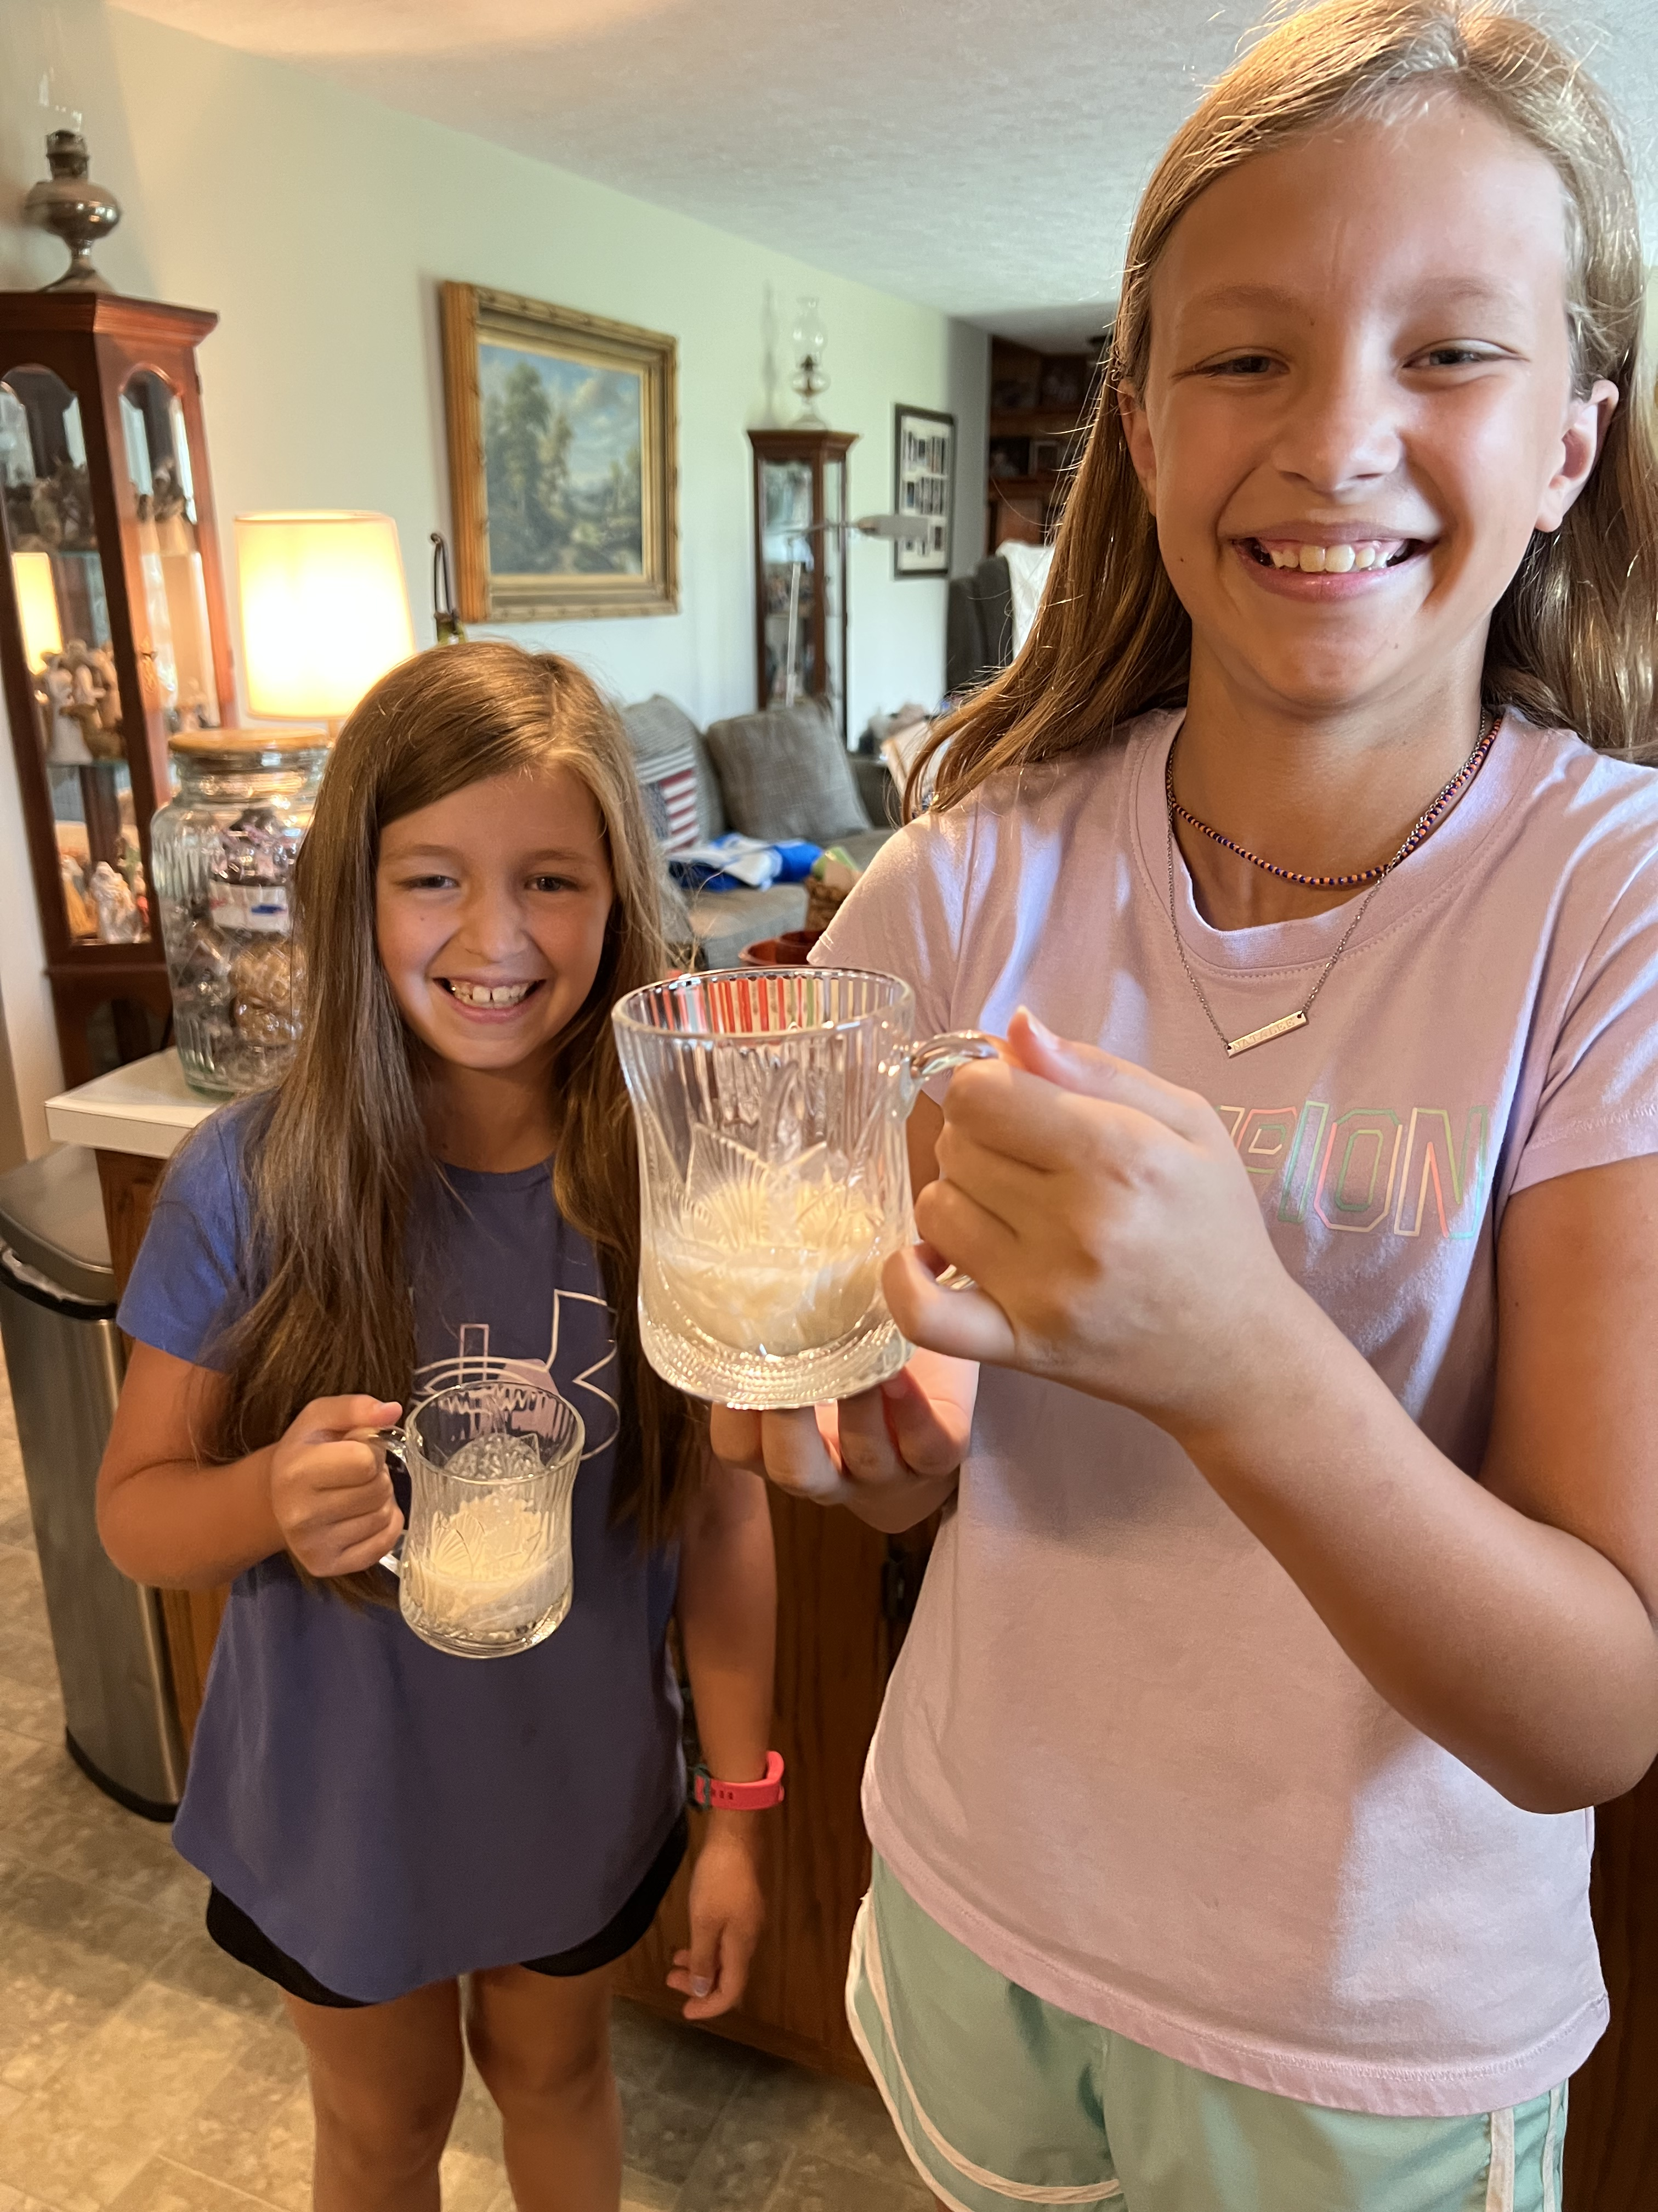
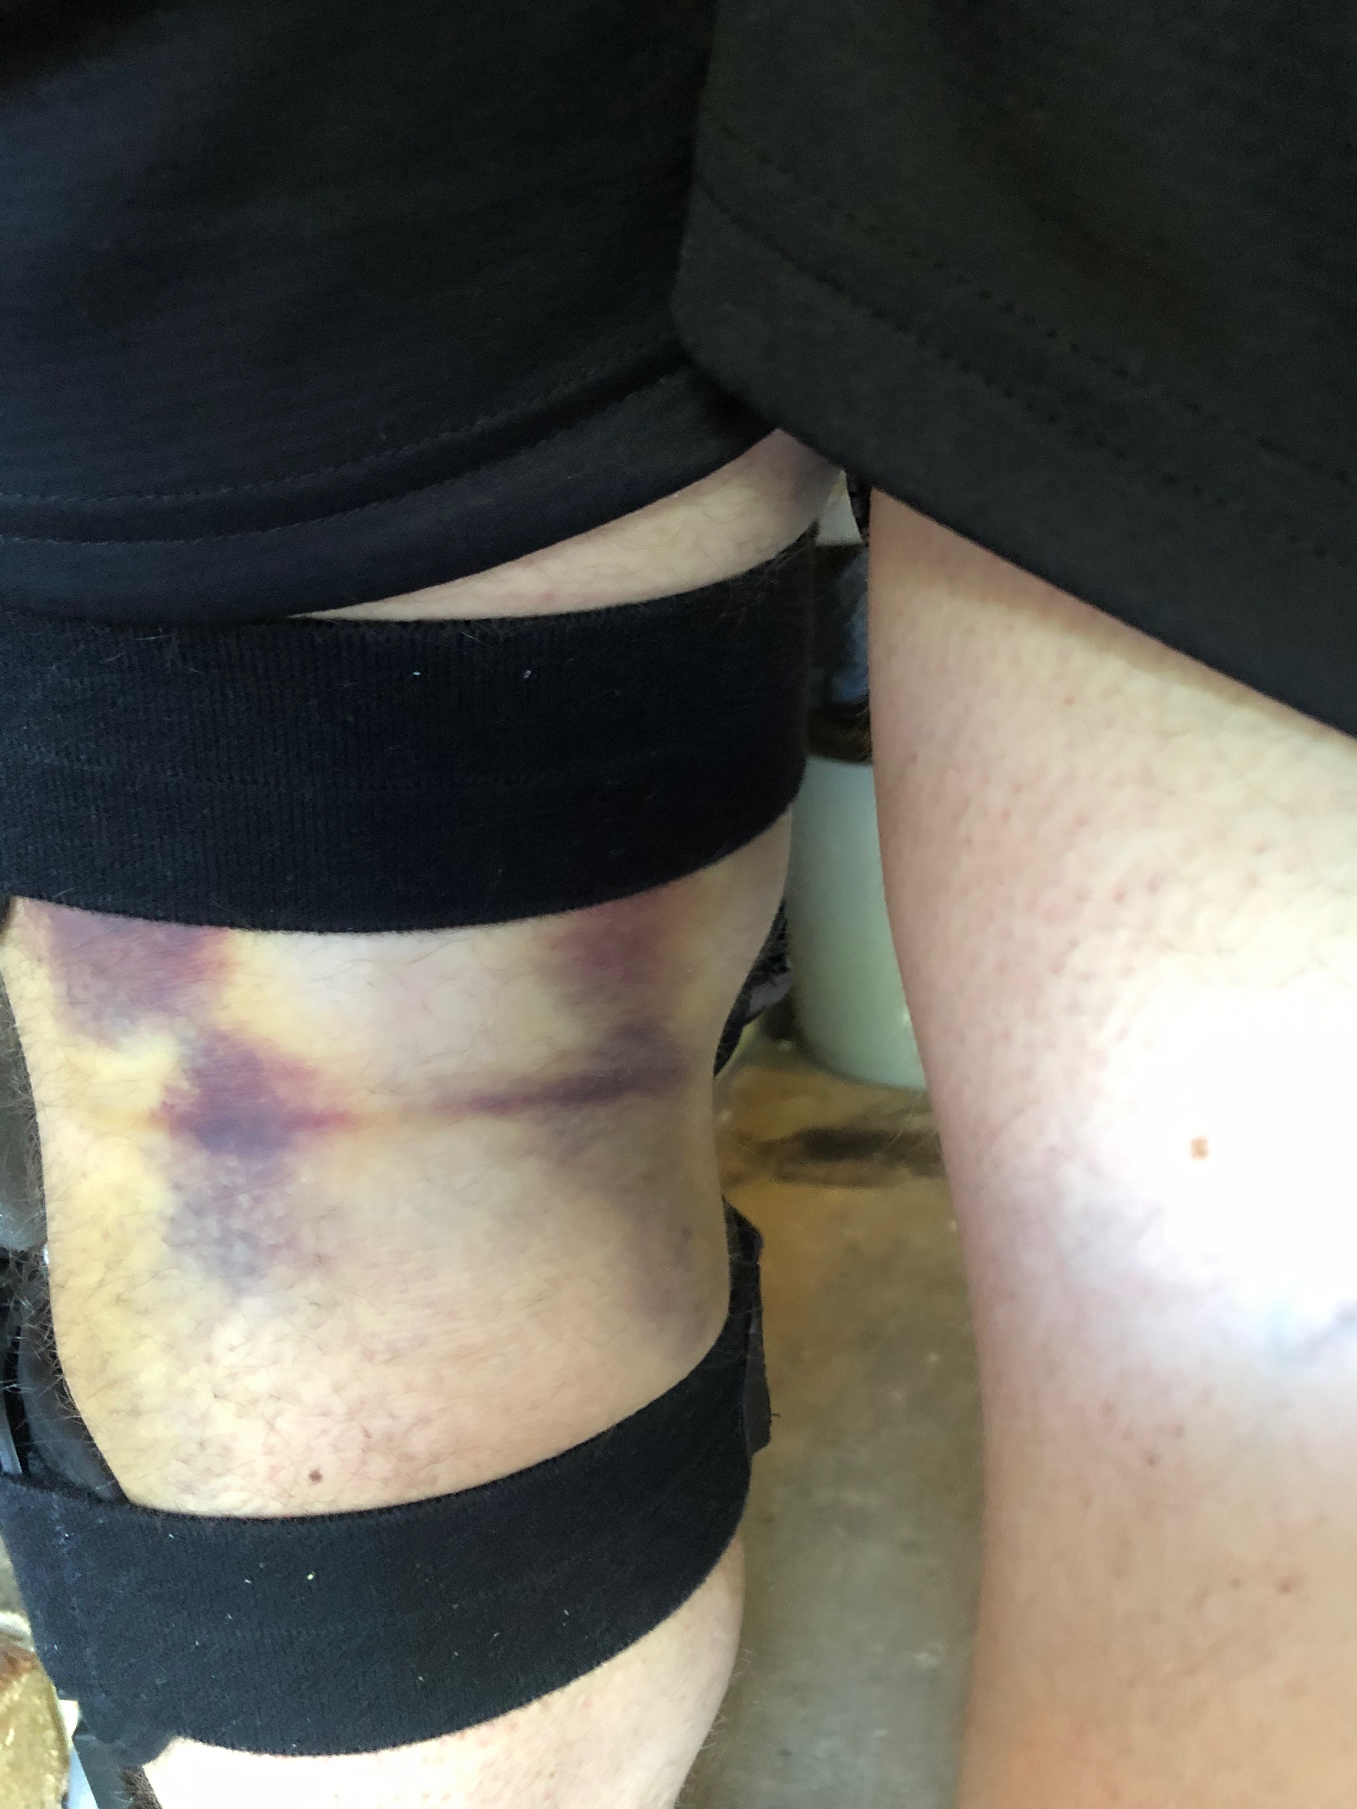
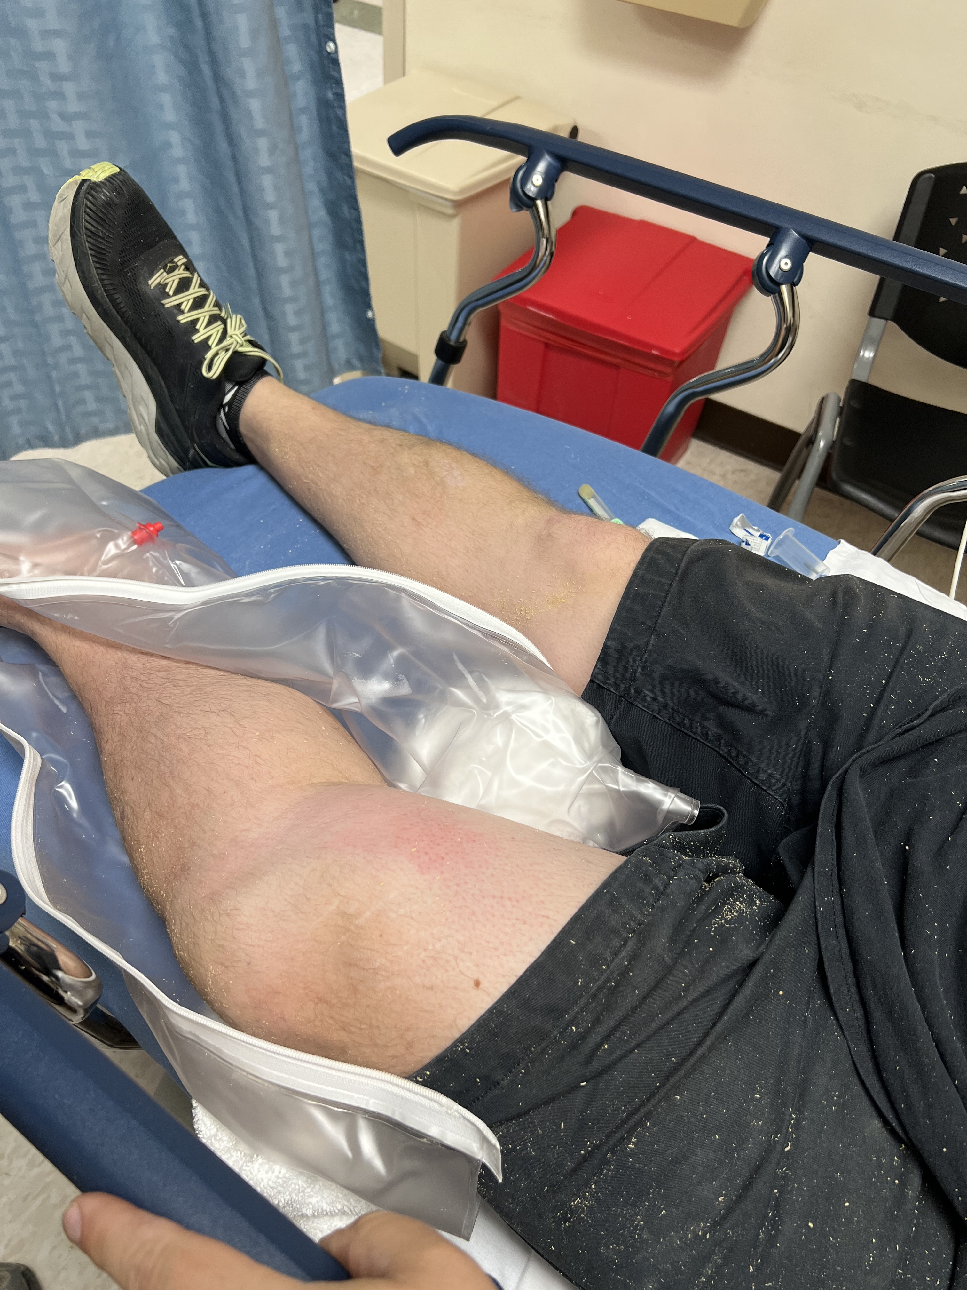

Hi there! Nice to meet you!

Slide 4
Agenda
Welcome Back! Updates?
High Impact Court Decisions
Public Law Change
Manual Changes
Latest PACT Act stuff
Pop Quiz!

Slide 5
What are court cases and why are they important?
Court Cases - started as a claim, went to appeals, passed the Board of Veterans Appeals, went to Court of Veterans Appeals (outside VA), then was appealed to the Federal Circuit Court.
A court case is the final judicial interpretation of the Code of Federal Regulations (CFR)
Court Cases set precedents - tells VA how to apply the rules of the law.

Slide 6
Court Decision’s – High Impact
Stevenson, Jr. v. McDonough October 4, 2022
Court of Veterans Appeals (CAVC) clarifies the definition of “additional disability” in regard to 1151 claims
Atilano v. McDonough, November 3, 2022
VA cannot refuse to hold a hearing based on the Veteran’s attendance

Slide 7
Stevenson, Jr. v. McDonough
October 4, 2022

Slide 8
Stevenson, Jr. v. McDonough, October 4, 2022
What the case is about:
Thomas Stevenson, Jr. was denied entitlement under 38 U.S.C. § 1151 for an unhealed wound of the right abdomen.
Mr. Stevenson served honorably in the U.S. Army from January 1968 to December 1970, including Vietnam service. He was service-connected for diabetes. He had open surgery to remove the gall bladder, and later developed a neuroma with scar pain. This resulted in treatment by RF ablation. The scar became an open wound and infected with MRSA (treated with daily dressing changes and antibiotics). – July 2014

Slide 9
Stevenson, Jr. v. McDonough, October 4, 2022
What the case is about:
Open wound continued into August 2014 and treated multiple times at VA community-based outpatient clinic (CBOC). Mr. Stevenson filed an 1151 claim in September 2014.
February 2015 – VAMC notes showed a completely healed wound without signs of herniation or infection.
September 2015 – RO denied the claim as there was no evidence of current disability.

Slide 10
Stevenson, Jr. v. McDonough, October 4, 2022
What the case is about:
Notice of Disagreement (NOD) filed January 2016 asserting that the VAMC was responsible for the MRSA infection and subsequent unhealed and painful wound.
March 2018 – Veteran elected modernized review process and higher-level review at the RO. September 2018 – HLR identified duty to assist error and ordered VA exam. February 2019 exam showed no residuals. March 2019 – HLR denied 1151 claim due to no “additional disability.”

Slide 11
Stevenson, Jr. v. McDonough, October 4, 2022
What the case is about:
April 2019 – supplemental claim filed. Mr. Stevenson did not deny that the wound had healed, but stated he was seeking compensation for the period the wound was open as it required home health nursing care and resulted in pain and suffering.
July 2019 – previous denial confirmed and continued.
August 2019 – VAF 10182 filed to appeal to the Board

Slide 12
Stevenson, Jr. v. McDonough, October 4, 2022
What the case is about:
March 2020 – Board denied entitlement due to no “additional disability” – relied on 2019 VA exam concluding no evidence of an unhealed wound.

Slide 13
Stevenson, Jr. v. McDonough, October 4, 2022
Argument:
Mr. Stevenson argued that the Board erred in conclusion that there was no additional disability at the time he filed his claim, instead relying on evidence after the fact.
McClain v. Nicholson - “Disability is satisfied when a claimant has a disability at the time a claim for VA disability compensation is filed or during the pendency of that claim and that a claimant may be granted service connection even though the disability resolves prior to the Secretary’s adjudication of the claim.”

Slide 14
Stevenson, Jr. v. McDonough, October 4, 2022
Argument:
The Board argues that Mr. Stevenson did not demonstrate additional disability because his condition prior to the July 2014 RF ablation and his condition in October 2014 was the same. The condition resolved and therefore does not constitute additional disability warranting compensation under section 1151. Disability under 110 is not analogous to disability under 1151.

Slide 15
Stevenson, Jr. v. McDonough, October 4, 2022
Conclusion:
§ 1151 does not define additional disability. In the absence of express statutory definition, the presumption is ”that Congress is intended to give these words their ordinary meanings.” The plain meaning of “additional” comports with §3.361(b) – and provide temporal guideposts for VA adjudicators to determine whether there is added disability.
Disability carries the same meaning in 1151 as Section 1110 “functional impairment of earning capacity.”

Slide 16
Stevenson, Jr. v. McDonough, October 4, 2022
Conclusion:
Board failed to consider Mr. Stevenson’s open abdominal wound, pain, discharge, and discomfort as demonstrating additional disability during the pendency of his claim.
The Board decision is SET ASIDE, the determination that Mr. Stevenson did not demonstrate additional disability is REVERSED, and the matter is REMANDED for further proceedings.

Slide 17
Stevenson, Jr. v. McDonough, October 4, 2022
What does this Mean?
The final conclusion is still pending, however, we could expect decisionmakers to more liberally interpret claims for “additional disability” for §1151.
The decision specifically noted that it was not the court’s intention to open the “floodgates” for 1151 claims, and it appears that the available evidence at the time the claim was filed simply was not fully considered.
What do you think?

Slide 18
Atilano v. McDonough
November 3, 2022

Slide 19
Atilano v. McDonough, November 3, 2022
What the case is about:
AKA Atilano II - This appeal was contested all the way to the Court of Appeals for the Federal Circuit (CAFC) from the CAVC.
Jesus G. Atilano had an appeal pending before the Board of Veterans Appeals (BVA), for which a hearing was requested. The BVA member declined to hold the hearing because the Veteran failed to attend. The Veteran’s counsel was present with an expert witness on issues relating to PTSD and total disability based on individual unemployability (TDIU).

Slide 20
Atilano v. McDonough, November 3, 2022
Argument:
The Federal Circuit vacated the Court’s judgement that 38 U.S.C. § 7107 required an appellant requesting a hearing to attend that hearing either in person or remotely via electronic means (Atilano v. Wilkie, 2019).
Mandate rule notes that a lower court is foreclosed from reconsidering issues decided on appeal by a higher court; law of the case doctrine.

Slide 21
Atilano v. McDonough, November 3, 2022
Argument:
The Federal Circuit concluded that only the statute was “at best silent” on the question as to whether a Veteran must be present at his hearing to present expert testimony.
Only the language ”does not unambiguously require a Veteran to be present.” 38 C.F.R. §20.700(b) – contemplates the person appearing for the hearing which is ”something less” demanding than the Veteran’s attendance

Slide 22
Atilano v. McDonough, November 3, 2022
Argument:
Federal Circuit supported Mr. Atalano’s position that a claimant too disabled to attend a hearing may still invoke the right to a Board hearing.

Slide 23
Atilano v. McDonough, November 3, 2022
Conclusion:
Board decision vacated with respect to PTSD and TDIU and remanded for further proceedings.
Court essentially made correction to a previous ruling, which is something new and unprecedented. This brings into question the appellate process and the authority of higher courts on lower ones.

Slide 24
Atilano v. McDonough, November 3, 2022
What does this mean?
“It’s very interesting”
“Horns of a dilemma” – either suppress independent judgment to arrive at the conclusion the Federal Circuit all but ordered us to adopt, OR we could defy the repudiation of the previous Chevron analysis and again affirm in contravention of every signal the Federal Circuit sent
“Appellate decisions command compliance, not agreement.”

Slide 25
Atilano v. McDonough, November 3, 2022
Outcome
Still pending, but decisionmakers have been cautioned about declining to hold hearings even if the veteran is not present.
… more to come…

Slide 26
One Recent Public Law Change
Auto allowance – grant up to $22,356 due to service-related disability
Previously was a once in a veteran’s lifetime
*NEW* - can be granted every 10 years (Public Law 117-333).
Applies 10 yrs. after signing, unless the veteran received a previous auto allowance 30 years ago
Part of a broader bill to expand benefits for veterans

Slide 27

Let’s take a break

Slide 28
Manual Changes
Burial Benefits M21-1, Part XI, Subpart iii – State or Tribal land plot or interment allowance benefit. VSR will contact the cemetery via telephone, document the call, complete other development, and notify the claimant.

Slide 29
Manual Changes
Eligibility to DIC to surviving spouses who remarry M21-1, Part VII, Subpart i., Ch. 2, Section E – when a remarriage statement is not needed for reconsideration of DIC:
If they indicated they have not remarried since the death of the veteran on their original application
Were at least age 55 (DIC 1/5/21 or later), or 57, as applicable, at the time of the original claim
There is no bar to full concurrent payment of SBP and the basic DIC rate when a surviving spouse is entitled to DIC by virtue of having remarried upon attaining age 55.

Slide 30
Manual Changes
M21-1, Part III. Subpart I, Chapter 1, Section A –
National guard and reserve:
DD214 ”Certificate of Uniformed Service” routinely issued for ADS of 90 days or more
15-day period of annual ADT training
Master Military Pay Account (MMPA) print can be used as record of ADT/ IADT service
NGB Form 22 documents spans of service, but does NOT verify individual periods of ADT/ IADT
There is no formal document issued at the time of reservist’s separation of retirement

Slide 31
Manual Changes
M21-1, Part III. Subpart I, Chapter 1, Section A (continued)
Space Force: now recognized in the manual
Presumptive service-connection for COVID-19
VAOPGCPREC 4-2022 – does apply for disabling conditions from administration of COVID-19 vaccine
Special provisions apply for presumptive s/c and residuals with periods of ADT/ IADT (38 USC 1164)

Slide 32
Manual Changes
COVID-19 claims guidance (M21-1, Part VIII, Subpart iii., Chapter 10, 19 and V.iii.3.6.d)
Discusses the presumption of s/c, theories of s/c, manifestation period, and definition of symptoms
Effective January 5, 2021

Slide 33
Manual Changes
M21-1, Part VIII, Subpart iii., Chapter 10 (continued)
Nomenclature:
Novel coronavirus
Coronavirus
Severe acute respiratory syndrome coronavirus 2 (SARS-CoV-2)
Coronavirus disease, and
COVID-19

Slide 34
Manual Changes
M21-1, Part VIII, Subpart iii., Chapter 10 (continued)
Presumption within defined period for qualifying service
Does NOT preclude claim by direct, aggravation, or secondary basis

Slide 35
Manual Changes
M21-1, Part VIII, Subpart iii., Chapter 10 (continued)
Symptoms are as defined by CDC’s website
Manifestation period for symptoms or death:
Service of more than 48 hours continuous in duration
Or within 14 days following separation (48 hours does not apply)
Service periods:
Active Duty 3/1/2020 – 1/5/2024
Active Duty (Training) 3/13/2020 – 1/5/24 (same for IADT)

Slide 36
Manual Changes
M21-1, Part VIII, Subpart iii., Chapter 10 (continued)
Special indicator must be applied to each associated contention
Exposure to COVID-19, without association of underlying disability, is not a substantially complete claim

Slide 37
Manual Changes
M21-1, Part VIII, Subpart iii., Chapter 10 (continued)
All normal development requirements apply
Examinations – positive COVID-19 test is NOT required before requesting an examination
Medical opinion may be needed to determine the date of manifestation
Infectious Diseases DBQ is the correct exam

Slide 38
Manual Changes
M21-1, Part VIII, Subpart iii., Chapter 10 (continued)
Rating – must consider all theories of entitlement
Confirmed diagnosis during service is sufficient to concede in-service event
Effective dates – liberalizing rules apply under 38 CFR 3.114

Slide 39
QUESTIONS?

Slide 40
Bonus Material (if there is time remaining)
Did you know?
Hypertension has been added as a presumptive condition?
3.320 has been updated with other conditions and is worth reviewing – e.g. COPD (formerly claimed as sinusitis/ rhinitis)
CLCW backlog

Slide 41
Let’s take a break

Slide 42

Game Time! Trivia Set Up!
To play, go to https://www.crowd.live/CRGTQ
OR scan this QR code with your smartphone
Create a name (doesn’t have to be your real name) AND choose your team.
The results of the game will be shared with all, so if you want to use an alias, feel free!

Slide 43
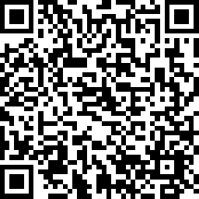
2023 Proficiency Training Conference Survey
Class: What’s New at VA
Please scan the QR Code or click on the link below to take an anonymous survey about your experience during the 2023 Proficiency Training Conference.
https://www.research.net/r/DC7Y2L2

