Slide 1
What’s New at NVS

Slide 2
Topics of Discussion
New Leadership
New Reporting Requirements
Office Coverage
Revoking POA
Separation Health Assessments
TVB Update
PACT Act Referrals
Your Turn

Slide 3
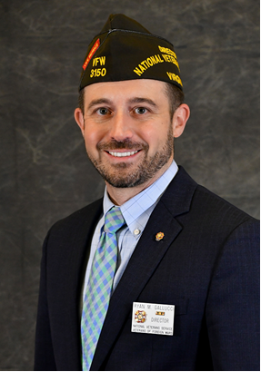
New Leadership
On March 1, 2023, the following leadership changes were made in the Washington Office:
Mr. Ryan Gallucci was selected to serve as the Executive Director of the Washington Office
Mr. Mike Figlioli was selected to serve as the NVS Director

Slide 4
New Reporting Requirements
Monthly DSO reports to NVS are no longer required
NVS now only requires an annual Post Service Officer School of Instruction report to be submitted by the end of June each year
Include the date and location of the training, topics taught, and a roster of attendees.
VA Claim award information can be found in the POA Summary Report in the OLP Resources section

Slide 5
Accreditation
As an organization recognized by VA for the purposes of preparation and prosecution of claims, VFW must establish guidelines for accreditation IAW 38 CFR §14.628
Guidelines are set forth in the NVS Policy & Procedure, as amended twice each year by the National Veterans Service Advisory Committee IAW VFW Manual of Procedure Section 518 (11)

Slide 6
Accreditation
Process Overview:
  Department or Employer completes pre-employment background check
  Department or Employer submits VFW Accreditation Packet to NVS
  NVS reviews for signature by National Certifying Representative (Director, NVS)
  NVS submits to VA OGC for processing
  VA OGC notifies candidates and VFW of accreditation
VFW Accreditation Packet:
  Letter of Appointment
  VA Form 21 (Most recent – February 2020)
  VFW Application for Accreditation
  Background Investigation Certification
  Completion certificate for TRIP or other comparable training offered by the State or NACVSO

Slide 7
Letter of Appointment
Items we look for:
By-name and title request for accreditation
Signature of appropriate authority:
  State Director or Commissioner
  State Rep. appointed to serve as VFW DSO
  State Training or hiring manager
  VFW Department Leadership
A formal letter is not required but is preferred. An email will suffice if it satisfies the name/title requirements and comes from the proper authority.

Slide 8
VA Form 21
The VA Form 21 must be properly filled out to be accepted
Commonly Missed Items:
1 – FULL name including middle
2 – Business Address
7A – Proper name of organization
  Veterans or Foreign Wars of the U.S.; Veterans of Foreign Wars; VFW are all acceptable
7B – Do not use a generic VFW office address if the
applicant is a state or county employee
8 – Cross-accreditations must have a primary.
10 – Signature of designee – cannot be digital
11 – Must be a current address
12 – 15 must be left blank.
***Must be Feb 2020 version (a new version is pending approval)***

Slide 9
VFW Application
Items we look for:
Must be 01.01.2022 version
Current Employer
Email Address – REQUIRED
Have you ever been fired from a job?
  If yes, MUST include explanation
  Looking for red flags on customer service or reliability.
  Example: Fired for failing to show up for shifts or for being rude to clients.
Have you even been convicted of a crime?
  If yes, MUST include explanation.
  Does not include minor traffic violations.
  Looking for history of financial impropriety or violence.
  Example: Convicted of check fraud or convicted of spousal abuse.

Slide 10
VFW Application
Items we look for:
Are you currently a service officer?
  Yes; organization; dates
Are you currently accredited with any other organizations?
  If employed by VFW answer must be no
  Must have a primary accreditation BEFORE applying for VFW accreditation if not employed by VFW; usually your state agency.

Slide 11
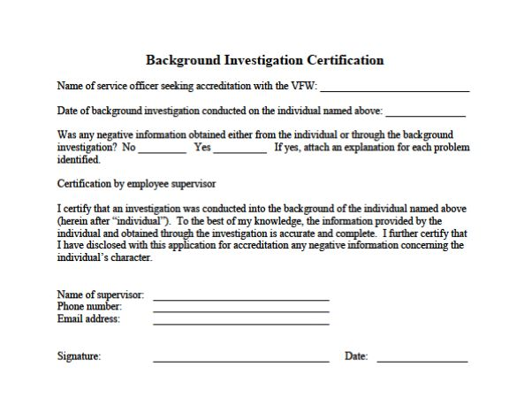
Background Investigation
Items we look for:
If yes for negative information, a separate page with an explanation must be included
  Similar “red flags” as VFW Application
Fields with Supervisor, Phone, Email, Signature, and Date must be completed
  “Supervisor” can include Department Commander, Adjutant, or Quartermaster, but should be a supervisor with the State Agency if not employed by the VFW
  Cannot include administrative staff
Standards for Background Investigations outlined in NVS Policy & Procedure

Slide 12
Processing
Process Completion:
  Forms are available in fillable PDF format electronically from NVS.
  Request and submit forms to Theresa Aldana at Taldana@vfw.org
  Once received, the packet will be reviewed and any areas needing correction will be identified prior to submission to OGC.
  NVS will notify the individual and supervisor via email when the accreditation is approved by OGC or if there are any errors.
Discussion: What has your experience been like seeking VFW accreditations over the years?

Slide 13
Office Coverage
The way we serve our veterans and their families has significantly changed since COVID-19
More people are using telework and flex time rather than traditional office hours
Ensure that during normal business hours your office has sufficient coverage to match the needs of the local community and that your outgoing messages are current
Don’t assume that because you are available that the veteran is too

Slide 14
Revoking POA
Sometimes it is in the best interest of the organization to stop working with an individual and revoke our authorization to represent them before the VA
You should make every reasonable attempt to resolve the situation before revoking representation
Reasons to revoke may include but are not limited to:
          Abusive or hostile behavior
          Recording conversations without consent
          Fraud
          Refusal to cooperate

Slide 15
Revoking POA
If you determine that revoking POA is the best course of action:
Notify your DSO and your RQAS/NVS
Send written correspondence to the veteran informing them of your decision to revoke – not an email
Notify VA that VFW is no longer the representative using a 21-4138 and include a copy of the letter to the veteran
Update VetraSpec/TVB to reflect the revocation, upload copies of the correspondence to the veteran and VA, and summarize your actions in the communications area
Remember – If there is an appeal pending at the BVA, you must get authorization from the NVS Director prior to revoking or accepting POA

Slide 16
Separation Health Assessments
Effective April 1, 2023, VA requires all transitioning service members who are submitting BDD claims or retiring through IDES to complete the Separation Health Assessment Part A Self-Assessment
Per the announcement from VACO, MSCs should help the service member obtain the SHA Part A. The service member must submit the SHA Part A with their BDD claim.
We have been told unofficially by MSCs that C&P exams will not be ordered for BDD claims until the SHA Part A has been submitted by the service member.

Slide 17
Separation Health Assessments
Items of note:
The new SHA Part A Self-Assessment is 14 pages long and asks the service member to answer 126 questions pertaining to specific medical conditions
If a BDD Claim is submitted absent a SHA Part A, VA will send out the first notice requesting the SHA Part A is submitted within 15 days
15 Days after the first notice, VA will send the service member a second notice requesting that the SHA Part A is submitted within 15 days
If the SHA Part A is not submitted by the service member, VA will exclude their claim from the BDD program and will process the claim traditionally after the Service Member has separated or retired

Slide 18
TVB Update
We are in the process of migrating from VetraSpec to TVB
The initial migration occurred in March; we are currently setting up accounts and preparing for the full migration which will occur on April 24, 2023
Once TVB is live, you will receive log in information from TVB and VetraSpec will be read-only

Slide 19
PACT Act Referrals
Since the launch of the PACT Act Referral site in November 2022, we have:
    Received more than 5200 referrals
    Averaged 62 referrals per day nationwide
    Averaged a total of 97 referrals per Department
What has your experience been?
What are your thoughts/suggestions to improve the site?

Slide 20
Your Turn
What topics would you like to discuss?

Slide 21
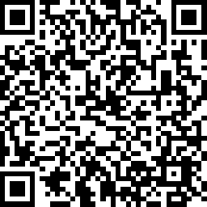
2023 Proficiency Training Conference Survey
Class: What’s New at NVS
Please scan the QR Code or click on the link below to take an anonymous survey about your experience during the 2023 Proficiency Training Conference.
https://www.research.net/r/DJXXND8

