Slide 1
The PACT Act, with special emphasis on the Camp Lejeune Justice Act
How VFW is assisting members with CLJA
Veterans of Foreign Wars
Fall 2022 Service Officer Training
Annapolis, Maryland
September 18, 2022

Slide 2


Objectives
Today’s Three Topics:
VFW – B&M Partnership update.
PACT Act – Quick Summary
Signed by President on August 10, 2022.
Overview of major changes.
Camp Lejeune Justice Act (CLJA):
Detailed description of mass tort.
Q&A focusing on CLJA and B&M representation.

Slide 3
VFW – Bergmann & Moore Partnership
© 2018-2021 Bergmann & Moore LLC

Slide 4

VFW – Bergmann & Moore Partnership
B&M Quick Facts:
Founded in 2004.
Accredited by VA’s OGC.
Based in Rockville, Maryland.
Staff of 100+, including 60 attorneys.
Focus only on VA disability claims/appeals.
In 2014, VFW and B&M signed an MOU to represent Veterans with a Board denial before the Court.
Eight years of trusted and transparent representation before the Court is at no cost to VFW or Veteran.

Slide 5

VFW – B&M Partnership Results after 8 years
B&M Court results show a 99% favorable outcome for Veterans during the last 8 years:
Category of Cases January 1, 2015 – June 21, 2022 | Number of Appeals | Percentage
Total Appeal Dispositions (36 appeals dismissed/withdrawn mostly due to death of Veteran/claimant) | 3358
Favorable Outcomes | 3326 | 99.0%
Joint Motion for Remand (VA Errors B&M Identified) | 2993 | 89.1%
Court Decision (Full or Partial Remand) | 323 | 9.6%
Settlement | 10 | 0.3%
Unfavorable Outcomes (Full Affirmance) | 32 | 1.0%

Slide 6
PACT Act (8/10/22) - Quick Summary
A combination of many bills.
Gives VA broad authority and support to research and create new presumptions for exposure-related conditions.
Major Sections of Public Law 117-168:
Title I – Expansion of Health Care Eligibility.
Title II – Toxic Exposure Presumption Process.
Title III – Improving the Establishment Of Service Connection. Process for Toxic-exposed Veterans.
Title IV – Presumptions of Service Connection
© 2018-2021 Bergmann & Moore LLC
Notes:
2022 Promise to Address Comprehensive Toxics Act.
-
Expands existing qualifying service locations for Vietnam War, Gulf War, and other toxic exposure sites.
Removes Gulf War manifestation limitation date and percent rating (formerly 10%).
Presumes exposure to particulates (Burn Pits).
Establishes 23 new medical conditions presumed associated by the exposure.
Expands free post-deployment VHA care to 10 years

Slide 7
Effective Date for PACT Act
The PACT Act includes a provision that phases in the effective dates of all 23 new presumptive conditions over several years (delayed effective dates).
Exceptions: homelessness, financial distress, over 85, or other good cause.
VA may delay implementation until regulations are issued
Notes:
Sec. McDonough (cite) has since suggested that the effective dates will not be staggered, that they will be the date of the law

Slide 8
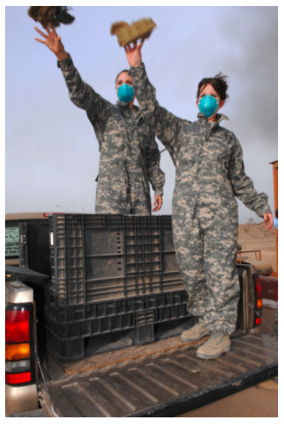
Other Medical Conditions
If the Veteran with qualifying service has a medical condition that is not included on the presumptive list, then the Veteran can still argue for direct service connection.
Avoid submitting general claim e.g. “burn pit exposure.” The Veteran must list a condition, assert deployment at the correct location and time, plus a theory of service connection such as an exposure to a toxin.
Iraq, 2008.
Notes:
A key part of the PACT act is that it gives VA general authority to create new presumptions of toxic exposures, dates, locations, and conditions.
In the past, VA has declined to create new presumptions of service connection by claiming that it lacked the authority to do so. This makes clear that VA has broad authority to create new presumptions.
It also creates transparency around how VA will go about doing this.
The act requires VA to annually publish a report on which potential presumptions are currently being studied.
It also authorizes VA to work with National Academies of Science Engineering and Medicine to study conditions

Slide 9
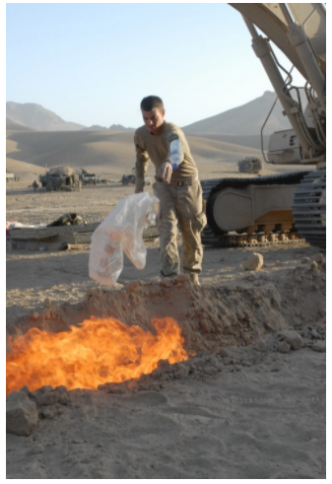
VA’s Duty to Assist
The PACT Act requires that VA provide a specific duty to assist in the form of a C&P exam:
When there is “evidence of a disability and evidence of participation in a toxic exposure risk activity” unless
When “the Secretary determines there is no indication of an association between the disability . . . and the toxic exposure risk activity”
C&P opinion must consider “total potential exposure” and “the synergistic, combined effect of all toxic exposure risk activities of the veteran.”
Afghanistan, 2011.
Notes:
This is a big section of the PACT act that amends the Duty to Assist under 38 U.S.C. § 5103A(d). This is supposed to make it easier to obtain an exam.
This is an extremely low standard and should mean that it is pretty rare for an exposure claim to be denied without VA at least seeking a medical opinion.
“total potential exposure” and “the synergistic, combined effect of all toxic exposure risk activities of the veteran.”
This is likely going to be very challenging for VA as total exposure is information that will often be hard to easily find in a Veteran’s records and it will probably take substantial expertise to address the combined effect of all exposures.
Don’t be surprised if you have dispute the adequacy of many examinations provided under this standard

Slide 10
Presumptions of Service Connection
Herbicides / Agent Orange, Section 403 and 404:
Adds presumption of exposure for all service at Thailand airbases plus American Samoa, Cambodia, Guam, Laos, and Johnson Atoll
Carefully review each location for specific time periods of eligibility.
Adds presumption of causation for hypertension:
Effective Oct. 2026.
Retroactive only for DIC claims.
Gulf War Claims, Section 405:
Eliminates manifestation time limitation.
Requires VA to provide a Gulf War claim exam “If a Persian Gulf veteran at a [VA] medical facility … presents with any one symptom associated with Gulf War Illness.”
Adds 6 areas: Afghanistan, Egypt, Israel, Jordan, Syria, and Turkey.
Notes:
Sections 403 and 404, which deal with Herbicide / Agent Orange claims
These sections expand the presumptions of where herbicides were used; It adds presumption of exposure for all service at Thai airbases plus American Samoa, Cambodia, Guam, Laos, and Johnson Atoll (for various time periods).
It also adds presumption of causation for hypertension. The science has long supported the creation of this presumption, but VA has resisted adding it.
However, this is one of the presumptions that has a delayed effective date -- presumption is not fully effective until Oct. of 2026.
Remember that a Veteran can seek to have it applied earlier with a showing of good cause, which includes being over the age of 85. Furthermore, it is retroactive under the PACT Act only for DIC claims.
That is just what the Act says. As we saw with the Blue Water Navy Act, the federal Courts could hold under the Nehmer class action lawsuit that the presumption is still retroactive for Veterans who were previously denied benefits. Accordingly, if you have a Veteran who has not already applied for benefits for hypertension, you should encourage them to file as soon as possible
GWC -- Previously, there was always a requirement that a condition manifest within a specific period of time after service.
Congress always moved the date back before it was reached, but now it is not an issue at all.
The PACT Act also requires VA to provide a Gulf War claim exam “If a Persian Gulf veteran at a [VA] medical facility … presents with any one symptom associated with Gulf War Illness.”
Note that this is not tied to the filing of a claim. You should ask Gulf War Veterans not only whether they have had an exam, but whether they have filed a claim based upon the results.
Finally, the act adds 6 new areas where the Gulf War presumptions apply: Afghanistan, Egypt, Israel, Jordan, Syria, and Turkey.
Gulf War claims were always confusing because these areas were excluded and now the availability of benefits should be much more consistent.

Slide 11

Presumptions of Service Connection
Burn Pits Claims, Section 406:
Presumes exposure using the expanded definitions of Gulf War service. See 38 U.S.C. § 1119
Creates two dozen presumptive conditions including 11 cancers and many serious respiratory conditions such as COPD and emphysema. See 38 U.S.C. § 1120
Effective dates staggered through October 2025.
Notes:
section 406, which affects Burn Pits Claims.
It is only very recently that VA has finalized regulations creating some burn pit presumptions and the PACT act marks a significant expansion beyond what VA has done.
[click] Initially, the coverage of the act presumes exposure using the expanded location definitions of Gulf War service. See 38 U.S.C. § 1119. Thus, it applies not just to service in Iraq and Afghanistan but to locations throughout the Middle East.
[click] Substantively, the act creates two dozen presumptive conditions including 11 cancers and many serious respiratory conditions such as COPD and emphysema.
[click] Once again, the act uses staggered effective dates so be careful and make sure that you don’t forget that a Veteran with good cause does not have to wait to apply for benefits.

Slide 12
Camp Lejeune Justice Act - PACT Act, Section 804 - Brief overview - How VFW is helping its members with CLJA
© 2018-2021 Bergmann & Moore LLC

Slide 13
Camp Lejeune Justice Act
CLJA Summary:
Opens door to a qualified population to participate in mass tort litigation, with a two-year period ending August 10, 2024.
Defines population as, “Veteran, or the legal representative of such an individual, who resided, worked, or was otherwise exposed (including in utero exposure)” at Camp Lejeune.
Requires exposure of “not less than 30 days” between August 1, 1953, and December 31, 1987.
All litigation will be handled with the U.S. District Court for the Eastern District in North Carolina.
Notes:
You cannot possibly have missed hearing about CLJA – the ads; the ads; the ads
Sect. 804:
No sovereign immunity
No punitive damages
Burden of proof is at least as likely as not
E.D.N.C. has exclusive jurisdiction.
Awards are offset against VA benefits
Statute of limitations is two years after the effective date of the PACT Act (Aug. 2024).

Slide 14
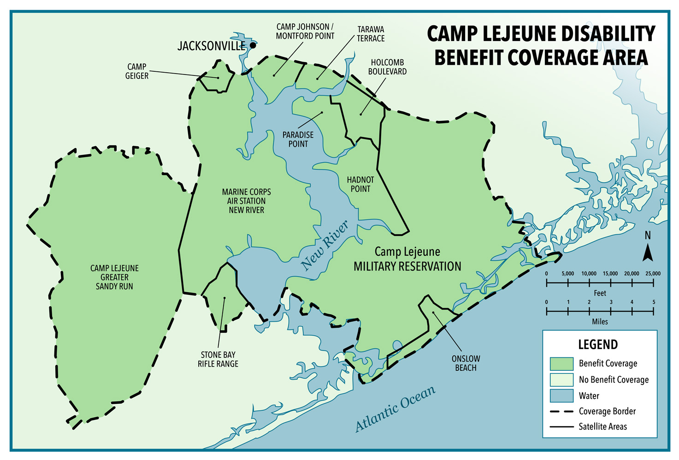
CLJA Eligibility Map from VA
VA’s Public Health Web Site
Source: VA, Camp Lejeune: Past Water Contamination
https://www.publichealth.va.gov/exposures/camp-lejeune/index.asp
Camp Lejeune Disability Benefit Coverage Area
Notes:
Read, click on numbers

Slide 15
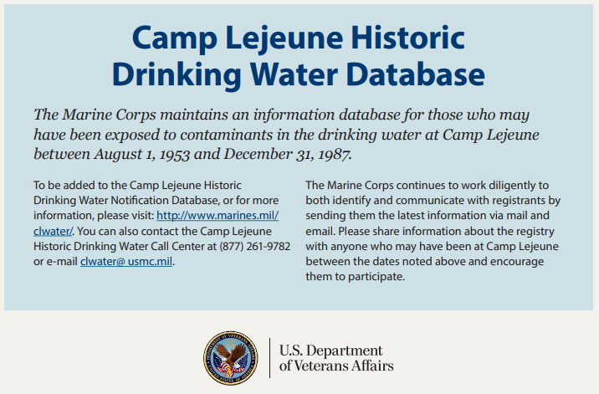
CLJA Drinking Water Database
VA’s Public Health Web Site
Source: VA, Camp Lejeune: Veteran and family health and disability benefits https://www.publichealth.va.gov/docs/exposures/camp_lejeune_brochure.pdf
Notes:
Read, click on numbers

Slide 16
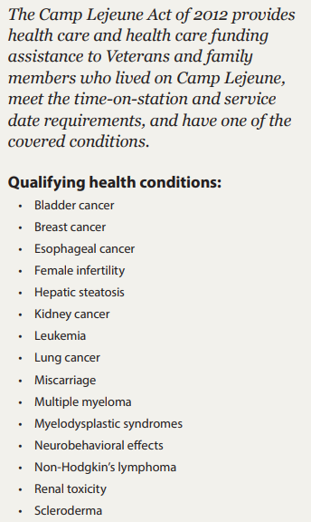
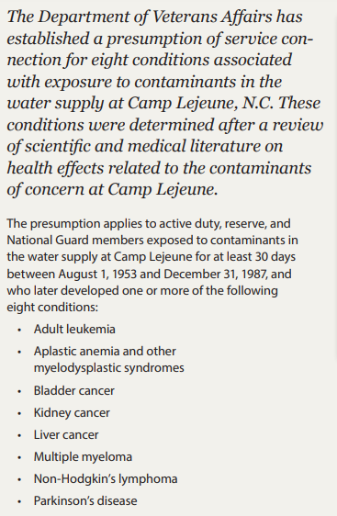
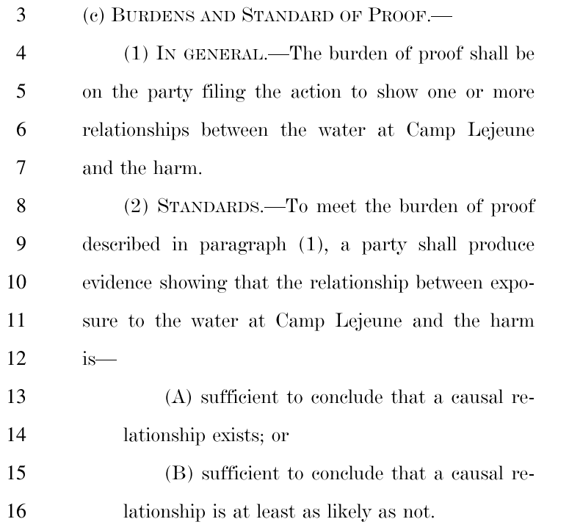
CLJA Presumptive Conditions
Source: Public Law 117-168, Section 804(c): https://www.congress.gov/bill/117th-congress/senate-bill/3373/text
Source: VA, Camp Lejeune: Veteran and family health and disability benefits https://www.publichealth.va.gov/docs/exposures/camp_lejeune_brochure.pdf
Notes:
Important notice -- Sec. 804 does not recognize any specific conditions, but VA previously recognized the conditions on the right

Slide 17

VFW – B&M MOU for CLJA
August 25, 2022 – MOU seeks to build trust:
Protect VFW members using education, advocacy, and assistance ~ details are under development.
Ensure VFW members receive the maximum benefits allowed ~ by creating a comparison tool.
Prevent VFW members from accepting a one-time CLJA benefit to the detriment of greater VA benefits.
Notes:
MOU’s stated purpose is to “create, implement, and execute a service project for VFW member interested in participating” in the CLJA litigation.

Slide 18

B&M Responsibilities
Set up a landing page for VFW members
Establish a dedicated phone number to answer questions.
Limit attorney fees to one-third of award.
Provide information on both VA and CLJA benefit and provide a recommendation.
Assist with any litigation regarding VA offset.
Refer possible VA claims to a VFW service officer
Notes:
When will the landing page to be set up??
RE last bullet – this still needs to be worked out with VFW – probably will need to be sent directly to dept. service office (cold vs. warm hand-off)

Slide 19
VFW Responsibilities
Notify members about the CLJA litigation and B&M partnership:
Inform via national magazine.
Inform Departments, Districts, and Posts.
Set up educational landing page for VFW members.
Perform outreach and refer VFW members to the landing page.
Ensure CLJA and VA information get out.
Notes:
Read, click on numbers

Slide 20
Example of B&M v. Other Firm
Compare Contingency Fees: One-Third v. Predatory One-Half:
Award Calculation Category | 33.3% Contingency Fee | 50.0% Contingency Fee
GROSS Court Award Under CLJA (Amount of Possible Offset) | $100,000 | $100,000
Up Front Fees | None | Unknown
Litigation Expenses Paid Before Contingency Fee (estimate) | $10,000 | --
Award After Expenses | $90,000 | --
One-Third Contingency Fee Based on $90,000 After Expenses | $30,000 | --
Larger One-Half Fee based on $100,000 Gross Award | -- | $50,000
Litigation Expenses Paid After Contingency Fee | -- | $10,000
NET Client Award After Fees and Expenses | $60,000 | $40,000
Bottom Line: 1/3 contingency fee may provide Up to 50% Higher NET Award | $20,000 | --
Notes:
- Possibility of fees limited to 25% -- we support

Slide 21
Six Inter-Connected CLJA Actors
The Veteran ~ this means VFW member, Veteran, or family of a Veteran ~ who may become both a CLJA Court plaintiff and a VA claimant.
VFW acts as the primary advocate the Veteran trusts.
B&M collaborates with VFW and acts to educate and protect Veteran to obtain maximum VA and Court benefits with minimum risk from predatory actors.
U.S. Navy is where Veterans must file initial claim.
U.S. District Court for the Eastern District of North Carolina maintains exclusive jurisdiction for lawsuit.
VA handles disability and survivor benefit claims.
Notes:
Read, click on numbers

Slide 22
CLJA Actors – 2
VFW posted notice at www.VFW.org for Veterans to see a VSO, file a VA claim, and be patient for details.
B&M is developing briefing materials, such as this presentation, to educate and protect VFW and Veterans.
U.S. Navy just released a new form to file an initial claim that is required before a Veteran can file suit.
U.S. District Court has not yet released special rules for filing lawsuits, fee limits, or other matters.
VA said Veterans can file a claim (or an intent to file), as PACT Act regulations will be issued in Jan. 2023.
Notes:
Read, click on numbers

Slide 23
CLJA Q&A
© 2018-2021 Bergmann & Moore LLC

Slide 24
CLJA Q&A – 1
Eligible Population: How many people might be eligible for the CLJA litigation?
An estimated one million people lived on Camp Lejeune from 1953 to 1987. See slide on Camp Lejeune Water Database.
Likely CLJA Claims: How many people may file claims under the new law?
There are no official estimates, yet mass torts usually involve about 10% of population, with an estimated cost in the billions.
VA Offset: How does a VA claim offset work?
We don’t know yet. The offset could be as narrow as only a VA compensation benefits paid for a condition VA granted service connection as related to Camp Lejeune. Or the offset could be as wide as any VA benefit or medical care as well as any Medicare or Medicaid benefit. Answers are expected by 2023.
Notes:
Read, click on numbers

Slide 25
CLJA Q&A – 2
Limit on Fees: Is it possible the Court may limit contingency fees to one-quarter of the Court award?
Yes. There are laws that limit attorney fees in similar situations. What’s more problematic is how some law firms are charging up to one-half contingency fee.
Changing Attorneys: If a Veteran has signed up with another law firm, can the Veteran switch to Bergmann & Moore?
Yes. The Veteran contacts B&M, signs an agreement with B&M, and ends the old agreement.
Ads: Are some TV and print ads wrong or misleading?
Yes. The airwaves and social media are flooded with incorrect information. For example, some ads imply the Veteran may have already won, or that there will be no VA offset. That’s why VFW and B&M are partnering for the CLJA, because we don’t want our Veterans to be the victims of unscrupulous actors.
Congress: Is Congress monitoring the ads and lawsuit?
The Congressional Budget Office estimated the Court awards may eventually pay out billions of dollars. We should expect Congress to pay close attention to the CLJA.
Notes:
Read, click on numbers

Slide 26

Next Steps – 1 – Contact VFW
Contact VFW. Each Veteran should see an accredited VFW service officer to determine eligibility for both VA benefits and the CLJA mass tort:
Follow guidance from VFW regarding the CLJA lawsuit and VA claims.
If the Veteran is eligible for VA benefits, then VFW should submit a VA disability claim (or intent to file).
If the Veteran is eligible for the CLJA litigation, then the VFW service officer should refer the Veteran to B&M.
Notes:
Read, click on numbers

Slide 27

Next Steps – 2 – Contact B&M
Contact B&M through landing page. Each potentially eligible Veteran should reach out to B&M and consider becoming a client. From there, B&M is working with a national mass tort law firm we carefully screened. Our B&M team will review each proposed settlement to see if the Veteran is maximizing both VA and CLJA benefits.
Notes:
Read, click on numbers

Slide 28

Next Steps – 3 – Carefully Decide
Carefully Decide. VFW and B&M want each Veteran to make the best-informed decision for both CLJA and VA benefits. This is why both VFW and B&M urge Veterans to closely compare VA benefits, attorney fees, and offsets before agreeing to any CLJA settlement.
Notes:
I know you are getting a lot of calls. We are trying to catch up and give you information to provide to those who are calling.

Slide 29

Thank You!
Bergmann & Moore thanks the Veterans of Foreign Wars for more than eight years of trust and partnership advocating for our nation’s Veterans.

