Slide 1

U.S. Department of Veterans Affairs
FOIA/Privacy Act
Briefed by:
Nate Miller, SSD Chief
November 2022

Slide 2
Consolidation
Records Management Center (RMC) started FOIA/PA consolidation in 2012, with full consolidation in 2014.
RMC is now the Centralized Services Division (CSD) in St. Louis, MO and process all compensation and pension FOIA/PA request.
Local Regional Offices (RO’s) are responsible for any other business line (VRE, LGY).

Slide 3
Types of Requests
FOIA is when a person is asking for a third parties' information.
True Privacy Act requests are for documents which only contain the requestors’ information. Like a DD214 request.
PA-FOIA Mixed Cases is the most common. These are cases in which a person is asking for their own record which also contains other individuals information. An example would be for a full claims folder. CSD must redact all the third party information but can release the requestors info.

Slide 4
TIPS from CSD
Veterans can check the status of their request on their VA.gov account, or by calling 800-827-1000
Veterans can request records by submitting a written request with a wet signature indicating the records they want.
  They do not need a standard form, but its simpler if they use the VA Form 20-10206, and SF-180.

Slide 5
TIPS from CSD
VBA Policy requires a wet signature. We cannot accept digital signatures.
Reminder: Veterans do not need a copy of their records to file a claim. VA will get their military records for them.

Slide 6
Policy and Forms
VBA Letter 20-19-09 is the current policy letter outlining VBA policy on processing requests for records.
VA Form 20-10206
SF-180

Slide 7
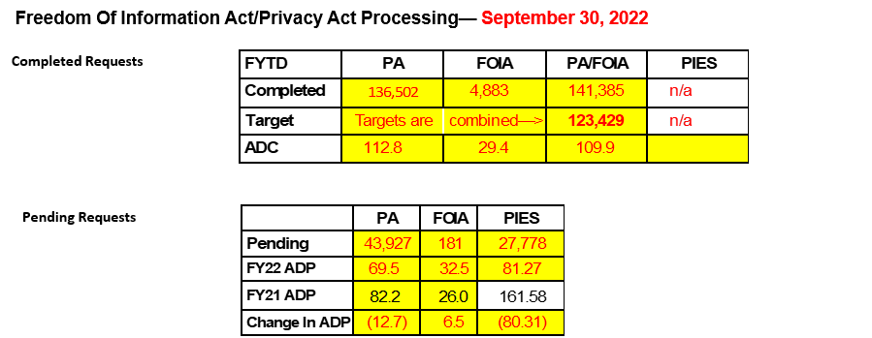
Data for EoM September 2022

Slide 8
Contact Information
Please send FOIA inquires and documents for review to the VBA FOIA Mailbox: FOIA.VBACO@va.gov

