Slide 1
PACT Act
A Path Toward Success

Slide 2
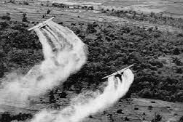
Long History of Segmented Benefits

Slide 3
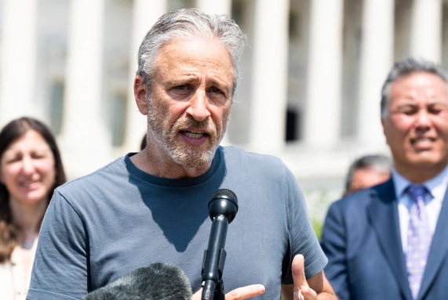
Initial Meetings

Slide 4

3 Major Bills With Similar Outcomes

Slide 5

Bringing It All Together

Slide 6
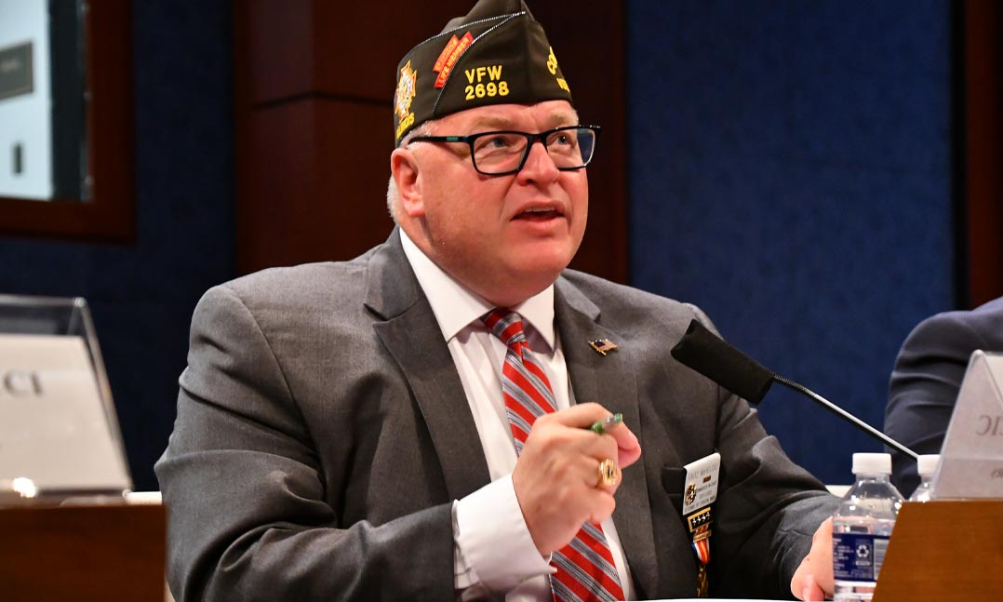
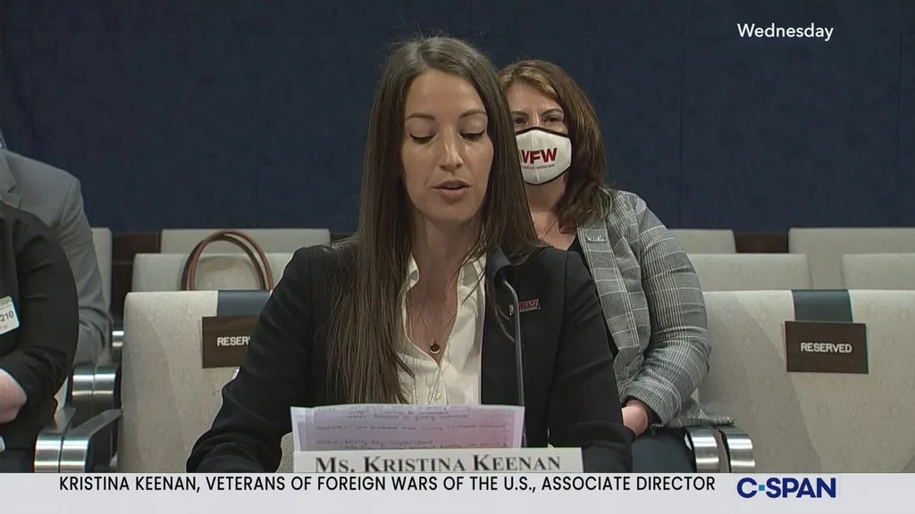

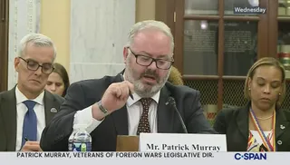
VFW Testified Six Times in the 117th Congress Alone

Slide 7

Whoops Blue Slip Issue

Slide 8

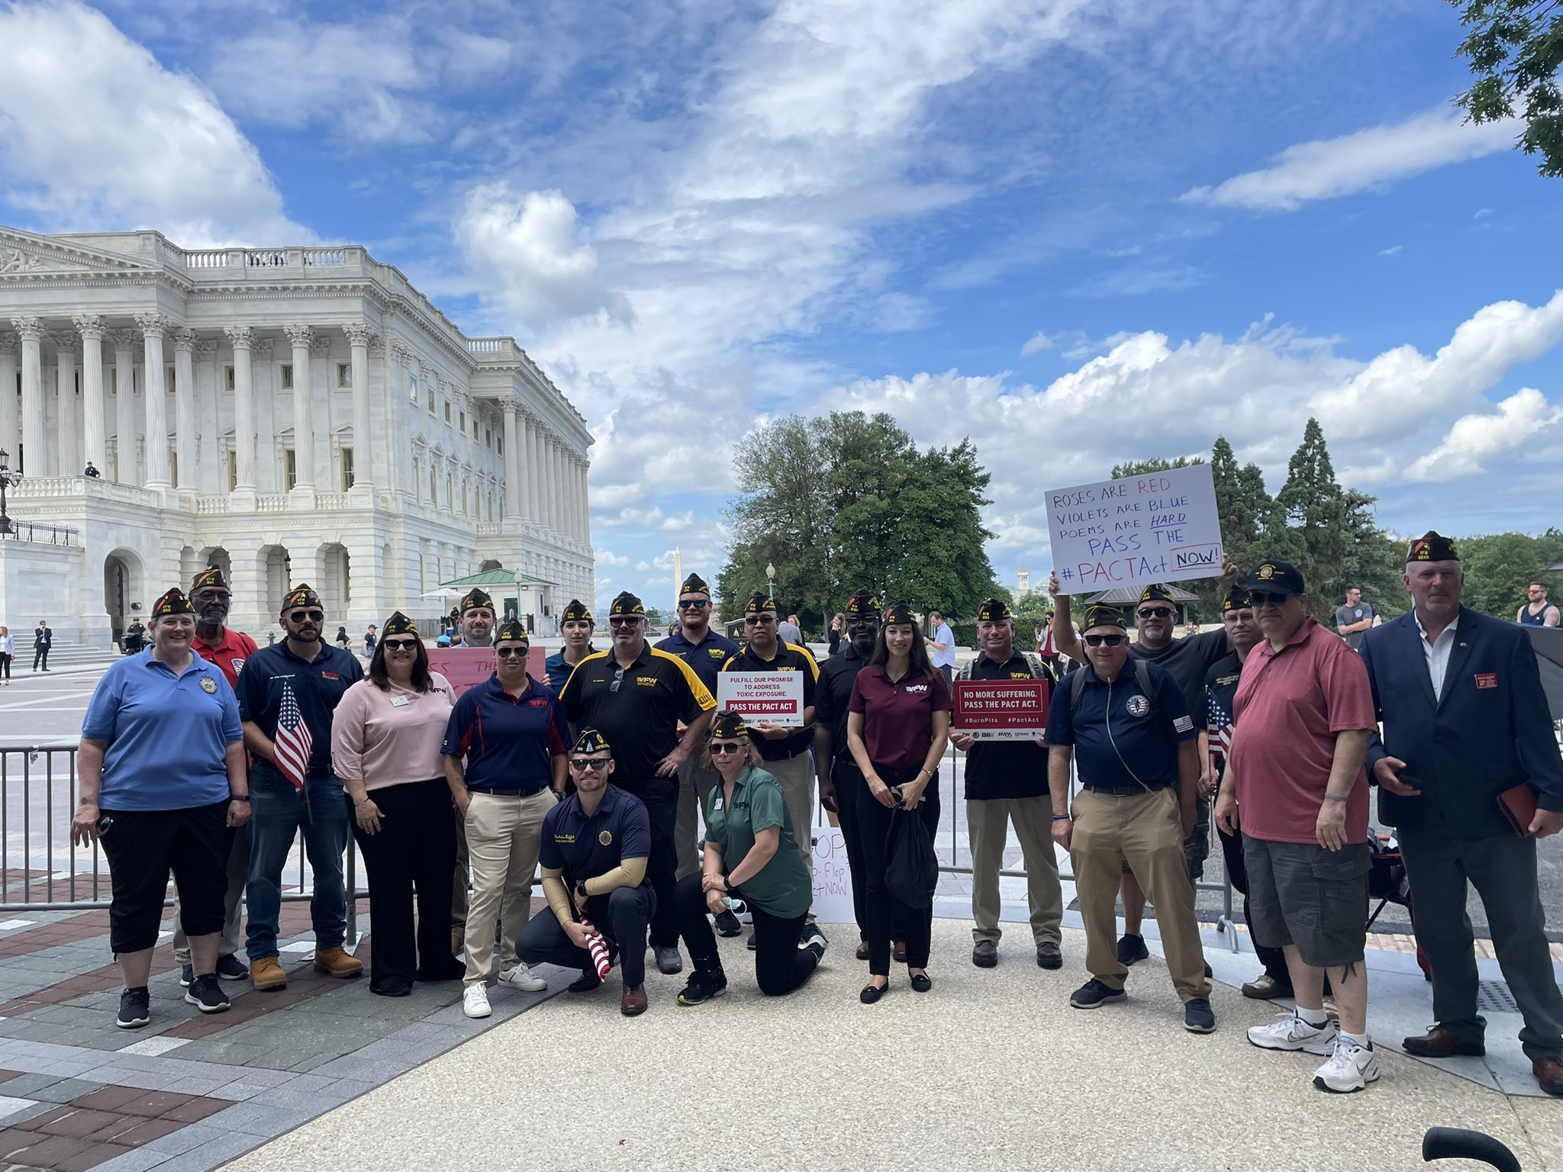
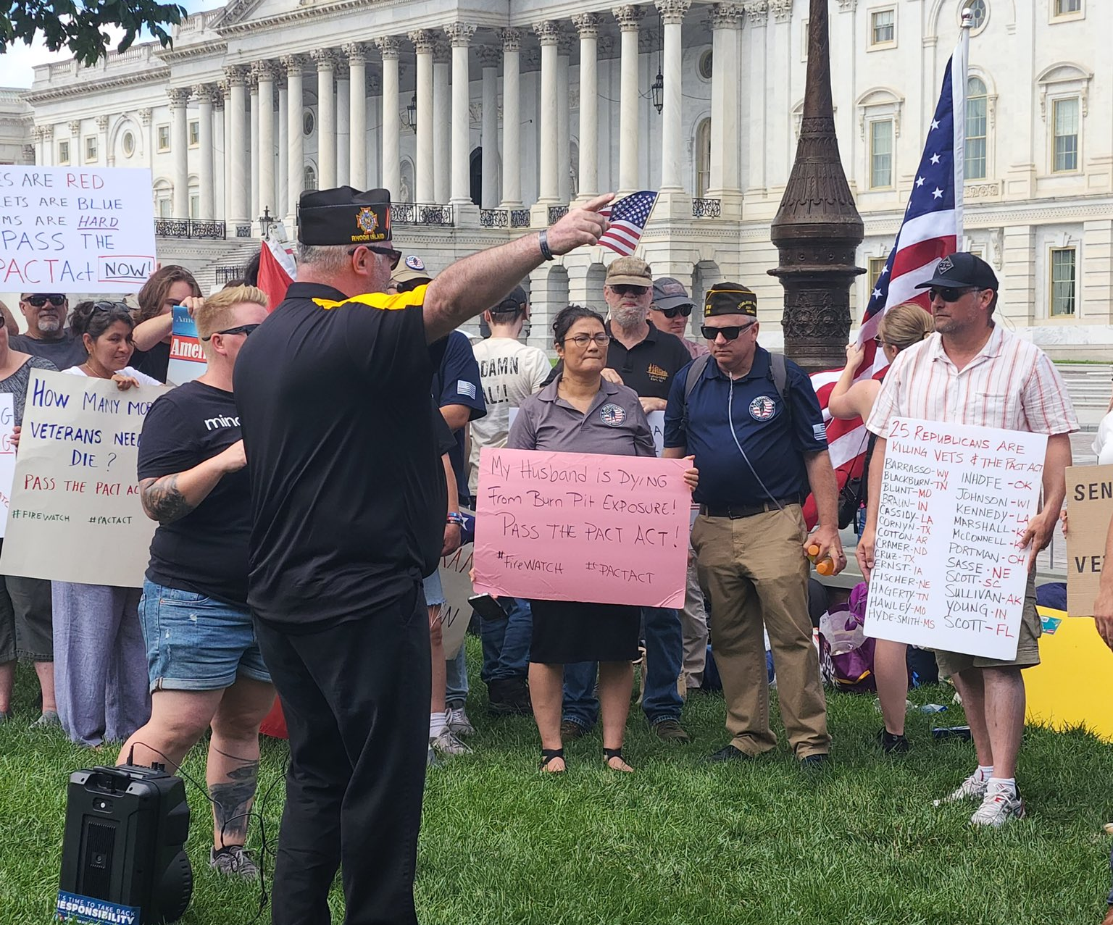
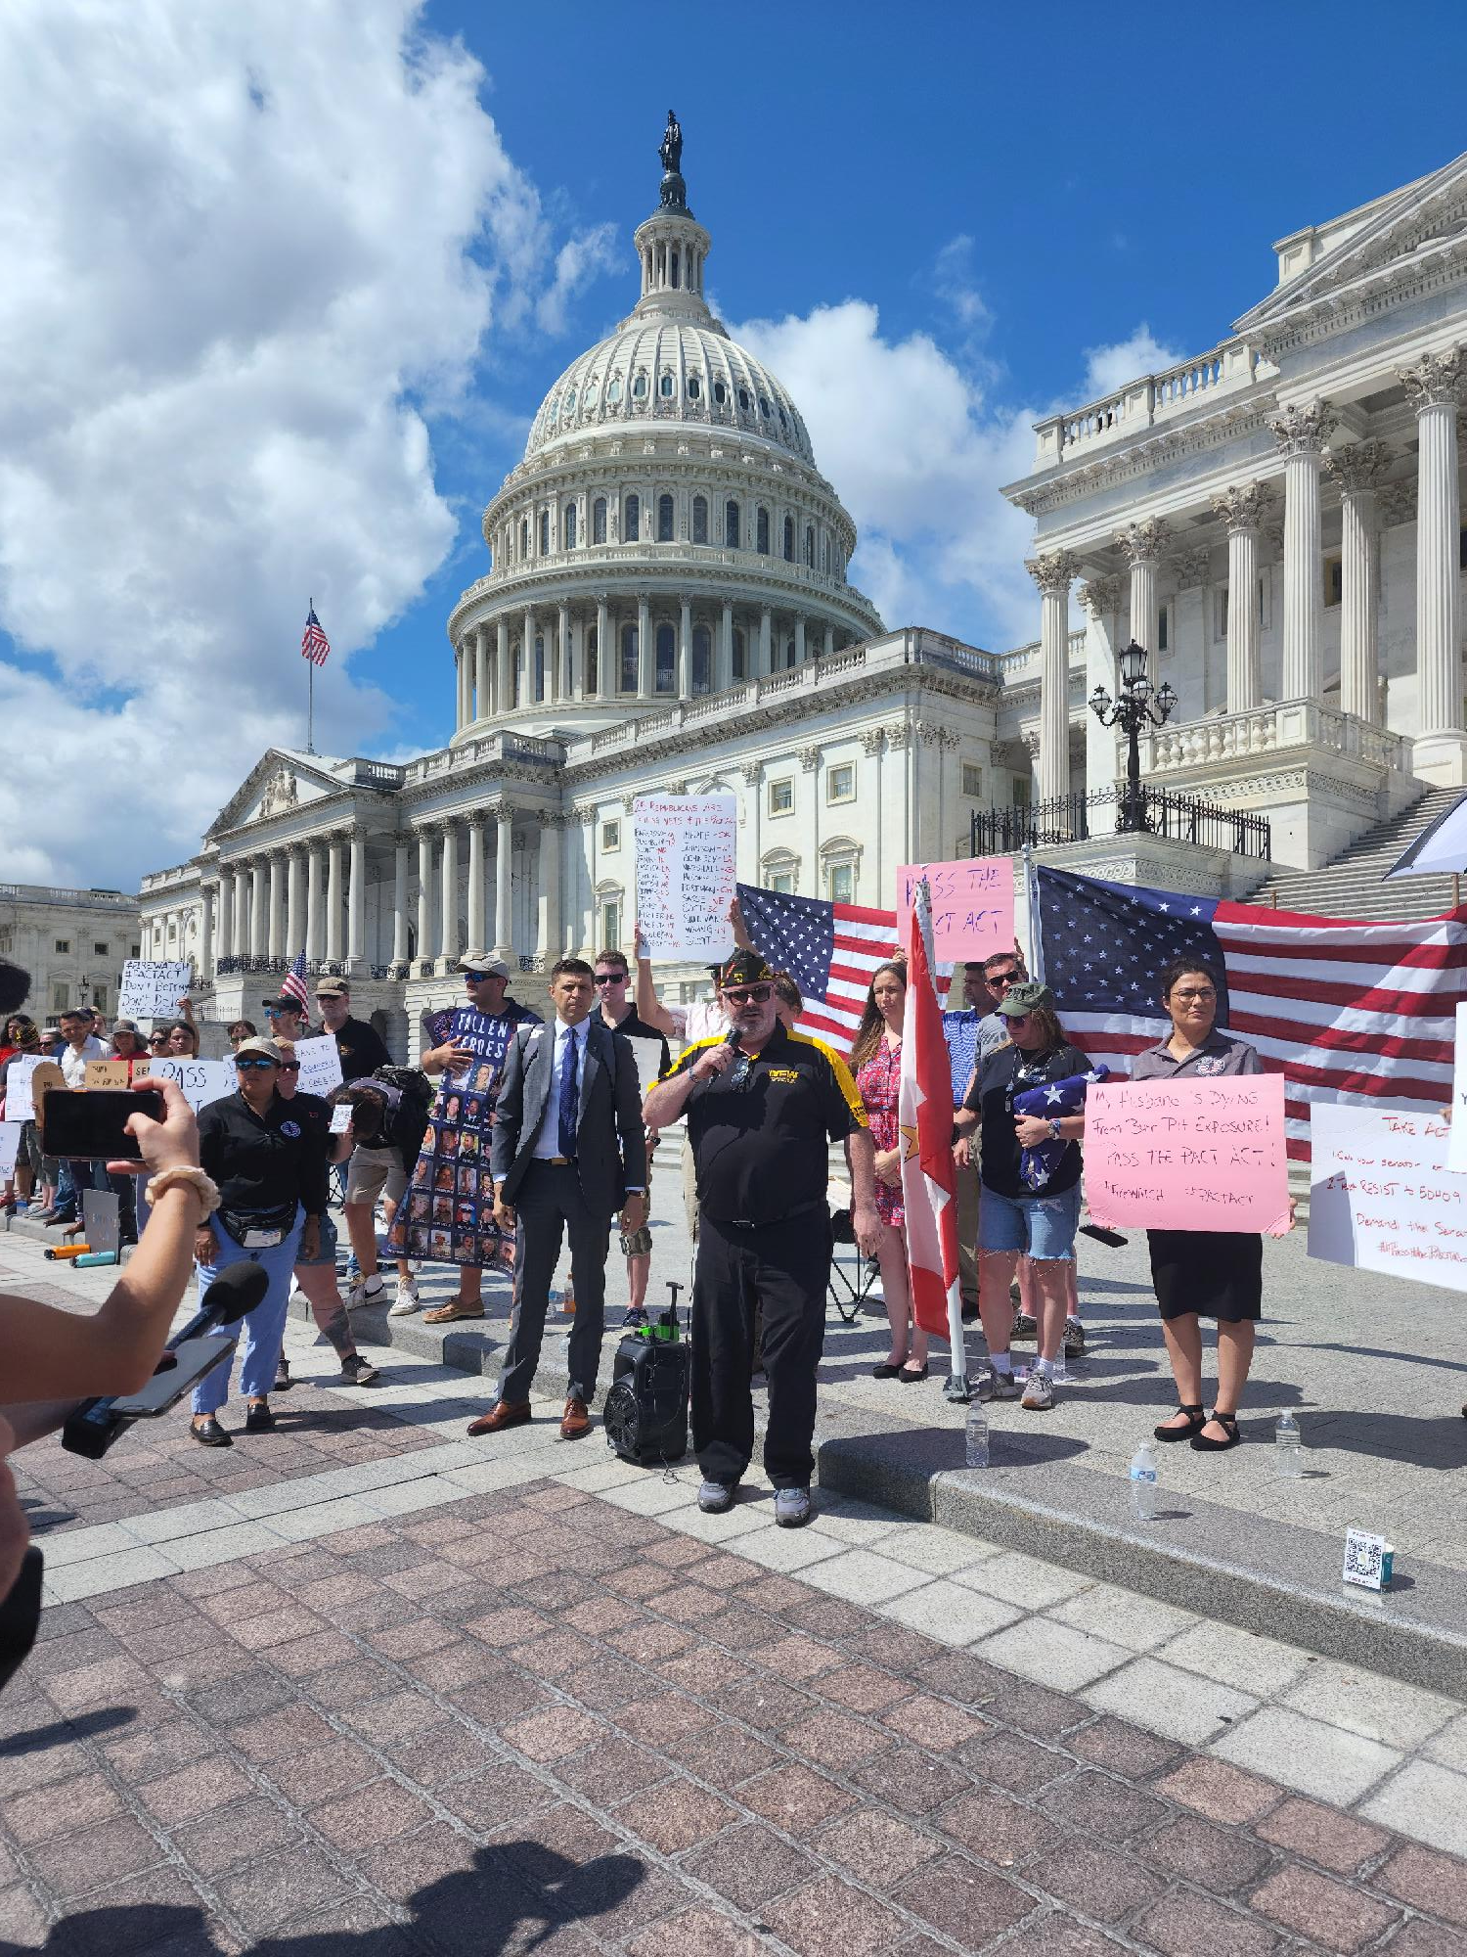
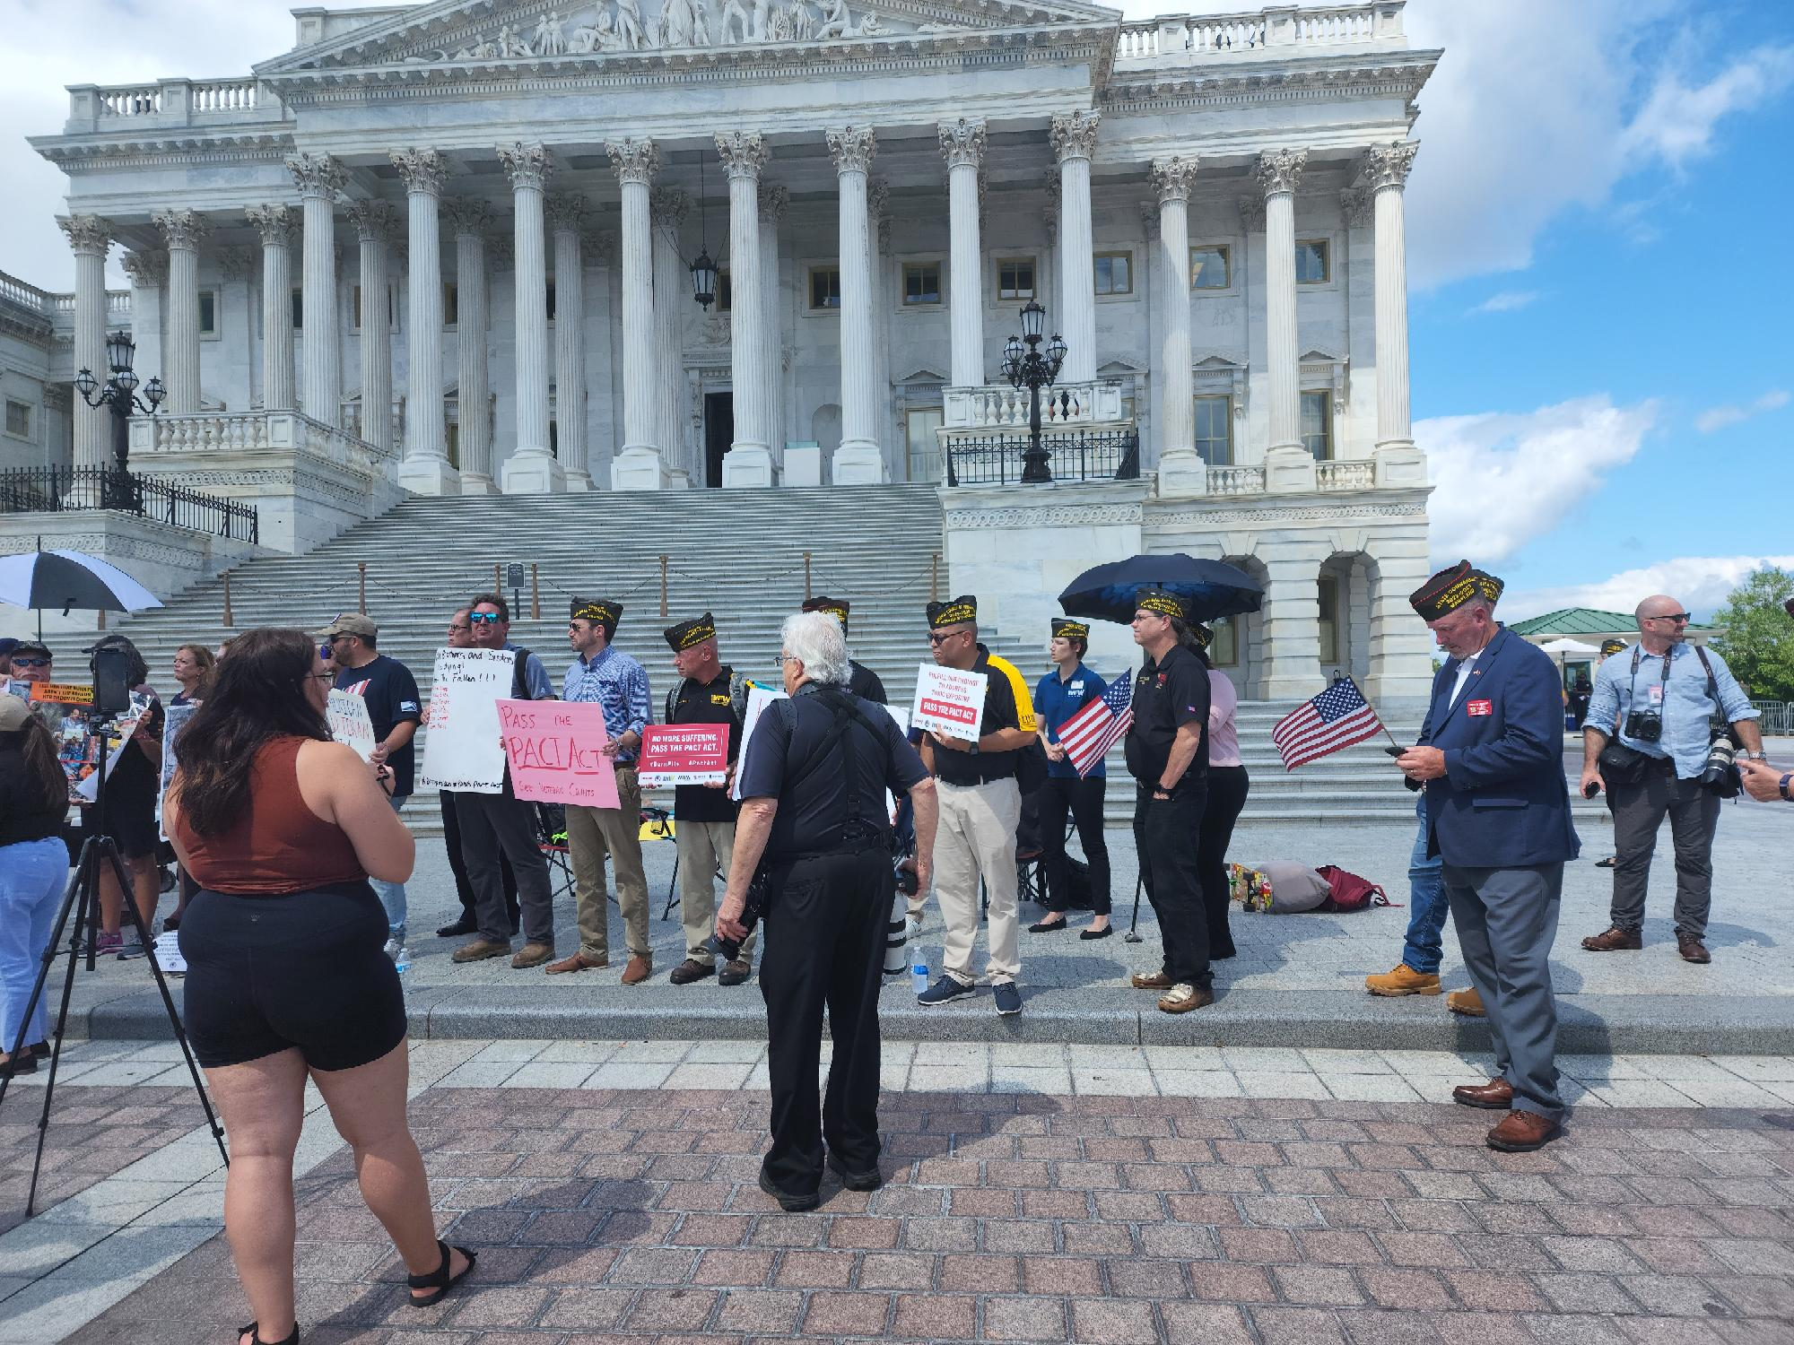

Slide 9
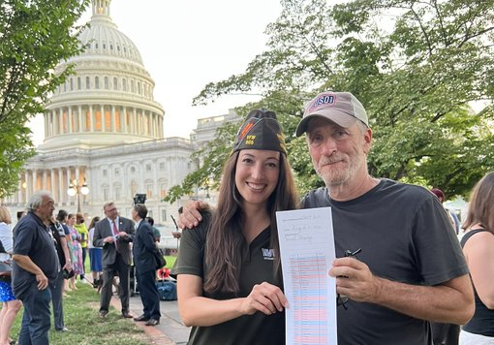
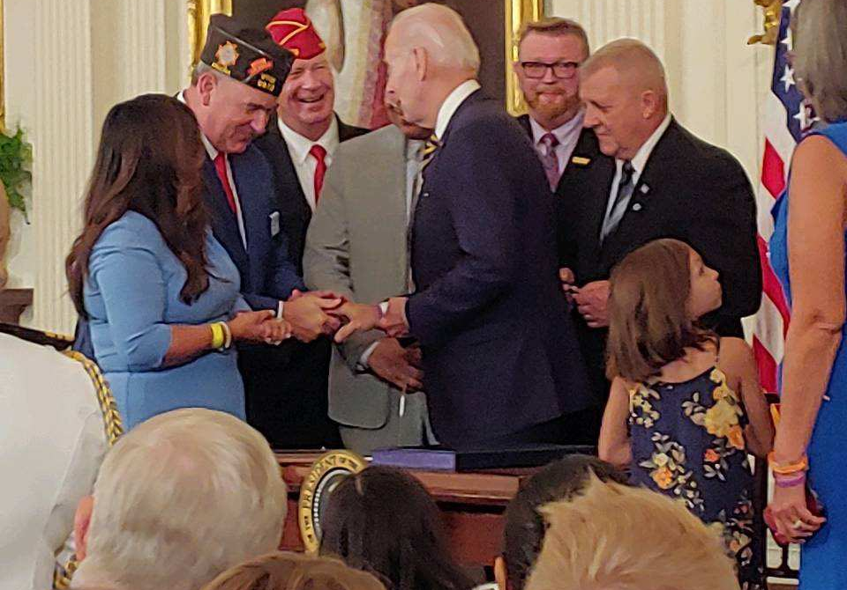
Final Bill Passage and Signing for 23 New Presumptive Conditions

Slide 10

Now Go Get To Work

Slide 11

Questions and Discussion

