Slide 1




PACT ACT OVERVIEW
All Things PACT Act 101

Slide 2

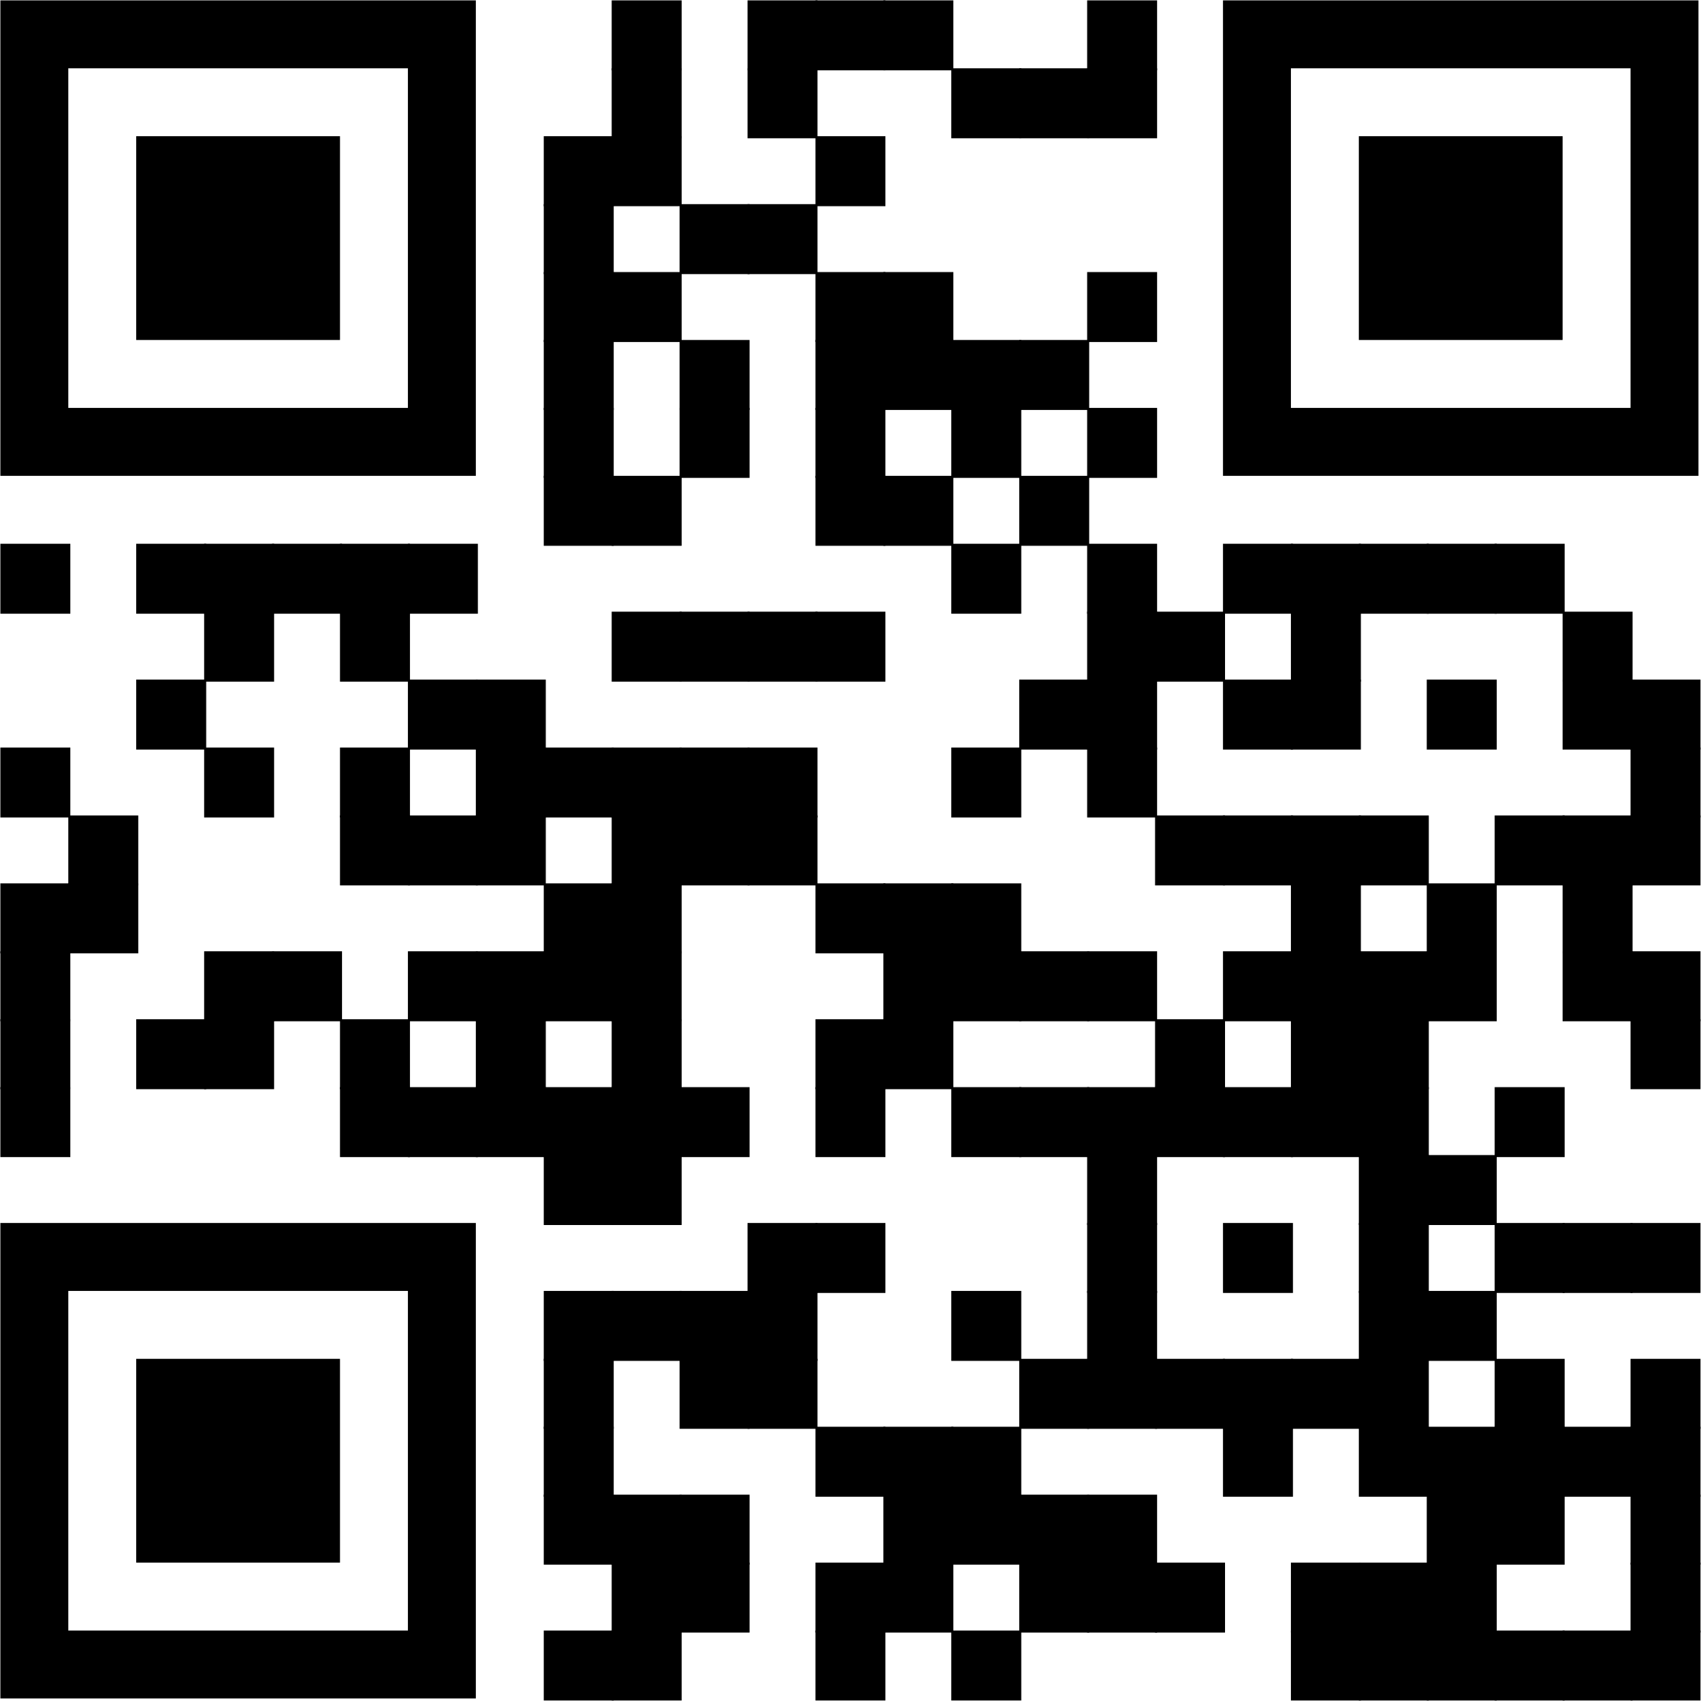
What is the PACT Act?
Vietnam
Gulf War Era
Post 9/11
The Promise to Address Comprehensive Toxics Act of 2022 …
is a new law that expands VA health care and benefits for Veterans exposed to burn pits and other toxic substances. This law helps us provide generations of Veterans—and their survivors—with the care and benefits they’ve earned and deserve.
The PACT Act
  Expands and extends eligibility for VA health care for Veterans with toxic exposures and Veterans of the Vietnam era, Gulf War era, and Post-9/11 era, and
  Expands eligibility for benefits for Veterans exposed to toxic substances.
va.gov/pact

Slide 3




Key Components of the PACT Act (1 of 2)
The Act expands and extends eligibility for VA health care for Veterans with toxic-exposures and Veterans of the Vietnam era, Gulf War era, and Post-9/11 era
VA will improve the decision-making process for determining what medical conditions will be considered for presumptive status.
Every enrolled Veteran will receive an initial toxic exposure screening and a follow-up screening every five years. Veterans who are not enrolled, but who are eligible to enroll, will have an opportunity to enroll and receive the screening.
VA health care staff and claims processors will receive toxic exposure-related
education and training.
va.gov/pact

Slide 4



Key Components of the PACT Act (2 of 2)
The Act requires research studies of the mortality of Veterans who served in Southwest Asia during the Gulf War;
Post-9/11 Veteran health trends; and Veteran cancer rates.
The Act will help VA build a stronger, more skilled workforce
to meet the growing demand for benefits and services
The Act authorizes 31 new medical facilities across the country, providing greater access to VA health care
va.gov/pact

Slide 5
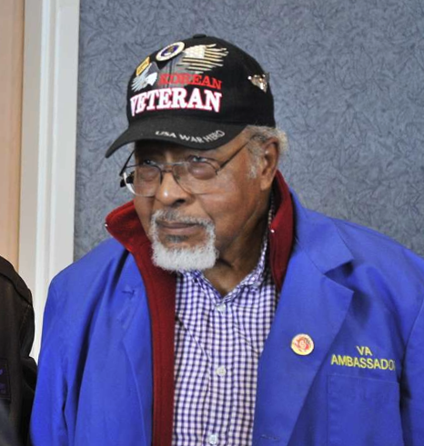
What conditions will be presumed to be service-connected?
As of Aug 10, a long list of new conditions are presumed to be service-connected due to various in-service toxic exposures. You should APPLY NOW at VA.gov/PACT so that your claim can be processed, and you can get your benefits.
Asthma (diagnosed after service)
Brain cancer
Chronic bronchitis
Chronic obstructive pulmonary disease (COPD)
Chronic rhinitis
Chronic sinusitis
Constrictive bronchiolitis or obliterative bronchiolitis
Emphysema
Gastrointestinal cancer of any type
Glioblastoma
Granulomatous disease
Head cancer of any type
High blood pressure (hypertension)
Interstitial lung disease (ILD)
Kidney cancer
Lymphatic cancer of any type
Lymphoma of any type
Melanoma
Monoclonal gammopathy of
undetermined significance (MGUS)
Neck cancer
Pancreatic cancer
Pleuritis
Pulmonary fibrosis
Reproductive cancer of any type
Respiratory (breathing-related) cancer of any type
Sarcoidosis
va.gov/pact

Slide 6


VA Health Care Eligibility Available Now
Vietnam Era Veterans: Veterans who served in the following locations and time periods can enroll in VA health care NOW:
  Republic of Vietnam (between January 9, 1962, and May 7, 1975),
  Thailand at any US or Royal Thai base (between January 9, 1962, and
  June 30, 1976)
  Laos (between December 1, 1965, and September 30, 1969)
  Certain Provinces in Cambodia (between April 16, 1969, and April 30, 1969)
  Guam or American Samoa or their territorial waters (between January 9, 1962, and July 31, 1980)
  Johnston Atoll, or a ship that called there, between January 1, 1972, and September 30, 1977
For Post-9/11 combat Veterans who separated or discharged between September 11, 2001, and October 1, 2013:
Special Enrollment Period – October 1, 2022 - October 1, 2023
Enrollment is free, there are no annual costs, and care may be free as well!
va.gov/pact
Notes:
In addition to Vietnam Era Veterans who can enroll in health care NOW, as of 1 October—there’s a Special Enrollment Period for certain post-9/11 combat Veterans (non-Vietnam). Enrollment is free, there are no annual costs, and care may be free as well! Details are at the link/QR code.
Bottom line: If you are a post-9/11 combat Veteran who has not previously enrolled in VA health care and who was separated or discharged between September 11, 2001, and October 1, 2013, Apply now under special enrollment as this window is only for one year—after that, you will need to be eligible under other criteria, which may not be immediate. This is an opportunity for more recently separated Veterans who didn’t take advantage of the 5-year window when they were discharged/separated to enroll for VA health care if they don’t meet other eligibility requirements.

Slide 7


Other affected Veterans and Survivors
What about additional benefits and care for other Veterans?...
Gulf War Veterans? What about survivors’ benefits?
Information for Vietnam-era Veterans,
Gulf War Veterans, survivors, and
SO MUCH MORE can be found at VA.gov/PACT
Get the care and benefits you EARNED and DESERVE!
Apply at VA.gov/PACT today.
va.gov/pact
Notes:
For the briefer, more details on Gulf War Veterans and survivors’ benefits if asked (an FAQ):
Gulf War Veterans:
Gulf War Veterans who performed active service in any of the following locations during the specified time periods will be eligible, on a rolling basis, to enroll if they haven’t previously enrolled:
On or after August 2, 1990, in Bahrain, Iraq, Kuwait, Oman , Qatar, Saudi Arabia, Somalia, or the United Arab Emirates
On or after September 11, 2001, in Afghanistan, Djibouti, Egypt, Jordan, Lebanon, Syria, Yemen, Uzbekistan, or any other country determined relevant by VA
Gulf War Veterans may also be eligible if they received certain medals (Armed Forces Expeditionary Medal, Service Specific Expeditionary Medal, Combat Era Specific Expeditionary Medal, Campaign Specific Medal, or other combat theater award medals established by Federal statute or Executive order) in connection with service during a period after the Persian Gulf War
If you’re a surviving family member of a Veteran, you may be eligible for these benefits:
A monthly VA Dependency and Indemnity Compensation (VA DIC) payment. You may qualify if you’re the surviving spouse, dependent child, or parent of a Veteran who died from a service-connected disability.
Learn how to apply for VA DIC
A one-time accrued benefits payment. You may qualify if you’re the surviving spouse, dependent child, or dependent parent of a Veteran who we owed unpaid benefits at the time of their death.
Learn about evidence needed for accrued benefits
A Survivors Pension. You may qualify if you’re the surviving spouse or child of a Veteran with wartime service.
Learn how to apply for a Survivors Pension
You may be eligible for these VA benefits as the surviving family member of a Veteran:
Burial benefits and memorial items such as a gravesite in a VA national cemetery or a free headstone, marker, or medallion.
A burial allowance to help with the Veteran’s burial and funeral costs. You may qualify if you’re the Veteran’s surviving spouse, partner, child, or parent.
Education and training. You may qualify if you’re the survivor of a Veteran who died in the line of duty or as a result of service-connected disabilities.
Health care through the Civilian Health and Medical Program of the Department of Veterans Affairs (CHAMPVA). You may qualify if you’re the survivor or dependent of a Veteran with a service-connected disability.
A VA-backed home loan. You may qualify if you’re the surviving spouse of a Veteran.

Slide 8
When / How should I file a claim?
APPLY NOW!
If you think you may be eligible for benefits and/or care under the PACT Act, apply now
  Go to VA.gov/PACT for more info!
  If you have questions, call 1-800-MyVA411
What if I’ve previously been denied?
  Veterans previously denied a toxic-exposure related claim are encouraged to file a supplemental claim. Once a supplemental claim is received, VA will review the claim under the new law.
More info at VA.gov/PACT
va.gov/pact
Notes:
For the briefer, please reiterate going through the website (or use the QR code!) to find the E-Z forms needed to file a claim and/or enroll in health care.

