Slide 1
The PACT Act

Slide 2
The Sergeant First Class Heath Robinson Honoring our Promise to Address Comprehensive Toxics (PACT) Act
The Sergeant First Class Heath Robinson Honoring our Promise to Address Comprehensive Toxics (PACT) Act commonly referred to as “The PACT Act”
The new law is named for former Sgt. First Class Heath Robinson who died in 2020 after battling lung cancer for three years. Robinson’s illness was attributed to smoke exposure from burning trash pits during his deployment to Iraq in 2006 and 2007.

Slide 3

The History of H.R 3967 Honoring our PACT Act of 2022
Introduced into the House on 6/17/2021
Reported to House, Part 1 2/22/2022
Passed House 3/3/2022
Passed Senate 6/16/2022
Signed into Law 8/10/2022

Slide 4
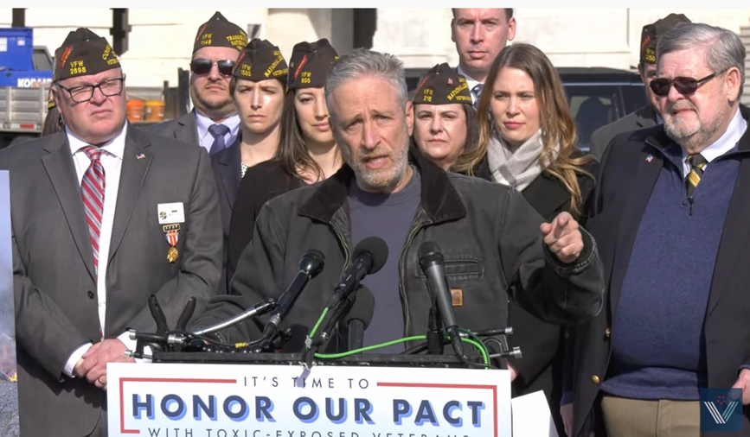
VFW’s Role in The PACT Act
Since the inception of the PACT Act, VFW’s National Legislative Service has been working with lawmakers to bring about Toxic Exposure Reform.
VFW deployed multiple “Take Action” campaigns through the VFW Action Corps to urge Americans to contact their senators and tell them to vote YES to the PACT Act.
The Call to Action reached American Personality Jon Stewart who played an instrumental role in assisting with getting the PACT Act passed.

Slide 5
What is the PACT Act?
The PACT Act is a new law that expands VA benefits and health care to veterans exposed to burn pits and other toxic substances. This law provides generations of veterans and their survivors with the care and benefits they’ve earned and deserve.

Slide 6
The PACT Act Health Care Eligibility
The law expands health care eligibility to several groups of veterans who may not have been eligible before. These groups are broken into 3 new categories:
Category 1: Veterans who participated in a toxic exposure risk activity (as defined by law) while serving on active duty, active duty for training, or inactive duty training.
Category 2: Veterans who were assigned to a duty station (including airspace above) in certain locations during specific periods of time. These specific dates and locations can be found on slides 14 & 15 of this presentation.
Category 3: Veterans who deployed in support of Operation Enduring Freedom, Operation Freedom’s Sentinel, Operation Iraqi Freedom, Operation New Dawn, Operation Inherent Resolve, or Resolute Support Mission.

Slide 7
PACT Act Eligibility Key Dates
August 10, 2022: PACT Act signed into law.
October 1, 2022: Veterans who served in the Republic of Vietnam, Thailand, Laos, certain provinces in Cambodia, Guam, or American Samoa (or their territorial waters), or the Johnston Atoll (or a ship that called there) during specific time periods may enroll in VA health care.
October 1, 2022 - October 1, 2023: Veterans who served on active duty in a theater of combat operations during a period of war after the Persian Gulf War or in combat against a hostile force during a period of hostilities after 11/11/98, and who were discharged or released between 9/11/01–10/1/13 may enroll in VA health care.
November 8, 2022: Toxic Exposure Screening starts for enrolled veterans.

Slide 8
PACT Act Eligibility Enrollment Dates
October 1, 2024: Phase in enrollment for health care for Veterans identified in Categories 1 and 2 who were discharged or released August 2, 1990 - September 11, 2001
October 1, 2026: Phase in enrollment for health care for Veterans identified in Categories 1 and 2 who were discharged or released September 12, 2001 - December 31, 2006
October 1, 2028: Phase in enrollment for health care for Veterans identified in Categories 1 and 2 who were discharged or released January 1, 2007 - December 31, 2012
October 1, 2030: Phase in enrollment for health care for Veterans identified in Categories 1 and 2 who were discharged or released January 1, 2013 - December 31, 2018
November 8, 2032: Phase in enrollment for health care for Veterans identified in Category 3

Slide 9
The PACT Act and VA Health Care
Additional ways the PACT Act expands VA Health care include:
The Act expands and extends eligibility for VA health care for veterans with toxic-exposures and veterans of the Vietnam era, Gulf War era, and Post-9/11 era.
VA will improve the decision-making process for determining what medical conditions will be considered for presumptive status.
Every enrolled veteran in VHA will receive an initial toxic exposure screening and a follow-up screening every five years. Veterans who are not enrolled, but who are eligible to enroll, will have an opportunity to enroll and receive the screening.

Slide 10
The PACT Act and VA Health Care
VA health care staff and claims processors will receive toxic exposure-related education and training.
The Act requires research studies on the mortality of veterans who served in Southwest Asia during the Gulf War, Post-9/11 veteran health trends, and veteran cancer rates.
The Act authorizes 31 new medical facilities across the country, providing greater access to VA health care.
Notes:
This is in lieu of the now defunct AIR Commission

Slide 11
The PACT Act and VA Health Care Enhanced Enrollment
The PACT Act brought some changes to VHA enhanced enrollment, most notably:
Enhanced Enrollment Eligibility for VA Healthcare for new veterans has been extended from 5 years to 10 years
Open Enhanced Enrollment begins October 1, 2022, through October 1, 2023
*Special note: Enhanced Enrollment is Priority Group 6 within VHA.
Notes:
Enhanced enrollment at PG6 – veterans who served in a theater of operation are now granted 10 years of healthcare immediately following discharge unless they meet the criteria for a higher priority group.

Slide 12
The PACT Act and VA Health Care
Eligibility for Enhanced Enrollment has been made for veterans who served in any of the following capacities:
On or after August 2, 1990: Iraq, Kuwait, Bahrain, Oman, Qatar, Saudi Arabia, Somalia (new), or U.A.E.
On or after September 11, 2001: Afghanistan, Djibouti, Egypt (new), Jordan (new), Lebanon (new), Syria, Yemen (new), or Uzbekistan,
Any risk of exposure recorded in an exposure record tracking system, including ILER,
Operations Iraqi Freedom, Enduring Freedom, New Dawn, Freedom’s Sentinel, Inherent Resolve, or Resolute Support Mission,
Any other location the VA Secretary determines is appropriate
Notes:
ILER - Individual Longitudinal Exposure Record: An individual, electronic record of exposures for each service member.
ILER will contain:
Time of deployments
Locations and events during deployments
All-hazard occupational data
Environmental hazards that were known or found later
Any monitoring performed in the area(s)
Medical encounter information (e.g., diagnosis, treatment, and laboratory data)
Medical concerns that should be addressed regarding possible exposures
ILER will be available to VA and DoD healthcare providers; epidemiologists and researchers; and VA disability evaluation and benefits determinations specialists. It will be used to improve internal processes and will not be available for individual access.

Slide 13
The PACT Act and VA Presumptive Benefits
The PACT Act has added more than 20 new presumptive conditions that veterans can file for if they meet the requirements.
What is “Presumptive” Service Connection?
VA presumes that certain disabilities were caused by military service. This is because of the unique circumstances of a specific veteran’s military service.
If a presumed condition is diagnosed in a Veteran within a certain group, they can be awarded disability compensation.

Slide 14
The PACT Act Presumptive Areas
The PACT Act determined that veterans who served in any of the below locations on or after August 2, 1990 had exposure to burn pits or other toxins. We call this having a presumption of exposure.
Bahrain Iraq Kuwait
Oman Qatar Saudi Arabia
Somalia The United Arab Emirates (UAE)
**Includes the airspace above any of these locations

Slide 15
The PACT Act Presumptive Areas
The PACT Act determined that veterans who served in any of the below locations on or after September 11, 2001 had exposure to burn pits or other toxins. We call this having a presumption of exposure.
Afghanistan Djibouti Egypt
Jordan Lebanon Syria
Uzbekistan Yemen
**Includes the airspace above any of these locations

Slide 16
The PACT Act Presumptive conditions for
Gulf War and Post 9/11 Veterans
Brain Cancer | Chronic Rhinitis
Glioblastoma | Chronic Sinusitis
Respiratory (Breathing-related) cancer of any type | Constrictive bronchiolitis
Gastrointestinal cancer of any type | Obliterative Bronchiolitis
Head cancer of any type | Emphysema
Lymphoma of any type | Granulomatous disease
Lymphatic cancer of any type | Interstitial lung disease (ILD)
Neck cancer | Pleuritis
Pancreatic Cancer | Pulmonary Fibrosis
Reproductive cancer of any type | Sarcoidosis
Kidney Cancer | Chronic Bronchitis
Melanoma | Chronic Obstructive Pulmonary Disease (COPD)
Asthma (Diagnosed after service)

Slide 17
The PACT Act Presumptive conditions for Vietnam
Veterans and those exposed to Tactical Herbicides
For Vietnam veterans and other veterans exposed to tactical herbicides, the PACT Act includes two Agent Orange presumptive conditions:
Monoclonal gammopathy of undetermined significance (MGUS)
High blood pressure (hypertension).
Notes:
Any conceded exposure to herbicides will qualify for this. Including Vietnam, Korean DMZ, C-123 aircraft, etc.
Vietnam: January 9, 1962, through May 7, 1975
Thailand: January 9, 1962, through June 30, 1976
Guam or American Samoa: January 9, 1962, through July 30, 1980
Laos: December 1, 1965, through September 30, 1969
Cambodia at Mimot or Krek, Kampong Cham Province: April 16, 1969, through April 30, 1969
Korean DMZ: Sept. 1, 1967, through August 31, 1971.

Slide 18
The PACT Act and When to File for VA Benefits
VA is accepting claims NOW for service connection for the new presumptive conditions outlined in PACT ACT.
If a veteran applies for one of the presumptive conditions and VA grants service connection, the effective date of the claim may be retroactive to August 10, 2022, the date the law went into effect, if the claim or Intent to File was filed within 1 year of the law’s passing.
Notes:
This is not “liberalizing” like NEHMER or others. There is no earlier effective date for previously filed claims.

Slide 19
Appealing Previously Denied Claims Under the PACT Act
If a veteran was previously denied service connection for one of the new presumptive conditions, they can appeal this decision by submitting two forms:
VA Form 20-0995: Used to request a Supplemental Claim of a VA Rating Decision a veteran disagrees with
VA Form 21-4138: Used as a statement in support of the claim being appealed on the VA Form 20-0995

Slide 20
The PACT Act and Dependency and Indemnity Compensation (DIC)
Dependents wanting to submit a claim for DIC or accrued benefits under the Pact Act must first verify the veteran’s cause of death is due to a presumptive condition.
Things to consider when filing for a DIC Claim:
Make sure the death certificate states the cause of death as one of the new PACT Act Presumptive conditions
Direct and Secondary service-connection can be considered to qualify for DIC/accrued benefits
The veteran did not need to file for the condition in the past. Entitlement to benefits can be established for survivors after the veteran’s death.
The application process has not changed to submit a DIC claim
Notes:
If the death certificate does not include this information, the surviving family member will need to request an amended death certificate. VA will NOT develop for this.

Slide 21
The PACT Act Effective Dates
When you filed your PACT Act Claim | Claim Effective Date if Benefits are Granted
Compensation claim filed Within 1 Year of the PACT Act signed (08/10/2022) | August 10, 2022
Compensation claim filed After 1 Year of the PACT Act being signed into Law | The effective date is the date the claim was submitted
Compensation claim was denied prior to the PACT Act being signed and veteran submits an appeal for the previously denied condition. | The effective date will be August 10, 2022, or one year prior to the filing of the appeal, whichever is later.
Dependency Indemnity Compensation (DIC) Claim filed and denied BEFORE the PACT Act was signed | The effective date will be the date the original DIC claim was filed.
Dependency Indemnity Compensation (DIC) Claim filed After the PACT Act was signed | The effective date will be August 10, 2022, or one year prior to the filing of the claim, whichever is later.

Slide 22
The PACT Act Section 804
Camp Lejeune Justice Act
The PACT Act also includes the Camp Lejeune Justice Act of 2022 (CLJA). (Section 804)
This section allows individuals exposed to contaminated water at Camp Lejeune to file lawsuits against the Government.
CLJA Lawsuits will not influence VA’s decision to provide benefits or health care and will not affect the amount of benefits or health care VA can provide.
IMPORTANT: If a veteran or family member is awarded relief by the court in a lawsuit brought under the CLJA, the award must be offset by the amount of any disability award, payment, or benefit VA provided relating to exposure to water at Camp Lejeune. This would reduce the amount of the award veterans or family members receive from the court, but it will not affect their VA benefits.

Slide 23
The PACT Act Section 804
Camp Lejeune Justice Act
In addition to the CLJA award being offset by the amount of any VA disability award, payment, or benefit CLJA Awards are also offset by Medicare or Medicaid benefits.
The U.S. Department of Justice has set up a phone number and email address for questions about the status of cases filed in federal court under the CLJA.
The phone number is (202) 353-4426, and the email is camplejeune.pactact@usdoj.gov.

Slide 24
PACT Act Info Initiative
On Wednesday November 16, 2022, VFW launched www.pactactinfo.org, a website to streamline referrals to our cadre of accredited service officers for VA Disability Claims.
When a veteran visits the site, they can answer a short series of questions to determine if they are potentially eligible for benefits and can also request that an accredited representative contact them to discuss their claim.

Slide 25

PACT Act Info Initiative
When a veteran visits the site, they have three options to choose from:
Check Eligibility for VA Benefits
Learn More About the PACT Act
Join Our Efforts

Slide 26
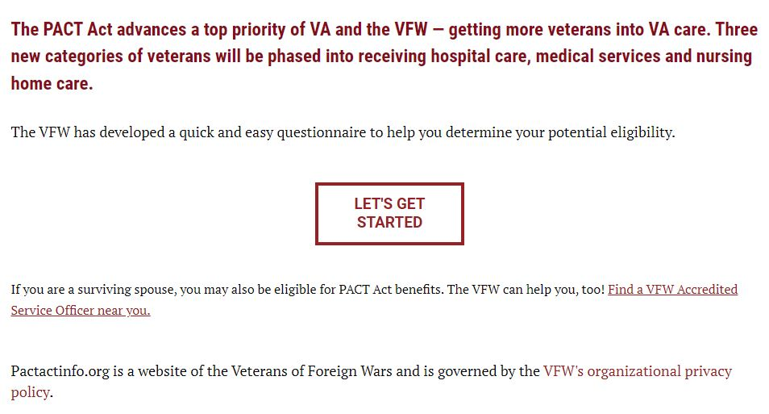
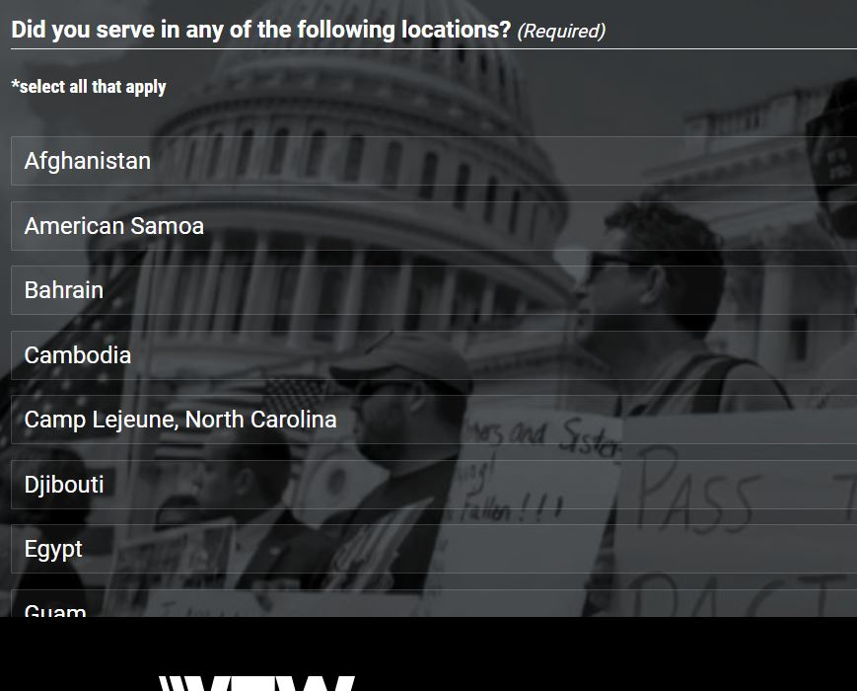
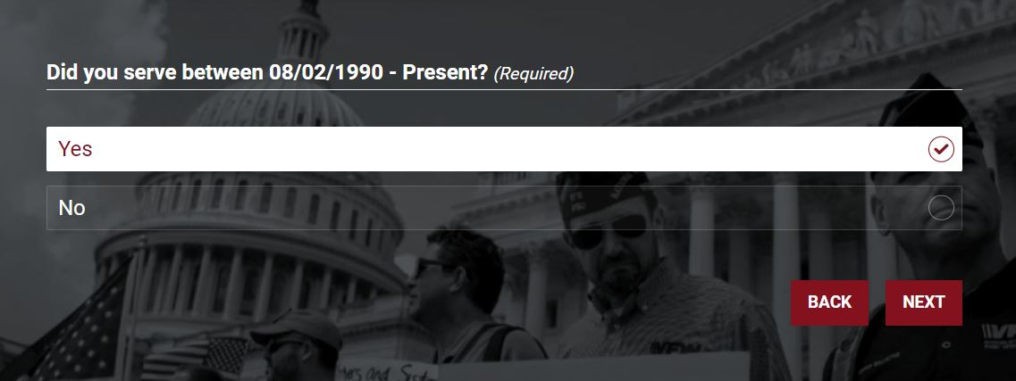
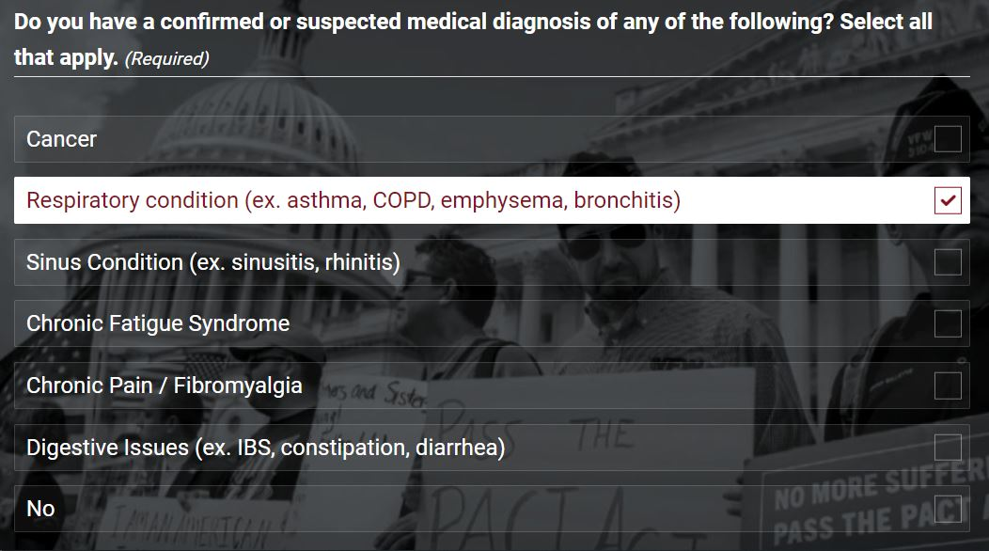
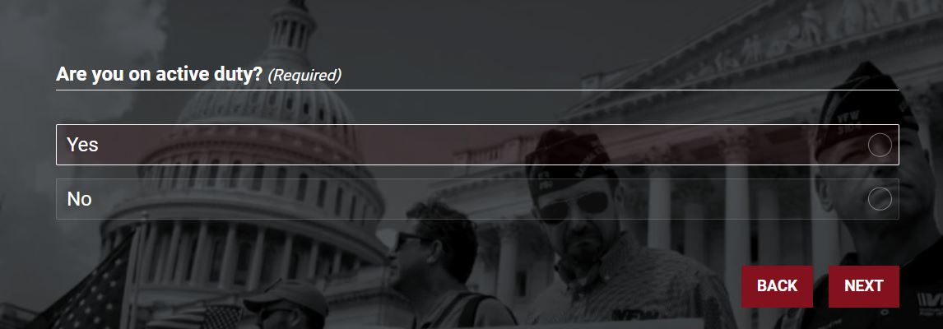
PACT Act Info Initiative –
Am I Eligible for Benefits?
If a veteran chooses “Am I eligible for Benefits” they will be taken to a brief survey that asks questions about their military service and medical conditions

Slide 27
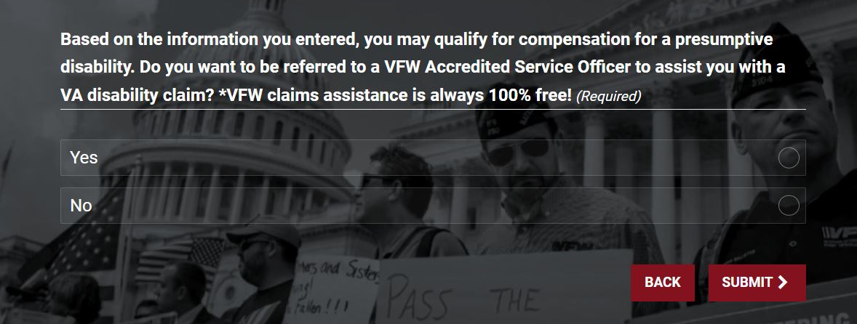
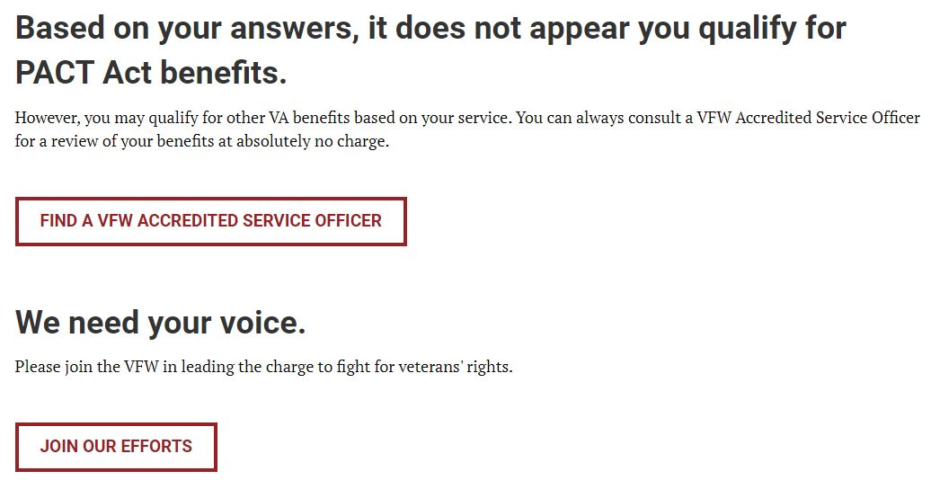
PACT Act Info Initiative –
Am I Eligible for Benefits?
When finished with the survey, the veteran will receive one of two messages:
Yes you may be eligible: If the veteran selects yes, they will be asked for their contact information and a referral will be sent to their local VFW service officer via email
You do not appear to qualify: The veteran is given to option to find a local VFW service officer or join the VFW

Slide 28
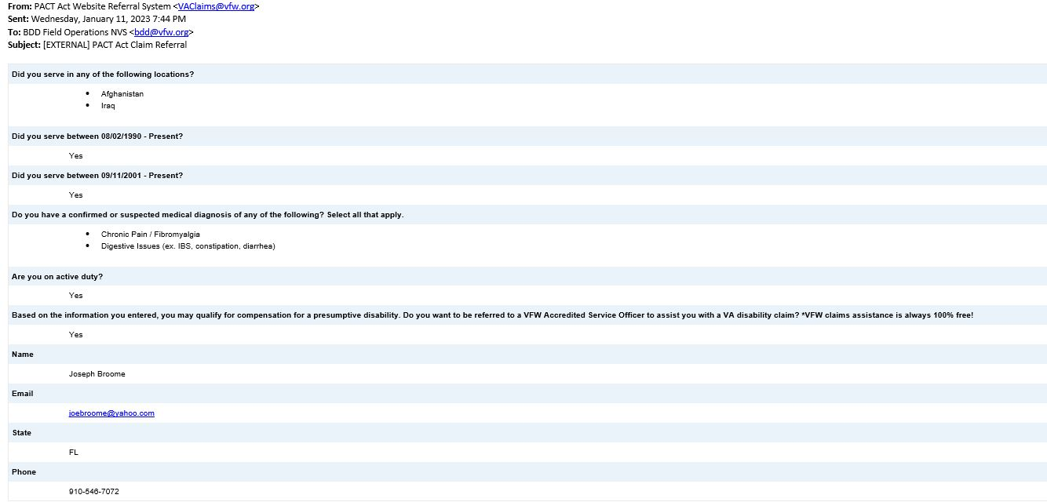
PACT Act Info Initiative –
Automatic Referrals
If a veteran requests a referral, it is routed to their local VFW Service Office or the NVS BDD Field Operations Team
Once received the veteran will be contacted within one week by a VFW accredited representative to assist them with their claim for VA benefits
Since the launch of the PACT Act Info Initiative, VFW has received more than 400 referrals from veterans needing help
John Smith
email@email.com
555-555-5555

Slide 29
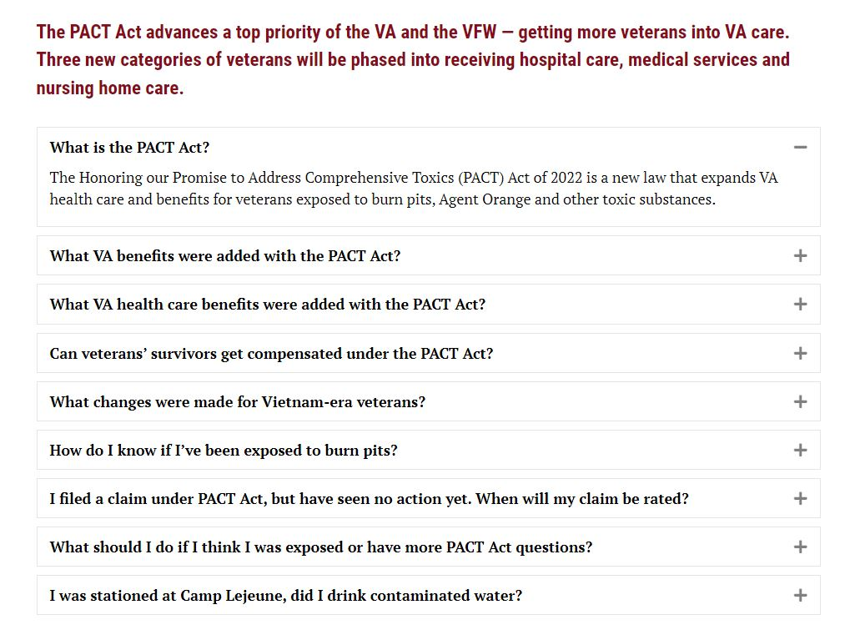
PACT Act Info Initiative
About the Pact Act
If a veteran wants to learn more about the PACT Act, they can select “Learn More” and they will be taken to a FAQ page

Slide 30
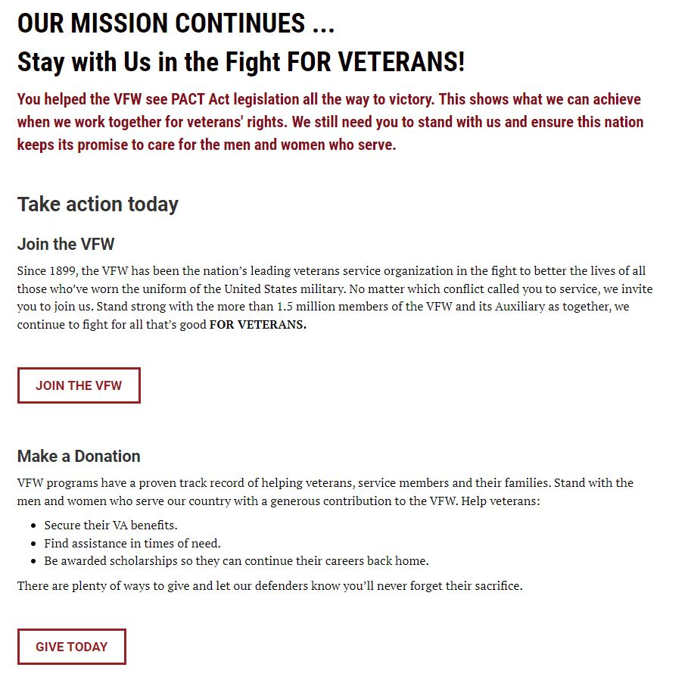
PACT Act Info Initiative
About the Pact Act
When a veteran selects “Join Our Efforts” they will see this page that offers options to join the VFW or make a donation.

Slide 31

Assistance with filing a Claim?
If you know of a veteran who has been diagnosed with one of the presumptive conditions listed in this presentation, invite them to visit www.pactactinfo.org to see if they may qualify for benefits.
The VFW has a worldwide network of professionally trained, accredited service officers standing by to assist all veterans obtain the benefits they’ve earned.
To find a local service officer visit: https://www.vfw.org/assistance/va-claims-separation-benefits

Slide 32
Questions?

