Slide 1
The PACT Act

Slide 2
The Sergeant First Class Heath Robinson Honoring our Promise to Address Comprehensive Toxics (PACT) Act
The Sergeant First Class Heath Robinson Honoring our Promise to Address Comprehensive Toxics (PACT) Act commonly referred to as “The PACT Act”
The new law is named for former Sgt. First Class Heath Robinson who died in 2020 after battling lung cancer for three years. Robinson’s illness was attributed to smoke exposure from burning trash pits during his deployment to Iraq in 2006 and 2007.

Slide 3

The History of H.R 3967 Honoring our PACT Act of 2022
Introduced into the House on 6/17/2021
Reported to House, Part 1 2/22/2022
Passed House 3/3/2022
Passed Senate 6/16/2022
Signed into Law 8/10/2022

Slide 4
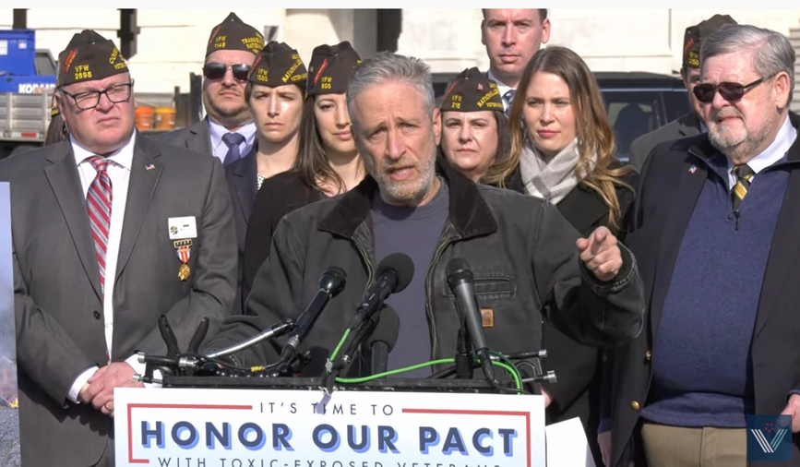
VFW’s Role in The PACT Act
Since the inception of the PACT Act, VFW’s National Legislative Service has been working with lawmakers to bring about Toxic Exposure Reform.
VFW deployed multiple “Take Action” campaigns through the VFW Action Corps to urge Americans to contact their senators and tell them to vote YES to the PACT Act.
The Call to Action reached American Personality Jon Stewart who played an instrumental role in assisting with getting the PACT Act passed.

Slide 5
What is the PACT Act?
The PACT Act is a new law that expands VA benefits and health care to veterans exposed to burn pits and other toxic substances. This law provides generations of veterans and their survivors with the care and benefits they’ve earned and deserve.

Slide 6
The PACT Act and VA Health Care
Ways the PACT Act expands VA Health care include:
The Act expands and extends eligibility for VA health care for veterans with toxic-exposures and veterans of the Vietnam era, Gulf War era, and Post-9/11 era.
VA will improve the decision-making process for determining what medical conditions will be considered for presumptive status.
Every enrolled veteran in VHA will receive an initial toxic exposure screening and a follow-up screening every five years. Veterans who are not enrolled, but who are eligible to enroll, will have an opportunity to enroll and receive the screening.
Notes:
Bullet 2 – The Act states that VA must collaborate with other agencies such as DoD to create the Toxic Exposure Research Working Group. This group will conduct toxic exposure research and will develop a 5-year strategic plan for research activities. The act also directs VA to study specific events like the Manhattan project, and diseases related to toxic exposure such as cancer rates, mental health, and respiratory disorders.

Slide 7
The PACT Act and VA Health Care
VA health care staff and claims processors will receive toxic exposure-related education and training.
The Act requires research studies on the mortality of veterans who served in Southwest Asia during the Gulf War, Post-9/11 veteran health trends, and veteran cancer rates.
The Act authorizes 31 new medical facilities across the country, providing greater access to VA health care.
Notes:
This is in lieu of the now defunct AIR Commission

Slide 8
The PACT Act and VA Health Care Enhanced Enrollment
The PACT Act brought some changes to VHA enhanced enrollment, most notably:
Enhanced Enrollment Eligibility for VA Healthcare for new veterans has been extended from 5 years to 10 years
Open Enhanced Enrollment begins October 1, 2022, through October 1, 2023
*Special note: Enhanced Enrollment is Priority Group 6 within VHA.
Notes:
Enhanced enrollment at PG6 – veterans who served in a theater of operation are now granted 10 years of healthcare immediately following discharge unless they meet the criteria for a higher priority group.

Slide 9
The PACT Act and VA Health Care
Eligibility for Enhanced Enrollment has been made for veterans who served in any of the following capacities:
On or after August 2, 1990: Iraq, Kuwait, Bahrain, Oman, Qatar, Saudi Arabia, Somalia (new), or U.A.E.
On or after September 11, 2001: Afghanistan, Djibouti, Egypt (new), Jordan (new), Lebanon (new), Syria, Yemen (new), or Uzbekistan,
Any risk of exposure recorded in an exposure record tracking system, including ILER,
Operations Iraqi Freedom, Enduring Freedom, New Dawn, Freedom’s Sentinel, Inherent Resolve, or Resolute Support Mission,
Any other location the VA Secretary determines is appropriate
Notes:
ILER - Individual Longitudinal Exposure Record: An individual, electronic record of exposures for each service member.
ILER will contain:
Time of deployments
Locations and events during deployments
All-hazard occupational data
Environmental hazards that were known or found later
Any monitoring performed in the area(s)
Medical encounter information (e.g., diagnosis, treatment, and laboratory data)
Medical concerns that should be addressed regarding possible exposures
ILER will be available to VA and DoD healthcare providers; epidemiologists and researchers; and VA disability evaluation and benefits determinations specialists. It will be used to improve internal processes and will not be available for individual access.

Slide 10
The PACT Act and VA Health Care
Permanent eligibility for VA care will be phased in over a 10-year period based on discharge date for each veteran serving in one or more of the specified locations:
October 1, 2024 for veterans discharged between 8/2/1990 and 9/11/2001
October 1, 2026 for veterans discharged between 9/12/2001 and 12/31/ 2006
October 1, 2028 for veterans discharged between 1/1/2007 and 12/31/2012
October 1, 2030 for veterans discharged between 1/1/2013, and 12/31/2018
October 1, 2032 for all others who participated in any of the covered contingency operations.
Permanent eligibility for VA care will begin October 1, 2032 for veterans who served in support of the listed operations but not in a specified location listed above.
Notes:
If a veteran does not currently qualify for permanent VA health care due to service dates, they should consider filing a claim for benefits as a granted claim will establish the healthcare at possibly a higher PG.

Slide 11
The PACT Act and VA Presumptive Benefits
The PACT Act has added more than 20 new presumptive conditions that veterans can file for if they meet the requirements.
What is “Presumptive” Service Connection?
VA presumes that certain disabilities were caused by military service. This is because of the unique circumstances of a specific veteran’s military service.
If a presumed condition is diagnosed in a Veteran within a certain group, they can be awarded disability compensation.

Slide 12
The PACT Act Presumptive Areas
The PACT Act determined that veterans who served in any of the below locations on or after August 2, 1990 had exposure to burn pits or other toxins. We call this having a presumption of exposure.
Bahrain Iraq Kuwait
Oman Qatar Saudi Arabia
Somalia The United Arab Emirates (UAE)
**Includes the airspace above any of these locations

Slide 13
The PACT Act Presumptive Areas
The PACT Act determined that veterans who served in any of the below locations on or after September 11, 2001 had exposure to burn pits or other toxins. We call this having a presumption of exposure.
Afghanistan Djibouti Egypt
Jordan Lebanon Syria
Uzbekistan Yemen
**Includes the airspace above any of these locations

Slide 14
The PACT Act Presumptive conditions for
Gulf War and Post 9/11 Veterans
Brain Cancer | Chronic Rhinitis
Glioblastoma | Chronic Sinusitis
Respiratory (Breathing-related) cancer of any type | Constrictive bronchiolitis
Gastrointestinal cancer of any type | Obliterative Bronchiolitis
Head cancer of any type | Emphysema
Lymphoma of any type | Granulomatous disease
Lymphatic cancer of any type | Interstitial lung disease (ILD)
Neck cancer | Pleuritis
Pancreatic Cancer | Pulmonary Fibrosis
Reproductive cancer of any type | Sarcoidosis
Kidney Cancer | Chronic Bronchitis
Melanoma | Chronic Obstructive Pulmonary Disease (COPD)
Asthma (Diagnosed after service)

Slide 15
The PACT Act Presumptive conditions for Vietnam
Veterans and those exposed to Tactical Herbicides
For Vietnam veterans and other veterans exposed to tactical herbicides, the PACT Act includes two Agent Orange presumptive conditions:
Monoclonal gammopathy of undetermined significance (MGUS)
High blood pressure (hypertension).
Notes:
Any conceded exposure to herbicides will qualify for this. Including Vietnam, Korean DMZ, C-123 aircraft, etc.
Vietnam: January 9, 1962, through May 7, 1975
Thailand: January 9, 1962, through June 30, 1976
Guam or American Samoa: January 9, 1962, through July 30, 1980
Laos: December 1, 1965, through September 30, 1969
Cambodia at Mimot or Krek, Kampong Cham Province: April 16, 1969, through April 30, 1969
Korean DMZ: Sept. 1, 1967, through August 31, 1971.

Slide 16
The PACT Act and When to File for VA Benefits
VA is accepting claims NOW for service connection for the new presumptive conditions outlined in PACT ACT.
VA is holding off on processing these claims until January 2023.
If a veteran applies for one of the presumptive conditions and VA grants service connection, the effective date of the claim may be retroactive to August 10, 2022, the date the law went into effect, if the claim or Intent to File was filed within 1 year of the law’s passing.
Notes:
This is not “liberalizing” like NEHMER or others. There is no earlier effective date for previously filed claims.

Slide 17
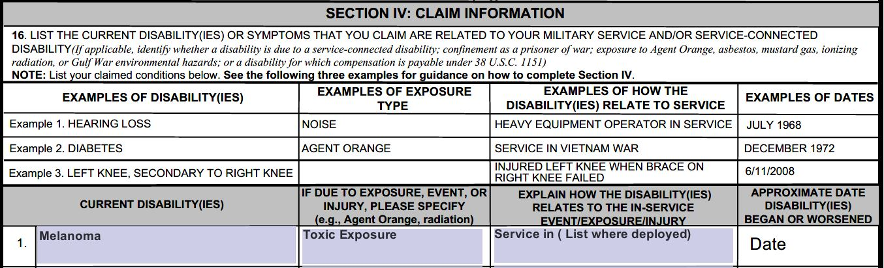
Filing a Claim
When filing for a PACT Act Presumptive, follow this example of a 21-526EZ requesting service connection for Melanoma due to Toxic Exposure

Slide 18
Appealing previously Denied claims under the PACT Act
If a veteran was previously denied service connection for one of the new presumptive conditions, they can appeal this decision by submitting two forms:
VA Form 20-0995: Used to request a Supplemental Claim of a VA Rating Decision a veteran disagrees with
VA Form 21-4138: Used as a statement in support of the claim being appealed on the 20-0995

Slide 19
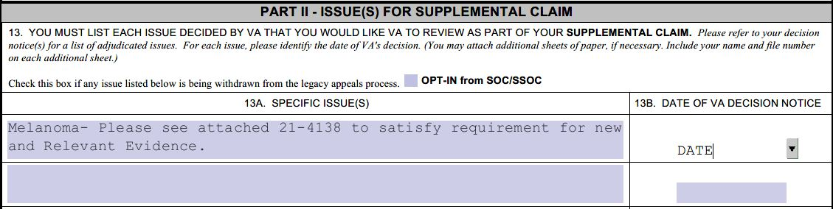
Appealing previously Denied claims under the PACT Act
When filing for an appeal of a previously denied PACT Act Presumptive, follow this example of a 20-0995 already filled in.

Slide 20
Appealing previously Denied claims under the PACT Act 21-4138
The other form needed is VA Form 21-4138 Statement in Support of Claim.
When filling out this form for a previously denied claim include the following verbiage:
(Veteran’s Name) has previously filed a claim for (condition) and this claim was denied on (date) due to (reason for denial). (Veteran’s name) served in (location) from (dates of service in that location) and is now eligible for presumptive service connection under the PACT Act of 2022. Please accept this statement in conjunction with the law change as new and relevant evidence and review the veteran’s claim for (condition). Your attention in this matter is greatly appreciated.

Slide 21
The PACT Act and Dependency and Indemnity Compensation (DIC)
Dependents wanting to submit a claim for DIC or accrued benefits under the Pact Act must first verify the veteran’s cause of death is due to a presumptive condition.
Things to consider when filing for a DIC Claim:
Make sure the death certificate states the cause of death as one of the new PACT Act Presumptive conditions
Direct and Secondary service-connection can be considered to qualify for DIC/accrued benefits
The veteran did not need to file for the condition in the past. Entitlement to benefits can be established for survivors after the veteran’s death.
The application process has not changed to submit a DIC claim
Notes:
If the death certificate does not include this information, the surviving family member will need to request an amended death certificate. VA will NOT develop for this.

Slide 22
Tort and 1151 claims & Receipt of VA Disability Benefits
Questions are still being raised about how the Camp LeJeune water Lawsuit will interact with service connection for the new presumptive conditions.
VA has not released guidance on how these two unique benefits will interact with each other.
VFW’s recommendation for veterans is to not officially sign anything regarding lawsuits until VA clarifies how the settlements will affect service-connected benefits and care.
Though filing with the lawsuit may be the right choice for some veterans, it is too early in the process to agree with an attorney concerning Camp LeJeune lawsuits.
Notes:
Offset: If the veteran is awarded VA benefits under 1151 (VA fault or negligence) and a settlement from a federal suit for the same disability, the veteran cannot receive both. Instead, VA will offset (withhold) the veteran’s benefits until the amount awarded from the settlement has accrued. Once the veteran has accrued enough benefits to offset the settlement amount, they will start receiving their benefits.

Slide 23
Assistance with filing a PACT Act Claim?
If you or a loved one has been diagnosed with one of the presumptive conditions listed in this presentation, we invite you to contact the Veteran’s of Foreign Wars to see if they qualify for service connection.
The VFW has a worldwide network of professionally trained, accredited service officers standing by to assist you in obtaining the benefits you have earned.
To find your local service officer visit: https://www.vfw.org/assistance/va-claims-separation-benefits

Slide 24
Questions?

