Slide 1
Using Stakeholder Enterprise Portal to Find Veterans Requesting Assistance

Slide 2
Stakeholder Enterprise Portal (SEP)
Accessing SEP
View New, Pending, and Accepted Representation Requests
Accepting Representation (POA) through SEP
Notes:
POA REQUEST ACCEPTANCE, USEFUL FOR ASSISTING VETERANS REMOTELY – PROVIDE EXAMPLE:
EXAMPLE: ASSISTING VETERAN OVER THE PHONE, EMAIL. VETERAN CAN REQUEST POA ON EBENEFITS AND YOU ACCEPT ON SEP AND WORK CLAIM FROM THERE.

Slide 3
Stakeholder Enterprise Portal (SEP)
Log into SEP website to pull up the POA requests pending in your state
  SEP Website: https://www.sep.va.gov/sep/web/guest/sep

Slide 4
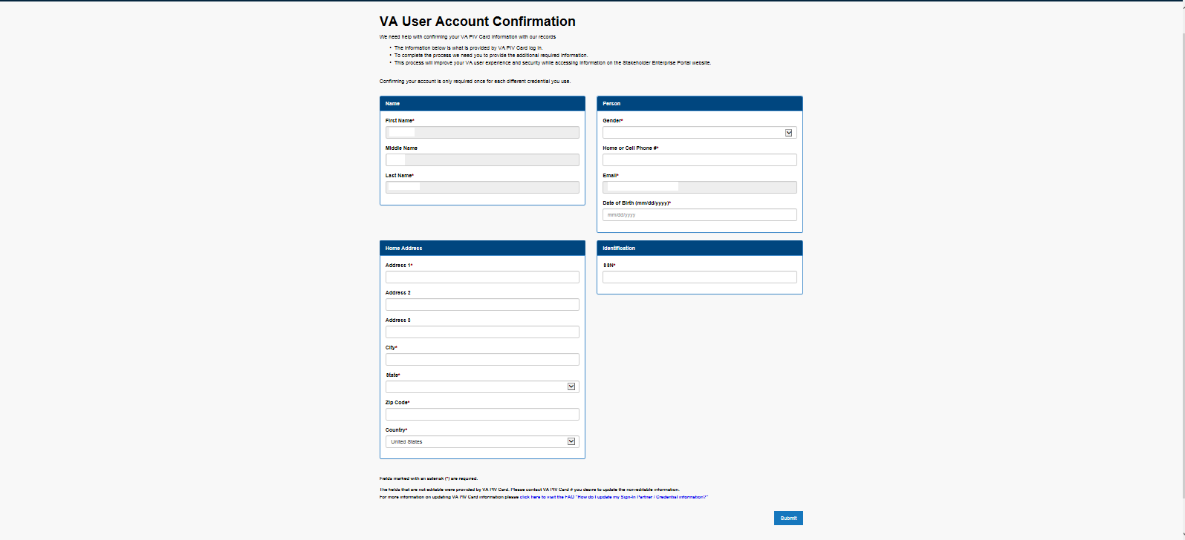
Stakeholder Enterprise Portal (SEP)
If this is your first time logging in, then you will need to register for SEP
Please complete all information requested and ensure that you input all correct information to include your OGC number
If you were recently accredited, make sure that your ISO has your OGC number, so that you can get your access level elevated.
If you receive an error message after registration, please contact Theresa Aldana at NVS (Taldana@vfw.org) and let her know that you need access to SEP
Notes:
EVERYONE REGISTERING FOR THE FIRST TIME, WILL MORE THAN LIKELY NEED TO HAVE THERESA GIVE THEM ACCESS TO ACCEPT OR DENY POA REQUEST. IT WILL BE UP TO DSO, IF THEY WANT TO PROVIDE THEM ACCESS, SO DSO SHOULD EMAIL THERESA REQUESTING ACCESS FOR SUCH INDIVIDUAL.

Slide 5
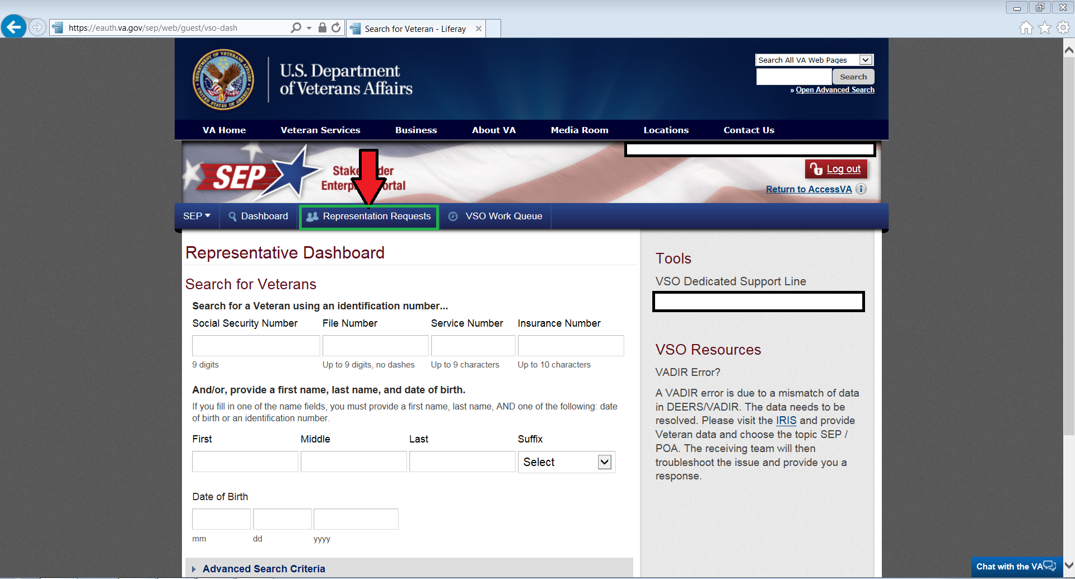
Stakeholder Enterprise Portal (SEP)
Select Representation Requests

Slide 6
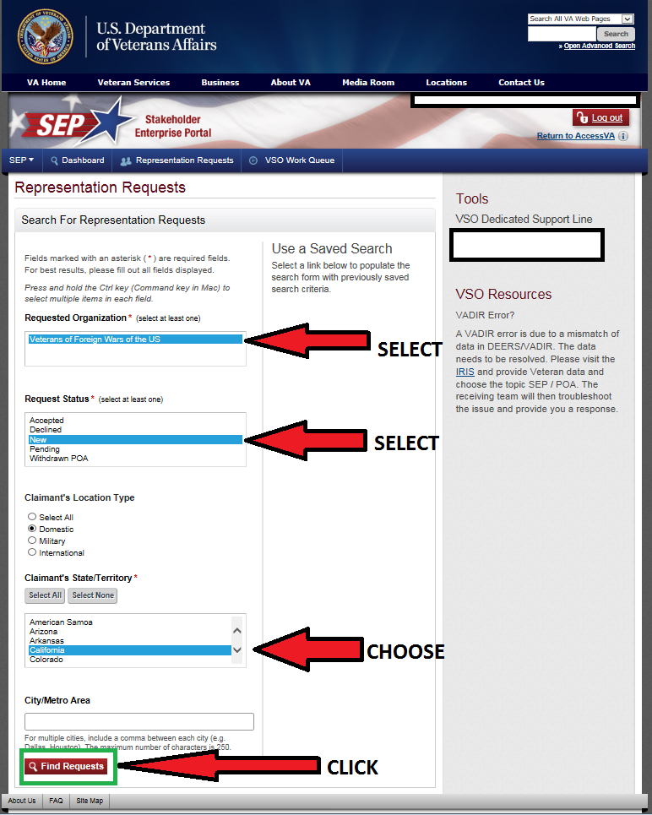
Stakeholder Enterprise Portal (SEP)
Click to select VFW
Click to select “new” request status
Choose the state that you want to search
Click “Find Requests”
Notes:
Note: When checking POAs in SEP, we recommend checking new and pending at the same time by clicking “Control” and selecting both “New” and “Pending”.

Slide 7
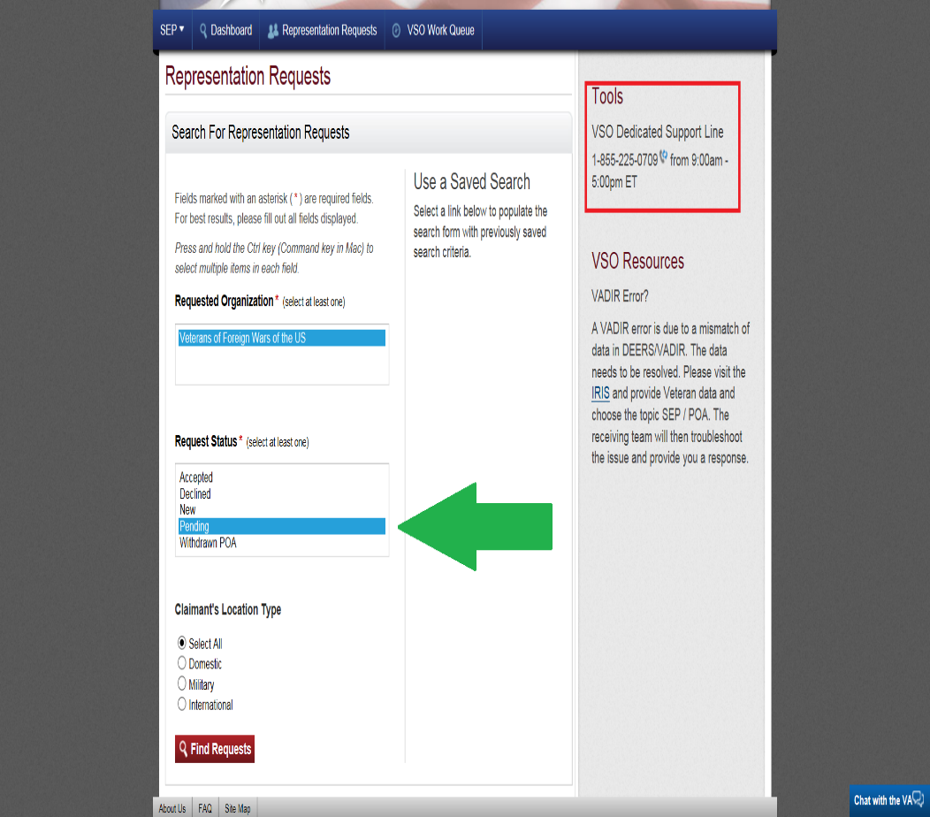
Stakeholder Enterprise Portal (SEP)
Another useful function is to select “pending” option as shown on the left with the green arrow.
This will allow you to view documents that someone has previously opened, but has not yet accepted or denied for POA purposes.
If you encounter any errors while attempting to access requests or accept POA, please call the dedicated VSO support line 1 (855) 225-0709 (highlighted in red).
Notes:
THIS ALLOWS YOU TO FIND REQUESTS THAT YOU HAVE LOOKED AT BEFOE, BUT HAVE NOT ACCEPTED OR DENIED
Note: When checking POAs in SEP, we recommend checking new and pending at the same time by clicking “Control” and selecting both “New” and “Pending”.

Slide 8
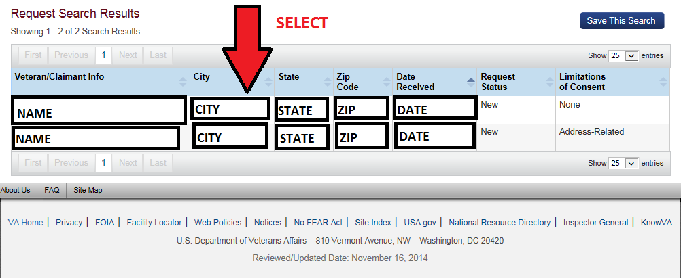
Stakeholder Enterprise Portal (SEP)
Once requests are generated, select the name to continue
HINT: Under “Limitations of Consent” ensure that the veteran did not put any limitation to health related information, otherwise the POA will need to be rejected. A solution is for you to contact the veteran and explain the reason for having access to health related information, so that the veteran can re-submit the request.
Notes:
IF ANYONE PUTS ANY LIMITATION ON HEALTH INFO, ATTEMPT TO FOLLOW UP WITH VETERAN AND EXPLAIN TO THEM, WHAT THE LIMITATION OF HEALTH INFO DOES TO POA ACCESS.
CREATE A TEMPLATE TO QUICKLY SEND EMAIL WITH EXPLANATION OF DENIAL AND REASON.

Slide 9
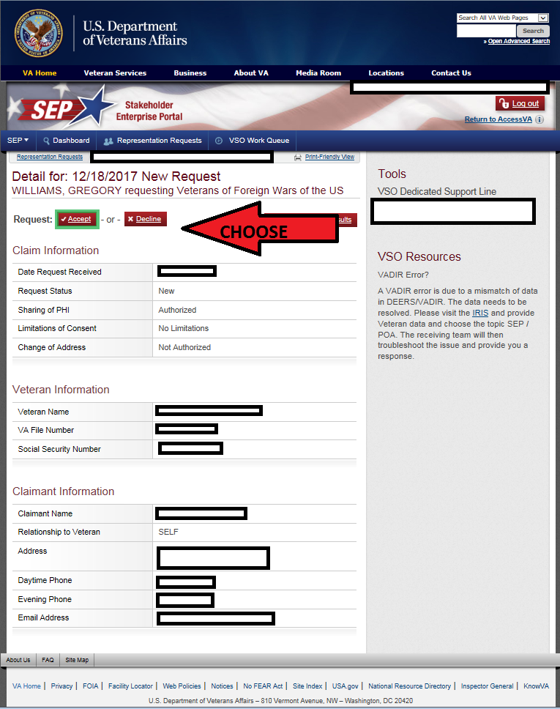
Stakeholder Enterprise Portal (SEP)
Before accepting a request, ensure that veteran does not have any formal appeals pending.
You can also verify any appeals or statuses of appeals by contacting your local appeals team
Remember: you can accept POA for veteran with an appeal as long as it is not filed at the BVA
Select “ACCEPT” or “DECLINE”

Slide 10
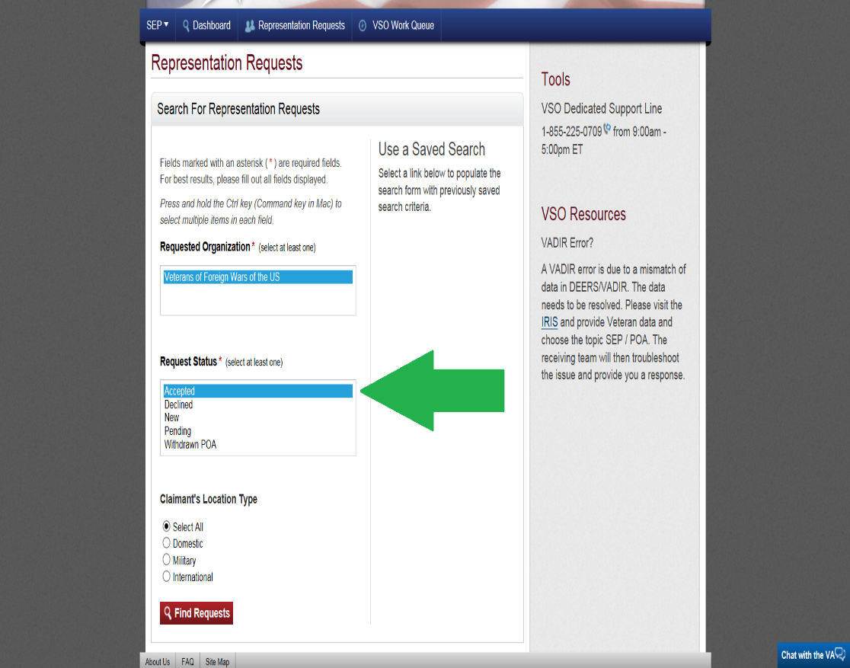
Stakeholder Enterprise Portal (SEP)
SEP allows you to view POA files you have accepted to later access via other systems
In order for you to access these files select the “accepted” option displayed on the left and click on “find request”.
This will allow you to view files accepted by VFW, so that you can add into VetraSpec or your office’s case management system.
Notes:
AFTER YOU ACCEPT A POA REQUEST, YOU CAN FIND THE REQUEST UNDER THE “ACCEPTED OPTION” - THIS CAN BE USEFUL TO LATER CREATE A VETRASPEC FILE.
ALL REQUESTS SHOULD BE TREATED JUST LIKE A LIVE PERSON IN FRONT OF YOU.

