Slide 1
Tyler Veterans Benefits (TVB)
Part 2

Slide 2
Lesson Plan
In this class we will learn how to:
How to submit claims using TVB
How to create a digital Signature

Slide 3
Submitting claims through TVB
The current version of TVB utilizes “Medical Conditions” to submit claims to VA.
This API is still under development and will be functional at a later date. Once this function is released, we will provide additional training.

Slide 4
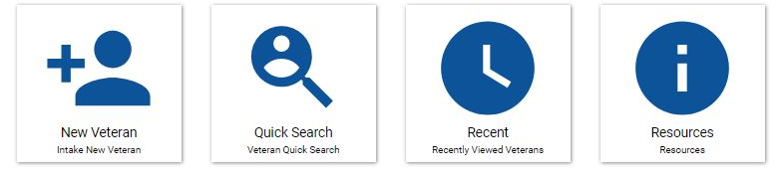
Submitting a claim to VA using TVB
When using TVB to submit a claim, you must first select the veteran you wish to submit a claim for.
From the home screen click Quick Search and type in your veteran’s name.

Slide 5
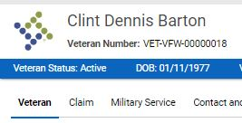

Submitting a claim to VA using TVB
Once you have your veteran folder opened, you will need to click on the Claim tab at the top.

Slide 6
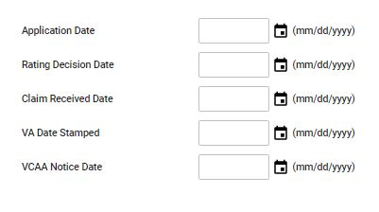
Submitting a claim to VA using TVB
You can update key dates at any time during the claim process

Slide 7
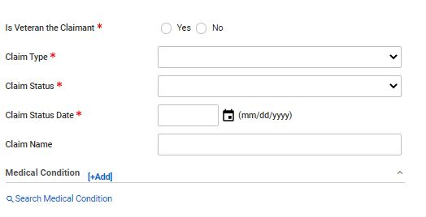
Submitting a claim to VA using TVB
Once you have clicked on the Claim tab the following screen will appear.
From here you will enter in the required information:
Is Veteran the claimant?
Claim Type: Compensation, DIC, Education, NSC Pension etc…
Claim Status: Active, Closed, Pending, HLR, Remand etc…

Slide 8
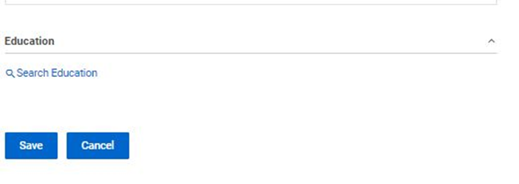
Submitting a claim to VA using TVB
Once you have captured the required fields click
“Save”

Slide 9
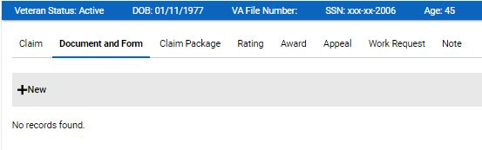
Submitting a claim to VA using TVB
Once you have saved you click, “Document and Form”
Underneath it click +New

Slide 10
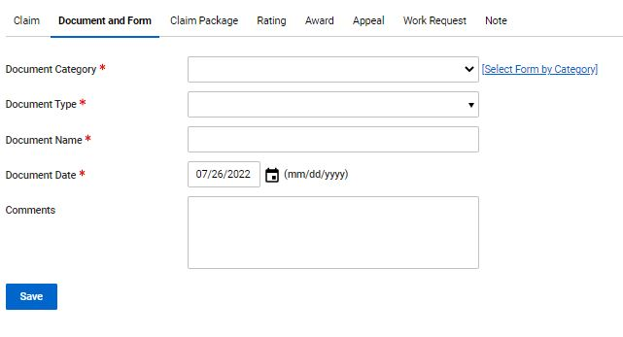
Submitting a claim to VA using TVB
Pressing +New takes you to this page where you will fill in the required fields
Document Category: Forms, General Correspondence, Other
Document Type: If Forms was previously selected VA Forms Populate this section
Document Name: does not auto populate
Document Date: This auto-populates to today’s date.

Slide 11
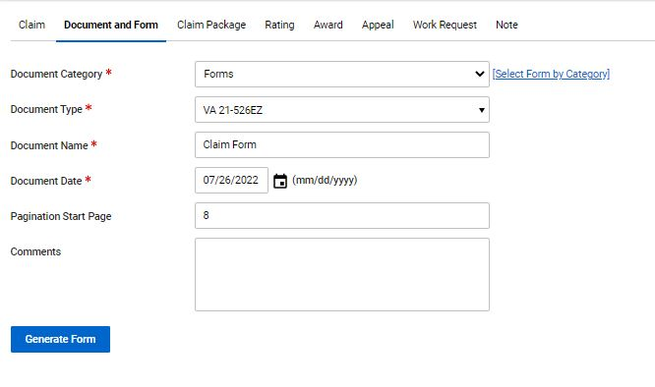
Submitting a claim to VA using TVB
Once everything is complete, click “Generate Form”

Slide 12
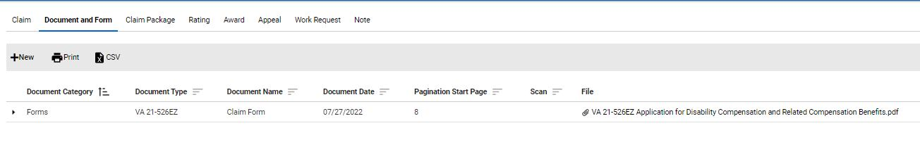
Submitting a claim to VA using TVB
Once the form has been generated, TVB will redirect you to the “Document and Form” Page and display your recently completed form.

Slide 13
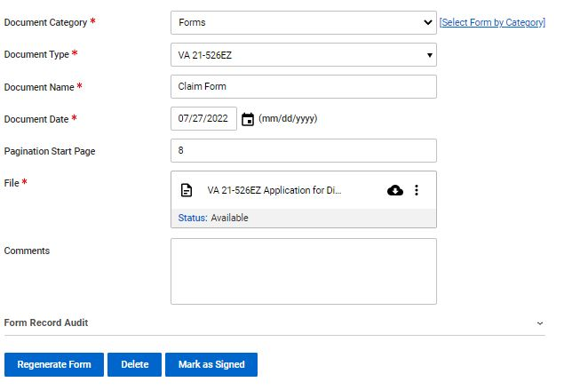
Submitting a claim to VA using TVB
When you click on the completed form it will take you to this screen:

Slide 14
Submitting a claim to VA using TVB
With the required fields completed, move your mouse over the 3 circles and click “Edit”

Slide 15
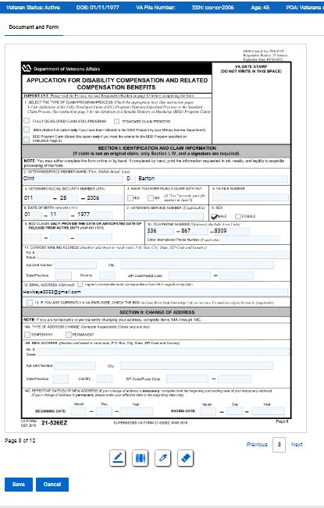
Submitting a claim to VA using TVB
When you click edit, it brings up the form you generated and allows you to edit it inside TVB!

Slide 16
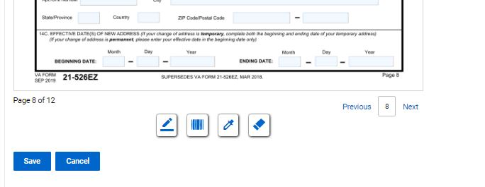
Submitting a claim to VA using TVB
At the bottom of the page you will see 4 symbols. These symbols are:
Add Signature Add Barcode Highlight Redact

Slide 17
Submitting a claim to VA using TVB
To navigate the pages of the form, click “Previous” or “Next”

Slide 18
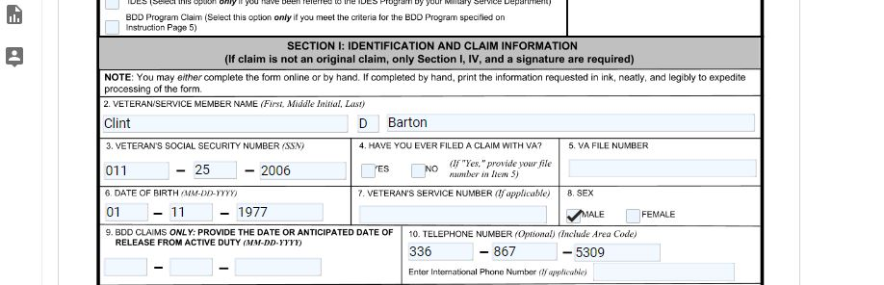
Submitting a claim to VA using TVB
All data that was entered into TVB will auto-populate into any form you create through TVB but the form will still need to be completed.

Slide 19
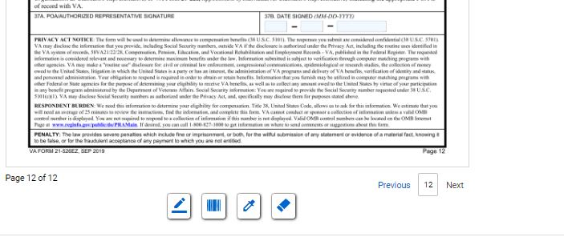
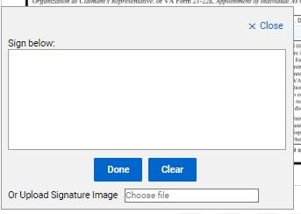

Submitting a claim to VA using TVB
Once the form is complete, it will need to be signed. To do this click “Add Signature” which will pop up the signature box.
In the signature box you can either manually create a signature using your mouse or upload a signature image. Once finished click save.
**We will cover how to create a digital signature at the end of this class**

Slide 20

Submitting a claim to VA using TVB
Once the signed document has been saved, Click
Mark as Signed
Once the document has been marked as signed, no edits on the signed form can be made. You will need to hit Save and move on to the next step in the claim process

Slide 21
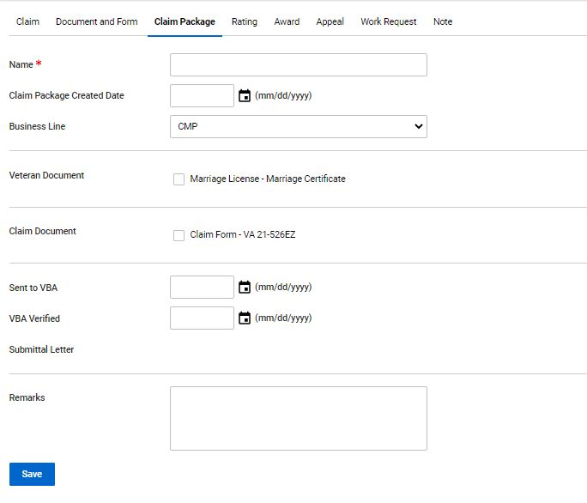
Submitting a claim to VA using TVB
Next click “Claim Package” and press “+New” which will take you to this screen.

Slide 22
Submitting a claim to VA using TVB
On this screen you will need to enter in the following:
1) Name of the claim
2) Claim Package Created Date
3) Select the Business Line
4) Select all documents you want sent to VA
5) Select the date you sent the claim to VBA
Press Save

Slide 23
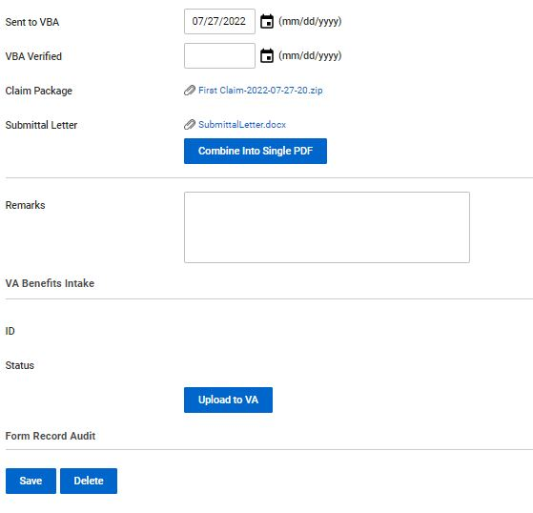

Submitting a claim to VA using TVB
Once saved you can view the changes prior to uploading the package to VA.
One thing to note is TVB will create a Submittal Letter which you can view. Once everything has been verified press “Upload to VA”

Slide 24
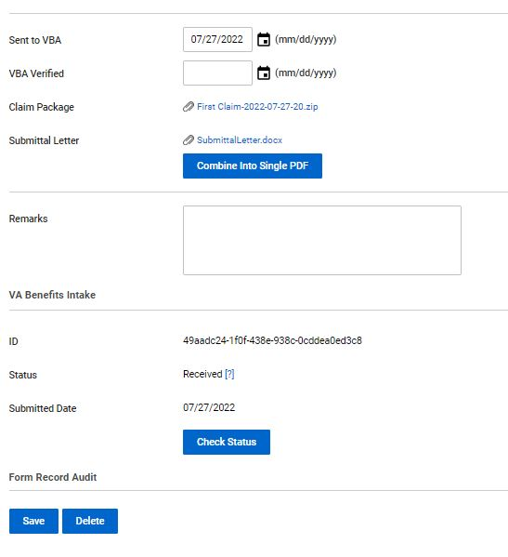

Submitting a claim to VA using TVB
After the claim is submitted you can check the status by clicking “Check Status”
Once the status shows received the effective date is preserved.

Slide 25
Creating a Signature Image
Here we will cover how to create a digital signature that is compatible with most programs

Slide 26
Creating a Signature Image
To add a Signature to an electronic Document, you will first need to create your signature. To do this in Adobe, you will first locate the Sign Document Icon

Slide 27
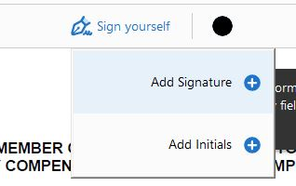
Creating a Signature Image
Once selected A drop-down box which looks like this will populate. You will then select “Add Signature”

Slide 28

Creating a Signature Image
Once you have selected Add Signature, you will be given 3 options to capture the signature:
1) Type
2) Draw
3) (Upload) Image
Type is the easiest option to choose from but all 3 will be accepted by VA.

Slide 29
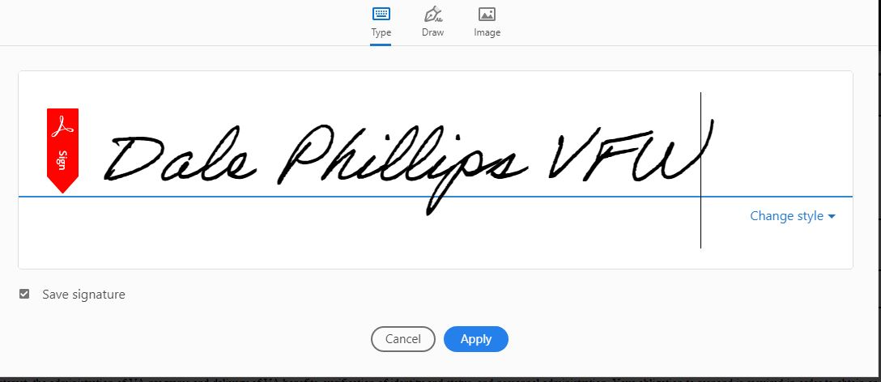
Creating a Signature Image
Once the signature is created, press “Apply”.
This will save your signature for future uses and allow you to apply the signature to the Electronic Document.

Slide 30
Saving a Signature Image
Now that you have your signature image, you will need to place it on a white background somewhere on the PDF.
With the signature in place you will need to open a new program called “Snipping Tool”
To find this tool open your computer’s start menu and search “Snipping Tool”. When you find it press the icon

Slide 31
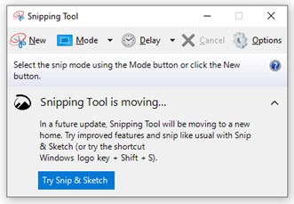
Saving a Signature Image
With the Snipping Tool Open click “New” which will change your curser to a +. From there you will cut out your signature.

Slide 32
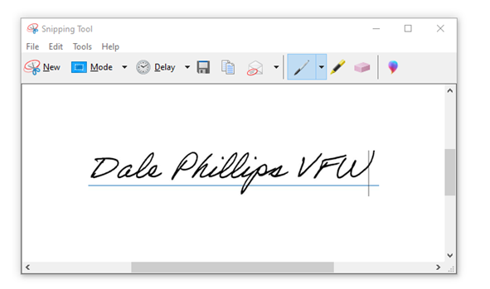
Saving a Signature Image
To save your captured signatured click
File
Save as
Choose where to save your signature

Slide 33
QUESTIONS?

