Slide 1
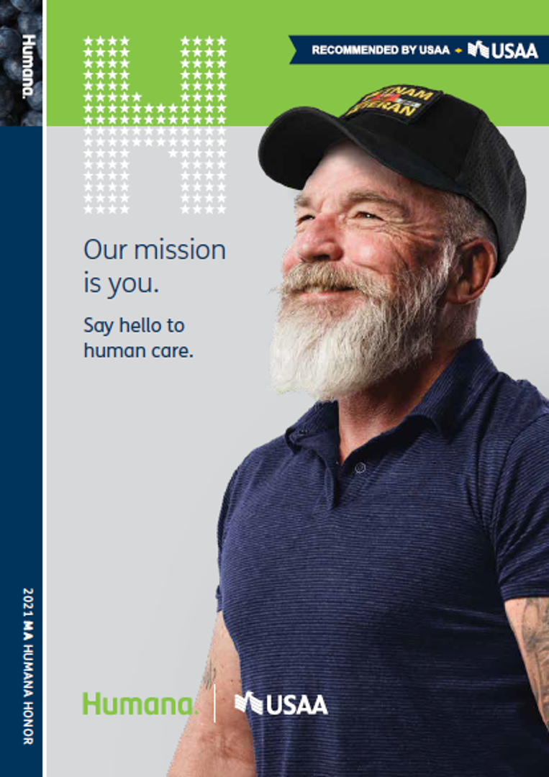
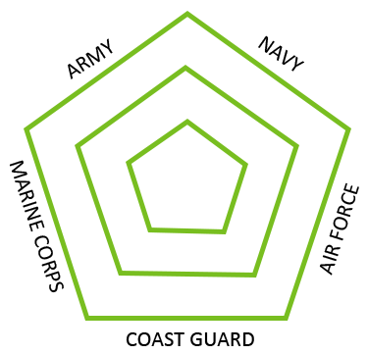

Understanding and meeting the healthcare needs of Veterans

Slide 2
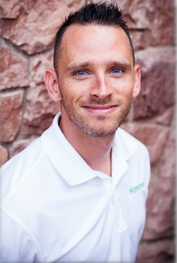
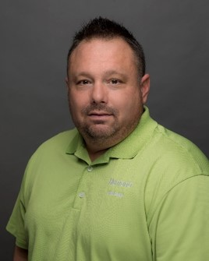
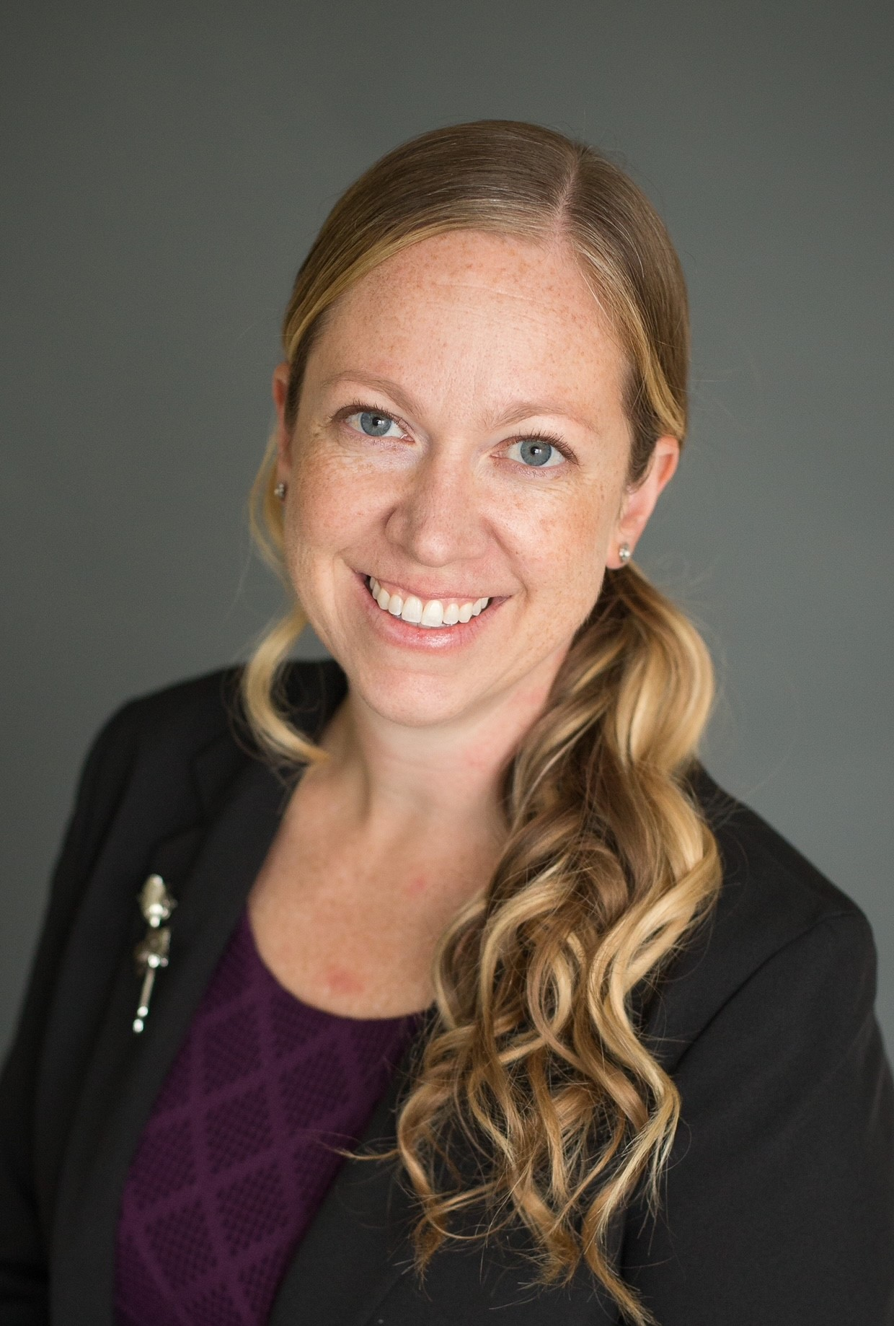
Today’s Speakers
Darin Davis
Humana Regional Veteran Executive Northwest
Scott Mathis
Humana Regional Veteran Executive Southwest
Stephanie Muckey
Humana Population Health Strategy Lead Veteran Bold Goal
Notes:
Good morning! I’m Stephanie Muckey and I’m the Population Health Lead for Humana’s Veteran Bold Goal. As a military spouse for more than 20 years myself, I care a lot about the Veteran health support that the Veteran Bold Goal represents. Today, I’ll introduce you to Humana’s Veteran Bold Goal initiative and show you where you fit in.

Slide 3
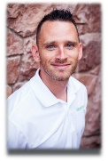

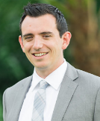
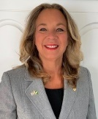
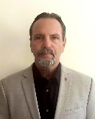
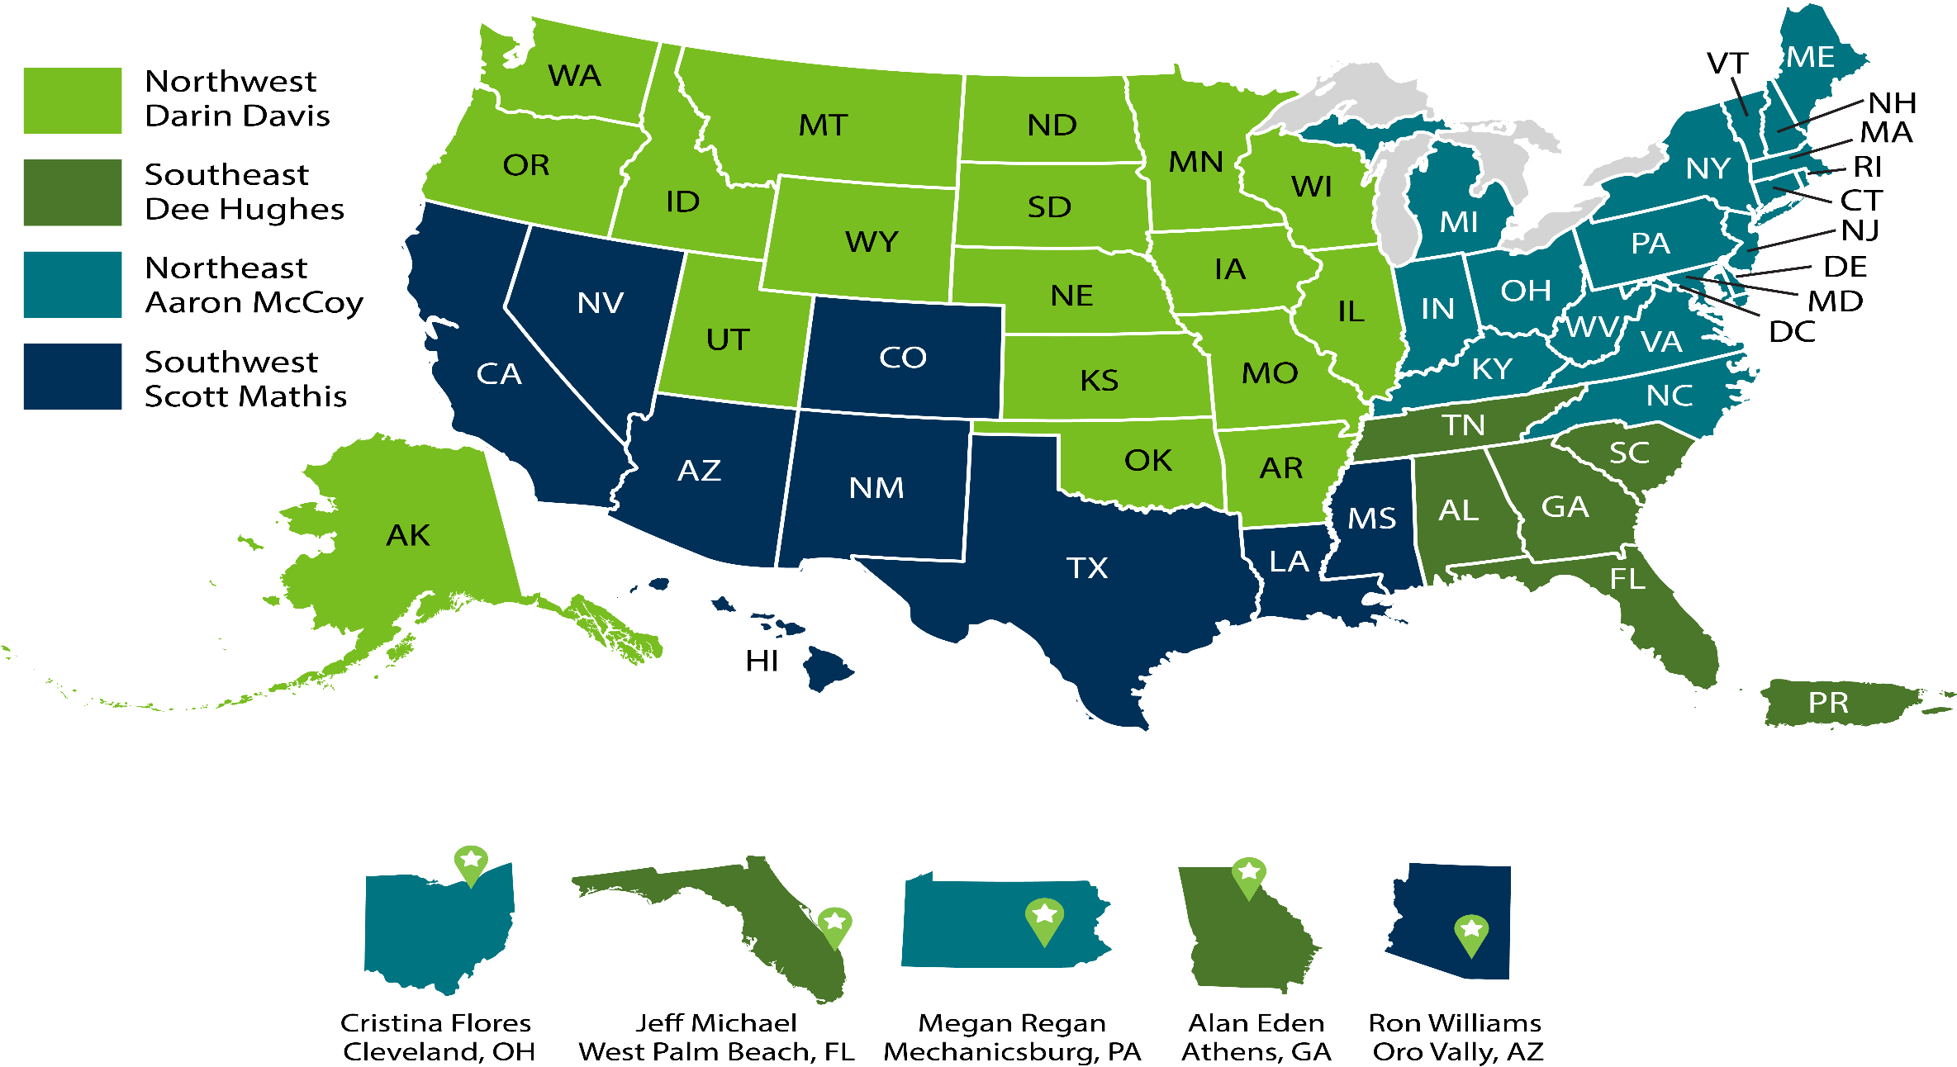
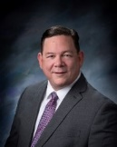

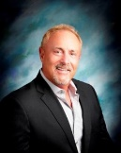
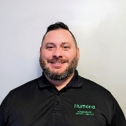
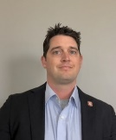

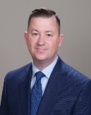
Regional Veteran Executives
Veteran Community Engagement Executives
Darin Davis
RVE Northwest
Scott Mathis
RVE Southwest
Aaron McCoy
RVE Northeast
Dee Hughes
RVE Southeast
George Vukovich
VCEE OH
Dave McNeil
VCEE NV/Southern CA
Megan Regan
VCEE PA
Ron Williams
VCEE AZ
Andy Zinkievich
VCEE NC/VA
Alan Eden
VCEE GA/SC
Andrea Ortiz
VCEE West TX
TBD
VCEE AR/OK/KS/MO
Tim Delaney
VCEE IL
Open
VCEE Orlando/Tampa

Slide 4
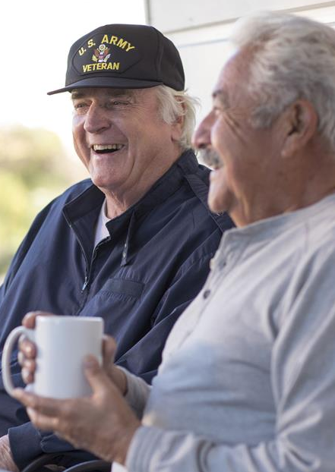
Our Mission
“Doing well while Doing good”
We are committed to strengthening our longstanding relationship with Veterans and the military community. With health at the core of everything we do, we are dedicated to helping Veterans and their families achieve lifelong well-being. Veterans protected us now allow us to return the favor. To learn more please contact your local Veteran Executive or Humana professional.
Notes:
There are more than 19 million* veterans in the United States and more than 9 million* veterans who are eligible for Medicare.
Each one of these veterans – just like each one of you – has a life story. They have health-related strengths and challenges. They have controllable and uncontrollable circumstances in their lives.
At Humana, we see veterans as individuals, and as a community.
Our mission is to strengthen our longstanding relationship with the military community. Specifically, to help veterans and their families achieve life-long well-being.​
These individuals have sacrificed so much for our country, and they deserve nothing but our best.
Source
Pew Research; April 5, 2021: 19 million veterans - https://www.pewresearch.org/fact-tank/2021/04/05/the-changing-face-of-americas-veteran-population/
USAA: 9 million veterans who are eligible for Medicare - https://www.usaa.com/inet/wc/insurance-humana-advantage?akredirect=true

Slide 5
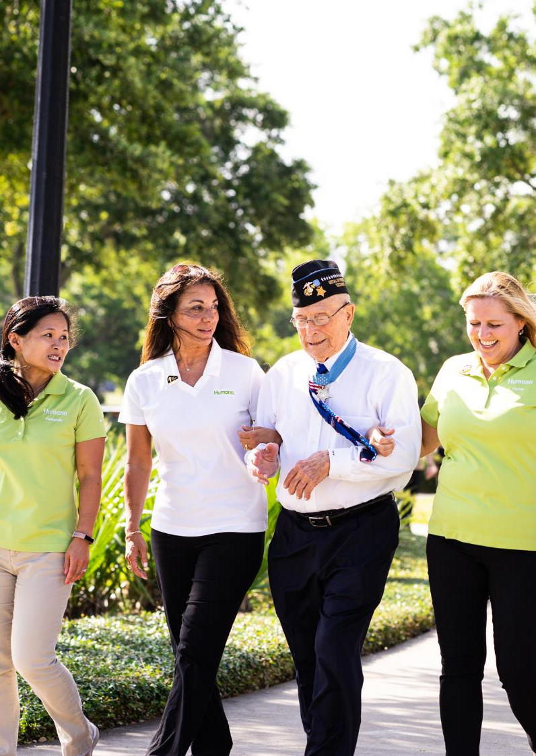

“When it comes to serving America’s Veterans and military families, Humana truly walks the talk.”
Debra Anderson VFW National Quartermaster General
Notes:
As you can imagine, when the VFW Quartermaster General Debra Anderson said, “When it comes to serving America’s Veterans and military families, Humana truly walks the talk,” we quickly wrote it down since it meant so much to hear.
We value our relationships with VSOs and the opportunity to work side by side with these organizations to identify and address the needs of n communities, such as social isolation and loneliness, food insecurity, homelessness, mental health, employment. ​

Slide 6
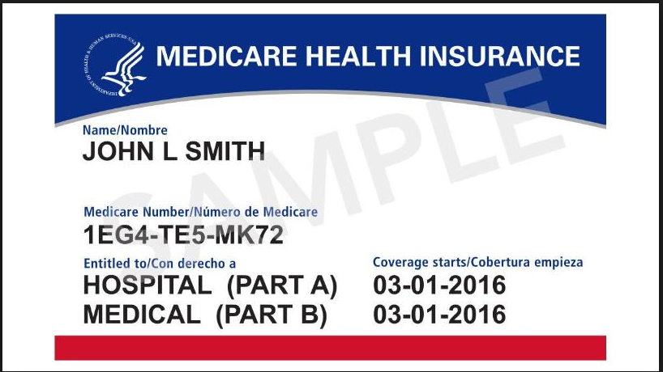
“VA does not recommend Veterans cancel or decline coverage in Medicare (or other health care or insurance programs) solely because they are enrolled in VA health care.”
I have VA Healthcare, why take out Part B?
Some Veterans consider opting out of Part B, to avoid paying the Part B premium. If they need to apply for Part B after their Initial Enrollment Period (IEP), they may pay a penalty because the VA Healthcare is NOT creditable medical coverage for Part B of Medicare (VA healthcare is creditable coverage for Part D of Medicare)
In order for a Veteran to get a Medicare Advantage plan, the person has to have Medicare Part B.
Medicare Part B and Medicare Advantage plans provides Veterans with more health care options.
VA and Medicare Advantage do NOT interfere with each other nor do they coordinate benefits. The VA does not file claims with Medicare (Parts A, B or C). The VA is a provider, but is not health insurance.
https://www.va.gov/healthbenefits/resources/publications/hbco/hbco_va_other_insurance.asp#:~:text=Under%20Medicare%20Part%20B%2C%20VA,be%20provided%20through%20an%20employer.&text=VA%20does%20not%20recommend%20Veterans,enrolled%20in%20VA%20health%20care.
https://www.va.gov/health-care/about-va-health-benefits/va-health-care-and-other-insurance/
Notes:
It’s important for veterans with VA healthcare to maintain both parts A & B of Medicare
Explain the implication of not enrolling in Part B when first eligible
It’s ultimately the veteran’s decision, but we want to do our part in educating veterans when we have the opportunity

Slide 7
VA Healthcare
Advantages | Challenges
Understands unique considerations and circumstances for the Veteran population Helps people who need help the most, per financial status or disability Affordable care Can have VA and other coverage, such as Medicare Advantage (MAPD or MA Only) | Not available to all Veterans Access to facilities – travel often required Many physicians choose private practice rather than working through the VA Can be difficult to obtain a 2nd opinion within the VA
Notes:
The VA provides comprehensive healthcare to veterans enrolled
There can be some challenges which can at times be address with Medicare Advantage plans
“2nd opinion” bullet point: The VA cannot contradict themselves so many Veterans will seek care at a private provider outside the VA for a 2nd opinion.

Slide 8
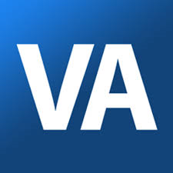
Benefits of Medicare Advantage
Obtain coverage for emergency services provided by non-VA providers
Choices and access to more providers, second opinions and RX formulary options
The combination of VA Health Care and a Medicare Advantage Plan provides the most options.
Potential savings opportunities
Plan extras
Notes:
ER coverage will be determined by the VA and the Veteran may be responsible for charges/the bill (unless they have an MA/MAPD plan in place)
Not every Veteran lives near a VA facility or wants to travel to the nearest one.
Some Veterans may travel (out of state or service area) and need access to providers outside of the VA. Veterans may need second opinions or want to see a specific provider outside of the VA.
Veterans may need to take prescriptions that are not covered by the VA or want to use a pharmacy that is closer to them.
Copays could be less for some Veterans when using their MA/MAPD plan (this could be for doctors visits and prescriptions)
Veterans may want access to programs like Silver Sneakers, OTC benefits as well as Dental and Vision coverage available in some MA/MAPD plans.

Slide 9
Benefits Continued:
The Plan is $0 premium and offers a Part B giveback (premium reduction/depends on market).
Enrolling in an MA/MAPD plan may augment VA coverage and help close any gaps in health care coverage.
MA/MAPD plans may provide Medicare-eligible veterans with additional health care services and location options.
MA/MAPD may give veterans access to dental coverage.
MA/MAPD plans offer a broad network, including Urgent Care access.
Anyone with Medicare Parts A and B and not only veterans can enroll in any MA/MAPD plans
Veterans can choose and enroll in any MA/MAPD plans
The combination of VA Health Care and a Medicare Advantage Plan provides the most options.

Slide 10
Delivering the service our veterans deserve: designated call center
Staffed by veterans, spouses of veterans, and self-selected veteran allies
Veteran icon and VA Health Care status in CRM enables quick identification of Veterans and their coverage status
Veteran-specific training orienting agents to veteran culture and their unique needs
2,407
MA Veteran calls handled by the designated team
11.7%
Higher issue resolution
1%
Fewer repeat calls
4.1%
Higher perfect call ratings
5.7%
Higher agent knowledge ratings
.7%
Higher agent satisfaction

Slide 11
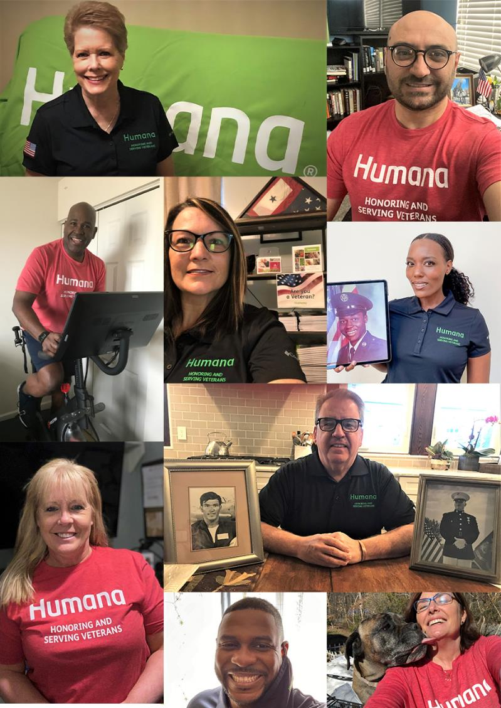
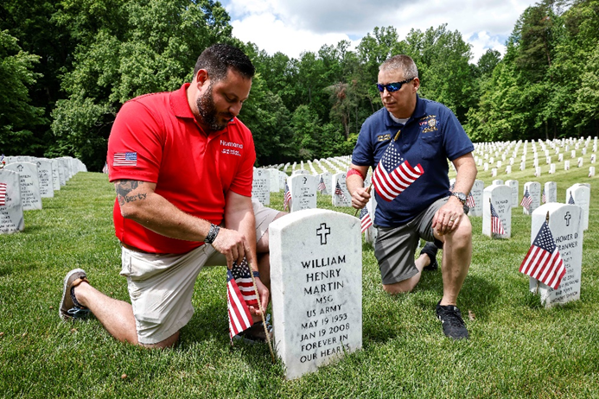
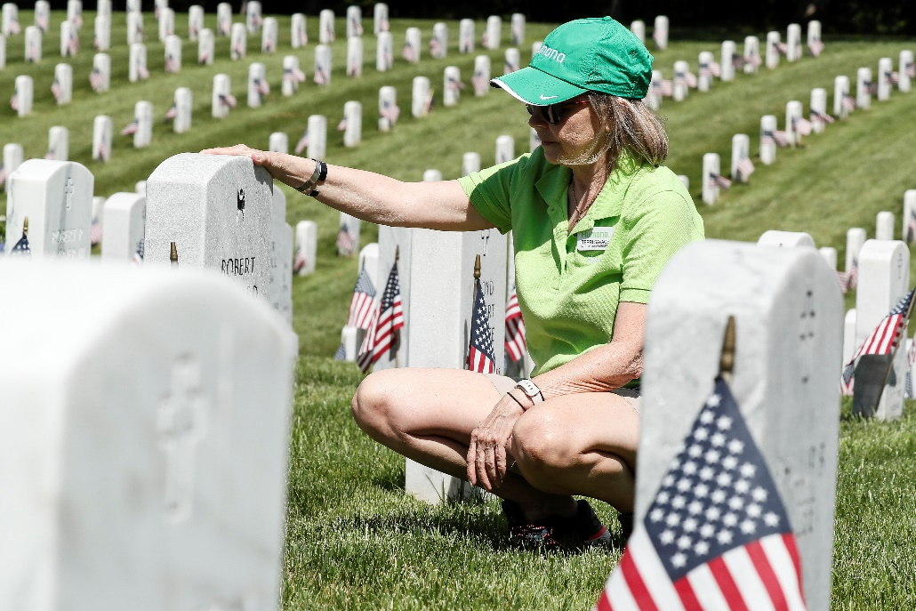
We have a team of people who lead with their hearts in our commitment to helping Veterans
“Veterans have earned their VA benefits, but they’ve also earned their Medicare benefits through years of working. Please encourage them to take advantage of both”.
Notes:
We have a team of tremendous individuals who, I can confidently say, lead with their hearts in everything they do, especially when it comes to helping veterans.
Each person has a story and uses their experience to help other veterans. For example, Megan and Alan joined our team in January of 2020. While the COVID-19 pandemic brought the world to a stop, Megan, Alan and their team found ways to safely help people in their community even during lockdowns.
We are also thankful to have a Gold Star Mother, Dee Hughes, who lives for what she can do to help the veteran community, and Stephanie Stephanie Muckey, has been a military advocate all her adult life, as spouse of a Marine who deployed 8 times, and mother raising two children.
I could go on, but I hope you understand how passionate we are about our team, the things that they do and how they truly lead with their heart.

Slide 12

VFW VSO Scholarship
Scholarship covers cost for additional service officers to attend 1 training per year
Market conducts VA Medicare 101 at Dept. level prior to VSO Training, SWAG included at market’s discretion
Utilize sponsorship to build deeper relationship with VSO recipient, VFW department and all VSOs across every market

Slide 13
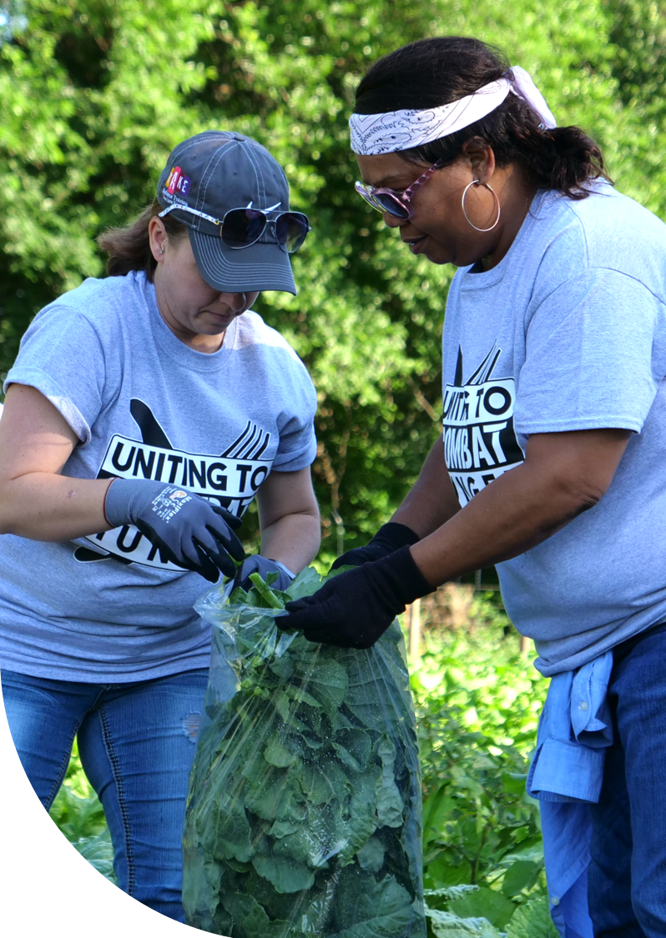
Why veteran health goes beyond the exam room
Notes:
So why do we need to look beyond the exam room to understand a Veteran’s health situation?

Slide 14





Multiple elements affect veteran health
Genetics
Healthy foods
Social factors
Behavior
Transportation
Safe housing
Medical care
Environment
Social connections
Notes:
Factors that influence health include genetics, behavior, environment, medical care, and social factors. Traditionally, healthcare and health insurance only addressed medical care. But social factors, known as social determinants of health or SDOH, play a role in overall health. Access to healthy food, a ride to the doctor, safe housing, and connections such as friends and family all contribute to a veteran’s wellbeing.
These SDOH affect everyone, but we’ve found that the groups served by Medicare Advantage plans including veterans are affected by disadvantages in this area. So what exactly does this look like for Veterans? Let’s take a look at some of these key social factors as they relate to Veterans.

Slide 15



Food insecurity and veterans
Food insecurity may disproportionately impact veterans who:
17%
Live in rural areas²
Experience mental illness²
Percentage of Humana Medicare Advantage veteran members experience food insecurity¹
Are female²
¹Bold Goal Whole Health Toolkit for Medicare Agents for the 2022 Plan Year, last accessed April 4, 2022, https://ignitewithhumana.com/ed/playbooks/bold-goal/bold-goal-whole-health-toolkit/
²Lutz, Jamie, “Food Insecurity among Veterans: Who is at Risk and How to Respond,” November 10, 2021, last accessed April 4, 2022, Center for Strategic & International Studies, https://www.csis.org/analysis/food-insecurity-among-veterans-who-risk-and-how-respond
Notes:
Food insecurity means not having reliable access to affordable and nutritious food. Just how big a problem is food insecurity for Veterans?
Let’s let the numbers tell the story. Working-age Veterans have a 7.4 percent greater risk of experiencing food insecurity than non-veterans. There are currently 1.3 million veterans living in a household that relies on SNAP because they can’t afford the food they need.
But some Veteran groups experience food insecurity more than others.
•2.8 percent more female Veterans are food insecure than male Veterans.
•Food insecurity of Veterans in rural areas is 13.9 percent higher than metropolitan areas and suburbs.
•22.5 percent more disabled veterans are food insecure than average working-age Veterans.
•and Veterans experiencing serious mental illness are 10 times more likely to be food insecure.
When we took a close look, we discovered that 17% of Veterans on Humana MA plans and more than a quarter of Humana MA members overall experience food insecurity. As you can see, food insecurity is a huge problem among Veterans. It’s hard to address health concerns when you’re worried about putting food on the table.

Slide 16
Loneliness/social isolation and veterans
Who is at risk
25%
Who are white, male and unmarried or unpartnered with lower educational attainment and lower incomes are greatly at risk³
Veterans aged 85 and older
Veterans aged 55-74 years old
Had the highest rate of suicide in 2019 (the most recent data year available)⁴
Percentage of Humana Medicare Advantage veteran members report feelings of loneliness and/or social isolation¹
¹Bold Goal Whole Health Toolkit for Medicare Agents for the 2022 Plan Year, last accessed April 4, 2022, https://ignitewithhumana.com/ed/playbooks/bold-goal/bold-goal-whole-health-toolkit/
³Zainab Suntai & Bethany White (2021) Social isolation among older veterans: findings from the National Health and Aging Trends Study, Aging & Mental Health, DOI: 10.1080/13607863.2021.1942434
⁴Ramchand, Rajeev, Suicide Among Veterans: Veterans' Issues in Focus. Santa Monica, CA: RAND Corporation, 2021. https://www.rand.org/pubs/perspectives/PEA1363-1.html
Notes:
Loneliness is just a feeling, right? As it turns out, studies show that loneliness and social isolation significantly increase the risk of premature death from all causes, rivaling other factors like smoking, obesity, and physical inactivity. They are associated with increased risk of dementia, heart disease, stroke, depression, anxiety, hospitalization, ER visits, and suicide.1
A quarter of Humana MA Veteran members report feelings of loneliness and/or social isolation; and 27.9% of Veterans reported having suicidal thoughts in the past two years.
1National Academies of Sciences, Engineering, and Medicine. 2020. Social Isolation and Loneliness in Older Adults: Opportunities for the Health Care System. Washington, DC: The National Academies Press. https://doi.org/10.17226/25663

Slide 17


Transportation and veterans
Impacts on transportation⁵
8%
Distance to care
Relying on public transit
Percentage of Humana Medicare Advantage veteran members have a transportation barrier¹
¹Bold Goal Whole Health Toolkit for Medicare Agents for the 2022 Plan Year, last accessed April 4, 2022, https://ignitewithhumana.com/ed/playbooks/bold-goal/bold-goal-whole-health-toolkit/
⁵Augustine MR, Mason T, Baim-Lance A, Boockvar K., “Reasons Older Veterans Use the Veterans Health Administration and Non-VHA Care in an Urban Environment.” Journal of American Board of Family Medicine. 2021 Mar-Apr; 34(2):291-300. doi: 10.3122/jabfm.2021.02.200332. PMID: 33832997
Notes:
Lack of reliable or affordable transportation presents a barrier to receiving medical care. This affects 8% of Humana MA Veteran members, and 10% of all Humana MA members.
Veterans who live farther from care sites and who depend on public transportation experience the greatest difficulty getting to medical visits. These conditions are more likely to be found in rural areas and certain urban areas.

Slide 18


Financial strain and veterans
Catastrophic household spending
Over 1.2 million veterans 65+ experience catastrophic household spending due to out-of-pocket healthcare costs driven by:⁶
31%
Percentage of Humana Medicare Advantage veteran members have
financial strain¹
Dental care costs
Prescription drug costs
Home healthcare costs
¹Bold Goal Whole Health Toolkit for Medicare Agents for the 2022 Plan Year, last accessed April 4, 2022, https://ignitewithhumana.com/ed/playbooks/bold-goal/bold-goal-whole-health-toolkit/
⁶Charles Liu, et al., “Improvements and Gaps in Financial Risk Protection Among Veterans Following the Affordable Care Act,” Journal of General Internal Medicine, 2022 Feb; 37(3): 573–581. Published online 2021 May 6. doi: 10.1007/s11606-021-06807-4
Notes:
Unexpected and high medical costs can create financial strain on Veterans. Over 1.2 million Veterans aged 65 and older experience catastrophic household spending due to out-of-pocket healthcare costs. The biggest include:
•Dental care
•Prescription drug costs
•and Home healthcare costs
31% of Humana MA Veteran members experience financial strain, and 41% of Humana MA members overall.

Slide 19



Housing insecurity and veterans
Housing insecurity and veteran memory loss
18%
The prevalence of Alzheimer’s disease and related dementias is higher among housing insecure veterans than stably housed veterans⁷
Percentage of Humana Medicare Advantage veteran members report having one or more housing quality issues¹
¹Bold Goal Whole Health Toolkit for Medicare Agents for the 2022 Plan Year, last accessed April 4, 2022, https://ignitewithhumana.com/ed/playbooks/bold-goal/bold-goal-whole-health-toolkit/
⁷Eric Jutkowitz, et al., “Prevalence of Alzheimer's disease and related dementias among veterans experiencing housing insecurity,” Journal of the Alzheimer’s Association, November 2021, DOI:10.1002/alz.12476
Notes:
The last factor we’ll look at is housing insecurity. It’s not enough to address homelessness, which is the main housing issue most people think of as relating to Veterans. Housing insecurity is the problem of insufficient housing, and it accounts for a wider range of housing issues. Housing quality issues can include high housing costs in proportion to income, substandard housing, overcrowding, sharing a home with another family, transience and homelessness.
Veterans experiencing housing instability are more likely to have Alzheimer’s disease and related dementias than those who are stably housed. Almost one out of five Humana MA Veteran members report experiencing at least one housing quality issue.

Slide 20
TRANSFORMING HEALTHCARE
Removing barriers to care to make it easier for members to achieve their best health
PARTNER in care
CONNECT to solutions
ACHIEVE best health
We PARTNER with communities, national organizations, providers and clinicians to remove barriers to health and enable value-based population health.
We CONNECT our members to solutions that enable best health - leveraging technology, insights, products and interventions.
We ACHIEVE positive health outcomes for our members, patients and communities, promoting scalable and sustainable industry-wide improvements in health.
Notes:
We remove barriers to care by:
Partnering with agents, communities, national organizations, providers and clinicians
Connecting members to solutions, and
Achieving positive health outcomes by focusing on the person first and promoting industry-wide improvements in health.

Slide 21
Listen for cues like these:
“I don’t leave the house much or talk to many people these days.”
“It’s hard for me to get to and from the doctor.”
“My grocery budget is very tight by the end of the month.”
“I can’t afford my rent this month.”
“I’m worried I’ll lose my housing.”
Be empathetic
Normalize their experience
Connect them with resources in their area
How you can help
Notes:
The best way to connect with veterans and make a difference is to listen. We can’t know what their needs, wants, lifestyle, and budget are until you ask them some questions. When they share about themselves, you may hear cues like these that signal SDOH barriers:
[Read slide quotes]

Slide 22
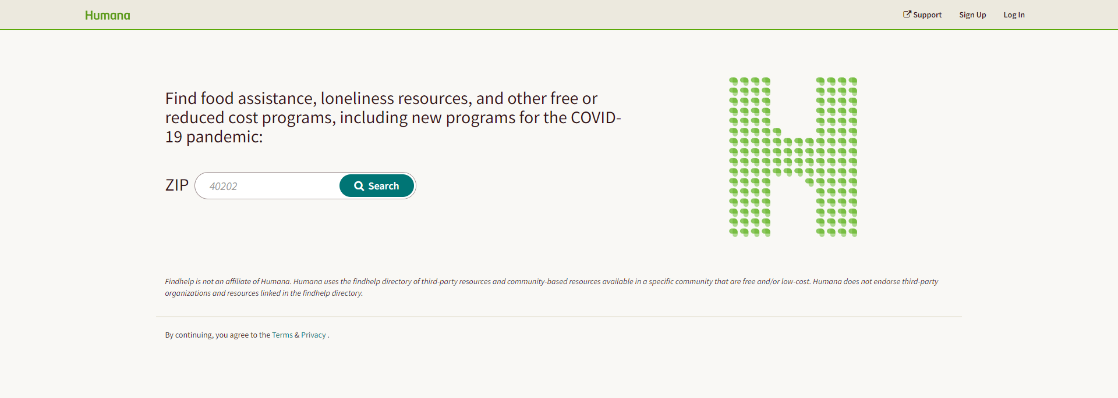
Connect veterans to resources in their local community
Humana Community Navigator
If an individual has identified health-related social needs, follow up by offering assistance connecting them to resources and services that may be available through their medical insurance, government programs and other community organizations through Humana Community Navigator (Humana.FindHelp.com). This service is used
to locate available food assistance, loneliness resources and other free or reduced-cost programs in an individual’s community.
In addition to providing access to thousands of resources, the following features are also available:
• ZIP code search based on service area
• Resources available to share via print, email and text
• Multi-language options for resources
• The ability to create folders to save favorites
Humana.FindHelp.com
Notes:
Findhelp.org is a really simple tool that helps you find free and low-cost community-based resources. You just type in your ZIP code and select the type of resource you’re looking for. It even translates webpages to provide in-language resource information.

Slide 23
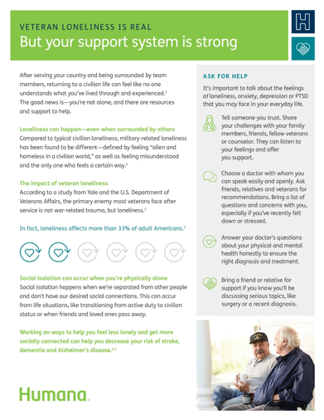
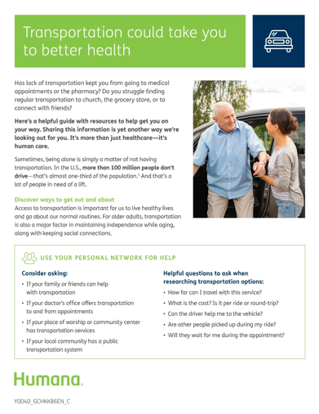
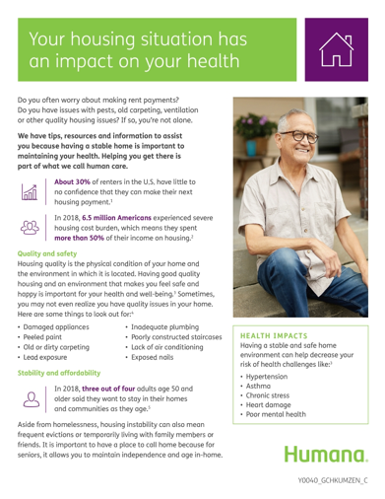
Flyers for print or download
Loneliness flyer
Transportation flyer
Housing flyer
https://populationhealth.humana.com/communities/veterans-and-humana
Notes:
The Bold Goal Whole Health Toolkit will help you apply the principles of the Bold Goal to your clients. It goes deeper into much of what we talked about here today, and it even has resources from Humana’s Marketing Resource Center to help you connect with Veterans.

Slide 24







Slide 25
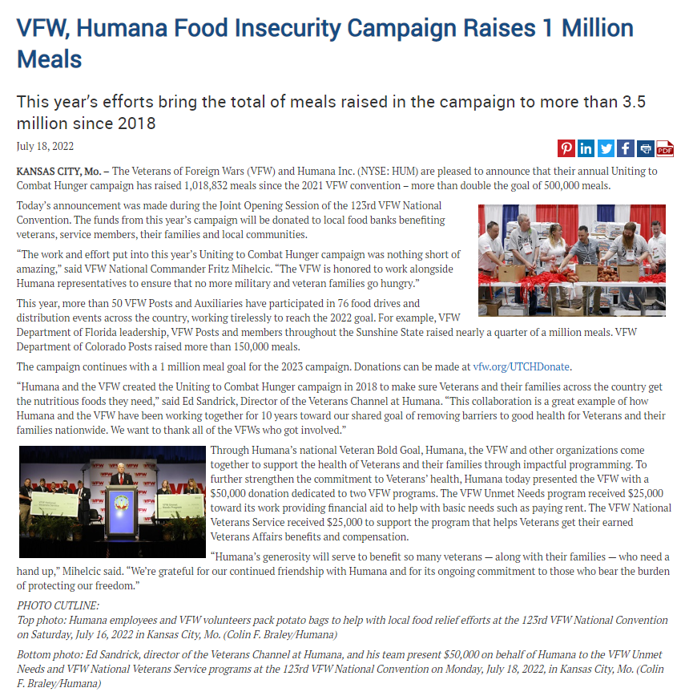
A collective impact campaign:
In our 6th year, VFW, Humana, and Feeding America team up to address food insecurity
A grassroots effort that relies on caring, self-motivated Humana associates, VFW Posts and Auxiliaries, to organize food drives, food distributions, fundraisers, gleanings, and community events to support local communities in fighting hunger
UTCH inaugural campaign launches at VFW National Convention with a focus on Kansas City, 175,000 meals raised
UTCH expands across the entire state of Florida, 321,528 meals raised
UTCH becomes a national campaign and 1 million meals are raised during a global pandemic
UTCH continues to grow, 1,047,369 meals raised
UTCH raises 1,018,832 meals in just 7 months
Over 3.5 million meals raised to date, campaign goal set to 1 million meals
2018
2019
2020
2021
2022
2023
*For internal use only
Notes:
Since 2012, Humana has had a partnership with the VFW to positively effect the health and well being of veterans and their families. In 2018, we kicked off UTCH to combat food insecurity. When we learned that 1 in 5 Veterans is food insecure, we knew had to do something about it. This year, we will be partnering again with the VFW to help fight food insecurity through a joint campaign “Uniting to Combat Hunger.”
He article you see on your screen is the VFW announcing to its 1.7 million VFW and Auxiliary members that together we anticipate collecting half a million meals to families that do not have enough to eat.

Slide 26
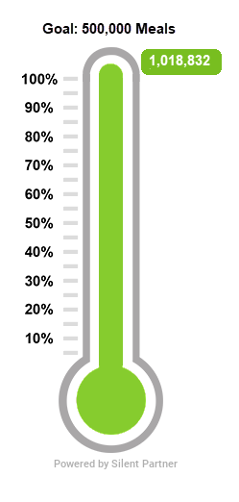
2022 Uniting to Combat Hunger Activations
WA
ME
OR
MN
SD
WI
NY
NE
IA
PA
NJ
CA
UT
IL
OH
MD
CO
MO
VA
NC
AZ
NM
1,018,832
meals
6858+
volunteer hours
SC
AL
GA
TX
76
food drives & distributions
50+
VFW posts & auxiliaries
AK
FL
Notes:
There were seven original Bold Goal markets. In 2019, we added Houston, Atlanta, Charlotte, and Military Health and Resilience (MHR) was formed to support our active military families. In 2020, we on-boarded Detroit and Cincinnati. In 2021, we added the Veteran Community, Charleston, WV, and New York City. Bringing the total to 20 - 18 BG markets and 2 Bold Goal Communities: Veteran’s and MHR as of March 2022.

Slide 27
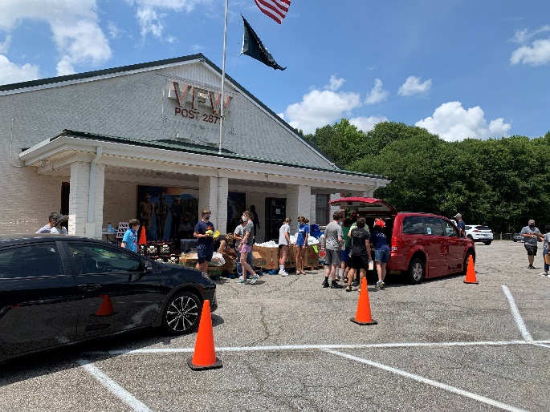
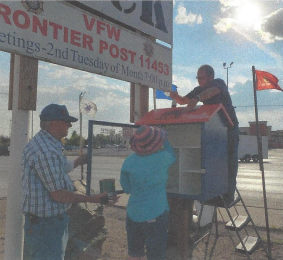
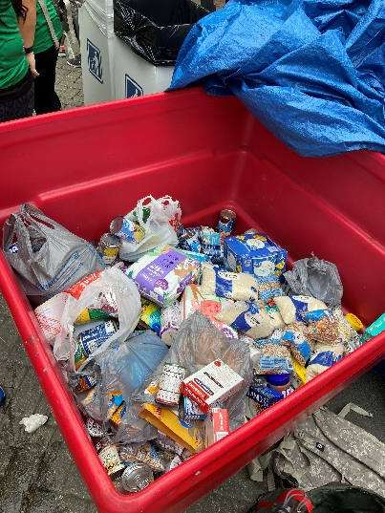
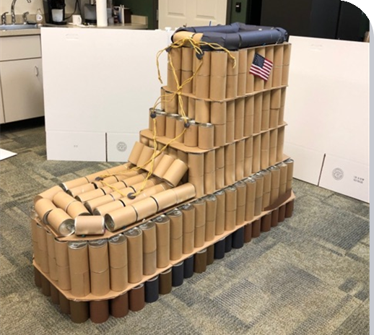
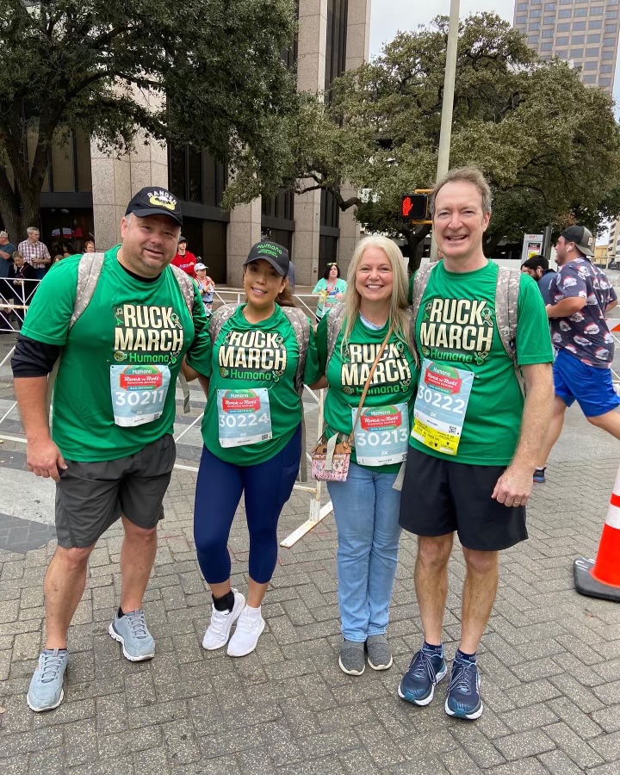
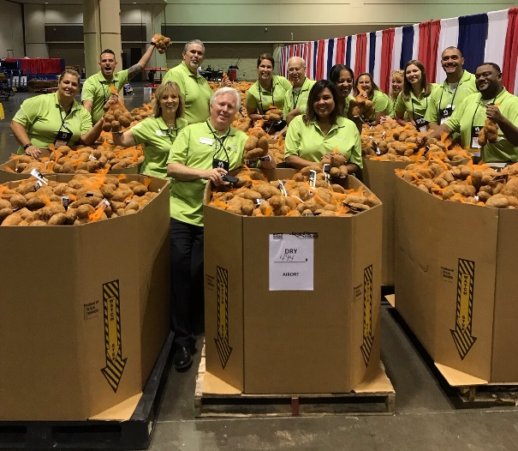
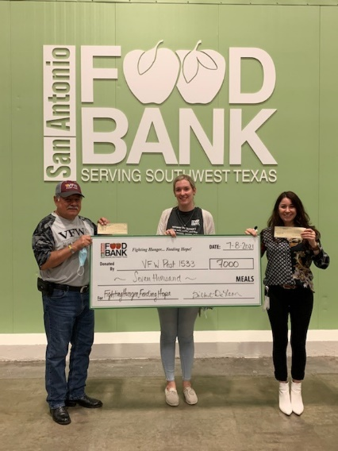
What kinds of activities count towards our Uniting to Combat Hunger Campaign?
Food Drives
Food Distributions
Little Free Pantries
Monetary Donations including Humana Match
Cantastic
Ruck Marches
Gleanings

Slide 28

VFW Foundation Uniting to Combat Hunger Grant
For every $1 raised by a VFW Post/Auxiliary to support Uniting to Combat Hunger, the VFW Foundation will provide a $1 match in the form of an unrestricted grant to the VFW/Auxiliary Post. A minimum of $500 must be raised to qualify for the matching grant.
For every pound of food donated to a food bank, food pantry or community kitchen, the VFW will provide a $1 match. A minimum of 500 lbs. must be collected to qualify for the matching grant.
For every hour that VFW Post/Auxiliary members volunteer to address food insecurity in their community, the Foundation will provide a $1 match in the form of an unrestricted grant to the VFW Post/Auxiliary. A minimum of 500 hours must be documented to qualify for the matching grant.
The VFW Foundation will reimburse Posts/Auxiliaries for up to $500 for constructing and placing a little free food pantry at their Post home or local community center. A Post/Auxiliary must provide receipts showing all expenses incurred in placing the pantry upon submitting their request.
Individual VFW members can make a donation at Donate to Veterans of Foreign Wars Foundation (bloomerang.co) and submit their receipt to their VFW post to count towards the grant
VFW can collect dollars and deliver directly to their local Feeding America site by getting a receipt that notates “UTCH Donation” on it
Connect with your local VFW and get them engaged!
Grant Period Currently Closed
VFW Grant can be located here:
UTCH-Grant-Application.pdf (azureedge.net)

Slide 29

Thank you!
Notes:
Thanks for taking the time today to learn about Humana’s Veteran Bold Goal. Together, we can overcome SDOH barriers and improve Healthy Days for Veterans. Be sure to explore the resources listed in this presentation. We’ll see you next time.

