Slide 1

VSO Accreditation Training
SEPTEMBER 2022

Slide 2
QTC Overview

Slide 3









QTC: Our Mission and Values
Quality
Timeliness
Customer Service
MISSION
To provide high-quality, timely, and customer-focused medical examination service solutions.
VALUES
Integrity
Innovation
Inclusion
Agility
Collaboration
Commitment
3
The inf ormation in this document is proprietary to QTC Management. It may not be used, reproduced, disclosed, or exported without the written approval of QTC Management.

Slide 4











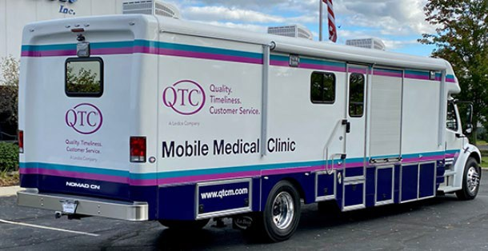
QTC Overview
3,000+ Employees, 17,000+ Medical Provider Network
Annual Services: >400,000 examinees and > 900,000 exams/diagnostics
VA Services | DOD | Disability and Occupational Health |  |  |  |  |  | Non Federal
VBA MDE | RHRP | DOL, FOH, RRB. FBI. USSS, SSA |  |  |  |  |  | IMX
Veterans Affairs | DHA | Dept. of Labor | Social Security Administration | US Railroad Retirement | Federal Occ Health | FBI | Secret Service | Multiple Customers
Disability Exams | Medical Readiness | Work Comp | Benefits Exams | Benefits Exams 23 Years 46 States | OH Exams | OH Exams 9 Years under FOH All 50 States | OH Exams 15 Years under FOH All 50 States | IME / Case Mgt
23 Years | Contract Award 6/21 | 25 Years | 37 Years |  | 15 Years |  |  | Up to 26 years
All 50 States | All 50 states + | All 50 States | 7 States |  | All 50 States |  |  | 9 states
128 Military Sites
International
Expertise
Provider Network Development | Tele-exams
Exam Protocol (Guided Medical Exams) | Clinic Operations
Case Management | Mobile Medicine
Examinee Call Center Management | Population Medicine
Infrastructure
17,000+ Provider Network | 358+ Traveling Providers
5 Case Management Centers | 256+ Per Diem Clinics
94+ Clinics | 10 Mobile Multi-Specialty Coaches
Examinations for America’s Heroes
The information in this document is proprietary to QTC Management. It may not be used, reproduced, disclosed, or exported without the written approval of QTC Management.

Slide 5








QTC’s Focus on the Customer’s Experience
In mid-2021 QTC made the investment to establish a new department with a dedicated and mindful CX culture to drive customer service initiatives, and policies and procedures across the QTC organization.
This department’s primary focus is the Veteran experience and ways to enhance the Veteran’s journey throughout the exam process with QTC.
Benefits of a robust Veteran experience strategy is to deliver internal and external interactions that create exceptional, high-quality experiences in each interaction throughout the organization.
The motivation from this team is the ability to sustain our growth and refine our efforts to deliver High-Quality, Timely Services with Premier Veteran Experiences (Q-T-C) to all of our customers and continue to make a positive difference in the lives of those we serve as well as their families.
5
The inf ormation in this document is proprietary to QTC Management. It may not be used, reproduced, disclosed, or exported without the written approval of QTC Management.

Slide 6
QTC Examination Process
The inf ormation in this document is proprietary to QTC Management. It may not be used, reproduced, disclosed, or exported without the written approval of QTC Management.

Slide 7





















High Level Examination Process
QTC’s Six Step Operational Methodology
1
2
3 4 5
6
Request Processing
Appointment Support
Medical Examination
Appointment Support
Report Delivery
Billing & Payment
eProcess Case Management
Receive Request
Scheduling
Notification
Examination Record
QA Review/ Provider Collaboration
Results Packaging/ Delivery
Stakeholder Relationship Management and Portals
Exam | Examinee | Provider | Medical | Appointment | Automated | Provider
Track | Portal | Portal | Evaluation | Provider Availability | Call | Relationship
 |  |  | Protocol | System (APAS) | Distribution | Management

Slide 8




Claimant Notifications
Process Step | Text | Call | Mail
Case triaged |  |  | Welcome letter is sent via FedEx overnight
Case prepped | Automated welcome text | Automated welcome call
Case Specialist (scheduler) |  | 2 attempts
If unable to schedule after 3 days |  |  | No-contact letter is sent via FedEx overnight
Appointment scheduled
If appt is scheduled | Automated appt text | Automated appt call | Claimant notification packet sent
Appt Confirmation* | 24-72 hours before appt | 24-72 hours before appt
*Appointment confirmation text/calls will stop once claimant confirms appointment

Slide 9
Examples of Claimant Notifications
Notification from VBA to Inform Claimant of Exam Scheduling
From: Veterans Benefits Administration < Veteransbenefits@messages.va.gov>
Subject: Compensation & Pension Examination Appointment Scheduling
Our records show that you filed a disability benefits claim and need to attend a Compensation & Pension (C&P) examination to complete your claim.
In the coming days, you will receive a phone call from QTC. We have included all their contact information along with how it will display on your landline device below, to schedule your examination appointment. You may also receive a text message.
QTC – Quality, Timeliness, Customer Service 1 (800) 682 – 9701
VA EXAM – QTC (CallerID Display)
It is important not to miss you scheduled exam, so please confirm the date, time, and location for your appointment. If you have any additional questions regarding your examination appointment, please contact:
QTC – Quality, Timeliness, Customer Service 1 (800) 682 – 9701
You can establish an account with QTC to view any upcoming appointments by registering at Examinee Login & Information on Medical Exam Appointments | QTC (qtcm.com)
You may also contact the VA at 1 (800) 827 – 1000 or visit us at: https://www.va.gov/disability/va-claim-exam/

Slide 10



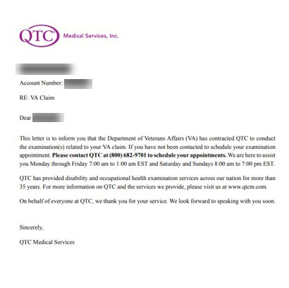




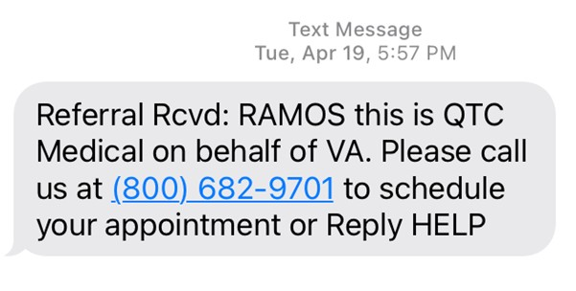
Examples of Claimant Notifications
Welcome Letter
Welcome Text Message

Slide 11











Availability
QTC’s scheduling application is geared towards providing a claimant with the closest/soonest options available.
On top of QTC’s scheduling search results, QTC’s polices require case specialists to always consider a claimant’s physical condition, location, and to maximize a claimant’s time with same day appointment scheduling.
If claimant is not available for exams within 8 calendar days, QTC will advise the claimant that we will transition the case back to the VA.
Claimants who want to schedule past 8 days due to expressing extenuating circumstances are escalated to leadership for review/approval.

Slide 12

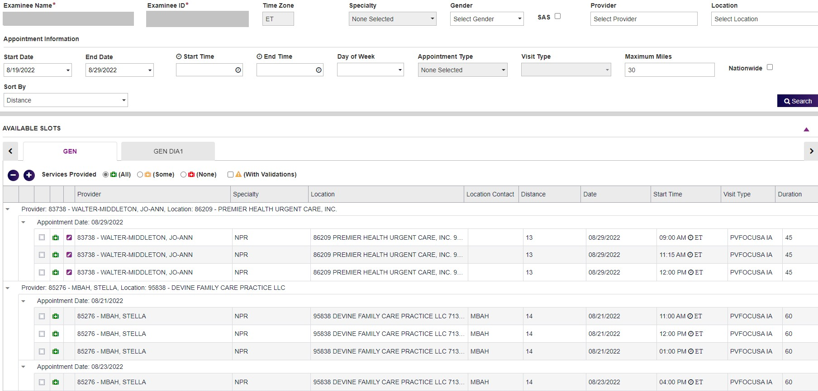
Availability (cont.)
QTC’s scheduling system shows the first available/closest provider to the claimant.

Slide 13

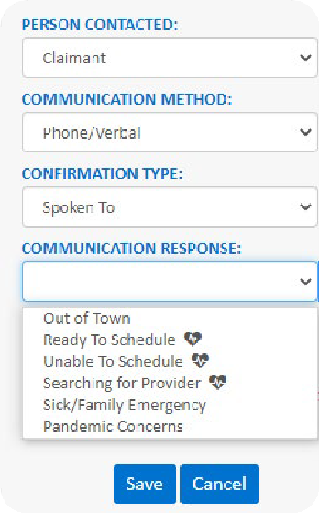
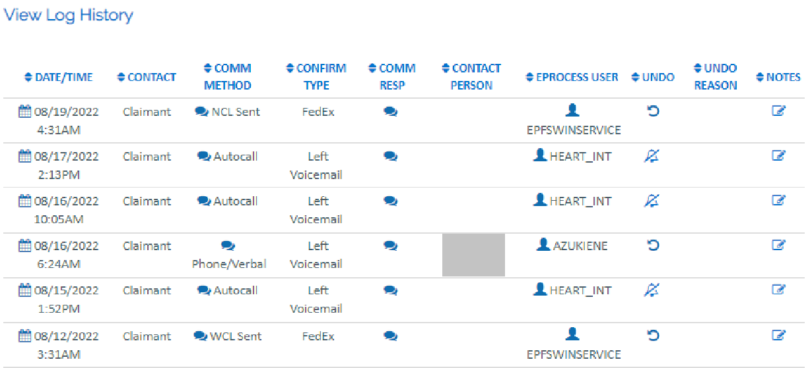
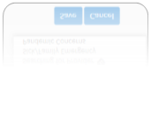
Tracking (Actions to Schedule Appt.)
 Case Specialists are to enter case notes for each attempt and track Positive Contact (PCNT) within the case management system.
 Contact attempts are shown in Exam Track.

Slide 14
QTC Claimant Notification Packages
The inf ormation in this document is proprietary to QTC Management. It may not be used, reproduced, disclosed, or exported without the written approval of QTC Management.

Slide 15


Claimant Notification Package (CNP)
Letters are tailored by Exam Setting (i.e. CNP/BDD/IDES) and includes the necessary appointment information that will guide claimants through the examination process.
The Appointment Notification Letter is made available to the claimant by mail within the Claimant Notification Packet (CNP) and Examinee Portal after an appointment has been set.
Includes Date/Time along with Provider name, specialty, address and credentialing information.
The CNP includes:
Cover Letter
Covid-19 Self Screening
QTC Appointment Letter with FAQs
Questionnaire
Driving Directions
Veteran Crisis Line (recently updated)
** FAQs include:
Do I need to attend this appointment?
What do I need to do?
Should I bring my medical records?
What if I have specialized accessibility needs?
Is this examination free?
Will I be reimbursed for travel Expenses?

Slide 16







Delivery of Claimant Notification Package
QTC leverages an Enterprise Printing and Fulfilment System (EPFS) through a secured third party business partner.
Packages are automatically generated and are processed, printed, and mailed by the vendor, allowing QTC staff to focus on delivering exceptional customer service.
The print vendor processes packets at 1:30 am PT, 9:30 am PT, & 1:00 pm PT.
Mailing logic built into the system sends the packet by various methods to arrive at least 3 days prior to the date of appointment.
USPS First Class
FedEx Express Saver
FedEx 2 Day Service
FedEx Priority Overnight

Slide 17






CNP Challenges and Delays
Wrong Address (mail returned or forwarded)
FedEx challenges to reach some remote areas
Inclement Weather
Print Vendor Business Disruption (rare and claimants are typically rescheduled if necessary)
Scheduling after Printing Cut-off time (typically rescheduled)
These reasons may result in the claimant receiving the appointment notification package late or after the exam date of appointment.

Slide 18

Future/Ongoing CNP Improvement Projects
Examinee Portal and MEP Integration (Medical History)
Option for Paperless CNP
Revision of the Physical CNP to Reduce Waste
Continuous Changes to Verbiage to Align with VA Requirements and Simplify Examination Process

Slide 19
VSO Supporting Claimants

Slide 20










Support Contact Numbers
National Call Center
VA Operations | 800.682.9701 | Monday-Friday 7am-1am EST Saturday-Sunday 8am-7pm EST
International | 213.474.2790 | Monday-Friday 7am-1am EST Saturday-Sunday 8am-7pm EST
Support Services
VSO Support - Email
Scheduling & Appt. Directions
WeCare@QTCM.com
Transportation Requests
Reimbursements Demographic Changes

Slide 21
Obtaining Information for Claimant
Claimant can contact QTC ahead of time to provide verbal authorization to speak to a VSO on their behalf.
QTC will document this in case management notes for any future correspondences that may occur.
Claimant and VSO can contact QTC together and provide authorization to speak to VSO on their behalf.
QTC will document this in case management notes for any future correspondences that may occur.
If a claimant is unable to communicate effectively during the scheduling process, QTC staff will review medical records for a possible POA (i.e., Power of Attorney) or authorization of third party forms (e.g., VA Form 21-0845) to authorize another individual to communicate/arrange for scheduling on their behalf.
A copy is not required to be obtained. Staff will document clearly in case management notes when a POA or third party is identified to speak on behalf of the claimant.

Slide 22
Exam Expectations - Treatment Vs. Evaluation
Understanding the examination process to assist in setting the right expectations for the exam and the best experience for the Veteran.
 QTC examiner’s goal is to evaluate the claimed condition(s) that have been requested by the VA.
 Primary–care provider is to treat a condition(s) and maintain one’s overall health.
 QTC examiner must follow strict instructions from the VA.
 Due to QTC examiners evaluating a condition, their approach may seem different than the approach of a primary care provider.
 Our CNP packages highlight the difference between a QTC examiner and one’s primary- care provider.
 QTC Providers are trained to discuss the evaluation process to set expectations and best experience with Veteran.
 Setting expectations together will assist in providing the best, most positive experience.

Slide 23




Feedback From the Field

