Slide 1
VSO VBMS Notification Process

Slide 2
The 6 Categories of notification
The Notification Process allows you to choose to be notified for one or more categories of VA Notifications. There are 6 categories, and they are:
Appeal
Development
Due Process
General
Notification
Medical Records

Slide 3
The 6 Categories of notification continued…
Each notification category has its own Description/Documents.
For example, the Appeal Category governs the following Descriptions/Documents:
BVA Decision
CAVC Decision
Appeal Notification Letter
BVA General
Appeal Satisfaction Notice
A Complete list of every Category and Description/Documents can be found on the last 3 slides of this presentation.

Slide 4
System Source Codes
1. After selecting the category of notification and correspondences, you can then select from the following System Source Codes to only search for what types of letters you want to review:
VBMSA – VBMS-Awards/Decision Letters
VBMSSYSACCT – VBMS System Account (Such as a document created within VBMS, like an exam request)
EVSS – Enterprise Veterans Self Service (Submissions through VA.gov, Stakeholder Enterprise Portal SEP, etc.)
VBMS-UI – VBMS User Intake (meaning an employee manually uploaded the document)
VVA – Virtual VA (VA retired the use of Virtual VA on June 1, 20217. VVA was a separate area electronic documents were housed)
VVA- Document Migration – With the retirement of Virtual VA – electronic documents were migrated into the efolder.
SMS- Source Material Sent. It represents that the document was uploaded via a scanning vendor.
CSRA – Is another acronym for folders converted and stored from a scanning vendor

Slide 5
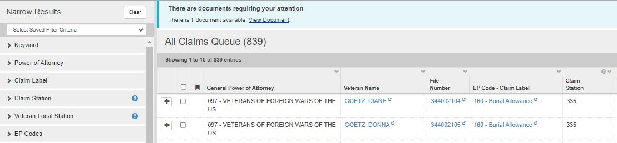
How does it work?
Step 1
Log into VBMS

Slide 6
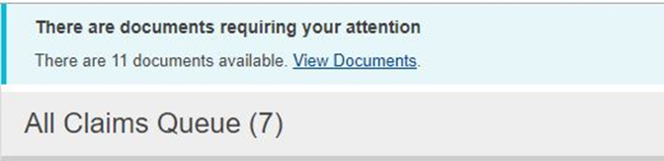
How does it work?
Step 2
Click on “View Documents” hyperlink located in the banner at the top of your VBMS all claims Queue
Special note* the documents that are available under View documents in this banner are for every new notification within our entire organization and cannot be filtered by office prior to loading.

Slide 7
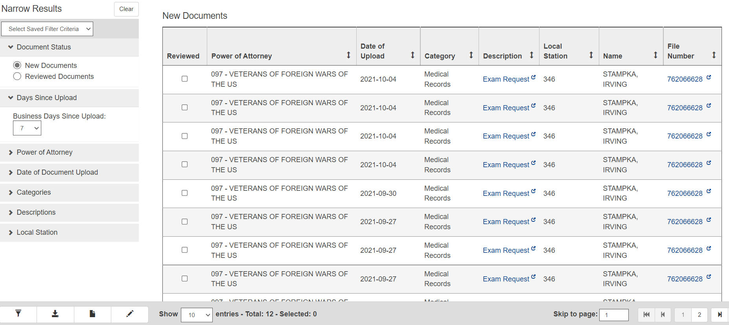
How does it work?
Step 3
Once you click on the banner you will be redirected to a page that contains all notifications for the organization.

Slide 8
How does it work?
Step 4
Now it’s time to set up your filters. These filters will narrow down all notifications so that only filtered results will be displayed.
Here are the filters and their role:
New or Acknowledged Documents: Filters new or previously acknowledged documents
Days since Upload: Shows only documents uploaded within X amount of busines days
Date of Document Upload: Allows you to select a specific date you wish to view
Categories: Appeal, Development, Due Process, General, Notification, Medical Records
Descriptions: Allows input of a specific document type as opposed to all in that category
Local Station: filters by all in your local station
System Source: Reduces the number of documents that are populated when choosing one of the 8 choices
Power of Attorney: If you have cross accreditation, you can choose which POA to view. Be sure to only view one POA at a time.
Special note* Claim station is the station the claim is being worked, whereas local station is the station associated with home address.
Special note* You can choose to filter by viewing every document/description, category or both when you set up your filters.

Slide 9
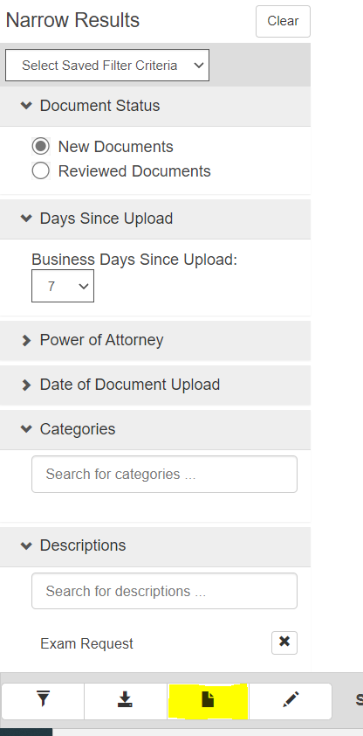
How does it work?
Step 4 continued
Once your filters are in place you will want to click “Save New Filter”.

Slide 10
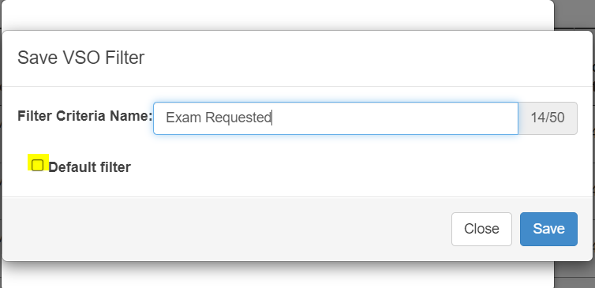
How does it work?
Step 4 continued
From here you can choose to name your filter as well as make it your Default Filter.
The Default filter will automatically populate only notifications that meet the filtered criteria every time you open this page.

Slide 11
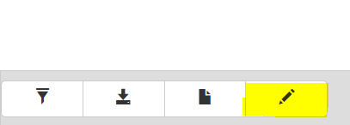
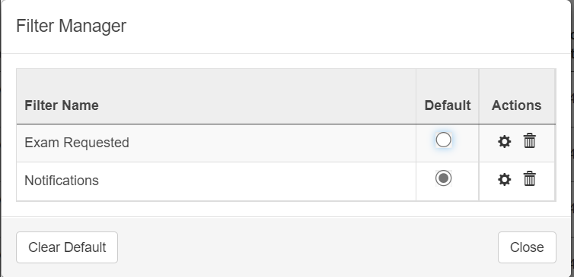
How does it work?
Step 4 continued
You can save multiple filters and manage them with the “Managed Saved filters button”.
When you press the Managed Saved Filters Button you are directed to the Filter Manager. This allows you to delete filters as well as change your Default Filter.

Slide 12
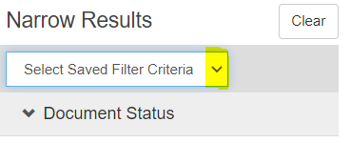
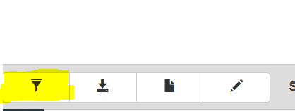
How does it work?
Step 4 continued
If you click on the drop-down arrow you can select what filter you would like to populate.
Once your desired filter is selected press the “Apply Filter” Button to update your queue.

Slide 13
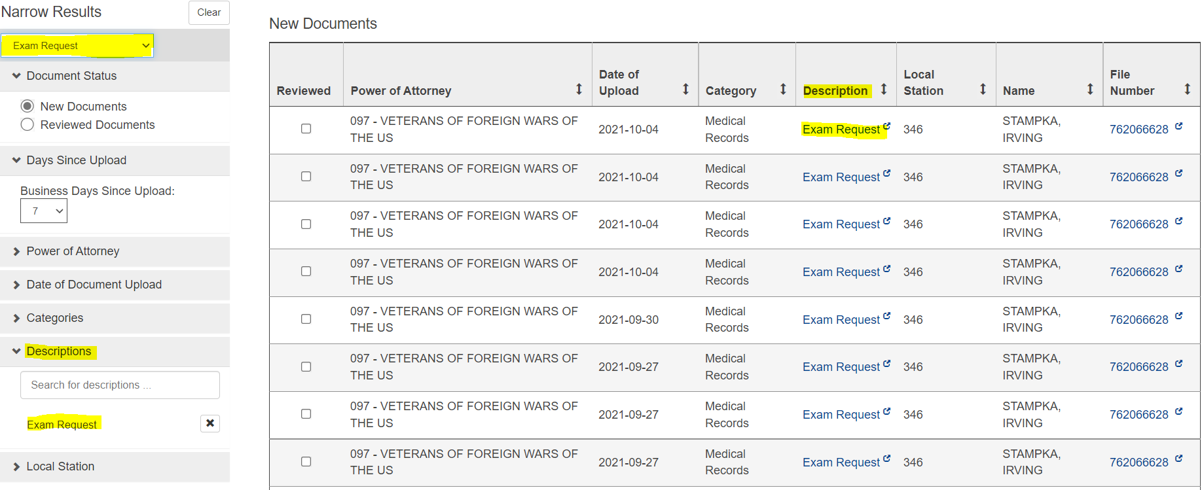
How does it work?
Step 5
Once your filters have been updated, your queue will now reflect only notifications that meet your perimeters.

Slide 14
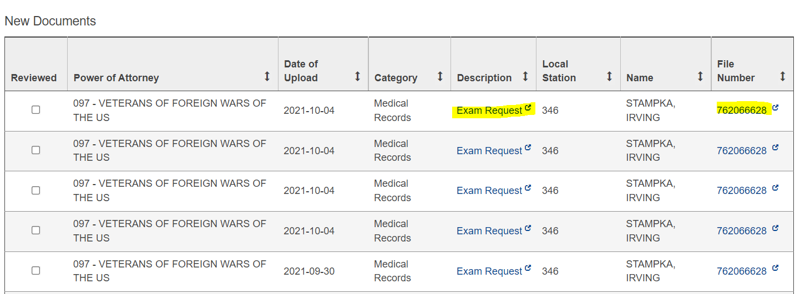
How does it work?
Step 6
With your updated work queue now in place you can review your filtered notifications.
Special Note* Clicking on the description item opens that specific item.
Special Note* Clicking on the file number opens the veterans claim folder

Slide 15
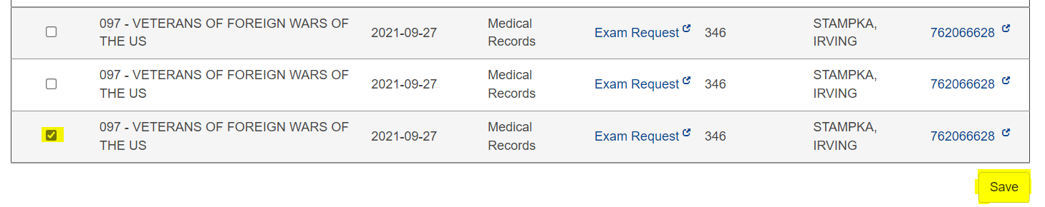
How does it work?
Step 7
Once you have viewed the notification you can clear it. To remove the notification, click on the “Acknowledged” box next to the notification you reviewed and click save.

Slide 16
3 MOST COMMON FILTER SETTINGS

Slide 17
VBMS FILTERS FOR NOTIFICATIONS
Document Status – Default is new documents
Power of Attorney – VFW
Date of Document – Date or dates you want to search
Categories – Choose Notification and Correspondence
Descriptions – Leave Blank
Local Station – This is your RO
Zip Code – Leave Blank
File number – Leave Blank
Award Station – Leave Blank
System Source – Choose VBMA and VBMS-UI
With these filters in place approximately 95 percent will be decision letters that you can review for errors and use for your DSO reports

Slide 18
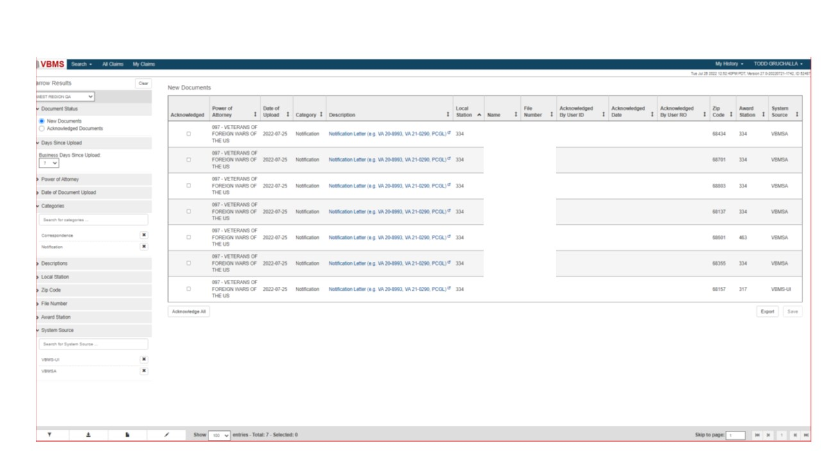

Slide 19
VBMS FILTERS FOR BVA/CAVC DECISIONS
Document Status – Default is New Documents
Power of Attorney – VFW
Date of Document – Date or dates you want to search
Categories – Leave Blank
Descriptions – Choose BVA Decision and CAVC Decision
Local Station – This is your RO
Zip Code – Leave Blank
File number – Leave Blank
Award Station – Leave Blank
System Source – Leave blank
With these filters in place only your BVA/CAVC letters will populate for your review.

Slide 20
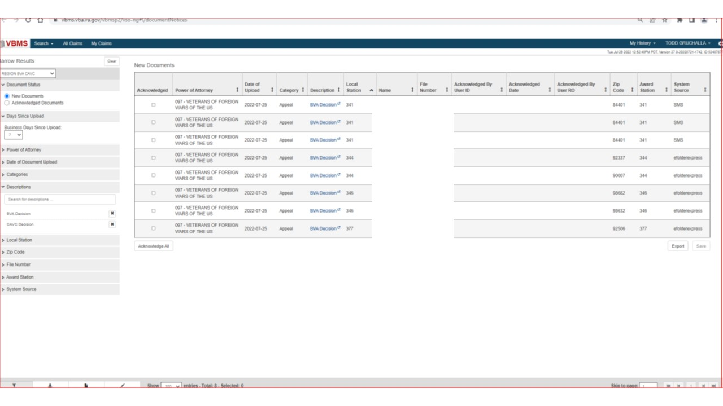

Slide 21
VBMS FILTERS FOR CORRESPONDENCES
Document Status – Default is New Documents, but I do check the Acknowledged documents to see who has gone thru the queue.
Power of Attorney – VFW
Date of Document upload – Date or dates you want to search
Categories – Leave blank
Descriptions – Choose correspondence
Local Station – This is your RO
Zip Code – Leave Blank
File number – Leave blank
Award Station – Leave blank
System Source – VBMS-UI
With these filters in place you can look at letters to see if something needs to be corrected, ie: claim on the wrong form, missing signature

Slide 22
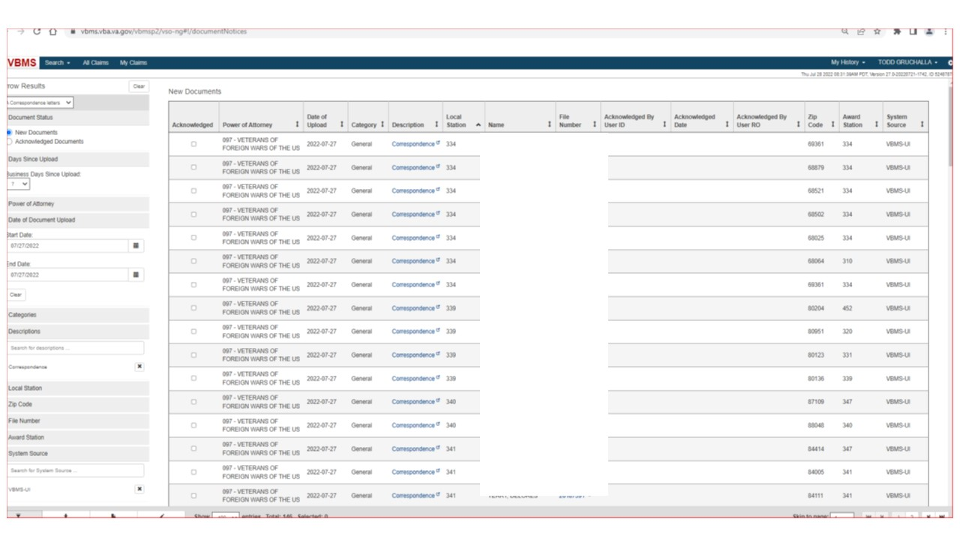

Slide 23
QUESTIONS?

Slide 24
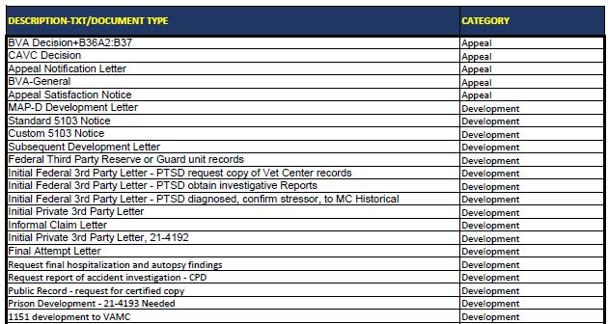
All Description/ Document types and Categories

Slide 25
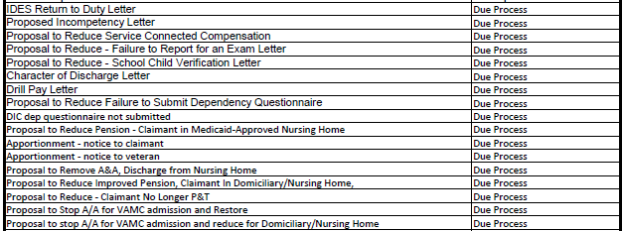
All Description/ Document types and Categories

Slide 26
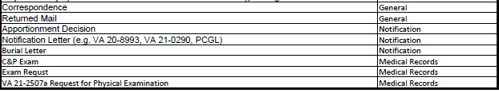
All Description/ Document types and Categories

