Slide 1
Combating Claim Sharks

Slide 2
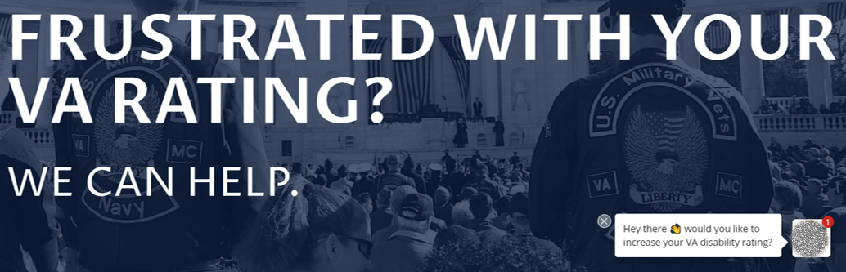

Learning Objectives
What is a claim shark?
Signs of a claim shark
What should veterans ask?
OGC Advice and Standards
Your responsibilities
NVS actions
Q&A

Slide 3
What is a Claim Shark?
A Claim Shark is an individual or company that “assists” or “consults” veterans with VA claims even though they are not accredited with VA
Many of these companies charge fees for their services, sometimes totaling in the tens of thousands of dollars for services that veterans can receive from you FOR FREE
These companies have used the pandemic to their advantage, offering fully remote “assistance” and easy to access “one click away buttons” in order to capitalize on the reduced resources available due to VA closures

Slide 4
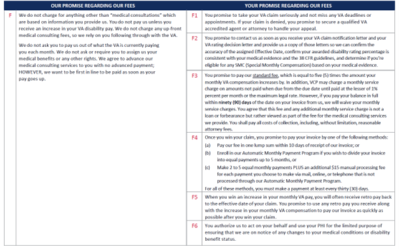
Telltale Signs of a Claim Shark
Most claim sharks advertise on social media, targeting veterans with statements such as:
Promising a guaranteed grant or increase in benefits
Telling clients they can “start” for free
Providing “Coaching” during the claims process
Giving a guaranteed success rate
"All I had to do was send in my medical records. Once I got my results back, I opened up the envelope and I was like 'Wow! 100%!'"
“Risk-Free. You Only Pay When You Get Paid.”

Slide 5
Telltale Signs of a Claim Shark
Claim sharks rarely claim to represent veterans, instead offering “Consulting Services” or “Benefits Advice”
They cannot access VBMS or other VA systems so they often ask for the veteran’s eBenefits password so they can “review the record”
Some companies instruct their clients to not inform VA that they are being “assisted” or disclose their fee structures to any other clients

Slide 6
What Should Veterans Be Asking?
As more and more claims sharks emerge, VA, VFW, and other legitimate organizations are instructing veterans to ask their representative about their services and intentions.
Questions such as: “Are you accredited?” or “Can I see your credentials?” should be welcomed
If asked these questions, show them your name in the Office of General Council (OGC) Accreditation Search website: http://www.va.gov/ogc/apps/accreditation/index.asp
OGC provides additional resources, to include a “Selecting a Representative” presentation available here: https://www.va.gov/ogc/accreditation.asp

Slide 7
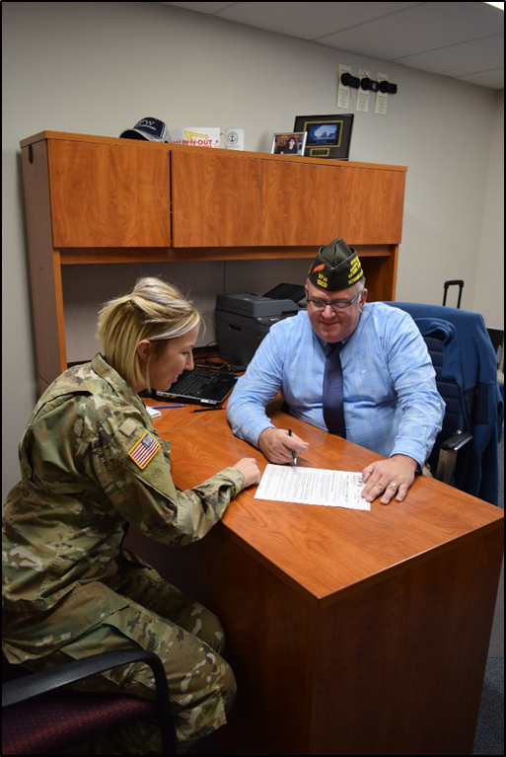
OGC Recommended Questions
When were you accredited by VA?
How long have you provided VA benefits claim assistance?
What is your training?
What types of claims have you filed in the past?
What is your experience with my type of claim?
Can you provide referrals from former clients?
How much contact may I reasonably expect from you, and what is your preferred method of communication?
Will you personally assist me in preparing and presenting my claim to VA?
Will anyone else assist you with my claim?
Will you represent me throughout the appeals process to include the Court of Appeals for Veterans Claims? What is your experience with the appeal process?
What are your fees?
What are the expected expenses?

Slide 8
OGC Standards of Conduct
The standards of conduct in 38 C.F.R. § 14.632 establish the appropriate behavior for VA-accredited attorneys, agents, and representatives.
VA-accredited individuals providing VA claims assistance shall:
Faithfully execute their duties on behalf of a VA claimant;
Be truthful in their dealings with claimants and VA;
Provide claimants with competent representation before VA; and
Act with reasonable diligence and promptness in representing claimants.
See 38 C.F.R. §§ 14.632 (a) & (b).

Slide 9
OGC Standards of Conduct
VA-accredited individuals shall not:
(1) Violate the standards of conduct as described in 38 C.F.R. § 14.632.
(2) Circumvent the rules of conduct through the actions of another.
(3) Engage in conduct involving fraud, deceit, misrepresentation, or dishonesty.
(4) Violate one or more of the provisions of title 38, United States Code, or title 38, Code of Federal Regulations.
(5) Enter into an agreement for, charge, solicit, or receive a fee that is clearly unreasonable or otherwise prohibited by law or regulation.
(6) Solicit, receive, or enter into agreements for gifts related to representation provided before an agency of original jurisdiction has issued a decision on a claim or claims and a Notice of Disagreement has been filed with respect to that decision.
(7) Delay, without good cause, the processing of a claim at any stage of the administrative process.
(8) Mislead, threaten, coerce, or deceive a claimant regarding benefits or other rights under programs administered by VA.
(9) Engage in, or counsel or advise a claimant to engage in, acts or behavior prejudicial to the fair and orderly conduct of administrative proceedings before VA.
(10) Disclose, without the claimant’s authorization, any information provided by VA for purposes of representation.
(11) Engage in any other unlawful or unethical conduct.

Slide 10
How Can You Help?
If you are assisting a veteran who has been “helped” by a claim shark, ask if they have information for the company and forward it to Todd Gruchalla at Tgruchalla@vfw.org
If the veteran can provide a copy of their contract it will be extremely helpful, even if it is not signed
NVS is compiling information to help VA put a stop to these practices as they are extremely harmful to veterans and often illegal

Slide 11
How Can You Help?
As tempting as it may be, do NOT conduct your own investigation into these companies
Do not contact them or post comments to their social media pages
If a veteran asks about a specific company, do not speak negatively, instead advise them to use an accredited representative and offer to check the OGC website.
Example: Accredited agents and attorneys may maintain web sites that look similar. However, any agreements that a veteran signs an agent or attorney is subject to strict VA oversight and perfectly legitimate. These sites WILL disclose VA accreditation.

Slide 12
What is NVS Doing?
This past year, VFW has taken several steps to help prevent these practices by VA and VSOs such as messaging, testimony to congress, and reporting these practices to the proper authorities as they are discovered
VFW is working with VA and congress to have legislation passed to enforce accreditation standards and provide penalties for those who are not in compliance
VFW is working with VBA, OGC, CFPB, DOJ and other agencies to identify unlawful and predatory practices for purposes of enforcement

Slide 13
What is NVS Doing?
When veterans select an accredited representative, they will be asked to fill out a VA Form 21-22 or VA Form 21-22a to be filed with VA for the purposes of representation.
If an entity offers to “help” with a VA claim, but does not ask the veteran to file this form with VA, then veterans should not work with them.
VFW has pitched this concept to VBA and VHA to help promote consumer awareness in the coming federal fiscal year 21-22.

Slide 14
QUESTIONS?

