Slide 1
In-Person Identity Proofing
ID.me & Veterans of Foreign Wars helping Veterans easily access VA.gov

Slide 2
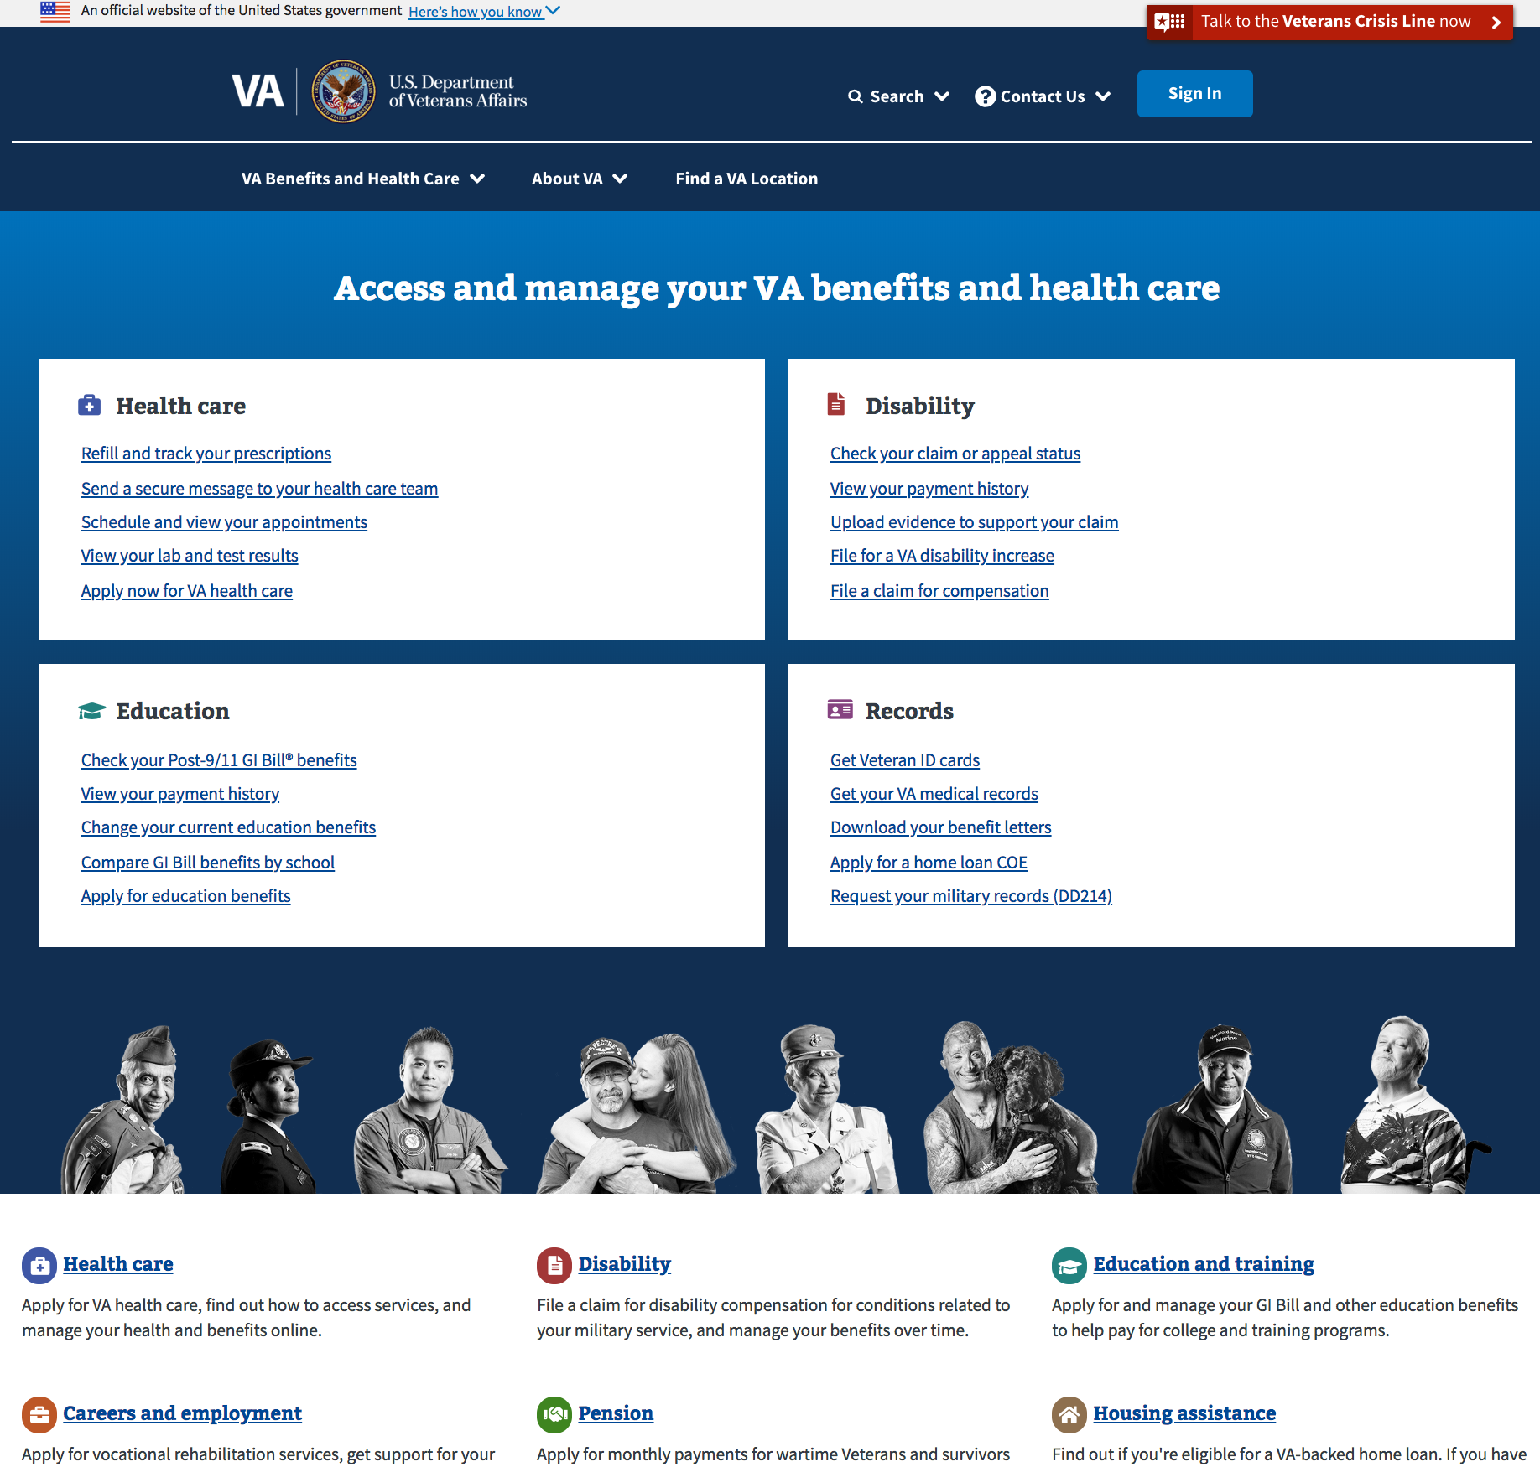
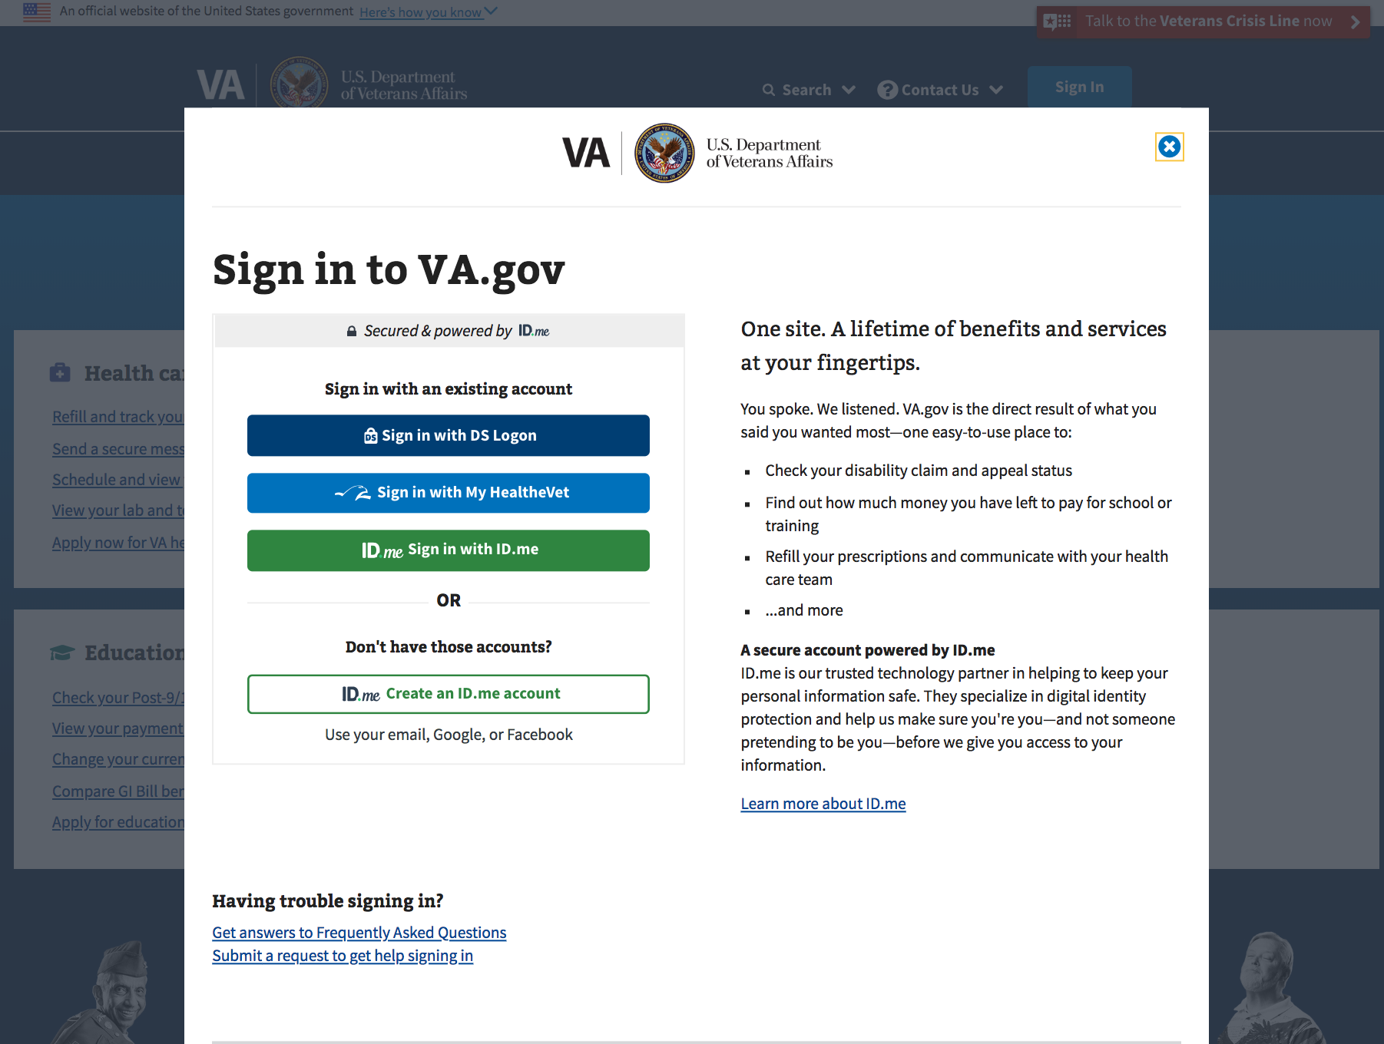
Front door to accessing VA.gov
ID.me provides identity verification & authentication for veterans accessing VA.gov

Slide 3
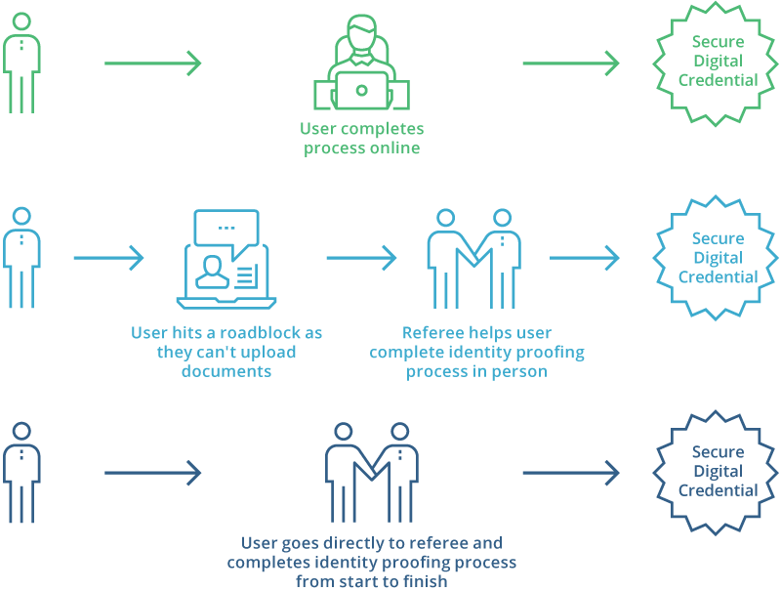
With ID.me, the user has 3 options:
Identity Proofing: Online or In Person
1
Online
Start online and finish in person with a trusted referee
In-person with trusted referee
2
3

Slide 4



In-person identity proofing closes the gaps for individuals who are challenged with online identity proofing due to the limitations of authoritative data sources or technology requirements:
Why In-Person Identity Proofing?
Individuals who use an unregistered prepaid phone or
do not have a telephone to their name
Individuals who do not have a driver’s license or passport
Individuals with a limited credit history with credit bureaus
Individuals who are uncomfortable with technology and require additional assistance

Slide 5

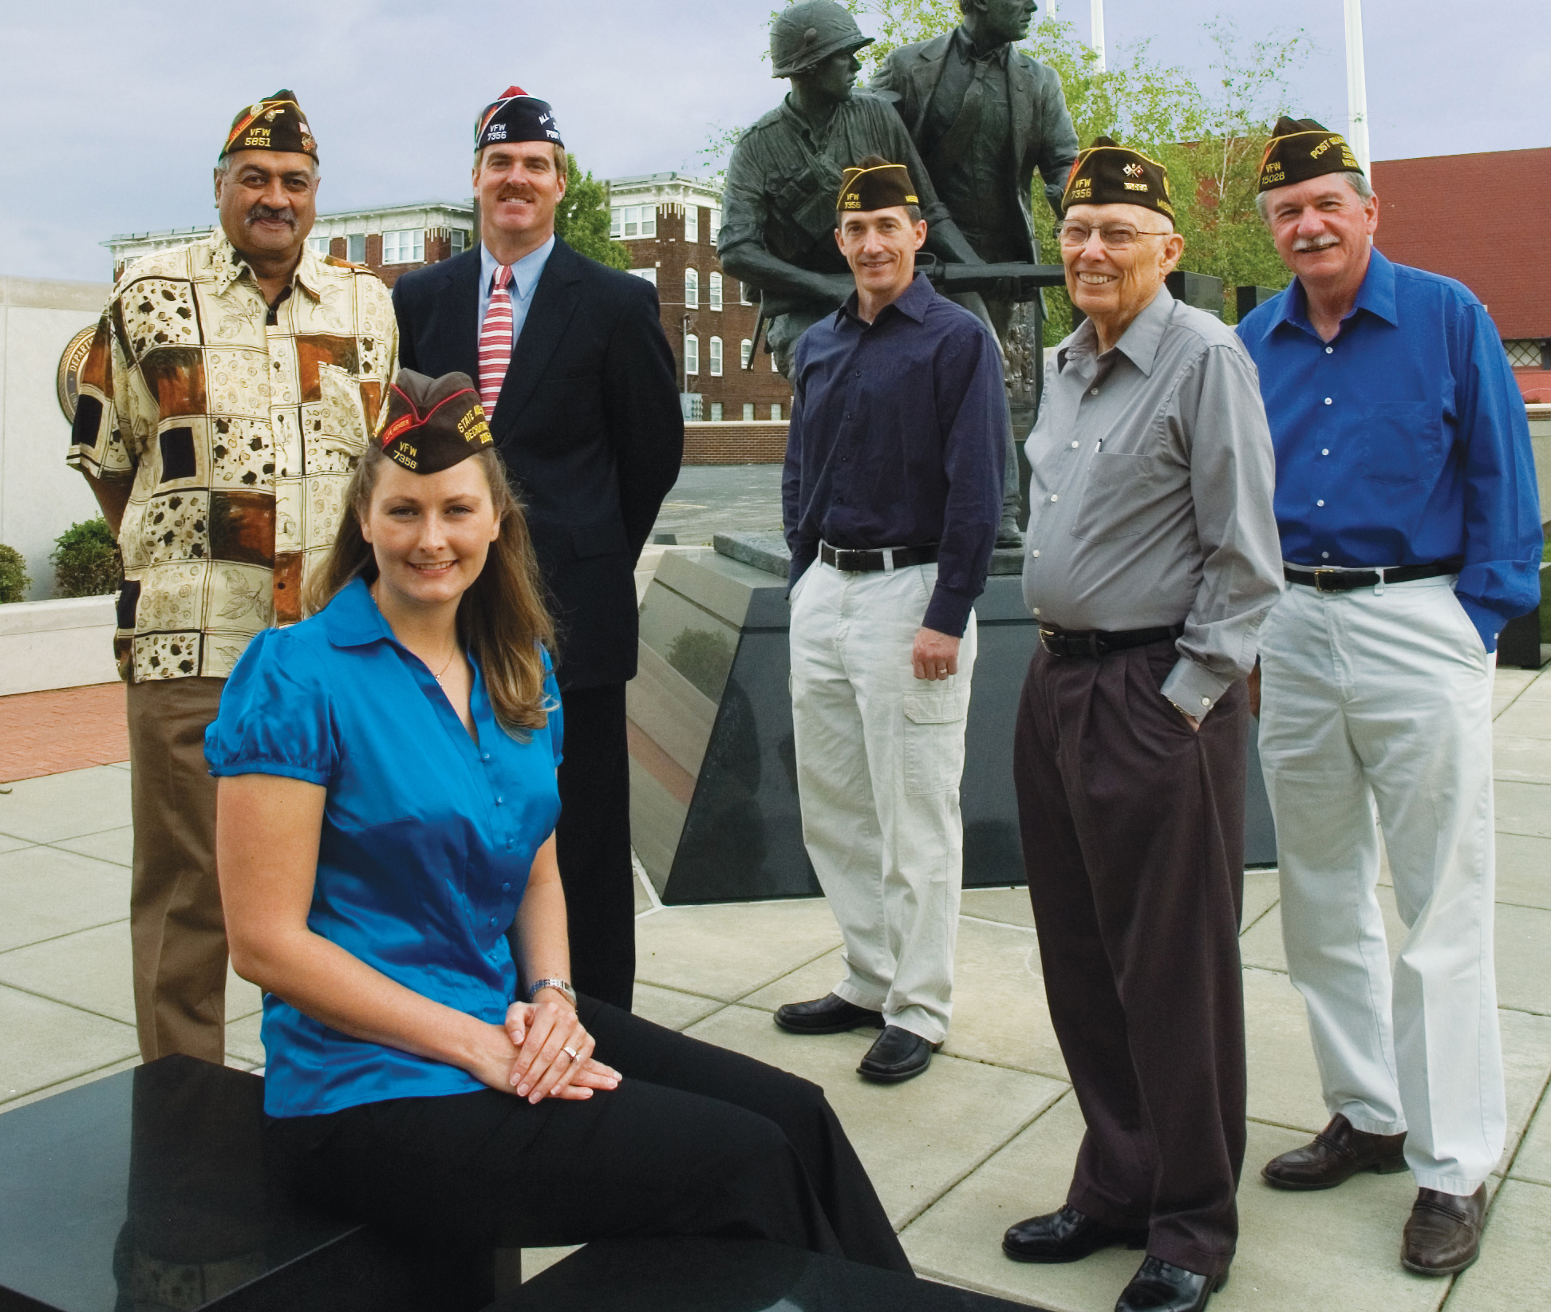




Who Can Act as a Trusted Referee?
Representatives of Veteran Service Organizations (VSOs) for the veteran community
Anyone who has:
Completed LOA3 or IAL/AAL 2 identity proofing
Passed the ID.me administered Training & Certification program
Is acting in a position of public trust AND is approved by the government agency
Administrative staff in doctors’ offices and hospitals to enable patient access to PHI
High school guidance counselors for students applying for financial aid
Other individuals in positions of trust such as notary public professionals or tax preparers
Confidential & Proprietary Information of ID.me
5

Slide 6
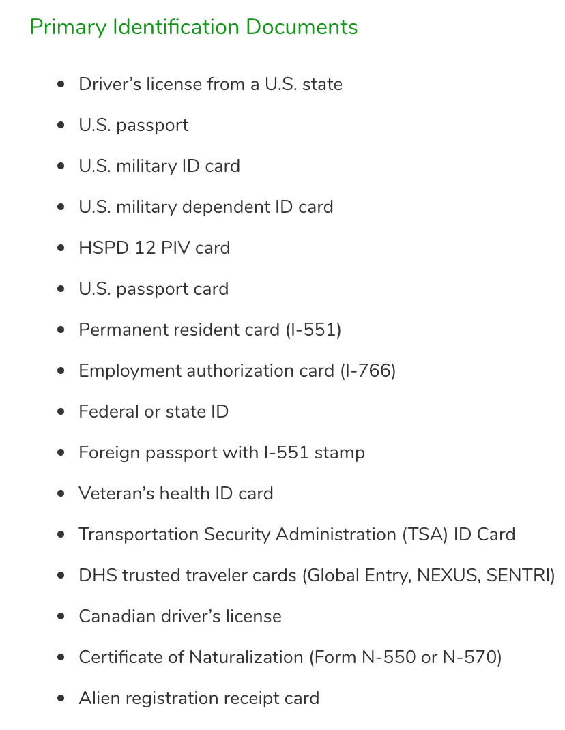
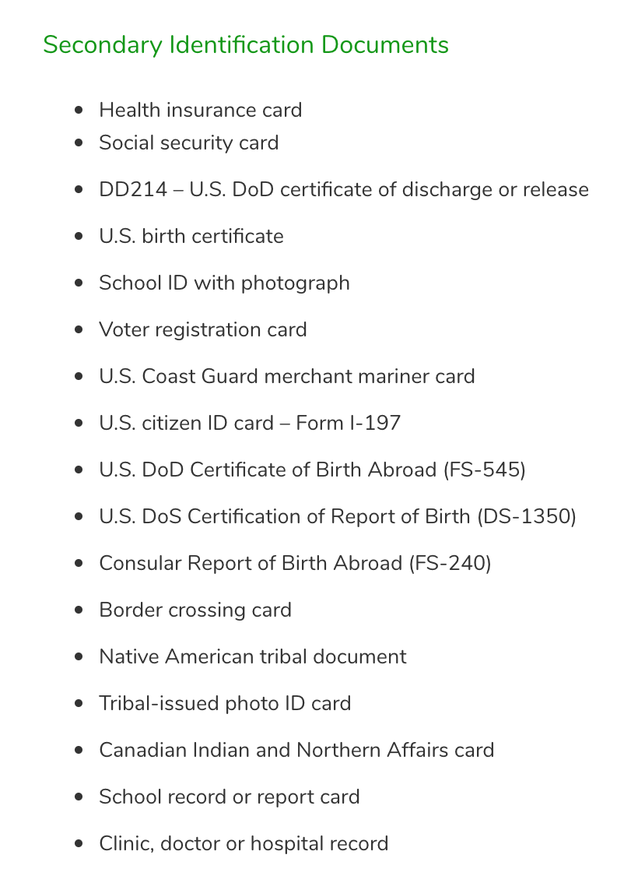
For in-person identity proofing, ID.me provides the user the option to present 2 primary pieces of evidence, OR, one primary and two secondary:
6

Slide 7


Slide 8
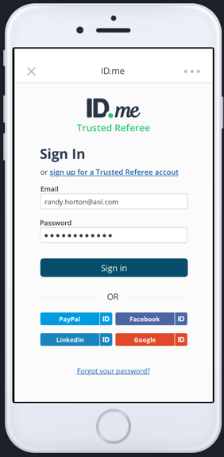

Slide 9
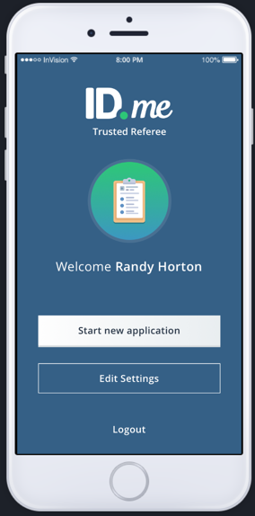

Slide 10
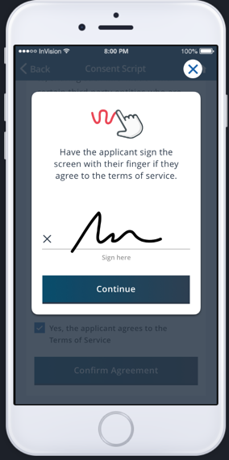

Slide 11
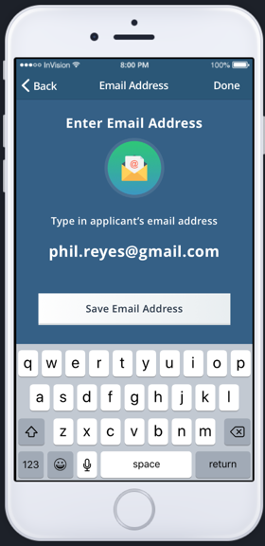

Slide 14
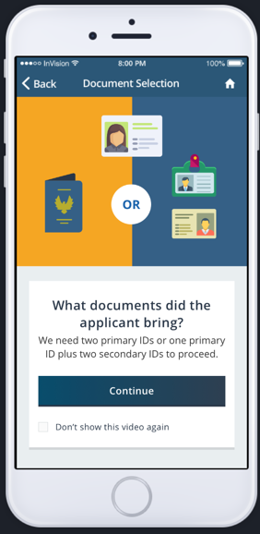

Slide 15
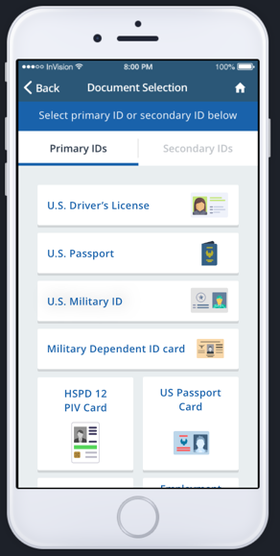

Slide 16
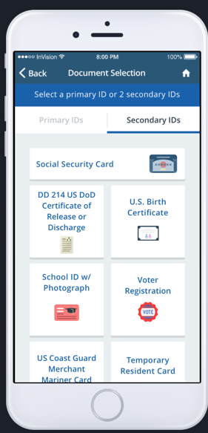

Slide 18
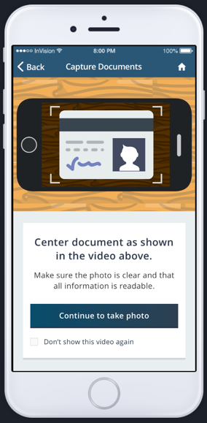

Slide 19
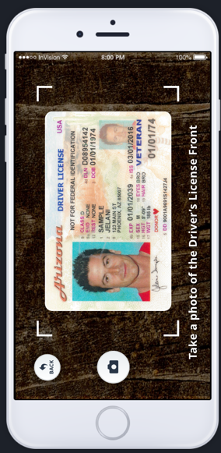

Slide 20
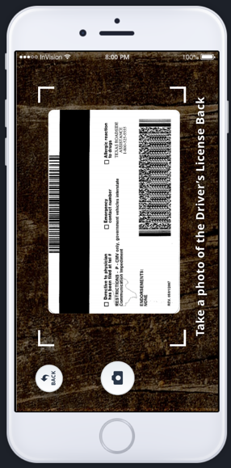

Slide 21
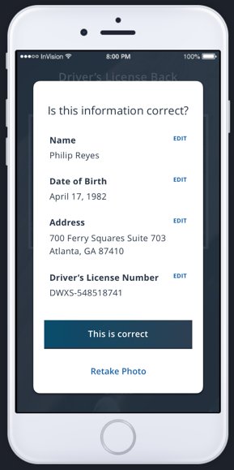

Slide 24
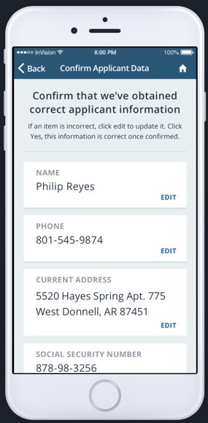

Slide 25
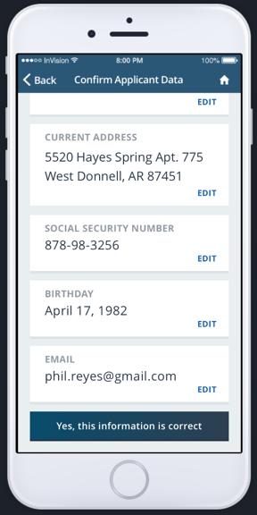

Slide 26
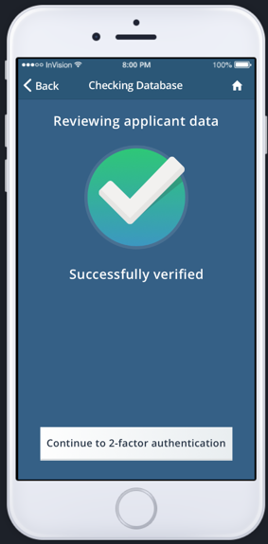

Slide 27
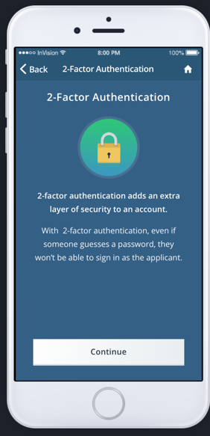

Slide 28
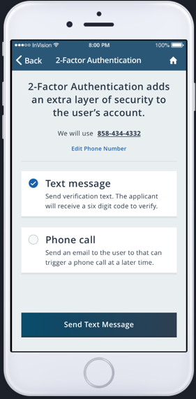

Slide 29
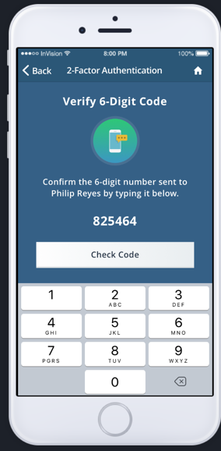

Slide 30
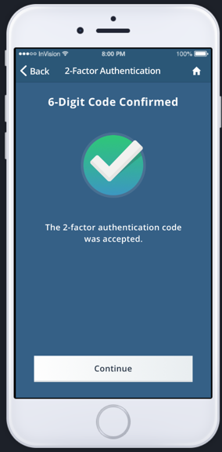

Slide 31
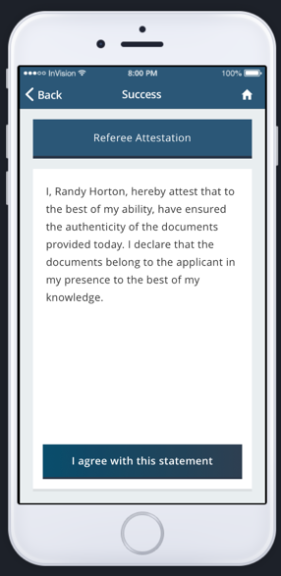

Slide 32
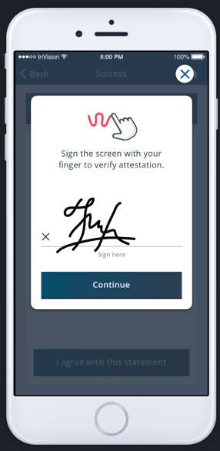

Slide 33
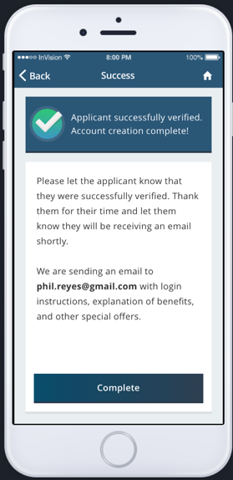

Slide 35
