Slide 1
Login.gov Account Set up

Slide 2
Login.gov Account Set up
To create an account in Login.gov you will need to go to
https://secure.login.gov/sign_up/enter_email
OR
Search Google for Create an Login.gov account and select the first option.

Slide 3
Login.gov Account Set up
Once on the webpage follow these steps:
Click “Create an account”
Enter in your email address
Select your email language
Click “I read and accept the Login.gov Rules of Use”
Click Submit

Slide 4
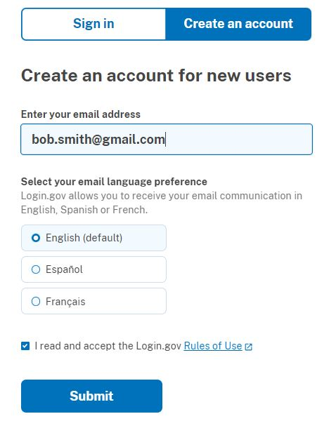
Login.gov Account Set up

Slide 5
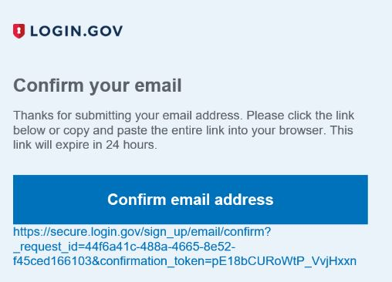
Login.gov Account Set up
After you click submit you will receive an email from Login.Gov asking you to confirm your email.

Slide 6
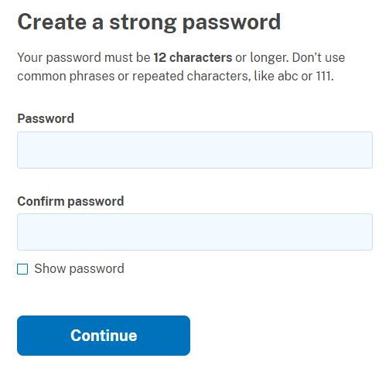
Login.gov Account Set up
After pressing, “confirm email address” a webpage will open to create a password for Login.gov.
Create a password and press Continue.

Slide 7
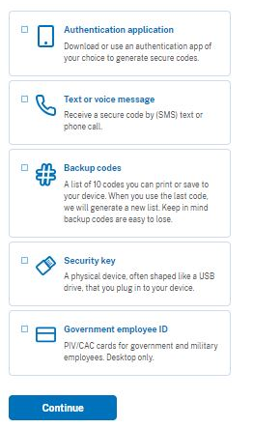
Login.gov Account Set up
After creating the password, Login.Gov will prompt for a second level of security by requiring an authentication method of your choosing. While VA recommends at least 2 authentications, only 1 is required.

Slide 8
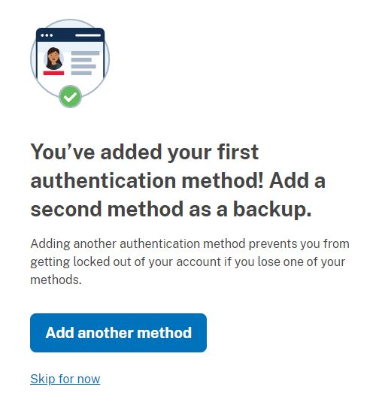
Login.gov Account Set up
After you verify your first authentication method, you can either add another method, or Skip for now to continue the account set up.

Slide 9
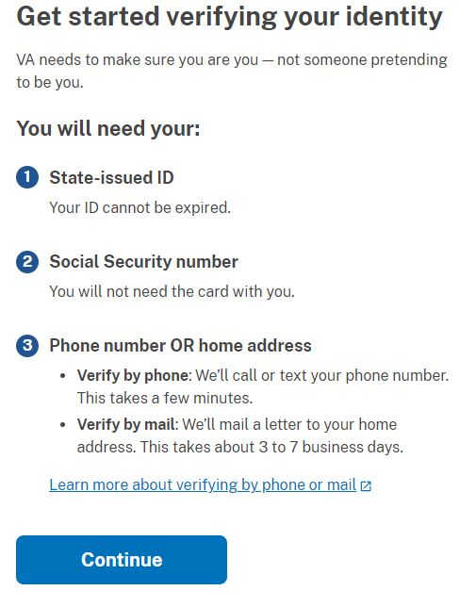
Login.gov Account Set up
Once the authentication method is complete, Login.gov will begin to verify your identity through 5 steps:
Getting Started
Verify your ID
Verify your information
Verify phone or address
Secure your account

Slide 10
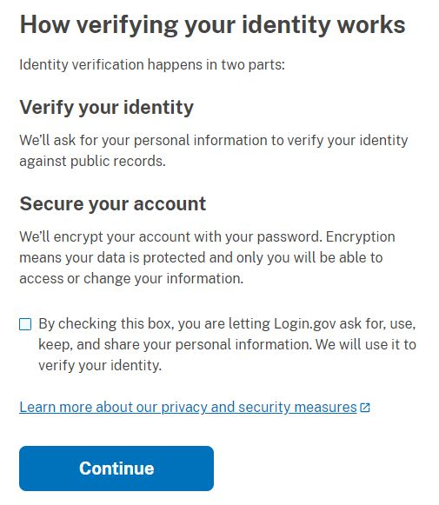
Login.gov Account Set up
Next page requires the box to be checked that allows login.gov to use and keep your information.
Click the box and press Continue to advance

Slide 11
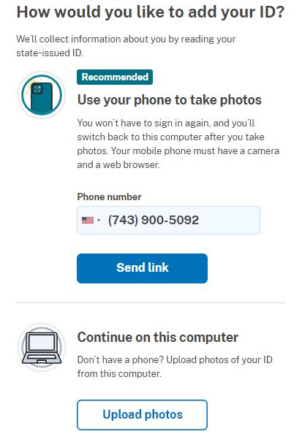
Login.gov Account Set up
Next page sets up how to add your ID to login.gov either through a mobile phone with a camera and web browser, or your computer.

Slide 12
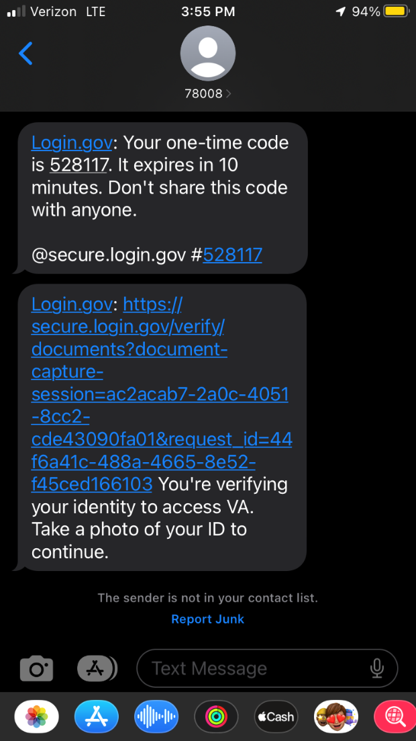
Login.gov Account Set up
If the cell phone option is selected a link will be sent through text message.

Slide 13
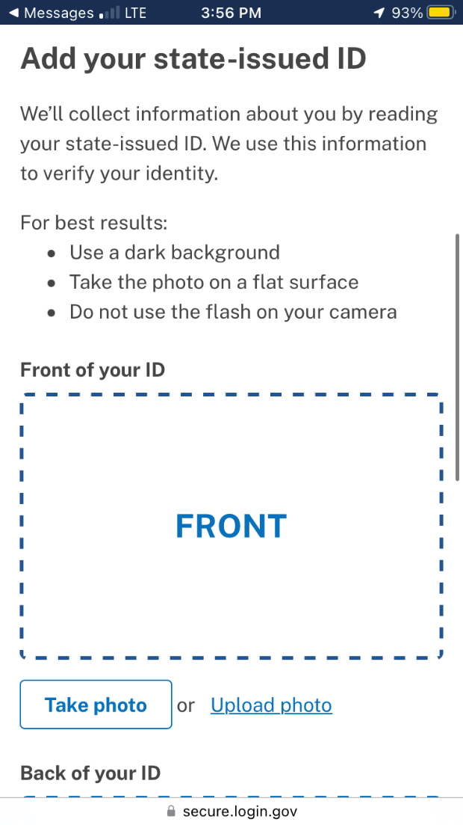
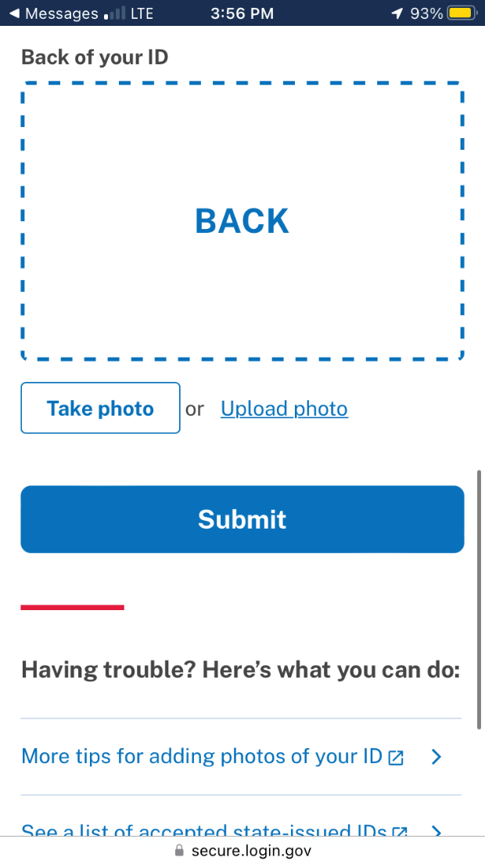
Login.gov Account Set up
After clicking on the text message link, a webpage on your phone will open asking for a photo of the front and back of your state issued ID.
With both photos captured, click Submit

Slide 14
Login.gov Account Set up
After you submit the pictures on your MOBILE PHONE, switch back to your COMPUTER to finish the Login.gov account creation.

Slide 15
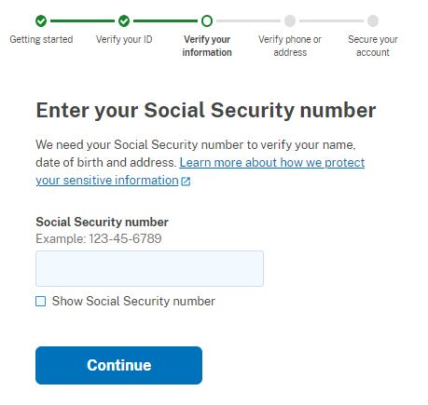
Login.gov Account Set up
From the computer, Login.gov will update its page to now ask for your social security number.
Enter in your social and hit Continue.

Slide 16
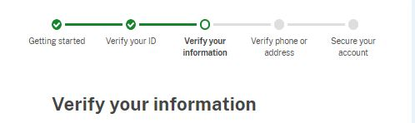
Login.gov Account Set up
The next page displays all entered information into login.gov. If correct press Continue.

Slide 17
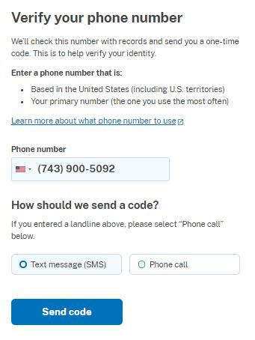
Login.gov Account Set up
The page after the verification page is to verify the phone or address associated with the account.
Choose either text message or phone call and hit Send Code

Slide 18
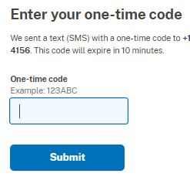
Login.gov Account Set up
Enter in the code that was received and press Submit.

Slide 19
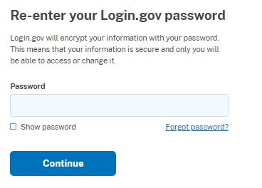
Login.gov Account Set up
The next page requires your password, once entered press Continue.

Slide 20
Login.gov Account Set up
The last page provides you with a personal key which should be saved, printed or downloaded as a text file to a secure location as this key is the only way to reset your Login.gov password should you lose it.

Slide 21
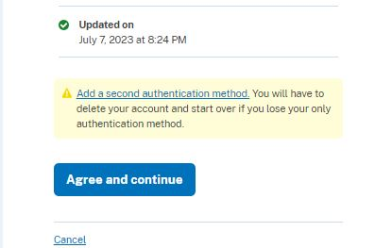
Login.gov Account Set up
The next page is to connect your verified information to VA. Verify that the information is correct and press Agree and Continue at the bottom.

