Slide 1
Technology and the Accredited Representative

Slide 2
Lesson Objectives
Outlook Features
Zoom and its Features
Computer programs to help your office
Computer Short Cuts and Functions to help with efficiency
Grammarly
Chat GPT

Slide 3

Outlook Features: Signature
A professional email signature builds credibility and ensures clients and colleagues have your contact info. VFW Email signatures include:
Name
Title
Department
Address
Phone Number
Fax Number
VA Accreditation Number

Slide 4
Outlook Features: Signature
To create an email signature users should:
Open Outlook and Click New Email
In the new email locate the Insert Tab
Find Signature, click the drop-down arrow and click Signatures
Click New and name the Signature
In the box provided enter in your contact information and click Save
Under “Choose Default Signature” Select the new signature for New messages and replies/forwards and click okay

Slide 5
Outlook Features: Email Folders
Outlook folders are a powerful way to organize your email, reduce inbox clutter, and improve productivity. By sorting emails into folders that can be accessed later, you are able to keep your inbox clean.
Beneficial email folders include:
Completed
Emails from Department
Emails from NVS
Frequently used Veteran Resources

Slide 6
Outlook Features: Email Folders
To create an email folder users should:
Open Outlook and locate Inbox and Right Click on it
Select New Folder from the Drop-down Menu
Name your new folder and hit Enter
From here users can drag emails into their newly created folder

Slide 7
Outlook Features: Email Templates
Outlook email templates allow VSOs to save and reuse pre-written messages, making routine communication faster and more consistent.
Whether you're sending appointment reminders, document checklists, or providing a phone call AAR, templates reduce typing time and ensure your messages are clear, professional, and accurate every time.
**Next to this presentation on the OLP are two Word documents that can be used as templates for common situations.**

Slide 8
Outlook Features: Creating Email Templates
To create an email Template users should:
Open a new email in Outlook
Draft the email you want to use. Users can also include forms to be associated with the email
Click File > Save As and Choose Outlook Template and name it

Slide 9
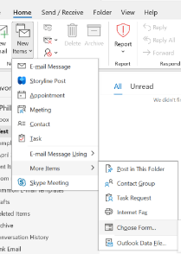

Outlook Features: Using Email Templates
To use an email Template users should:
In Outlook locate Home and then New Items > More Items > Choose Form
In the “Look In” Dropdown, select User Templates in File System
Choose your Template and click open.
Customize it as needed and hit send

Slide 10
Outlook Features: Out of Office Replies
Out of Office Replies (OOR) in Outlook let others know you're unavailable and when they can expect a response.
Setting up an OOR ensures that veterans, leadership, and colleagues are informed during your time away and can get the help they need from alternate contacts if necessary. It helps maintain trust, professionalism, and uninterrupted service.

Slide 11
Outlook Features: Out of Office Replies
To create an email signature users should:
Open Outlook and Click File and select Automatic Replies (Out of Office)
In the Pop-up Window, select Send Automatic Replies
Check Only send during this time range and set your start/end times
Write your message for both Inside and Outside My Organization
Click Ok to activate

Slide 12
Example of a Good Out of Office Reply
Thank you for contacting the Veterans of Foreign Wars; I am currently out of the office and will return on 5/1/2025.
I will reply back to your correspondence as soon as I am able to and appreciate your understanding if it may take a day or so to reach back out.
If you need immediate assistance, please reach out to John Wick at Jwick@vfw.org
Thank you for your service to our Great Nation and I hope you have a great day!

Slide 13
Example of a Bad Out of Office Reply
“The office is closed for Christmas”
As crazy as it sounds, we have seen that Out of Office Reply for offices in the month of July!
If you use an OOR be sure that you are keeping it updated for why your office is closed.

Slide 14
Out of Office Voicemails
An Out of Office voicemail message keeps communication professional and ensures veterans, coworkers, and NVS know:
You're currently unavailable
When you’ll return
Who to contact for urgent matters

Slide 15
Out of Office Voicemail Example
Hello, you've reached [Your Name], [Your Title] with VFW.
I'm currently out of the office and will return on [Date].
If you need immediate assistance, please contact [Backup Person’s Name] at [Phone Number] or email [Email Address].
For a faster response please email me your questions to Jwick@vfw.org
Thank you, and I hope you have a great day

Slide 16
Zoom and its Features
Zoom is a reliable and easy-to-use video conferencing platform that helps connect with one-on-one meetings, training sessions, or department calls.
Knowing the core features of Zoom allows you to communicate clearly, stay organized, and maintain a professional virtual presence.

Slide 17
Zoom and its Features
The Following are features of Zoom which all users should know:
Audio On/Off: Clicking the microphone icon turns your mic on/off. This prevents Background noise and allows you to speak clearly when needed.
Video On/Off: Clicking the Camera Icon turns your camera on/off. It is common courtesy to keep your camera on during a Zoom call unless needed.

Slide 18
Zoom and its Features
Chat: Allows you to view the call’s chat. Defaults to everyone but users can message others directly and privately.
React: This allows users to raise their hand to be called on or other reactions.
Share: Allows users to share their screen. Users with multiple screens will need to select the correct monitor.

Slide 19
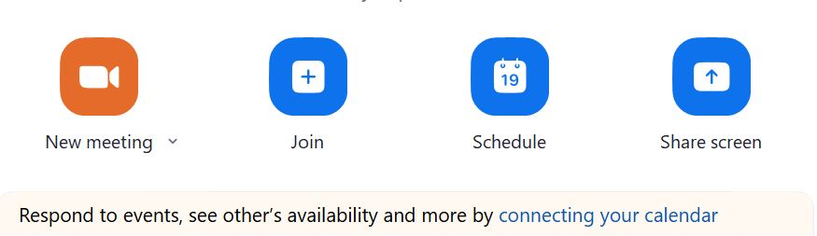
Scheduling a Zoom Call
To schedule a Zoom call open the app and locate the home screen.
From there click Schedule

Slide 20
Scheduling a Zoom Call
The Schedule Page will pop up and you will need to enter in the following information:
Meeting Name
Scheduled date/time
Attendees: You can enter in the users email address which sill send a calendar invite through Outlook
Once everything is entered in Hit Send

Slide 21
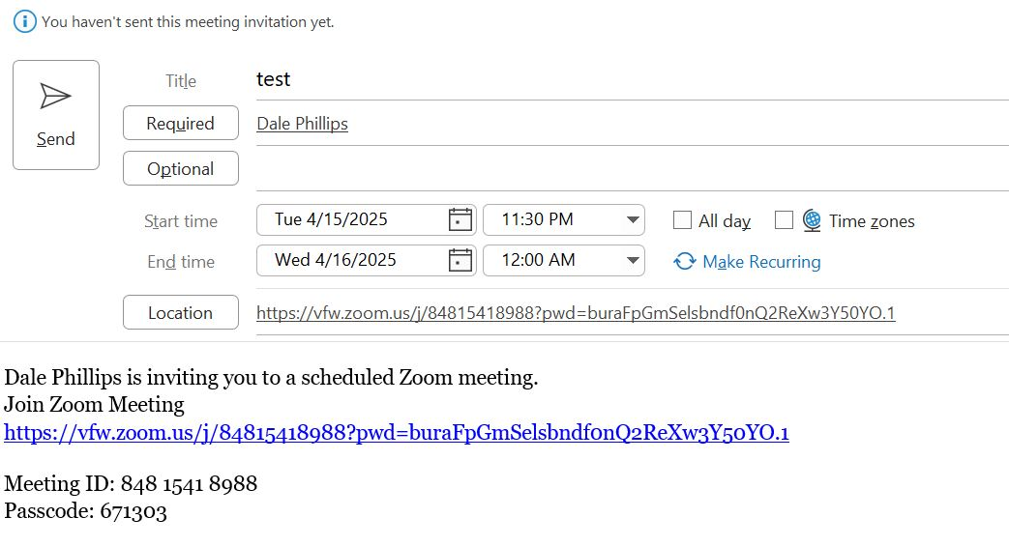
Scheduling a Zoom Call
An email invite for your scheduled Zoom call will appear which allows users to add additional attendees email addresses.
Confirm everything is correct and hit Send

Slide 22
Computer Program Tips Logins and Passwords
In this virtual age we must keep up with dozens of log-in information and it can be exhausting. Below is a way to do this securely:
Open a Word document
Copy and paste the web address of the website you will be accessing
Type in your Username and Passwords underneath each website
Secure the document by going to File > Info
Click Protect Document and choose Encrypt with Password
Enter and Re-enter in your password and click Ok
**Be sure to save your password for this document someplace else as if you forget it you cannot recover this password protected document**

Slide 23
Computer Program Snipping Tool
The Snipping Tool is a built-in Windows feature that allows you to quickly capture screenshots of anything on your screen.
Whether you need to grab part of a document, a signature, or a helpful website, the Snipping Tool makes it easy to save and share exactly what you see.
To open the Snipping Tool:
Click the Start button or press the Windows key.
Type "Snipping Tool" in the search bar.
Click on the Snipping Tool app to open it.
Click New and “Snipp” what you need to digitally.
The snippet is opened as a jpeg and can be saved by clicking file save as

Slide 24
Computer Program Adobe PDF and Signatures
Computers with Adobe can use this program to create a digital signature for themselves to be attached to forms later on. To do this open Adobe and:
Locate the tab that says E-Sign
Locate Add Signature and put your First Name, Last name and OGC Number in the signature line
Place the signature on a blank area of the PDF
Open the Snipping tool and snip out your new signature
Save it to your desktop
This signature can be used for forms in TVB that require a VSO Signature

Slide 25
Computer Short Cuts and Functions
Shortcut | What It Does
Ctrl + F | Find words or phrases in a document, webpage, or email.
Ctrl + C | Copy selected text or items.
Ctrl + V | Paste copied text or items.
Ctrl + Z | Undo the last action.
Ctrl + Y | Redo the last action that was undone.
Ctrl + S | Save the current file or document.
Ctrl + P | Print the current document or page.
Alt + Tab | Switch between open programs/windows.
Windows Key + D | Show desktop (minimizes all open windows).
Windows Key + L | Lock your computer (great for protecting sensitive info quickly).
Windows Key + V | Open Clipboard History (must be enabled in settings first).
Windows Key + Plus (+) or (-) | Activate Magnifier to zoom in or out areas of your screen.
Ctrl + Mouse Scroll Wheel | Zoom in or out in most applications (like browsers or Word).

Slide 26
Control F Purpose
One of the most beneficial features for reviewing medical records (or anything visibly typed on your screen) is the Find Feature which is done by pressing Control + F.
This can be help search for specific conditions in medical records or key words or phrases in Grants, or proposed legislation.
**It can even help you search through PowerPoint or PDF presentations when taking your end-of-conference test.**

Slide 27
Grammarly and its Features
Grammarly is a free writing assistant tool that checks your spelling, grammar, punctuation, clarity, and tone in real-time. Grammarly helps you:
Saves Time: Instantly corrects mistakes so you don’t have to proofread multiple times.
Professional Appearance: Helps avoid embarrassing typos or unclear sentences in official communications.
Improves Clarity: Suggests rewording for confusing or wordy sentences.
Tone Checker: Helps you maintain a respectful and helpful tone—especially when writing sensitive responses.

Slide 28
Grammarly and its Features
To use the Grammarly Web App visit www.grammarly.com. and then follow the steps below:
Create a free account (or sign in).
Click “New” to start a new document.
Begin typing or paste your text.
Grammarly will underline suggestions and corrections.
Click each suggestion to review and apply fixes.

Slide 29
Grammarly as a Browser Extension
To use the Grammarly as a Browser extension follow the steps below:
Go to www.grammarly.com. and select "Apps".
Choose your browser (Chrome, Edge, Firefox) and install the extension.
Log in with your Grammarly account.
Grammarly will now check your writing on web-based email (like Outlook Web), VA websites, forms, and more.

Slide 30
Grammarly in Microsoft Word or Outlook
To use the Grammarly in Microsoft Word or Outlook follow the steps below:
Go to www.grammarly.com. and Download the Grammarly for Microsoft Office plugin
Install it and open Word or Outlook.
You’ll now see a Grammarly tab—click it to activate.
It will automatically start checking your documents or emails.

Slide 31
Chat GPT and the VSO
ChatGPT is an AI-powered virtual assistant developed by OpenAI. It’s like having a 24/7 research partner, writing coach, idea generator, and tech helper rolled into one—ready to help you with just about anything you can type out.
Whether you're writing an appeal, preparing a PowerPoint, troubleshooting Outlook, or trying to explain a benefit program to a Veteran—ChatGPT can give you fast, accurate, and human-like assistance in seconds.

Slide 32
How to Install ChatGPT
Go to chat.openai.com using any web browser (Chrome, Edge, Safari, etc.)
Create an AccountClick “Sign Up” Use an email address or sign in with Google, Microsoft, or Apple. Free accounts are available, and a paid version (ChatGPT Plus) unlocks more features
Start a conversation and ask chat to perform whatever you need.

Slide 33
Ways Chat GPT can Help your Office
Draft appeal letters, benefit explanations, outreach emails, and social media posts.
Instantly correct grammar, rewrite for tone, or simplify complex VA language.
Help translate hard to understand medical records
Summarize dense documents and translate VA policies into easy-to-understand language.
Ask questions about VA benefits, claims processes, forms, or legislation.
Get plain-English summaries of complex topics like TDIU, Dependency, or DIC.

Slide 34
Ways Chat GPT can Help your Office
Get step-by-step tech support for programs like Outlook, Zoom, Word, Excel, and more.
Brainstorm new outreach ideas, event themes, or Membership.
Build customized step-by-step checklists for specific claims like TDIU, or DIC so you don’t miss a thing when building a file.
Write Call/Conversation Scripts – Generate respectful and clear talking points for tough discussions or hearings
Convert rough notes into polished Statements in Support of Claim

Slide 35
Don’t forget the Basics!
Are all the cords plugged in including plugged into the wall AND electronic?
For AV Equipment ensure they are plugged into the monitor securely
CTRL + ALT + DEL allows users to bring up the task bar and close programs that are not responding and need to be closed manually
Bookmark favorite websites such as TVB, the OLP and the eCFR in your browser.
If your computer is going slow or freezing restart it by holding down the power button for 5-10 seconds.
Right Click your mouse to bring up special menus such as Copy, or Delete
Use the windows search bar to find what you are looking for

Slide 36
Questions?

