Slide 1
Benefits Delivery At Discharge
September 2023

Slide 2

Lesson Objectives
Eligibility
BDD-Excluded
Overseas BDD Claims
Service Treatment Records
Separation Physicals
DoD Safe
Service Records
Claims Processing
Rating review
Effective Dates

Slide 3
Eligibility
Service members (SM) may use the BDD program if they meet All the following requirements:
On full-time active duty (including a member of the National Guard, Reserves, or Coast Guard), and
Have a confirmed separation date, and
File claim 180 to 90 days prior to the ACTUAL separation date, and
Attend VA exams within 45 days from the date the claim was submitted, and
Provide a copy of their Complete service treatment records (STR) for the current period of service

Slide 4
BDD-Excluded Claims
The following issues and conditions are excluded from BDD claim processing:
Service members who do not meet eligibility requirements, or:
Are seriously ill or injured
Lost a body part
Are terminally ill
Require a VA exam in a foreign country (exceptions)
Service members awaiting discharge while hospitalized
Require a character of discharge determination

Slide 5
BDD-Excluded Exam Guidance
When a BDD-excluded claimant submits a copy of their STRs and is available for 45 days from the date their claim was submitted to report for exams, VA will schedule the veteran for exams within 5 days of the STRs being submitted.
Though the service member is on active duty, they are still considered a BDD-Excluded claimant and are not required to submit the SHA part A with their STRs.
Special note Note: Claimants who file pre-separation claims that are excluded from the BDD program will receive a general medical examination – not an SHA examination.
M21-1 X.i.6.C.2.e. Special Considerations on Requesting Examinations

Slide 6
Overseas BDD Claims
Service members may file a disability claim under the BDD program while stationed overseas.
Same eligibility requirements
Time on station to finish their medical exams in country

Slide 7
BDD Overseas Claims
NVS has a dedicated Pre-Discharge Claims Representative who handles overseas BDD Claims:
Miranda Drummond
National Capital Region
200 Maryland Ave NE
Washington, DC 20002
Phone : (202) 608-8374.
Email: Mdrummond@vfw.org

Slide 8
BDD Overseas Claims
A class on foreign claims was presented during the May 2022 PTC; it can be found in the Past Training Conferences file of VFW Online Learning Portal Resources Section

Slide 9
Service Treatment Records (STR)
STRs must be requested from the Service member’s Military Treatment Facility (MTF).
These requests can require 30-45 days to process
Behavioral Health Records must be requested separately
Private medical records, clinical records/specialty clinics
Dental Records
FOIA Requests, Recruiters and Coast Guard often have their records in multiple locations

Slide 10
Service Treatment Records (continued)
STRs may include any or all of the following:
Armed Forces Health Longitudinal Technology Application (AHLTA)
Health Artifact and Image Management Solution (HAIMS)
Military Health System (MHS) Genesis
Hard copy records (scanned)
Behavioral Health (Sensitive Notes)

Slide 11
Separation Health Assessment (SHA)
VA Requires that all transition service members retiring through IDES or submitting BDD claims to complete a SHA Part A Self-Assessment.
When a BDD claim is received and is missing the SHA Part A VA will send out two notices.
Each Notice has a 15-day suspense date instructing the Service Member to complete and submit the SHA Part A.
If the Service Member does not submit the SHA Part A after both notices from VA, VA will exclude the claim from the BDD program and the claim will be processed after the Service member has separated or retired.
A copy of the SHA Part A can be found in the VA Resources page in the OLP.

Slide 12
DoD SAFE
Department of Defense Secure Access File Exchange (DoD SAFE) is a secure file transfer system that allows for DoD CAC users the capability to securely Send and Receive large files, including files that are too large to be transmitted via email.
Sending Files: Authenticated CAC users can send files to any address.
Receiving Files: Users can receive files by following the URL contained in an email notifying recipients of the files and by providing a passcode.
A maximum of 25 files can be sent with a maximum package size of 8 GB for all files sent and there is no limit on how many times files can be transferred.
DoD Safe website can be found at: https://safe.apps.mil

Slide 13
Complete Package
A complete package consists of:
VA Form 21-22
VA Form 21-526EZ
STRs/Private treatment records/Dental Records
SHA, Part A
Potentially:
VAF 21-686c
VAF 21-674
Dependent documents (Birth cert, Social Security card, Marriage Cert, Divorce Decrees)
Previous DD-214s
Current DD 214?

Slide 14
Additional Considerations Prior to Submission
Presumption of soundness/Entry Physical
Aggravation of pre-existing conditions
Prior Service/VA Claim: (always ask)
Increased evaluations
Resumption of payments
Previous denials

Slide 15
Additional Considerations Prior to Submission
Item 1, 21-526EZ – Check BDD box
Item 8, 21-526EZ – Enter confirmed separation date
Section II, 21-526EZ – Change of Address
Section VIII, 21-526EZ – Service Pay

Slide 16
Additional Considerations Prior to Submission: Pregnancy
If a service member is pregnant when filing their BDD claim, the medical examiner may, at their discretion, defer some or all examinations because of pregnancy.
VA will then rate any claimed conditions that may be awarded based on the evidence of record and defer any additional disabilities that could not be examined until the conclusion of the pregnancy.

Slide 17
Service Records
Service Records are requested by VA upon receipt of a claim via the Defense Personnel Records Information Retrieval System (DPRIS)
The U.S. Armed Forces maintain an Official Military Personnel File (OMPF) for every Veteran and Service Member
Contains:
Enlistment and re-enlistment contracts
Entry Physical
GI Bill Elections
SGLI elections
Performance Evaluations
Training Completion Certificates

Slide 18
BDD Claim Processing
BDD claims will initially be assigned EP Code and claim label 336 – BDD
After all development actions - 110 – BDD-initial, or 010 – BDD-initial 8+ issues
Date of Claim will be day after discharge
EP 020, BDD-Non-Original for supplemental
Hurry up and wait
SM should expect a decision “soon” after separation

Slide 19
BDD-Excluded Claim Processing
A BDD-excluded claim will be processed under the Fully Developed Claim (FDC) or the standard VA claims process.
Once standard development is complete, no other development is required until the day after discharge.
National Work Queue (NWQ) will route the claim for additional development, requesting exams
Service members should expect a decision months after separation
This is the same process for additional contentions submitted after 90 days prior to separation

Slide 20
Actions During Pendency of the Claim
Verify C’EST, contentions list
Exam prep
Monitor for exam request and completion
PACT Act deferrals
Watch for decision within 30 days of discharge
Extension on active duty happens, notify VA immediately
Notes:
Explain to students what C’EST means

Slide 21
Exam Prep
C&P Exams can be a stressful time for a veteran especially if they are unsure what to expect.
Take a few moments to explain the C&P Process
Remember the C&P Exam is a snapshot of what an average day is like for the veteran living with their disabilities.
Be Honest, if it hurts say OUCH!
It’s okay if you can’t bend that far without hurting, tell the examiner.
It is the veteran’s time, be sure that if they have additional information during the exam that it is said before the exam is completed
Notes:
Ask students to raise hands and ask if they have gone through a C/P Exam. Ask them to keep their hands up if they wish they were better prepared before they went to their exams.

Slide 22
Monitoring the Claim
VBMS is updated in real time for all its users; meaning that the moment a vendor sends a completed C&P Exam to VA, VSOs are able to view it too.
With VBMS updating in real time, monitoring the claim allows for the correction of potential errors before they can occur. Common errors include:
Inadequate exams
Incorrect exam requested
Rating decided without exams requested
Notes:
Ask students to raise hands and ask if they have gone through a C/P Exam. Ask them to keep their hands up if they wish they were better prepared before they went to their exams.

Slide 23
Reviewing a Rating Decision
Ensure that you have the correct rating decision to review and determine the type of rating.
Look at the issues decided compared to what the veteran claimed on the claim form – Are they the same? Did VA address all the issues?
Check the evidence VA used to make their determination. Did they consider all of the pertinent evidence in the file?
Notes:
Correct veteran for decision / most recent rating decision
Scope of claim / difference between scope & secondary Inferred vs. Invited

Slide 24
Reviewing a Rating Decision
Review the Reasons for Decision. Did VA correctly decide each issue? If the issue was granted, use your CFR to determine if the correct rating percentage was applied. If the issue was denied, look at the reason and determine if it is a valid reason for denial.
Check the effective dates for each granted issue.
Determine if bilateral factors, special benefits, or ancillary benefits have been correctly applied.
Notes:
4) VA is dependent on Evaluation Builder & DBQs

Slide 25
What To Do if You Find an Error
If you discover an error during your review notify the veteran and discuss possible appeal options
Annotate the error and any actions taken in TVB.
Remember: There is a big difference between a factual error and a difference in opinion. Not every denial is an error.
Notes:
Cite references when addressing errors
What is Promulgation?
Ways of annotating errors and actions taken
PTSD Example Difference vs. Error Differences should likely be appealed

Slide 26
Common Errors
Missed Evidence: Did VA consider all of the evidence? Did they miss something in the STR, Medical Record, E-Folder?
Effective Dates: Did VA apply the correct effective date?
Bilateral Factors: Did VA apply all of the eligible bilateral factors?
Special Monthly Benefits: Is the veteran eligible for SMC?
Chapter 35: Did VA grant CH 35 if eligible?
Missed contentions: Did VA address all issues claimed?
Notes:
DBQ Only Considered

Slide 27
BDD Effective Dates
Effective date of claim – Day after discharge or Release from Active Duty (RAD) ((RAD+1))
Effective date of payment – First day of the month after the entitlement arose
First payment – First day of the month after effective date of payment
Claims filed within one year of discharge
Intent To File

Slide 28
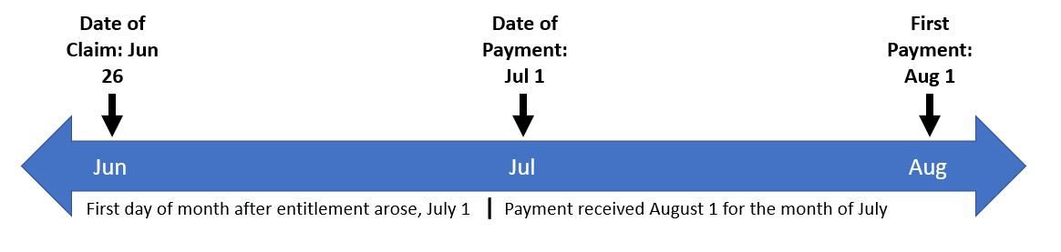
BDD Effective Dates
Separation date: June 25
Effective Date of Claim: June 26
Effective Date of Payment: July 1
First Payment: August 1

Slide 29
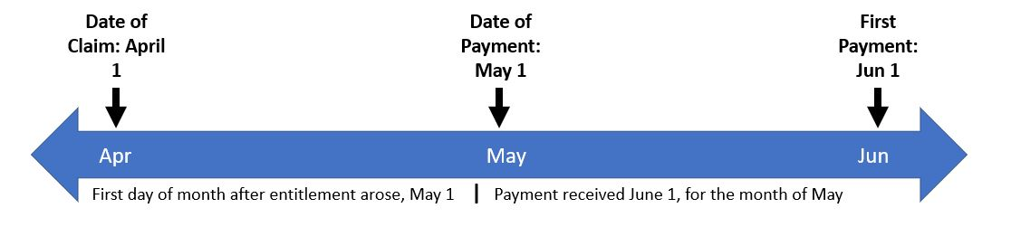
BDD Effective Dates
Retirement date: March 31
Effective Date of Claim: April 1
Effective Date of Payment: May 1
First Payment: June 1

Slide 30
VFW BDD Myths
MYTH: BDD Claims are complicated, and I will mess them up.
TRUTH: You have just had a presentation on the BDD Program, were provided resources and contacts to assist you in with BDD claims, you’ve got this!

Slide 31
VFW BDD Myths
MYTH: I am not allowed to do BDD claims because NVS has a team dedicated to BDD claims
TRUTH: Everyone is allowed and encouraged to file BDD claims for service members in their area. However, if the Service Member is located near an NVS BDD site, you should direct them there if possible

Slide 32
VFW BDD Myths
MYTH: I can help BDD Veterans but need to send them to the BDD team
TRUTH: If is more advantageous for the veteran to have you work their BDD claim rather than send it to the BDD team, that’s ok. Do what is best for the veteran.

Slide 33
VFW BDD Myths
MYTH: Actively looking for BDD claims won't help my office.
TRUTH: When National Guard or Reserve units return from deployment they are full of VFW MEMBERSHIP ELIGIBLE service members.
A homecoming BDD claim event is a great way to meet with and help these veterans.

Slide 34
Team BDD or Team Department? It’s Neither
We are ALL Team VFW
We come from all branches of service and all components.
Some have deployed, some haven’t.
Some have spent 30 years in, some haven’t.
We ALL take care of ALL who served, their families, caregivers and survivors.
Its not Team BDD or Team Department, it’s Team VFW and
No One Does More For Veterans!

Slide 35
We are here to help
As we finish this block of instruction, I want to say that my team and I are here to help you with any of your BDD related questions.
We are stronger when we work together and I encourage you to reach out to us.
If you have any issues, please do not hesitate to let me know and I will take care of the issue.
Thank you for your time and I welcome your questions.

Slide 36
BDD Locations
Camp Lejeune, NC
Ft. Liberty, NC
Ft. Cavazos, TX
Las Vegas, NV
San Diego Naval Base
Camp Pendleton, CA
Ft. Campbell, KY
Ft. Stewart, GA
Ft. Drum, NY
Winston-Salem, NC
Salt Lake City, UT
Ft. Carson, CO
Ft. Riley, KS
Naval Base Norfolk
San Diego VARO, CA
Ft. Bliss, TX
Military District of Washington
Walter Reed at Bethesda
Joint Base Anacostia-Bolling
Joint Base Andrews
Navy Yard
Marine Corps Base Quantico, VA
U.S. Naval Academy
Joint Base Myer-Henderson Hall
Fort Belvoir and Fort Meade

Slide 37
References
M21-1 X.i.6.A - Introduction to Pre-Discharge Claims
M21-1 X.i.6.B - Benefits Delivery at Discharge and Initial Processing
M21-1 X.i.6.C - Division of Responsibilities – BDD and BDD-Excluded Claims
M21-1 X.i.6.D - Ancillary Benefits and Other Issues Involving BDD and BDD-Excluded Claims
M21-1 IV.i.2.E.3 - Pre-Discharge Examinations
M21-1 X.i.6.d.5.a. – Information to provide pregnant claimants during an initial meeting

Slide 38
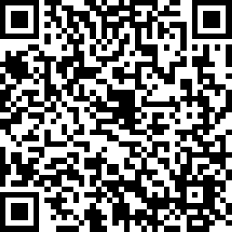
2023 Skill Level Training Conference Survey
Benefits Delivered at Discharge (BDD)
Please scan the QR Code or click on the link below to take an anonymous survey about your experience during the 2023 Skill Level Training Conference.
https://www.research.net/r/FSBKJVP

