Slide 1

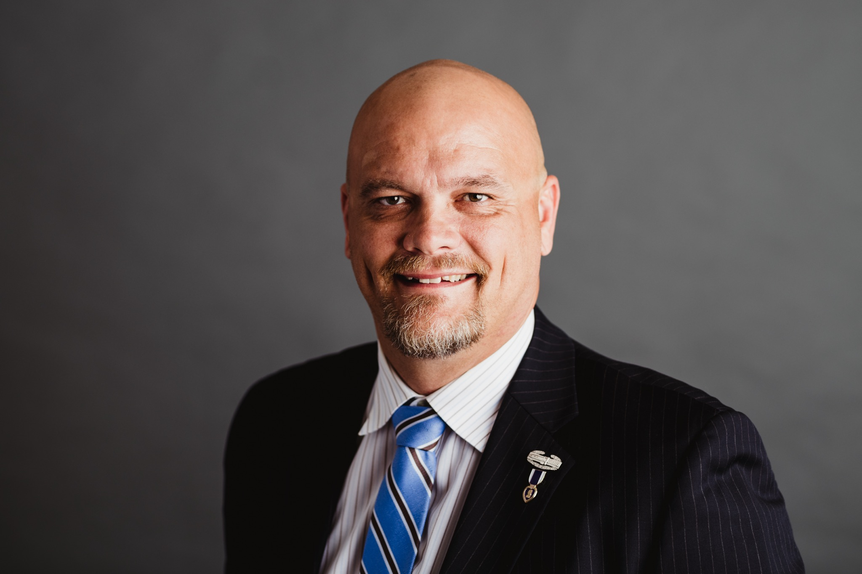


CAMP LEJEUNE JUSTICE ACT
Jason E. Johns
Johns Law Office, LLC and
Baird, Mandalas, Brockstedt & Federico, LLC
Iraq War Veteran (Army)-Purple Heart Recipient
PSC – Department of Wisconsin
VFW National Legislative Committee

Slide 2



Toxic Contamination of Water
From 1953-1987, massive contamination of the water at Camp Lejeune occurred resulting in the base becoming the site of one the worst public health disasters in our nation’s history.
Levels of hazardous chemicals were among the highest ever seen in a large, public water system, Trichloroethylene (TCE), an industrial solvent and known carcinogen, is considered “safe” for human consumption by the EPA if found at 5 ppb. TCE in the water fountain at Berkeley Manor Elementary School was 1,444 ppb...
For decades, personnel & family members at Camp Lejeune complained to base officials of “foul smelling” water. Taking hot showers, baths, and washing hands only vaporized the chemicals and put them into the air, compounding the harm of the toxins by inhalation into one’s respiratory system.
In the mid-1960’s base officials became aware that personnel and their families were getting sick and in the early 1970’s were informed of numerous harmful chemicals detected in the water supply. Yet they chose to ignore it, kept it quiet, and did nothing.

Slide 3

Examples of Toxic Contamination
ABC One-Hour cleaners, which opened in the 1950s, was releasing dozens of gallons of the highly toxic solvent Perchloroethylene (PCE) into the groundwater it shared with Tarawa Terrace on an almost daily basis. In 1989, the EPA formally added ABC to the list of the nation's worst hazardous-waste sites.
In the 1950’s, fuel began leaking into the water from faulty underground storage tanks. Over time, 800,000 gallons of fuel leaked directly into the water.
Strontium-90, an isotope known to cause leukemia and other cancers entered the water supply from a radioactive dump site located near the Rifle Range.
Weekly from 1958 to 1977, at a wash rack off Center Road in the heart of the base, an estimated 350 gallons of pesticide-laced water from cleaning equipment flowed directly onto the ground.
From 1946-1971, a burn dump at Hadnot Point was used for disposal of garbage, industrial waste, and construction debris. Afterwards, the site was graded over and seeded with grass to become a park with a fishing pond.
A disposal area at Courthouse Bay was used for dumping 400,000 gallons of waste oil and 20,000 gallons of battery acid directly into the New River.

Slide 4
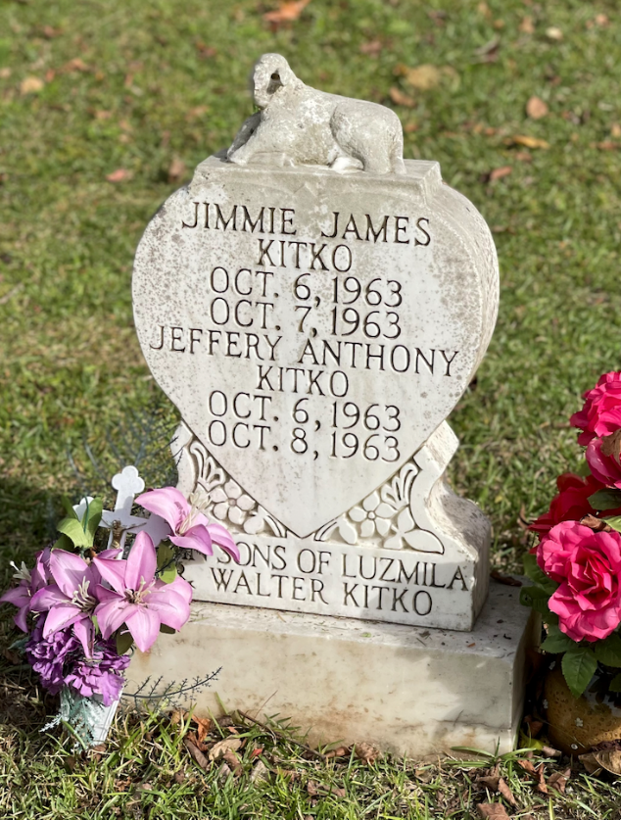
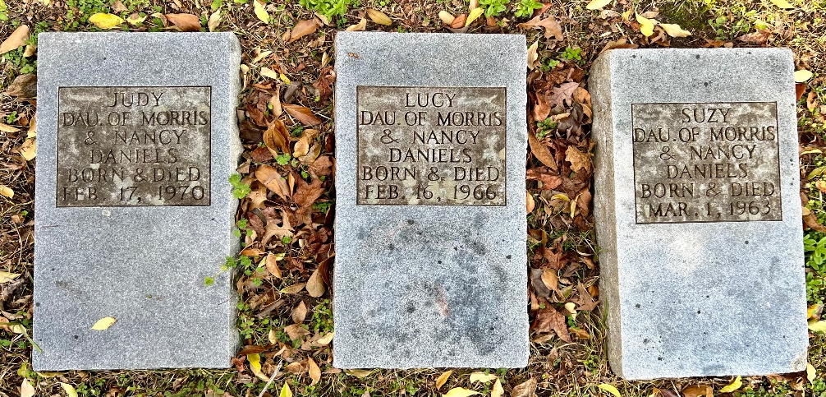
“Baby Heaven”
Beginning in the late 1950s babies born on the base were dying the same day, or within days of delivery. Some born without craniums, parts of their brain, open spinal columns, missing lungs, irreversible heart defects. Throughout the next 30 years, hundreds of these babies were buried in a city of Jacksonville cemetery in what became known as “Baby Heaven.”
Many children who survived beyond days of their birth developed leukemia, neurological issues, and cardiac issues, just to name a few. Many of these children did not live to adulthood.

Slide 5

The PACT Act/CLJA
In 2009, claims stemming from groundwater contamination at Camp Lejeune were filed, but ultimately rejected due to federal government immunity and North Carolina's 10-year statute of limitations on bringing personal injury claims.
On August 10, 2022, thanks to Congressional advocacy efforts led by the VFW, the PACT Act was signed into law. A section within known as the Camp Lejeune Justice Act (CLJA) waived government immunity; accepted liability; and provided a path to pursue lawsuits against the federal government for illnesses and other health impacts caused by toxic water contamination at Camp Lejeune.

Slide 6

Do I Qualify?
Under the CLJA, an individual may qualify if:
  Resided, worked, or was otherwise exposed (including in utero exposure) to the ground water at Camp Lejeune for not less than 30 days;
  During the period between August 1, 1953, to December 31, 1987, and;
  Diagnosed with a cancer, serious illness, or numerous other health conditions shown to be caused by TCE, PCE, vinyl chloride, benzene, and other toxins found in the water.
  Surviving family members may pursue a claim on behalf of their deceased loved one who meets the above eligibility requirements.

Slide 7

CONDITIONS & ILLNESSES
VA Presumptive Conditions
  Adult leukemia
  Aplastic anemia (blood condition that occurs when your bone marrow cannot make enough new blood cells for your body to work normally)
  Bladder cancer
  Kidney cancer
  Liver cancer
  Multiple myeloma (cancerous plasma cells accumulate in the bone marrow and crowd out healthy blood cells)
  Non-Hodgkin’s lymphoma
  Parkinson’s disease

Slide 8
CONDITIONS & ILLNESSES (Cont.)
Agency for Toxic Substances and Disease Registry/Other Science & Medical Studies
  Alzheimer’s disease
  ALS/Lou Gehrig’s disease
  Autoimmune diseases
  Birth defects/cognitive disabilities/oral cleft defect
  Cancers: Breast/Lung/Appendix/Bile duct/Bowel/Brain/Central Nervous System/Cervical/Colorectal/Esophageal/Gallbladder/Intestinal/Hodgkin’s Lymphoma/Ovarian/Pancreatic/Prostate/Rectal/Sinus/Soft tissues sarcoma/Spinal/Thyroid
  Epilepsy
  Female infertility/pregnancy issues
  Fatty liver disease
  Kidney disease
  Lupus
  Miscarriage
  Multiple Sclerosis
  Nerve damage
  Renal toxicity/end stage renal disease
  Bone marrow blood cell development disorders
  Scleroderma (chronic autoimmune disease that affects skin & internal organs)
  Neurobehavioral effects

Slide 9
Legal Claim Process-CLJA
Step 1: File an administrative claim with US Navy JAG by August 10, 2024.
  6 months to approve, deny, or do nothing with your claim.
  As of August, nearly 100K claims have been filed with Navy JAG and no settlement awards have been offered by the Dept. of the Navy.
Step 2: Right to appeal denial by filing a lawsuit in U.S. District Court for the Eastern District of North Carolina.
Award: If case proven, you will receive either of: (1) amount of damages sought via administrative claim; (2) settlement award amount offered by DOJ; (3) court award after winning at trial.
Although the government has accepted liability, you still need to prove your condition is caused by the chemicals and other toxins found in the groundwater. There is no “presumption” in a court of law and strategically applying medical & scientific evidence will be important. This is why it is vital to be represented by a legal team experienced with environmental law and groundwater contamination torts.

Slide 10


Offset and Your Benefits
The U.S. Department of Veterans Affairs has issued guidance stating the amount of any disability award, payment, or benefit received for a condition related to Camp Lejeune will only reduce the amount of the award and will:
  NOT reduce rating percentage or monthly compensation;
  NOT affect eligibility for other VA benefits or services;
  NOT affect benefits or healthcare the VA provides to you now or in the future.
  For more info: www.VA.gov/CampLejeune

Slide 11
New Elective “Presumptive” Option for Settlement
On September 6th the Department of Justice announced a new voluntary framework to evaluate and potentially settle claims with some claimants. It is known as the “Elective Option” or EO.
If a veteran is service-connected for Lejeune, they can rely on those benefits to establish eligibility for an EO settlement offer and any settlement received will not be offset by previous benefits received.
The EO grid framework is broke down by conditions that the Agency for Toxic Substance and Disease Registry (“ATSDR”) has identified as “at least as likely as not” (Tier 2) or “more likely than not” (Tier 1) and only covers the following NINE conditions: Tier 1: Kidney cancer, Liver Cancer, Non-Hodgkin Lymphoma, Leukemias, Bladder Cancer. Tier 2: Multiple Myeloma, Parkinson’s Disease, Kidney Disease/End State Renal Disease and Systemic Sclerosis/Systemic Scleroderma.
For Tier 1 conditions pay out would be based on length of time onboard Lejeune: $150K (30-364 days); $300K (1 year to 5 years); $450K (more than 5 years).
For Tier 2 conditions its is: $100K (30-64 days); $250K (1 year to 5 years); $400K (more than 5 years).
Only providing $100K additional for death claims. Maximum amount available is $550K.

Slide 12

Why the VFW Entrusts BMBF Law
Our team is entrusted by the VFW because of our depth of experience in groundwater contamination cases and our core commitment to doing right by veterans and their families throughout the process. We believe in justice over the dollar and pledge:
25% CONTINGENCY FEE (plus any costs and fees incurred for trial as required by NC law).
NO OUT-OF-POCKET COSTS OR FEES.
COORDINATE WITH VFW ACCREDITED SERVICE OFFICERS to assure veterans & surviving spouses have applied for all VA benefits they are eligible for.
PERSONAL & REAL TIME CONTACT WITH YOUR ATTORNEY. You get our direct office lines and cell phone numbers, not a call center.

Slide 13
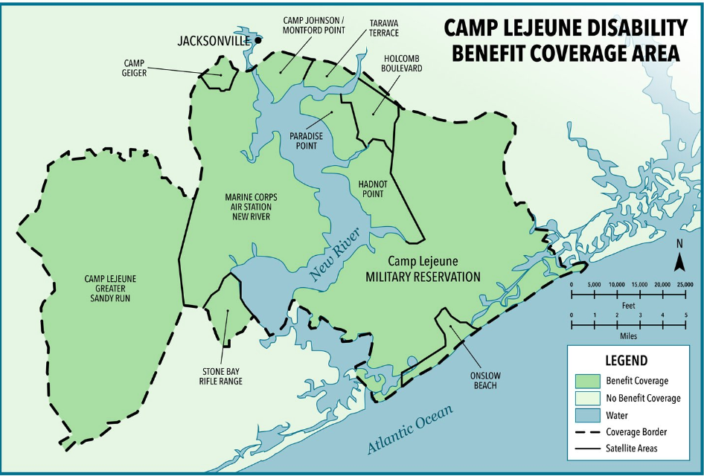
www.CampLejeuneGroundwater.com/VFW
Jason E. Johns jason@johnslaw.biz (608) 209-0805

