Slide 1
July 2023 Briefing
UNACCREDITED
CLAIM SHARKS

Slide 2

VA Statement
Statement from VA Press Secretary Terrence Hayes, July 5, 2023:
  “A business or individual who prepares, presents, or prosecutes VA benefit claims without proper accreditation by the Department is doing so contrary to law.
  “A complete list of VA-recognized organizations and VA-accredited individuals can be found here."

Slide 3
Briefing Objectives
Learn about unaccredited individuals and companies illegally representing and charging fees
to Veterans to file a VA disability claim:
  Define “VA-accredited” v. “unaccredited.”
  Learn about structure and size of claim sharks.
  Learn about their business processes.
  Learn about their goals.
  Learn actions to stop claim sharks.

Slide 4
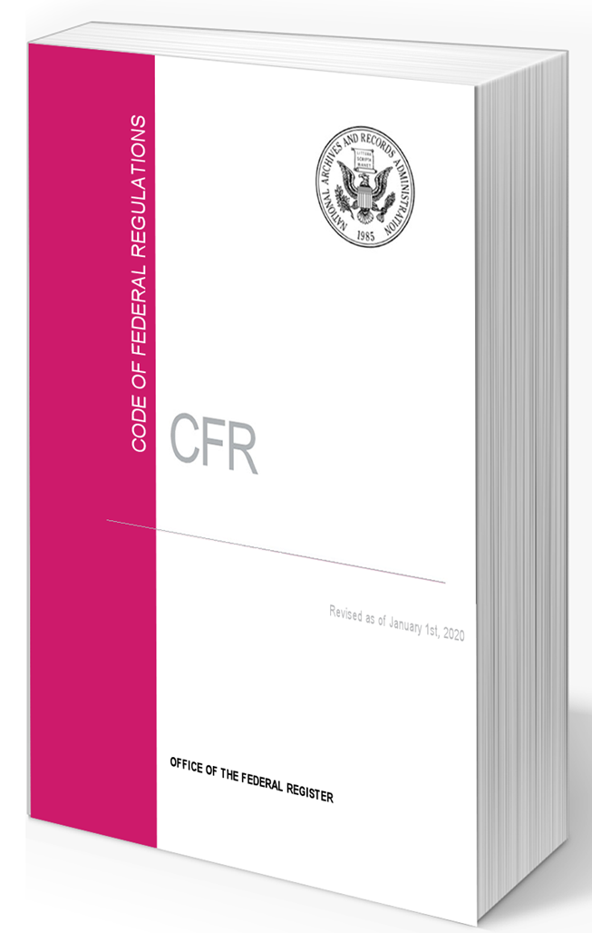
Define “VA Accredited”
  VA regulations are clear about representation:
  “No individual may assist claimants in the preparation, presentation, and prosecution of claims for VA benefits as an agent or attorney unless he or she has first been accredited by VA for such purpose.” 38 CFR 14.629(b)

Slide 5

“VA Accredited” – 2
  VA regulations are clear about charging a Veteran a fee to file a claim:
  “Only [VA] accredited agents and attorneys may receive fees from claimants or appellants for their services provided in connection with representation.” 38 CFR 14.629(f)

Slide 6
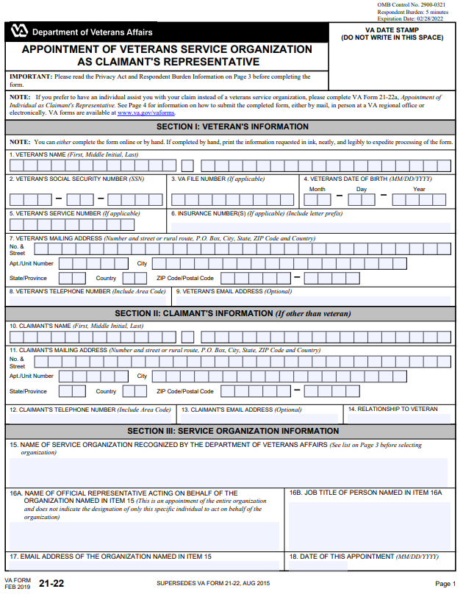
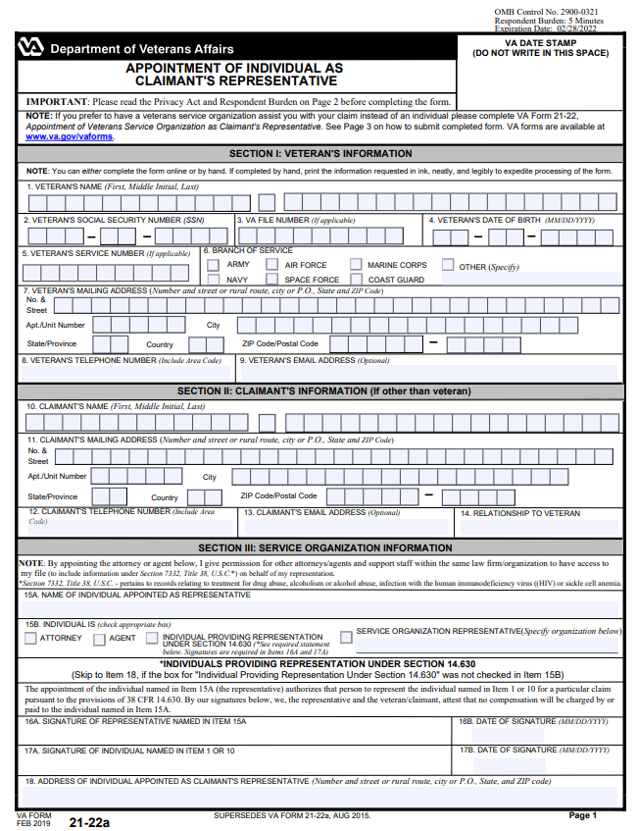
“VA Accredited” – 3
Anyone accredited by VA:
Requires every Veteran to sign a VA “Power of Attorney” (POA) form and submit it to VA.
Uses a signed POA to submit documents and access VA claim records.
VA Form 21-22 used by accredited VSOs.
VA Form 21-22a, used by accredited claims agents and attorneys.

Slide 7


“VA Accredited” – 4
  VA accreditation and charging fees
    VA-accredited VSOs (such as VFW, The Legion, etc.) are trained and do not charge fees.
    VA-accredited attorneys and claims agents can charge fees to Veterans, but only after VA has issued a decision.
    - Fee is based on a percentage of
    retroactive benefits.
    - Cannot charge fees before filing a claim.

Slide 8
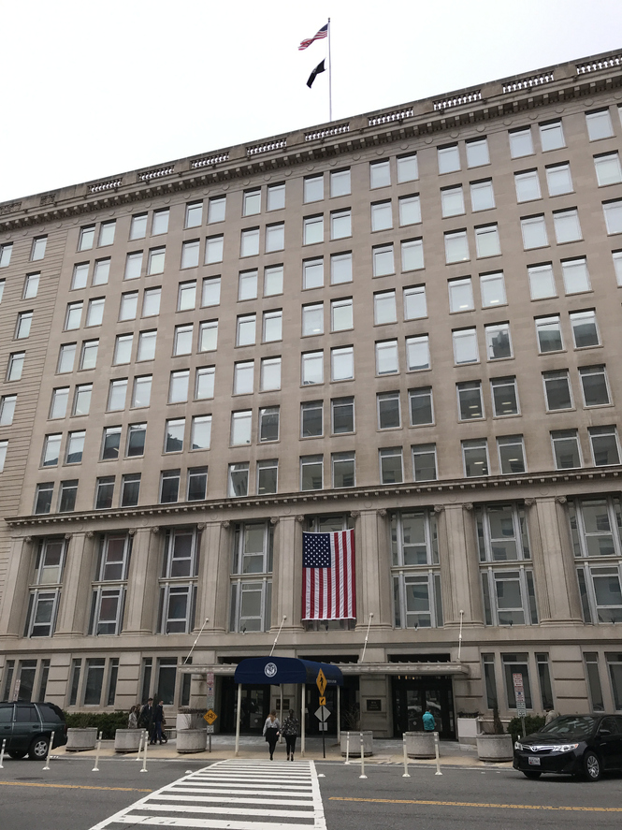
“VA Accredited” – 5
  VA accreditation is straightforward:
  A person must be approved by VA’s Office of the General Counsel (OGC).
  Accredited individuals agree to follow VA’s Standards of Conduct.
  To confirm a person is accredited by VA, go to OGC’s Accreditation Search website.
Department of Veterans Affairs Central Office, Washington, DC

Slide 9

Define “Unaccredited”
  “Unaccredited” means not approved by VA:
  Filing a VA claim without prior VA accreditation is a crime.
  Charging a fee to file a VA claim without prior VA accreditation is a crime.
  Unaccredited people and companies do not:
    File a POA form with VA.
    Receive VA approval to access a Veteran’s online records.

Slide 10
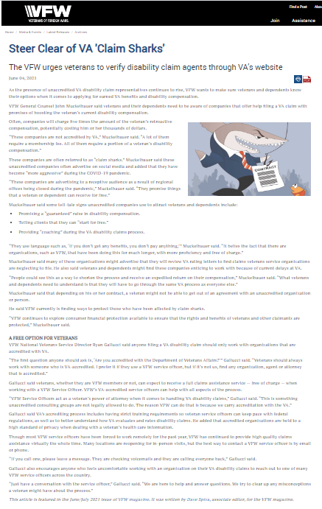
“Unaccredited” – 2
  VFW refers to unaccredited people and companies as “claim sharks.”
  Claim sharks choose not to be accredited by VA.
    Sharks do not follow VA’s Standards of Conduct or regulations.
    Sharks file claims and charge fees in violation of VA regulations.

Slide 11

“Unaccredited” – 3
  There is limited VA oversight because VA usually learns about an unaccredited person after a Veteran files a complaint with OGC.
  OGC enforcement is difficult as the law prohibiting representation and charges has no teeth.
  VA cannot impose fines or jail time for unaccredited people and companies who file claims or charge fees.

Slide 12
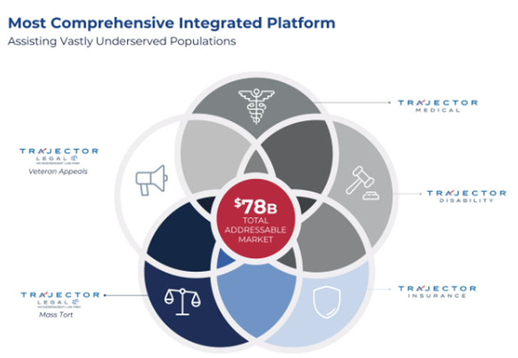

Unaccredited Shark Facts
Trajector is the largest
unaccredited shark:
Trajector reports
it handles VA:
  Disability claims.
  Claim appeals.
  Claim medical exams.
Source: SEC, Oct. 18, 2021.

Slide 13
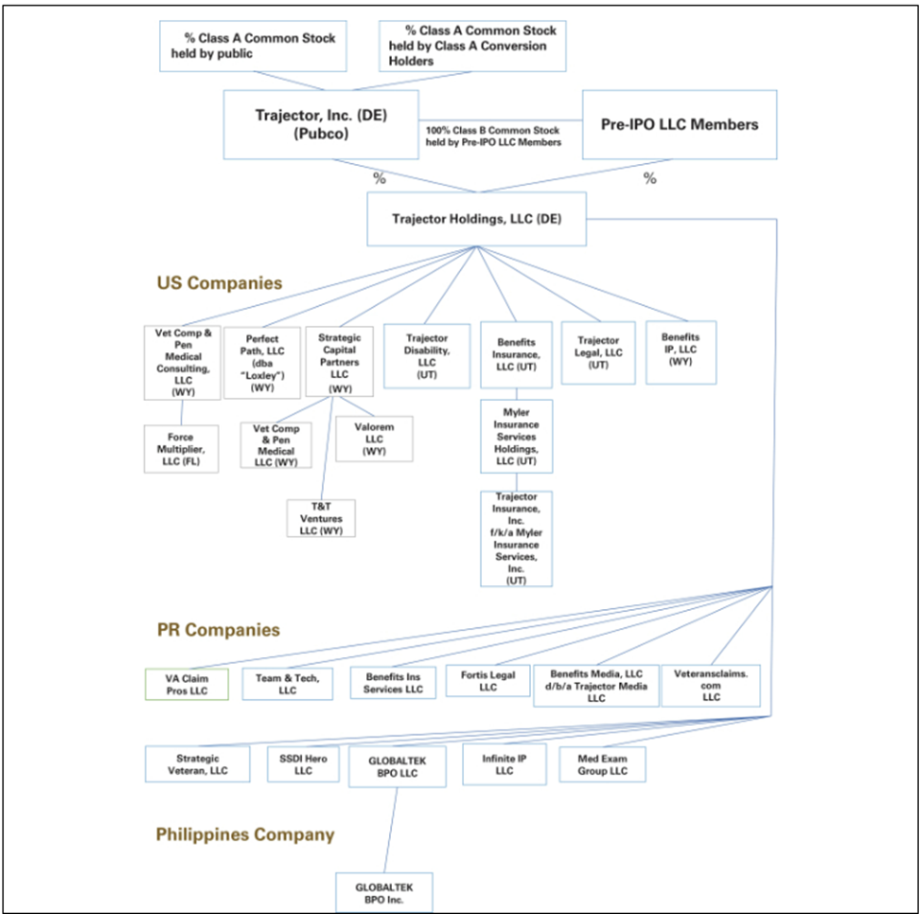
Shark Facts – 2
Unaccredited Trajector attempted to become a publicly traded company worth $100 million.
Trajector was previously known as Vet Comp & Pen.
Offices in US, Puerto Rico, and Philippines.
Source: SEC, Oct. 18, 2021, reporting annual income of more than $100 million. Trajector withdrew their public offering in Jan. 2022.

Slide 14

Size of Unaccredited Sharks
Claim sharks are quickly growing:
In 2017, a few small sharks illegally charged fees to a few hundred Veterans.
By 2021, Trajector reported 250,000+ clients.
By 2021, Trajector had 1,300+ employees. In 2023, it added 500 staff in the Philippines.

Slide 15

Size of Sharks – 2
In 2023, another shark illegally charged an average of $5,000 in fees per victimized Veteran.
Claim shark job for a “Senior Product Manager – Customer Service” pays up to $120,000.
Sharks recruit Veterans, VA staff, and VSOs.

Slide 16
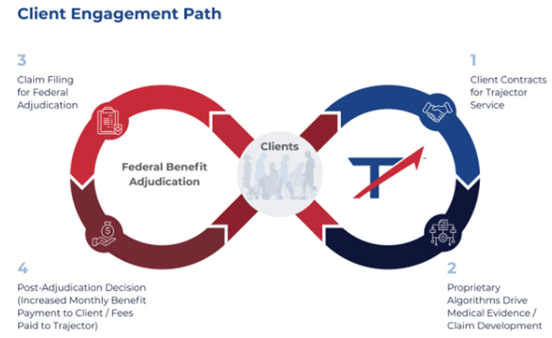
Process of Unaccredited Sharks
Trajector’s four step “Client Engagement.”
Source: SEC, Oct. 18, 2021.

Slide 17
Process – 2, Luring Veterans
Here is how the unaccredited lure and harm Veterans:
Misleading ads: Sharks lure Veterans to text, email, or phone the company and quickly sign a contract to pay “membership” fees up front, or fees amounting to five times the increase in the amount of VA monthly compensation.
Computer software: Sharks “develop” and prepare the VA claim. Sharks request the Veteran’s passwords to their computerized VA healthcare and benefit records. Sharks put the personal information of Veterans at risk.

Slide 18
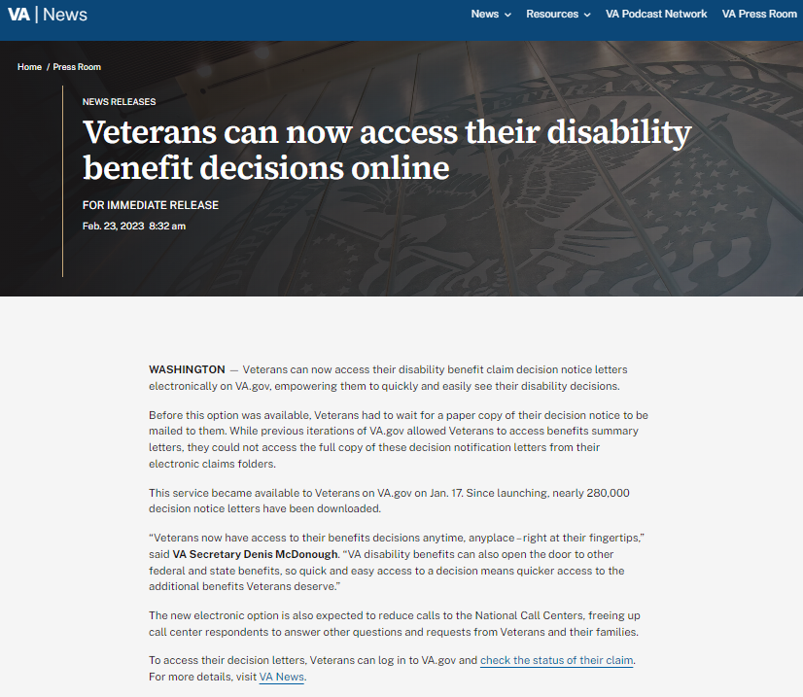
Process – 3, Luring Veterans
Veterans do part of the work by uploading, mailing, or faxing a claim to VA because the claim shark can’t.
When VA issues a rating decision to the Veteran, the shark contacts the Veteran and demands payment of illegal fees.

Slide 19
Process – 4, False Ads
  Sharks obtain more VA benefits. False. VFW testimony before Congress in 2022 proves VSOs secure more VA benefits than unaccredited sharks.
  Sharks are faster than VA-accredited VSOs. False. VA processes claims in the order VA receives them (except for advance on docket due to age, illness, or financial hardship).
  Sharks provide Veterans with “choice” and “full support”. False. VA-accredited VSOs provide VA healthcare enrollment, burial and pension claims, education benefits, and more. VA-accredited VSOs receive continuing education plus VA privacy and security training. Sharks don’t.

Slide 20


Claim Shark Goals
VA pays Veterans about $135 billion per year in disability benefits:
Sharks seek to avoid legal accountability for assisting Veterans with filing claims and for charging Veterans fees.
Sharks seek to increase their income: “Our average fee equates to approximately 2% of the average lifetime monetary value of the cash benefits our Veteran clients will receive.”

Slide 21

Goals – 2, Legalize Criminal Acts
Sharks seek a law to legalize what is now criminal activity and thus absolve them of past crimes of charging Veterans fees.
Sharks seek immediate VA accreditation to expand their activities.
Sharks move jobs overseas to avoid VA oversight and accountability.
Sharks focus only on VA claims because other services assisting Veterans cost money and time (i.e., VA health care enrollment).

Slide 22
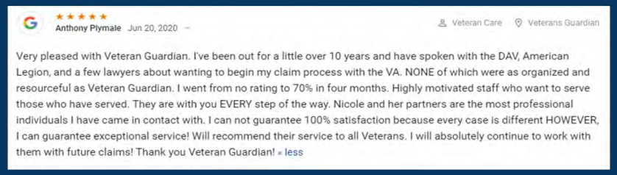
Goals – 3, Attack VSOs
In March 2023, Congress held a hearing, and claim shark testimony included 40 pages of attacks on VSOs:
Source: Testimony of Veterans Guardian, House Committee on Veterans’ Affairs, March 29, 2023, page 31.

Slide 23

Veteran and VSO Call to Action
Share VA’s warning about unaccredited claim sharks:
  Don’t pay anyone to file a VA claim.
  No VA accreditation means no claim.
  Don’t ever share your VA passwords.
  Be aware: Follow the news such as Texas Tribune article.

Slide 24

Call to Action – 2
Stop false and misleading ads by claim sharks, especially on social media.
Stop claim sharks from illegally accessing Veterans’ VA claim and medical records.
Demand VA publicize a list of claim sharks that VA has ordered to cease and desist from charging Veterans fees.

Slide 25
Step One: Collect Evidence
  Contract and fee agreements. A contract by someone unaccredited to perform an illegal act, such as filing a claim or charging a fee, is unenforceable.
  Letters, emails, and voice mails. These provide evidence of harassment by the shark to collect on the unenforceable contract.
  Payment receipts. These provide additional facts showing a claim shark illegally charged a fee.

Slide 26
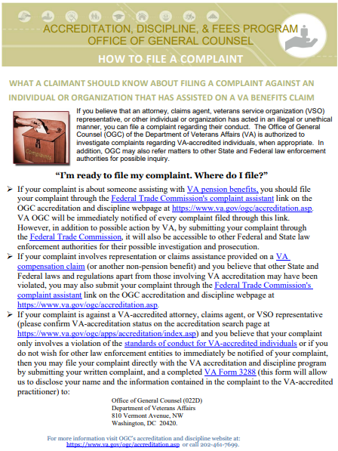
Step Two: Report
VA’s Office of the General Counsel: “How to File a Complaint”.
VA’s Office of the Inspector General: 800-488-8244.
Federal Trade Commission: Report Fraud / Scams.
State Attorneys General, Search for your state AG.

Slide 27

Legislative Call to Action
Maintain current VA rules. No one should pay a fee to file a claim.
Significantly beef up VA staffing. Strengthen VA enforcement of unaccredited bad actors from illegally filing claims and charging Veterans fees.
End VA automatic withholding of attorney and agent fees. Veterans should pay fees only after quality and timely representation.

