Slide 1
Using Electronic Submission Systems
VFW Basic Training

Slide 2
Lesson Plan
Approving POA requests, submitting claims and evidence using the VA Stakeholder Enterprise Portal (SEP)
How to submit claims using TVB
Submitting claims and viewing previously submitted claims through QuickSubmit
Understanding when to use each system

Slide 3
Before using any Electronic Submission Method
Recommended Scanner Settings:
Image quality: Normal (300 dpi)
Color Mode: B&W
Scanning Side: Duplex (Double-sided)
Image Rotation: Automatic
Blank Page Removal: Yes
Continue Scanning after last page: Yes
You May want to have a PDF editor installed such as Adobe Acrobat DC or Nuance Power PDF Standard if you have large files that need to be split
Notes:
ENSURE TO EXPLAIN THE IMPORTANCE OF CHECKING SETTINGS OF SCANNER TO ENSURE THAT FILES ARE SMALLER AND QUICKER TO UPLOAD

Slide 4
Stakeholder Enterprise Portal (SEP)
The Stakeholder Enterprise Portal was created to allow accredited representatives a way to see what the veteran sees in eBenefits
Claims and evidence can be uploaded through this portal
This is where electronic POA requests are reviewed
Notes:
SPEND SOME TIME EXPLAINING WHAT SEP IS GOOD FOR, SUCH AS UPLOADING RECORDS, THAT YOU WOULD LIKE UPLOADED INTO VBMS FASTER.
POA REQUEST ACCEPTANCE, USEFUL FOR ASSISTING VETERANS REMOTELY – PROVIDE EXAMPLE:
EXAMPLE: ASSISTING VETERAN OVER THE PHONE, EMAIL. VETERAN CAN REQUEST POA ON EBENEFITS AND YOU ACCEPT ON SEP AND WORK CLAIM FROM THERE.

Slide 5
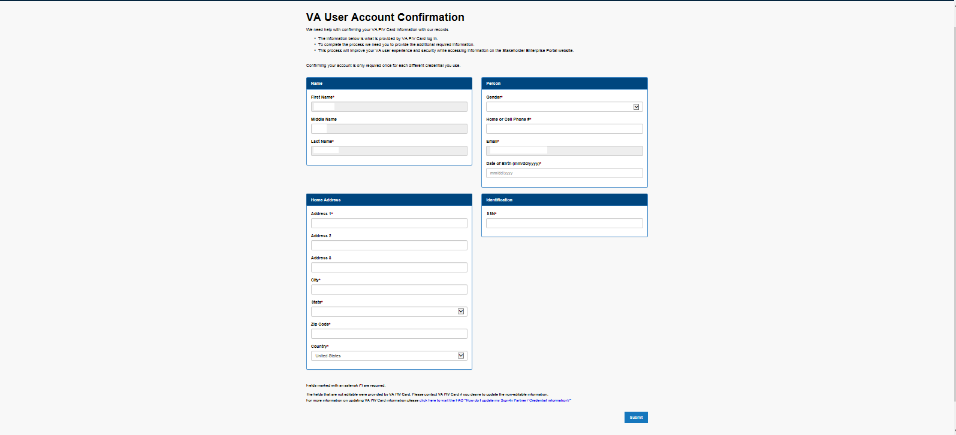
SEP: Registration
To access the portal go to
https://www.sep.va.gov/sep/web/guest/sep
If this is your first time logging in, you will need to register for SEP
If you cannot access POA requests, you may need to request that capability by emailing Theresa Aldana (taldana@vfw.org)
Notes:
EVERYONE REGISTERING FOR FIRST TIME, WILL MORE THAN LIKELY NEED TO HAVE THERESA GIVE THEM ACCESS TO ACCEPT OR DENY POA REQUEST. IT WILL BE UP TO DSO, IF THEY WANT TO PROVIDE THEM ACCESS, SO THAT HE/SHE, CAN EMAIL THERESA REQUESTING ACCESS FOR SUCH INDIVIDUAL.

Slide 6
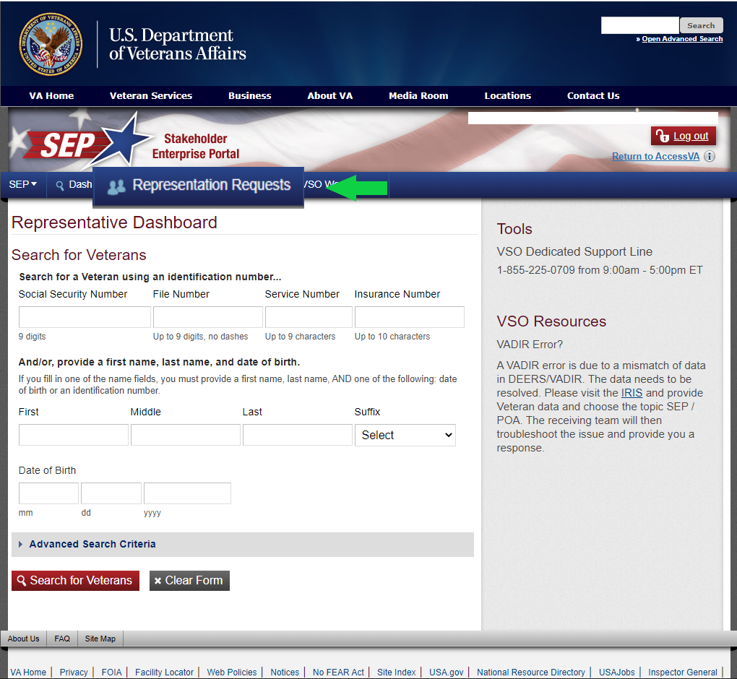
SEP: Reviewing Representation Requests
Select Representation Requests

Slide 7
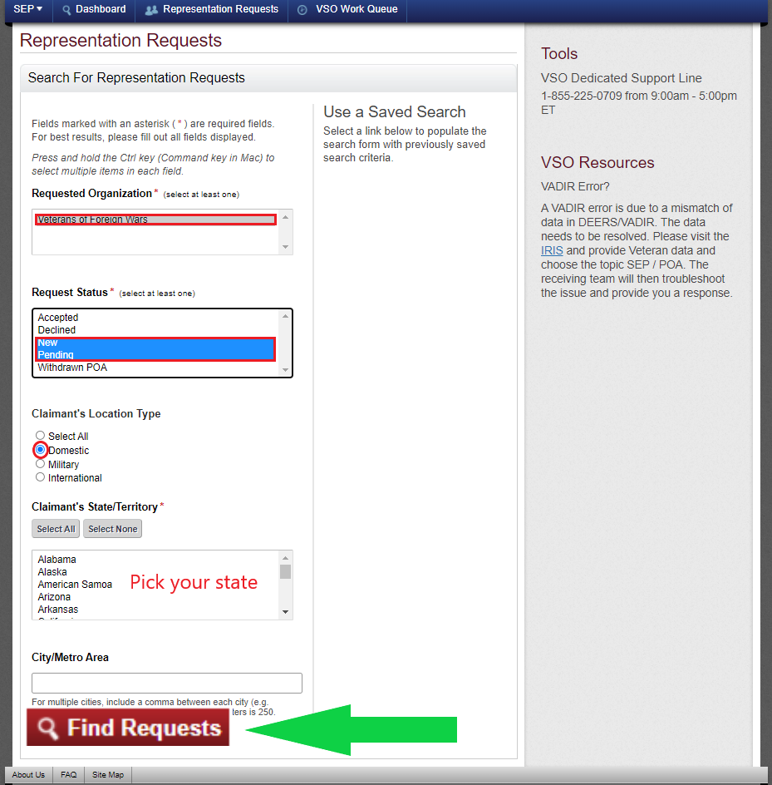
SEP: Reviewing Representation Requests
Select VFW
Hold Ctrl and select New and Pending
Choose the state that you want to search
Click “Find Requests”

Slide 8
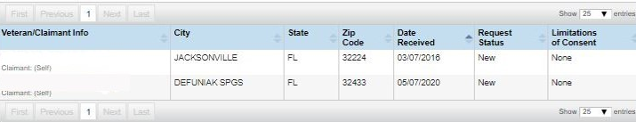
SEP: Reviewing Representation Requests
Once requests are generated, select the name to continue and see limited information for the veteran
Under “Limitations of Consent” ensure that the veteran did not put any limitation to health-related information, otherwise the POA will need to be rejected.
A solution is for you to contact the veteran and explain the reason for having access to health-related information, so that the veteran can re-submit the request.
SMITH, JOHN PAUL
JONES, DAVEY L
Notes:
EXPLAIN TO CLASS THAT IF ANYONE PUTS ANY LIMITATION ON HEALTH INFO, THEN THEY SHOULD ATTEMPT TO FOLLOW UP WITH VETERAN AND EXPLAIN TO THEM, WHAT THE LIMITATION OF HEALTH INFO DOES TO POA ACCESS.
SUGGEST TO CLASS TO CREATE A TEMPLATE TO QUICKLY SEND EMAIL WITH EXPLANATION OF DENIAL AND REASON.

Slide 9
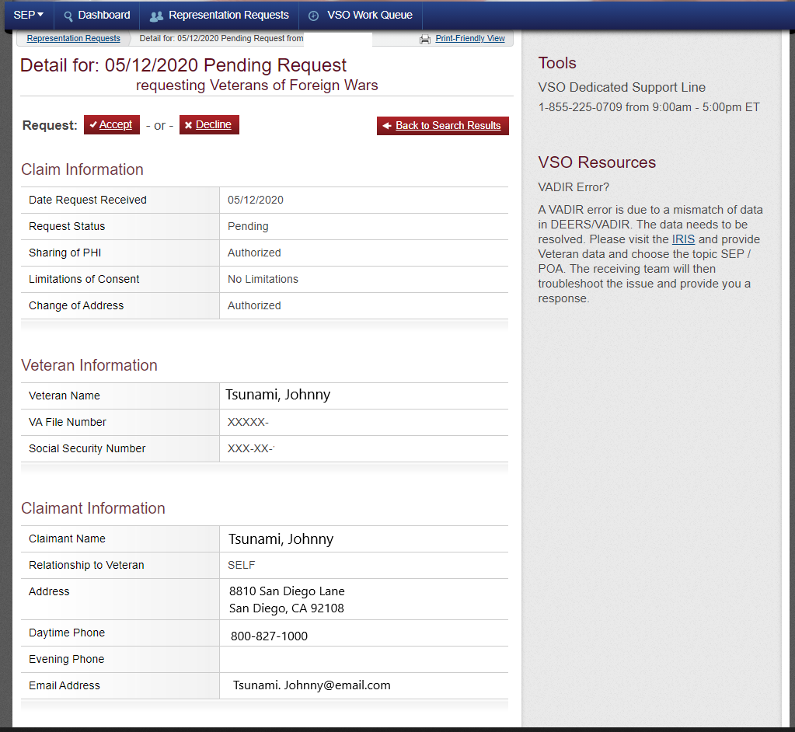
SEP: Reviewing Representation Requests
Before accepting a request, ensure that the veteran has no formal appeals pending
You can verify appeals statuses by contacting the local appeals team
Remember: You can accept POA for the veteran as long as an appeal to the BVA has not been submitted
If you accept a POA that has a pending appeal at BVA contact VA Public Contact to remove the POA
Select “ACCEPT” or “DECLINE”
Notes:
ENCOURAGE THEM TO MAKE A POC AT LOCAL APPEALS TEAM, SO THAT THEY CAN FIND ANY STATUS OF APPEALS FOR POA REQUEST.

Slide 10
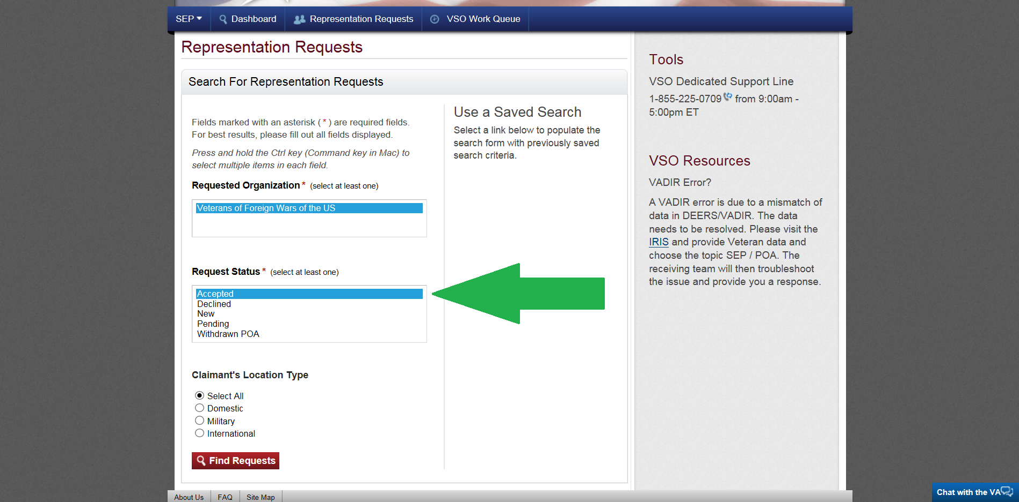
SEP: Viewing Accepted Requests
SEP allows you to view POA files you have accepted
To access these files, select the “accepted” option displayed on the left and click on “find request”.
This will allow you to view clients accepted by VFW, so that you can add them into VetraSpec.

Slide 11
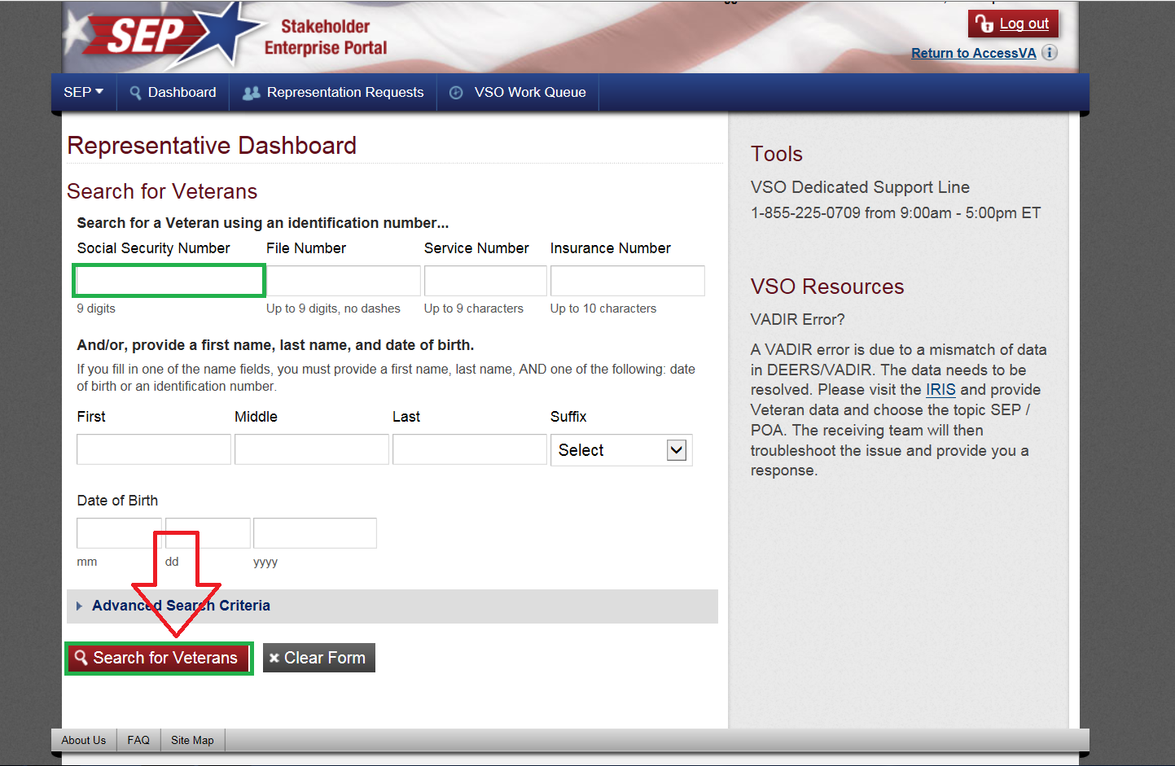
SEP: Viewing a Veteran’s File
SEP allows you to view what the veteran sees in eBenefits
The easiest way to search for a veteran is by by SSN in the Dashboard
Afterwards click on “search for veterans”

Slide 12
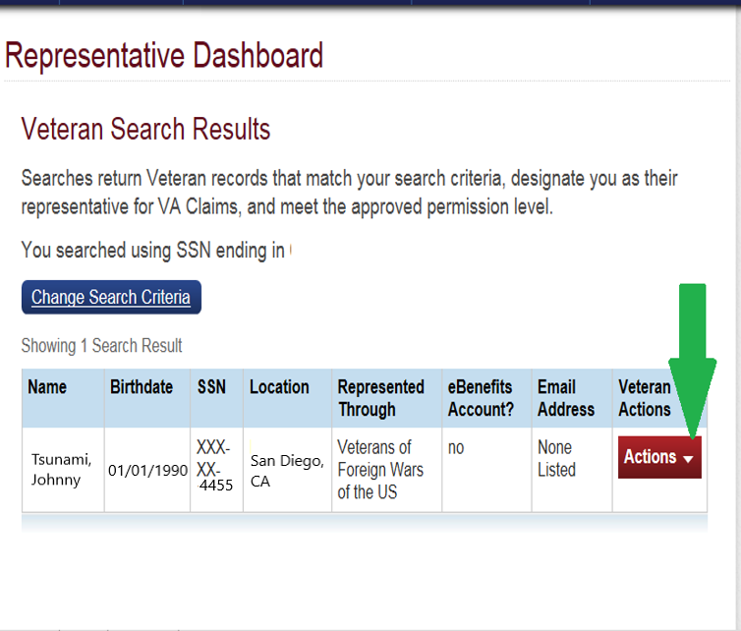
SEP: Completing Forms and Uploading Documents
After you search for veterans file, this screen on left will appear
From here there are many actions that you can select from

Slide 13
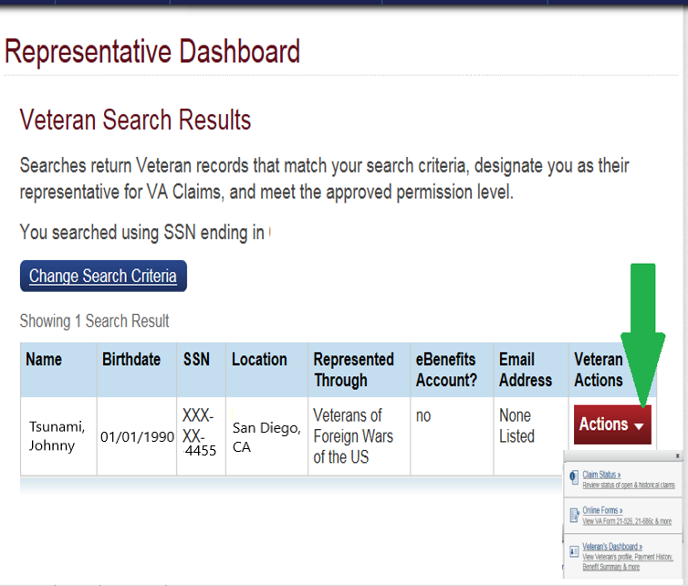
SEP: Completing Forms and Uploading Documents
To upload documents, first click on “actions” then click on “Claim Status”
This will bring you to the Work in Process screen as shown on next slide
You can also start a new form, such as VA form 21-526ez by selecting “online forms”

Slide 14
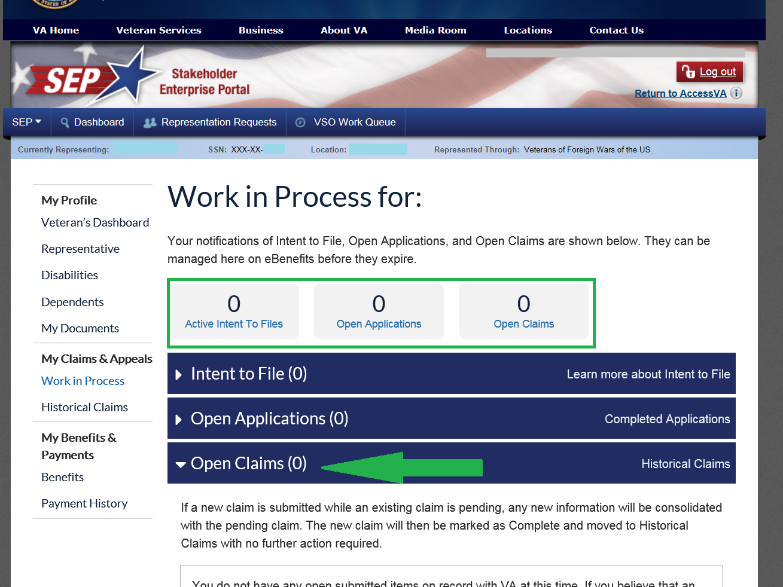
SEP: Completing Forms and Uploading Documents
To upload documents into a pending claim, select “Open Claims”
This will expand the window to allow you to “upload documents”
This screen also shows what the file has open or pending you can get a quick idea of any ITF’s, pending claims or open claims.
For more detailed claim information use VBMS

Slide 15
SEP: Completing Forms and Uploading Documents
Submittals in SEP must be logged into TVB communications with a brief description of the claim action.
If any evidence was uploaded to SEP, you must upload it to TVB as well
Will the Veteran see the SEP submittal?

Slide 16
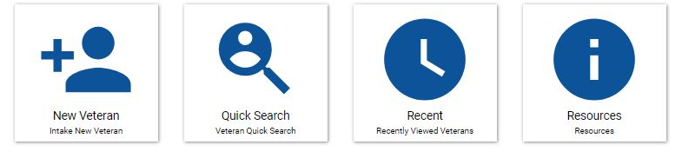
Submitting a claim to VA using TVB
When using TVB to submit a claim, you must first select the veteran you wish to submit a claim for.
From the home screen click Quick Search and type in your veteran’s name.

Slide 17
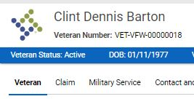

Submitting a claim to VA using TVB
Once you have your veteran folder opened, you will need to click on the Claim tab at the top.

Slide 18
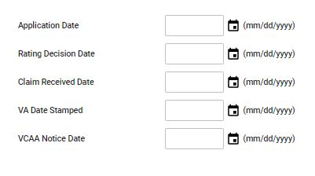
Submitting a claim to VA using TVB
You can update key dates at any time during the claim process

Slide 19
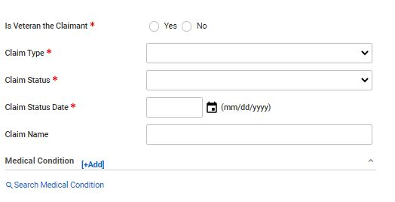
Submitting a claim to VA using TVB
Once you have clicked on the Claim tab the following screen will appear.
From here you will enter in the required information:
Is Veteran the claimant?
Claim Type: Compensation, DIC, Education, NSC Pension ECT…
Claim Status: Active, Closed, Pending, HLR, Remand ECT…

Slide 20
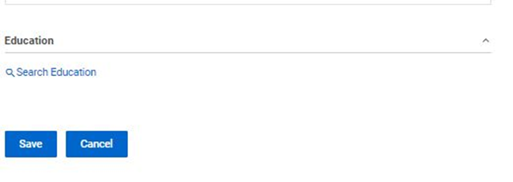
Submitting a claim to VA using TVB
Once you have captured the required fields click
“Save”

Slide 21
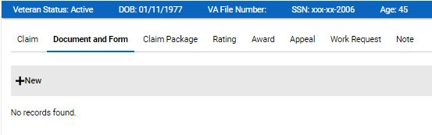
Submitting a claim to VA using TVB
Once you have saved you click, “Document and Form” and underneath it click +New

Slide 22
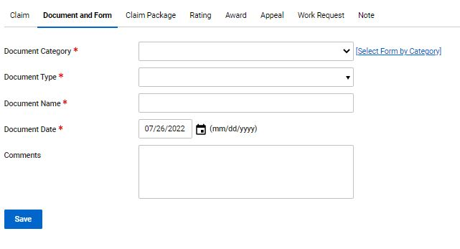
Submitting a claim to VA using TVB
Pressing +New takes you to this page where you will fill in the required fields
Document Category: Forms, General Correspondence, Other
Document Type: If Forms was previously selected VA Forms Populate this section
Document Name: does not auto populate
Document Date: This auto-populates to today’s date.

Slide 23
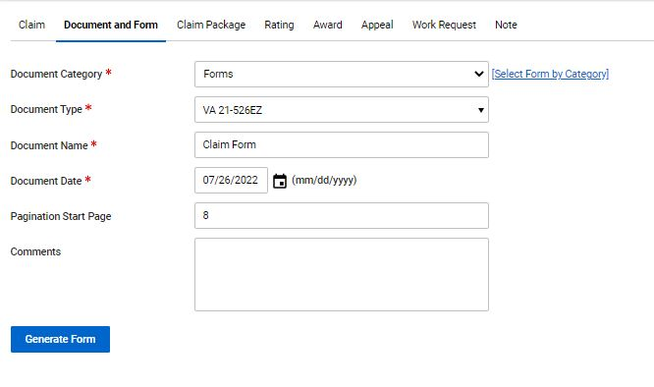
Submitting a claim to VA using TVB
Once everything is complete, click “Generate Form”

Slide 24
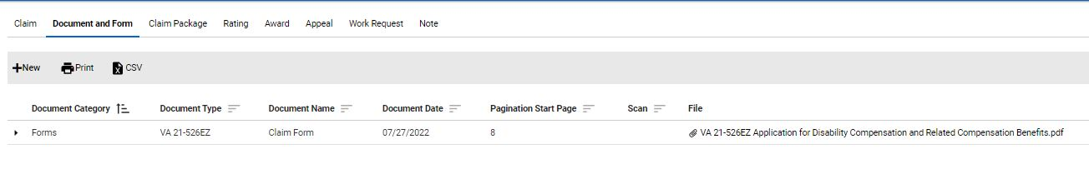
Submitting a claim to VA using TVB
Once the form has been generated, TVB will redirect you to the “Document and Form” Page and display your recently completed form.

Slide 25
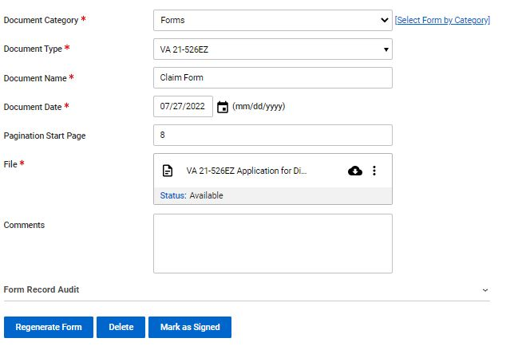
Submitting a claim to VA using TVB
When you click on the completed form it will take you to this screen:

Slide 26
Submitting a claim to VA using TVB
With the required fields completed, move your mouse over the 3 circles and click “Edit”

Slide 27
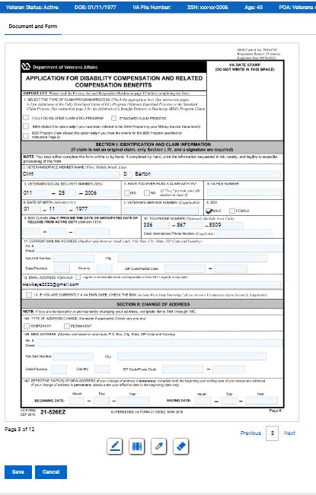
Submitting a claim to VA using TVB
When you click edit, it brings up the form you generated and allows you to Edit it inside TVB!

Slide 28
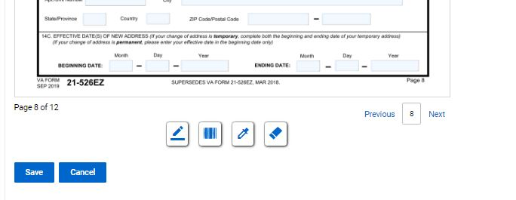
Submitting a claim to VA using TVB
At the bottom of the page you will see 4 symbols. These symbols are:
Add Signature Add Barcode Highlight Redact

Slide 29
Submitting a claim to VA using TVB
To navigate the pages of the form, click “Previous” or “Next”

Slide 30
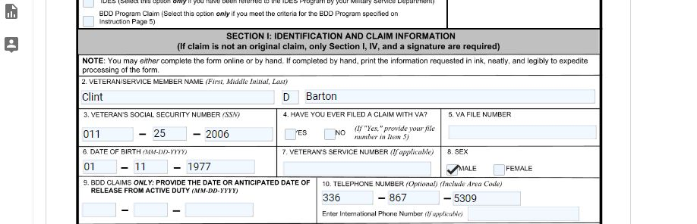
Submitting a claim to VA using TVB
All data that was entered into TVB will auto-populate into any form you create through TVB but the form will still need to be completed.

Slide 31
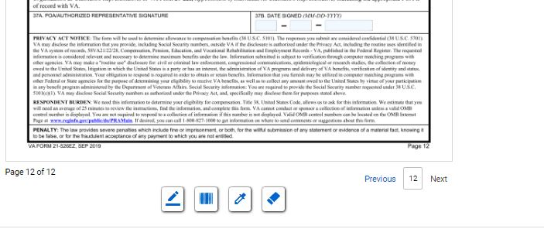
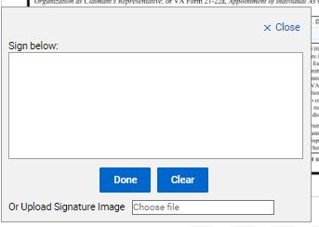

Submitting a claim to VA using TVB
Once the form is complete, it will need to be signed. To do this click “Add Signature” which will pop up the signature box.
In the signature box you can either manually create a signature using your mouse or upload a signature image. Once finished click save.
**We will cover how to create a digital signature at the end of this class**

Slide 32

Submitting a claim to VA using TVB
Once the signed document has been saved, Click
Mark as Signed
Once the document has been marked as signed, no edits on the signed form can be made. You will need to hit Save and move on to the next step in the claim process

Slide 33
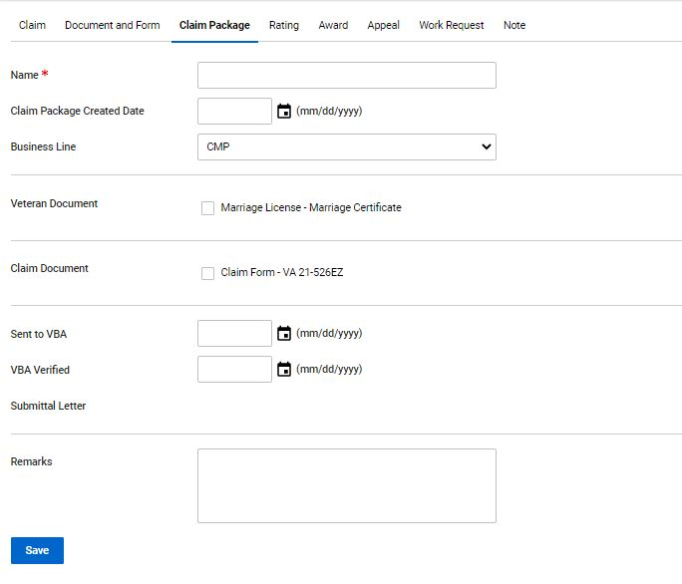
Submitting a claim to VA using TVB
Next click “Claim Package” and press “+New” which will take you to this screen.

Slide 34
Submitting a claim to VA using TVB
On this screen you will need to enter in the following:
1) Name of the claim
2) Claim Package Created Date
3) Select the Business Line
4) Select all documents you want sent to VA
5) Select the date you sent the claim to VBA
Press Save

Slide 35
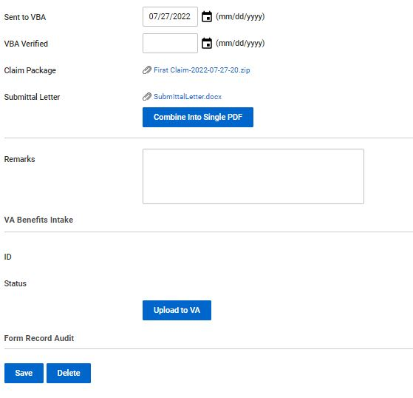

Submitting a claim to VA using TVB
Once saved you can view the changes prior to uploading the package to VA.
One thing to note is TVB will create a Submittal Letter which you can view. Once everything has been verified press “Upload to VA”

Slide 36
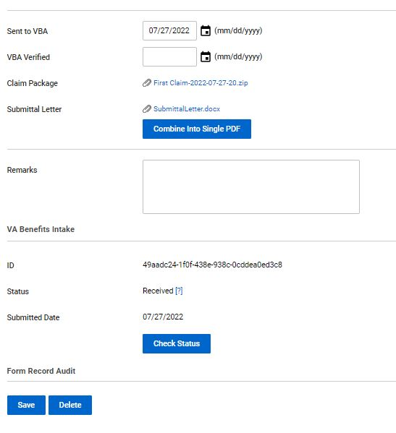

Submitting a claim to VA using TVB
After the claim is submitted you can check the status by clicking “Check Status”
Once the status shows received the effective date is preserved.

Slide 37
What is QuickSubmit
QuickSubmit is an online application that provides the ability to upload Veteran evidence electronically to the Claims Intake Center.
QuickSubmit also provides an audit history of all material uploaded to Digitized Mail Handling Service (DMHS).
To access QuickSubmit go to https://eauth.va.gov/accessva/?cspSelectFor=quicksubmit

Slide 38
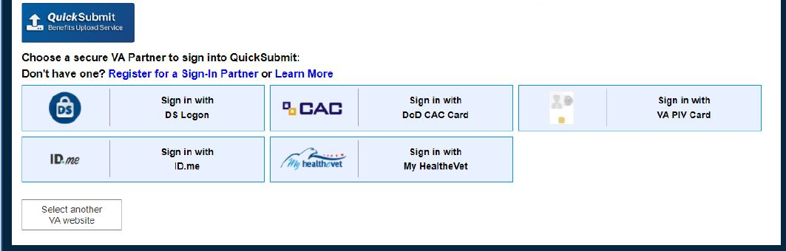
Logging into QuickSubmit
To login using a VA PIV card from within the VA network, select the VA graphic and select the credentials associated with your PIV.
To login with external authentication, select the type of authentication applicable and follow the instructions.

Slide 39
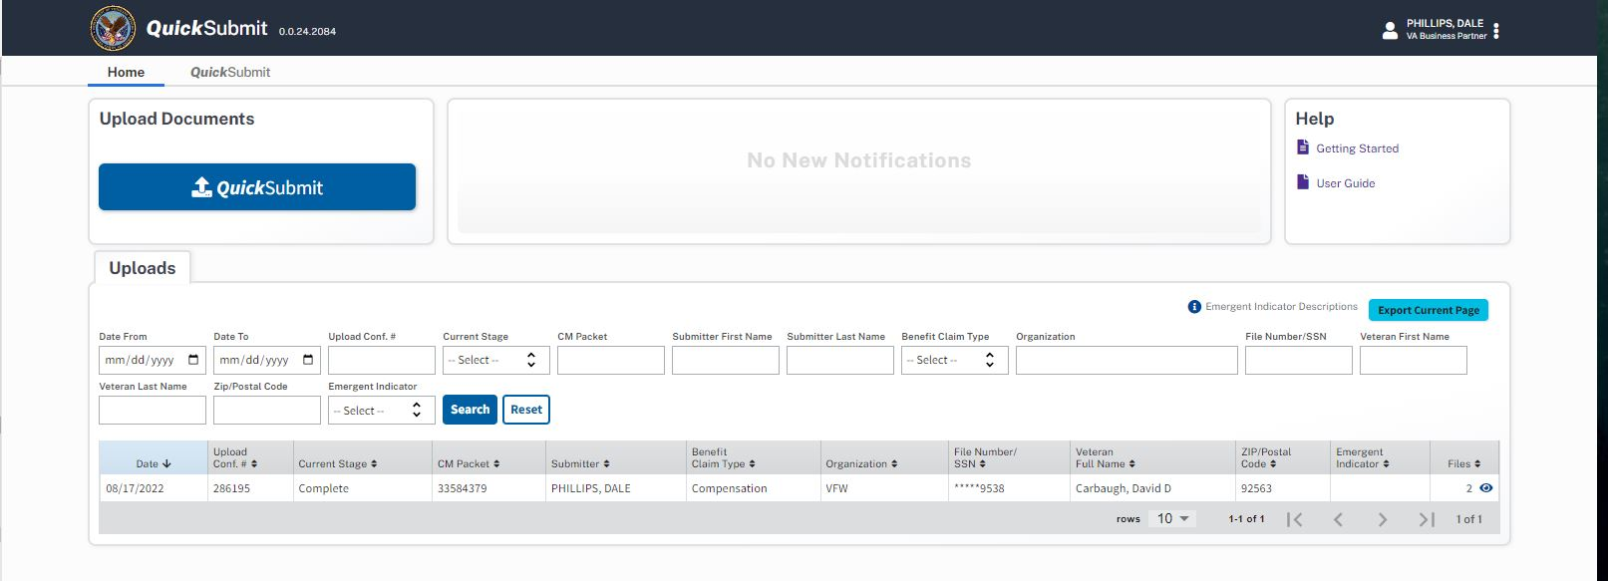
The QuickSubmit Home page
Once you have successfully logged into QuickSubmit, you will come across the QuickSubmit Homepage

Slide 40
The QuickSubmit Home page
From the Homepage you can:
1) View your uploads
2) Search your previous Uploads by different criteria
3) Export your current page of Uploads into an Excel Document
4) View the QuickSubmit Quick Reference Guide or User Guide
5) Switch from the Home screen to the QuickSubmit Screen

Slide 41
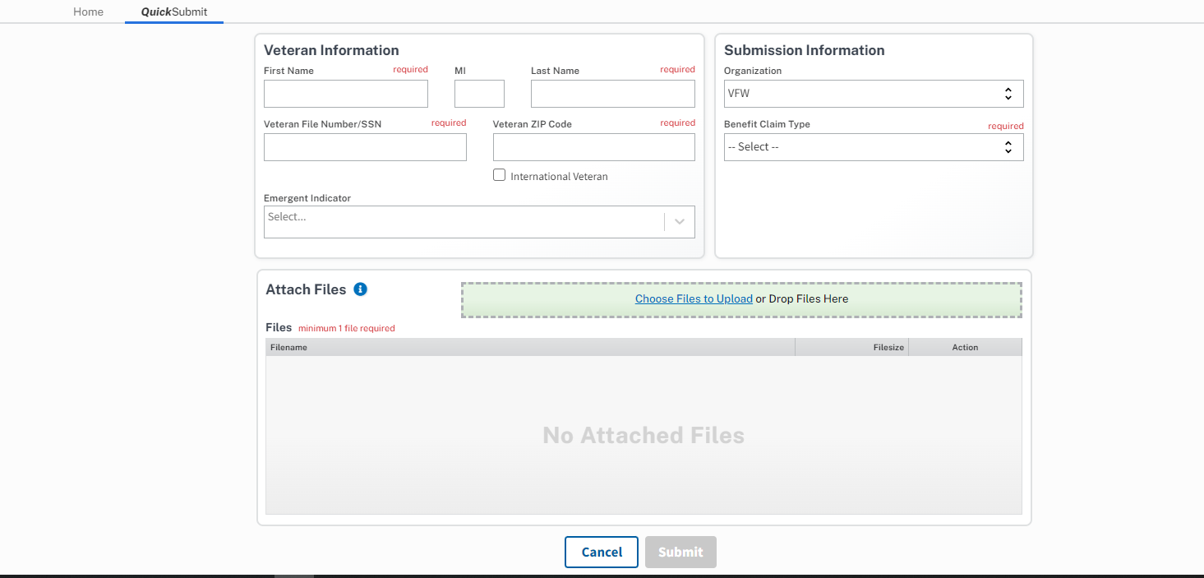
The QuickSubmit page

Slide 42
The QuickSubmit page
On the QuickSubmit Page fill out the required fields.
Under Benefit Claim Type select from the drop-down menu which type of benefit you are submitting for.
If the veteran is experiencing hardship such as Homelessness or being Terminally ill, you can flag the claim using the Emergent Indicator selection.

Slide 43
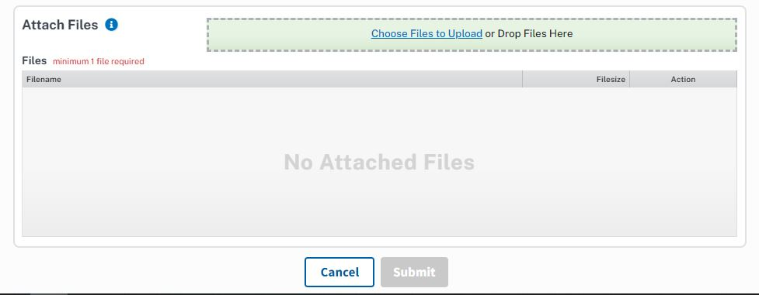
Attaching files and submitting the claim.
When Attaching files in QuickSubmit you can choose your files to upload or drag and drop them into the green box. With your files attached, click “Submit”

Slide 44
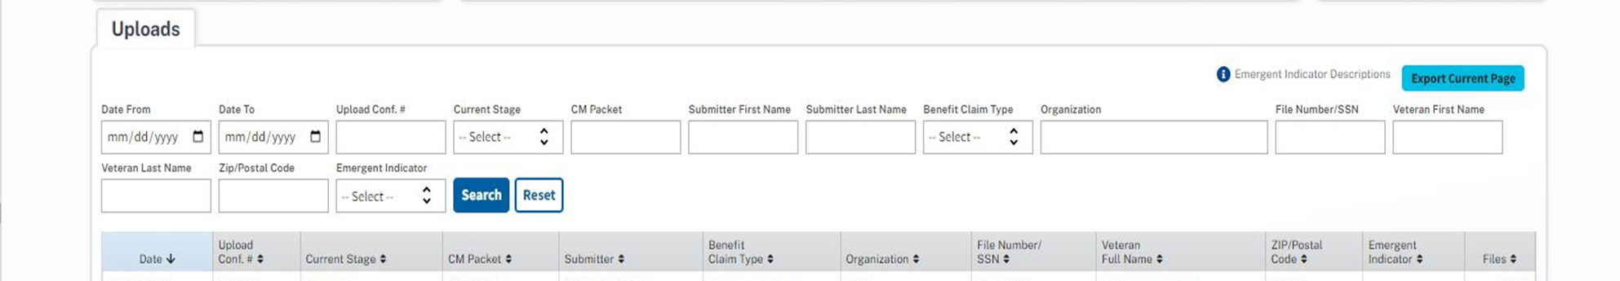
Viewing previously uploaded claims
With your claim successfully sent to VA, you can view your submissions under “Uploads” on the QuickSubmit Home page

Slide 45
Creating a Signature Image
Here we will cover how to create a digital signature that is compatible with most programs

Slide 46
Creating a Signature Image
To add a Signature to an electronic Document, you will first need to create your signature. To do this in Adobe, you will first locate the Sign Document Icon

Slide 47
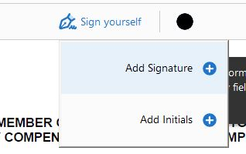
Creating a Signature Image
Once selected A drop-down box which looks like this will populate. You will then select “Add Signature”

Slide 48

Creating a Signature Image
Once you have selected Add Signature, you will be given 3 options to capture the signature:
1) Type
2) Draw
3) (Upload) Image
Type is the easiest option to choose from but all 3 will be accepted by VA.

Slide 49
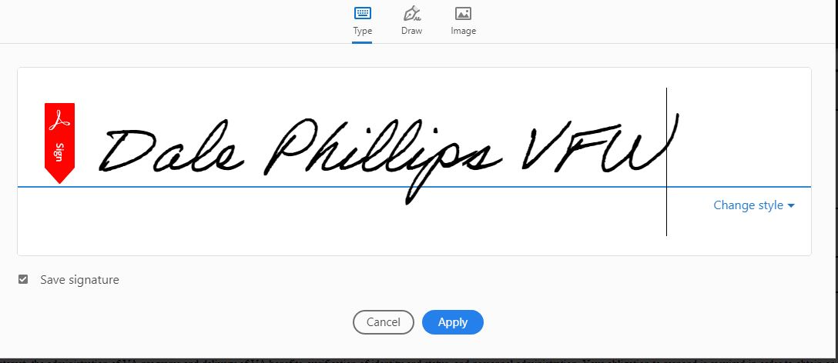
Creating a Signature Image
Once the signature is created, press “Apply”.
This will save your signature for future uses and allow you to apply the signature to the Electronic Document.

Slide 50
Saving a Signature Image
Now that you have your signature image, you will need to place it on a white background somewhere on the PDF.
With the signature in place you will need to open a new program called “Snipping Tool”
To find this tool open your computer’s start menu and search “Snipping Tool”. When you find it press the icon

Slide 51
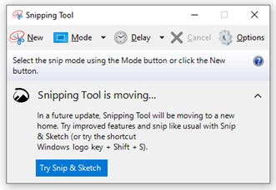
Saving a Signature Image
With the Snipping Tool Open click “New” which will change your curser to a +. From there you will cut out your signature.

Slide 52
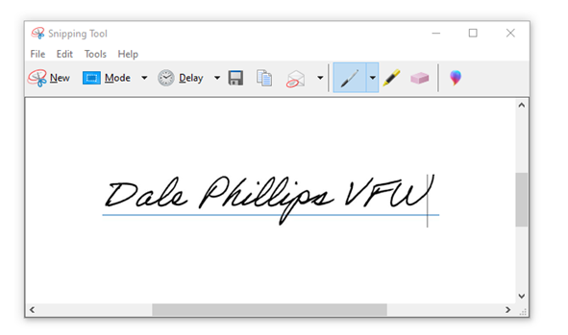
Saving a Signature Image
To save your captured signatured click
File
Save as
Choose where to save your signature

Slide 53
Review
Remember what each system is most useful for:
TVB- submitting claims directly without a 2nd system
SEP- Accepting POA requests, VAF 686c & VAF 674
Quick Submit - Useful for submitting anything (replaces fax machines)

Slide 54
QUESTIONS?

