Slide 1
NVS Health Team Update
September 2023

Slide 2
Session Topics
VA Health Care Enrollment Deadline – PACT Act
Million Veteran Program
VHA Health Outcomes Military Exposure
VHA Ride Share
ATLAS Update
Foreign Medical Program
Women Veterans Initiatives
LGBTQ+
Surveys

Slide 3
PACT Act Health Care Enrollment
Deadline – September 30 2023
Who?
Veterans who deployed to a combat zone
Never enrolled in VA health care
Left active duty between Sept 11 2001 – Oct 1 2013
Why is this important?
VA.gov/PACT

Slide 4
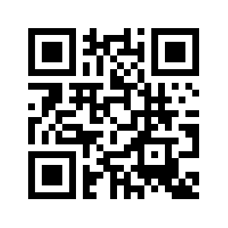
PACT Act Health Care Enrollment
Deadline – September 30 2023
Who?
Veterans who deployed to a combat zone
Never enrolled in VA health care
Left active duty between Sept 11 2001 – Oct 1 2013
Why is this important?
VA.gov/PACT

Slide 5
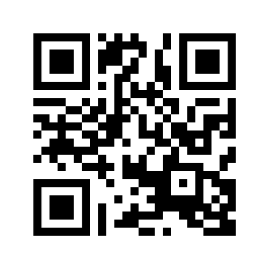
Million Veteran Program
It’s a research program, not a claim
Helps VA understand military lifestyle, genes, exposures affect health
A way ahead in improving health care
Problems like (not all-inclusive)
Cardiovascular disease/Cancer
PTSD/Mental Health
One-time blood draw
Sharing access to health records
Occasional surveys

Slide 6
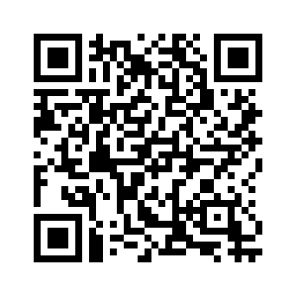
Health Outcomes Military Exposure (HOME)
Consists of:
Epidemiology Program – studies veterans’ health and healthcare
Environmental Health – evaluates research, recommends policy and develops education materials on military exposures
Next listening session tentatively
Nov 07 (info will be posted in FR)
They fall under Office of Patient Services

Slide 7
VHA Ride Share
Eligible Veterans in 18 states and Puerto Rico will have access to supplemental transportation to and from their medical care thanks to the VHA Uber-Health Connect Initiative.
The ride share program is available at 60 VAMCs (18 states and Puerto Rico).

Slide 8
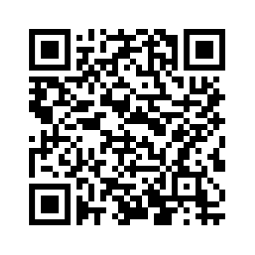
Beneficiary Travel Reimbursement
Health Care travel for eligible veterans and caregivers:
Car, plane, train, bus, taxi, light rail
May include meals and lodging for
certain circumstances

Slide 9
Beneficiary Travel (Veteran)
Eligibility:
Traveling for care at a VA health facility or for VA-approved care at a non-VA health facility
VA Disability rating of 30% or higher, or
You’re traveling for treatment of a service-connected condition, even if you're not at 30%, or
You receive a VA pension, or
You have an income that’s below the maximum annual VA pension rate, or
You can’t afford to pay for your travel (must be VHA approved prior to travel), or
You’re traveling for a scheduled VA claim exam, to get a service dog, or for VA-approved transplant care

Slide 10
Beneficiary Travel (Caregiver)
VA will pay for transportation and related lodging and meals for non-Veterans – Eligibility:
The person is your family caregiver under the National Caregiver Program traveling to receive caregiver training or to support your care, or
The person is your medically required attendant traveling with you to support your care, or
The person is your transplant care donor or support person

Slide 11
ATLAS
Accessing Telehealth through Local Area Stations
Part of VA’s “Anywhere to Anywhere Telehealth” initiative to enhance the accessibility of VA health care.
Offers veterans a convenient secure space to connect with a VA provider through video telehealth
There are 24 ATLAS sites
VFW Posts host 5 sites
There are more sites across the country

Slide 12
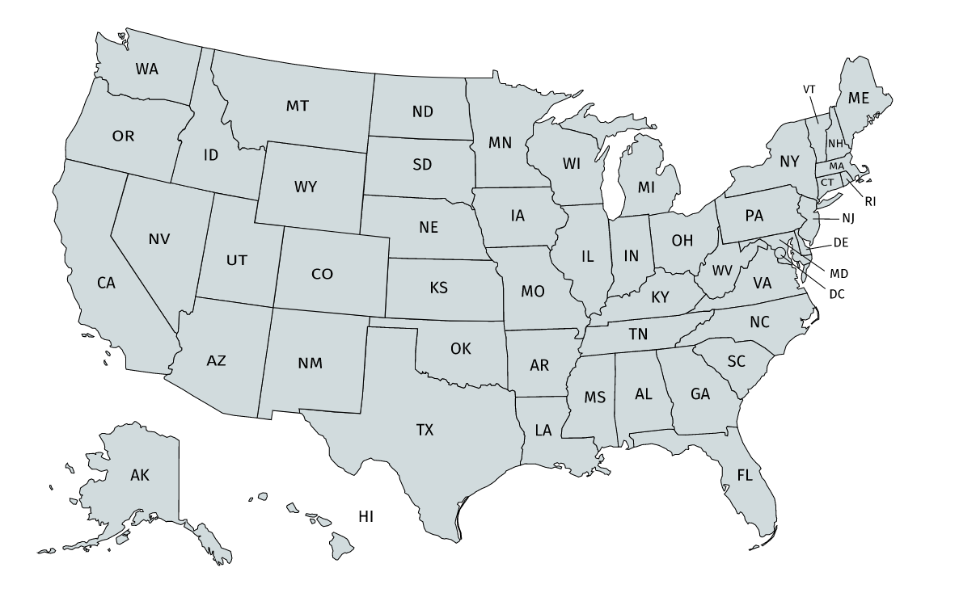
ATLAS VFW Sites
VFW
Eureka, MT
American Legion
Emporia, KS
Walmart
Fond du Lac, WI
Walmart
Howell, MI
NACVSO
Huron County, OH
VFW
Gowanda, NY
VFW
Linesville, PA
NACVSO
Greene County, PA
American Legion
Springfield, VA
VFW
Los Banos, CA
Walmart
Asheboro, NC
American Legion
Wickenburg, AZ
Walmart
Boone, NC
Sage Memorial
Navajo Nation, AZ
American Legion
Wellston, OH
Walmart
Keokuk, IA
Heart of Kansas
Larned, KS
VFW
Athens, TX

Slide 13
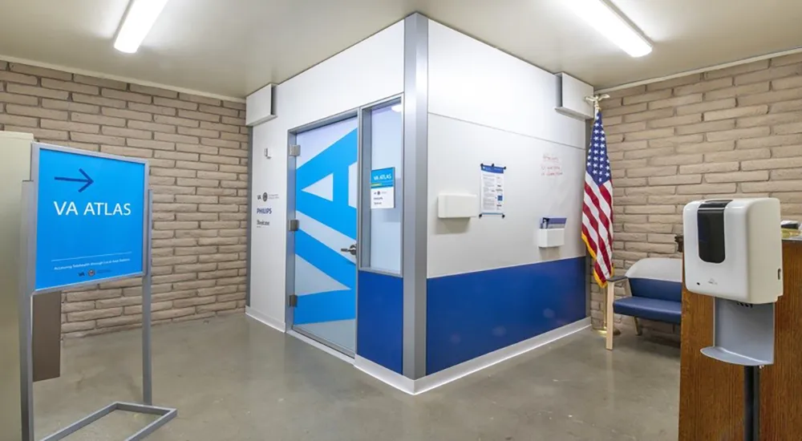
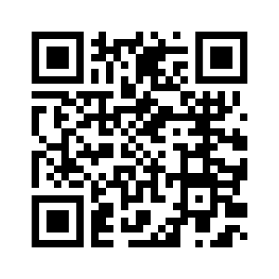
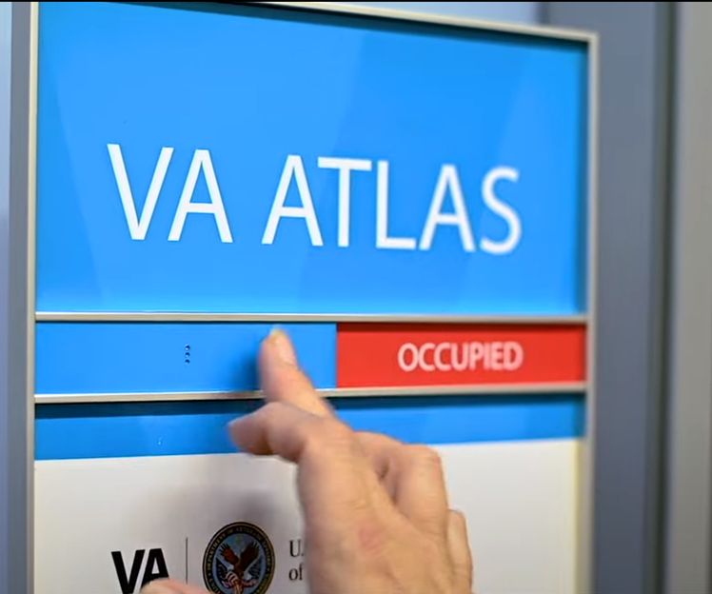
ATLAS Pod
ATLAS Los Banos
Video
QR Code

Slide 14
Foreign Medical Program
Foreign Country Travel or residence (Part of the VA Community Care Program)
Limited to services medically necessary to treat a VA-rated, service-connected disability
or for a condition associated with/aggravating a service-connected disability
VA may authorize foreign medical services for any condition if you are participating in the VA Vocational Rehabilitation Program (Title 38, U.S. Code, Chapter 31)

Slide 15
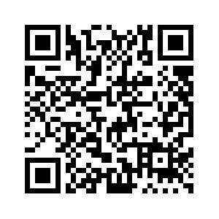
Foreign Medical Program (cont)
Best to enroll with FMP prior to travel or foreign residence
Must submit a reimbursement form to FMP
Reimbursement can take up to 12 months
Treasury check

Slide 16
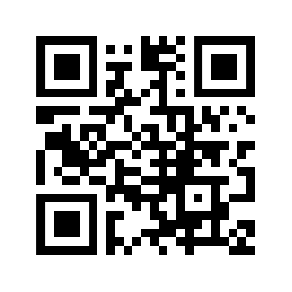
Women Veterans Health Initiatives
VA expands eligibility for clinically appropriate mammography screenings to women veterans who have experienced toxic exposure.
Women Veterans Call Center – answered by females. 855-829-6636 (Call, Chat, or Text).
Center for Women Veterans

Slide 17
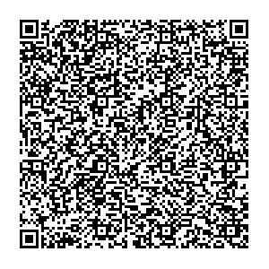
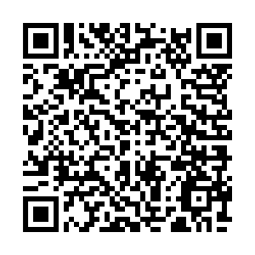
End of Life Planning Toolkit
VA offers programs to assist with end-of-life planning
Advanced Care Planning – Ensures a veteran’s loved ones know what the future needs and preferences are when it come to health care.
VA burial benefits for all legal types of burials.
End of Life Planning Toolkit
VA Geriatrics Page

Slide 18
VFW Health Surveys
Health Care Survey
Womens’ Health Survey

Slide 19
End Of Transmission
Questions

