Slide 1
The PACT Act
Vicki Von Loh
September 2023

Slide 2
The PACT Act and VA Presumptive Benefits
The PACT Act has added more than 25 new presumptive conditions that veterans can file for if they meet the requirements.
What is “Presumptive” Service Connection?
VA presumes that certain disabilities were caused by military service. This is because of the unique circumstances of a specific veteran’s military service.
If a presumed condition is diagnosed in a Veteran within a certain group, they can be awarded disability compensation.

Slide 3
The PACT Act Presumptive Areas
The PACT Act determined that veterans who served in any of the below locations on or after August 2, 1990 had exposure to burn pits or other toxins. We call this having a presumption of exposure.
Bahrain Iraq Kuwait
Oman Qatar Saudi Arabia
Somalia The United Arab Emirates (UAE)
**Includes the airspace above any of these locations

Slide 4
The PACT Act Presumptive Areas
The PACT Act determined that veterans who served in any of the below locations on or after September 11, 2001 had exposure to burn pits or other toxins. We call this having a presumption of exposure.
Afghanistan Djibouti Egypt
Jordan Lebanon Syria
Uzbekistan Yemen
**Includes the airspace above any of these locations

Slide 5
New Presumptive Conditions for Herbicide Exposure
Monoclonal Gammopathy of Undetermined Origin (MGUS)
Hypertension

Slide 6
Monoclonal Gammopathy of Undetermined Significance (MGUS)
Monoclonal gammopathy of undetermined significance (MGUS) is a condition in which an atypical protein is found in the blood. The protein is called monoclonal protein or M protein.
This protein is made in the soft, blood-producing tissue in the center of bones. This blood-producing tissue is bone marrow. Monoclonal gammopathy of undetermined significance occurs most often in older men.
MGUS usually causes no problems. But sometimes it can lead to more-serious diseases. These include some forms of blood cancer.
People who have high amounts of this protein in the blood need regular checkups. That's so they can get earlier treatment if the condition gets worse. If it doesn't get worse, MGUS doesn't need treatment.

Slide 7
Monoclonal Gammopathy of Undetermined Significance (MGUS)(cont)
Rated as: analogous to Multiple myeloma: Symptomatic multiple myeloma
DC 7712
Symptomatic multiple meloma. 100
Asymptomatic, smoldering, or monoclonal gammopathy of undetermined significance (MGUS). 0
Note (1): Current validated biomarkers of symptomatic multiple myeloma and asymptomatic multiple myeloma, smoldering, or monoclonal gammopathy of undetermined significance (MGUS) are acceptable for the diagnosis of multiple myeloma as defined by the American Society of Hematology (ASH) and International Myeloma Working Group (IMWG)

Slide 8
Monoclonal Gammopathy of Undetermined Significance (MGUS)(cont)
Note (2): The 100 percent evaluation shall continue for five years after the diagnosis of symptomatic multiple myeloma, at which time the appropriate disability evaluation shall be determined by mandatory VA examination. Any reduction in evaluation based upon that or any subsequent examination shall be subject to the provisions of § 3.105(e) and § 3.344 (a)and (b) of this chapter

Slide 9
Key Points of Hypertension
Evaluated under DC 7101
0% vs 10%

Slide 10
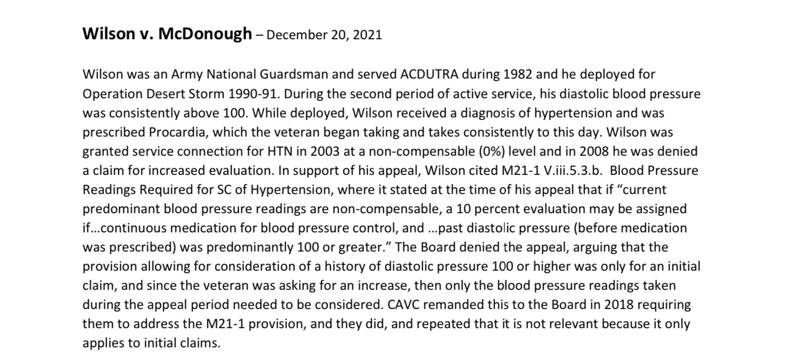
Wilson v. McDonough

Slide 11
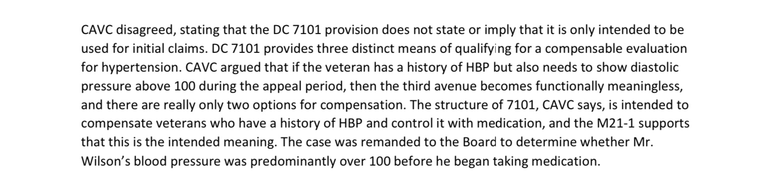
Wilson v. McDonough (continued)

Slide 12
Hypertension. DC 7101
Hypertensive vascular disease (hypertension and isolated systolic hypertension):
Diastolic pressure predominantly 130 or more 60
Diastolic pressure predominantly 120 or more 40
Diastolic pressure predominantly 110 or more, or; systolic pressure predominantly 200 or more 20
Diastolic pressure predominantly 100 or more, or; systolic pressure predominantly 160 or more, or; minimum evaluation for an individual with a history of diastolic pressure predominantly 100 or more who requires continuous medication for control. 10

Slide 13
Hypertension (continued)
Note (1): Hypertension or isolated systolic hypertension must be confirmed by readings taken two or more times on at least three different days. For purposes of this section, the term hypertension means that the diastolic blood pressure is predominantly 90mm. or greater, and isolated systolic hypertension means that the systolic blood pressure is predominantly 160mm. or greater with a diastolic blood pressure of less than 90mm.
Note (2): Evaluate hypertension due to aortic insufficiency or hyperthyroidism, which is usually the isolated systolic type, as part of the condition causing it rather than by a separate evaluation.
Note (3): Evaluate hypertension separately from hypertensive heart disease and other types of heart disease.

Slide 14
New Presumptive Conditions
For Disabilities Occurring
In Persian Gulf Veterans

Slide 15
Individual longitudinal Exposure Record
(ILER)
Individual Longitudinal Exposure Record (ILER)
Section 1119 (c) defines exposure tracking record system as any system, program, or pilot program used by the Secretary of Veterans Affairs or the Secretary of Defense to track how veterans or members of the Armed Forces have been exposed to various occupational or environmental hazards.

Slide 16
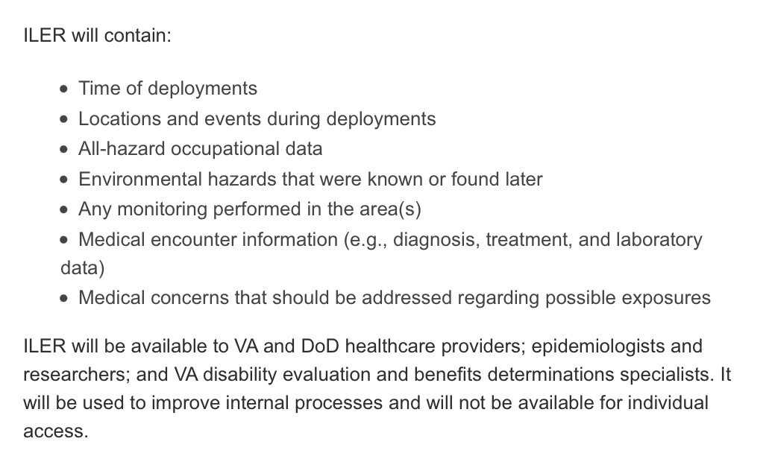
ILER

Slide 17
ILER
There is now a requirement which requires the use of the Individual Longitudinal Exposure (ILER), ILER-like tool or similar database during claims adjudication.
VA will establish a list of chemicals, substances and airborne hazards and presumes that a covered Veteran was exposed to the identified substances, chemicals and airborne hazards during qualified service.
A medical nexus examination will be required for toxic exposure risk activities, unless the evidence of record is sufficient.

Slide 18
Toxic Exposure Risk Activity
Toxic exposure risk activity (TERA) is defined in 38 USC 1710(e)(4)(C) as any activity that requires a corresponding entry into an exposure tracking records system (as defined in Section 1119(c); or that the Secretary determines qualifies for purposes of this subsection when taking into account what is reasonably prudent to protect the health of Veterans

Slide 19
Toxic Exposure Veteran
Toxic exposed Veteran is defined in 38 USC 101 (38) and means any Veteran described in Section 1710(e)(1) of this title.
38 USC 1710(e)(1) addresses healthcare eligibility and expands upon Vietnam herbicide exposed veterans, radiation exposed veterans Persian Gulf veterans, chemical and biological warfare testing, armed forces who served at Camp LeJeune and veterans who participated in a toxic risk activity.

Slide 20
Toxic Exposure
Toxic exposure is defined in 38 USC 101(37) to include, a toxic exposure risk activity (TERA), as defined in Section 1710(e)(4), and an exposure to a substance, chemical or airborne hazard identified in the list under section 1119(b)(2).
38 USC 1710(e)(4) defines the terms Vietnam-era herbicide exposed, radiation exposed Veteran and TERA
38 USC 1119(b)(2) states the Secretary of VA shall establish and maintain a list that identifies substances, chemicals and airborne hazards that are appropriate for presumptions of specific toxic exposure for members who served in certain locations

Slide 21
TERA Exception Job Aid
38 U.S.C. § 1168(b) provides that the examination requirements for TERA-related claims do not apply if the Secretary determines there is no indication of an association between the disability claimed by the Veteran and participation in the TERA.
At this time, claims processors should not order an examination based upon a TERA if one of the following exceptions applies.
1. Non-presumptive claims based on physical trauma. The Veteran claims service connection for a non-presumptive disability that is based on physical trauma (e.g., blunt force trauma, trauma due to repetitive use, penetrating trauma). Note: Hearing loss is not considered a physical trauma under this exception.

Slide 22
TERA Exception Job Aid (continued)
2. Mental disorders. This includes any condition contained in
38 C.F.R. § 4.130, the mental disorders section of the VA Schedule for Rating Disabilities.
Note: Toxic exposure can result in symptoms of neurobehavioral decline, like decreased memory and concentration. A diagnosis of a mental disorder should be considered on a direct or secondary basis.
3. Conditions determined to have no positive association with herbicide exposure. These are conditions determined by the Secretary based on cumulative scientific data reported by the National Academies of Science since 1993 and are as follows

Slide 23
TERA Exception Job Aid (continued)
4. Claims for disabilities that manifested during military service or with an etiology not associated with toxic exposure. This exception applies to conditions that manifested during service for which a medical nexus opinion would not be needed to decide service connection on a direct basis (evidence of chronicity or continuity is of record) and to claims where the evidence of record indicates that the claimed condition is clearly related to an etiology that is not associated with toxic exposure (to include post-service event).
Important: Claims processors must liberally apply reasonable doubt when determining if this exception applies. When there is an approximate balance of evidence, err on the side of caution and request the TERA disability examination and medical nexus opinion.

Slide 24
TERA Exception Job Aid –
Malignant conditions (Cancers)
Melanoma
Nonmelanoma skin cancer (basal cell and squamous cell)
Hepatobiliary cancers (liver, gallbladder, and bile ducts), and pancreatic cancer
Cancers of the pleura, mediastinum, and other unspecified sites within the respiratory system and intrathoracic organs
Bone and connective tissue cancer
Endocrine cancers (including thyroid and thymus)
Cancers of the reproductive organs (cervix, uterus, ovary, testes, and penis; excluding prostate)
Cancers of the digestive organs (esophageal cancer; stomach cancer; colorectal cancer (including small intestine and anus))

Slide 25
TERA Exception Job Aid –
Malignant conditions (Cancers) continued
Renal cancer (kidney and renal pelvis)
Cancers of the brain and nervous system (including eye)•
Leukemia (other than all chronic B-cell leukemias including chronic lymphocytic leukemia and hairy cell leukemia)
Cancers of the oral cavity (including lips and tongue), pharynx (including tonsils), and nasal cavity (including ears and sinuses)

Slide 26
TERA Exception
Non-Malignant Conditions
Osteoporosis
Farmer’s lung
Chronic obstructive pulmonary disease
Immune system disorders (immune suppression, allergy, and autoimmunity)
Neurodegenerative diseases (including amyotrophic lateral sclerosis (ALS) but excluding Parkinson's disease and Parkinsonism)
Asthma
Hearing loss
Neurobehavioral disorders (cognitive and neuropsychiatric)
Circulatory disorders (other than hypertension, ischemic heart disease, and stroke)

Slide 27
TERA Exception
Non-Malignant Conditions (continued)
Endometriosis
Diseases of the eye
Gastrointestinal, metabolic, and digestive disorders
Chronic peripheral nervous system disorders (other than early-onset peripheral neuropathy)
Note: The malignant and non-malignant conditions under this exception (Exception 3) only apply to herbicide exposure. Claims processors must still consider all evidence as there may be a record of a different TERA (other than herbicides).

Slide 28
The PACT Act Presumptive conditions for
Gulf War and Post 9/11 Veterans
Brain Cancer | Chronic Rhinitis
Glioblastoma | Chronic Sinusitis
Respiratory (Breathing-related) cancer of any type | Constrictive bronchiolitis
Gastrointestinal cancer of any type | Obliterative Bronchiolitis
Head cancer of any type | Emphysema
Lymphoma of any type | Granulomatous disease
Lymphatic cancer of any type | Interstitial lung disease (ILD)
Neck cancer | Pleuritis
Pancreatic Cancer | Pulmonary Fibrosis
Reproductive cancer of any type | Sarcoidosis
Kidney Cancer | Chronic Bronchitis
Melanoma | Chronic Obstructive Pulmonary Disease (COPD)
Asthma (Diagnosed after service)

Slide 29
How Does VA Rate Cancers
Associated with the PACT Act

Slide 30
38 CFR 4.71a. DC 5012
Bones, neoplasm, malignant, primary or secondary 100
Note: The 100 percent rating will be continued for 1 year following the cessation of surgical, X-ray, antineoplastic chemotherapy or other prescribed therapeutic procedure.
If there has been no local recurrence or metastases, rate based on residuals.

Slide 31
38 CFR 4.73. DC 5329
Sarcoma, soft tissue (of muscle, fat, or fibrous connective tissue). 100
Note: A rating of 100 percent shall continue beyond the cessation of any surgery, radiation treatment, antineoplastic chemotherapy or other therapeutic procedures. Six months after discontinuance of such treatment, the appropriate disability rating shall be determined by mandatory VA examination.
Any change in evaluation based upon that or any subsequent examination shall be subject to the provisions of § 3.105(e) of this chapter. If there has been no local recurrence or metastasis, rate on residual impairment of function.

Slide 32
38 CFR 4.79. DC 6014
Malignant neoplasms of the eye, orbit, and adnexa (excluding skin): Malignant neoplasms of the eye, orbit, and adnexa (excluding skin) that require therapy that is comparable to those used for systemic malignancies, i.e., systemic chemotherapy, X-ray therapy more extensive than to the area of the eye, or surgery more extensive than enucleation 100
Note: Continue the 100 percent rating beyond the cessation of any surgical, X-ray, antineoplastic chemotherapy, or other therapeutic procedure. Six months after discontinuance of such treatment, the appropriate disability rating will be determined by mandatory VA examination. Any change in evaluation based upon that or any subsequent examination will be subject to the provisions of § 3.105(e) of this chapter. If there has been no local recurrence or metastasis, evaluate based on residuals

Slide 33
38 CFR 4.79. DC 6014. (Continued )
Malignant neoplasms of the eye, orbit, and adnexa (excluding skin) that do not require therapy comparable to that for systemic malignancies:
Separately evaluate visual and nonvisual impairment, e.g., disfigurement (diagnostic code 7800), and combine the evaluations

Slide 34
38 CFR 4.73. DC 6819
Neoplasms, malignant, any specified part of respiratory system exclusive of skin growths 100
Note: A rating of 100 percent shall continue beyond the cessation of any surgical, X-ray, antineoplastic chemotherapy or other therapeutic procedure. Six months after discontinuance of such treatment, the appropriate disability rating shall be determined by mandatory VA examination.
Any change in evaluation based upon that or any subsequent examination shall be subject to the provisions of § 3.105(e) of this chapter. If there has been no local recurrence or metastasis, rate on residuals.

Slide 35
38 CFR 4.114. DC 7343
Malignant neoplasms of the digestive system, exclusive of skin growths 100
Note: A rating of 100 percent shall continue beyond the cessation of any surgical, X-ray, antineoplastic chemotherapy or other therapeutic procedure. Six months after discontinuance of such treatment, the appropriate disability rating shall be determined by mandatory VA examination.
Any change in evaluation based upon that or any subsequent examination shall be subject to the provisions of § 3.105(e) of this chapter. If there has been no local recurrence or metastasis, rate on residuals.

Slide 36
38 CFR 4.115b. DC 7528
Malignant neoplasms of the genitourinary system 100
Note—Following the cessation of surgical, X-ray, antineoplastic chemotherapy or other therapeutic procedure, the rating of 100 percent shall continue with a mandatory VA examination at the expiration of six months.
Any change in evaluation based upon that or any subsequent examination shall be subject to the provisions of § 3.105(e) of this chapter. If there has been no local reoccurrence or metastasis, rate on residuals as voiding dysfunction or renal dysfunction, whichever is predominant.

Slide 37
38 CFR 4.116. DC 7627
Malignant neoplasms of gynecological system 100
Note: A rating of 100 percent shall continue beyond the cessation of any surgical, radiation, antineoplastic chemotherapy or other therapeutic procedures. Six months after discontinuance of such treatment, the appropriate disability rating shall be determined by mandatory VA examination.
Any change in evaluation based upon that or any subsequent examination shall be subject to the provisions of § 3.105(e) of this chapter. Rate chronic residuals to include scars, lymphedema, disfigurement, and/or other impairment of function under the appropriate diagnostic code(s) within the appropriate body system

Slide 38
38 CFR 4.116. DC 7630
Malignant neoplasms of the breast 100
Note: A rating of 100 percent shall continue beyond the cessation of any surgical, radiation, antineoplastic chemotherapy or other therapeutic procedure. Six months after discontinuance of such treatment, the appropriate disability rating shall be determined by mandatory VA examination.
Any change in evaluation based upon that or any subsequent examination shall be subject to the provisions of § 3.105(e) of this chapter. Rate chronic residuals according to impairment of function due to scars, lymphedema, or disfigurement (e.g., limitation of arm, shoulder, and wrist motion, or loss of grip strength, or loss of sensation, or residuals from harvesting of muscles for reconstructive purposes), and/or under diagnostic code 7626

Slide 39
38 CFR 4.117. DC 7709
Hodgkin's lymphoma: With active disease or during a treatment phase 100
Note: A 100 percent evaluation shall continue beyond the cessation of any surgical therapy, radiation therapy, antineoplastic chemotherapy, or other therapeutic procedures. Six months after discontinuance of such treatment, the appropriate disability rating shall be determined by mandatory VA examination.
Any reduction in evaluation based upon that or any subsequent examination shall be subject to the provisions of § 3.105(e) of this chapter. If there has been no local recurrence or metastasis, rate on residuals under the appropriate diagnostic code(s)

Slide 40
38 CFR 4.117 DC 7715
Non-Hodgkin's lymphoma: When there is active disease, during treatment phase, or with indolent and non-contiguous phase of low grade NHL 100
Note: A 100 percent evaluation shall continue beyond the cessation of any surgical therapy, radiation therapy, antineoplastic chemotherapy, or other therapeutic procedures.
Two years after discontinuance of such treatment, the appropriate disability rating shall be determined by mandatory VA examination. Any reduction in evaluation based upon that or any subsequent examination shall be subject to the provisions of § 3.105(e) of this chapter. If there has been no recurrence, rate on residuals under the appropriate diagnostic code(s

Slide 41
38 CFR 4.118. DC 7818
Malignant skin neoplasms (other than malignant melanoma): Rate as disfigurement of the head, face, or neck (DC 7800), scars (DC's 7801, 7802, 7803, 7804, or 7805), or impairment of function
Note: If a skin malignancy requires therapy that is comparable to that used for systemic malignancies, i.e., systemic chemotherapy, X-ray therapy more extensive than to the skin, or surgery more extensive than wide local excision, a 100-percent evaluation will be assigned from the date of onset of treatment, and will continue, with a mandatory VA examination six months following the completion of such antineoplastic treatment, and any change in evaluation based upon that or any subsequent examination will be subject to the provisions of § 3.105(e) of this chapter. If there has been no local recurrence or metastasis, evaluation will then be made on residuals. If treatment is confined to the skin, the provisions for a 100-percent evaluation do not apply.

Slide 42
38 CFR 4.118. DC 7833
Malignant melanoma: Rate as scars (DC's 7801, 7802, 7803, 7804, or 7805), disfigurement of the head, face, or neck (DC 7800), or impairment of function (under the appropriate body system)
Note: If a skin malignancy requires therapy that is comparable to that used for systemic malignancies, i.e., systemic chemotherapy, X-ray therapy more extensive than to the skin, or surgery more extensive than wide local excision, a 100-percent evaluation will be assigned from the date of onset of treatment, and will continue, with a mandatory VA examination six months following the completion of such antineoplastic treatment, and any change in evaluation based upon that or any subsequent examination will be subject to the provisions of § 3.105(e). If there has been no local recurrence or metastasis, evaluation will then be made on residuals. If treatment is confined to the skin, the provisions for a 100-percent evaluation do not apply.

Slide 43
38 CFR 4.119. DC 7914
Neoplasm, malignant, any specified part of the endocrine system 100
Note: A rating of 100 percent shall continue beyond the cessation of any surgical, X-ray, antineoplastic chemotherapy or other therapeutic procedure. Six months after discontinuance of such treatment, the appropriate disability rating shall be determined by mandatory VA examination.
Any change in evaluation based upon that or any subsequent examination shall be subject to the provisions of § 3.105(e) of this chapter. If there has been no local recurrence or metastasis, rate on residuals.

Slide 44
38 CFR 4.124a. DC 8002 and 8021
8002 Malignant organic diseases of central nervous system. 100
Note: The rating in code 8002 will be continued for 2 years following cessation of surgical, chemotherapeutic or other treatment modality. At this point, if the residuals have stabilized, the rating will be made on neurological residuals according to symptomatology.
8021 Malignant Brain. 100
Note: The rating in code 8021 will be continued for 2 years following cessation of surgical, chemotherapeutic or other treatment modality. At this point, if the residuals have stabilized, the rating will be made on neurological residuals according to symptomatology.
Minimum rating. 30

Slide 45
38 CFR 4.124a. DC 8540
Soft-tissue sarcoma (of neurogenic origin) 100
Note: The 100 percent rating will be continued for 6 months following the cessation of surgical, X-ray, antineoplastic chemotherapy or other therapeutic procedure. At this point, if there has been no local recurrence or metastases, the rating will be made on residuals.

Slide 46
38 CFR 4.150. DC 9918
Neoplasm, hard and soft tissue, malignant 100
Note: A rating of 100 percent shall continue beyond the cessation of any surgical, radiation, antineoplastic chemotherapy or other therapeutic procedure. Six months after discontinuance of such treatment, the appropriate disability rating shall be determined by mandatory VA examination.
Any change in evaluation based upon that or any subsequent examination shall be subject to the provisions of § 3.105(e) of this chapter. If there has been no local recurrence or metastasis, rate on residuals such as loss of supporting structures (bone or teeth) and/or functional impairment due to scarring

Slide 47
38 CFR 4.96
Special provisions regarding evaluation of respiratory conditions.

Slide 48
Respiratory Conditions
38 CFR 4.97

Slide 49
DC 6510-6514. Sinusitis
General Rating Formula for Sinusitis (DC's 6510 through 6514):
Following radical surgery with chronic osteomyelitis, or; near constant sinusitis characterized by headaches, pain and tenderness of affected sinus, and purulent discharge or crusting after repeated surgeries 50
Three or more incapacitating episodes per year of sinusitis requiring prolonged (lasting four to six weeks) antibiotic treatment, or; more than six non-incapacitating episodes per year of sinusitis characterized by headaches, pain, and purulent discharge or crusting 30

Slide 50
DC 6510-6514. Sinusitis (continued)
One or two incapacitating episodes per year of sinusitis requiring prolonged (lasting four to six weeks) antibiotic treatment, or; three to six non-incapacitating episodes per year of sinusitis characterized by headaches, pain, and purulent discharge or crusting. 10
Detected by X-ray only 0
Note: An incapacitating episode of sinusitis means one that requires bed rest and treatment by a physician.

Slide 51
DC 6522 and 6524
6522 Allergic or vasomotor rhinitis:
With polyps 30
Without polyps, but with greater than 50-percent obstruction of nasal passage on both sides or complete obstruction on one side. 10
6524 Granulomatous rhinitis: Wegener's granulomatosis, lethal midline
granuloma 100
Other types of granulomatous infection. 20

Slide 52
DC 6732
Pleurisy, tuberculous, active or inactive.
Rate under §§4.88c – Ratings for inactive non pulmonary tuberculosis initially entitled after 8/19/1968 or
4.89- Ratings for inactive non pulmonary tuberculosis in effect on 8/19/1968 (graduated rating which was repealed) whichever is appropriate.

Slide 53
DC 6845
Chronic pleural effusion or fibrosis.
General Rating Formula for Restrictive Lung Disease (diagnostic codes 6840 through 6845): FEV–1 less than 40 percent of predicted value, or; the ratio of Forced Expiratory Volume in one second to Forced Vital Capacity (FEV–1/FVC) less than 40 percent, or; Diffusion Capacity of the Lung for Carbon Monoxide by the Single Breath Method (DLCO (SB)) less than 40-percent predicted, or; maximum exercise capacity less than 15 ml/kg/min oxygen consumption (with cardiac or respiratory limitation), or; cor pulmonale (right heart failure), or; right ventricular hypertrophy, or; pulmonary hypertension (shown by Echo or cardiac catheterization), or; episode(s) of acute respiratory failure, or; requires outpatient oxygen therapy. 100

Slide 54
DC 6845 (continued)
FEV–1 of 40- to 55-percent predicted, or; FEV–1/FVC of 40 to 55 percent, or; DLCO (SB) of 40- to 55-percent predicted, or; maximum oxygen consumption of 15 to 20 ml/kg/min (with cardiorespiratory limit) 60
FEV–1 of 56- to 70-percent predicted, or; FEV–1/FVC of 56 to 70 percent, or; DLCO (SB) 56- to 65-percent predicted 30
FEV–1 of 71- to 80-percent predicted, or; FEV–1/FVC of 71 to 80 percent, or; DLCO (SB) 66- to 80-percent predicted 10
Or rate primary disorder.

Slide 55
DC 6845 (continued)
Note (1): A 100-percent rating shall be assigned for pleurisy with empyema, with or without pleurocutaneous fistula, until resolved.
Note (2): Following episodes of total spontaneous pneumothorax, a rating of 100 percent shall be assigned as of the date of hospital admission and shall continue for three months from the first day of the month after hospital discharge.
Note (3): Gunshot wounds of the pleural cavity with bullet or missile retained in lung, pain or discomfort on exertion, or with scattered rales or some limitation of excursion of diaphragm or of lower chest expansion shall be rated at least 20-percent disabling. Disabling injuries of shoulder girdle muscles (Groups I to IV) shall be separately rated and combined with ratings for respiratory involvement. Involvement of Muscle Group XXI (DC 5321), however, will not be separately rated.

Slide 56
DC 6846
Sarcoidosis:
Cor pulmonale, or; cardiac involvement with congestive heart failure, or; progressive pulmonary disease with fever, night sweats, and weight loss despite treatment 100
Pulmonary involvement requiring systemic high dose (therapeutic) corticosteroids for control 60
Pulmonary involvement with persistent symptoms requiring chronic low dose (maintenance) or intermittent corticosteroids 30
Chronic hilar adenopathy or stable lung infiltrates without symptoms or physiologic impairment 0
Or rate active disease or residuals as chronic bronchitis (DC 6600) and extra-pulmonary involvement under specific body system involved

Slide 57
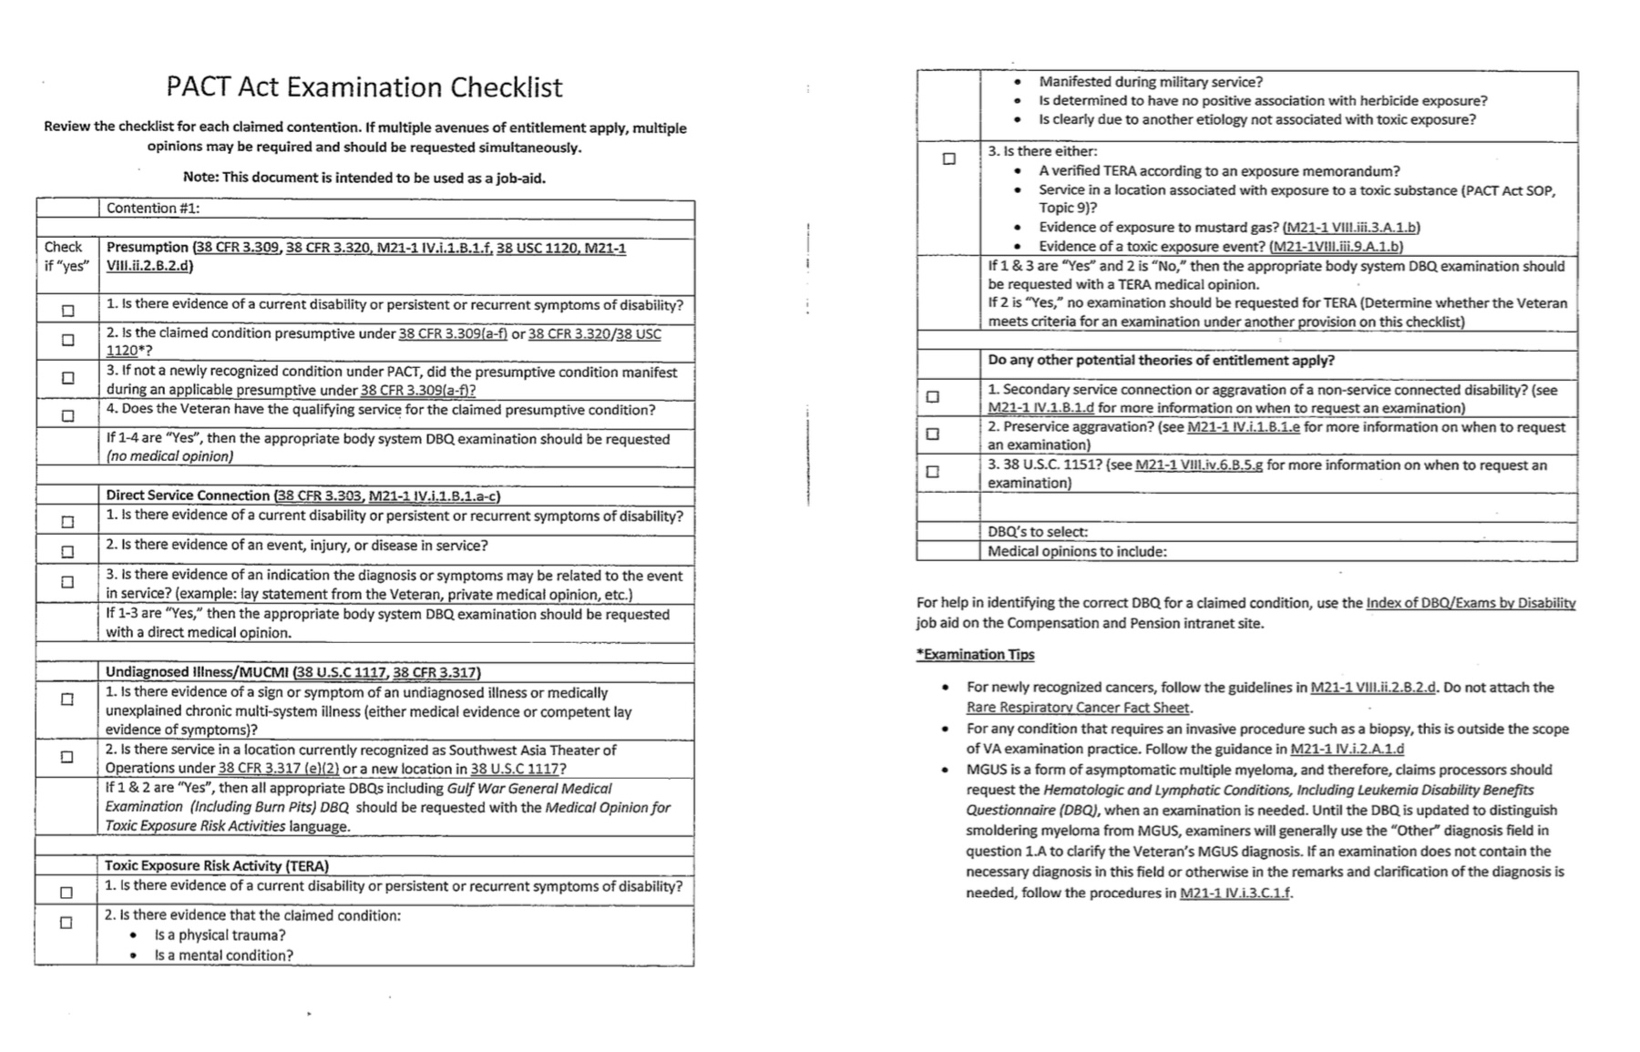
PACT Act Examination Checklist

Slide 58
Effective Dates
Effective Date of Law August 10, 2022
If ITF or 21-526EZ filed prior to
August 14, 2023 effective date August 10, 2022
38 CFR 3.114 applies – if diagnosed prior to
August 10, 2022, effective date will be one year prior
to date of claim, ie. Date of claim 9/2/23, diagnosed
7/25/2023, effective date 7/25/2023

Slide 59
Camp Lejuene
VFW suggests the use of two law firms to represent Camp Lejuene veterans
- Bergman and Moore
- Baird Mandalas Brockstedt and Federico (BMBF)
VA benefits will be offset by money awarded under claims for Camp Lejuene…..

Slide 60
References
38 CFR 4.71a
38 CFR 4.73
38 CFR 4.79
38 CFR 4.88
38 CFR 4.89
38 CFR 4.96
38 CFR 4.97
38 CFR 4.114
38 CFR 4.115b
38 CFR 4.116
38 CFR 4.117
38 CFR 4.118
38 CFR 4.119
38 CFR 4.124a
38 CFR 4.130
38 CFR 4.150
38 USC 1119
38 USC 1710
38 CFR 3.105(e)

Slide 61
References (continued)
Compensation Services PACT Act Information Page (behind firewall)
VFW PACT Resources Page
M21-1 V.iii.4.A
Disability Benefits Questionnaires (DBQ)
Persian Gulf and/or Infections Diseases (Other than tuberculosis) DBQ

Slide 62
Questions?
Vicki Von Loh
vvonloh@gmail.com
402-499-6836

Slide 63

2023 Skill Level Training Conference Survey
Rating PACT Act Conditions
Please scan the QR Code or click on the link below to take an anonymous survey about your experience during the 2023 Skill Level Training Conference.
https://www.research.net/r/8H578ZL

