Slide 1
TVB Claims Management System
September 2023

Slide 2
Lesson Objectives
Assigning a veteran
How to run a report
VA Benefits Claims log in process
How to check POA status
Using VA Benefits claims to submit ITF, POA and 526EZ

Slide 3
Assigning a Veteran
The foundation for TVB is in properly assigning claims to the correct service officer. Failure to do this results in reports not being able to be run and extra work through repeated steps later.

Slide 4
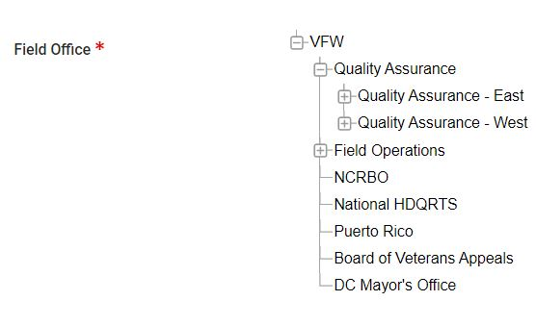
Assigning a Veteran to the Field Office
When creating a new veteran folder in TVB, follow these steps to assign the veteran to the correct Field Office:
In the required area of Field Office, Select the + next to VFW to expand the drop-down menu
Click Quality Assurance (QA).
Click on the region your office is located in QA East or QA West

Slide 5
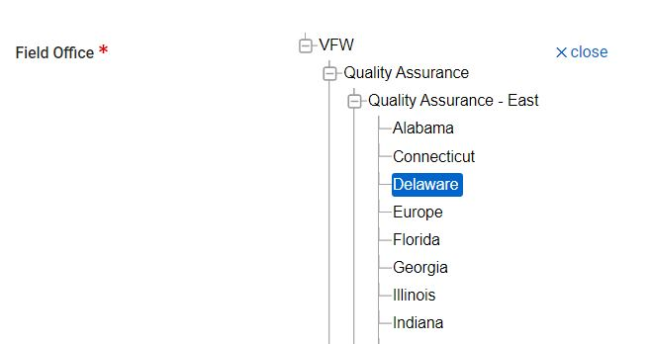
Assigning a Veteran to the Field Office
With the correct Quality Assurance Region Selected a new dropdown will populate with that region’s states.
Select the State your office is located in to correctly assign the Field Office

Slide 6
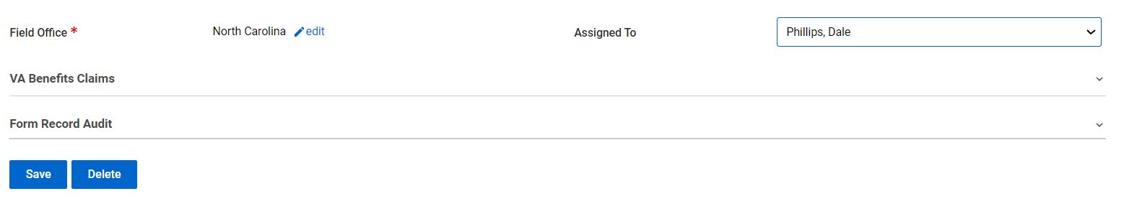
Assigning a Veteran to the VSO
With the field office correctly assigned the VSO can now assign the veteran to their TVB profile by:
Click the dropdown box next to Assigned To and select Your Name.
Click either Save or Save and Create New Claim to complete process.

Slide 7
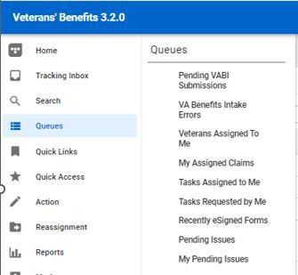
Veterans Assigned to Me
All veterans that are assigned to the user can be viewed in one location in TVB.
To view these veterans click:
Queues
Veterans Assigned to Me

Slide 8
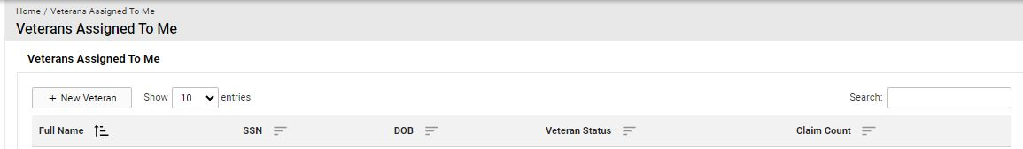
Veterans Assigned To Me Queue
The Veterans Assigned to Me Queue has the following filters which change the displayed results based on the filter selected:
Full Name
SSN
DOB
Veteran Status
Claim Count

Slide 9
Veterans Assigned To Me Queue
In addition to filtering results in this queue, a search box is available to search through the results.

Slide 10
Why Data Entry Maters
TVB can capture all data related to a veteran, their military service and even VFW membership eligibility.
Reports can be run on the information entered and the data generated can be used to identify trends to help with future veteran benefit law changes.

Slide 11
TVB Reports
All data entered into TVB is utilized when running report.
If a veteran folder IS NOT assigned to a Service Officer and Field Office it WILL NOT be captured in reports.
To ensure reports are accurate, ALL VETERAN FOLDERS MUST BE ASSIGNED TO A SERVICE OFFICER AND FIELD OFFICE

Slide 12
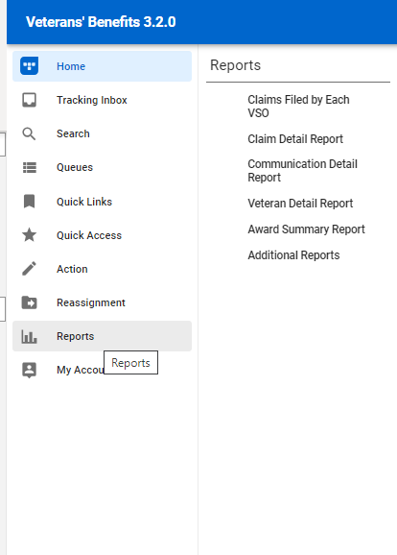
TVB Reports
On the TVB Column is the “Reports” which contains the following TVB-generated Reports:
Claims filed by Each VSO
Claim detail Report
Communication Detail Report
Veteran Detail Report
Award Summary Report
Additional Reports

Slide 13
TVB Reports
Reporting in TVB starts with displaying ALL VFW Data and as filters are selected, the results narrow based on the filters.
All reports require a Start Date and an End Date to be ran.
Reports can be generated in a HTML Web page, PDF, Word (RTF) or Excel document

Slide 14
TVB Report Types
Claims filed by Each VSO: Report displays all claims filed by each VSO and can be filtered by the claim status such as Active, or Board Appeal.
Claim Detail Report: Report displays the types of claims filed by each VSO and can be filtered by Claim type such as Compensation or Burial
Communication Detail Report: Report displays all communications filed by each VSO and can be filtered by the Communication type or Method

Slide 15
TVB Report Types
Veteran Detail Report: This report is only for those who have a cross accreditation and is used to view their veterans based on POA
Award Summary Report: Any award data captured in TVB can be utilized for this report. While this is an option, NVS posts award data on the OLP every month.
Additional Reports: The additional Reports tab houses additional reports such as Conflict summary report or a Demographic Report. Remember, All data in TVB is able to be searched for or reported.

Slide 16
TVB Search function
All data entered in TVB can be searched for later.
On the TVB column is the Search field which contains two types of search options:
Standard Search and Advanced Search
The most frequent search is for a Veteran, but a search for a Communication or Note is also possible.

Slide 17
Standard Search
The Standard Search for a veteran has the following additional filters to assist in displaying only the desired results.
Veteran | Address
Claim | Appeal
Award | Claim Package
Document and Form | Rating
Contact and Dependent | Document
Education | Email
Employment | Financial Assistance
Medical Condition | Military Service
Other Names Served | Previous Marriage

Slide 18
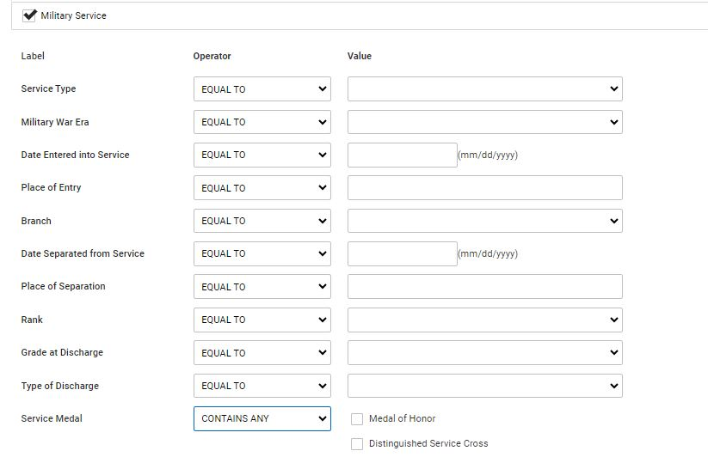
Standard Search
Clicking on any of the extra filters, populates additional fields that further narrow down the displayed results.

Slide 19
Standard Search
Clicking on the dropdown boxes under Operator will display all available options for that field’s selection.
These fields govern the results from the entries made in the Value Boxes and include:
Equal To: Data must match exactly
Not Equal To : Will exclude any results that are an exact match
Like: Data similar to the actual data is produced. Example Brad and Bradly will both populate for the same veteran.
Not Like: Data will not exclude any results that are a partial match
Starts With: Can enter in partial data that starts with
Ends With: Can enter in partial data that ends with

Slide 20
Advanced Search
The advanced search allows users to search for any data entered into any field within TVB.
NVS has created a search to locate VFW-Eligible members using the Advanced Search function

Slide 21
VFW Membership Search
To run the VFW membership report in TVB, users will need to maintain the following practices:
Assign every veteran folder to a Field Office and a TVB User
Fill in the Military Service tab of the veteran’s folder

Slide 22
Military Service Tab and VFW Membership
To capture data needed for the VFW member report, follow these steps:
Select Military Service Tab in TVB
Enter the Branch of Service
Enter the Date Entered and the Date Separated from Service
Enter the Place of Entry
Locate the Service Medal section, scroll down and select Other
In Other Service Medals enter VFW Member Eligible or Surviving Spouse Eligible

Slide 23
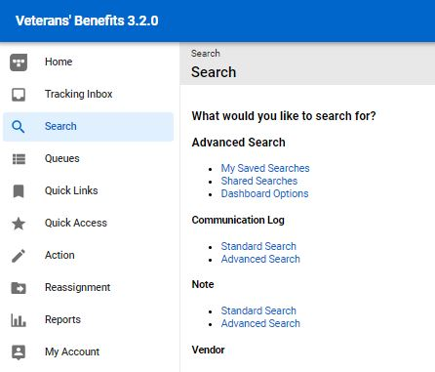
VFW Membership Search Set Up
To run the VFW membership report first select Search from the TVB Column then select Shared Searches

Slide 24
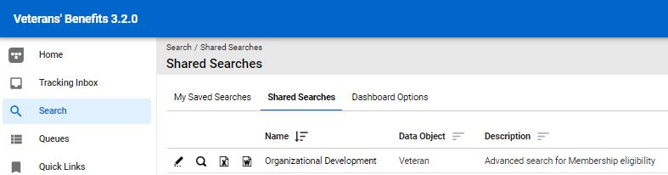
VFW Membership Search Set Up
Select the Pencil icon/edit feature to the left of Organizational Development

Slide 25
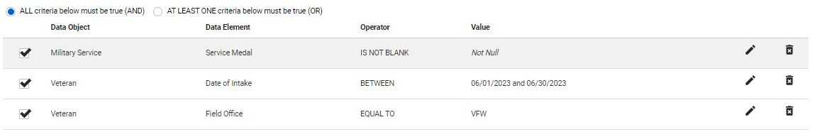
VFW Membership Search Set Up
Select the Pencil Icons to change the Date of Intake and Field Office to filter the search to display results from the inputed time and your Field Office.
Special note** No action is required for the Service Medal element as this is already populated with the correct information.

Slide 26
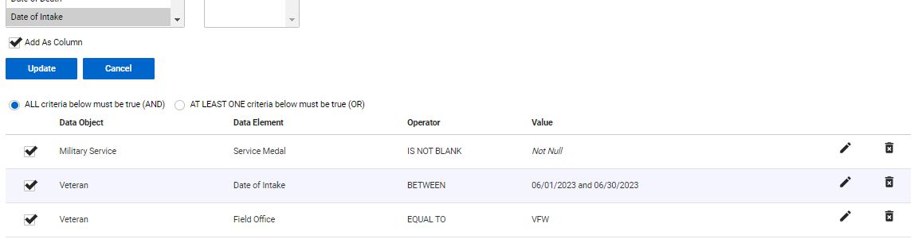
VFW Membership Search Set Up
Once the data has been captured, press Update to save progress for that field.
Please note that users will need to press Update after data is entered in for EACH FIELD

Slide 27
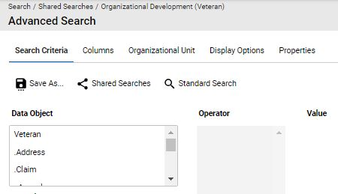
VFW Membership Search Set Up
With both fields updated to reflect the changes made, click Save As
Special Note**
The Date of intake must be updated for each search as failure to do so will only display the previous month’s results

Slide 28
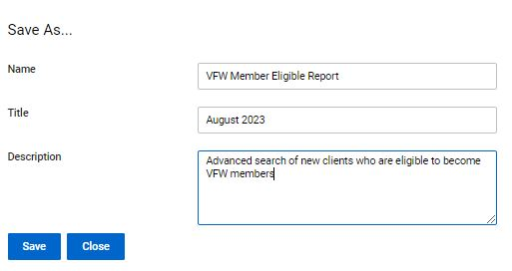
VFW Membership Search Set Up
After hitting Save As, the screen will be updated with 3 fields that can be updated before the search is saved.
Enter in the applicable data and press Save

Slide 29
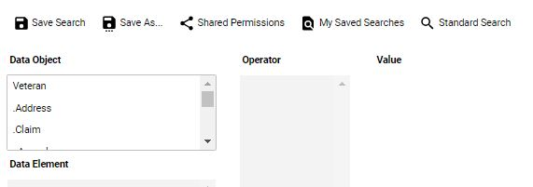
VFW Membership Report
To view the recently saved search press My Saved Searches

Slide 30
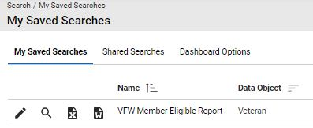
VFW Membership Report
With the newly saved search located, press the Excel button to generate an Excel spreadsheet of VFW Member-Eligible veterans

Slide 31
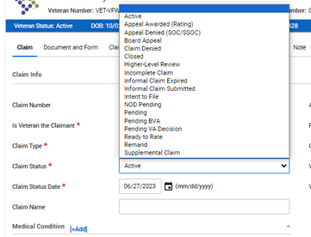
Claim Status Update
When submitting claims through TVB, it is Required to select from the appropriate claim status selection:
Active: 21-526EZ, 686C, 21P-530, 10-10EZ, 21P-527EZ, 21P-534EZ
Higher Level Review: 20-0996
Intent to File: 21-0966
Supplemental Claim: 20-0995
Incomplete claim: 21-22 and any other documents or supporting forms submitted to VA

Slide 32
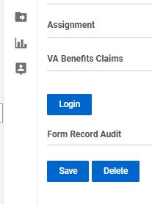
VA Benefits Claims
TVB has an API called VA Benefits Claims which allows TVB to connect to VA.gov.
This allows for some actions in TVB to be done in REAL TIME
The VA Benefits Claims API can be found when inside a veteran's folder toward the bottom of the page.
Click Login to connect to continue with this API

Slide 33
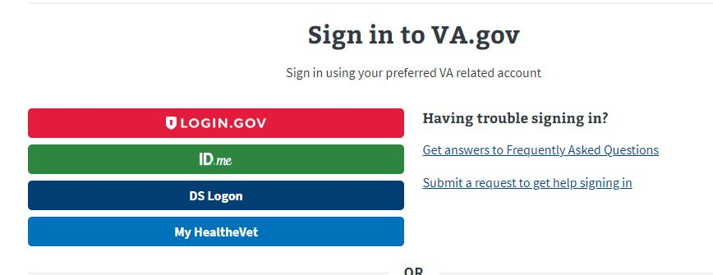
VA Benefits Claims
When utilizing this functionality, TVB requires the user to sign in to VA.gov using one of the following log in methods:

Slide 34
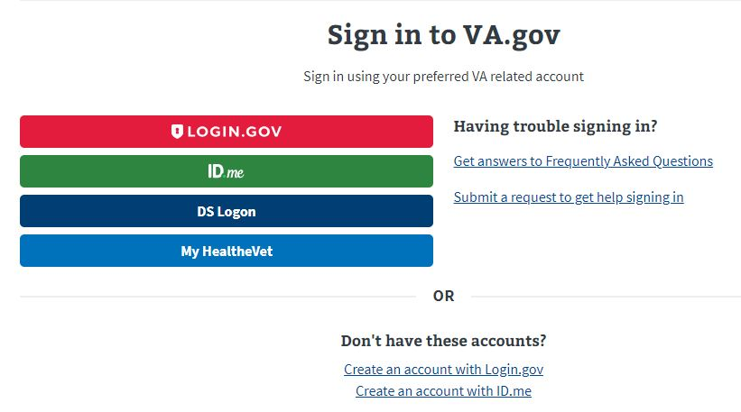
VA Benefits Log
If the user does not have any of these accounts, they can create either an Login.gov or ID.me account directly from the page by clicking the hyperlinks at the bottom.

Slide 35
Account Set up
An in depth guide for creating either a Login.gov or ID.ME account can be found in the OLP next to this presentation.

Slide 36
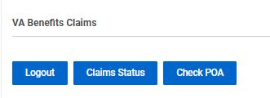
VA Benefits Claims
Once logged into the VA Benefits Claims section, clicking on VA Benefits Claims will populate new buttons.

Slide 37
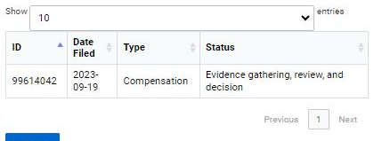
VA Benefits Claims: Claim Status
The Claim Status button will populate all the veteran’s claims (past and present) and show the Date Filed, Claim Type and Status of the claim

Slide 38
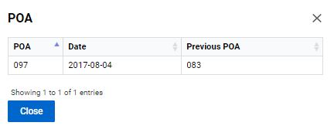
VA Benefits Claims: Check POA
The Check POA button will populate the veteran’s current POA as well as list any Previous POAs.

Slide 39
VA Benefits Claims: Submitting Forms Directly into VBMS
Another function of VA Benefits Claims is the ability to submit 21-22s, ITFs and 526EZs directly into VBMS.
To utilize this function, the following must be true.
Logged into VA.gov through VA Benefits Claims
The veteran’s folder is assigned to Your Field Office and Yourself.

Slide 40
VA Benefits Claims: Submitting Forms Directly into VBMS
To submit a form directly into VBMS a claim must first be created.
From the veteran folder Create a new claim and hit Save.
Create the form using the Document and Form Tab and once complete press Marked As Signed.
** If the claim folder does not have a form that has been Marked As Signed nothing will populate in the Signed Form Document Box**

Slide 41
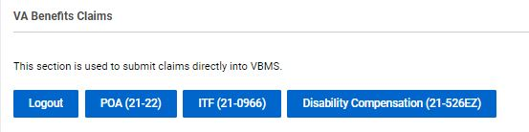
VA Benefits Claims: Submitting Forms Directly into VBMS
With the form Marked As Signed, follow the TVB Breadcrumb Trail back to the claim created.
Scroll back down to VA Benefits Claims and 3 new buttons have populated: POA(21-22) ITF(21-0966) Disability Compensation (21-526EZ)

Slide 42
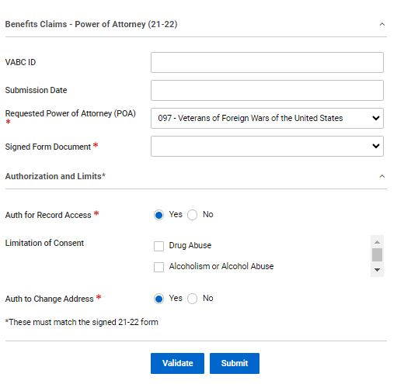
Submitting Forms Directly into VBMS POA(21-22)
The POA(21-22) button takes the user to a page where they can attach a TVB Created, Marked As Signed 21-22 directly to VBMS.
*Please note for those who have multiple accreditations to select the correct POA *

Slide 43
Submitting Forms Directly into VBMS POA(21-22)
The page contains required fields such as POA, Signed Form Document and Authorizations and limits.
Signed Form Document has a dropdown box that will populate with the claim form that was generated and Marked As Signed in TVB

Slide 44
Submitting Forms Directly into VBMS POA(21-22)
With all required fields addressed, click submit to Submit the form to VBMS.
*Please note that the Authorization and limits on the signed 21-22 MUST MATCH the boxes displayed on the page. *

Slide 45
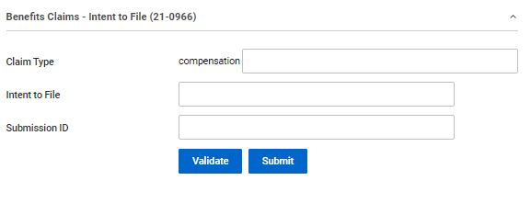
Submitting Forms Directly into VBMS ITF (21-0966)
To submit an ITF a TVB claim must be created.
With the Claim created select ITF (21-0966) which takes the user to the ITF screen.

Slide 46
Submitting Forms Directly into VBMS ITF (21-0966)
Press Validate to confirm POA with VA, TVB will provide a message that says valid if good or an error message that will need to be corrected.
After confirmation press submit
TVB will populate the previously empty boxes with:
Claim Type
Intent to File Date of Submission
Submission ID (confirmation number)

Slide 47
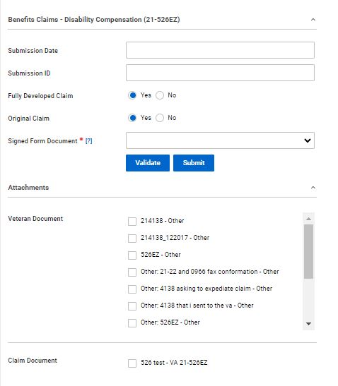
Submitting Forms Directly into VBMS Disability Compensation (21-526EZ)
The 21-526EZ button takes the user to a page where they can attach a TVB Created, Marked As Signed 21-526EZ directly to VBMS.
Signed Form Document has a dropdown box that will populate with the claim form that was generated and Marked As Signed in TVB

Slide 48
Submitting Forms Directly into VBMS Disability Compensation (21-526EZ)
The page only has the Signed Form Document as a required field but will default to Fully Developed Claim and Original Claim.
Veteran Documents can also be submitted with the 21-526EZ directly into VBMS.

Slide 49
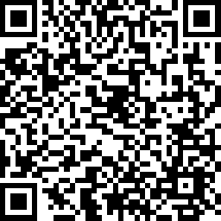
2023 Skill Level Training Conference Survey
Tyler’s Veteran Benefits (TVB)
Please scan the QR Code or click on the link below to take an anonymous survey about your experience during the 2023 Skill Level Training Conference.
https://www.research.net/r/8PC8JLW

