Slide 1
VSO VBMS Notification Process

Slide 2
What is the VSO Notification Queue
The VSO Notification Queue is a work queue in VBMS that documents every “Notification” associated with a veteran claim.
On average there are 60,000+ notifications in VFW’s Notification queue each day.
By the conclusion of this class, you will have learned how to filter this number to only reflect notifications that meet your office’s specific needs.

Slide 3
The 6 Categories of notification
The Notification Process allows you to choose to be notified for one or more categories of VA Notifications. There are 6 categories, and they are:
Appeal
Development
Due Process
General
Notification
Medical Records

Slide 4
The 6 Categories of notification continued…
Each notification category has its own Description/Documents.
For example, the Appeal Category governs the following Descriptions/Documents:
BVA Decision
CAVC Decision
Appeal Notification Letter
BVA General
Appeal Satisfaction Notice
A Complete list of every Category and Description/Documents can be found on the last 3 slides of this presentation.

Slide 5
System Source Codes
System Codes further filter your results by narrowing down the types of notifications by system. Examples include:
VBMSA – VBMS-Awards/Decision Letters
VBMSSYSACCT – VBMS System Account (Such as a document created within VBMS, like an exam request)
EVSS – Enterprise Veterans Self Service (Submissions through VA.gov, Stakeholder Enterprise Portal SEP, etc.)
VBMS-UI – VBMS User Intake (meaning an employee manually uploaded the document)

Slide 6
System Source Codes
VVA – Virtual VA (VA retired the use of Virtual VA on June 1, 20217. VVA was a separate area electronic documents were housed)
VVA – Document Migration – With the retirement of Virtual VA – electronic documents were migrated into the efolder.
SMS – Source Material Sent. It represents that the document was uploaded via a scanning vendor.
CSRA – Is another acronym for folders converted and stored from a scanning vendor

Slide 7
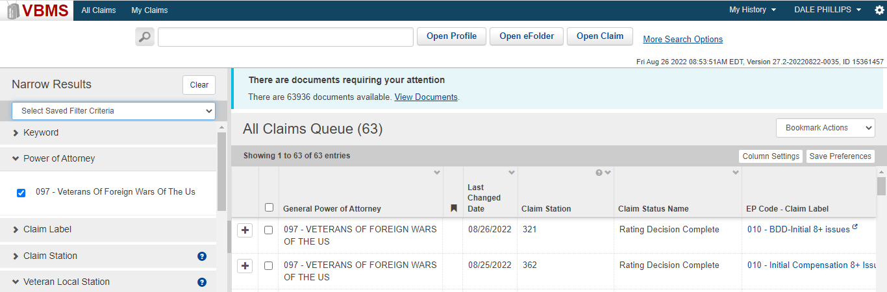
How does it work?
Step 1
Log into VBMS

Slide 8
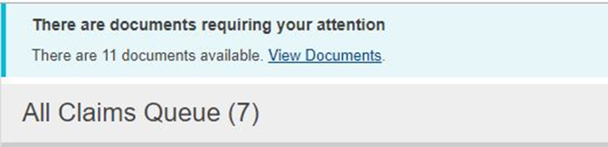
How does it work?
Step 2
Click on “View Documents” hyperlink located in the banner at the top of your VBMS all claims Queue

Slide 9
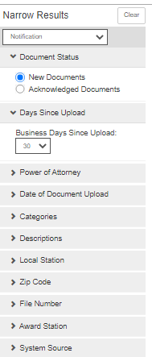
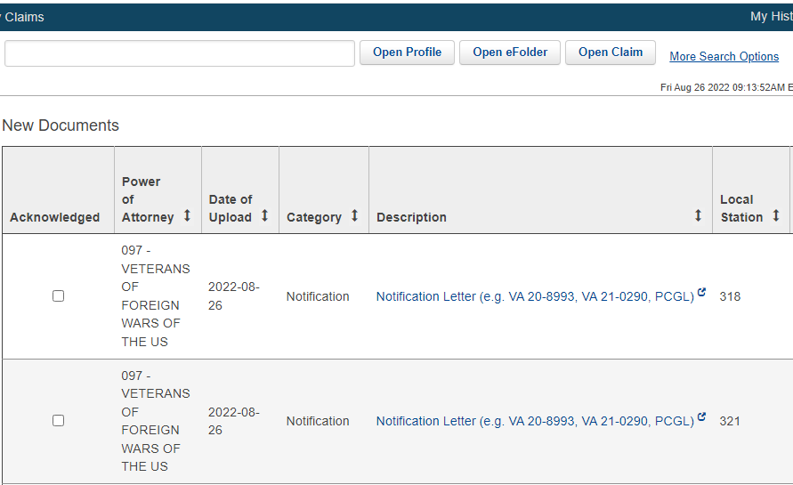
How does it work?
Step 3 Once you click on the banner you will be redirected to a page that contains all notifications for the organization.

Slide 10
How does it work?
Step 4
Now it’s time to set up your filters. These filters will narrow down all notifications so that only filtered results will be displayed.
New or Acknowledged Documents: Filters new or previously acknowledged documents
Days since Upload: Shows only documents uploaded within X amount of busines days
Date of Document Upload: Allows you to select a specific date you wish to view
Categories: Appeal, Development, Due Process, General, Notification, Medical Records

Slide 11
Step 4 continued..
Descriptions: Allows input of a specific document type as opposed to all in that category
Local Station: filters by all in your local station
System Source: Reduces the number of documents that are populated when choosing one of the 8 choices
Power of Attorney: If you have cross accreditation, you can choose which POA to view. Be sure to only view one POA at a time.
Special note* Claim station is the station the claim is being worked, whereas local station is the station associated with home address.
Special note* You can choose to filter by viewing every document/description, category or both when you set up your filters.

Slide 12
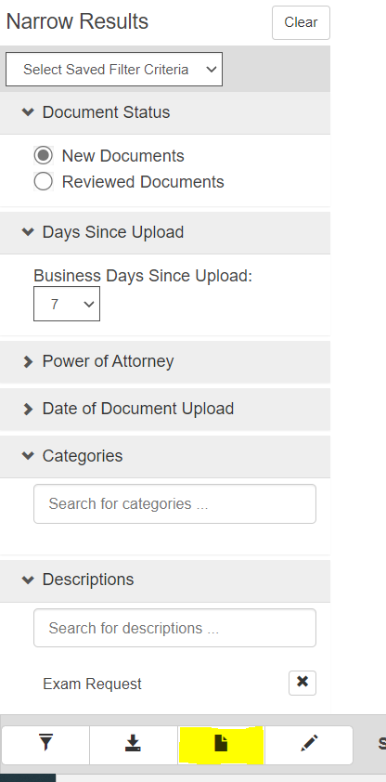
How does it work?
Step 4 continued
Once your filters are in place you will want to click “Save New Filter”.

Slide 13
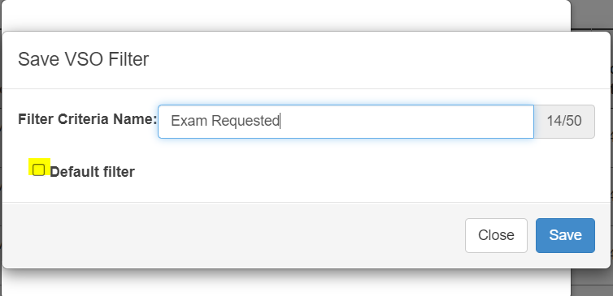
How does it work?
Step 4 continued
From here you can choose to name your filter as well as make it your Default Filter.
The Default filter will automatically populate only notifications that meet the filtered criteria every time you open this page.

Slide 14
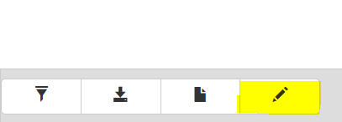
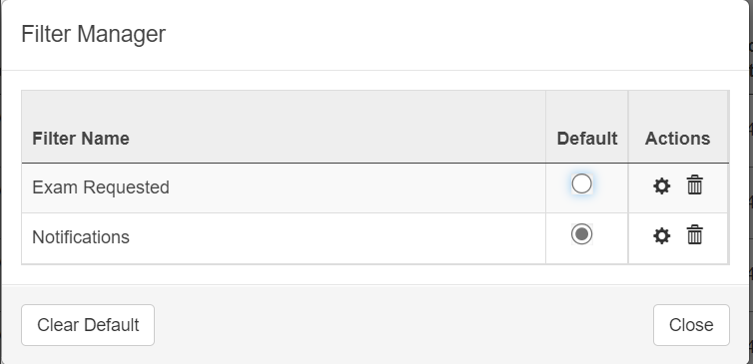
How does it work?
Step 4 continued
You can save multiple filters and manage them with the “Managed Saved filters button”.
When you press the Managed Saved Filters Button you are directed to the Filter Manager. This allows you to delete filters as well as change your Default Filter.

Slide 15
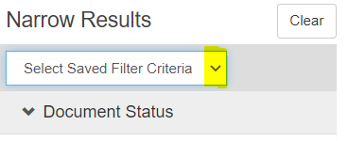
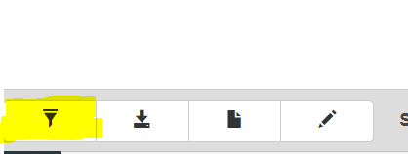
How does it work?
Step 4 continued
If you click on the drop-down arrow you can select what filter you would like to populate.
Once your desired filter is selected press the “Apply Filter” Button to update your queue.

Slide 16
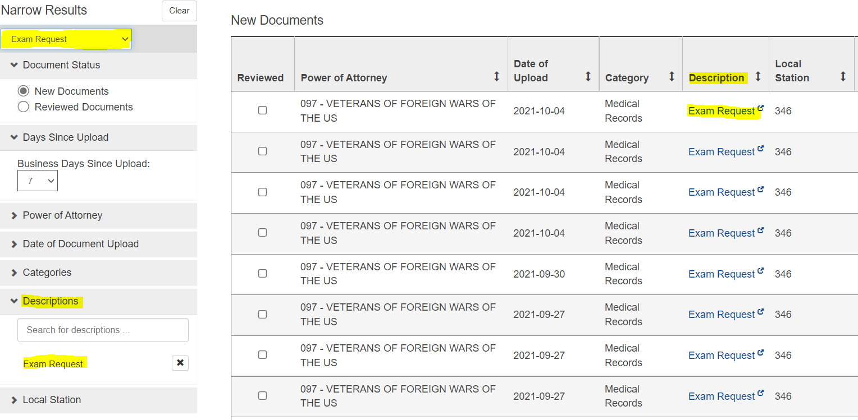
How does it work?
Step 5
Once your filters have been updated, your queue will now reflect only notifications that meet your perimeters.

Slide 17
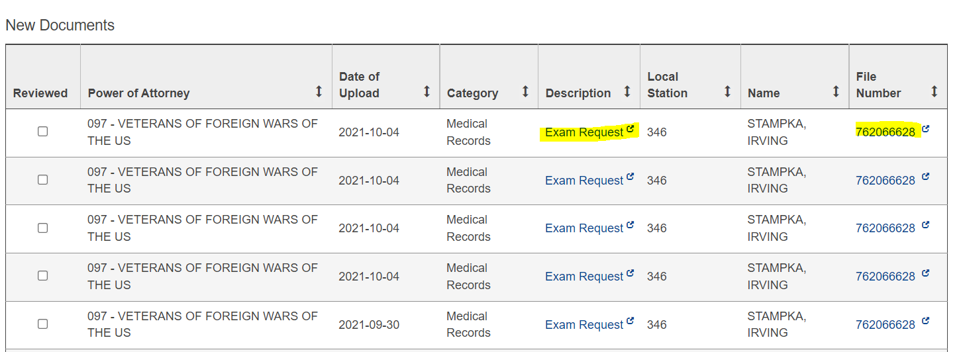
How does it work?
Step 6
With your updated work queue now in place you can review your filtered notifications.
Special Note* Clicking on the description item opens that specific item.
Special Note* Clicking on the file number opens the veterans claim folder

Slide 18
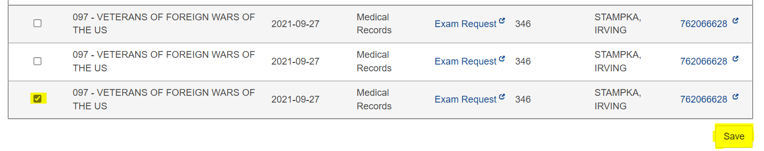
How does it work?
Step 7
Once you have viewed the notification you can clear it. To remove the notification, click on the “Acknowledged” box next to the notification you reviewed and click save.

Slide 19
Helpful Filter Set-ups
The following slides contain beneficial filter settings to help you navigate the VSO queue for common searches

Slide 20
VBMS FILTERS FOR BVA/CAVC DECISIONS
Used to review Rating Decisions
Document Status – Default is new documents
Power of Attorney – VFW
Date of Document – Date or dates you want to search
Categories – Choose Notification and Correspondence
Descriptions – Leave Blank
Local Station – This is your RO
Zip Code – Leave Blank
File number – Leave Blank
Award Station – Leave Blank

Slide 21
VBMS FILTERS FOR BVA/CAVC DECISIONS
Used to review BVA/CAVC Decisions
Document Status – Default is New Documents
Power of Attorney – VFW
Date of Document – Date or dates you want to search
Categories – Leave Blank
Descriptions – Choose BVA Decision and CAVC Decision
Local Station – This is your RO
Zip Code – Leave Blank
File number – Leave Blank
Award Station – Leave Blank
System Source – Leave blank

Slide 22
VBMS FILTERS for CORRESPONDENCES
Used to view Correspondence: Letters may include: claims on a wrong form or a missing signature.
Document Status – Default is New Documents, but I do check the Acknowledged documents to see who has gone thru the queue.
Power of Attorney – VFW
Date of Document upload – Date or dates you want to search
Categories – Leave blank
Descriptions – Choose correspondence
Local Station – This is your RO
Zip Code – Leave Blank
File number – Leave blank
Award Station – Leave blank
System Source – VBMS-UI

Slide 23
QUESTIONS?

Slide 24
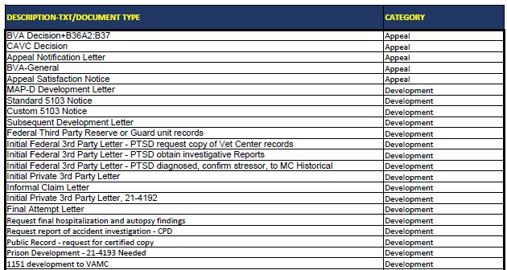
All Description/ Document types and Categories

Slide 25
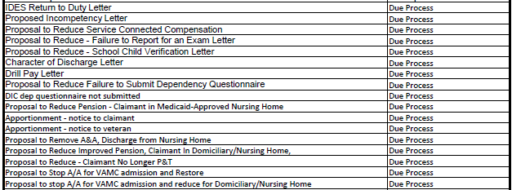
All Description/ Document types and Categories

Slide 26
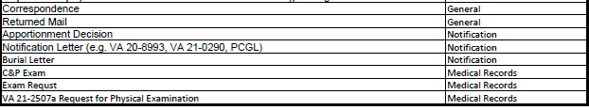
All Description/ Document types and Categories

