Slide 1
WORKLOAD MANAGEMENT
VFW Basic Training

Slide 2
WORKLOAD MANAGEMENT
In this class we are going to discuss ways to help you be successful in your office
The suggestions made in this class are NOT mandatory rather you should use what you feel will help make your workday easier

Slide 3
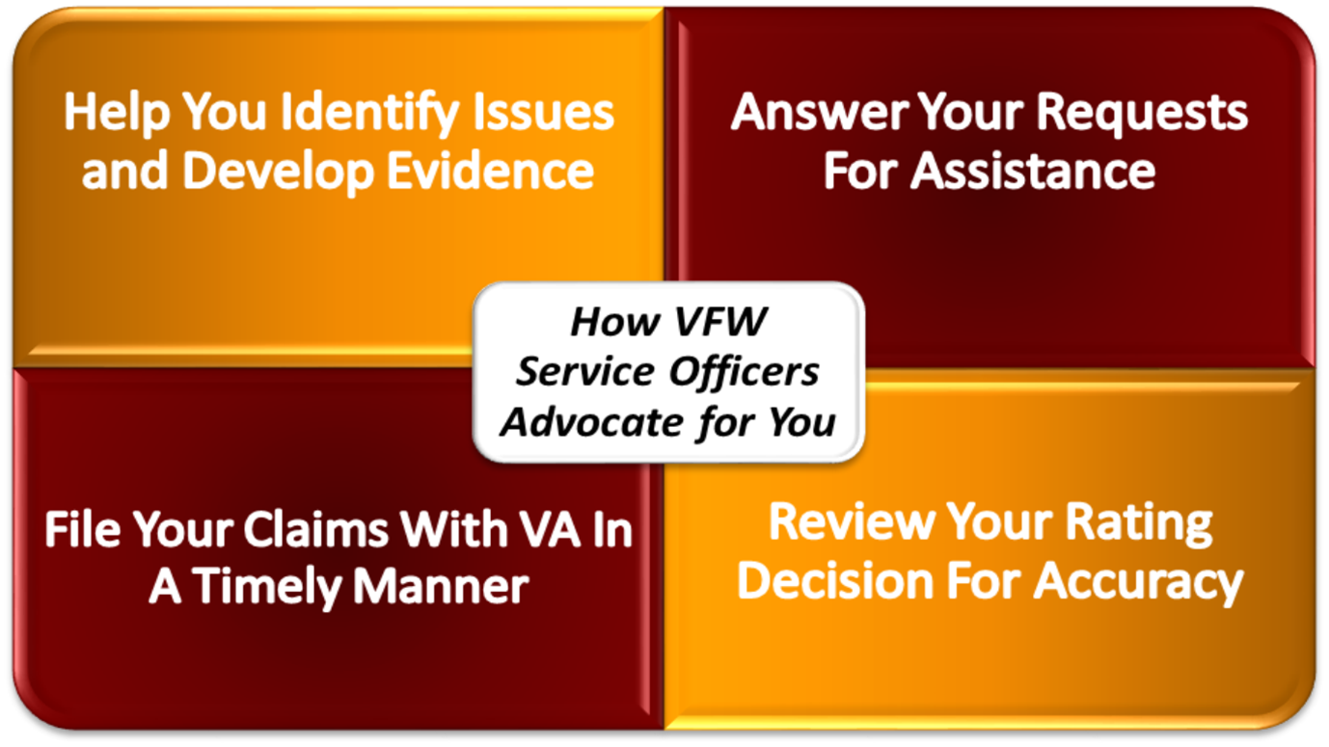
The Four Core Tasks
Notes:
This is just a title slide to identify the tasks, you will go into detail later.

Slide 4
FILE CLAIMS TIMELY
The most important task of a Service Officer is to ensure that all forms are completed correctly and filed in a timely manner.
If a claim is filed late, the veteran or claimant could miss out on benefits
What does timely mean?
Notes:
Talk about what is timely.
Each situation is different so what is "timely" for a claim End of Month (EOM) may mean nothing if it's September 3 and the appeal period ends on September 5.

Slide 5
FILE CLAIMS TIMELY
Here are some suggestions to help make sure you don’t miss an effective date
Structure your day – If you have a routine, you will remember to complete your tasks (more on this later)
Give yourself ample time to complete your tasks and understand that even the best schedule can be shattered by the unexpected
Notes:
Emphasize that we are just suggesting… we cannot mandate their schedules

Slide 6
FILE CLAIMS TIMELY
Don’t hold onto submissions – as soon as it is ready to submit, get it submitted!
Use electronic submission methods – They are more secure, faster, and easier to track than faxing
Ensure that you and your clients know their deadlines!
Notes:
Emphasize that we are just suggesting… we cannot mandate their schedules

Slide 7
MEET WITH VETERANS AND DEVELOP EVIDENCE
When you meet with veterans, ensure that you are providing them with a safe and professional environment to discuss their claim.
Notes:
Talk about MST, widows, PTSD and sensitive topics

Slide 8
MEET WITH VETERANS AND DEVELOP EVIDENCE
Whether you are meeting with the veteran face to face, over the phone, or virtually using Zoom or Teams you must always ensure that the veteran is your priority during your meeting.
Phone calls, emails, and other distractions can wait until after your meeting.
Privacy should be of the utmost concern – ensure that your conversation remains within the room
Notes:
Talk about MST, widows, PTSD and sensitive topics

Slide 9
MEET WITH VETERANS AND DEVELOP EVIDENCE
Review all of the evidence the veteran provided prior to submitting it to VA.
NEVER submit evidence without reviewing it first
If the evidence is detrimental to the claim, explain why and offer suggestions on how to obtain better evidence.
If the veteran is adamant about submitting negative evidence, remember it’s their claim; we are here to advise.
Notes:
Don't answer the phone, don't text or Facebook. Their time is as important as yours.

Slide 10
MEET WITH VETERANS AND DEVELOP EVIDENCE
If additional evidence is needed, give the veteran a written list of what to get and how to submit it to you.
Ensure that the veteran understands when you need the information back from them
If a veteran needs a medical nexus, provide the Medical Nexus Fact Sheet that is available on the VFW Online Learning Portal
Notes:
Bullet 1 – This will help you to avoid wasted time waiting for the programs to load while you are the phone with the veteran.

Slide 11
ANSWER REQUESTS FOR ASSISTANCE
All phone calls and emails should be returned within 1-2 business days.
Outgoing messages on email and voicemail should be current and give the veteran basic information
Template emails can be very helpful, but ensure they are relevant and tailored to the situation
Give the veteran a “Goal Date” to follow up
REMEMBER YOUR ROUTINE!!!
Notes:
The #1 complaint we get at NVS is not returning phone calls
Emphasize the phone calls, return other DSO calls ASAP
Goal date – Give the veteran a specific or range of dates for them to call back. (i.e. VA usually takes at least 4 months for a claim so if you don’t hear anything by (insert timeframe) give me a call and I’ll look into it.)

Slide 12
SETTING EXPECTATIONS
Managing expectations is important for managing your time - veterans who don’t understand the process will spend a lot of time contacting you.
Explain the process and give claimants a realistic timeline.
Don’t overpromise on what you can do, be genuine to the veteran.
It is better to paint a realistic picture than give false hope
Let the veteran know how they can help you. For example: obtaining records or lay statements. Writing it down for them whether on paper or email, will assist in follow up.

Slide 13
SETTING EXPECTATIONS
Explaining the claims process thoroughly NOW will help prevent numerous phone calls or emails LATER!

Slide 14
REVIEWING DECISIONS AND ADVOCATING FOR VETERANS
Reviewing decisions for accuracy is one of the most important functions of a VFW representative
WHY?
Be sure that you determine what the rating should be before approaching the VA or contacting the veteran
When approaching VA about an issue research it completely and know which regulations apply
Notes:
Do NOT simply tell the VA that they made a mistake. Do the research and come up with a potential solution and give the VA your solution. Be professional and choose your battles.

Slide 15
REVIEWING DECISIONS AND ADVOCATING FOR VETERANS
As an accredited representative you are there to look out for the veteran’s best interest
This sometimes includes telling veterans what they don’t want to hear
Whenever advocating for a veteran be professional
Though its easy to get frustrated and angry with VA, you must still approach VA with a collaborative attitude
Notes:
Do NOT simply tell the VA that they made a mistake. Do the research and come up with a potential solution and give the VA your solution. Be professional and choose your battles.

Slide 16
OFFICE ESSENTIALS – ACCOUNTABILITY
You must keep a record of who has visited your office
Verifying when a veteran received assistance
Sign in logs are the tried and true method
Once a sign in sheet is filled, keep an electronic record of it
Why are sign in sheets important?
Notes:
Keep the sign in sheets indefinitely
Sign in sheets can also help if there are unfiled claim allegations

Slide 17
OFFICE ESSENTIALS – ACCOUNTABILITY
Whenever you meet with VA you must keep a record of the interaction
For general VA meetings:
Take good notes during your meetings with VA, then write up a brief summary, keep an electronic copy and distribute it to those who need the information
For meetings about a specific veteran or claim:
Take good notes, write up a brief summary and upload it to either communications or documents in the veteran’s file
Notes:
This includes VSCM meetings, hearings, and informal conferences

Slide 18
OFFICE ESSENTIALS – ACCOUNTABILITY
Return Receipts
If you are in an office that accepts submissions directly, request that the VA date stamp a copy of a submission letter and return it to you, then scan it into TVB
If you fax in claims, scan a copy of the fax transmission receipt into TVB
When using the QuickSubmit, copy the confirmation number into the communications or documents tab in TVB
When using SEP, take a screenshot of the confirmation and upload it to the documents section of TVB
Why are return receipts important?
Notes:
VA can lose things!

Slide 19
TRAINING ESSENTIALS – NVS UPDATES
Several times a year National Veterans Service publishes and distributes via email an update about subjects that are important to you
NVS Updates can also be accessed on the Online Learning Portal in the Resources area
Many VA law changes and VFW policy changes are explained in these updates, so it is imperative that you read them
Once an update is published NVS hosts a virtual forum to discuss the topics and answer any questions
If you are not receiving the NVS Update please contact Chris Macinkowicz at cmacinkowicz@vfw.org
Notes:
Stress that these are IMPORTANT!!!!!

Slide 20
TRAINING ESSENTIALS – VARO TRAINING
Most VAROs will provide training on various topics to VSOs if asked.
Coordinate with other VSOs and the VSCM or Change Management Agent (CMA), to provide training.
Notes:
EXPLAIN VSCM Acronym- Veteran Service Center Manager- Right under RO Director

Slide 21
TRAINING ESSENTIALS – Online Learning Portal
You should set aside time at least once a month for training
Training should include new concepts as well as reinforcement of previously covered topics
The VFW OLP is a resource that can be used for this purpose

Slide 22
WORKPLACE ESSENTIALS – WELLNESS
Make sure that you take your breaks
Burnout can and does happen
Recognize your coworkers hard work and offer help if they need it

Slide 23
WORKPLACE ESSENTIALS – WELLNESS
It’s ok to take a few minute breather between appointments or calls
Notes:
You can’t help others if you aren’t in a calm space.

Slide 24
WORKPLACE ESSENTIALS VARO RELATIONSHIP
We are all on the same team, it is not VFW vs VA
Before approaching the VA with an issue, research it and have a plan with a potential solution
Recognize and show appreciation for the VA’s work
What are some ways to show appreciation at the VARO?
Notes:
Possible answers: Certs of Appreciation, holiday treats, thank you email/letter

Slide 25
MANAGING YOUR OFFICE
Don’t micromanage! You have enough work to do without taking on other’s responsibilities
Distribute the workload based on experience and expertise – remember claims consultants are fully trained representatives
Communication is key. Inform your coworkers of your status and schedule in order to help the office run smoother
Remember, the VFW is a team, you MUST work together

Slide 26
CONTROLLING THE CHAOS
Establish office management routines and stick to them.
Routine tasks need routine procedures; if you want to stay organized and keep things running smoothly.
Set up routines for handling paperwork and reviewing decisions – this will help you to remember to complete your tasks
For instance, every piece of paper that comes into your office should be handled, acted upon, and filed – not haphazardly piled on a desk.
What are some routines in your office that help you keep organized?
Notes:
Ask what some of the routine tasks in their offices are….
Ratings need to be reviewed daily

Slide 27
CONTROLLING THE CHAOS
Set up clearly defined responsibilities
Good office management depends on people knowing who is responsible for what –accountable PEOPLE get things done.
When you delegate responsibilities, make sure the task is appropriate to the person, understood, and supervised.
Notes:
Don’t have the admin reviewing decisions…

Slide 28
CONTROLLING THE CHAOS
Take a walk through your office and have a seat.
When you walk through the office, do you have to detour around obstacles or run the risk of tripping over something?
When you sit down at a desk, can you work comfortably there? Are things logically arranged so that the things that you would use most at the desk are closest at hand?
Sit on the other side of your desk too and look around… What do you see?
Things like dead plants, broken office equipment, trash, and clutter have no place in the office.
Notes:
Sit where the veteran would sit and take a look around… what do you see? Should it be improved?

Slide 29
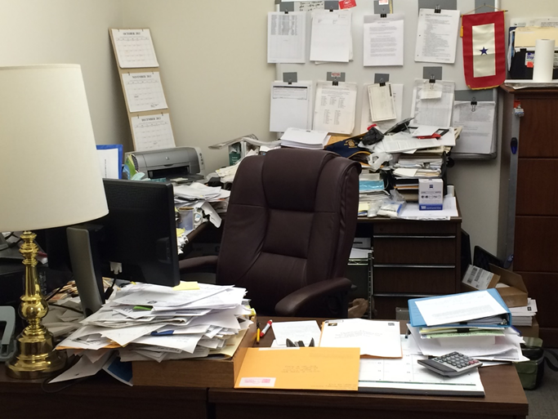
CONTROLLING THE CHAOS
All personally identifiable information must be secured and out of sight from the veteran.
Notes:
This is an office that was visited by QA
Out based VSO’s such as hospital or field officers need to set up a routine to make sure that all PII is locked up. If you share an office with a different organization, you need to make sure that other VSOs do not have access to your PII. This includes breaks and overnights.

Slide 30
EMERGENCY PLANNING
Veterans may get frustrated with you and the VA
Though this is rare, if a veteran gets violent, you need to be able to escape and call the police / security
Ensure that you have a clear route to the exit in case you need to leave quickly
Know what to do in a medical emergency
Talk to your facilities manager about panic buttons and other emergency protocols
Notes:
While this doesn't happen often it is best to think about these situations ahead of time and be prepared.

Slide 31
A FEW HELPFUL HINTS…
Keep things simple
Make sure that you don’t overcomplicate things. If something seems simple, it probably is.
Learn from your mistakes
Everybody makes mistakes.
Don’t hide from your mistakes; learn from them
Admit when you need help
Everybody needs a little help now and then
If you feel like you are overloaded or falling behind, don’t be afraid to ask for help.

Slide 32
Questions?

