Slide 1
VA Fiduciary Program

Slide 2
Reference Material
VA fiduciary web address with links to short videos:
http://www.benefits.va.gov/fiduciary/index.asp#
Fiduciary Program Manual:
https://www.knowva.ebenefits.va.gov/system/templates/selfservice/va_ssnew/help/customer/locale/en-US/portal/554400000001018/topic/554400000004378/Fiduciary-Program-Manual

Slide 3
Reference Material
Fiduciary Guide
38 CFR Part 13: Fiduciary Activities
M21-1, Pt. III, Subpart v, Chapter 9, Section B

Slide 4
Why did VA establish the Fiduciary Program?
VA's Fiduciary Program was established to protect the benefits paid to veterans and other beneficiaries who, due to injury, disease, or due to age, are unable to manage their financial affairs through the appointment and oversight of a fiduciary.

Slide 5
Authority to establish the Fiduciary Program
38 USC 501: Rules and regulations
38 USC 512: Delegation of authority; assignment of functions and duties
38 USC 5502 - Payments to and supervision of fiduciaries
Title 38 CFR, 13.1 to 13.111

Slide 6
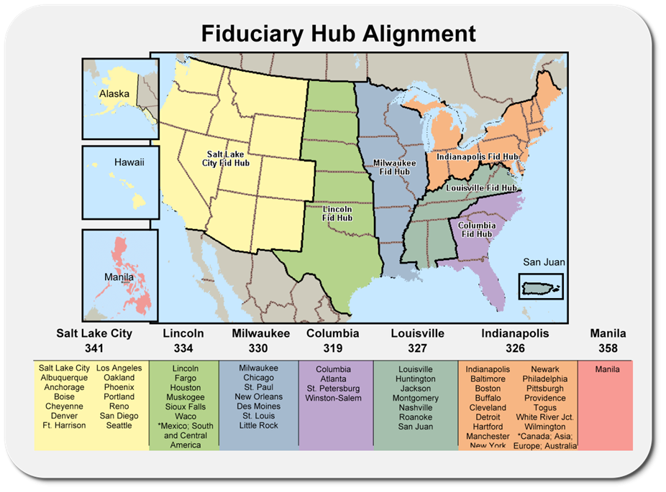

Slide 7
Composition of the Fiduciary Hub by teams
Action Mail
  Legal Instrument Examiners (LIEs) address inquiries.
Promulgation Team
  Finalize incompetency ratings forwarded from the VARO/PMC completed by Fiduciary Service Representative (FSR).
  Set up Initial Appointment (IA).
  Process retroactive/withheld benefits.
Field Examiner (FE) Teams
  Conduct field examinations, select the best-suited fiduciary, and investigate alleged or suspected misuse of funds.

Slide 8
Composition of the Fiduciary Hub by teams
Exam Team
  LIEs process completed field exams.
  Set diaries for future appointments.
Misuse Team
  LIEs conduct analysis and initiate development on potential misuse cases.
  Prepare misuse determinations and notifications for management concurrence.
  Aggressively follow-up on accountings >- 120 days past due.
Quality Review and Training Team
  Quality Review Specialists (QRS) complete review of work, identify errors and provide training to employees.
Accounting/Cursory Review Team
  LIEs review all incoming accounting for completeness.
  Audit federal and court accountings.
Phone Team
  LIEs answer incoming calls for Hub region.

Slide 9
VA definition of Incompetency
38 CFR 3.353 Determinations of incompetency and competency
Definition of mental incompetency
A mentally incompetent person is one who because of injury or disease lacks the mental capacity to contract or to manage his or her own affairs, including disbursement of funds without limitation

Slide 10
Rating of Incompetency
VA will only determine an individual to be unable to manage his or her financial affairs after receipt of medical documentation or if a court of competent jurisdiction has already made the determination.

Slide 11
How are incompetency ratings processed?
All initial competency decisions are made by the Veterans Service Center (VSC), or Pension Management Center (PMC) by a Rating Veteran Service Representative (RVSR).
All evidence is reviewed, and a VA exam is scheduled, if necessary.
A Rating Decision is prepared by the VSC/PMC proposing a finding of incompetency, and the veteran/beneficiary is provided a due process period of 60 days.
Notes:
Can this be appealed? No, this is a proposal.

Slide 12
Where is the final rating of incompetency prepared?
Once the Proposed Rating Decision is finalized and due process issued, the jurisdiction of the incompetency proposal final determination is forwarded to the appropriate Fiduciary Hub
Upon expiration (or waiver) of the due process period, a final incompetency Rating Decision is completed by the Fiduciary Hub Promulgation Team.
The veteran/beneficiary is notified of the final decision and the Fiduciary Hub Promulgation Team initiates an Initial Appointment (IA) field exam with the intention of appointing a fiduciary, custodian, or guardian.
VA is authorized to select and appoint the person or legal entity best suited to receive benefits in a fiduciary capacity.

Slide 13
Consequences of being rated incompetent by VA
The following are NOT affected by a VA rating of incompetent:
Non-VA Finances
Right to vote
Contract
Notes:
Contract- Ability to enter contracts, buying a car etc.

Slide 14
Consequences of being rated incompetent by VA
The following ARE affected by a VA rating of incompetent:
Spending of VA benefits
Under the provisions of The Brady Handgun Violence Prevention Act,
  Purchasing,
  Possessing,
  Receiving or
  Transporting a firearm or ammunition if you have “been adjudicated as a mental defective or been committed to a mental institution.”
Notes:
Can request a waiver for Brady, need legal/medical documentation stating that gun ownership is not an issue

Slide 15
Consequences of being rated incompetent by VA
In compliance with this act, the VA reports the names of incompetent beneficiaries to the Federal Bureau of Investigations (FBI).
Names are added to a database called the National Instant Criminal Background Check System (NICS).
Gun dealers must check NICS for the name of a potential buyer before selling him/her a firearm.
A fine and/or imprisoned if a beneficiary knowingly violates this law.

Slide 16
Rights if rated incompetent
The beneficiary has the right to:
Appeal VA's decision of incompetency within 1 year of final notice.
Appeal VA's selection of the fiduciary.
Appeal to the Board of Veterans' Appeals (Board) by telling the VA of the disagreement with the decision and request the Board to review it, or
Provide the VA with evidence not already of record that may lead to a change in VA’s decision.

Slide 17
Rights if rated incompetent
Apply to VA for relief of firearms prohibitions imposed by the law by submitting a request to VA. VA will determine whether such relief is warranted under M21-1, Pt. III, Subpart v, Chapter 9
Request to have the inability to manage VA benefits be re-evaluated.
If a re-evaluation is requested, submit the request in writing with any supporting medical evidence to the Regional Office of jurisdiction (ROJ) or controlling Pension Management Center.
Have a new fiduciary appointed, at any time.

Slide 18
The VA Field Examination
An initial VA Field Examination will be scheduled for the purpose of appointing a fiduciary to assist in managing VA benefits. During the field examination, the following information needs to be available for review by the field examiner:
  Photo identification.
  The source and amount of all monthly bills, recurring expenses (annual, bi-annual, quarterly, etc.), and income.
  A list of all assets, to include bank accounts, owned property, stocks, bonds, life insurance, burial plans, etc.
  Name, phone number, and address of next of kin.

Slide 19
Types of Field Examinations
Some common types of exams :
Initial Appointment (IA) examination
Follow-Up (FB) examination (6 months for supervised direct pay, or every 1, 2 or 3 years, depending on circumstances)
May qualify for alternate contact follow-up (via phone or mail)
Misuse investigation

Slide 20
Follow-up Field Exams
During the follow-up field examination, VA interviews the beneficiary, contacts the fiduciary, and either recommends continuing the appointment or replacing the fiduciary
Scheduling Follow-up Exams:
      6 month follow-up exam for supervised direct pay
      First follow-up one year after the initial field examination
      Subsequent follow-ups based on the circumstances unique to each individual beneficiary’s situation

Slide 21
Follow-up Field Exams
VA may conduct an unscheduled field exam when:
A problem is identified
A public report of concern is received, OR
The fiduciary fails to respond or inappropriately responds to a VA telephone or correspondence inquiry
VA performs field examinations through face-to-face contact, telephone call or letter

Slide 22
How is a fiduciary appointed?
Upon determining a beneficiary is unable to manage his or her financial affairs, VA will appoint a fiduciary.
The fiduciary, normally chosen by the beneficiary, must undergo an investigation of their suitability to serve.
The fiduciary is responsible to the beneficiary and oversees financial management of VA benefit payments.
Generally, family members or friends serve as fiduciaries for beneficiaries; however, when friends and family are not able to serve, VA looks for qualified individuals or organizations to serve as a fiduciary.

Slide 23
Selection of a Fiduciary
During the selection process, the VA will first seek to qualify the individual the beneficiary desires to serve as the fiduciary.
The fiduciary selection is based on an assessment of the qualifications of the proposed fiduciary. When seeking a fiduciary the following individuals may be considered:

Slide 24
Selection of a Fiduciary
A spouse or family member
Court-appointed fiduciaries
Another interested party, or
A professional fiduciary

Slide 25
Selection of a Fiduciary
An assessment of the qualifications of a proposed fiduciary includes, but is not limited to:
The willingness to serve and abide by all agreements
An interview with a VA representative
Credit report review
An inquiry into the criminal background, and
Interviews with character witnesses

Slide 26
Want to be a Fiduciary?
If an individual would like to become a fiduciary for a family member or friend, he or she should submit a request with the beneficiary‘s name and VA file number, and their name and contact information to the VA regional office.
VFW accredited representatives are NOT able to serve as a fiduciary per VFW policy and procedures.
Notes:
Code of Conduct for VFW Representatives, possible but need approval from Director, NVS- RARE
4138
4. “As a VFW accredited representative, under no circumstances, should you serve as guardian, committee or fiduciary by any other designation, of veterans or other persons receiving benefits from the Department of Veterans Affairs”

Slide 27
Fiduciary Responsibilities
Any individual appointed as a VA fiduciary is responsible for managing the beneficiary‘s VA Income and ensuring the beneficiary‘s just debts are paid
Do you think there are any other responsibilities?

Slide 28
Fiduciary Responsibilities
Utilizing the funds for daily needs (e.g., food, clothing, housing, medical expenses, and personal items) of the beneficiary and his/her recognized dependents
Never borrowing, loaning, or gifting funds belonging to the beneficiary
Reporting any of the following changes to the VA immediately:
  Change in address or phone number of the beneficiary or fiduciary
  Change in income or dependents
  Incarceration of the beneficiary
  Hospitalization of the beneficiary in a VA or state facility, and
  Death of the beneficiary or the beneficiary’s dependents
Notes:
Strict - TV example VA says no TV for you

Slide 29
Fiduciary Responsibilities
Establishing a properly titled bank account as follows:
  (Beneficiary’s Name), by (Fiduciary’s Name, Federal Fiduciary)
Never commingling the beneficiary‘s funds with those of another
Never withdrawing cash from the beneficiary’s account by counter, check payable to cash, or ATM withdrawal
Timely submitting periodic accountings when required

Slide 30
Fiduciary Responsibilities
Keeping accurate, complete records and receipts, regardless of any requirement to submit periodic accountings
Conserving excess funds in a federally or state insured interest bearing account or United States savings bonds
Registering saving bonds to reflect proper ownership and the existence of the fiduciary relationship, as follows: (Beneficiary‘s Name), (Social Security No.), under custodianship by designation of the Department of Veterans Affairs

Slide 31
Fiduciary Responsibilities
Reporting any event that affects the beneficiary‘s payment or entitlement to benefits and promptly returning any payment that the beneficiary is not due
Notifying VA of any changes or circumstances that would affect your performance as a payee or your decision to continue to serve as a payee (e.g., you sell or transfer your business)
Returning any funds owned by the beneficiary to VA if you stop serving as the fiduciary

Slide 32
Fiduciary Responsibilities
Notifying the VA if the beneficiary‘s condition improves to a point where you believe he or she no longer needs a fiduciary
Protecting the beneficiary‘s funds from the claims of creditors since the beneficiary‘s funds are protected by law

Slide 33
Accountings
VA requires annual accountings when:
  The fiduciary is also the beneficiary’s court-appointed fiduciary
  VA has authorized a fee (4%) to be paid to the fiduciary
  The funds under management by the fiduciary exceed $10,000
  Subject to audit to ensure proper use of funds

Slide 34
Fiduciary Onsite Review
VA may conduct onsite reviews of fiduciaries as necessary to ensure the well-being of beneficiaries or prevent exploitation of beneficiary funds.
Onsite reviews are intended to ensure fiduciaries are performing their duties satisfactorily and to protect beneficiaries from misuse of their benefits by the fiduciaries.
Under 38 U.S.C. 5508, VA must conduct periodic onsite reviews of any fiduciary who is located in the United States and serving more than 20 beneficiaries and who has total VA funds under management for beneficiaries in excess of $50,000, as adjusted by VA under 38 U.S.C. 5312

Slide 35
Misuse Investigations
A misuse investigation is conducted to address allegations of misuse made against a fiduciary.
Allegations may be generated by complaints from the beneficiary or other interested third party
Allegations may also be generated by VA if questionable actions or practices are discovered during routine operations
LIE requests on VA Form 21-3537a
FE completes investigation on 21-3537b

Slide 36
Supervised Direct Pay
If a Field Examiner determines that the beneficiary can manage their own benefits with limited and temporary supervision, they may recommend Supervised Direct Pay instead of a fiduciary.
When on SDP, the Fiduciary Hub will help the beneficiary develop a budget and conduct periodic reviews.
At or before the 12-month mark, another field examination will be scheduled to determine if the veteran can manage their benefits without supervision

Slide 37
Supervised Direct Pay
If the field examination shows that the beneficiary can manage their own benefits without supervision, a decision letter will be sent out and the fiduciary hub will no longer manage any payments
If the beneficiary still needs assistance, the Fiduciary hub will either assign a fiduciary or extend SDP for one more year
There can only be one extension of SDP

Slide 38
Contacting the Fiduciary Hubs
If you need to contact one of the Fiduciary Hubs, call (888) 407-0144 and select the appropriate Fiduciary hub or use mailing address which can be found on VA’s website.

Slide 39
Questions?
Notes:
How do you check status? Call Fid Hub no access to these systems
What if vet disagrees with incompetency determination? Within 60 days submit evidence to the contrary, after 60 days, submit appeal with evidence (medical opinions, bank statements, buddy statements, court documents

