Slide 1
Navigating Politics as an Accredited Representative
Rob Couture
Dir., Comms & Public Affairs
VFW Washington Office
Brittany Dymond Murray
Associate Dir., Comms & Public Affairs
VFW Washington Office
September 2024

Slide 2
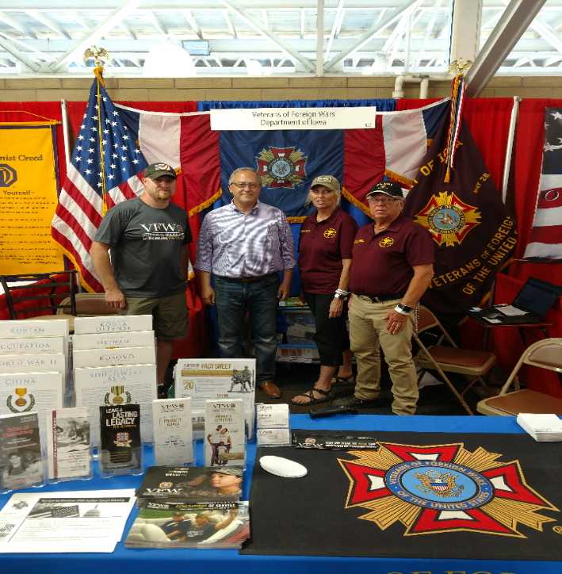
The VFW and Politics
The VFW is a congressionally-chartered, Veteran Service Organization that engages in non-partisan legislative advocacy.
All politics is local!
  Members of Congress want to hear from their veteran constituents
  Share your experience, but
  know the VFW’s stance
Campaign Season
  Get Out the Vote
  Do your civic duty
  Know your right and left limits
Notes:
Know the members of Congress and US Senators from your state. Use your status and access to garner support for the VFW’s legislative priorities.
Election:
DO’s
Do attend candidate Town Hall Meetings and other events and push our issues.
Do set up voter registration drives /Get Out the Vote Campaigns on the local level.
Do provide carpool service on Election Day to help the elderly and disabled get to the voting booth.
Do support and work for your favorite candidates as a voting constituent. As an individual and VFW member you can work or campaign on behalf of your favorite candidate - and are encouraged to do so. • Do wear your VFW cap.
DON’Ts
Don’t endorse candidates on behalf of the VFW as a Post, District, Department or National Leader.

Slide 3
Political Activities
DO’s
Attend candidate town hall meetings and other events to ask candidates where they stand on our issues
Set up voter registration drives / Get Out the Vote campaigns on the local level
Provide carpool service on Election Day to help the elderly and disabled get to the voting booths
Volunteer to be a poll worker
Support and work for your favorite candidates as an individual voting constituent
Wear your VFW cap at public events such as town halls, rallies, forums, or debates

Slide 4
Political Activities
DON’Ts
Don’t endorse (explicitly or implicitly) candidates on behalf of the VFW National Organization, Department, District or Post
Don’t wear your VFW cap when actively campaigning for a candidate, such as soliciting donations or knocking on doors asking people to pledge their vote for a candidate, or speaking in favor of a candidate at political rallies

Slide 5
QUESTIONS?
For legislative questions, visit vfw.org/advocacy or contact
VFW National Legislative Service
  Email: pmurray@vfw.org
  Call: (202) 608-8365

