Slide 1
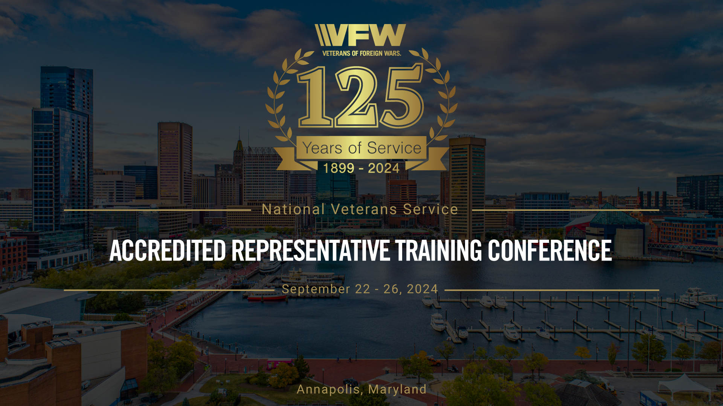
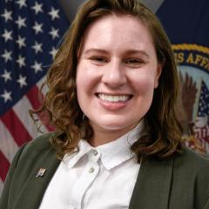
VA Center for Minority Veterans
Dr. Stephanie Guedj

Slide 2
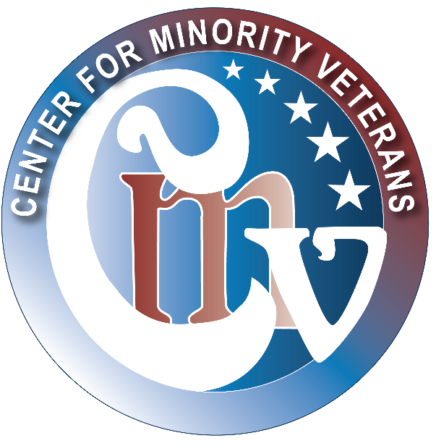
Center for Minority Veterans
Notes:
I’d like to start by thanking the organizers of this training for inviting me to speak today. My name is Dr. Stephanie Guedj, and I am currently serving as the LGBTQ+ Liaison detailee for the Center for Minority Veterans at the VA. In this role, my primary focus is advocating for and supporting LGBTQ+ Veterans, ensuring that their unique needs are addressed within the VA system. I’ve been with the VA since 2014, initially as a psychology trainee and now in various roles including as a psychologist in the PTSD Clinic and the LGBTQ+ Veteran Care Coordinator at the Washington DC VAMC. My focus has always been on supporting diverse Veteran populations, particularly LGBTQ+ Veterans, and ensuring their voices are heard in the broader VA system.
The purpose of my presentation today is to share with you more about the Center for Minority Veterans, who we are, and what we do. The CMV was established to ensure that minority Veterans, including those who identify as racial and ethnic minorities, LGBTQ+, women, and others, are provided with equitable access to VA benefits and services. Our work centers on advocacy, policy development, and creating a bridge between the VA and the communities we serve. We aim to ensure that the diverse voices of minority Veterans are heard, their experiences recognized, and their needs met.
I will be walking you through the organizational structure of the CMV, highlighting our key initiatives, and explaining how we collaborate with various stakeholders, including Veteran Service Organizations such as VFW, to support minority Veterans. By the end of this presentation, I hope you’ll have a better understanding of how the CMV operates and how we can work together to create a more inclusive and supportive environment for all Veterans.

Slide 3
Who Are We?
The Center for Minority Veterans (CMV) was established by Public Law (PL) 103-446 on November 2, 1994, in response to low utilization of VA benefits and services* by minority Veterans.
PL 103-446 defines “minority group member” as a Veteran who is:
Asian American;
Black;
Hispanic;
Native American (including American Indian, Alaskan Native, and Native Hawaiian); or
Pacific-Islander American.
CMV also supports Administration and SecVA Goals:
Executive Order On Advancing Racial Equity and Support for Underserved Communities Through the Federal Government (EO 13985)
VA Strategic Objective 2.1 - Reaching all Veterans
*Benefits do not accrue to Veterans based on their race or ethnicity except the Native American Direct Loan (NADL) Program.
Notes:
To start, CMV’s primary goal is to provide intentional engagement, outreach, support, and assistance to minority Veterans. This means addressing their unique challenges and ensuring they have equitable access to VA benefits, healthcare, services, and programs that they deserve.
Now, let’s take a moment to understand the origin story of the CMV and their vital role in serving Veterans. The CMV was established on November 2, 1994, through Public Law 103-446. This legislation was a response to the low utilization of VA benefits and services by minority Veterans. Under this law, a "minority group member" includes Veterans who are Asian American, Black, Hispanic, Native American, or Pacific Islander.
The creation of CMV was pivotal in addressing disparities and ensuring that these veterans, who faced historical inequities, receive the benefits and services they’ve earned.
In addition to its foundational mandate, the CMV supports broader administrative goals like Executive Order 13985, focused on Advancing Racial Equity and Support for Underserved Communities. This aims to tackle systemic inequities and improve access to resources for underserved communities. It also supports the VA Strategic Objective 2.1, titled "Reaching All Veterans," which focuses on ensuring that every Veteran, no matter their background, has full access to the VA’s services and resources.
It’s important to emphasize that VA benefits generally do not accrue based on race or ethnicity. However, there is one specific exception—the Native American Direct Loan (NADL) Program, which directly supports Native American Veterans with their homeownership goals.
Understanding this foundation helps us appreciate CMV’s ongoing role in advocating for and supporting minority Veterans. The work they do ensures that minority Veterans receive the equitable service and representation they deserve.
Now, let’s look at some of the key activities CMV undertakes:
We make strategic recommendations to the Secretary of Veterans Affairs and other department officials about programs for minority Veterans.
We promote the use of benefits by minority Veterans and actively participate in outreach efforts to engage with them.
CMV serves as a resource center, providing information on successful programs that improve services for minority Veterans. Additionally, CMV conducts social and demographic research on the needs of minority Veterans to ensure programs meet their needs.
We evaluate complaints made by or on behalf of minority Veterans to ensure the services provided by the VA are adequate and timely.
CMV works closely with Federal, State, local, and private programs to promote policies that benefit minority Veterans.
Another important area is their support of medical research focused on health issues affecting minority Veterans, advising on areas that require more attention. Lastly, CMV provides administrative support to the Advisory Committee on Minority Veterans and other relevant entities.

Slide 4
CMV Legislative Highlights
Legislative Proposal
Alignment with Administration and VA policies and Strategic Objective 2.1, Reaching All Veterans, which includes underserved, marginalized, and at-risk Veterans
Representative Sheila Cherfilus-McCormick (D-Fl) and 14 co-sponsors introduced the HR 4325 - Historically Underserved Veterans Inclusion Act of 2023
Expands to include “historically underserved” groups to include, but not limited to:
  LGBTQ+
  Language barriers
  Without citizenship status
  Religious minorities
  Allows for SEVA to consider additional groups
Notes:
Since that time, new legislation has come about to expand PL 103-446. Specifically, HR 4325 - The Historically Underserved Veterans Inclusion Act of 2023.
Now, PL 103-446 was an important step toward improving benefits for all veterans, focusing on healthcare and disability services. However, it didn’t specifically address the unique needs of underserved populations like LGBTQ+ veterans, minority veterans, or veterans in rural areas.
That’s where HR 4325 comes in. This act explicitly names these historically underserved groups, ensuring they are now prioritized in the VA system.
It also mandates better data collection, so the VA can gain a deeper understanding of the experiences and challenges faced by these groups. This allows for more targeted outreach and tailored services, including healthcare, mental health support, and disability compensation.
By addressing these gaps, HR 4325 directly aligns with Strategic Objective 2.1: Reaching All Veterans, which emphasizes the VA’s commitment to ensuring that every veteran—regardless of background or location—has access to the care and benefits they’ve earned. HR 4325 furthers this mission by ensuring that historically underserved veterans receive the recognition and support they deserve.
In short, HR 4325 builds on PL 103-446 by closing the gap and making sure that all veterans, especially those who have been overlooked, are included in VA services and care.

Slide 5
Mission and Vision
Vision
Campion minority Veterans by ensuring awareness of, and equitable access to, the benefits and services they have earned by serving our Nation, with the goal of enhancing the well-being of Veterans, their families, and survivors.
Mission
Advise and make recommendations to the Secretary of VA on the adoption and implementation of policies and programs affecting minority Veterans
Promote the use of VA benefits by minority Veterans and the conduct of outreach activities to minority Veterans
Conduct and sponsor appropriate social and demographic research on the needs of minority Veterans
Advise the Secretary when laws or policies have the effect of discouraging the use of benefits by minority Veterans
Publicize the results of medical research which are of particular significance to minority Veterans
Provide support and administrative services to the Advisory Committee on Minority Veterans
Notes:
So now that you have a little background on how CMV came to be. I’d like to share more about our vision and mission for the care of our Veterans. Our vision is to empower minority veterans by ensuring they are aware of and have equitable access to the benefits and services they’ve earned. Our mission includes advising on policy implementation, promoting VA benefits usage, conducting research, and providing support to the Advisory Committee on Minority Veterans.
Looking ahead to 2024, we have several strategic goals:
1) We aim to enhance our visibility with both internal stakeholders and external community partners.
2) We plan to leverage technology to engage veterans, families, caregivers, and survivors through virtual workshops, mobile apps, webinars, and more.
3) We will analyze veteran participation across different demographics and geographic locations to identify gaps and create targeted strategies to improve engagement.
4) We’ll foster collaborative partnerships and streamline communication to ensure efficient program updates and feedback.”

Slide 6
Organizational Chart
James Albino
Director
Carl McPherson
Staff Assistant
Debra Walker
Deputy Director
Minority Veterans Program
Advocacy/Engagement/ Outreach
Research and Data
Carmen Drummond
Minority Veterans Program Manager / Hispanic Veterans Liaison
Dwayne Campbell
African American Veterans Liaison
VACANT
Research and Data Liaison
D’Andrea Jacobs
Hispanic Veterans Liaison
Gregorio Kishketon
American Indian Veterans Liaison
Ron Sagudan
Native Hawaiian, Asian American, Pacific Islander Veterans Liaison
6
Notes:
Here is the Center for Minority Veterans' organizational chart. At the top, we have our Executive Director, James Albino, and our Deputy Director, Debra Walker. Carmen Drummond serves as our MVP Program Manager and the Hispanic Veterans Liaison. Additionally, we have Liaisons dedicated to representing specific minority Veteran groups: Dwayne Campbell is our African American Veterans Liaison, Dee Jacobs serves as the Hispanic Veterans Liaison, Gregoria Kishketon is our American Indian Veterans Liaison, and Ron Sagudan represents Native Hawaiian, Asian American, and Pacific Islander Veterans.
Now, you may notice that the LGBTQ+ Liaison role is not reflected on this chart. That’s because this role was introduced in April 2023 and is still in the process of being formalized. We’re working toward creating a full-time position to ensure that the LGBTQ+ Veteran community has permanent representation within CMV.

Slide 7
Shift in Veteran Demographics
The Veteran population is becoming increasingly diverse in terms of gender and racial/ethnic backgrounds.
Take Away: We must adapt to meet the unique needs of a more diverse and evolving Veteran population.
Notes:
As we look at the evolving demographics of the Veteran population, it's important to highlight how this landscape is changing. If we compare the breakdown from 2021 with projections for 2041, we see a significant shift toward a more diverse Veteran population. In 2021, Veterans who identified as part of a racial minority made up about a quarter of the total population. By 2041, that figure is projected to grow to nearly half, reflecting the increasing diversity in our Veteran community.
Additionally, we’re seeing a rapid increase in the number of women Veterans. Today, more than 2 million women Veterans live in the U.S. In 2000, women Veterans made up just 4% of the total Veteran population. By 2040, they are projected to make up 18%, making women the fastest-growing group of Veterans.
These shifts are important to pay attention to because the VA must ultimately adapt to meet the unique needs of a more diverse and evolving Veteran population. Different racial, ethnic, and gender groups often have distinct healthcare challenges, cultural considerations, and barriers to access. By paying attention to these changes now, we can better tailor our services, from healthcare delivery to benefits outreach, ensuring we provide culturally competent care and equitable access for all Veterans.
This data allows us to anticipate and address gaps in care and services, ultimately improving how we support the Veterans who rely on us. By being proactive in understanding these demographic shifts, we can make informed decisions that lead to more personalized, effective care for every Veteran. I’ll give you some examples of this from my own experience as an LGBTQ+ Veteran Care Coordinator (which is separate from my work as the LGBTQ Liaison). Trans and gender diverse individuals are overrepresented in the Veteran population. Meaning, you’ll find a higher proportion of trans and gender diverse folks in the military and Veteran communities than you will amongst civilians. Gender diverse folks often have unique healthcare needs. One of the most common requests I get from my Veterans is for gender-affirming care. And in fact, the VA offers many types of services for gender-affirming care services because of course there is a need and a demand for it. We’re also getting better at demonstrating the data around these needs with improved data collection and tracking of sexual orientation and gender identity, and with that we hope to continue expanding care services and improving access to medically necessary services.

Slide 8
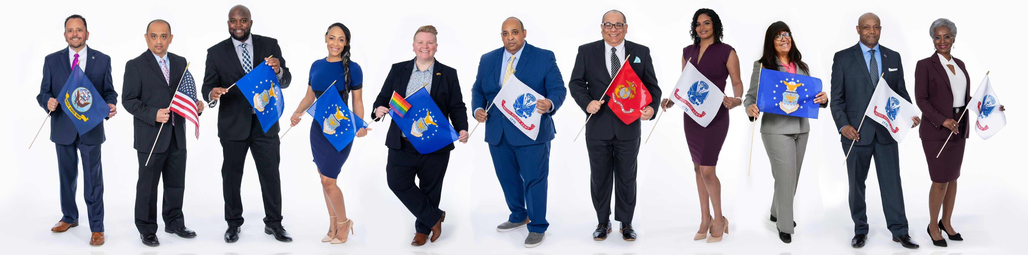
CMV Focus Areas
Advisory Committee on Minority Veterans (ACMV) is appointed by the Secretary and advises on VA’s administration of benefits and provision of health care and services to minority Veterans. Advisory Committee on Minority Veterans - Center for Minority Veterans (CMV) (va.gov)
Minority Veteran Program (MVP) increases awareness of minority Veteran-related issues at the local level and to develop strategies for increasing Veterans’ participation in VA healthcare, benefit programs, and other services. This is the Center’s boots on the ground program, and a very important footprint with Minority Veteran Program Coordinators (MVPCs) from VHA, VBA, and NCA as points of contact for local facilities..
CMV Liaisons provide case management for individual Veterans requesting assistance with accessing VA benefits, health care and services or who believe they have been subject to discrimination while interacting with VA. Liaisons work closely with the MVPCs for resolutions.
Research, Reports and Recommendations leverage data from across the Department, federal government and other sources to improve outcomes for minority Veterans.
Notes:
Here is an overview of our focus areas.
The Advisory Committee on Minority Veterans (ACMV) is crucial in advising the Secretary on VA’s service delivery. The committee members, appointed by the Secretary, represent various minority groups and offer invaluable insights through recommendations, reports, and direct engagement with stakeholders.
Our Minority Veteran Program is driven by the Minority Veteran Program Manager and includes a network of Program Coordinators and Liaisons. This program aims to increase awareness of minority veteran issues and develop strategies to enhance participation in VA services. Coordinators provide direct support at VA centers and advocate for improved service delivery.”
CMV Liaisons are dedicated to understanding the unique needs of specific minority communities. They engage with external stakeholders, provide case management for veterans seeking assistance, and advocate for equitable access to VA benefits and services.
CMV conducts research to better understand social determinants of health and barriers faced by minority veterans. This research informs our strategies and helps improve outcomes for our veterans.

Slide 9
CMV Updates
September 17 – 19: Congressional Hispanic Caucus Institute Leadership Conference, Washington, DC (in-person)
September 18: Hispanic Heritage Month Program (hybrid)
September 20: Don’t Ask, Don’t Tell Program (virtual)
September 21 – 22: Pacific Islander Festival Association, San Diego, CA (in-person)
September 23: Million Veteran Program Celebration, Washington, DC (in-person)
October 2: Hispanic Heritage Month Program (hybrid)
October 8 – 10: Out & Equal Workplace Summit, Orlando, FL (in-person)
October 10 – 12: NAACP 82nd Georgia State Conference, Augusta, GA (in-person)
October 16: Hispanic Heritage Month Program (hybrid)
October 18: Filipino Heritage Month Program (hybrid)
October 24 – 27: NAACP California/Hawaii State Conference, Los Angeles, CA (in-person)
November 2: CMV and CWV 30th Birthday
November 6: Native American Heritage Month Program (hybrid)
November 12: Disabled Veterans National Foundation Veterans Resource Fairs, Silver Spring, MD (in-person)
November 13: Native American Heritage Month Program (in-person)
November 20: Transgender Day of Remembrance (hybrid)
November 20: Native American Heritage Month Program (hybrid)
February 5, 2025: Black History Month Program (hybrid)
February 26, 2025: Black History Month Program (hybrid)
Notes:
Here is an overview of recent and upcoming events for special observances.

Slide 10
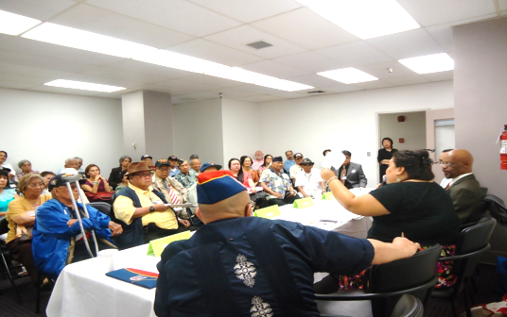
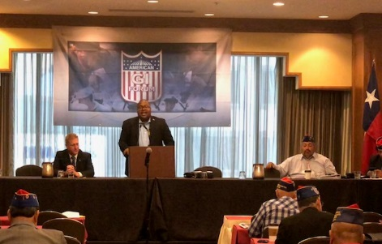
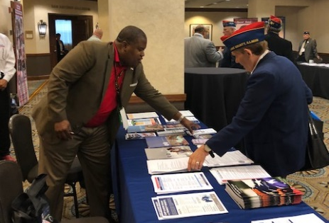
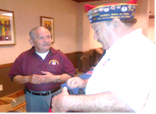
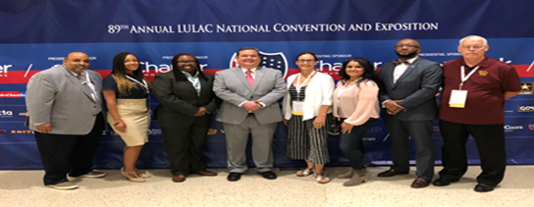
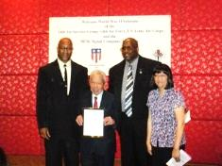
Outreach, Engagement and Collaboration
Support and initiate activities that educate and sensitize internal and external partners to the unique needs of minority Veterans.
Target and participate in outreach activities and educational forums utilizing Community Networks.
Assist CMV in disseminating information.
Notes:
At the Center for Minority Veterans, one of our core responsibilities is outreach and engagement with both internal and external stakeholders to ensure minority Veterans' unique needs are recognized and addressed.
We support and initiate activities that educate and sensitize staff, both within the VA and in the broader community. This means developing and participating in programs and training sessions designed to enhance cultural awareness, helping staff to better understand the challenges and experiences of minority Veterans. By doing so, we foster a more inclusive environment that ensures all Veterans receive equitable care and services.
To broaden our reach, we also participate in targeted outreach activities and educational forums, working with community networks that are vital to connecting us with minority Veterans. These networks allow us to engage directly with Veterans in their communities and build relationships that enable us to better understand and respond to their needs.
Finally, a key part of our mission is to assist in disseminating important information from CMV. Whether it’s sharing new policies, resources, or opportunities for Veterans, our goal is to ensure that minority Veterans are well-informed and able to access the benefits and services they have earned.
Through these efforts, we aim to strengthen our engagement with minority Veterans, improve awareness among service providers, and build lasting partnerships with community networks to ensure no Veteran is left behind
CMV engages with Veteran Service Organizations (VSOs) through several key avenues:
Advocacy and Legislative Support: CMV partners with VSOs like the VFW to advocate for legislation benefiting minority veterans. This includes drafting position papers, testifying at Congressional hearings, and organizing grassroots lobbying to ensure minority veterans' issues are prioritized in legislative discussions.
Outreach and Engagement: Together with VSOs, CMV participates in community events, town halls, and seminars to educate minority veterans about available benefits and services. This outreach helps overcome the information barriers that minority veterans often face.
Partnership in Research and Policy Development: CMV and VSOs collaborate on collecting and analyzing data on minority veteran populations. They work on research projects and reports to identify trends, barriers, and disparities in benefits and care, which inform policy recommendations and program enhancements.
Participation in National Events: CMV and VSOs come together for national observances and events such as MVPC trainings, Minority Veterans Summits, and Veterans Day celebrations. These events serve to raise awareness and provide direct services to veterans."

Slide 11
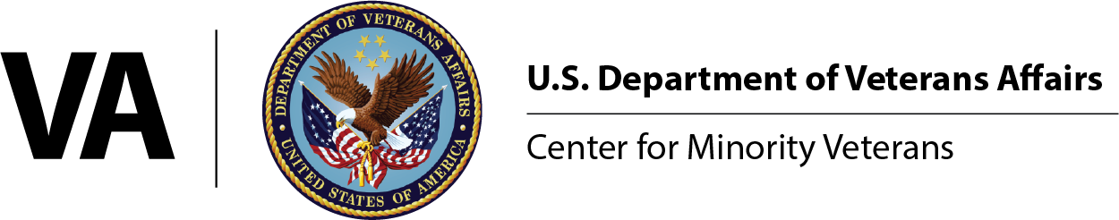
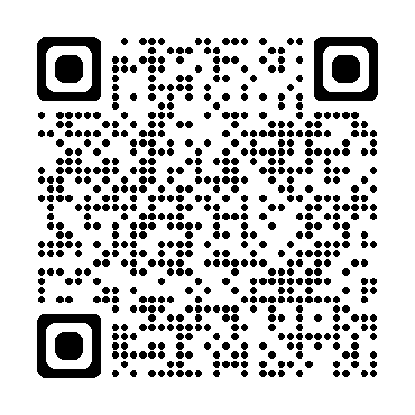



Connect with CMV
Scan our QR code to join our mailing list!
vacocmv@va.gov
(202) 461-6191
www.va.gov/centerforminorityveterans/
Notes:
For more information about our programs and updates, please visit our website. You can scan this QR code to join our mailing list as well.
Thank you for your time and attention today! I welcome any questions.

